Slide 1
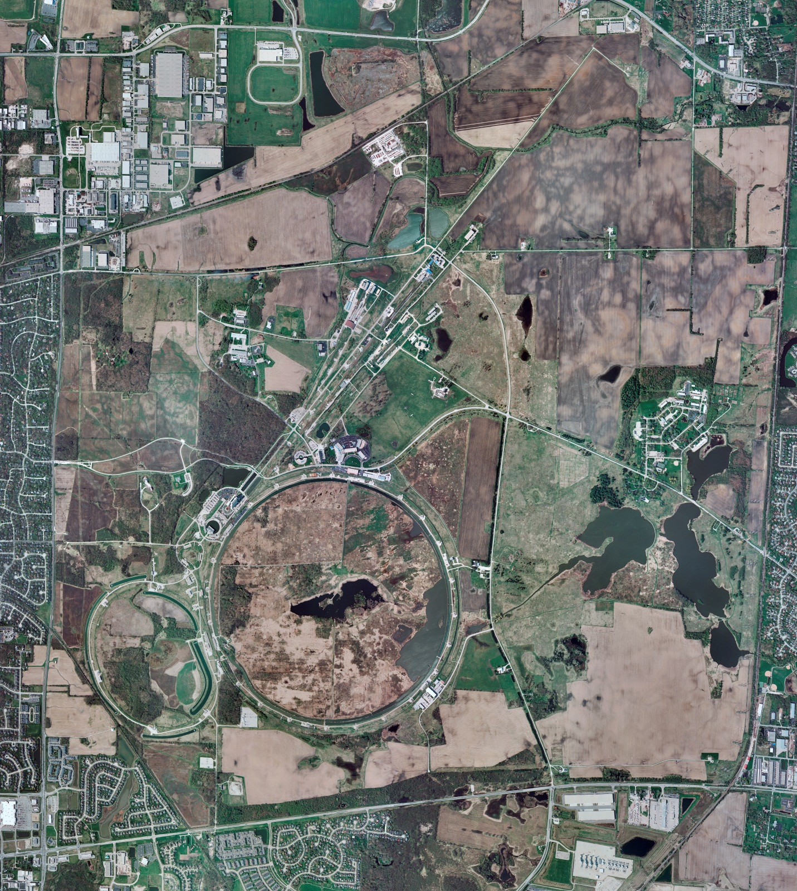
Helium Cryogenics
Status 11/22/2024 J.Makara
CMTF: SCP cold and running fine; CMTS: HECM26 at 2 K for RF testing, in spite of instability of level control
PIP2IT: South Stand being modified for SSR2 pCM
North Stand empty
MCTF: cryo system shut down at RT
MDB/HTS: at RT
MDB/STC: at RT
MDB Magnet: at RT
NML/FAST: Cryo system is shut down and isolated for extended shutdown period
CC1: at RT
CC2: at RT
CM: at RT
IB1: cryo system restart in progress with Purification started
Muon Campus: at RT with comprs off and system depressurized; LN2 system at RT; g-2 Expt Hall at ODH=0 (not ODH area)
Misc: …

