Slide 1
Muon Campus Shutdown Report
Jim Morgan
Friday 09:00 Ops Meeting
November 22, 2024

Slide 2
Muon Campus status
Electrostatic Septum ESS2 installation and new stand check-out for both septa
Vacuum continues to pump down in ESS region
Noticed periodic vacuum “burps” on ion pumps and ion gauges
Clearing electrode power supply work on ESS2
Motion-control check-out began on ESS1 & ESS2, modifying limit switch brackets
Q205 rad hard quadrupole and modified vacuum pipe installation
Quadrupole was aligned on Wednesday
Vacuum connections still need to be made up
Some discussion about new Q205 pipe geometry and vacuum connections
Domestic water line repair north of AP-0 and over MI-8 Line
Berm integrity needs to be checked after repairs
Ring, Extraction and M4 Enclosure doors switched back to operational cores
Shutdown keys no longer work, need to get keys from MCR for access
Muon LCW resistivity continues to be poor
LCW make-up rate increased yesterday, not sure it’s a leak
AP-0 A/C work paused, reasons unclear
Study – M1-M3 Optics
Study – Alternative M5 optics

Slide 3
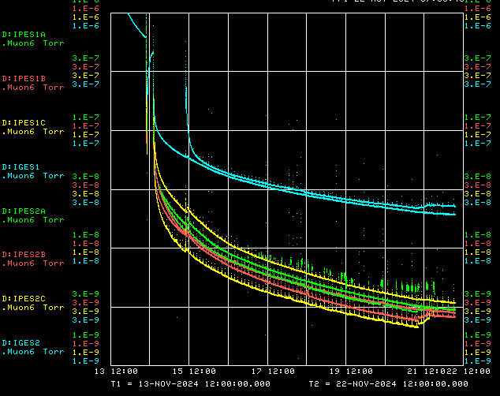
ESS region vacuum pump-down
Ion Gauges
Target vacuum for high voltage conditioning
Ion Pumps

Slide 4
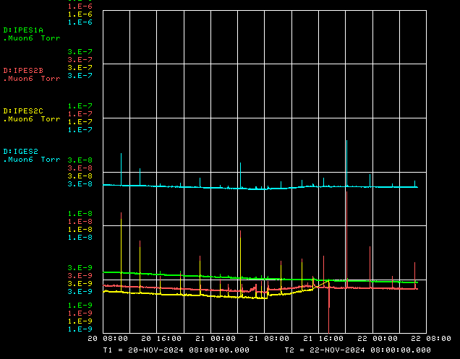
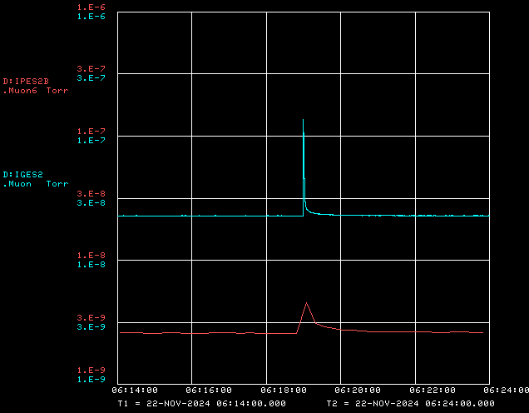
Periodic vacuum burps in ESS region

Slide 5
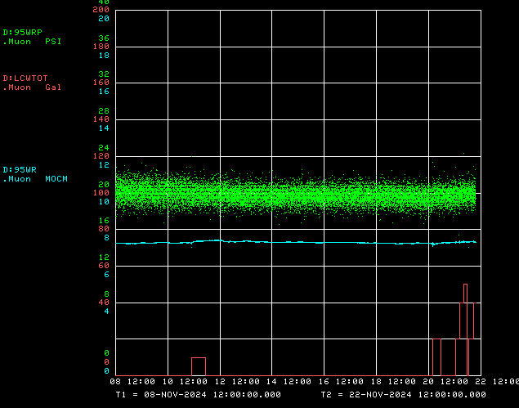
Muon LCW daily make-up volume
LCW return pressure
LCW conductivity
Daily make-up

Slide 6
Upcoming work
D30 installation work
ESS area vacuum pump-down continues, trying to understand source of “burps”
Hope to reach target 1E-8 Torr on ion gauges for high voltage conditioning next week
Q205 vacuum connections and pump-down
Domestic water line repairs south of AP-0 may have compromised shielding
Close to Transport berm, need to survey to understand if berm was disturbed
Excavation for new water line crossed over MI-8 tunnel
Other upcoming work
Continue ESS1 & ESS2 motion-control check-out and limit switch modifications
Repair Kirk Key hardware on disconnects, requires more modifications to disconnect
Replace several power supply circuit breakers and some primary wiring
Prepare to install Mu2e Extinction Monitor Collimator in Absorber area
M4 Final Focus vacuum installation, A/C dipole installation
Preparing for beam operation later this month
Safety system testing
Final walk-throughs and corrections before powering magnets
Work towards power supply check-out and preparations for beam
Concerned that PIP-II construction could impact beam operation in January

