Slide 1
0900 AD Shutdown Scheduling Meeting
Marty Murphy
22 Nov. 2024

Slide 2
Current Status
MI-8 Collimator work is complete for this year. Will resume Summer ‘25. Interlocks are complete allowing Booster dump studies during the day.
Domestic water excavation near Kautz Rd wrapped Wednesday night. Alignment completed a topological survey Thursday (thanks Chuck & crew!). Those data are now with ISD to convert to a drawing for RSO to assess shielding.
MI LCW
Ring temperatures stabilized at 90F earlier this week. On Wednesday BNB power supplies were energized and local LCW temp reached 103F, before PS were de-energized.
In response we have lowered the LCW temperature regulation to 70F. This has caused a number of small leaks (slow drippers) around the ring.
Ops accessed Thursday with a thermal imaging camera to better understand cooling in the tunnel. Results were not expected and more work is needed.
MI Power
AD continues to work with ISD to determine the best configuration for powering beam lines and to adjust LOTO procedures as needed.

Slide 3
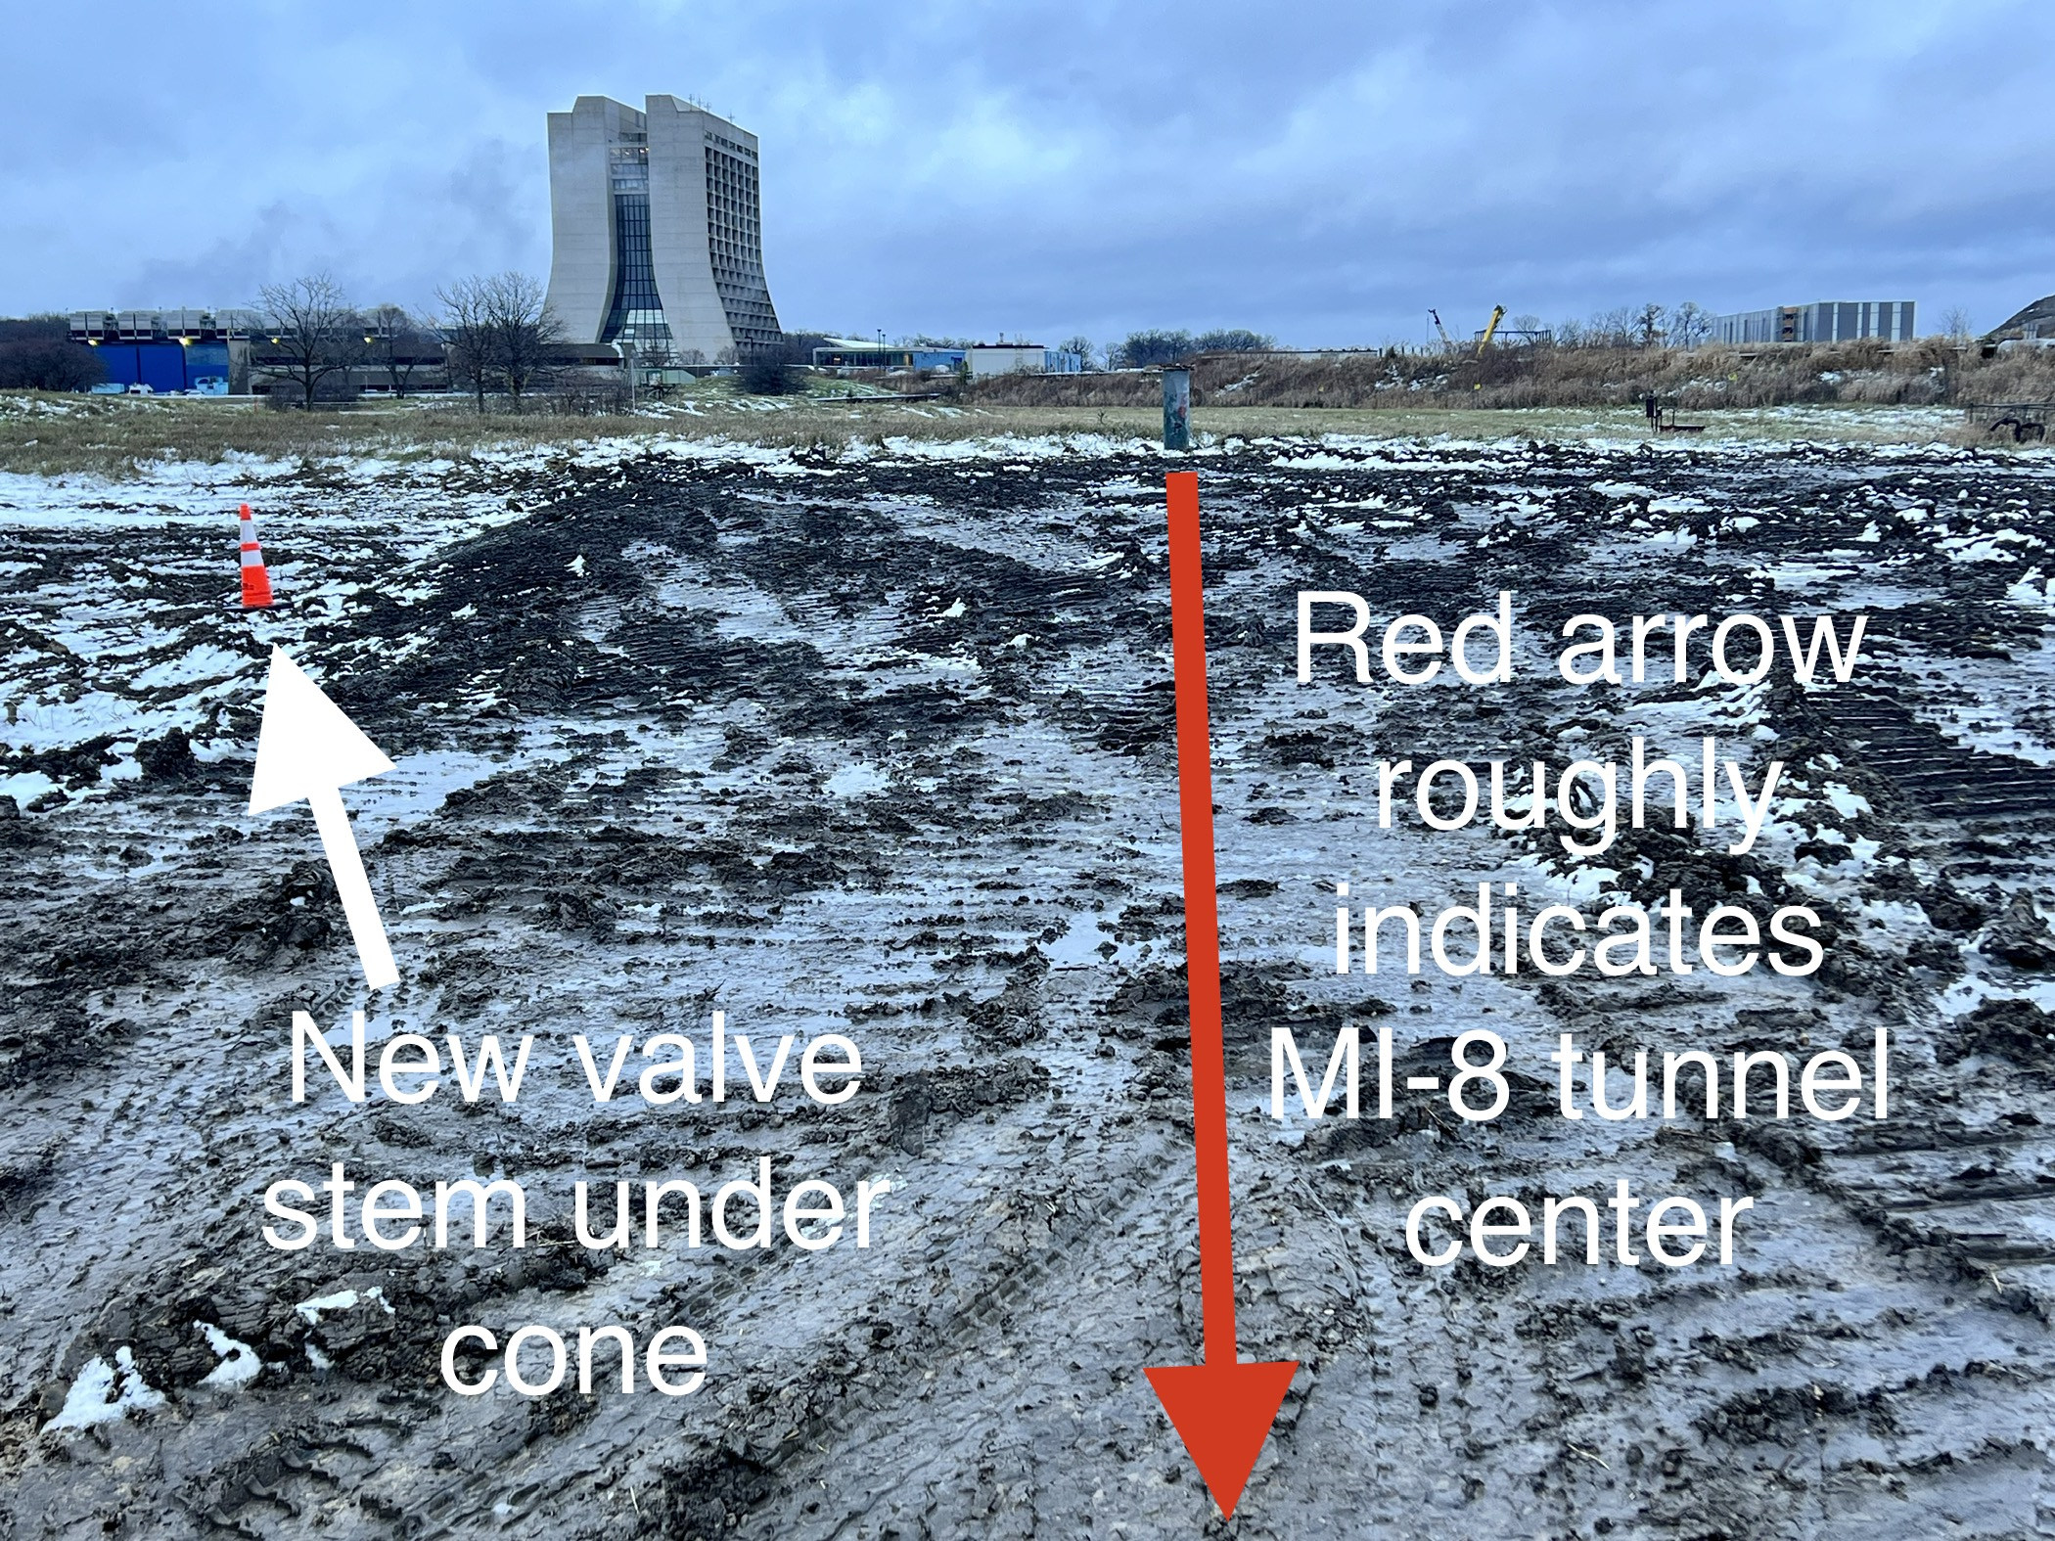
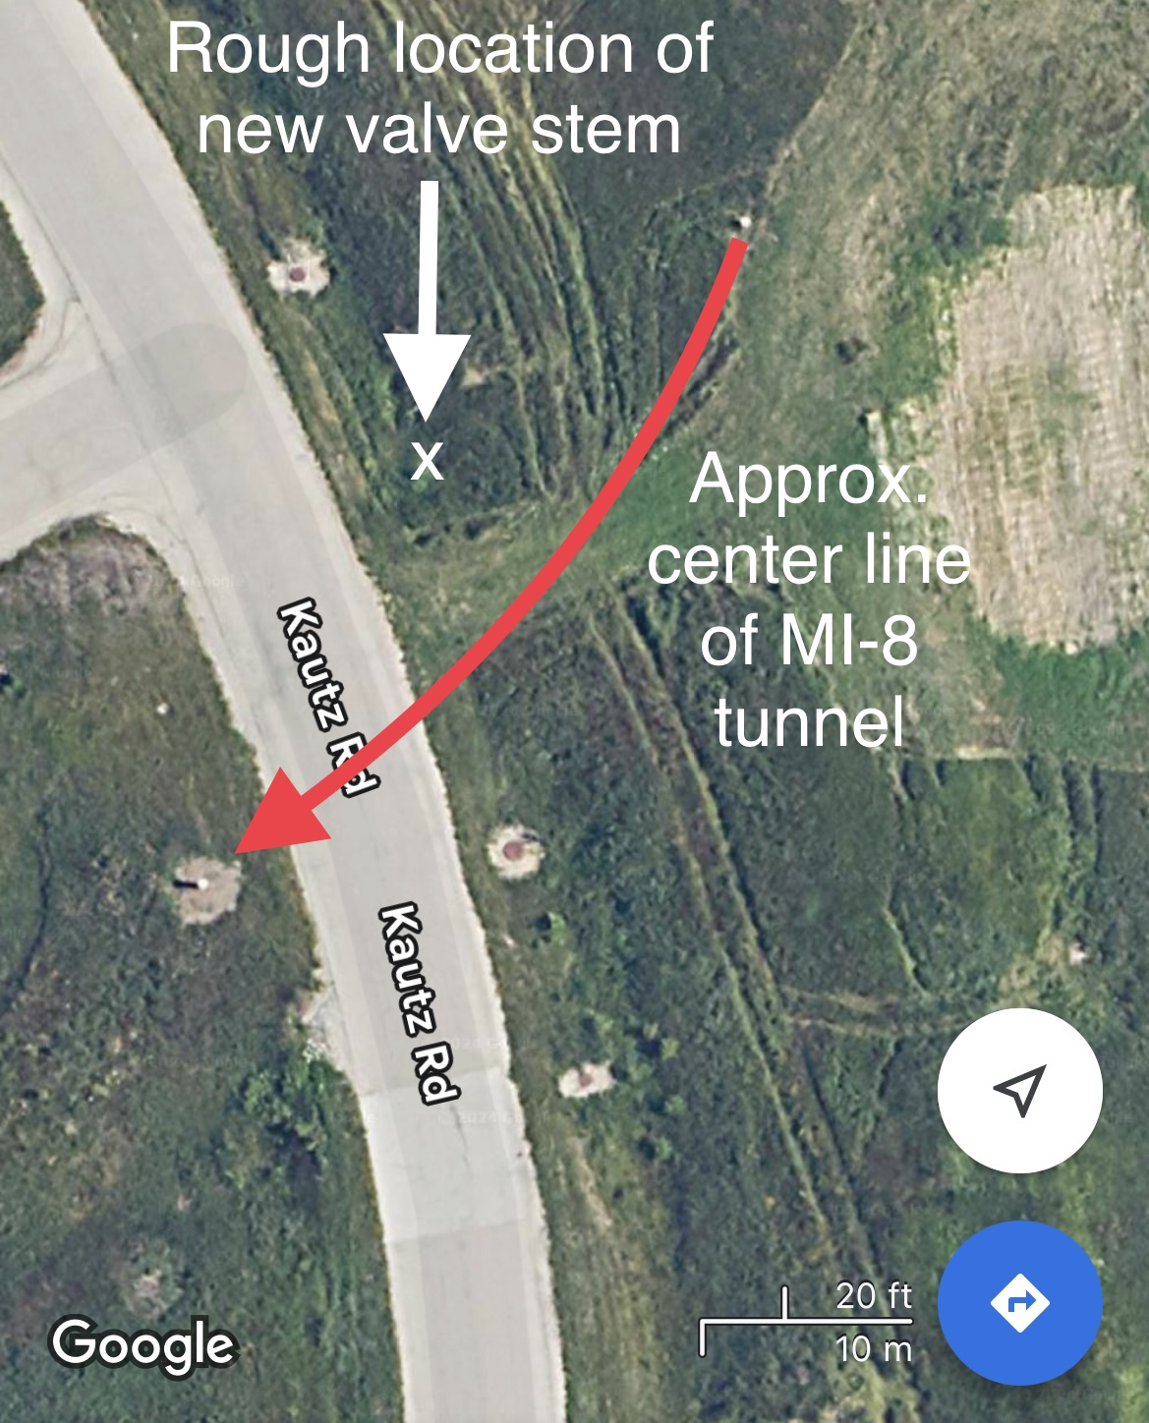
MI-8 Berm:
Left: View from Kautz Rd. looking NE. Right: overhead view

Slide 4
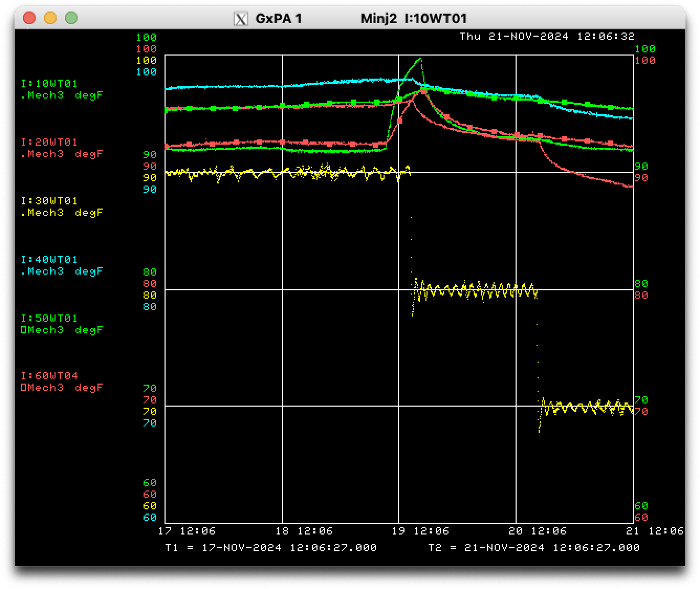
MI LCW Temperature Sunday through Thursday

Slide 5
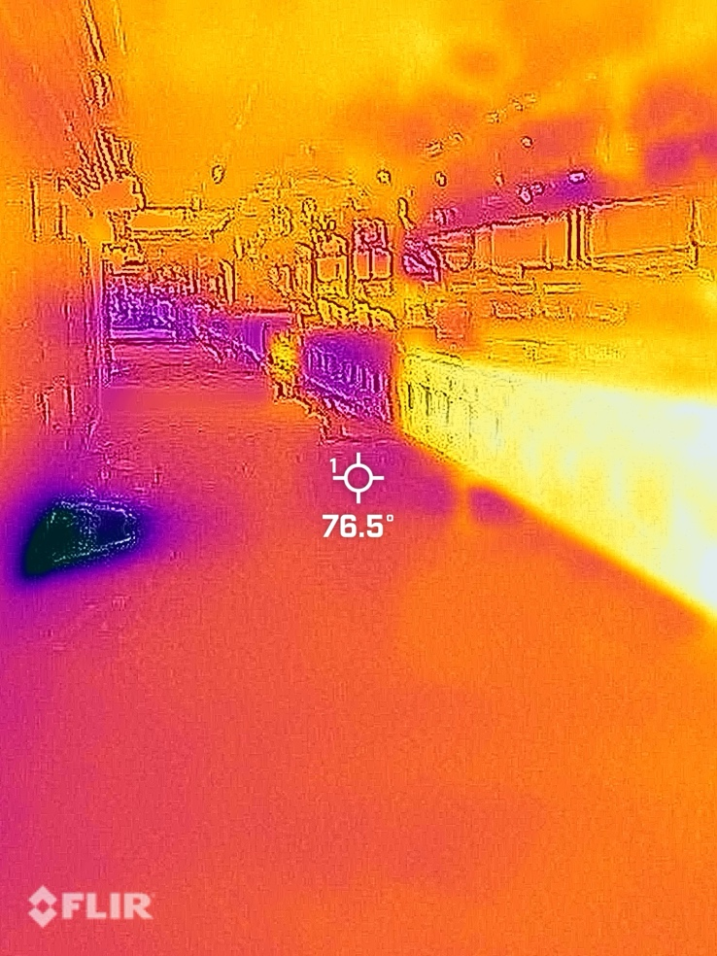
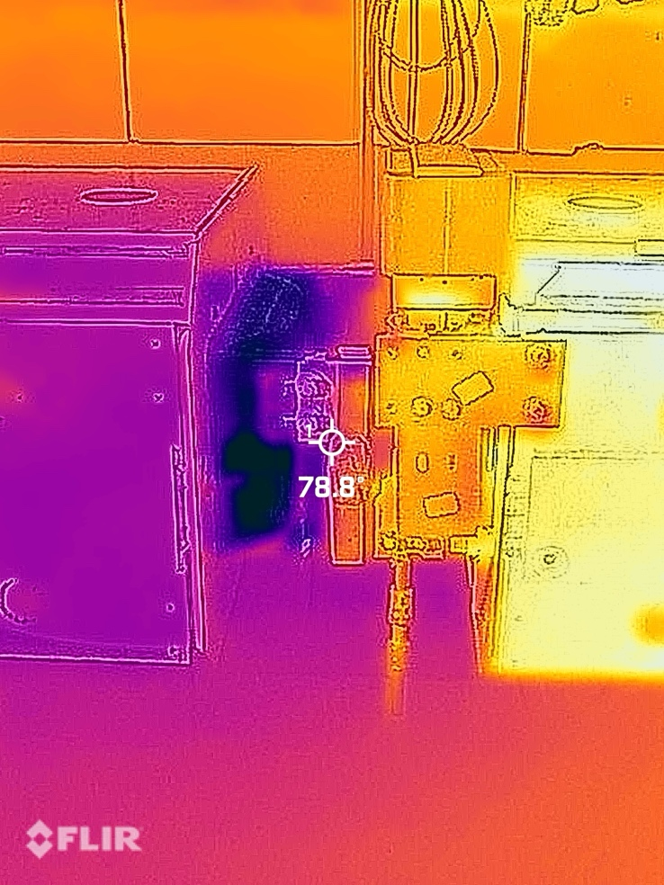
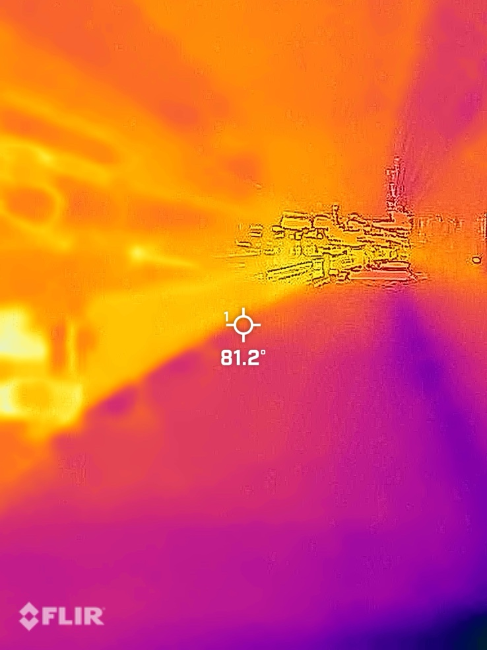
216-218
Hard edge in temperature at 216-218
70°F downstream, 90°F upstream

Slide 6
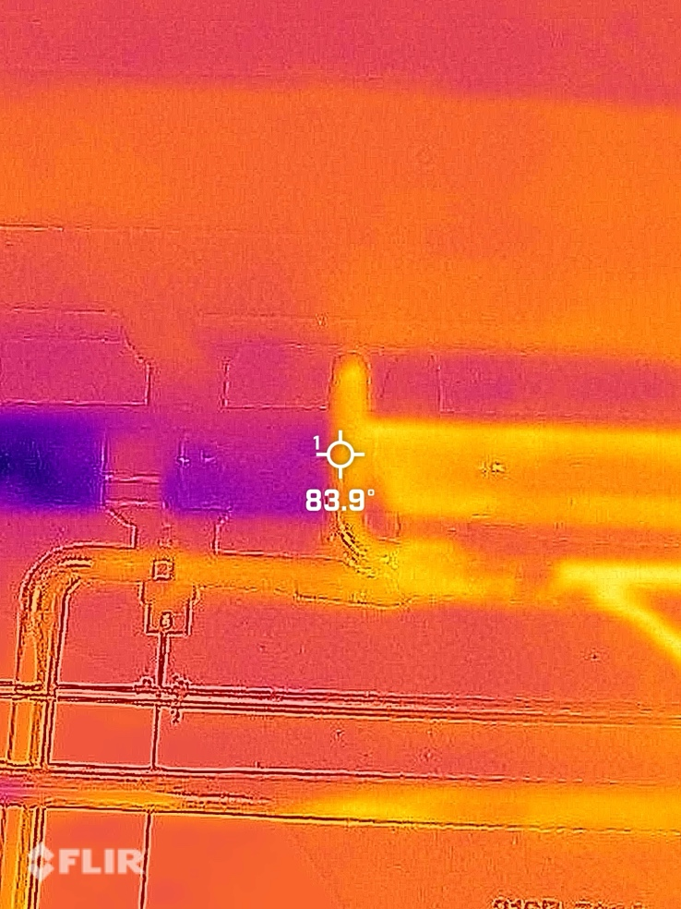
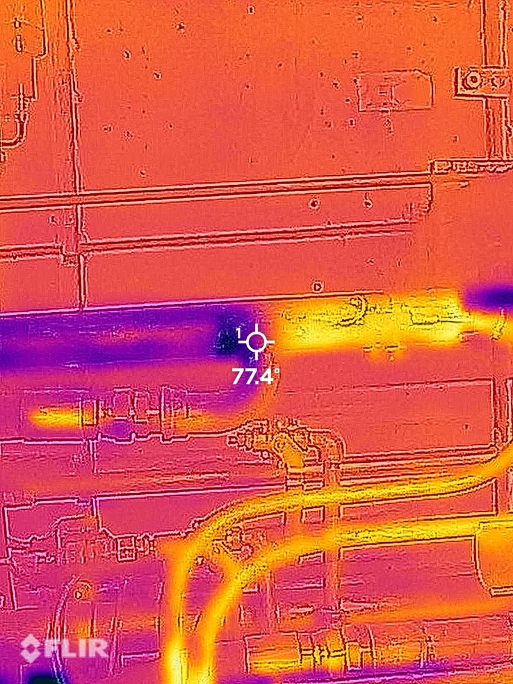
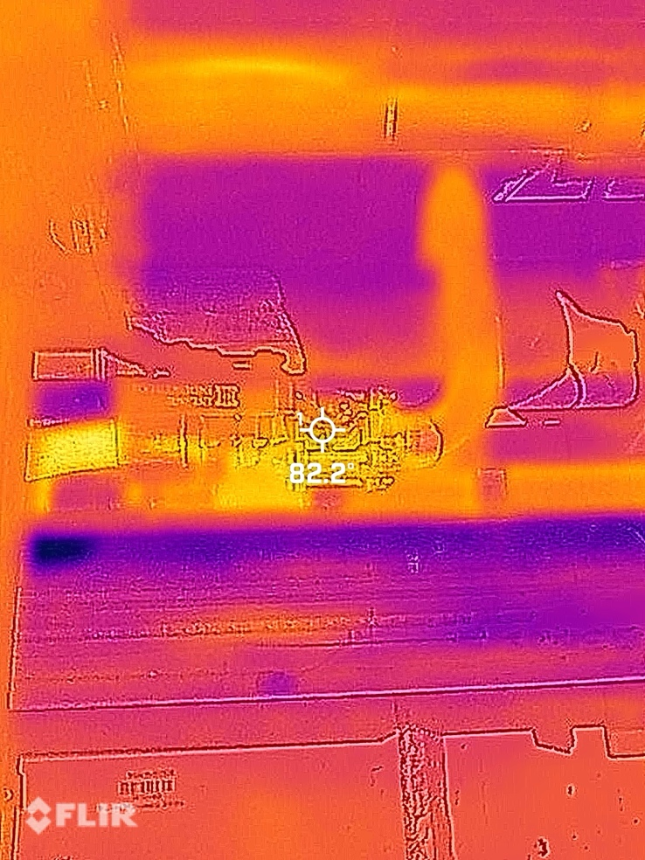
216-218
Supply Header
Quad Bus
Return Header
Temperature gradient is at tees

Slide 7
Plan:
For Beam to BNB:
Access today with fluids people to continue investigation into improving LCW flow to BNB.
External assessment of FNAL analysis of MI heat exchangers is in Procurement. AD management is trying to expedite the process.
MI-8 Berm USI in progress for ISD water excavation.
MI-8/10 beam sign-offs in progress.
For Everything Else:
Dual PA testing of MIRF continues on day shift.
MI 332 dipole water leak seemed to re-appear last week. Inspection this week shows it’s dry. Regardless, it will be replaced in Summer ’25.
Working to resume magnet moves in HRAs in 30-straight section.
Completed Power Outages at MI 52 & 62.

