Slide 1
Project Activities for MSD
Mayling Wong-Squires
AD Operations Friday 9am Meeting
22 November 2024

Slide 2
LBNF Primary Vacuum and Magnet Installation
Kevin Duel, Ty Funk, Jason Morin, Kathrine Laureto, Scott Oplt, Will Derylo, Dan Vrbos
Magnet Installation
  Procurement for corrector magnet stand prototype fabrication started
  NuMI quad magnet retrieval procedures getting finalized
    Relocating and verifying installation equipment is good
  Primary Beam Enclosure dipole stand design continues with modeling and drawings, engineering note updates
  Toroid, RWCM and BPM instrumentation stand design continues
Primary Vacuum
  Kicker ceramic beam tube TiN coating
    Vendor testing coating setup and working out issues before applying to 12” beam tube samples
  Work on drawings and models for relocation of MI/RR components continues
  Updating quad and dipole magnet models and drawings with new beam tube design

Slide 3
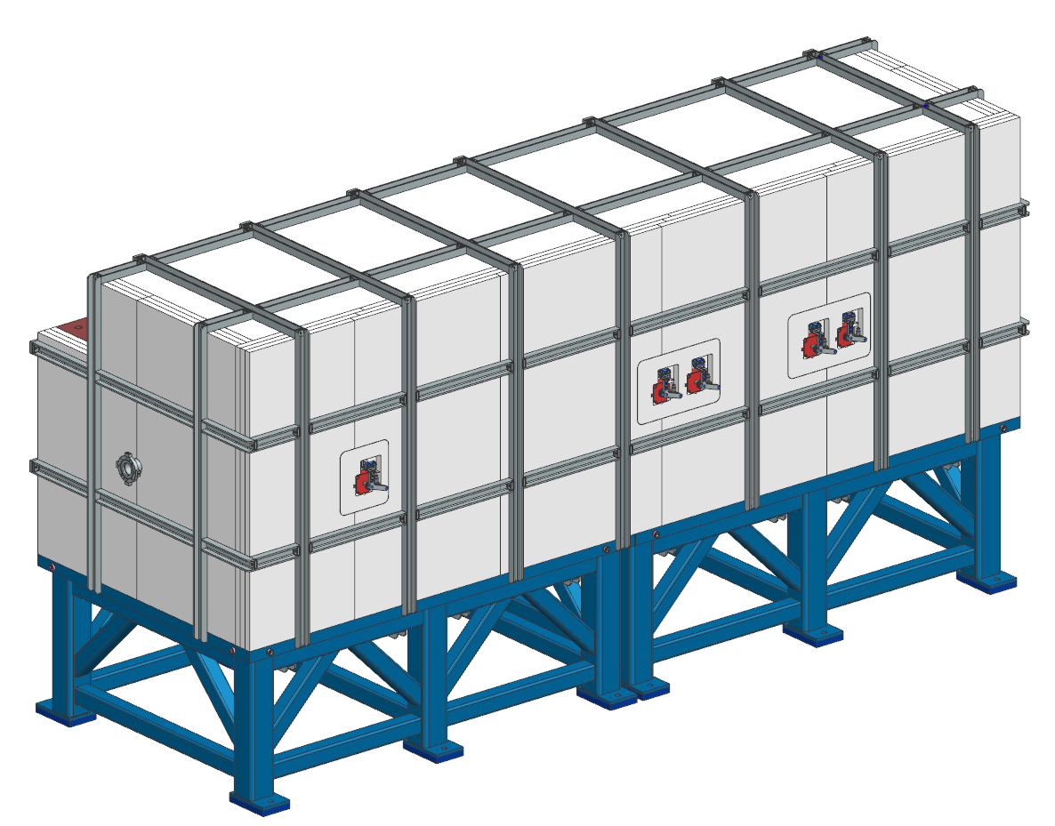
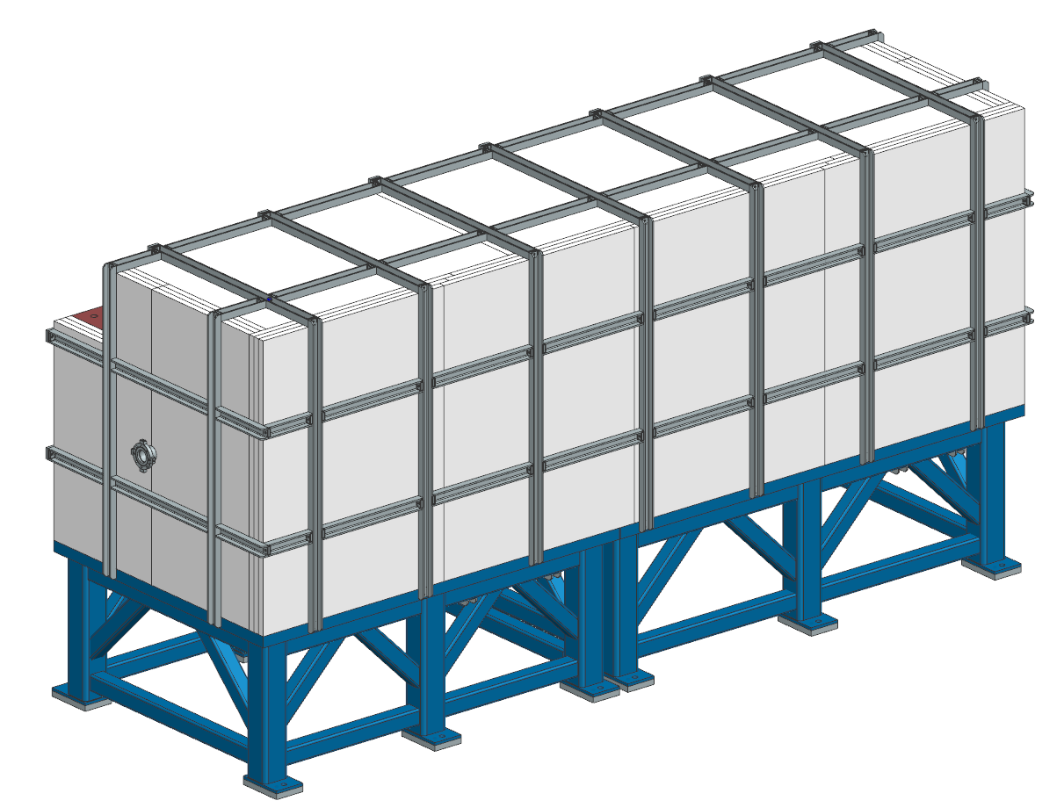
PIP-II BTL Collimators
Bob Donahue
PRR deliverables
  Engineering note approved and released
  Initial revision of all drawings released
  Eight individual procurement/fabrication packages identified
  SOWs are written for each procurement package
    SOWs are being reviewed
Small design updates based on MI-8 collimator assembly lessons learned
    3D model is updated
    6 drawings need to be released at Revision A
Horizontal collimator
Vertical collimator

