Slide 1
Mu2e report
Greg Rakness (FNAL)
Friday 9am AD meeting
22-Nov-2024
https://indico.fnal.gov/event/67147/

Slide 2
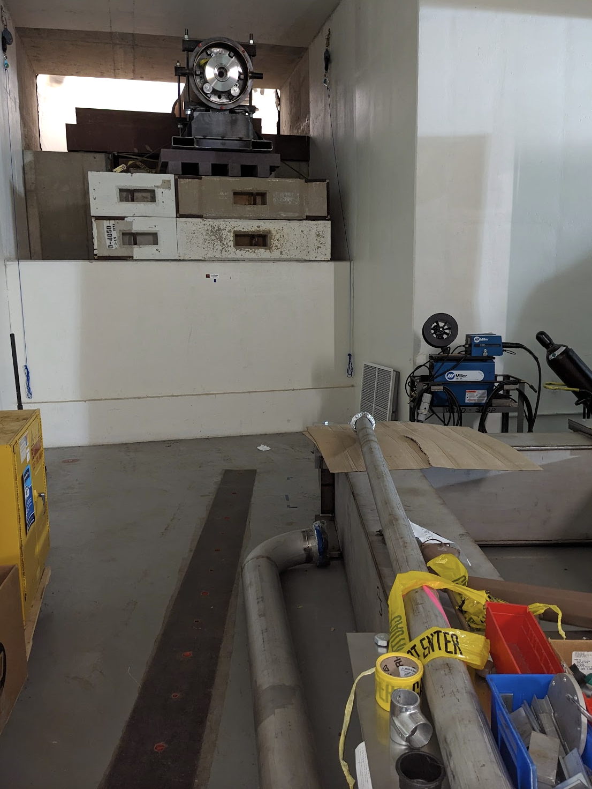
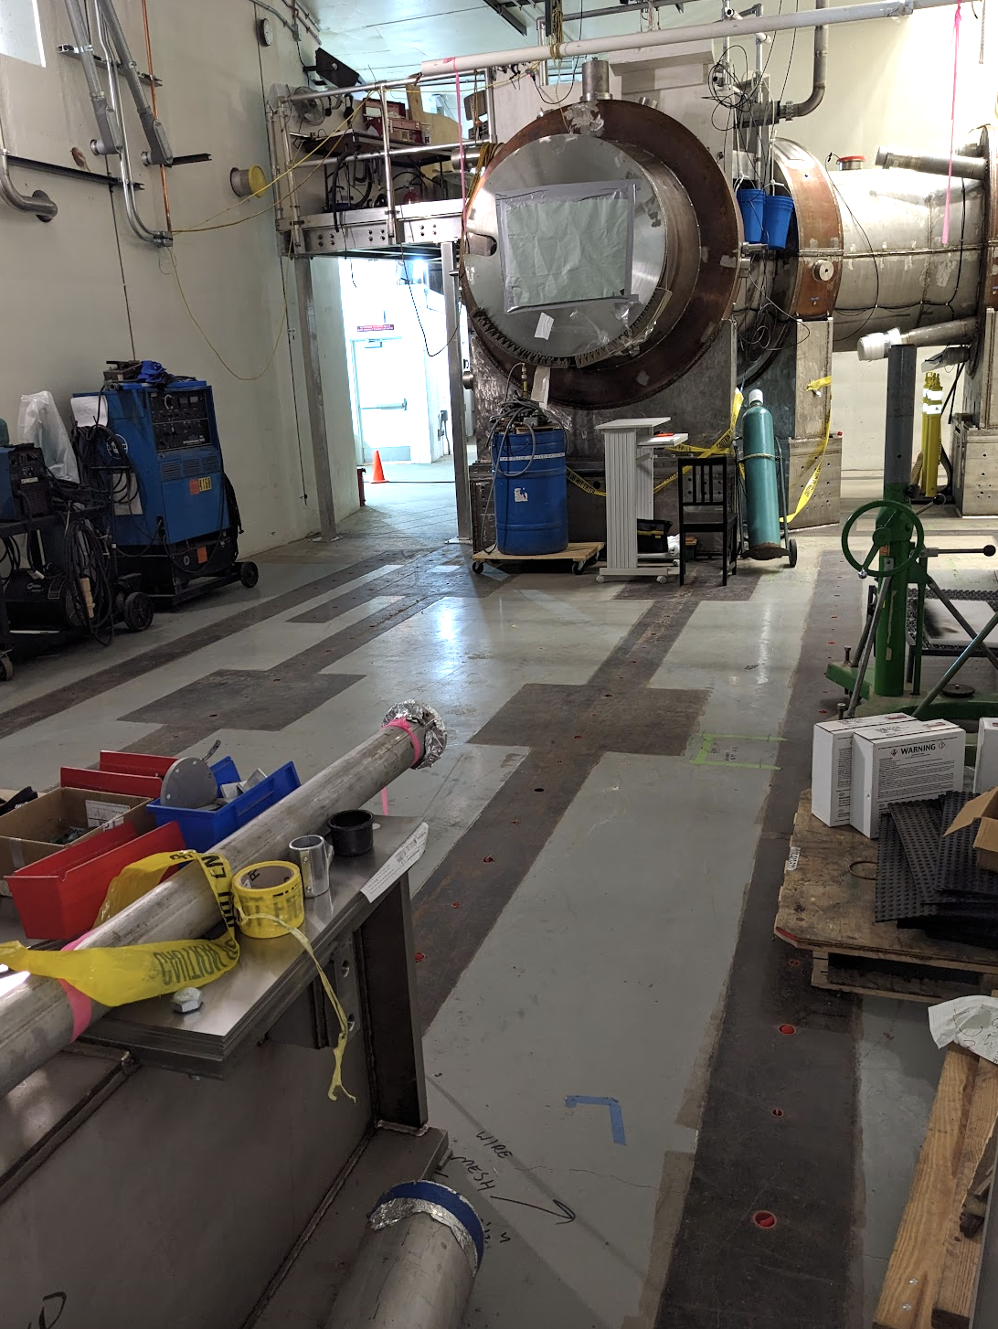
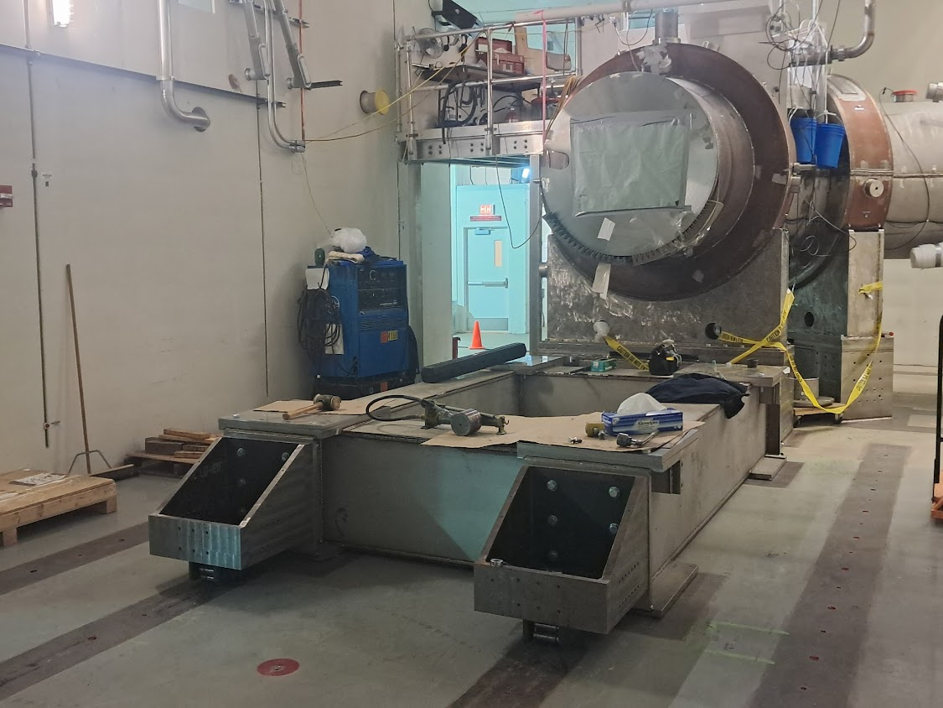
Preparation to hang Extinction Monitor Collimator
Moved Production Solenoid stand so that AD can hang the extinction collimator filter
Prep work needed to receive the PS in any case…. We just advanced this work…

Slide 3
Dump resistors moved, Calorimeter DT generator
Moving Solenoids dump resistor refurbishment + testing from Mu2e loading dock to D0 Assembly Building
Frees loading dock to receive DS end cap and Production Solenoid
Calorimeter DT generator is back at FNAL after having been worked on by the vendor
Next: install and restore operations

Slide 4
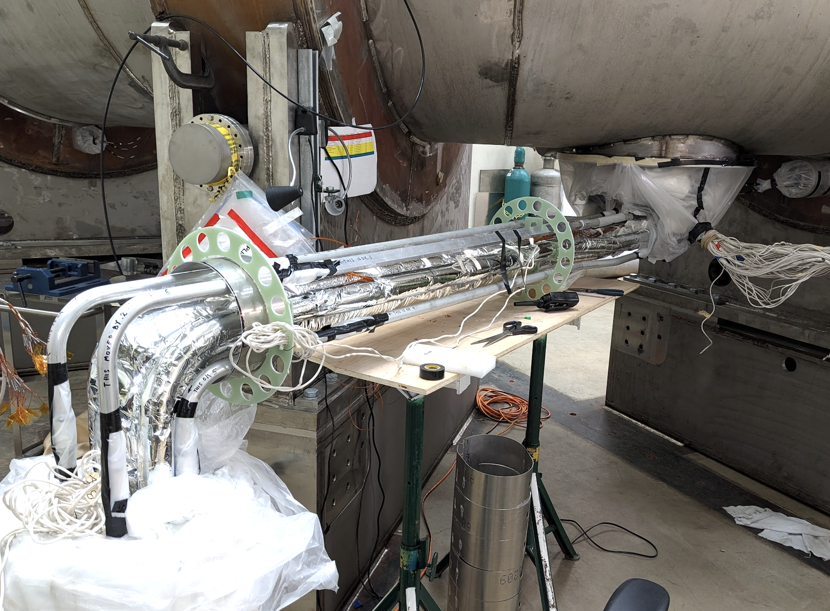
Cryo work (1/2)
TSu + TSd : splice interconnects have been made
Congratulations to Solenoids for these end-to-end connections
TSu interconnect : currently wiring voltage taps
TSd interconnect
Helium piping MLI complete
Currently leak checking nitrogen piping

Slide 5
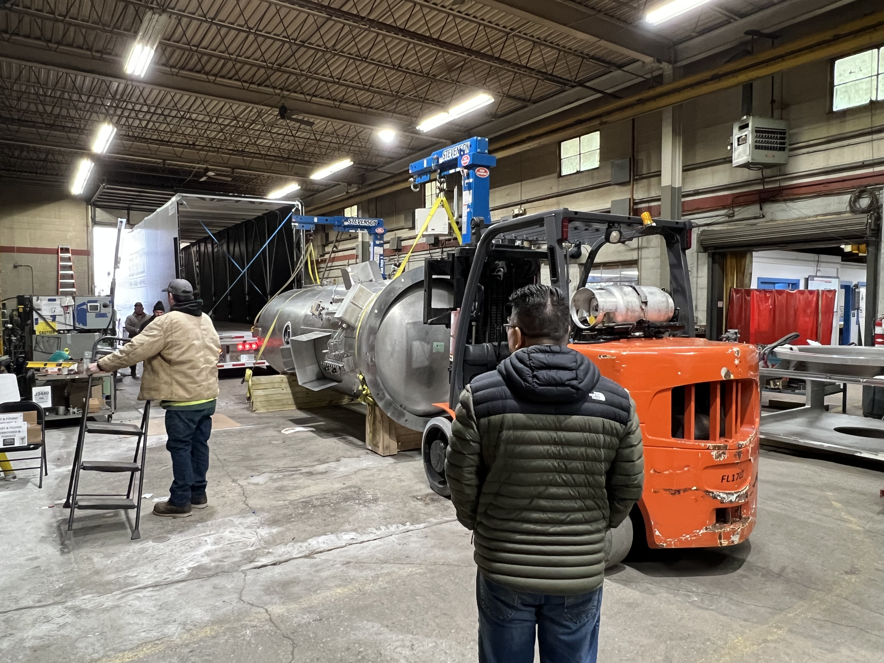
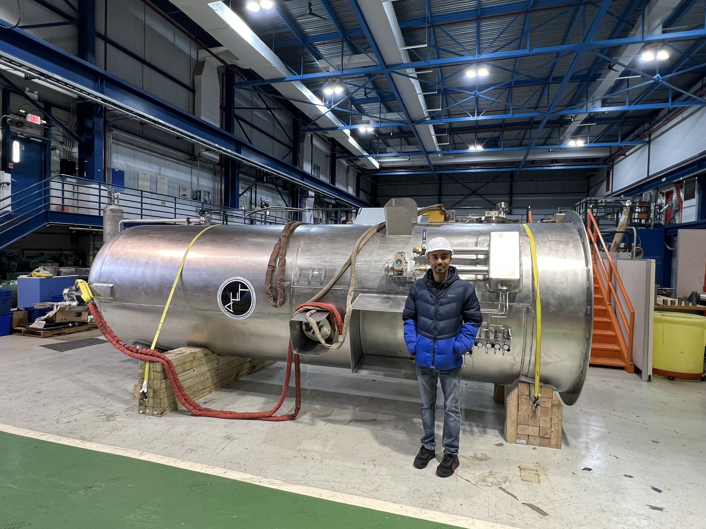
Cryo work (2/2)
Cryogenic Full Flow Purifier has arrived at DAB
… where it will be staged until installation at MC1
At vendor
At DAB

