Slide 1
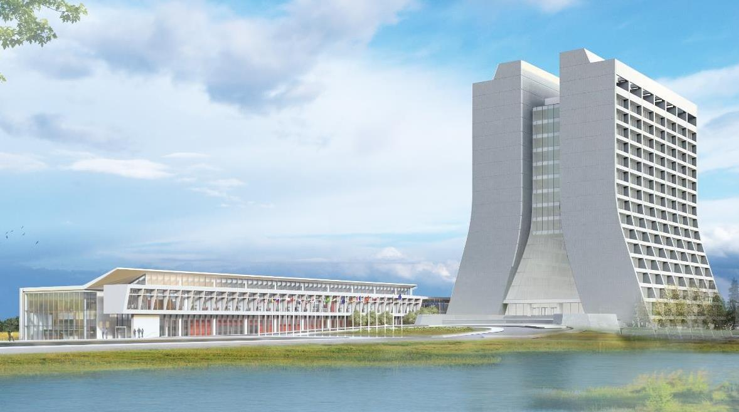
Infrastructure Services Division Updates
Pressing Issues / Special Topic:
Water Main – mostly complete
Sewer pipe repairs (NML) – Completed
Winter Prep – Site Services sending requests for opportunities.
Noteworthy Items:
Fire Protection Collaboration – The lab’s direction to move from past operating to a safer building envelope including staying off the radar of DOE Standard 420.1C Facility Safety
Something cool – and safety related: We toured all the wooden stairs and asset tagging will begin soon.

Slide 2
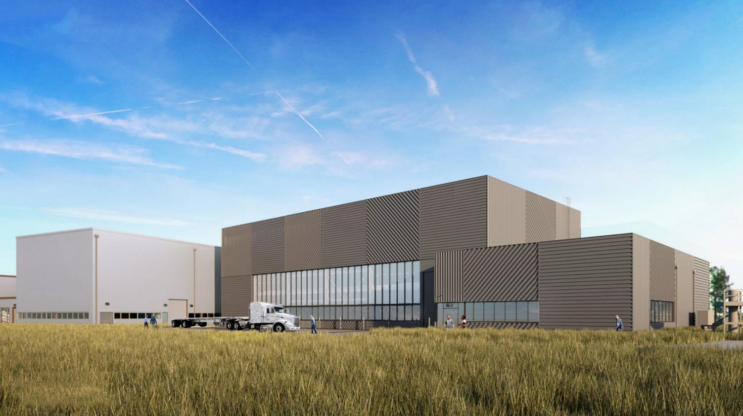
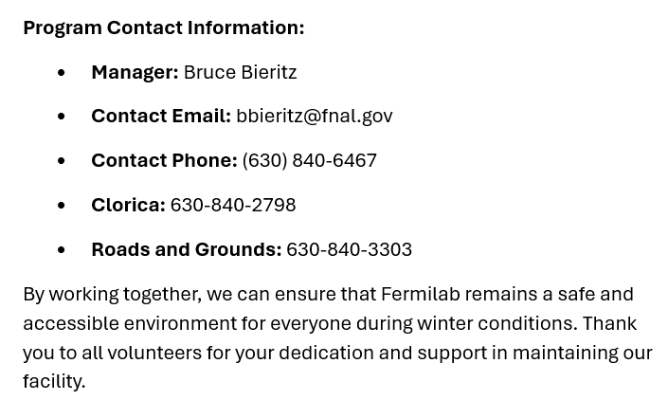
Special Topic:
Winter Prep
Site Services is sending the word out that snow clearing has opportunities for volunteers (address) to keep the areas around the Lab clear and safe.
Employees interested in volunteering should send an email with their contact information and the building they wish to assist with snow removal to 👉
Clorica will refill salt supplies upon request. To request a refill, contact Clorica at 630-840-2798.
Store salt in a designated area within the building, ensuring it is easily accessible for use during snow events.

Slide 3
Key Takeaways:
FCA = Facility Condition Assessments
Safety in the equipment realm are items like:
Exterior doors
Fire panels
Exposed wires
RPZ monitoring
FCA’s will become more of a focus to hit the DOE requirements of facilities conditions.

Slide 4
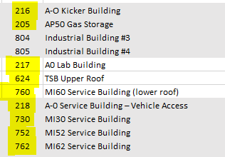
Noteworthy Items
New batch of new roofs are being walked by contractor. There will be 2 contractors performing the work.
C-0 Renovations – LED lights are being installed
Discovery Road – Painting project for the buildings on discovery road is in the planning phase. Req/SOW turned and being reviewed.
Old/Unused Equipment – Working on Roof Cleanups and MMR’s for stuff around the buildings. Planning with departments on getting items not needed off the roof. In Process.
Service Agreement – Verifying AD/ISD equipment is moving along nicely at about 40% of roughly 8000-line items. In Progress
New Roofs
MAB - Complete
Minos - is prepping (Emergency Roof on highbay in progress),
Village Gym/Fuel Station - are next up and just waiting on different phases of the projects to firm up dates.
Minos – Emergency Roof – In review process. In Progress
NS3 – Emergency Roof – 98% complete

Slide 5
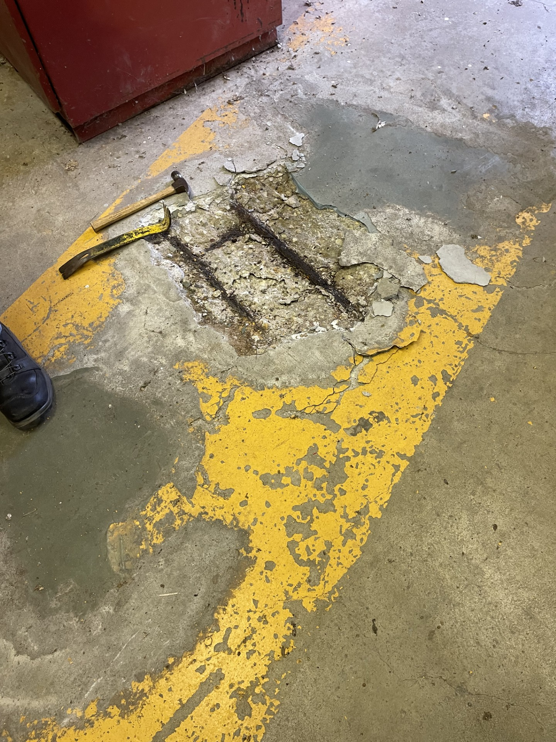
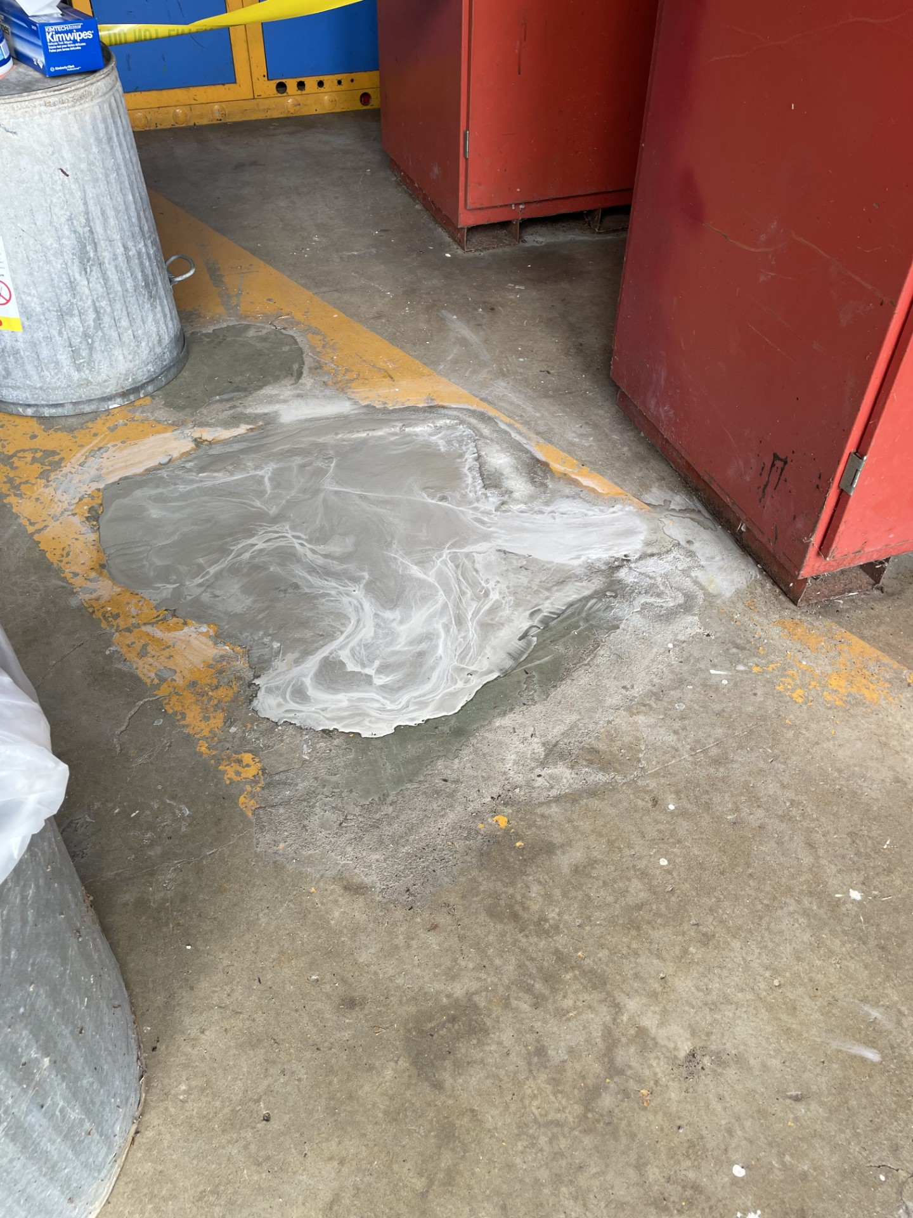
Active Projects still in motion and Contractors on Site
AD Projects:
Door EOL Replacements – Requisition for 13 doors on the EOL list is in progress. Plus 4 others on a fast track working with Scott on locations like SWA, ME7, & AP0, MT Worm. No Change – Awaiting Approval
Office Refurbishing – TGC-113/SEA-212 Approved, XGE-106/TGC-109 Approved, XGC-129/XGW-114 Approved, XGE-124/TGS-125 Approved, WGW-106/XGW-108 Approved, XGW-107 Approved, Building Req’s now – no change
Exterior Ladder EOL replacements – Currently 24 ladders are targeted. SOW is being developed. Approved, will move forward.
AD Elevator/Dumbwaiter Maintenance – Larger Plan being developed
- MI-8 Elevator – Went down but thanks to fast notification we had it back in a
few hours.
- MTA Elevator – stuck halfway down and was fixed right away.
- SSB Dumbwaiter – Still being evaluated for a safety plan.

Slide 6
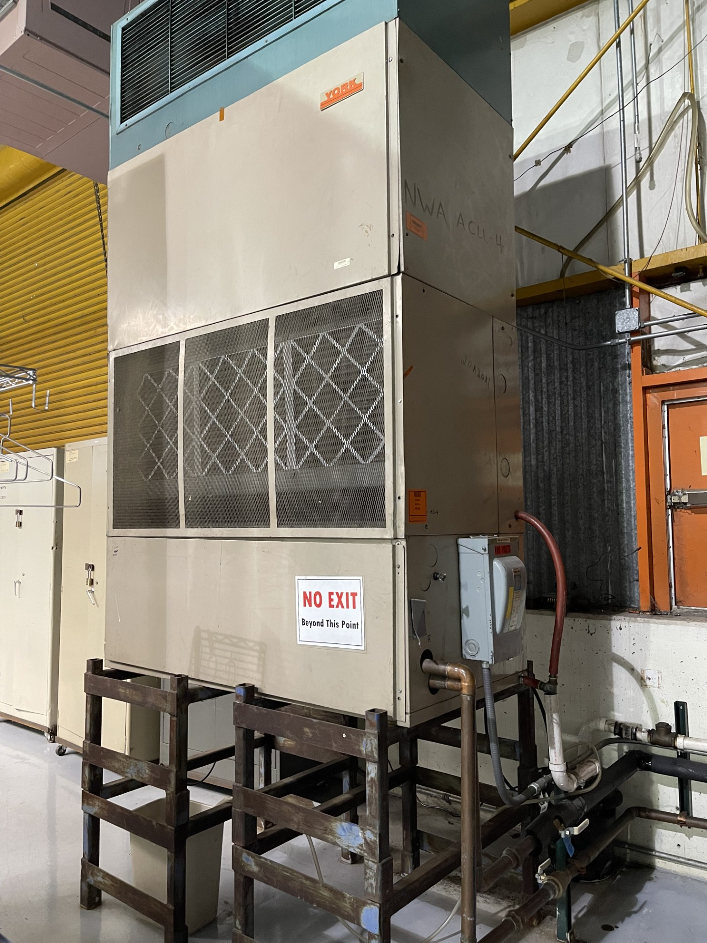
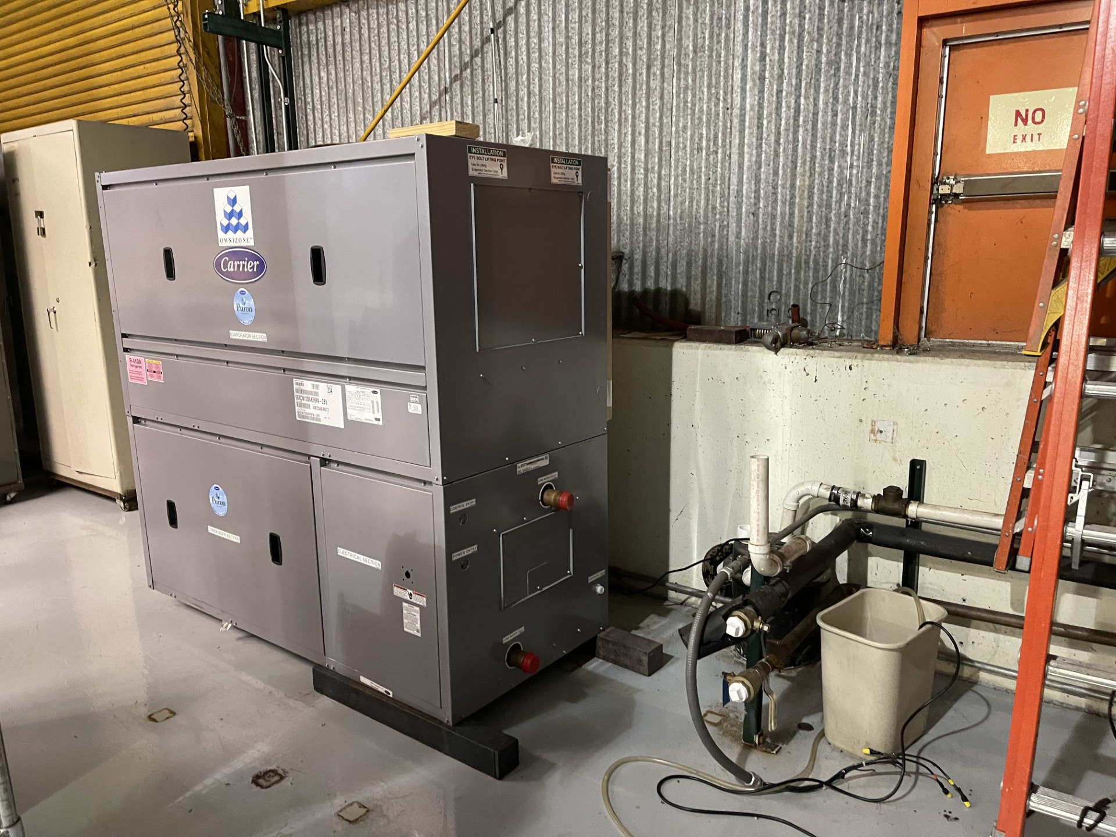
Active Projects still in motion and Contractors on Site
AD Projects:
NTF Safety Project – Area scanned and ready to schedule the rail install.
Potential next Projects – A0 cleanroom sanitary line replacement (performed walkdown and waiting on quote), MI Building Concrete Coatings, C0 Service Building (in beginning phase). – No Change
Lighting Work/Upgrades – CMTF have been halted due to other lab priorities - Received new scheduling information from CMTF and working the FPCs to see if we can work into the schedule.
Foundation Leaks – MT6/MC2/Wilson Hall – In procurement.
Electrification Project – In Motion
NWA & NS4 – Various work orders are being handled/planned/scheduled.
And More…

