Slide 1
Accelerator Division All Hands
Summer Shutdown Summary
Tony Busch
AD Shutdown Coordinator
Planning & Integration Department

Slide 2
ShutCo to Runco
Switchover from ShutCo to RunCo
  Transitioning into Beam running happened on
    Friday November 8th @ 00:01 hrs.
  Runco’s (2nd Tour)
    George Deinlein
    Jason Crnkovic

Slide 3
Shutdown 2024
Our Original Shutdown parameters were:
Duration: 10 weeks
Many coordinators and managers were very helpful in getting a schedule together that was viable for the 10 week timeframe.
Due to the Kautz Road transformer fire and other issues ie… Main Injector heat exchangers, we were extended several weeks.

Slide 4
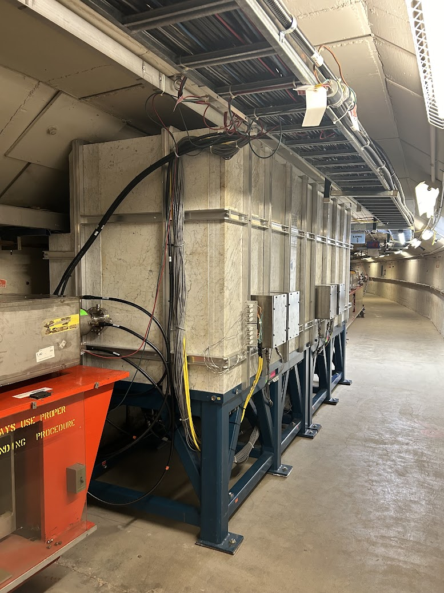
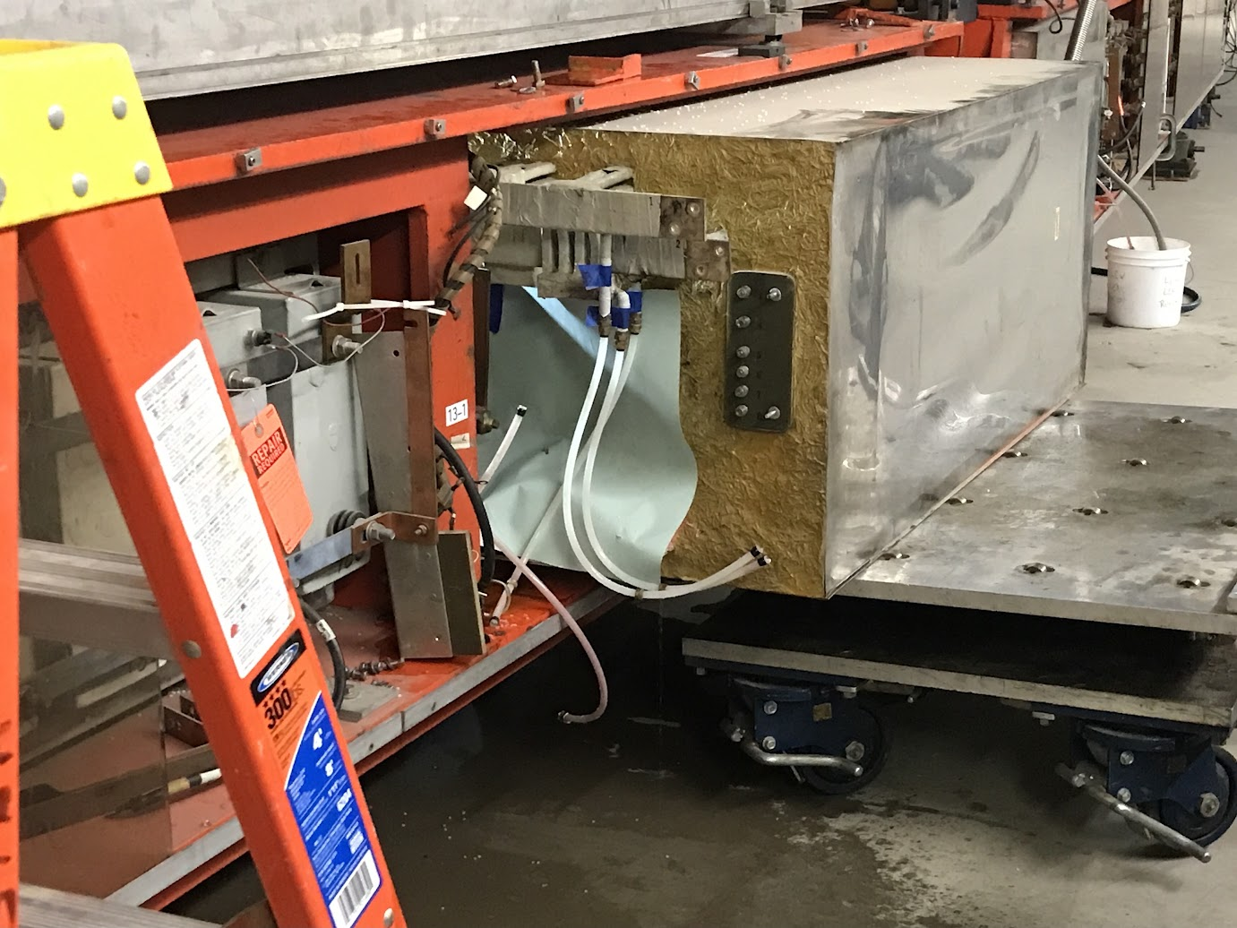
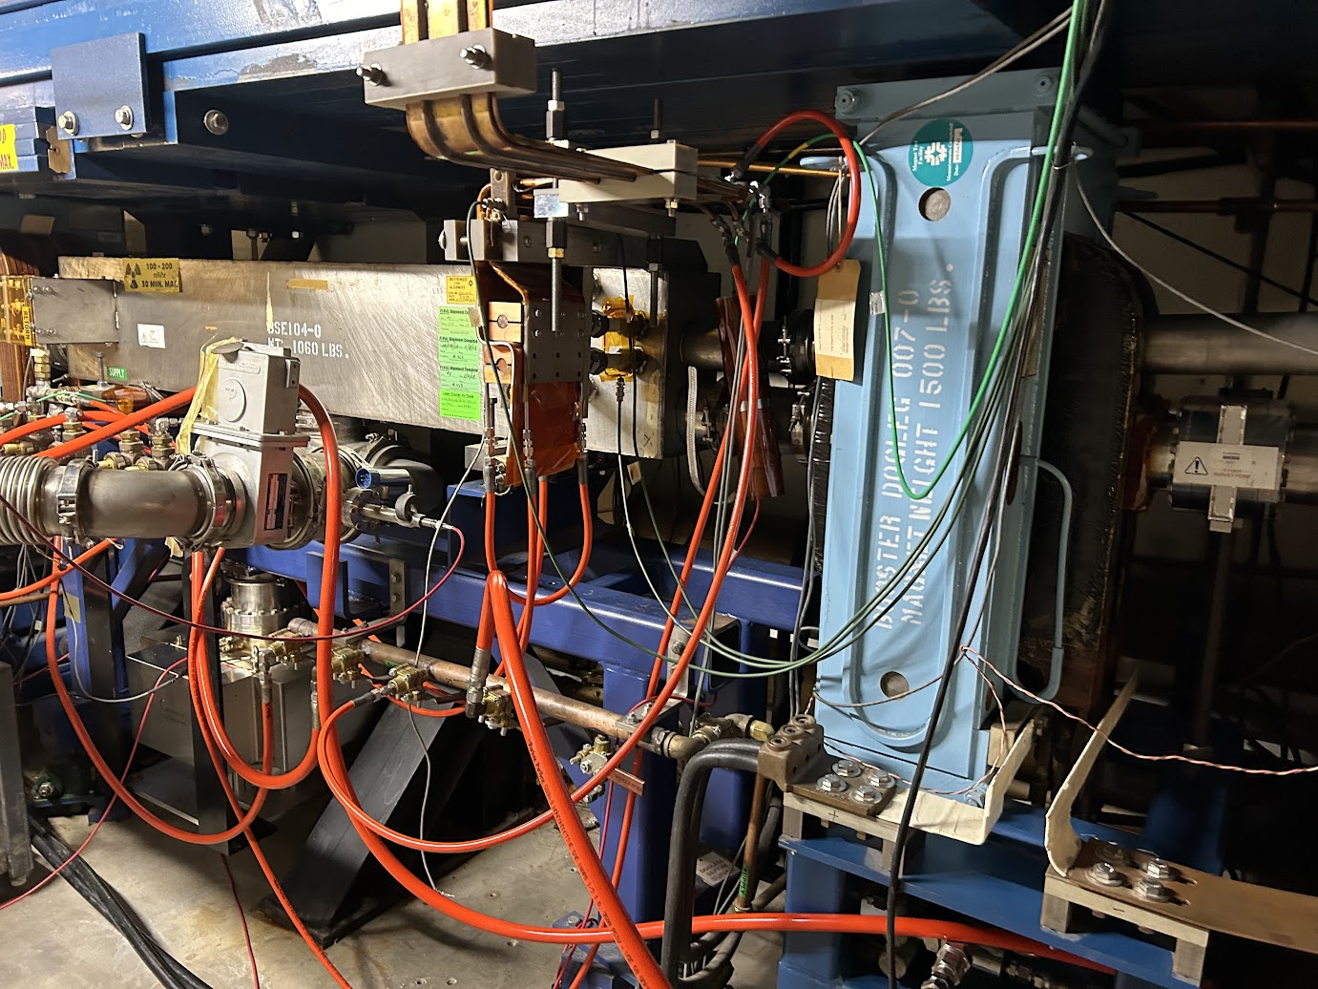
Booster Shutdown Work
Two girder chokes refurbished.
MP03 extraction septa manifold LCW leak repair and hose replacement.
New Collimator installed.
Major effort, Booster, MSD, Controls, Iron Workers, Instrumentation, Alignment, & Safety.

Slide 5
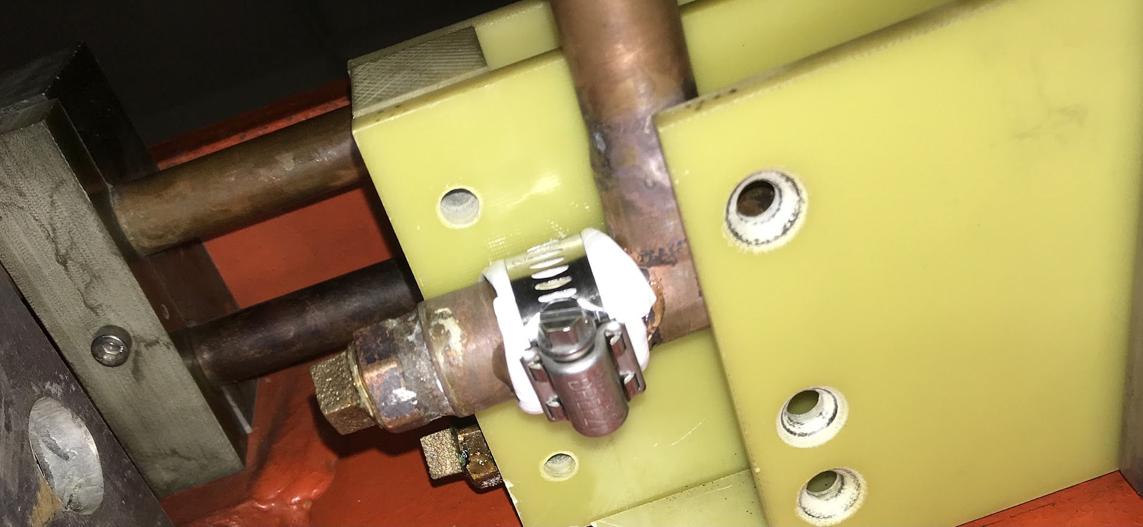
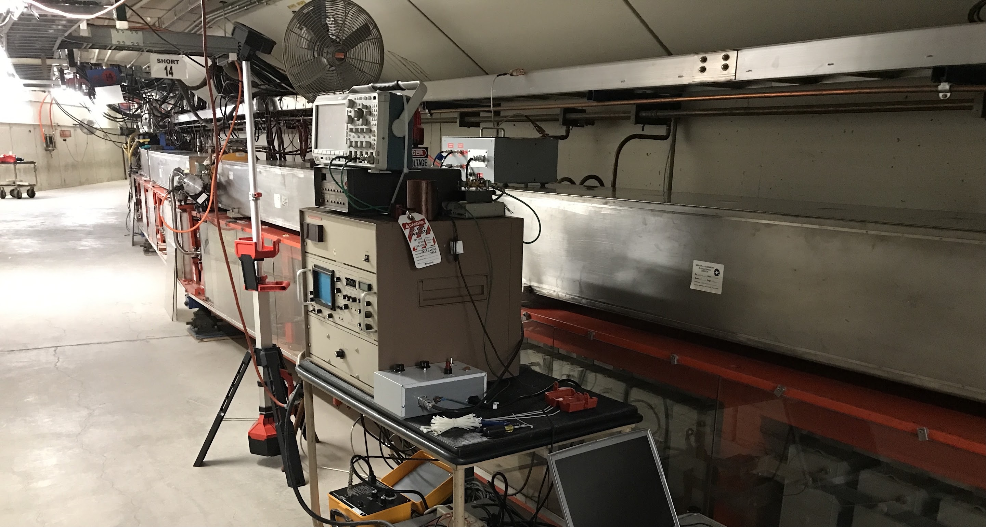
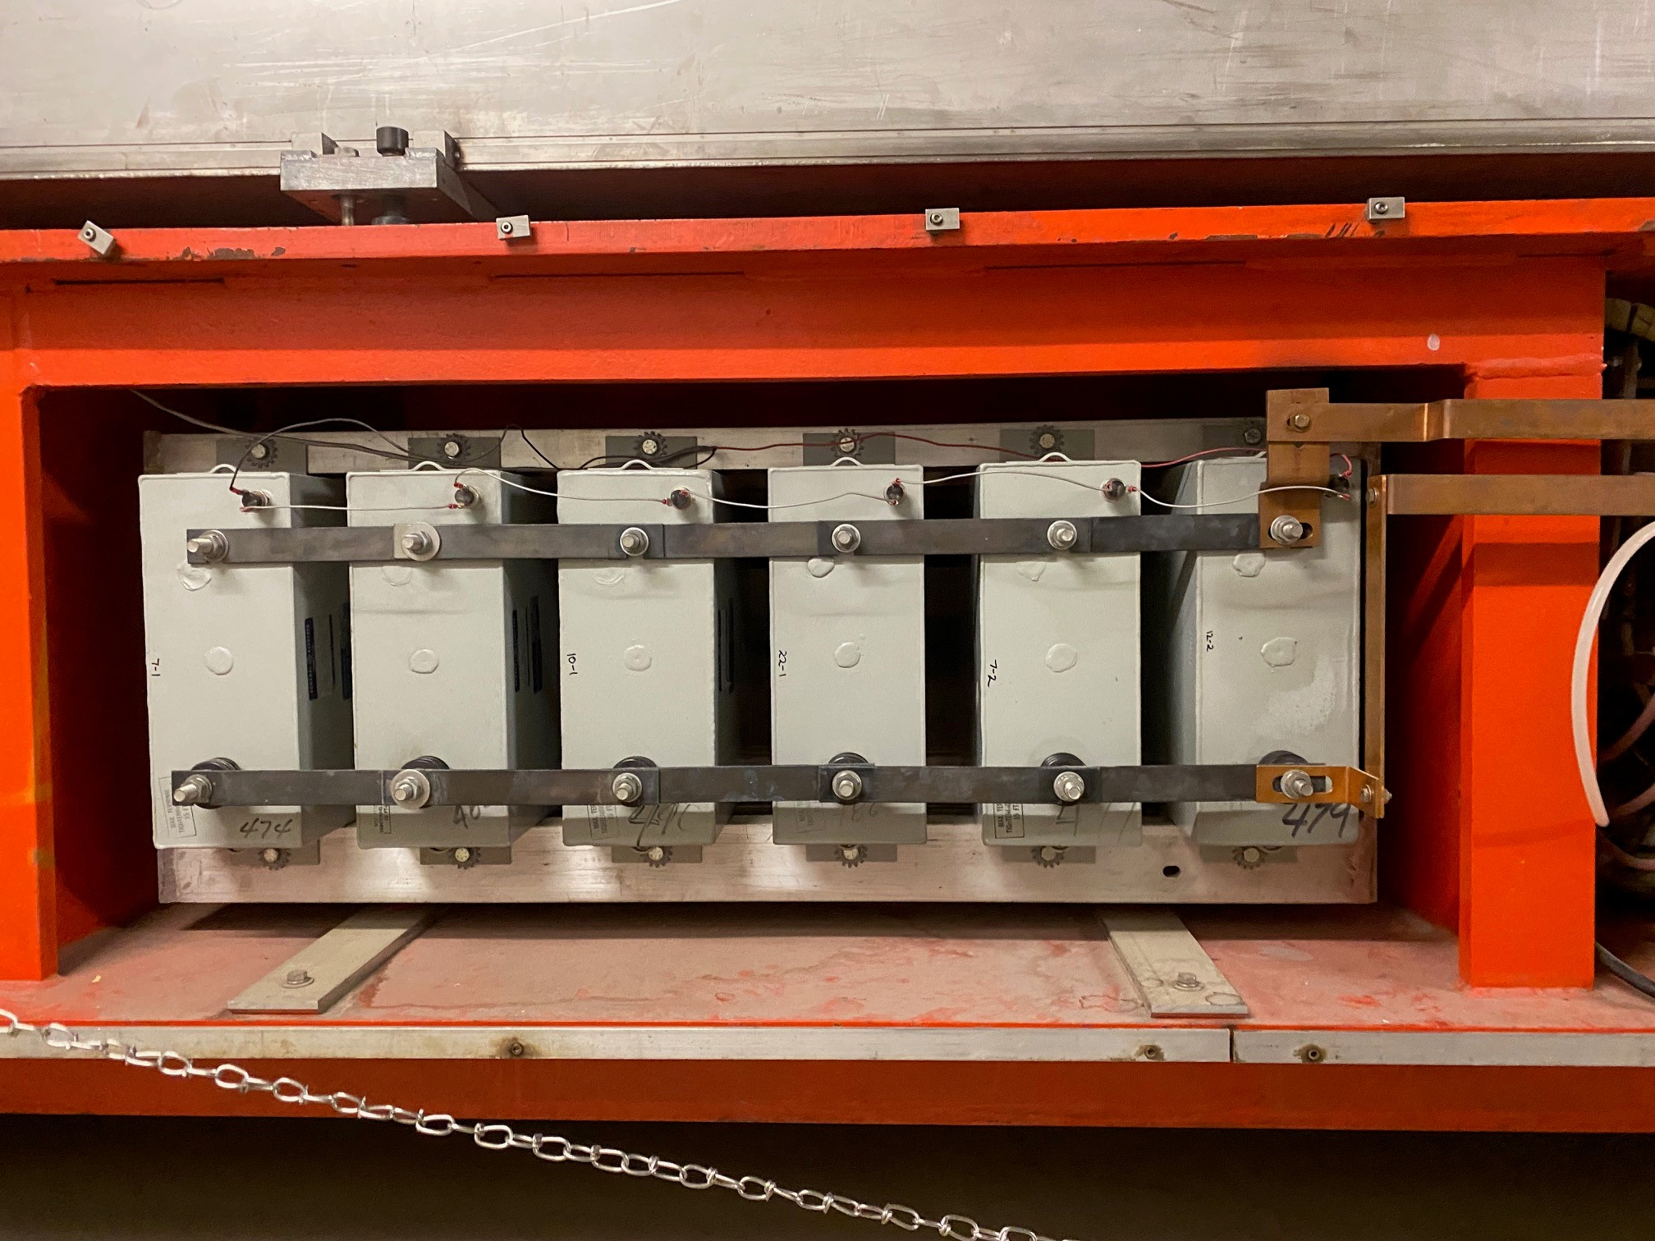
Booster Shutdown Work
Operational gradient magnet corona testing. Part of planning for 20 Hz running with PIPII.
P2-2 girder manifold LCW leak patch. Extremely difficult area to work behind girder.
P6 HRA replaced bad girder capacitors

Slide 6
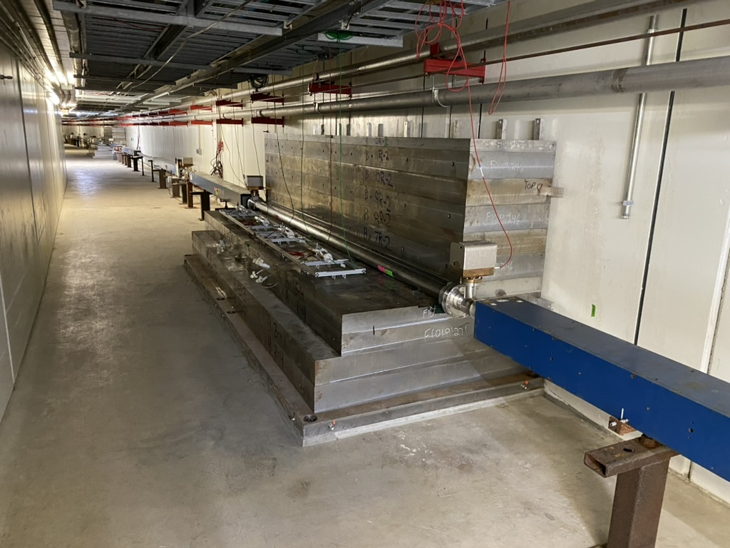
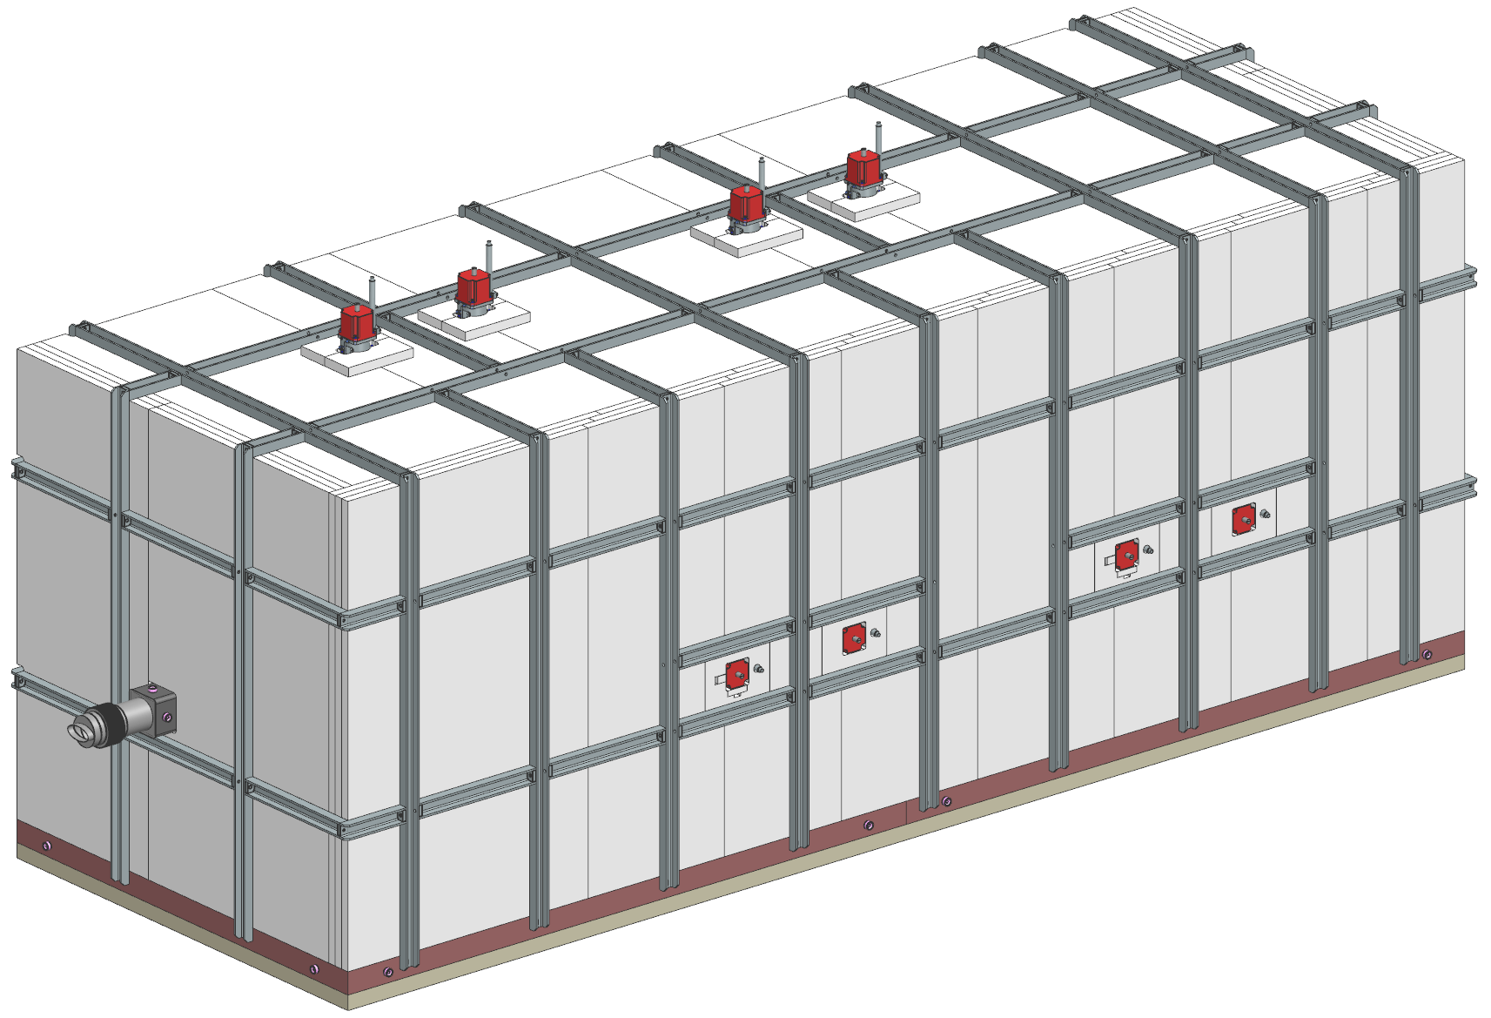
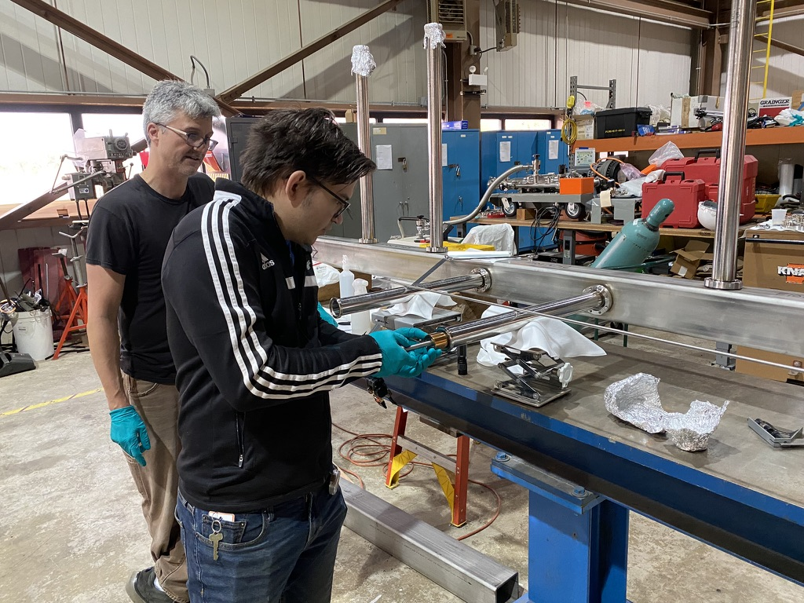
Main Injector 8 Gev Collimators
2 Collimators
  825-826 and 827-828
Weight per collimator station: ~175,000 lbs. (88 tons)
  Installation is on hold until next
Shutdown. Currently ~75% complete. Vacuum chambers are assembled and ready to install during the next shutdown.
    Re-installed gradient magnets
    Re-installed spool piece
    New IPs installed and powered
BLM system installed
  Fully assembled jaws and vacuum chambers for both 825 and 827

Slide 7
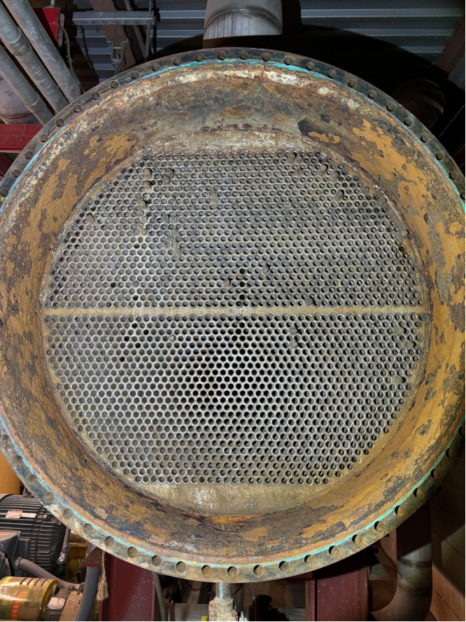
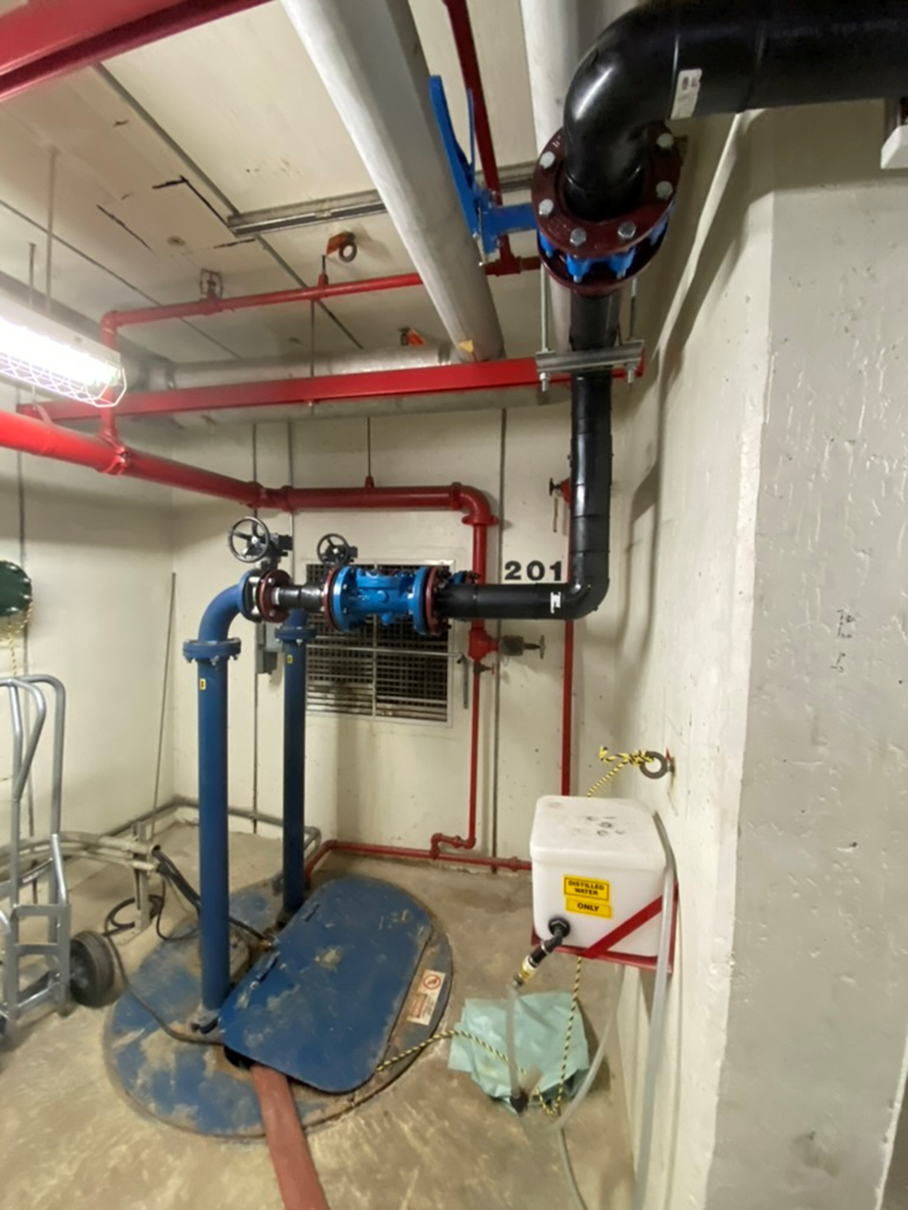
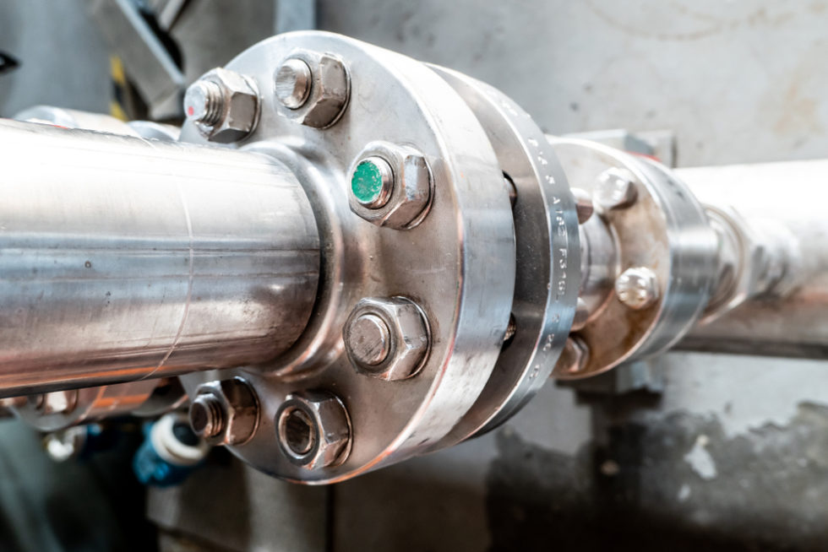
Main Injector shutdown work
MI 201 and 218 Sump Discharge Repairs. Replaced with HDPE.
Main Injector heat exchangers have corrosion issues. All heat exchangers are being evaluated for use.
All MI LCW Pump Discharge Gaskets were replaced over a 2 week period.

Slide 8
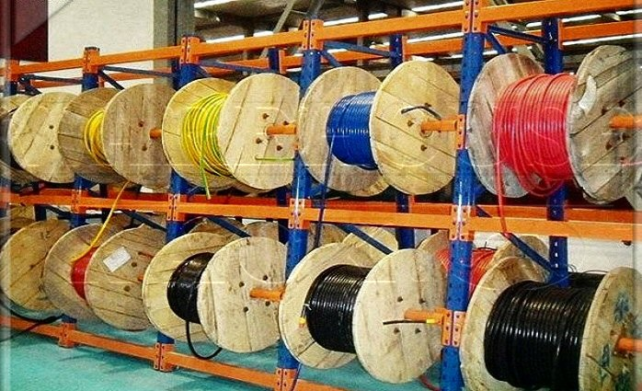
Electrical work/ upgrades
Dual PA’s at MI 60 for PIP2.
8 GeV and Booster collimators. The Controls group contributed work on both Booster and 8 GeV controllers.
Upper and lower dipole at MI 20.
Numerous other pulls.

Slide 9
Power Electronics Systems Department
SEL-751 relay installation.
Transformer secondary cable replacement for MI-20 Lower & Upper.
Add filter cap bleeder resistors to support faster rep rate.
Add high-temp lugs to dipole supplies to support faster rep rate
Controls electrolytic cap replacement for MP02/MP03/ORBUMP
I:Q847 commissioning
Added 480V test points in multiple power supplies and disconnects across the accelerator complex to help support the absence of voltage verification.

Slide 10
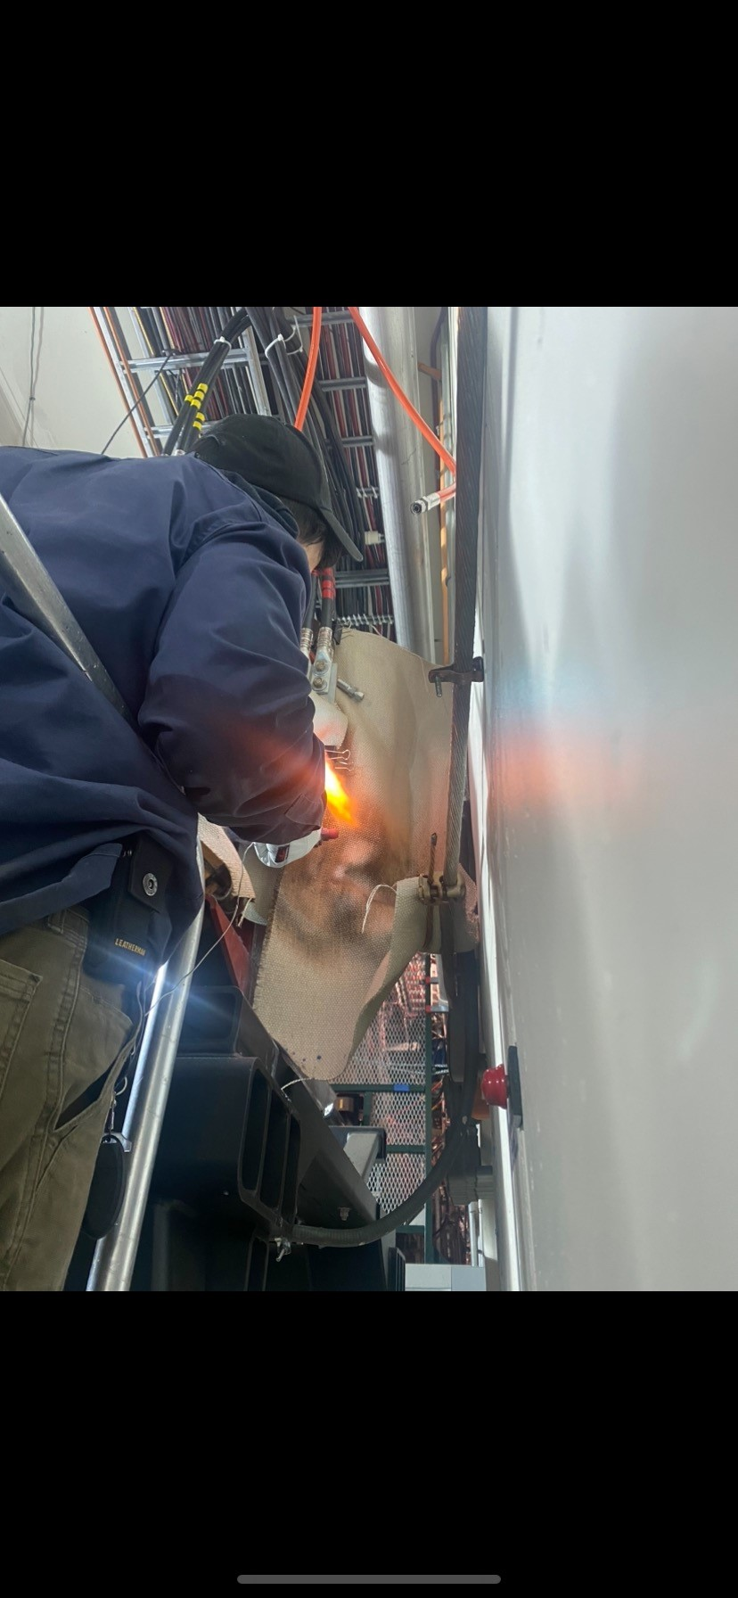

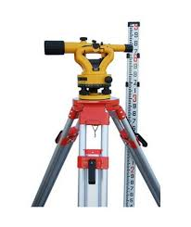

Shutdown work support
APSTD Accelerator support crew
Alignment And Metrology
ES&H safety officers and radiation safety

Slide 11
Safety Record for the past 2 shutdowns
  Total Number of Injuries during shutdown periods (the past 2 years)
                0 !!
  This number is attributed to all of your hard work and attention to detail. Accidents can happen, but working safely is not an accident.
11/15/2024
Busch | All Hands Shutdown 2024

Slide 12
Schedule completion and upcoming work
    We had ~ 650 jobs/tasks listed on the schedule.
    79% of the jobs were safely completed.
    We need to stay ahead of known issues such as procurement and delivery dates that keep slipping.
    Radioactive/ Hazardous waste disposal one of the top priorities. I will be working with radiation safety to continue to refine this process and move forward with the waste pickups.
    Next year we will be allotted 10 weeks for shutdown work.
    Meetings will be starting in January to plan the next shutdown and work schedule.

Slide 13
Questions

