Slide 1
9 O’Clock Meeting
Nathan Ruffatti
MCR Crew Chief
Friday, Nov 22th, 2024

Slide 2
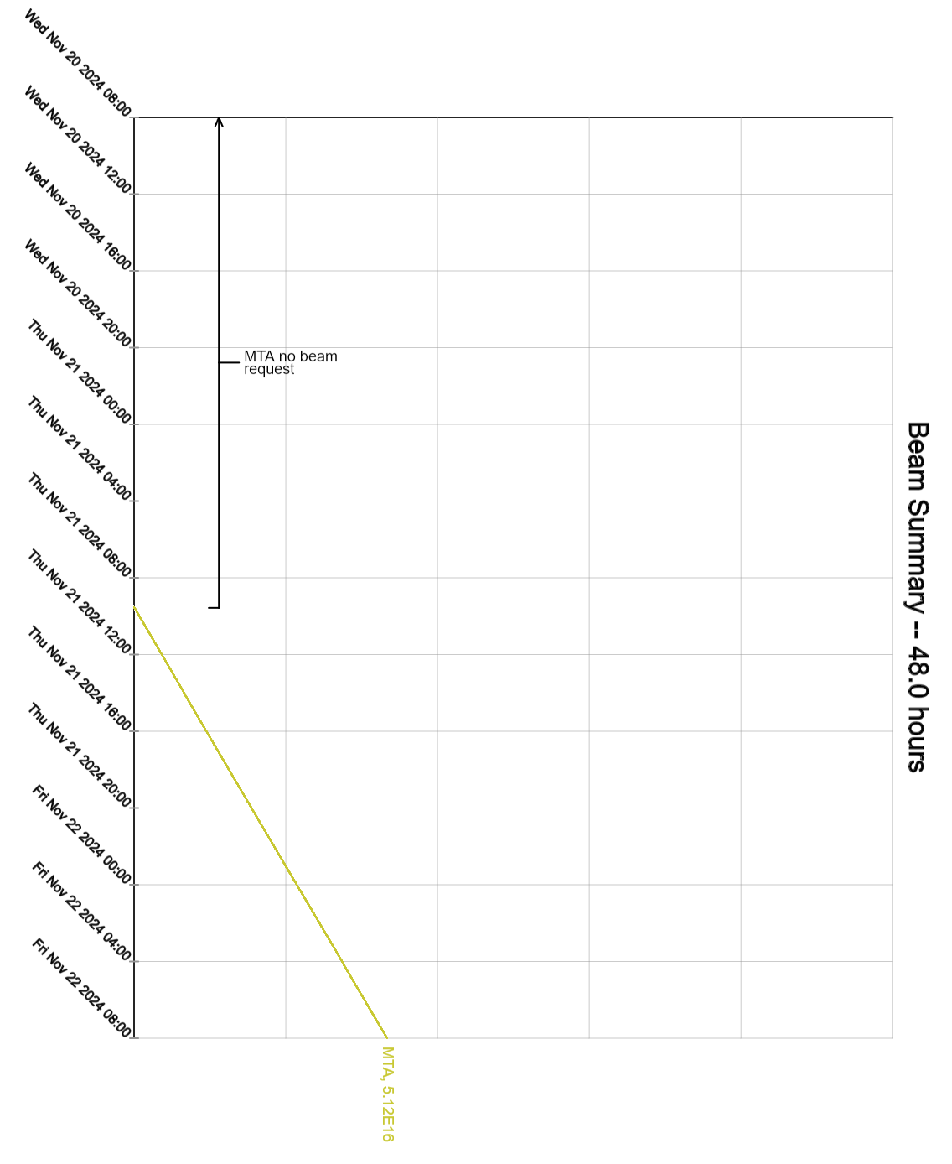
Since Wednesday…
Wednesday:
E & F-Sector Outage
Linac and Booster Studies
Thursday:
Booster East power outage
F-Sector Outage
Muon re-core to operational cores
MIRF17 cavity leak repaired
Beam to MTA and Booster Studies
Friday:
A & F-Sector Outage
Beam to MTA

