Slide 1



302.4.01 Magnets Vertical Test at BNL
Weekly Status
Febin Kurian
25-Nov-2024

Slide 2
MQXFA12b
Cooldown– started on 19th Nov.
Magnet reached 4.5K on 22nd Nov.
  Electrical checks -- Complete
Magnet is cooling down to 1.9K
  HiPot at 1.9 K – Underway
  Quench protection system tests– Expected today
  Splice resistance measurements – Expected Tuesday
  Spontaneous quench test program – Tuesday/Wednesday

Slide 3
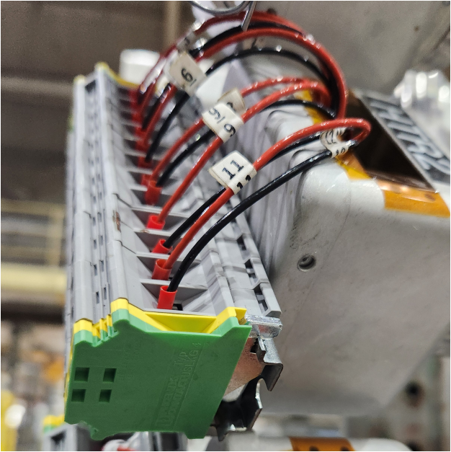
Second Top Hat Repair
  Heaters: All Passed Hi Pot
  V-taps: Undergoing pin-by-pin hipot
    Passed: VT1, VT2, VT3, VT6
    Failed: VT4, VT5 → plans to work on V-taps in between quench training

Slide 4
CRYOGENIC STATUS
CTI 4000 system status
  Running
Linde 1610 system status
  Running

Slide 5
MQXFA 18
Shipped to FNAL last week (Thursday).

