Slide 1
302.4.04 – Cryo-assemblies Horizontal Test Weekly status report
G. Chlachidze
Nov. 25th, 2024

Slide 2
Next Steps
LQXFA/B02 Test Traveler is closed
LQXFA/B02 Test Report – The latest draft under internal review
LQXFA/B03 test preparations:
Run plan drafted
Test checklist drafted
Checkout forms – work in progress

Slide 3
Next Steps
Short term steps to improve/expedite the controlled cooldown and warmup at Stand 4
Complete insulation of the helium lines & relief valves upstream to the HX - Done
Update/Improve the controlled cooldown and warmup procedures for cryo-operators – Planned for next week
Replace faulty GHe flow-meter – Work starts this week

Slide 4
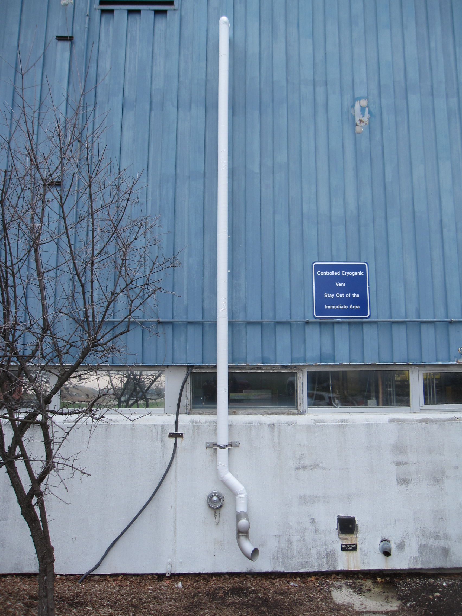
Next Steps
Nitrogen vent

Slide 5
New Warm Finger Assembly
SS inner tube of 4.25” OD and 0.083” thick wall not available
Custom order will cost about $60-80k
We could replace it with 4.5” OD and 0.120” thick wall
Will reduce the gap between the inner and outer tubes from 7.4 mm to 4.2 mm in radius. Room for about 10 layers of MLI instead of 15 layers in the baseline design
Will increase the ID from 103.7 to 108.2 mm - requires different probe bearings
3 more mirrors to be purchased ($5k) as they are glued to the bearing ring

Slide 6
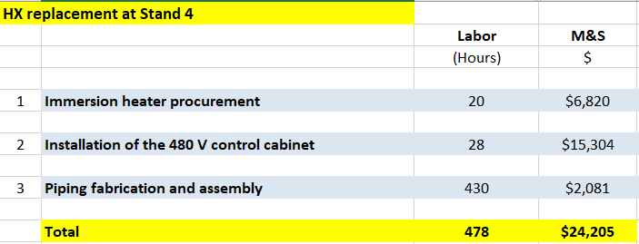
Next Steps
Long term improvements may include replacement of the heat exchanger at Stand 4
Two main goals for the HX replacement: increased reliability of the cold operation and faster cooldown and warmup
Cost estimate based on the installation experience at CMTF in 2023

Slide 7
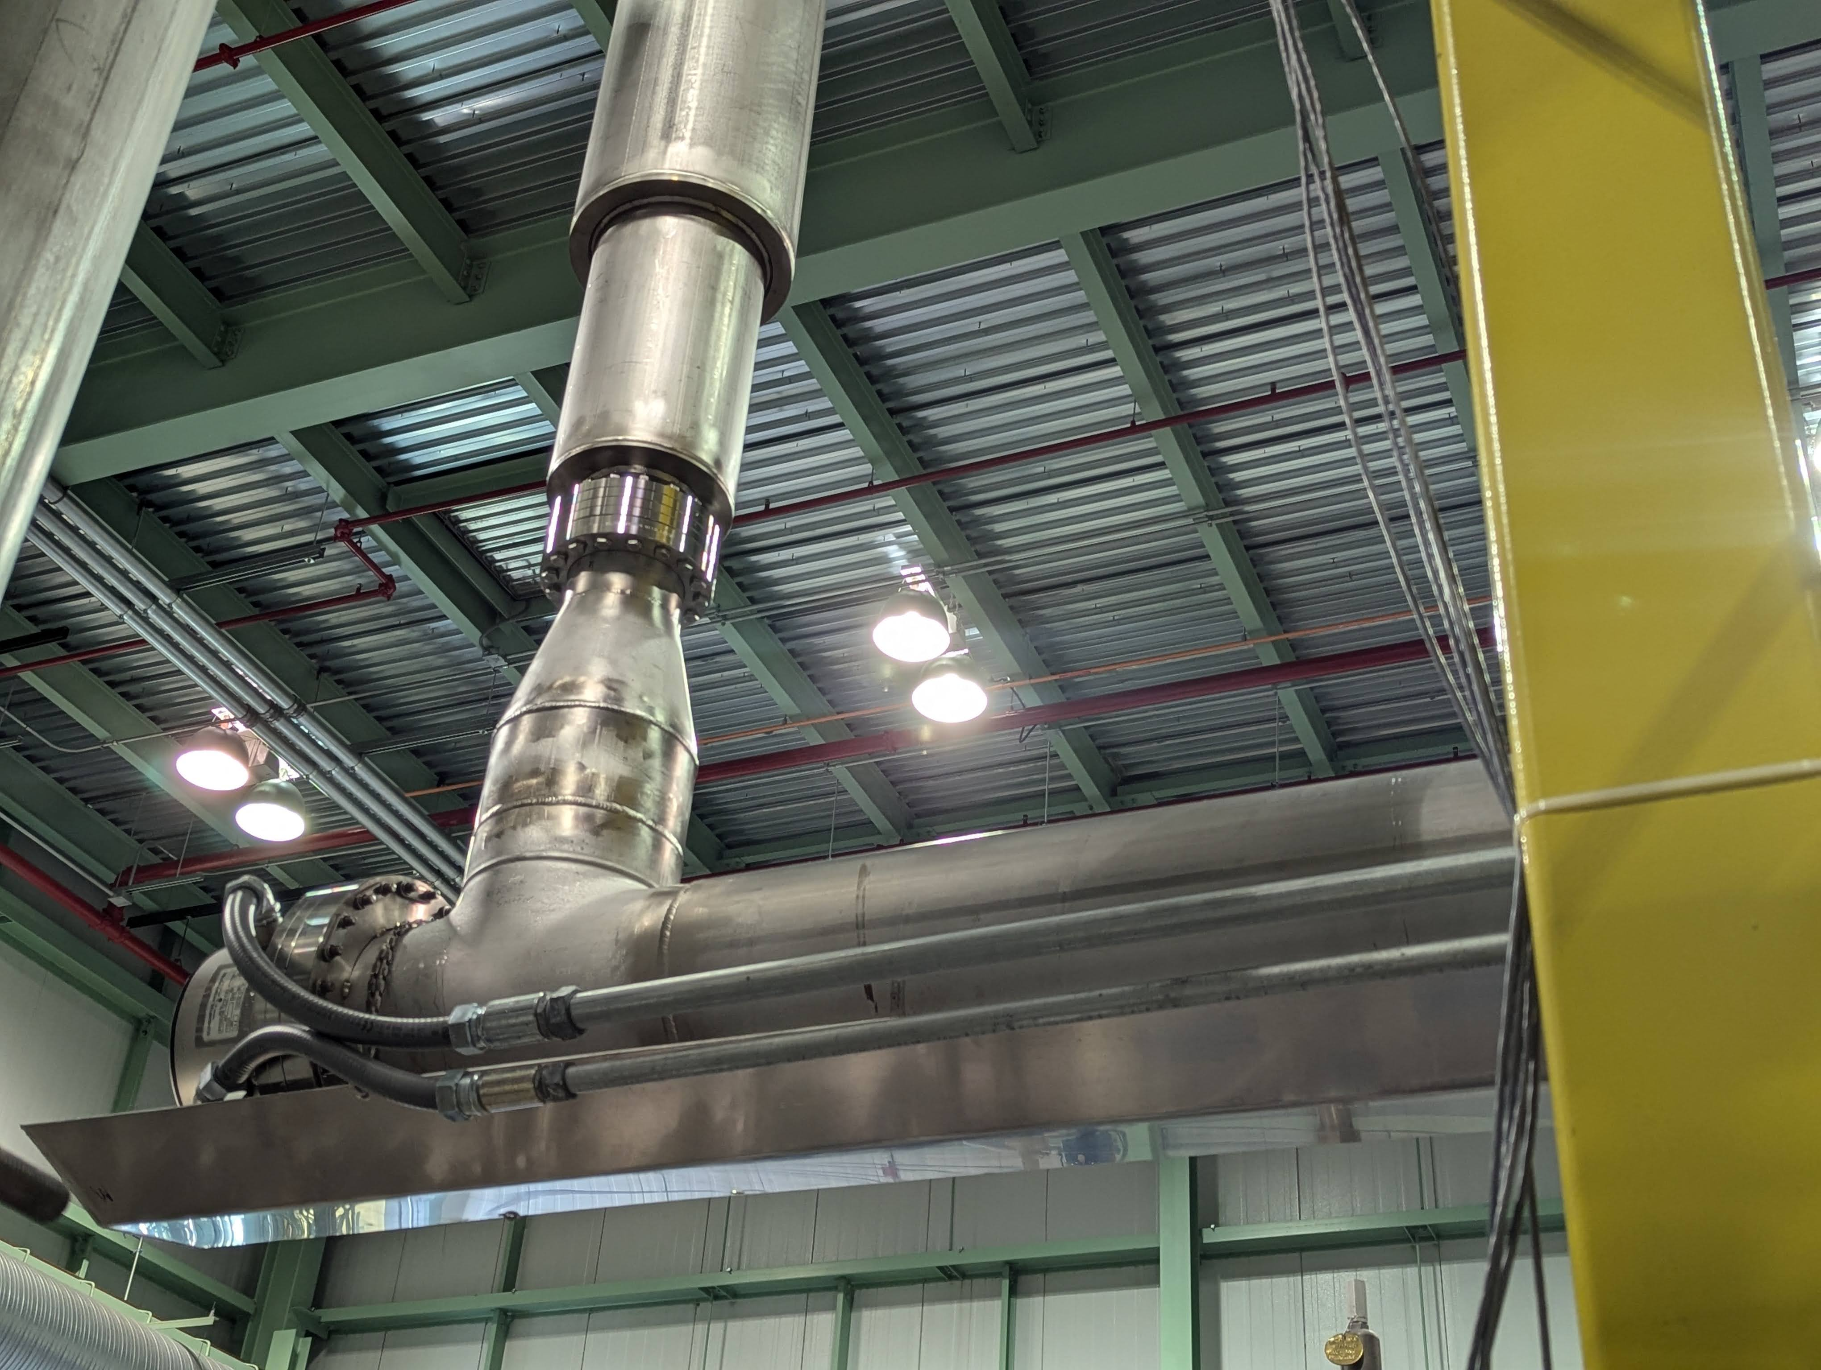
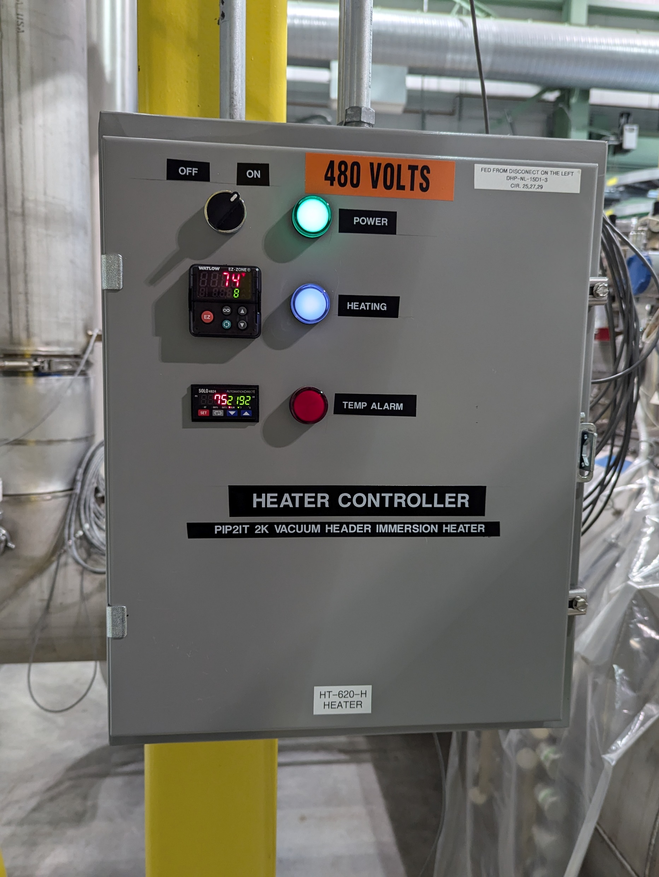
HX Replacement
Powerful immersion heaters already in use at various test facilities, including in IB1
Design for 16.5 kW heater is available, rough cost estimate 50-60 k$
With this improvement we could safely run with Ghe flow up to 18 g/s
Need to replace the sub-cooler if we want to exceed 20 g/s
Helium flow
Immersion Heater with Conflat Flange

