Slide 1
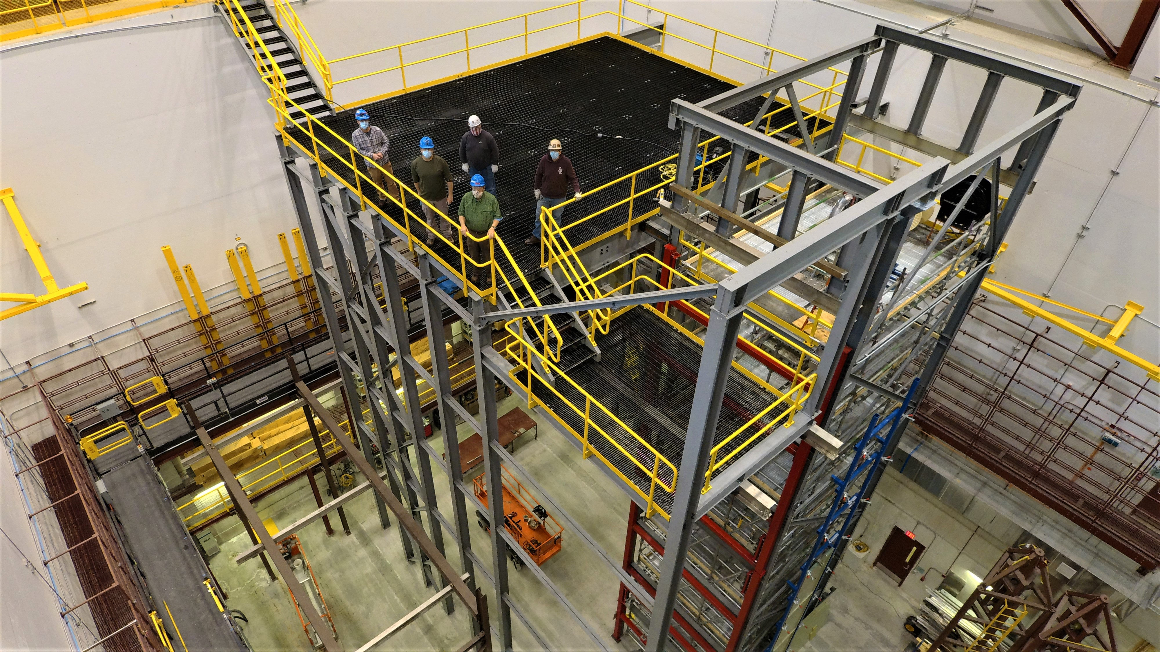
December 2024
APA tests at Ash River
Ship to SURF List
William Miller
25 November 2024
Phase 2 DSS support structure at Ash River

Slide 2
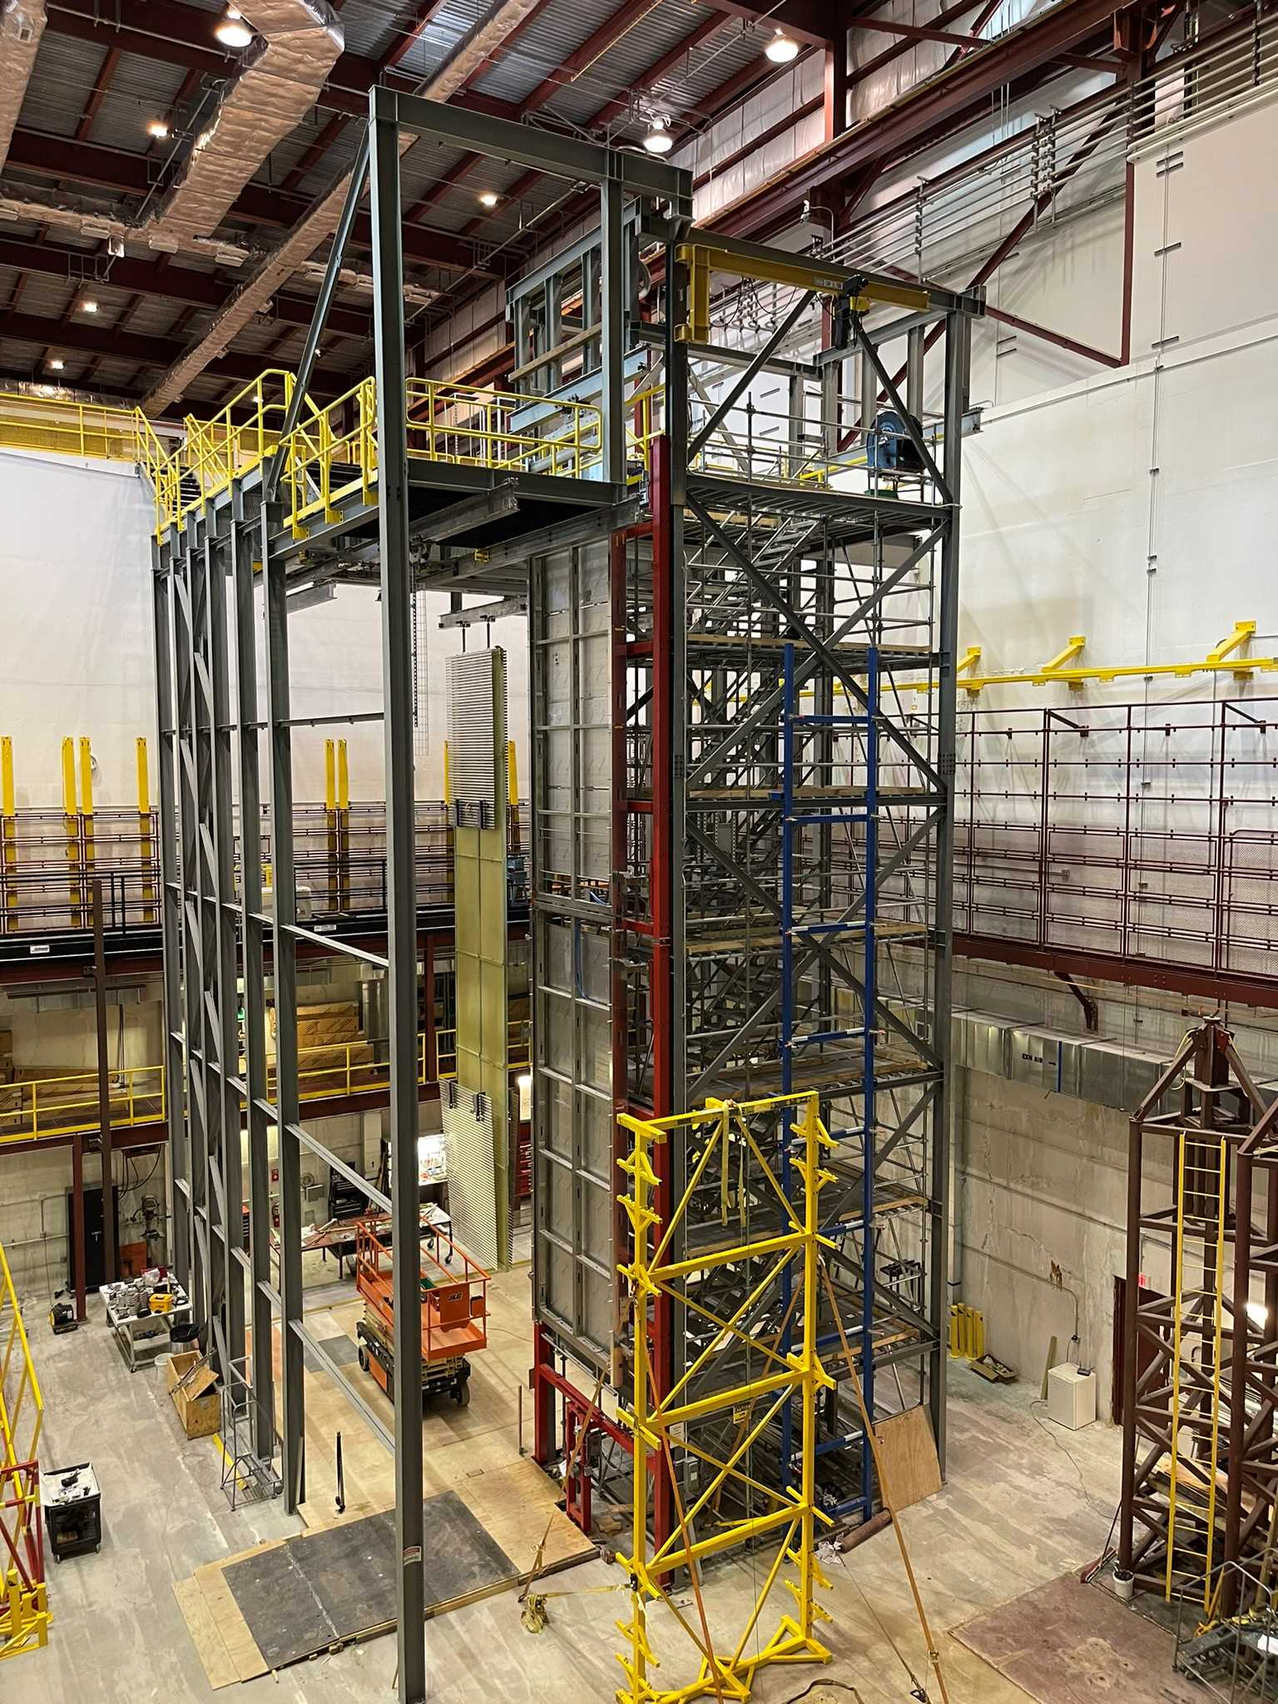
Goals – Dec. 3-11, 2024
Participants
APA Alignment in Assembly Frame
Using two doublets in Phase 2 Cryostat
Row 25 tests
What to Ship to SURF-Now
List of materials
Decommissioning Phase 2 and the APA tower
Closeout of DUNE work at Ash River

Slide 3
List of Visitors-Dec 3rd- 11th
Bill Miller
Jim Stewart
Marzio Nessi
Olga Beltramello
Eric James
Anselmo Villanueva
Tom Wieber
Kyle Rovick
Nickolas Carouso
Brian Rebel
Joe Munski (PSL)
Ash River Crew-Matt N., Brian L., Tina L., Karl K. Chris S.
Ash Trail Lodge can help with housing Provide some lunches/dinners, on week of Dec 2nd.
Hotels also available in I. Falls
Need to finalize everyone's travel plans so we can make the final arrangements for lunches.

Slide 4
APA Envelope Test
Status now is the top production APA has been removed and is in the ASF so the APA Yoke Plate can be installed.
Can we complete the production frame doublet and prepare it for movement in the cryostat Tuesday/Wednesday or should we wait till Olga arrives Thursday?
Tuesday/Wednesday build Endwall. (I was not planning to install ground plane)
Dec. 9th build the second doublet (Ash River APA Frames) and the new CERN adjustable linkages the second week, test cable installation, survey and move into cryostat.

Slide 5
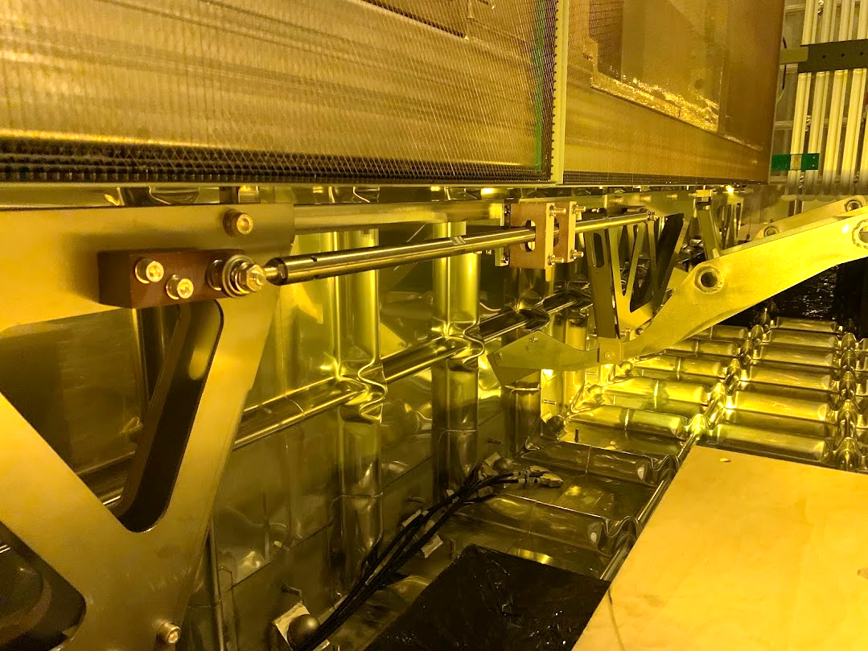
Bringing in the next APA
After testing the APA envelope of the Ash River APA frames with all the visitors present move it into position in cryostat
The APA doublet has 2 alignment pins, one on each APA. They must be in place before the next APA doublet is moved into position
Once both doublets place install the FC brackets and the APA alignment rod being delivered by PSL.
Set up that Total Station and survey the two doublets in position.
Deploy the Top and Bottom FC. Re-survey?
APA alignment Pin
APA alignment Rod at CERN

Slide 6
What to ship to SURF
We have started a general list of what we have at Ash River. MANY of the useful items we had at Ash River are being used at CERN.
I have a detailed list of equipment that was purchased and there are some items that need to be decided on that were left over from the Soudan Lab.
We can’t take anything that would be needed for decommissioning NOvA that was purchased with University/NOvA grants.
Consortia TPC Equipments | EDMS #
APA Equipment
APA Assmbly Frame/accuator /Controls | 2112698 |  | PSL
Old APA Frames |  |  | PSL
APA yoke and assorted fittings |  |  | PSL
APA Trolleys | 2733998 |  | Ash River
HV End Wall and FC Equipment
CPA Assembly Frame | 2382268 |  | HV
End Wall tooling | 2786837 |  | Ash River
Assorted FC tooling
FC installation tooling | 2786834 |  | HV
FC storage carts | 2788024 |  | HV
FC Assembly Table | 2787710 |  | HV
FC Latches |  |  | HV
CPA and End Wall Trolleys |  |  | Ash River
CPA | 2633164 |  | HV
End Wall | 2633165 |  | HV
FC | 2633166 |  | HV
Shuttle beam tooling
A Clear list needs to be made during visit so estimated packaging and shipping costs can be estimated

Slide 7
Decommissioning Phase 2 and APA Tower
Clearly, we need to understand the timeline needed to complete any HD tests that we have listed
Matt has started the process of putting together an RFI to understand what the costs would be to decommission. We would like at least a few estimates, so we understand scope of the work.
We would put out a formal bid package as soon as we understand the schedule
We are working on clarification of what equipment is property of UMN and what can be transferred to DUNE.
Timeline on DUNE funding is we would run out in ~March depending on costs of shipping and decommissioning.

Slide 8
Summary
At this point we do not know when we the synchronized hoists for the VD HV Field will be delivered. These need to be tested on both the loading dock where the gantry crane is located now but also moved to Phase 2 structure so we can deploy the hoists the full distance.
It has been a fantastic Trial Assembly Area for both ProtoDUNE and DUNE we started summer of 2016 and will complete spring of 2025!
It has greatly improved the installation plan, documentation and final design of the Horizontal Drift Detector!
We have many tasks to complete the second week. HOPEFULLY, we can get them done Monday/Tuesday, so we have time for a Debriefing/lessons learned Wednesday morning. Several people are leaving by noon on Wednesday.
Some of us will be at the lab Saturday and Sunday to review DUNE documentation and try and finalize what equipment gets shipped.
We will also review the decommissioning plan and try to understand all of our options

