Slide 1
FD1/FD2 Installation Engineering Update
Nicholas Joniak
11/26/2024

Slide 2
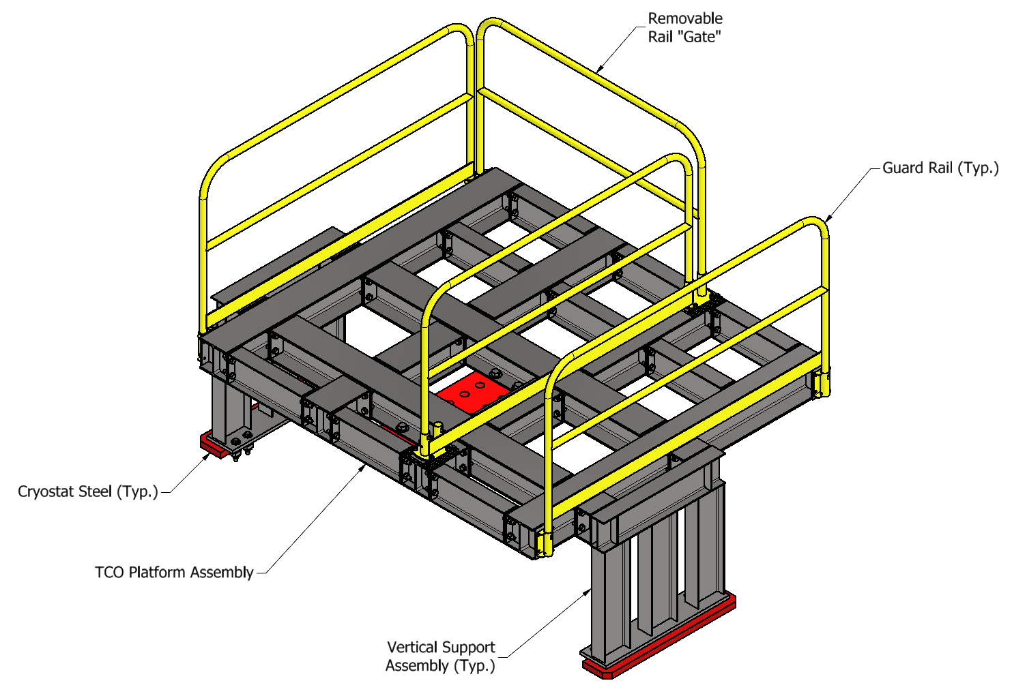
Engineering Updates
Procurement Status:
  Upcoming:
    See engineering updates.
  Existing:
    No update.
FD2 TCO:
  Analysis Plans submitted to compliance office for review:
    TCO Hoist Beam.
    TCO Platform.

Slide 3
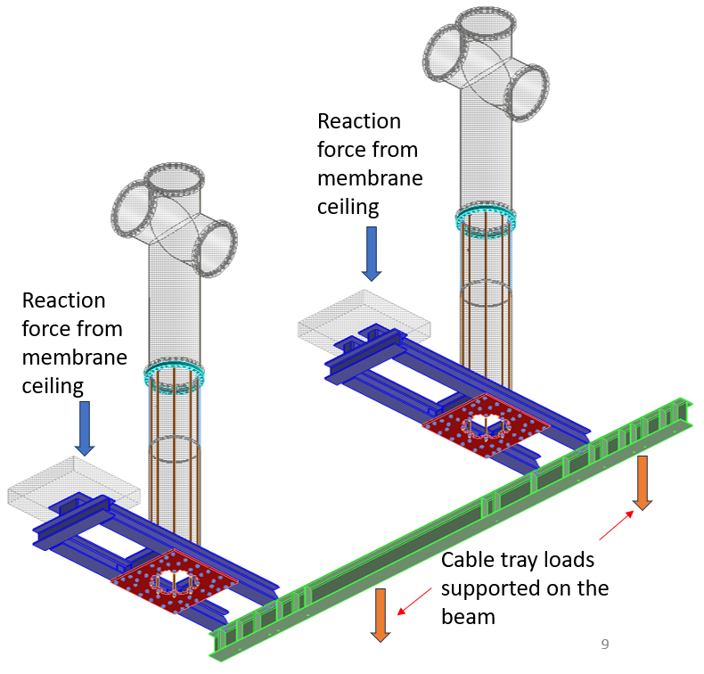
Engineering Updates
Vertical Drift – BDE Cable Tray Support
  Design presented at last SURF engineering workshop relied on boundary conditions that are not “guaranteed”.
    Upper membrane subject to vertical movement during installation and cooldown/filling.
      Unknown preload required in threaded rods to enable the counter-rotation elements to transfer load back to the membrane.
    Membrane pattern different at every location and not confirmable until installation.
  Exercise being performed to verify if a “simplified” design is viable.

Slide 4
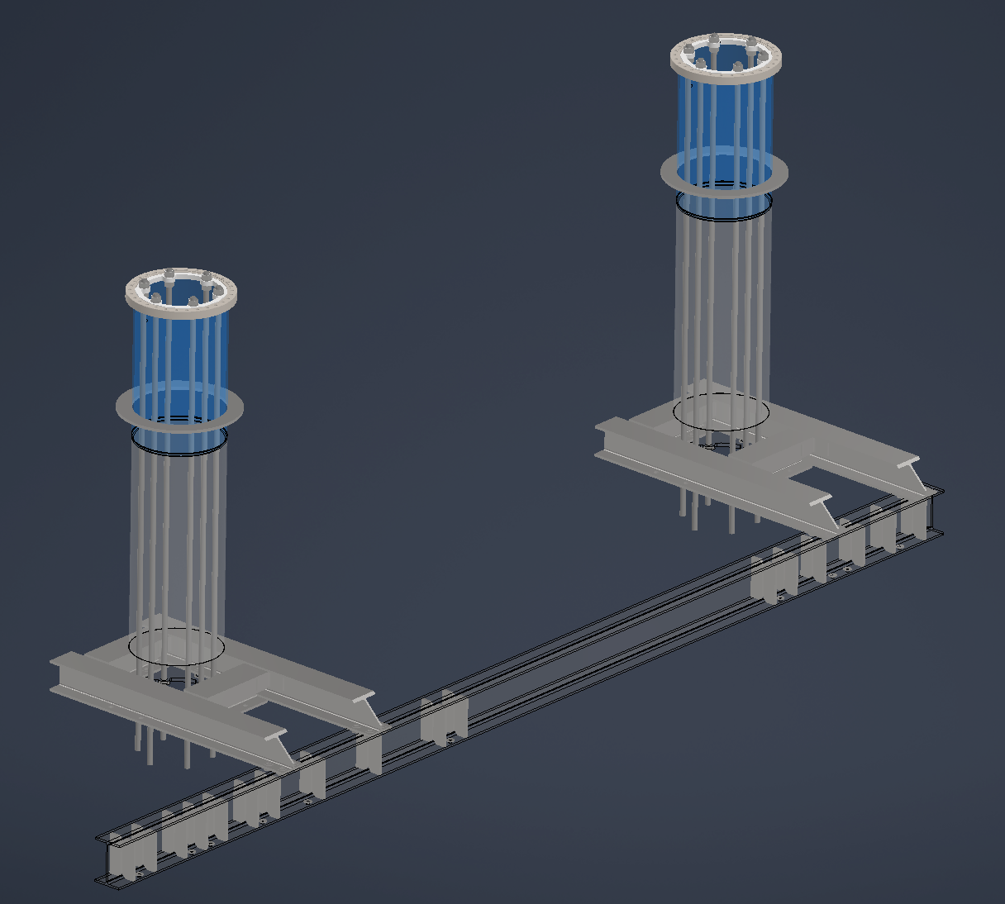
Engineering Updates
Vertical Drift – BDE Cable Tray Support
  Proposed alternate direction is to rework the design to eliminate the counter-rotation element by strengthening all the main support connections to limit deformation.
    Preliminary analyses are promising, though certain elements still require some hardening and further work.
  The intent is for a design that does not rely on uncertainties to function effectively, and to lower the unit cost and complexity.

