Slide 1
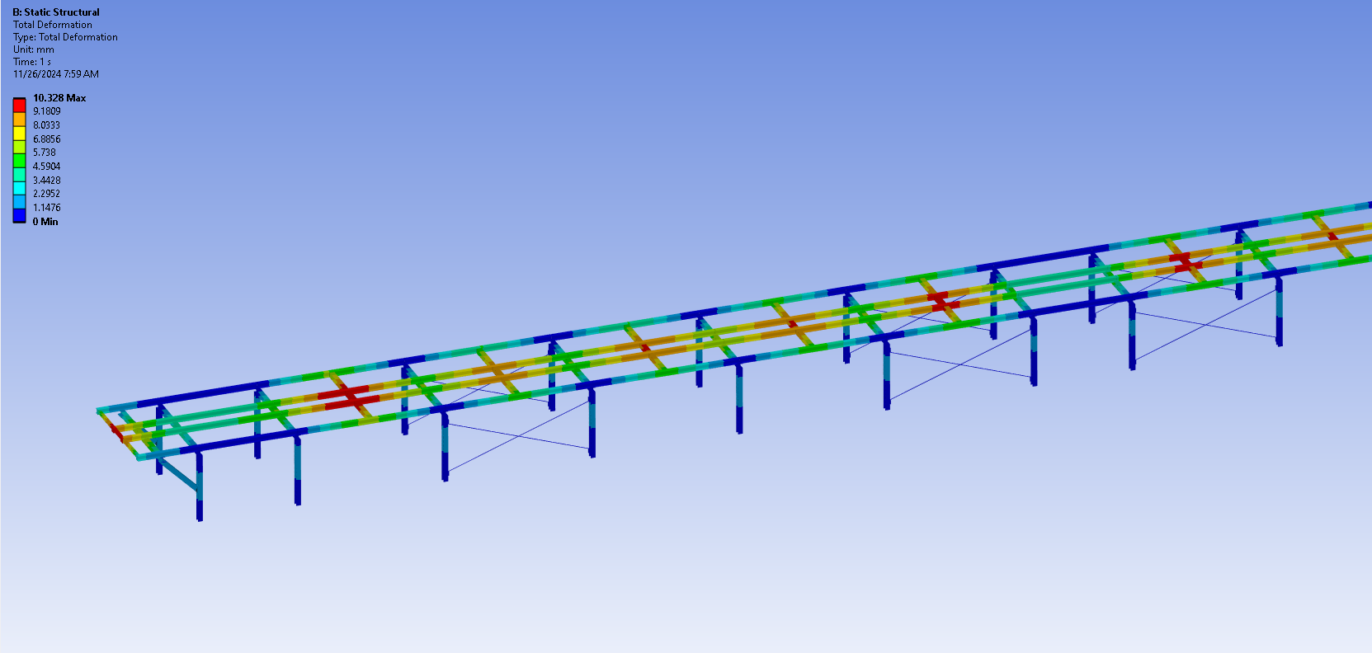
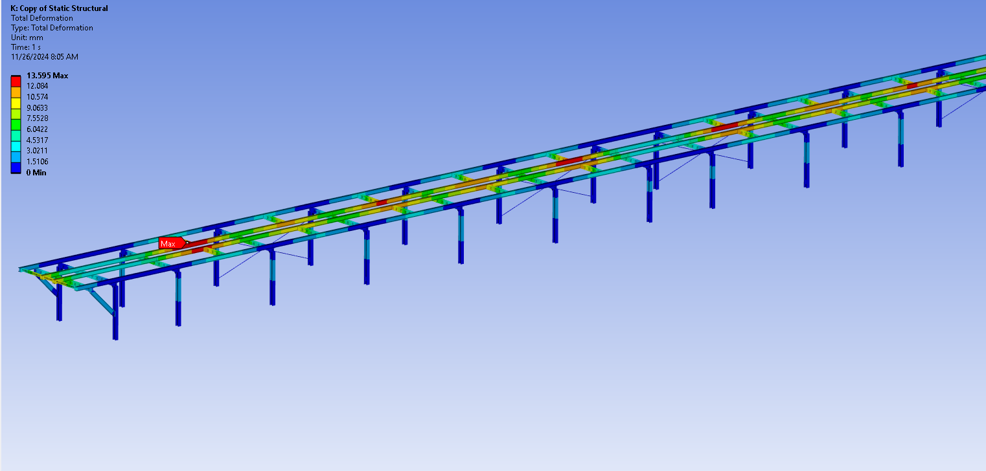
Week of 11/19/2024
Condensation prevention PRR was held on 21st Nov.
Concerns about fiberglass machining underground. Checking with the manufacturer to see if they could cut intake holes.
Checking with Erik V about tolerances on the intake holes.
Procurement document https://edms.cern.ch/document/3192084/1
Design report herehttps://edms.cern.ch/document/3192089/1
Drawings
https://edms.cern.ch/document/3192091/1
Week of 11/26/2024
Continue working on the condensation ducting comments.
Detector mezzanine
Short perpendicular bracing solved the buckling issues on the long sections of the beams.
Continue optimizing the short brace sizes.
Tested suppressing cross bracing on detector side of the mezzanine.

Slide 2
HD/VD Detector Mezzanine
Status
Working on engineering analysis and note on updated model
Install Activity:
Installed one portal at a time.
06-June-26
Tech Spec. | 234809 | In work
3D Model | 234790 | In work
Eng. Analysis | 2822247 | In work
CO Report | 252309 | Empty
2D Drawings | 234790 | Empty
Schedule Contact | 252399 | Empty
Install Procedure | 252429 | Empty
Store/Move 120d - 4mo
Fabrication
60d – 3mo
Procurement plan
Railing and flooring off-the-shelf
Stairs off-the-shelf with supports built into mezzanine structure.
Installed by contractor.
Procurement
180d – 6mo
Latest “Submit to Procurement”
06-May-25
Fabrication/installation
PRR Target: December 2024

