Slide 1
Update on Tianlai Hardware Status
Jixia Li
2024/11/26

Slide 2
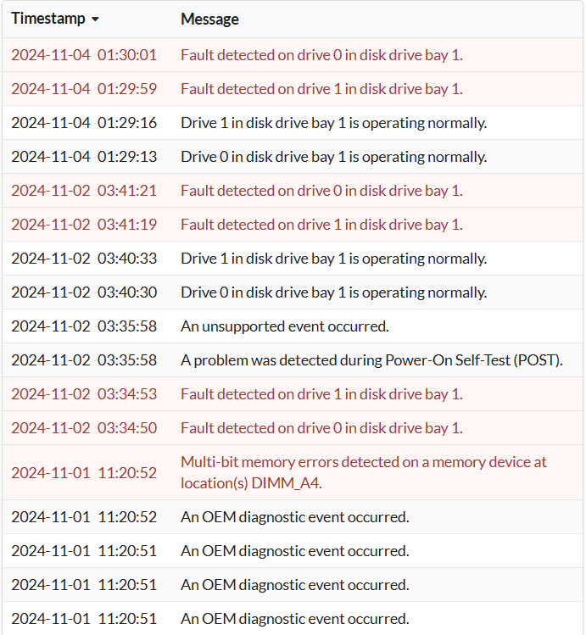
Cylinder FRB detect system
Cylctrl server system SSD failed.
Server sent to Guangdong for repair.

Slide 3
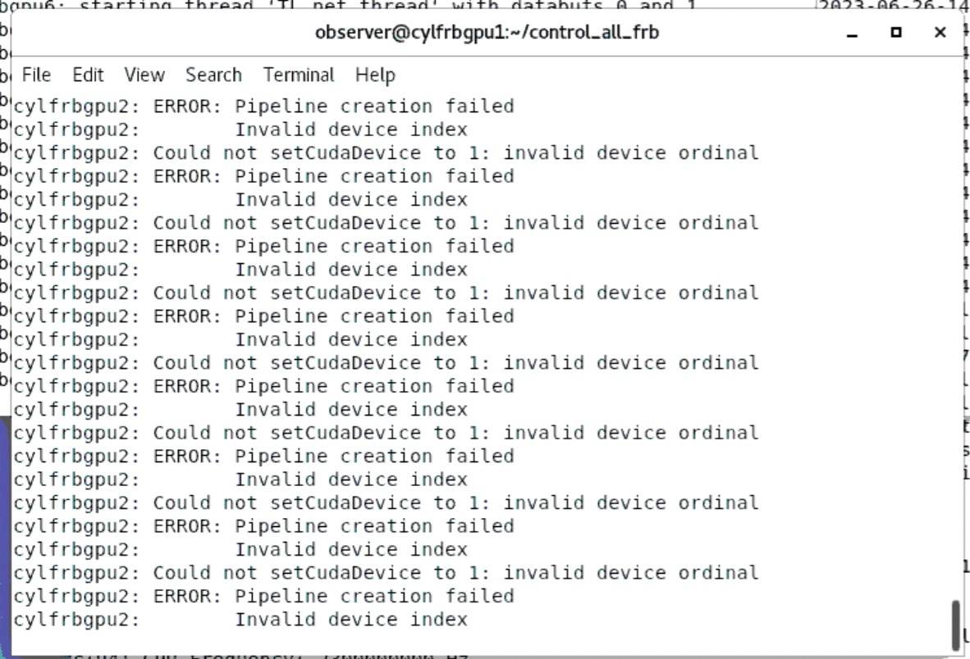
Cylinder FRB detect system
Cylctrl server system SSD failed.
Server sent to Guangdong for repair.
Cuda problem remains.
Error occurred occasionally on cylfrbgpu2.
Compatibility?

Slide 4
Cylinder correlator system
No-correlation problem between roach boards turns out to be caused by false output of 1PPS signal.
Upgrade GPU card from GTX690 to RTX3080 for 2 Xengine servers.
Roach 7 netboot resolved by setting environment variables in u-Boot.

Slide 5
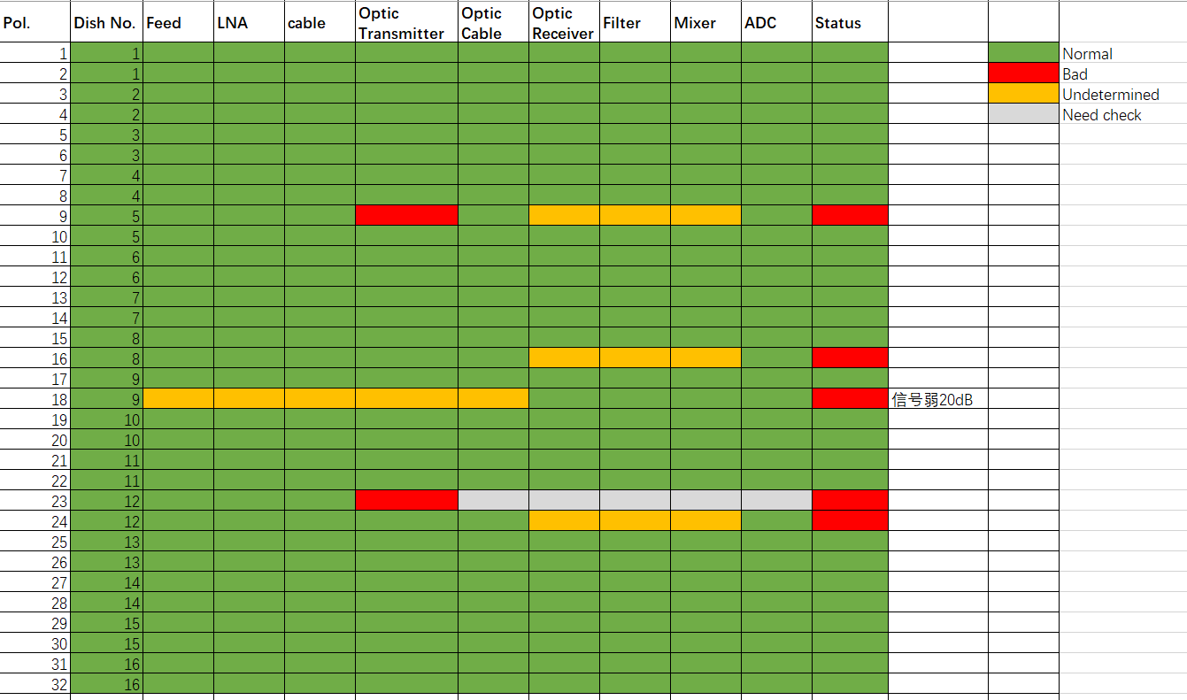
Dish correlation system

Slide 6
New dish antennas built.
Need connection (power cable and serial cable).
Update control program.

