Slide 1
Cathode – Orsay suspension test
Orsay suspension tests of a cathode (pair)
(The second cart was not available)
Process time for the following actions = Less than one hour

Slide 2
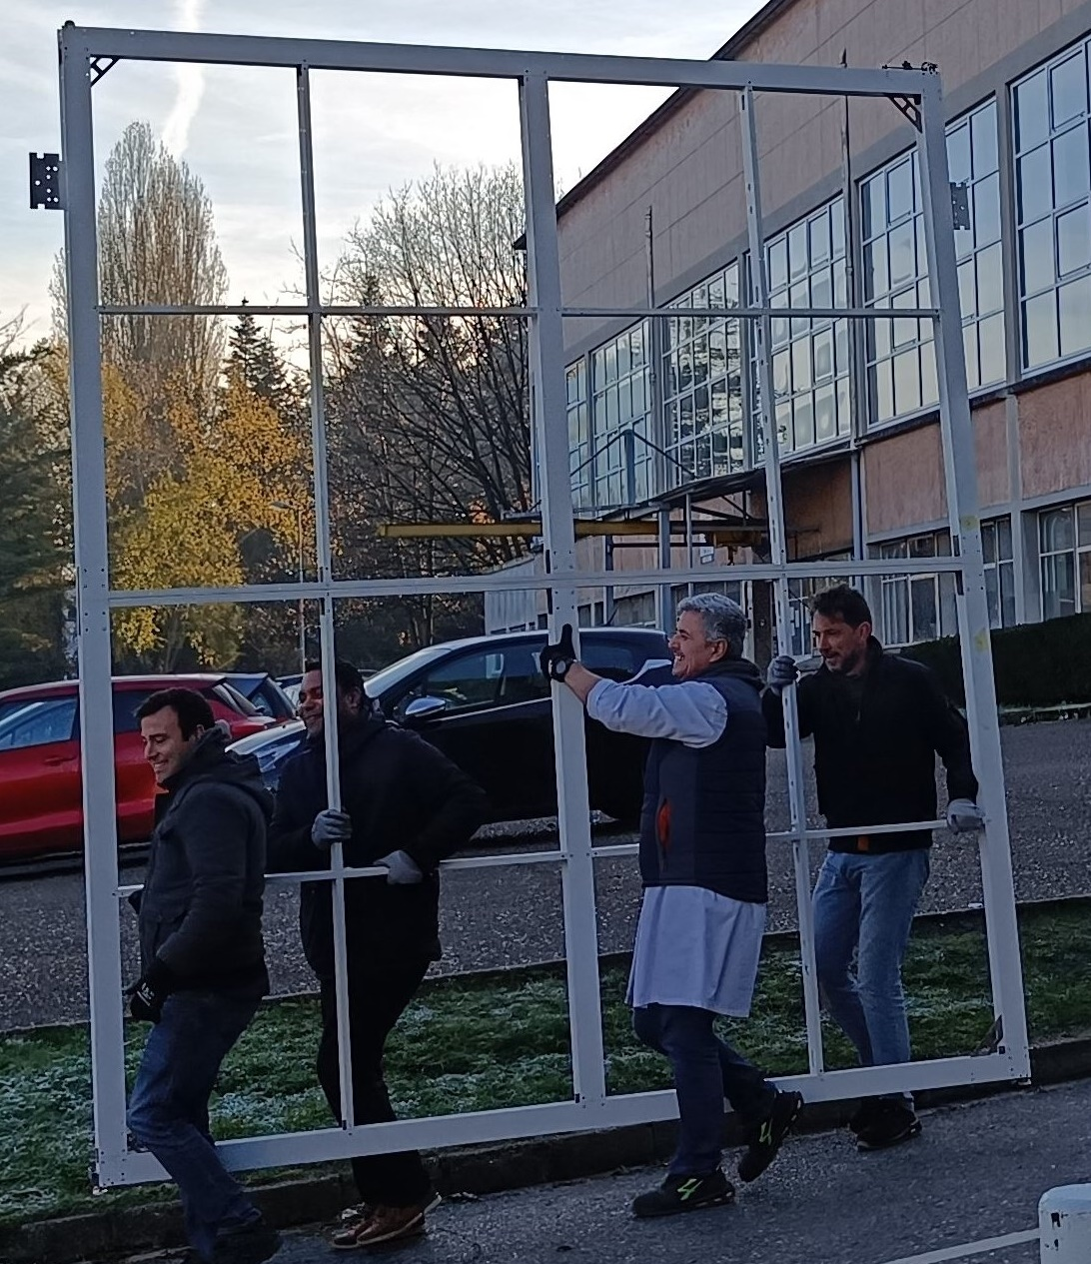
Easy shipment between IJCLAB building

Slide 3
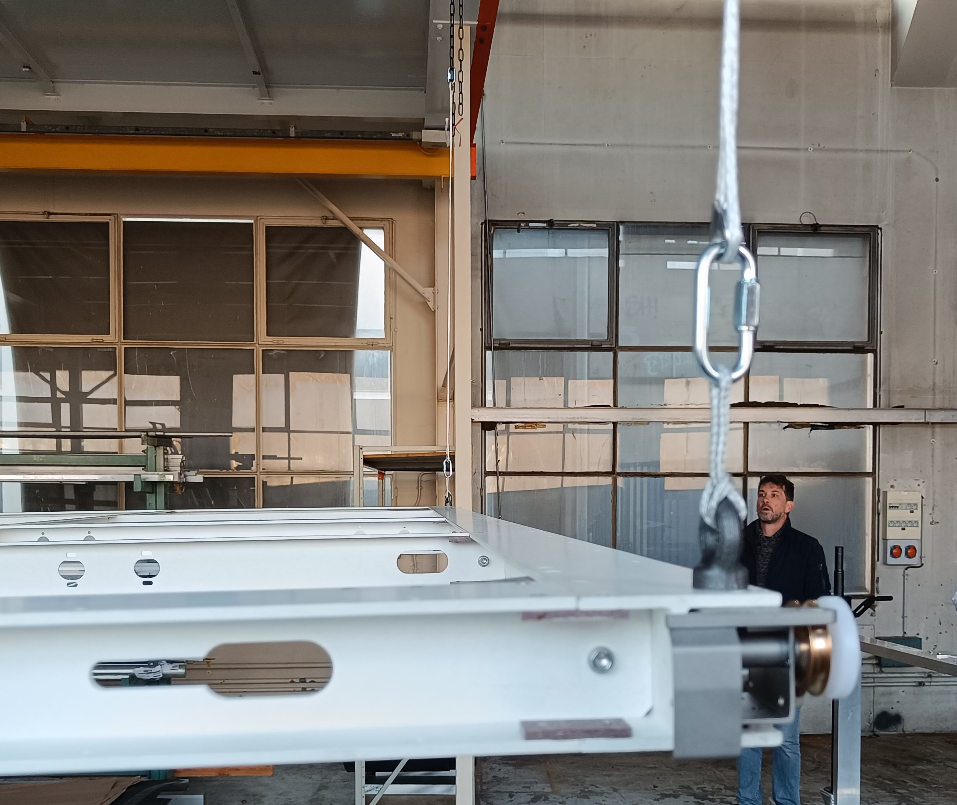
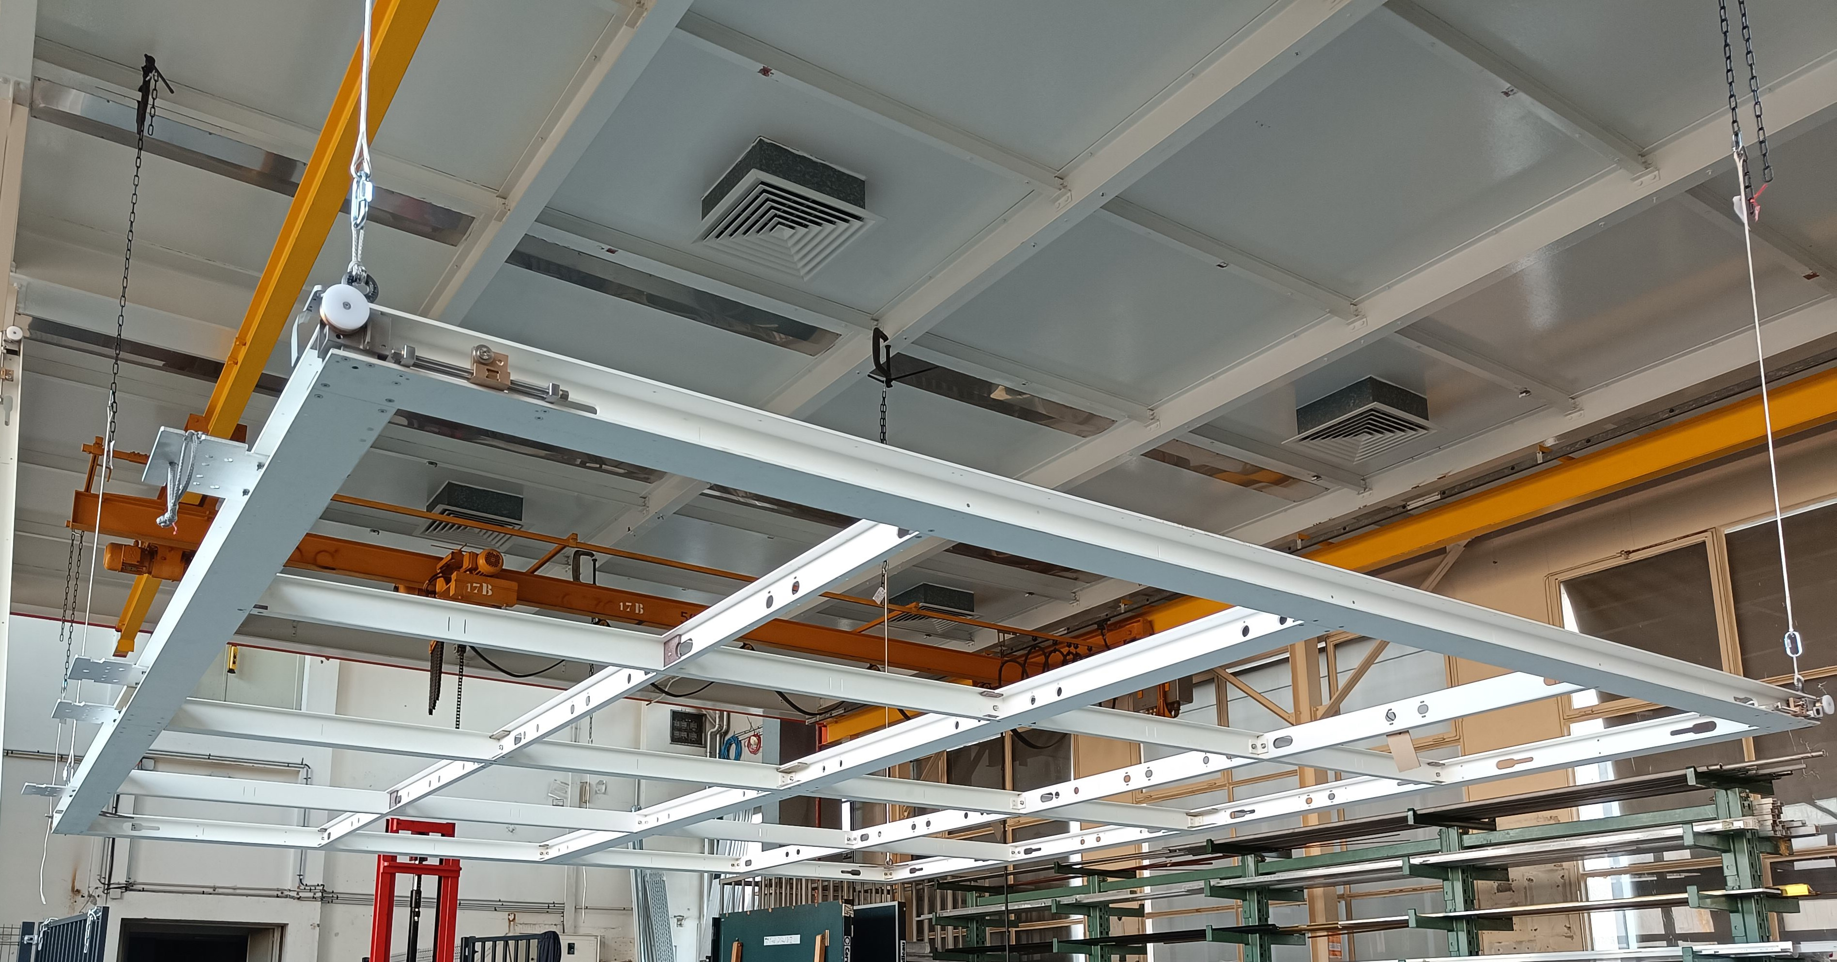
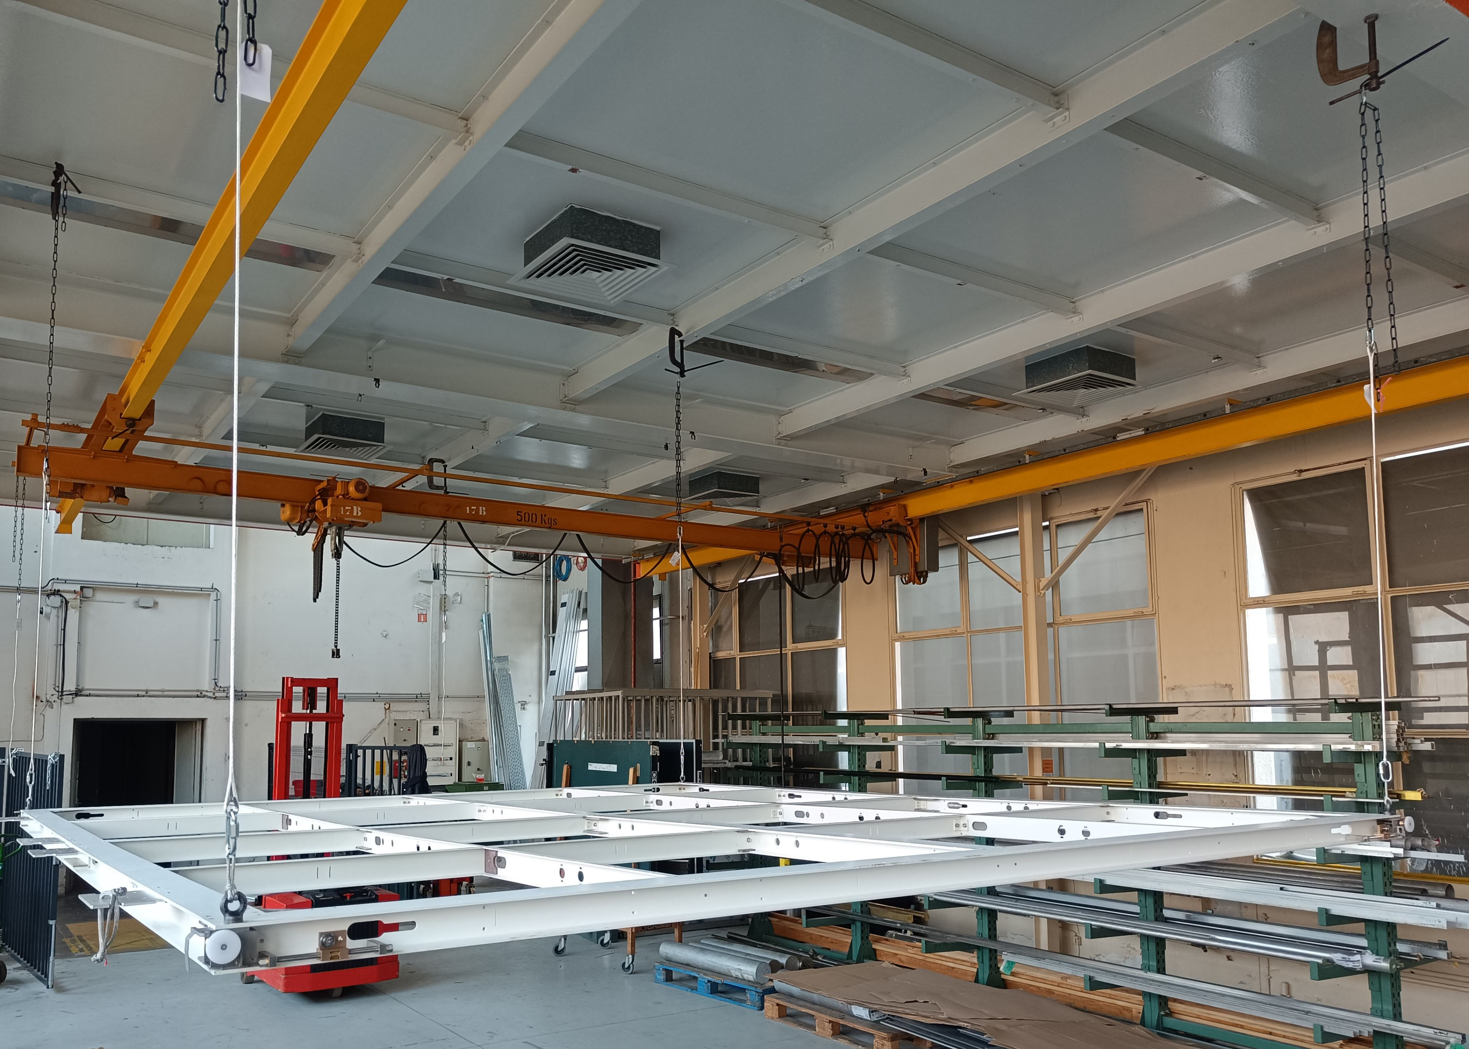
1- frame attached to dyneema cables
The frames are equipped of eye rings at corners on top face.
Assumption: The frames are lifted with the scissor lift and attached to the dyneema ropes initially attached to the SST TADs .

Slide 4
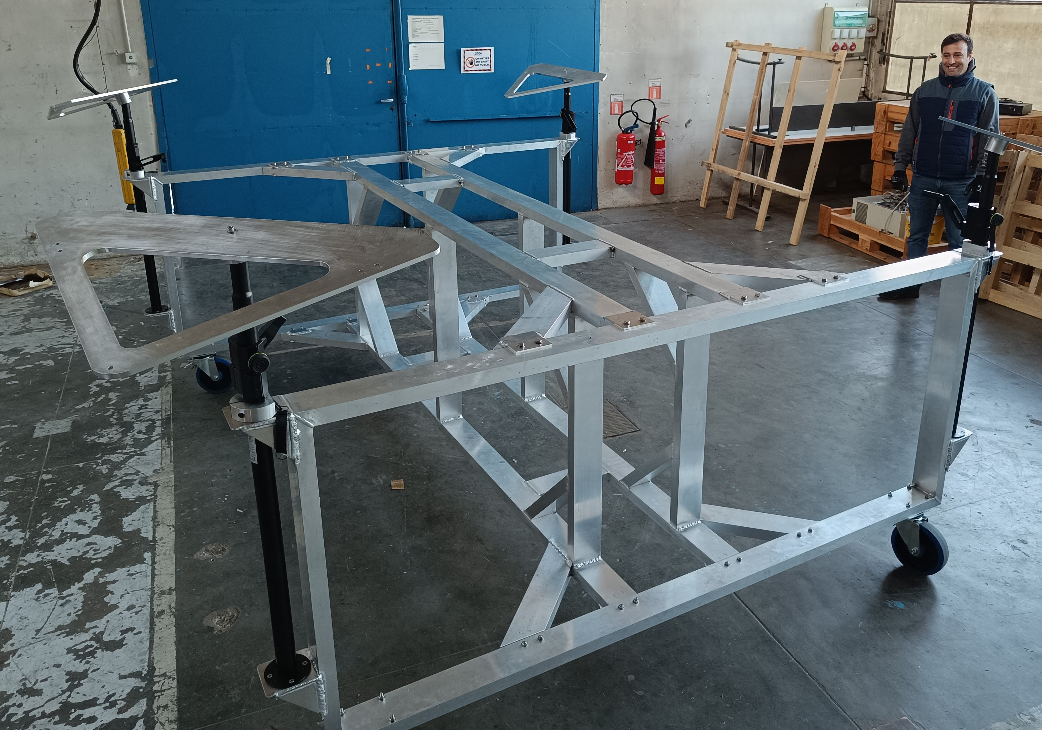
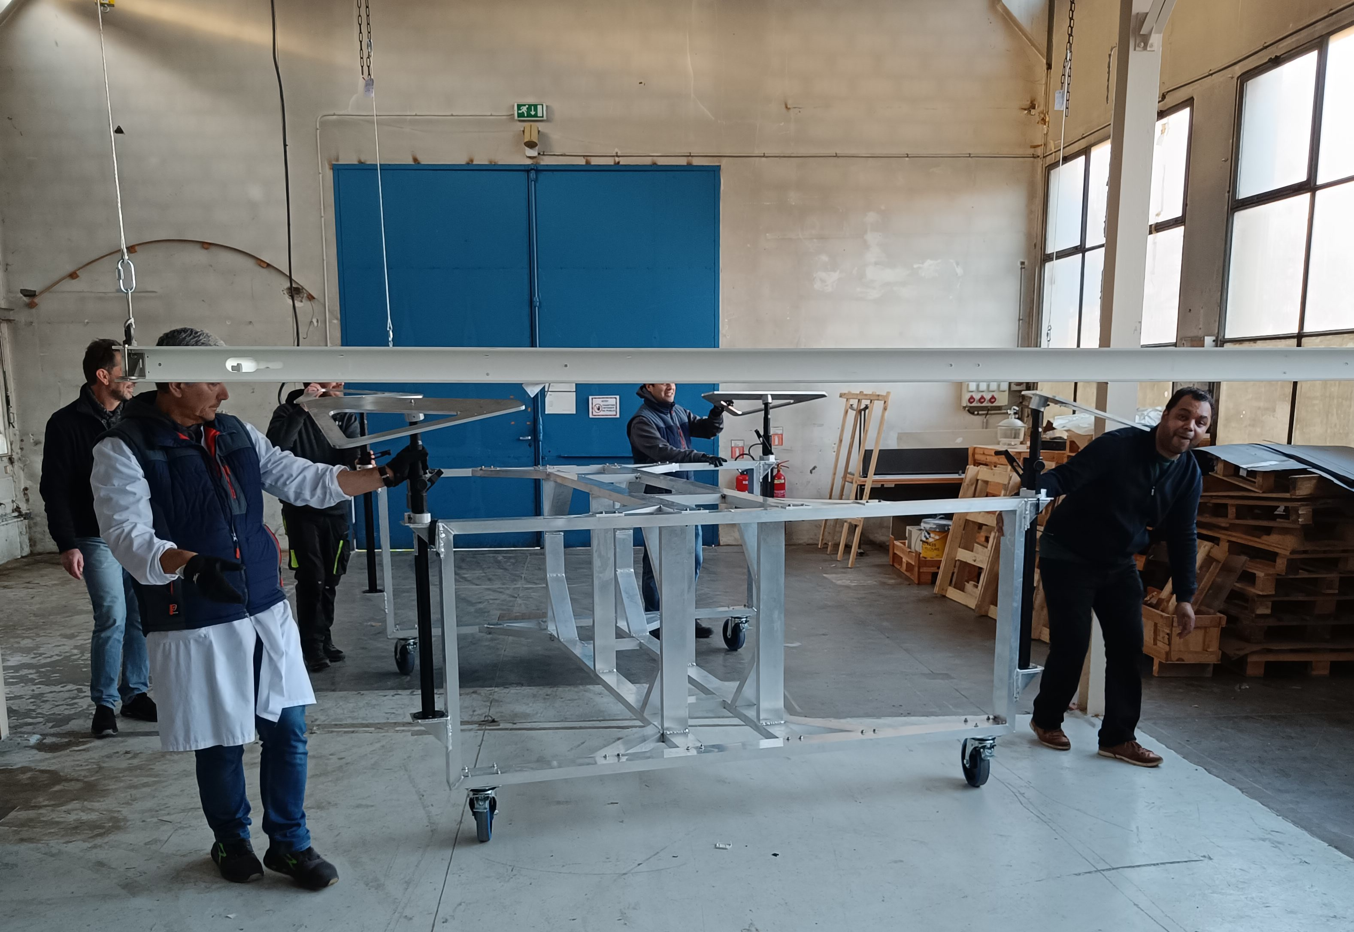
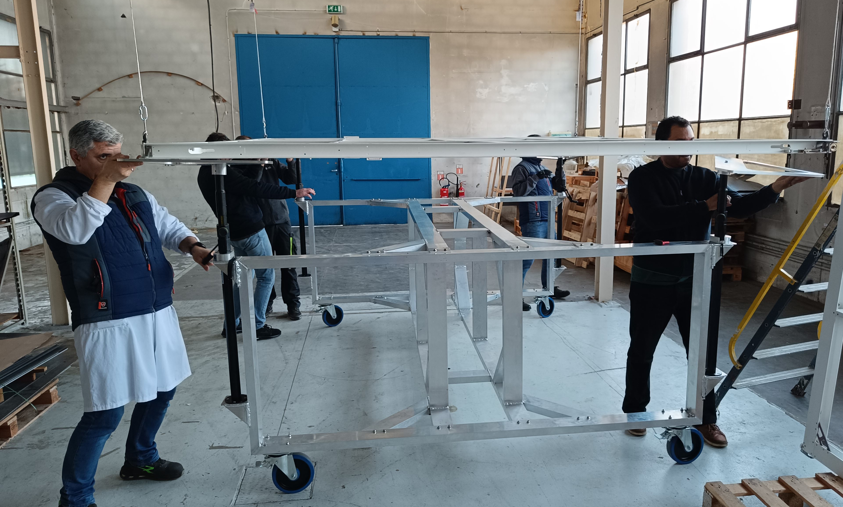
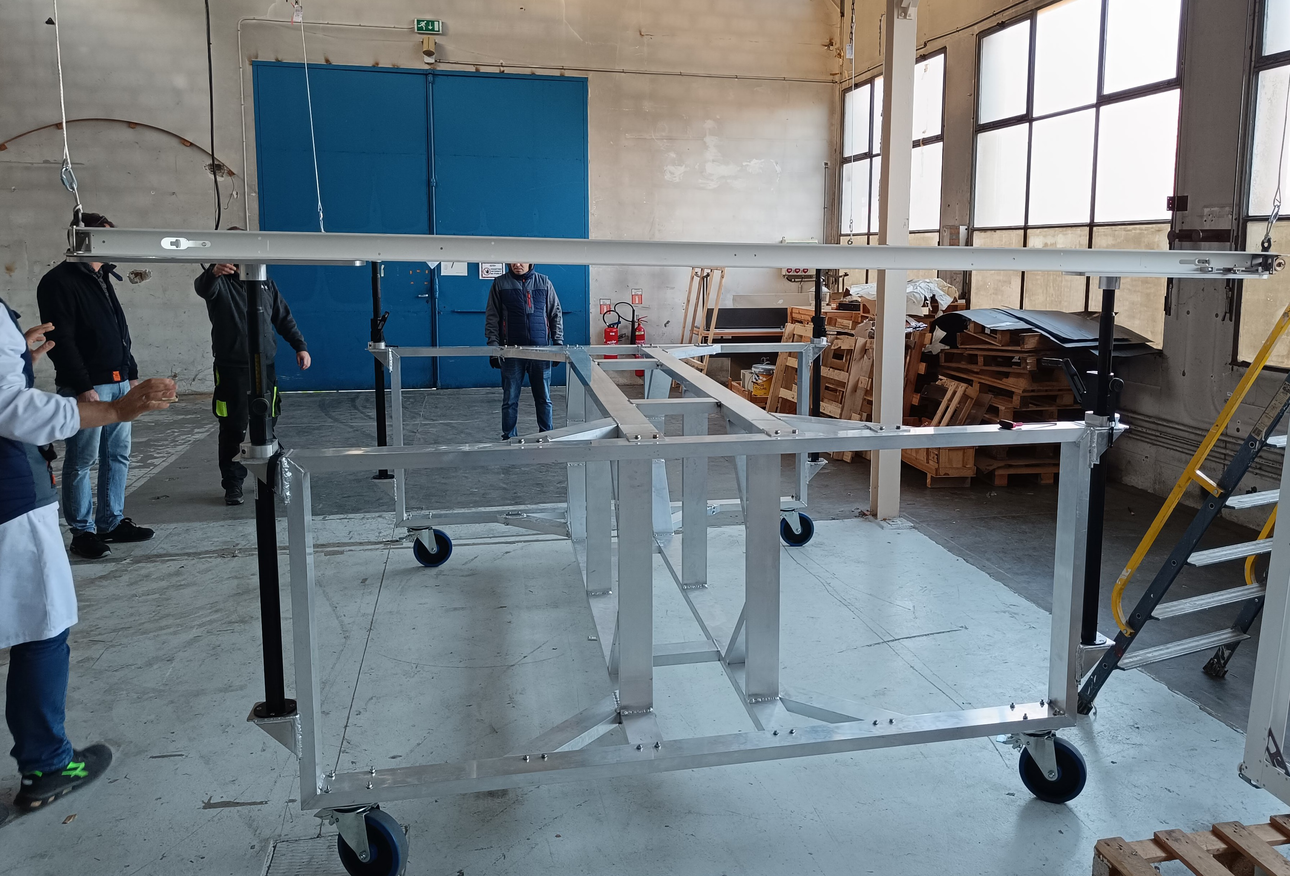
2- Installation cart approach and connection
Approach under the frame
Installation cart with its 4 corner plates
Assumption: The frames are lifted with the scissor lift and attached to the dyneema ropes initially attached to the SST TADs .
Position under the frame and screwing of the corner plate to the frame
Load release on ropes and assembly ready for fiber installation

Slide 5
3- Fiber installation
When 2 frames are on their carts, the ropes are disconnected, eye rings removed on top face
=> the fiber bundles can be inserted.

Slide 6
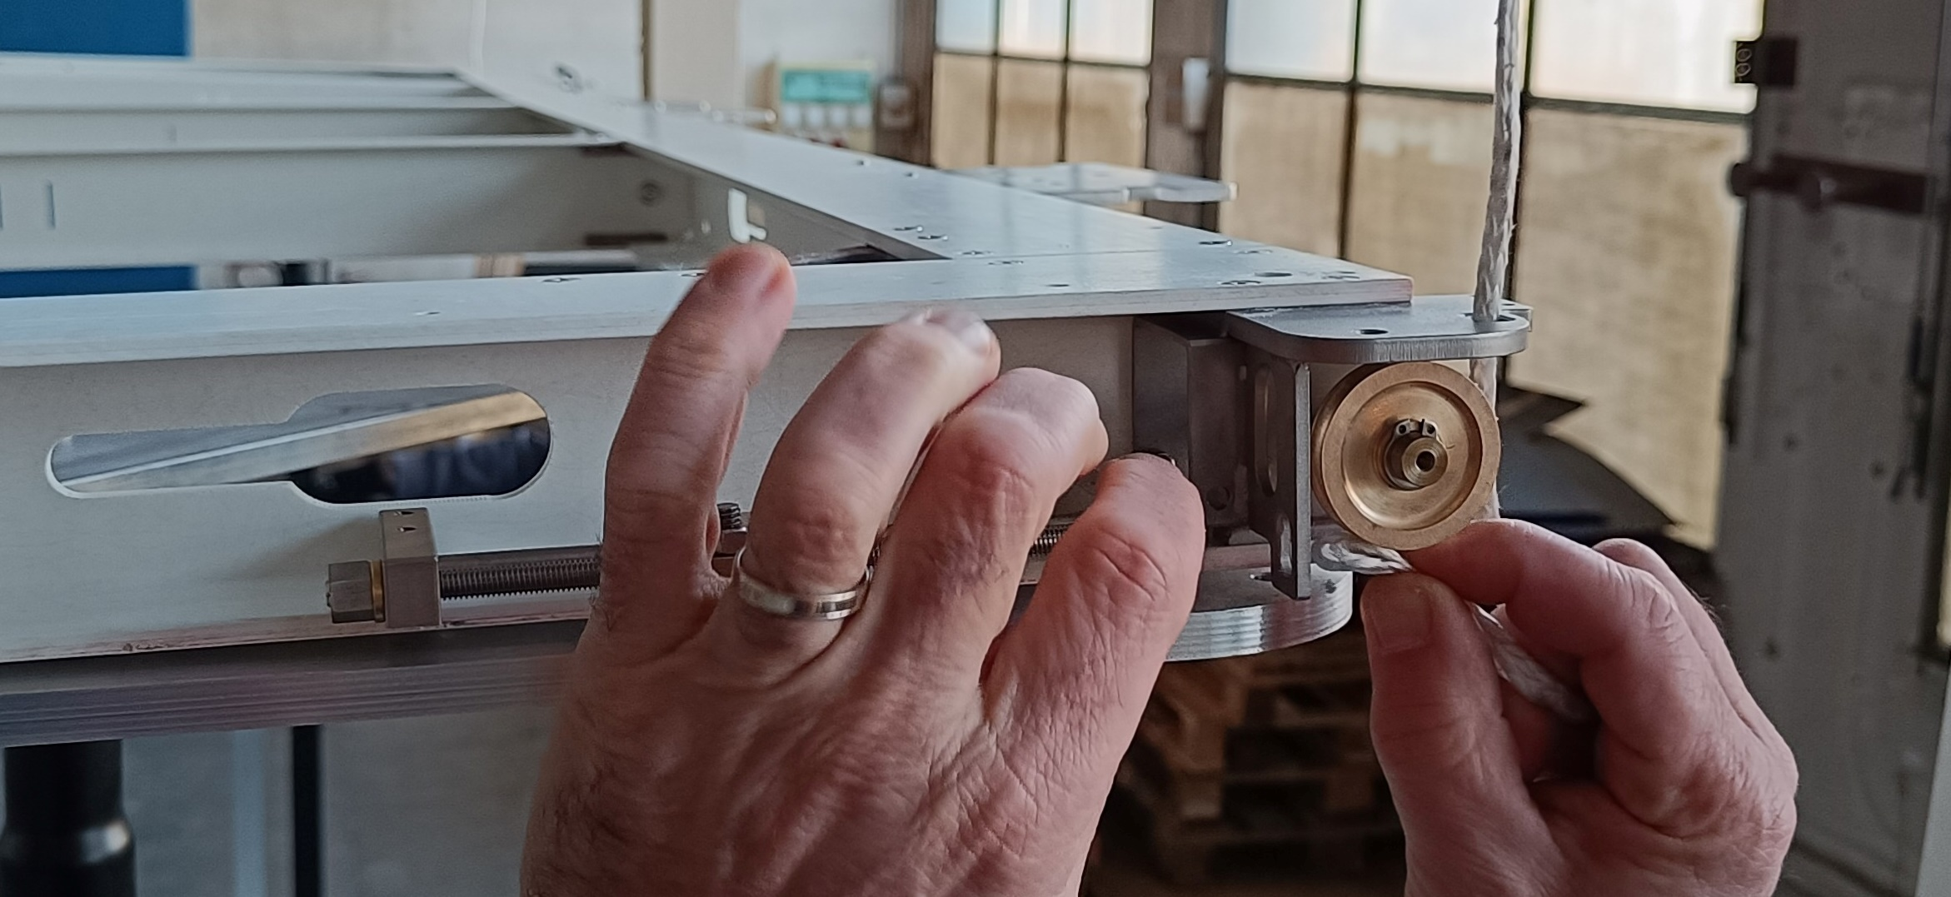
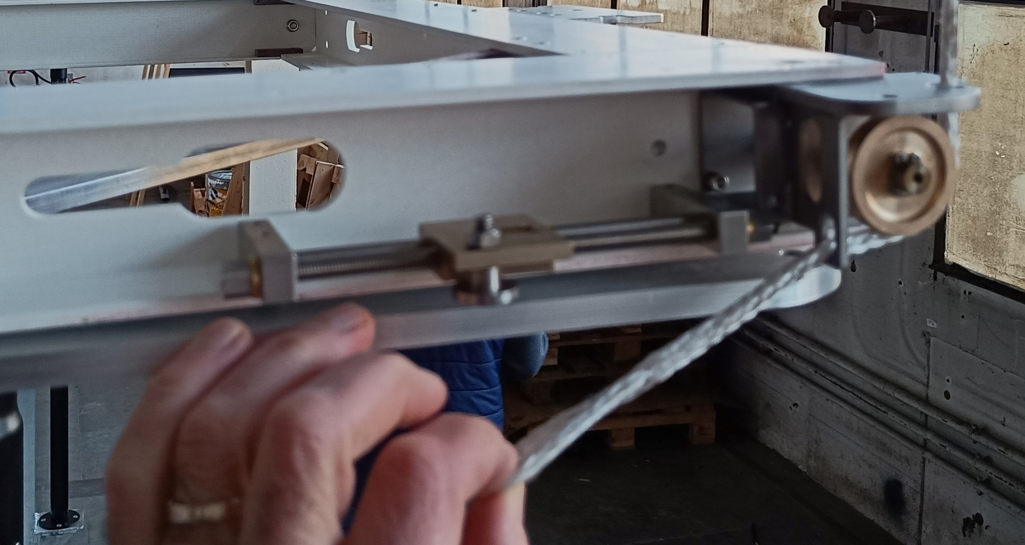
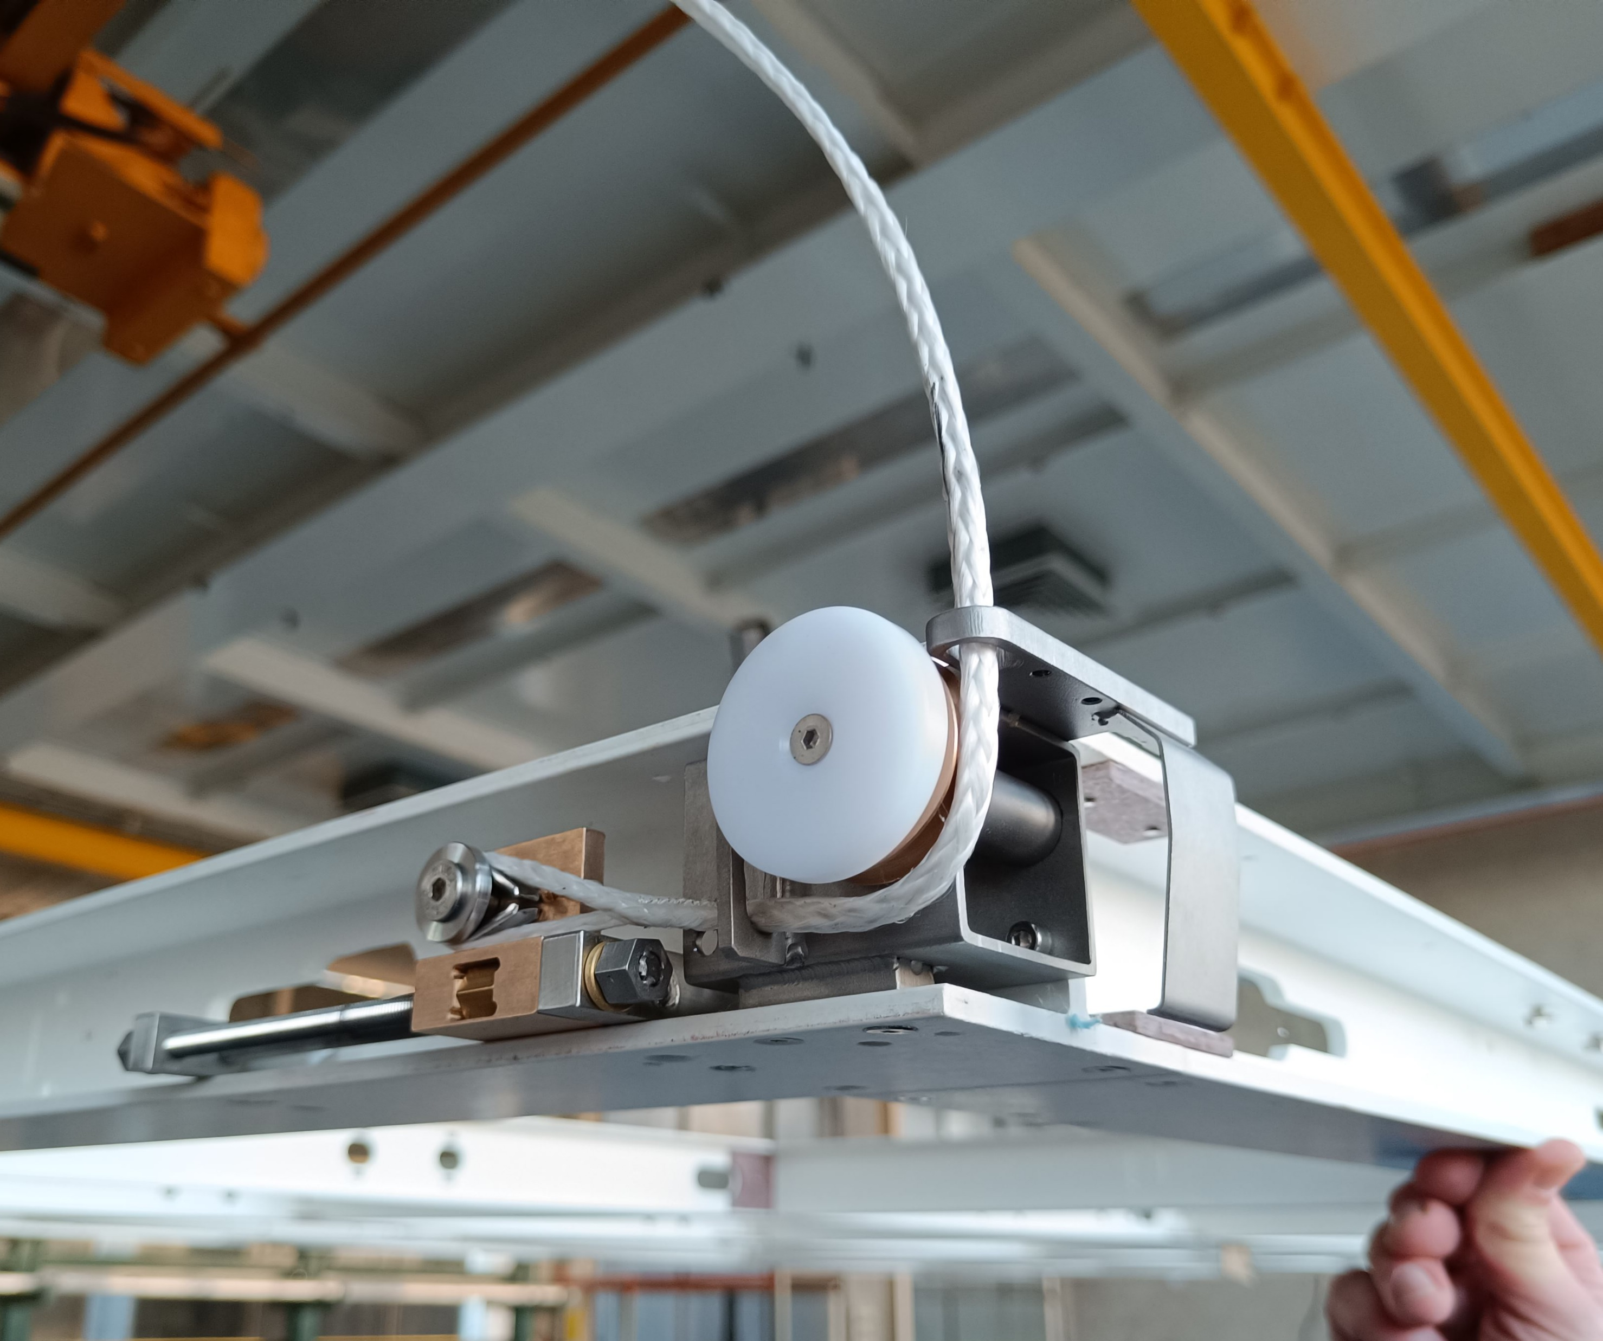
4- Ropes insertion in LADs
First the LADs are set in down position (-65 mm to be under neighbor frame)
Then , the ropes without “cosse-coeurs” (heart pod) are inserted into LAD guiding holes and pulley
The rope is connected on the LAD trolley with its cosse coeur
Secure guiding slots to avoid “pulley out”

Slide 7
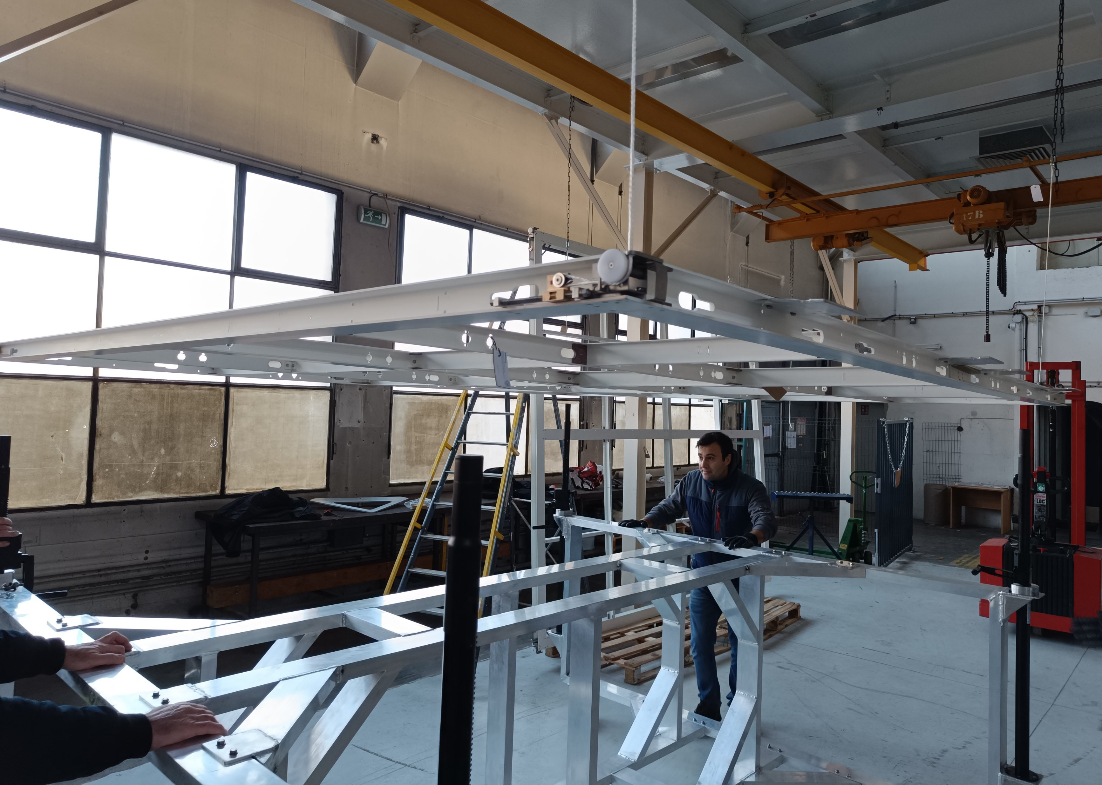
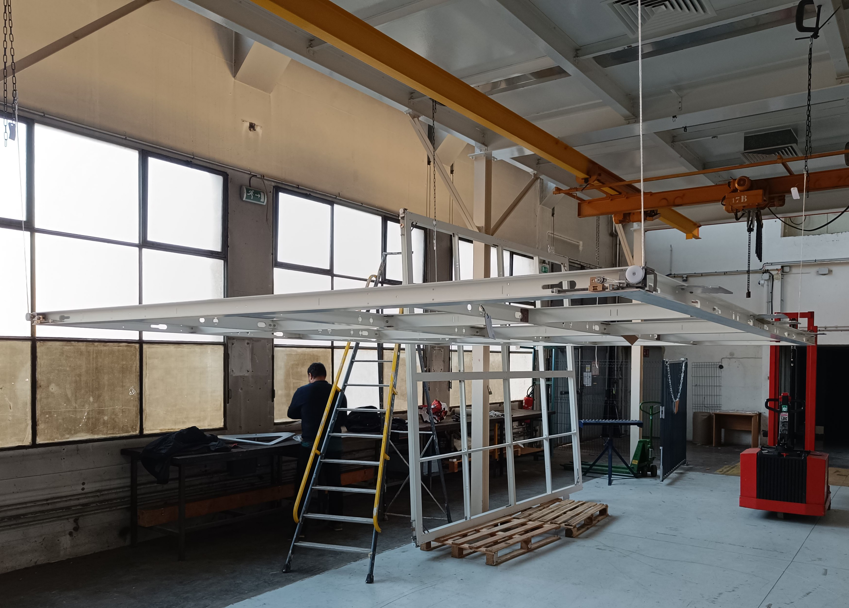
5- Load transfer on the ropes and LADs
Once the 6 ropes are connected on the cathode pair:
The corner plates are unscrewed and the LAD are set up to nominal position (65 mm above). The cart are removed.

Slide 8
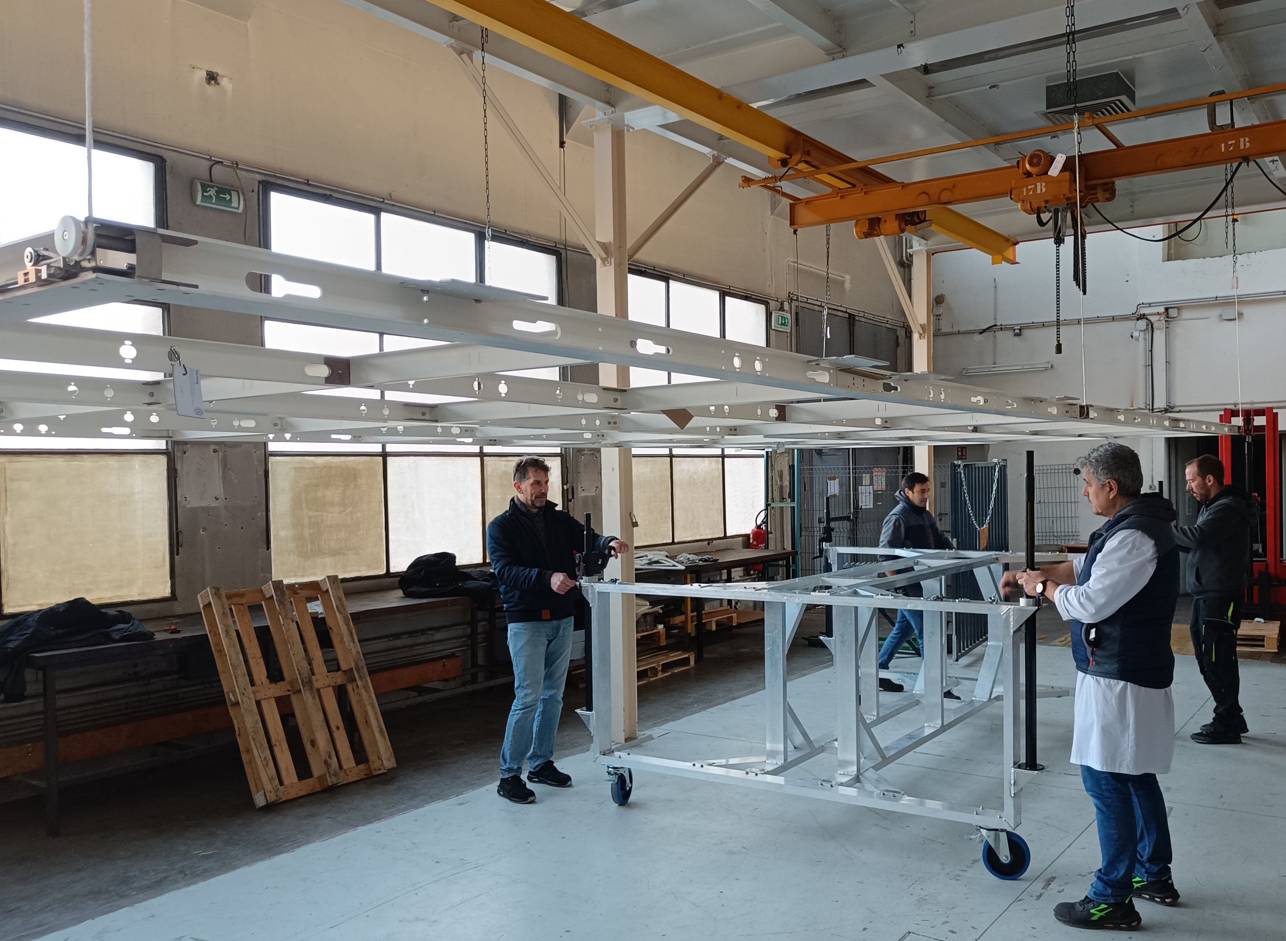
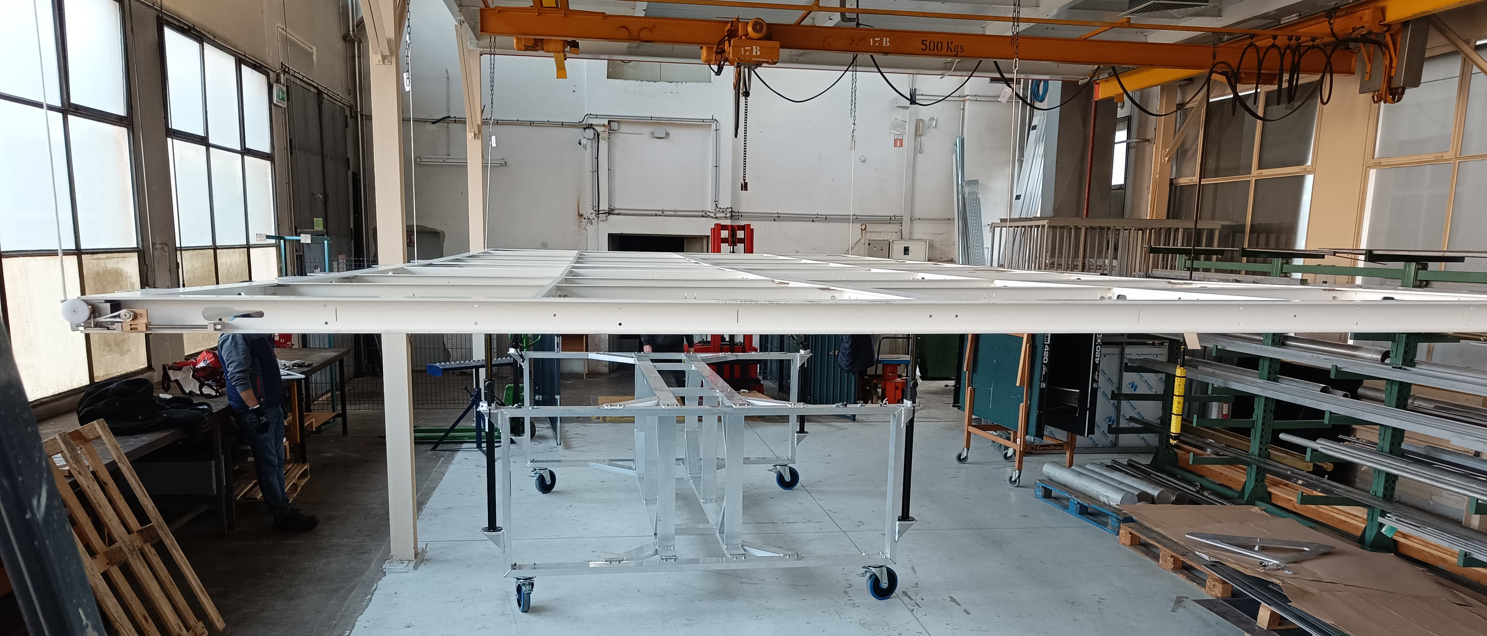
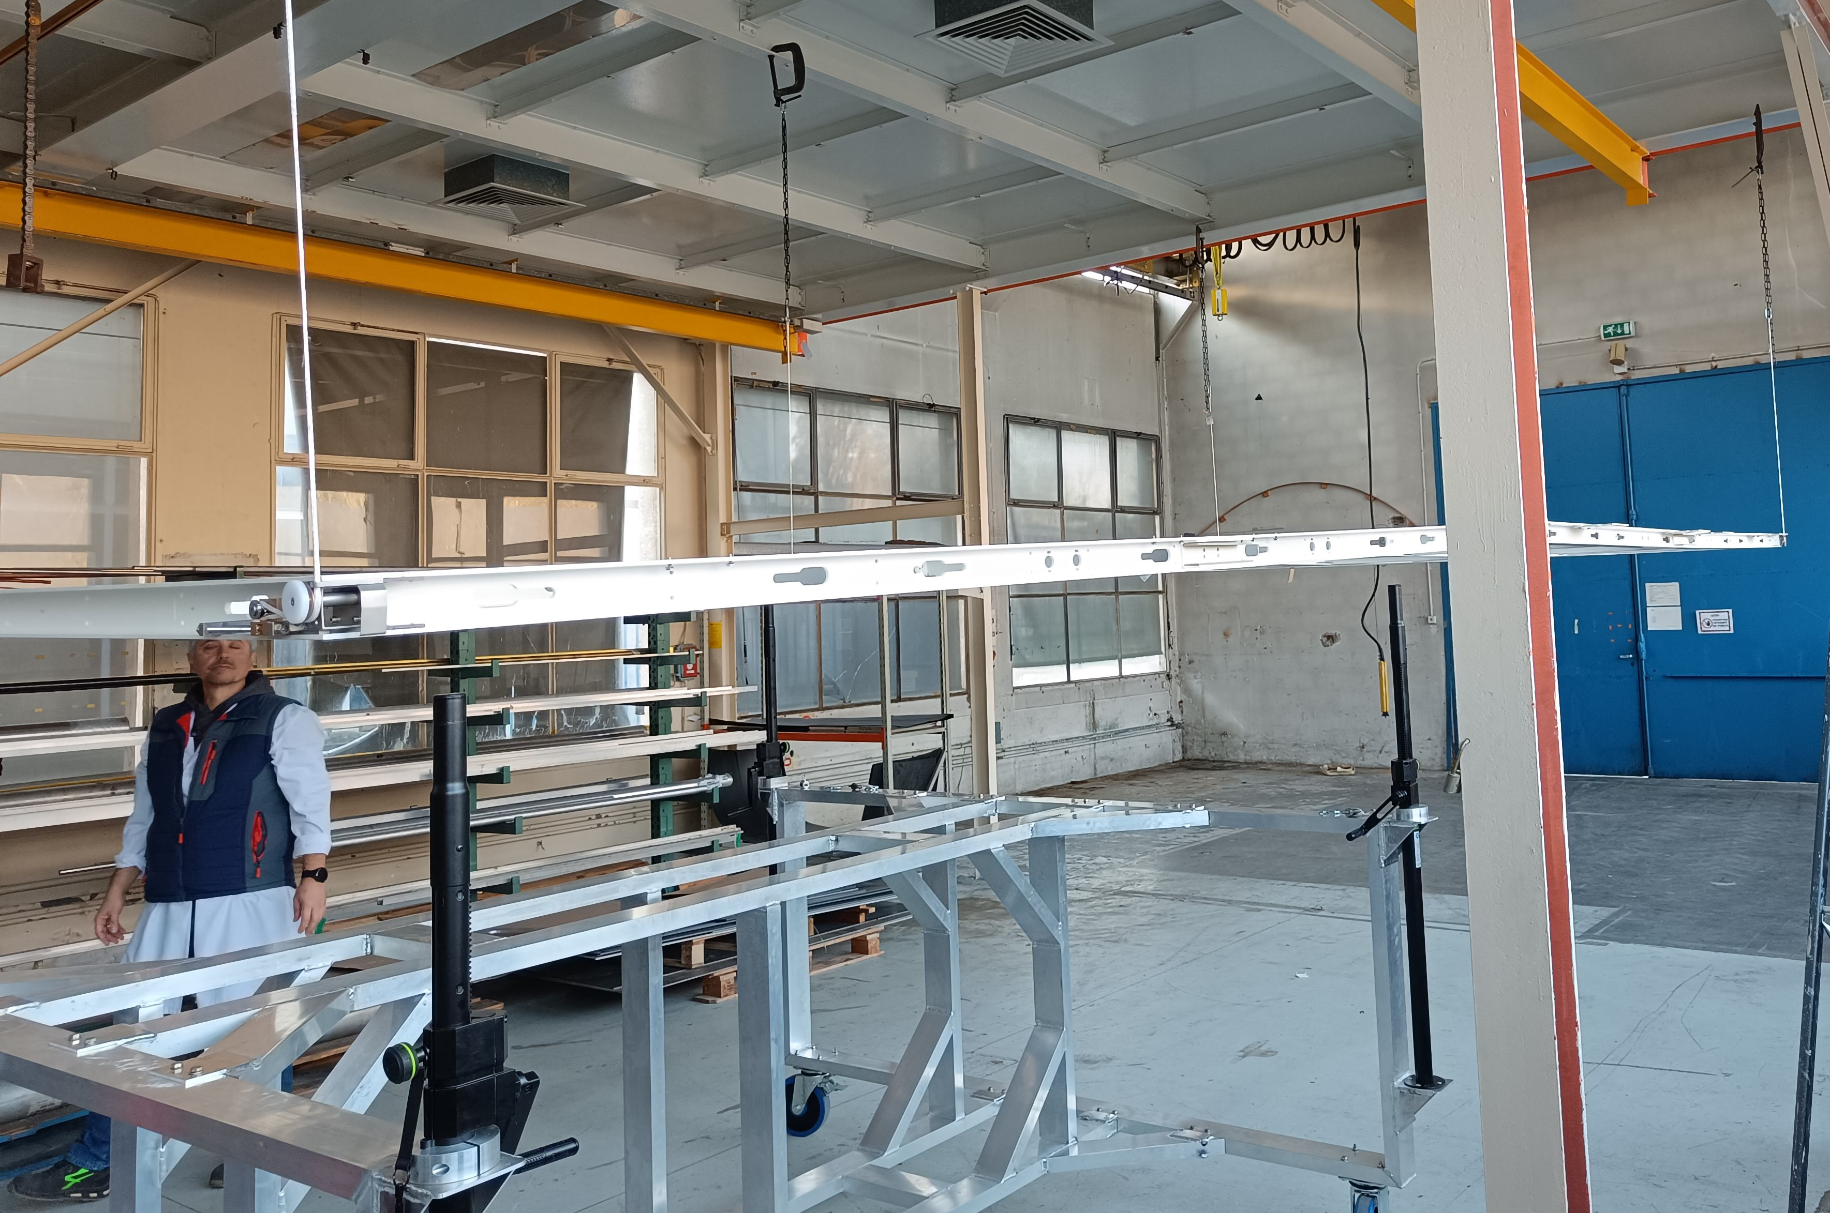
6- Same process for the second frame
Once the 6 ropes are connected on the cathode pair:
The corner plates are unscrewed and the LAD are set up to nominal position (65 mm above). The cart are removed.

Slide 9
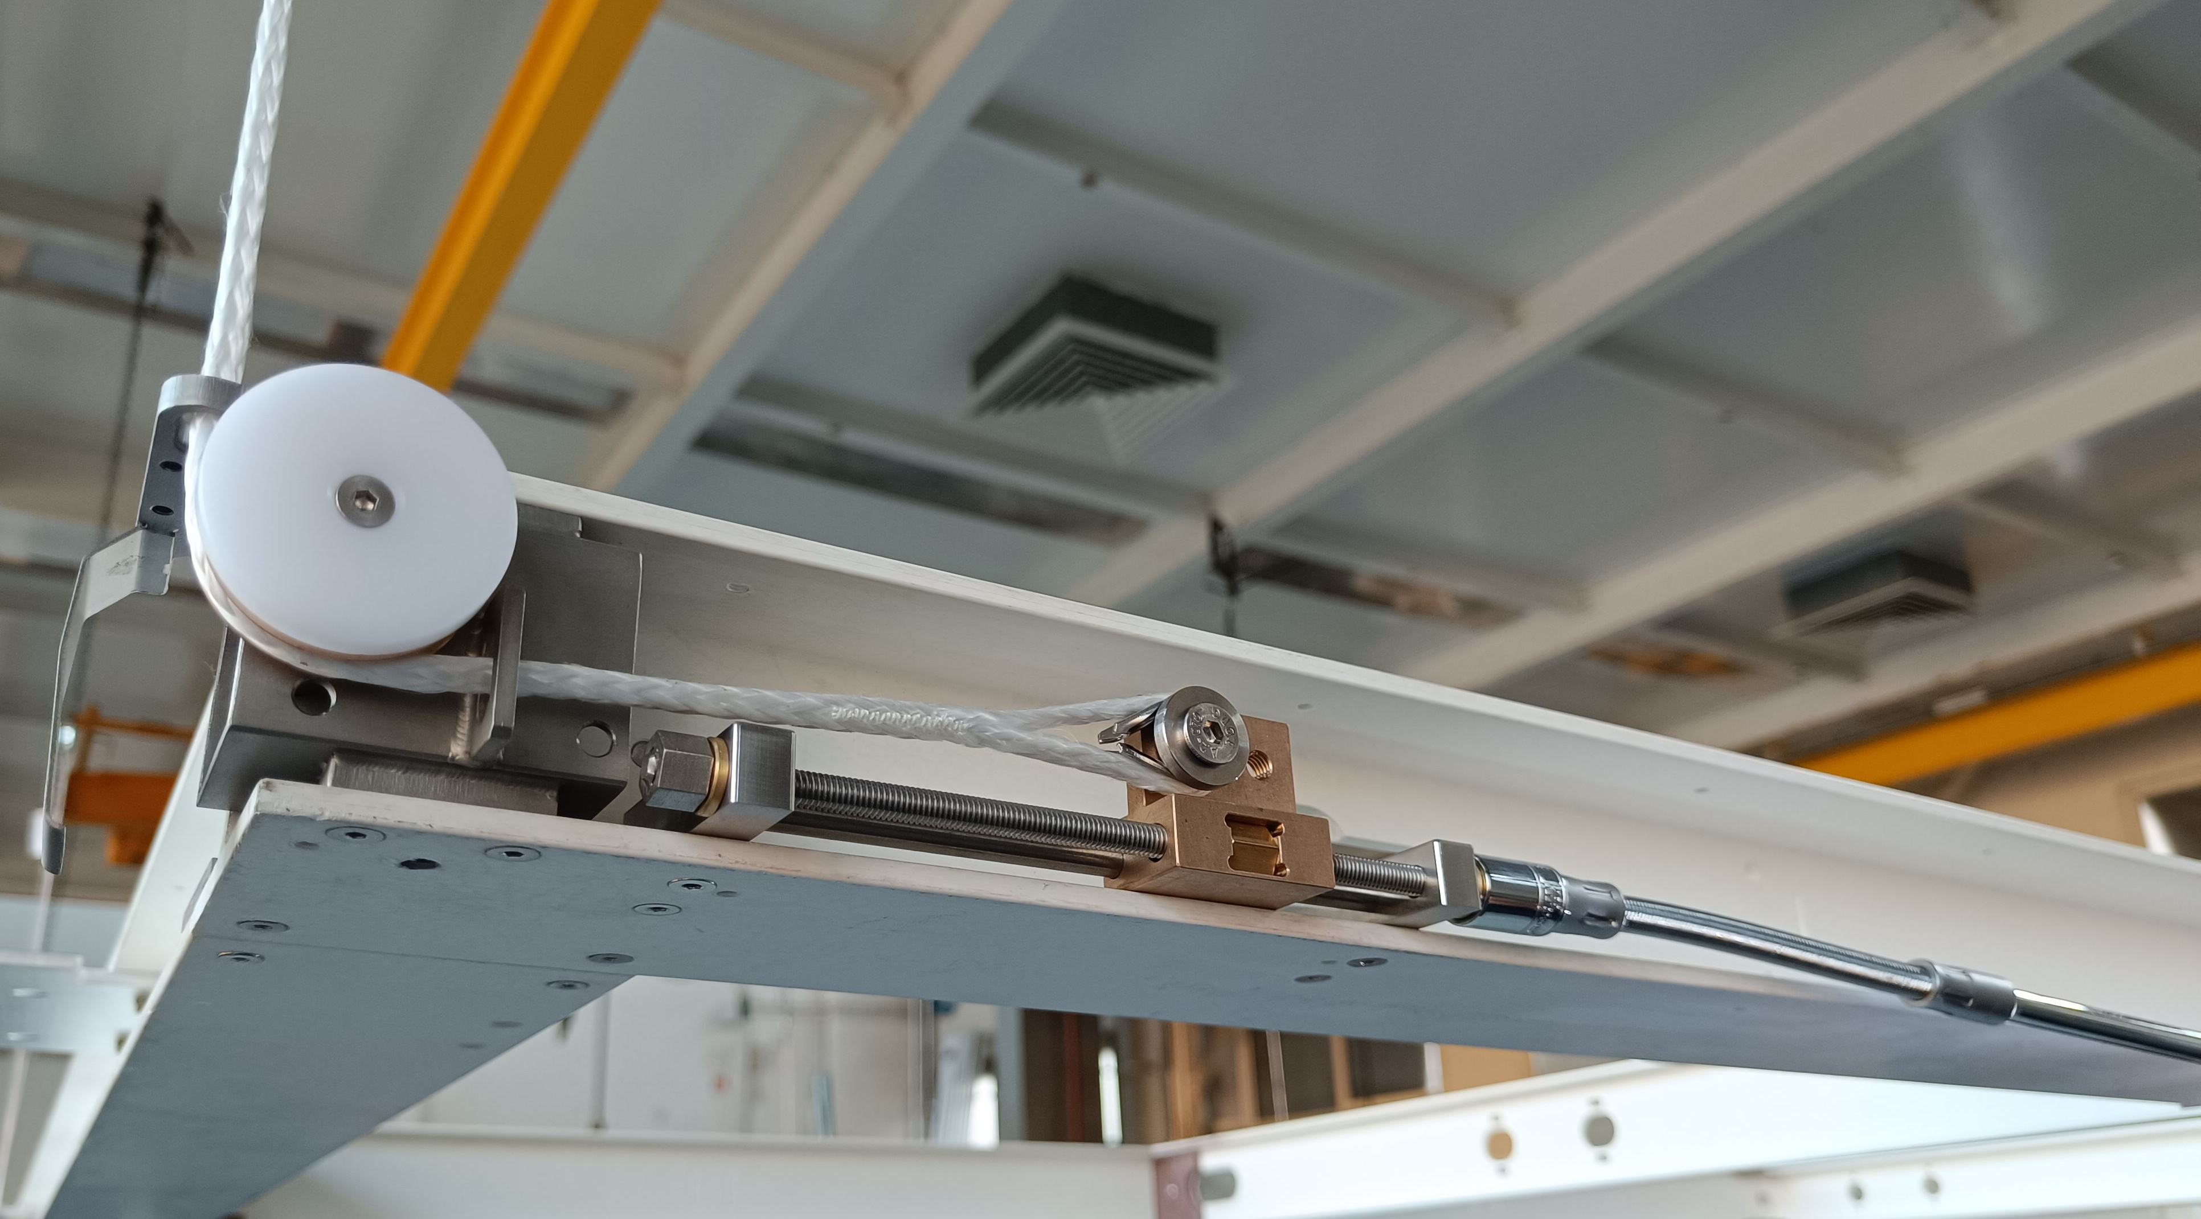
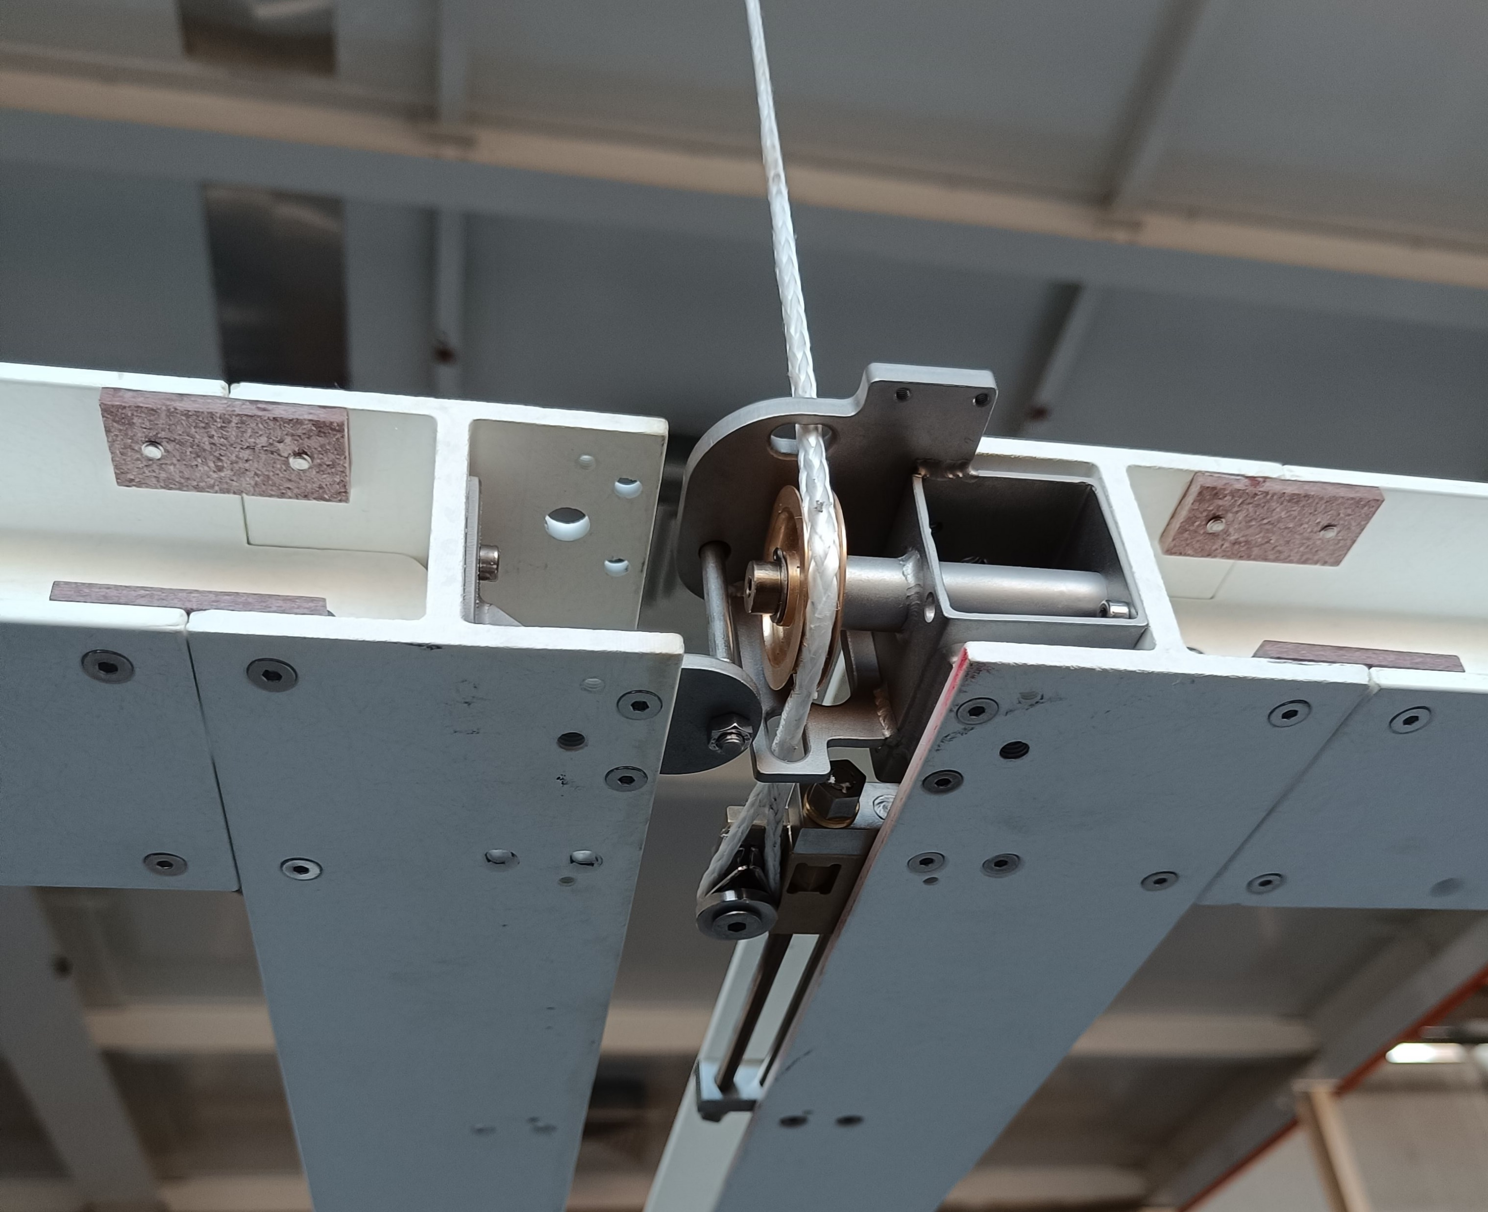
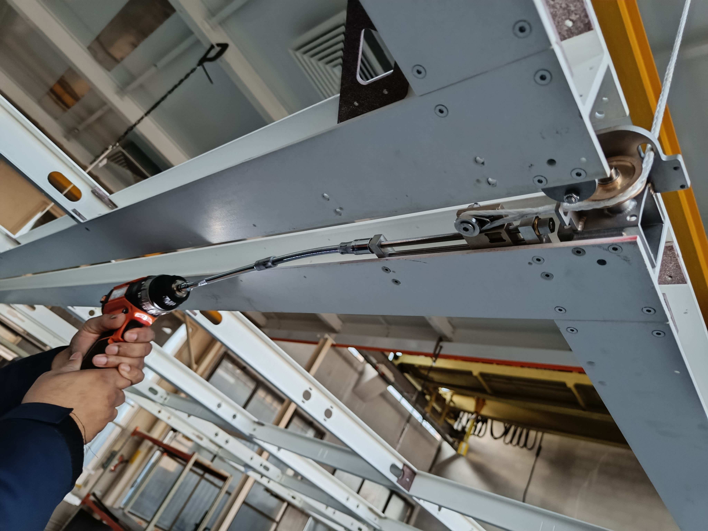
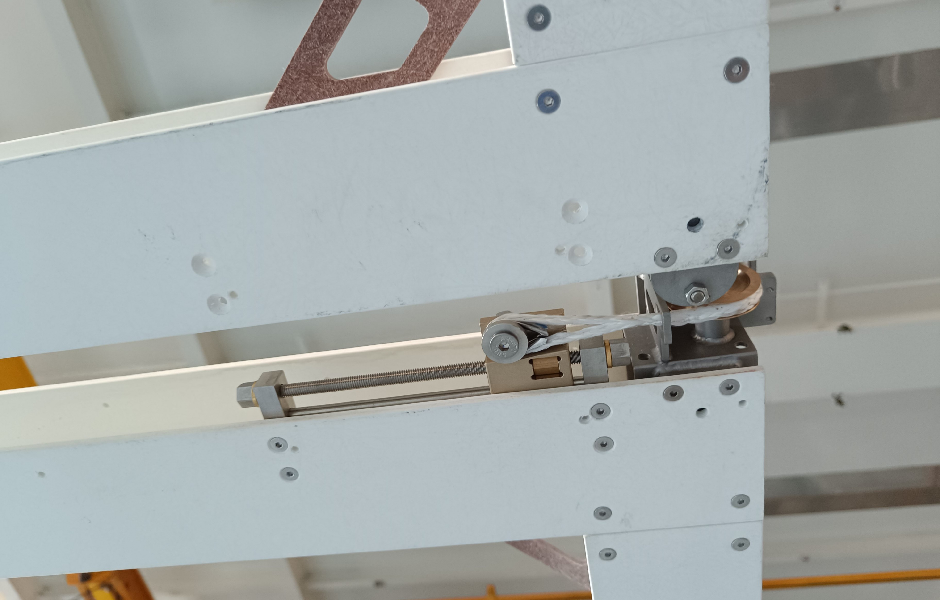
View of the LADs
Corner LAD in nominal position (+30/-65mm)
Mid LAD with L support
Easy adjustment with a screwdriver

Slide 10
Videos of the LAD adjustment and conclusion
Mid LAD
Corner LAD
Next step:
Use the second cart
Check fiber insertion
Check LAD access with the mesh

