Slide 1
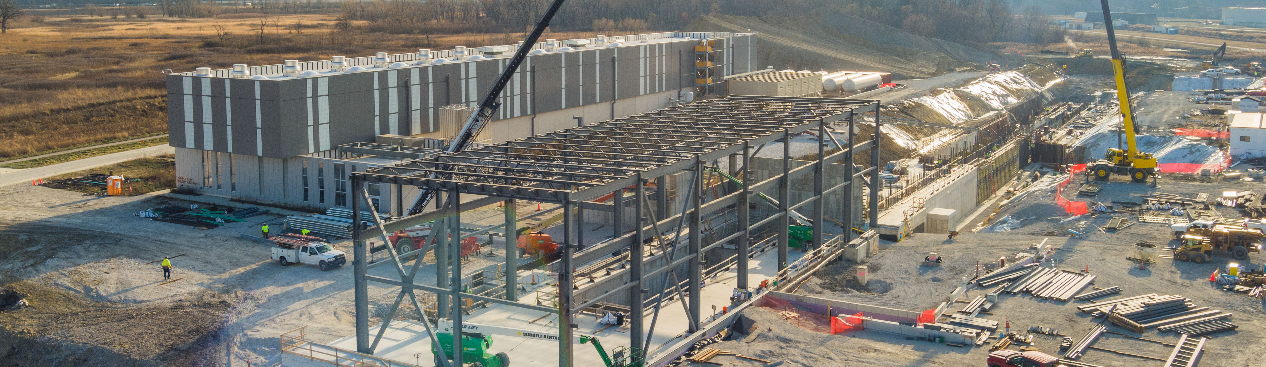
PIP-II Report
PIP-II Team
Project Management Group
December 2024

Slide 2
Project Management
The Cryoplant Cold Box is in Romeoville, it will arrive on-site on December 19 and will remain in the staging area till January 7, when it will be moved to the PIP-II site.
Follow the journey here: https://pip2.fnal.gov/?page_id=10435
The team received positive feedback at the November IPR. The next DOE review is planned for the last week of July 2025.
The project received the go-ahead to ESAAB for the CD4 of the ECF subproject. ESAAB is planned for Jan 16, 2025.
FY25 labor rates have been implemented, resulting in a $4M saving.
The Linac Complex work is proceeding on schedule, ~60% of the tunnel is completed.
Zanon received the contract to be signed for the LB650 production cavities from INFN
4 DAE visitors started their 3 months visit on December 2nd. They are participating to LLRF and HPRF activities.
2

Slide 3
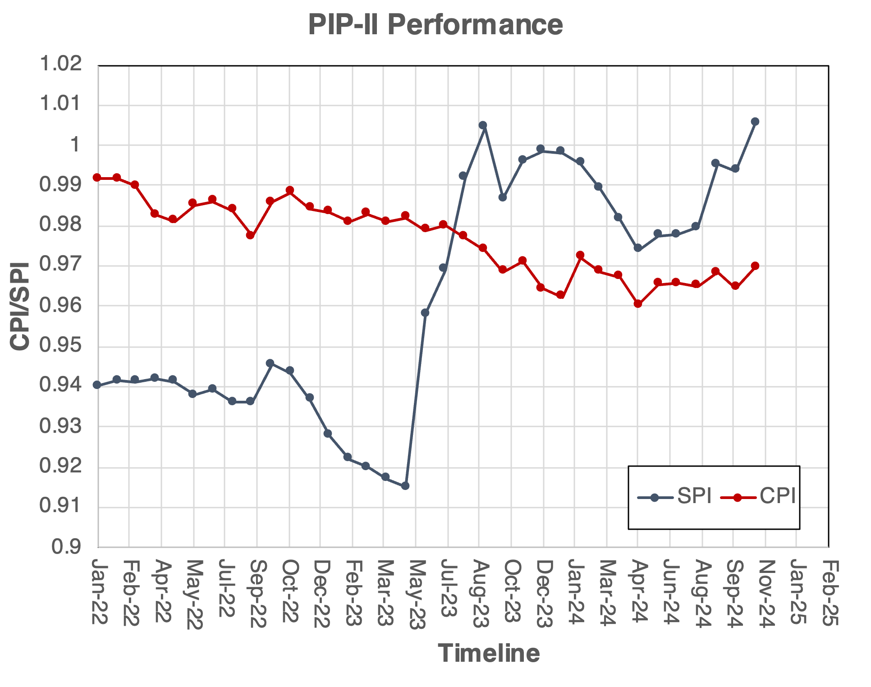
Financials
SPI
1.01
+0.02
CPI
0.97
0.00
BSI
0.93
0.00
BEI
0.92
-0.01
ETi
0.92
-0.01
%Com
48.8
2.30
Notable SV Variances:
SRF/LIC adjustment from the previous month's positive SV
CF P6 alignment to subcontract execution after bulletin 2
Notable CV Variances:
SRF/LIC adjustment from the previous month's positive CV and recoverable costs
AccS recoverable costs
CF P6 alignment to subcontract execution after bulletin 2

Slide 4
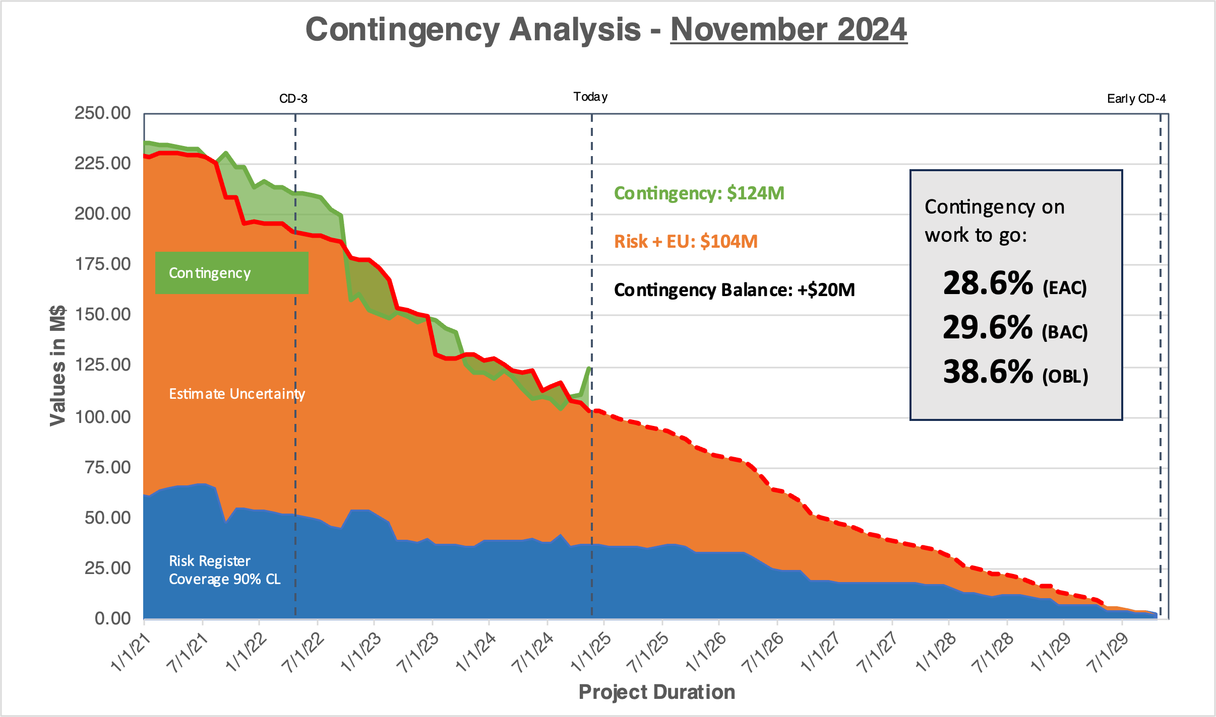
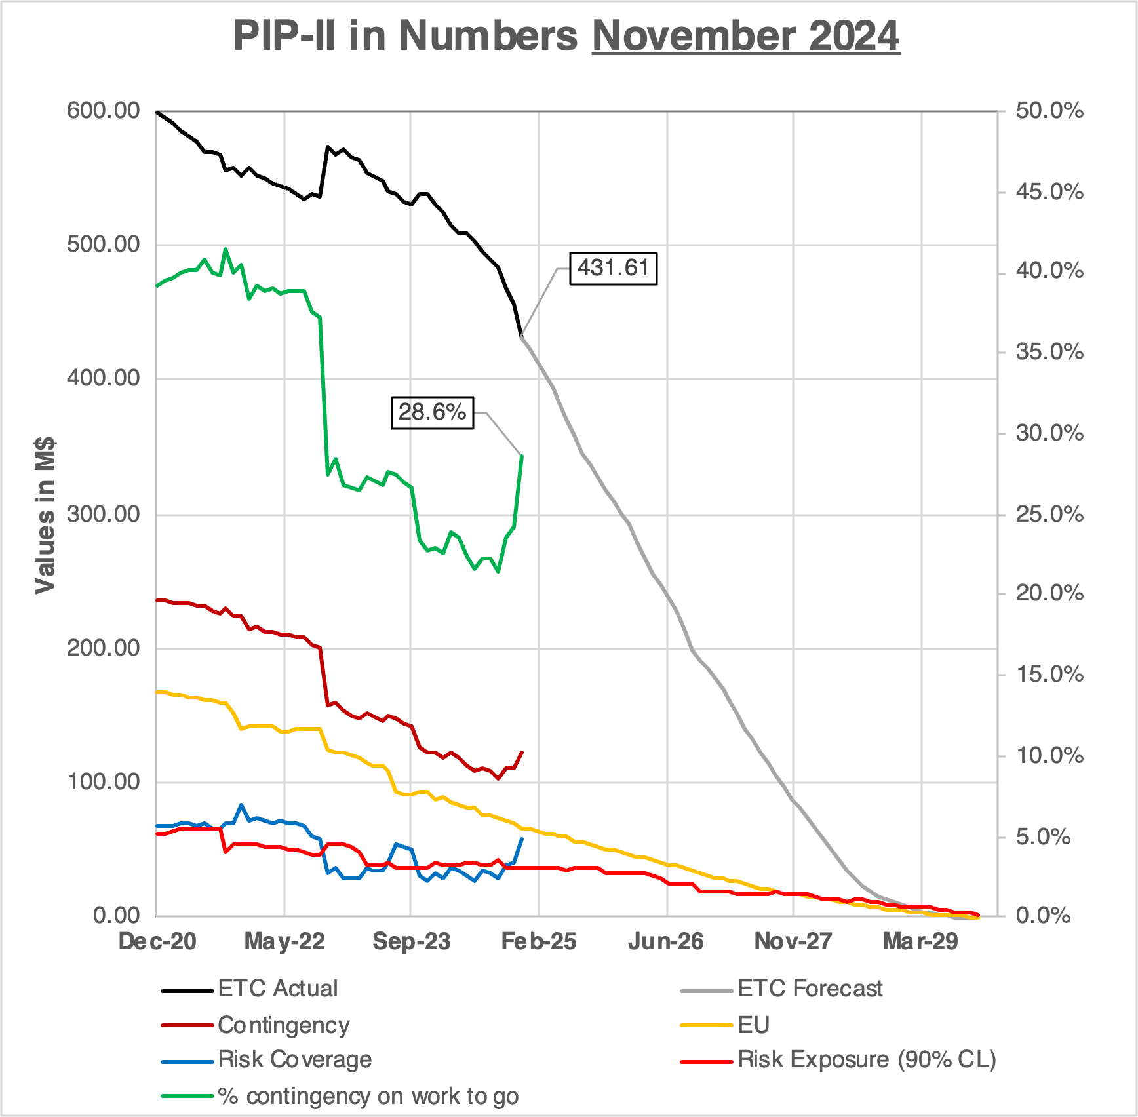
RLS Development Status
Contingency on WTG recovering now at 28.6% (+4.4%)
The critical path through CF.
BCRs for -$11.2M, including an update of FY25 rates and P6 roles adjustment.
Early CD-4 stable
Schedule contingency 40 months
4
Notes:
Add

Slide 5
QA
QC Planning / Execution
  CryoPlant Electrical QC Plan formal approval sent via Teamcenter on 12/2.
  SSR1 & SSR2 Cryomodule QC Plan formal approval to be sent via Teamcenter on 12/19.
Added iTrack review and items for P2MAC #11, DOE/SC Follow-up Review of PIP-II, CD-4 Review of the ECF Subproject, and Incoming Inspection & Acceptance Self-Assessment.
Held quarterly meeting with Quality Control Coordination Group (QCCG)
  Provided Lessons Learned presentation of the latest three lessons learned entered in the database.
  Updated team with Quality Control Alignment Matrix (QCAM) entries
  Discussed protentional Quality Workshops for 2025 with attendees
Approved Cryoplant DVB Platform QC Plan for vendor Lindblad via sub-contractor M&I Steel.
Reviewed and Approved Statement of Work for Ion Source. Also kicked off draft of QC Plan.
Reviewed and commented on Statement of Work for 325 MHz Circulators.
Reviewed and commented on Statement of Work for BTL Collimator – Steel Plates.
  Provided additional comments to the other eight BTL Collimator SOWs as well.
Assisted in developing new Technical Integration webpage.
Updated Quality metrics included on next two slides.
5
Notes:
Who was interviewed,a dd statistics o QC per each system, standard QA on SOW to mark on DOE414 based on check list for QA

Slide 6
QA/QC Metrics

Slide 7
QA/QC Metrics
*Average days to close 182 days

Slide 8
ESH
The new PIP-II CF Construction Safety Manager, Jamey Payne, began work on November 11, 2024. The transition phase with the interim construction safety manager was completed on November 27. Jamey is now fully integrated into the CF team and working very closely with the subcontractors on site, his positive influence is already being felt at the project level.
Rob Beebe has relieved Amy Pavnica from her role as interim PIP-II ESH Manger. Rob is currently working with the team to ensure that ESH is more present in the PIP-II Project as a whole.
A ROC meeting (Rehearsal of Concept) regarding the upcoming coldbox transportation activities was conducted with FSO to ensure that all parties are familiar with the tasks that will be performed when the equipment arrives on site at Fermilab. Feed back was positive.
ESH walkthroughs and DOE/FSO safety walkthroughs have been positive and are continuing to be documented via Predictive Solutions.
PIP-II Hazard Analysis Report (HAR) was updated on December 6.
The Environmental Management System (EMS) is currently being reviewed and updated.
The ODH Analysis for the PIP-II Tunnel is being reviewed and out for comments by stakeholders.
ES&H is meeting weekly with CryoPlant Make Ready 2 Electrical Construction Coordination Team.
8

Slide 9
International
DAE:
  DAE's Cryoplant coldbox is at Romeoville, IL and will be at Fermilab in December!!! It will be moved into the PIP-II cryoplant building in January. This is the single largest IKC component! This reflects years of collaborative work by DAE's BARC and Fermilab. Follow the journey HERE. More info in SRF-Cryo slide.
  Fermilab, BARC, & RRCAT Lab Director's met on 18-Nov and discussed FRA to FermiForward transition. Subsequent meeting to be scheduled for discussions on the DAE deliverables and timeline.
  70 kW SSA internal review is still ongoing, with the FDR now being planned for late-January or early-February of September.
  Short-term (3 months) visitors for 325 MHz HPRF and LLRF have arrived and working with Fermilab teams.
CEA:
  CEA LB650 PPCM procurements are progressing, & team is preparing to perform validatory cavity cleanroom assembly steps that will be validated at FNAL's STC. First cavity for validation is in France, and expected to be delivered to CEA in December or early-January.
CNRS/IN2P3/IJCLab: In facility upgrade mode (no change since last month).
INFN:
  INFN cavity contract has been finalized and sent to the vendor for signature. Thereafter will be signed by INFN President, formalizing it.
UKRI:
  HB650 Cavities: 2nd pre-series jacketed cavity arrived at UKRI. Will be tested in January after cryo maintenance period.
  Second Fermilab cavity was rewashed and tested by URKI. Cavity was field emission free, further validating the UK system/process.
WUST, WUT, TUL:
  WUST cost-shared funding proposal is now with WUST legal and projects departments for review, approval, and submission to the Polish Ministry of Higher Education and Science.
  WUT proposal are being prepared for submission to the Polish government, as cost-shared IKC. Fermilab contract to WUT for the 50% is imminent.
  Work progressing through FNAL POs.
9

Slide 10
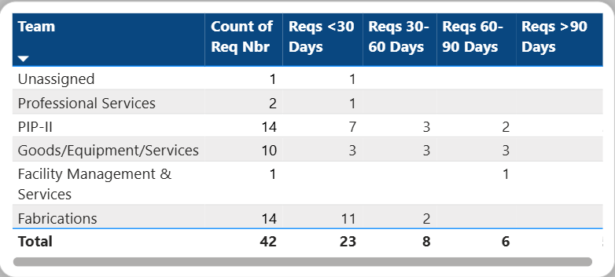
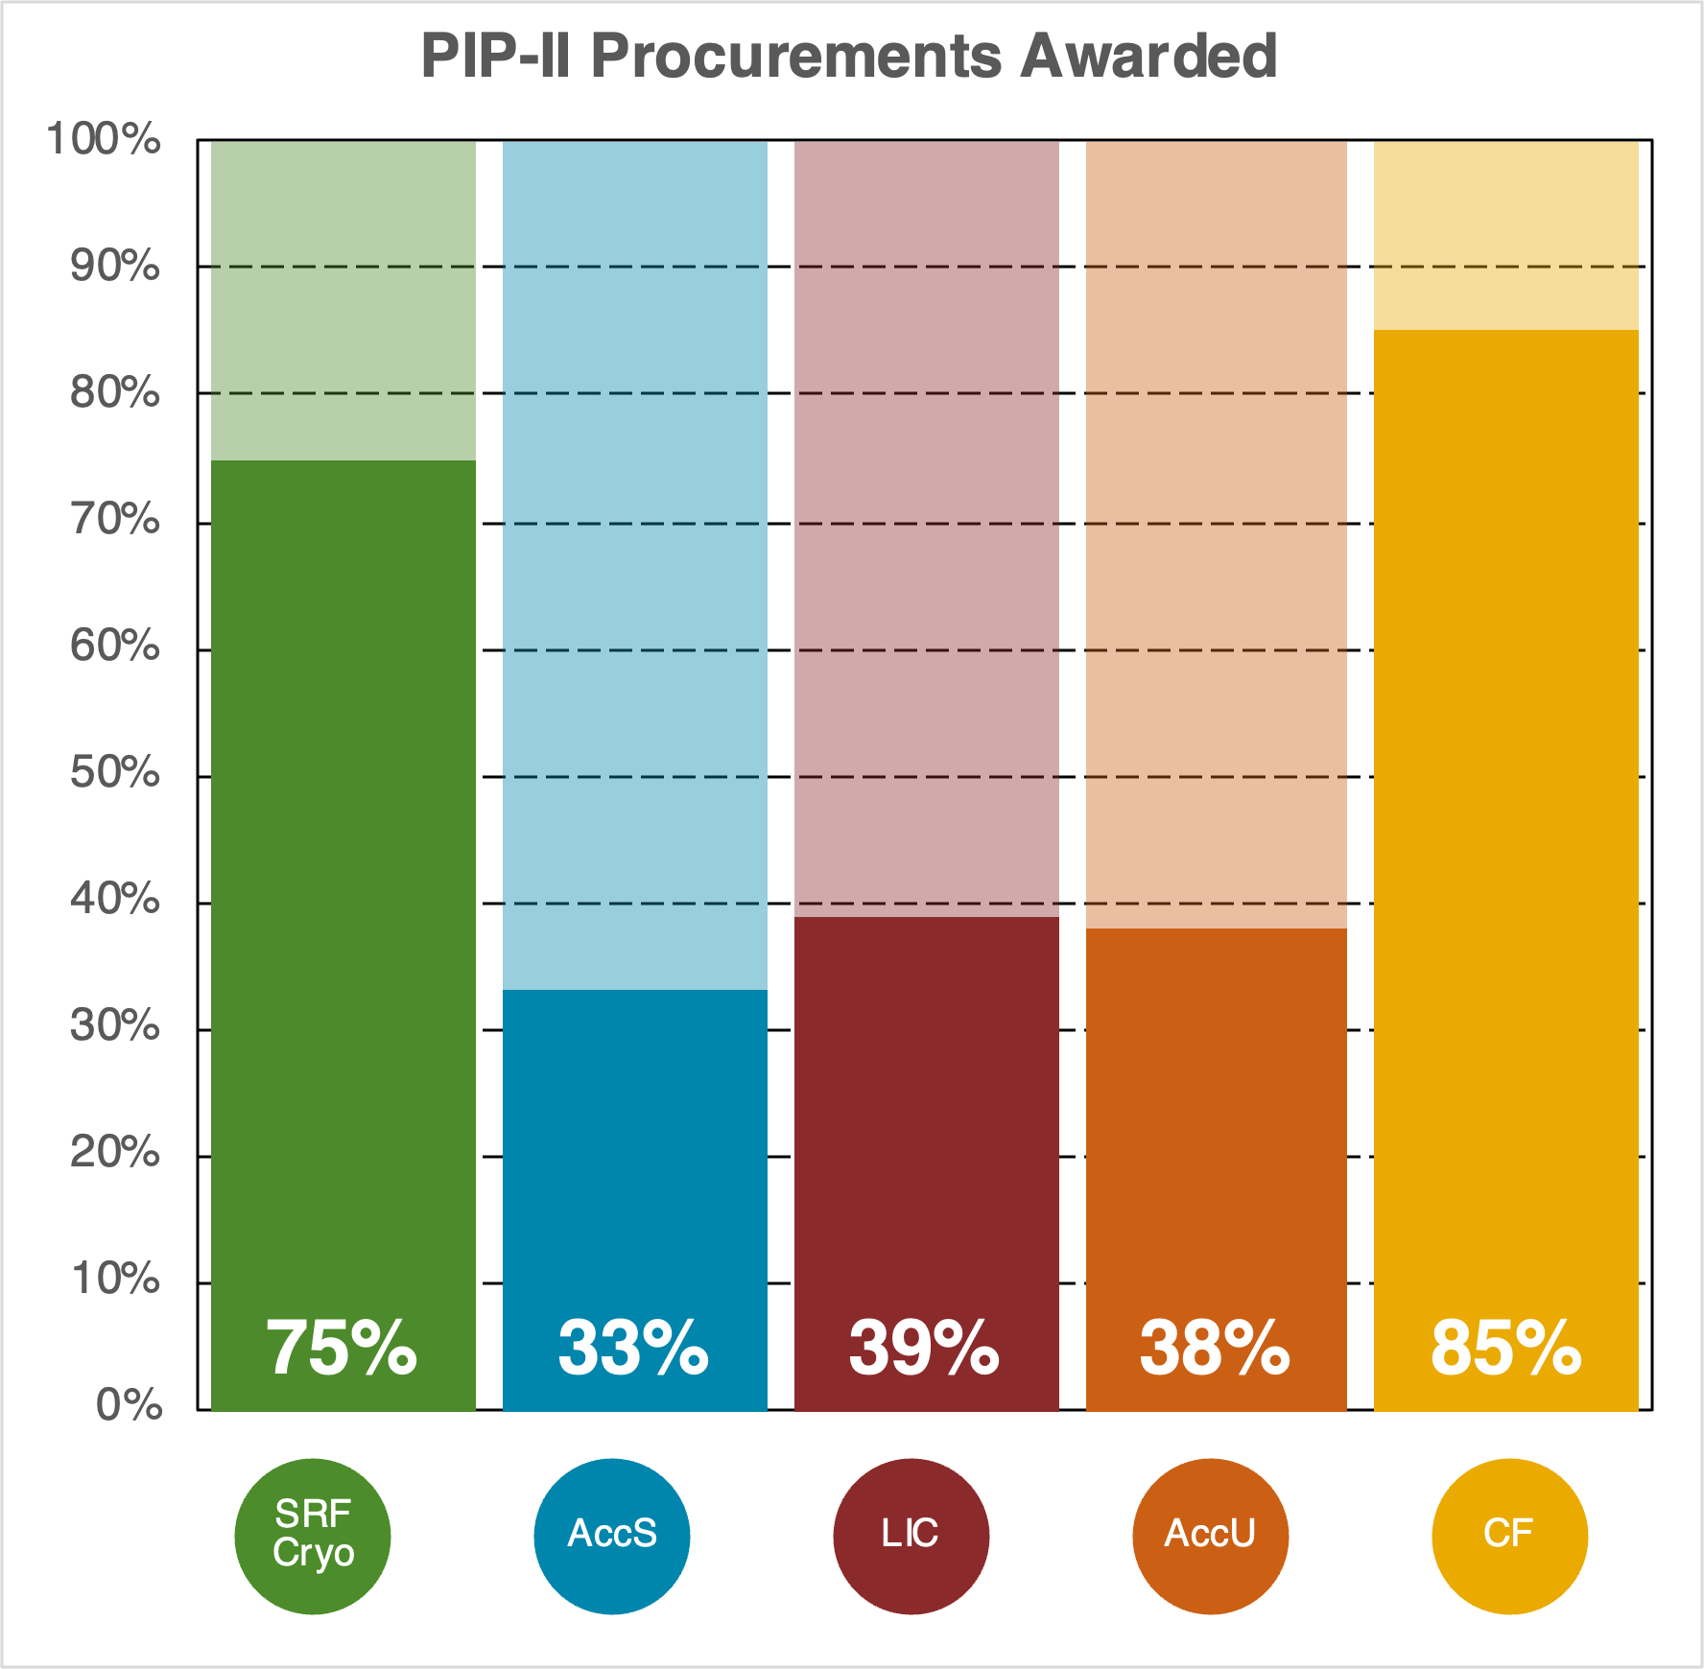
Procurement
Key Items
Advance Acquisition Plan
PIP-II Procurement Page
Power BI Dashboard
Procurement Status
Req in Procurement 42
Previous month 59
Value $23.9M

Slide 11
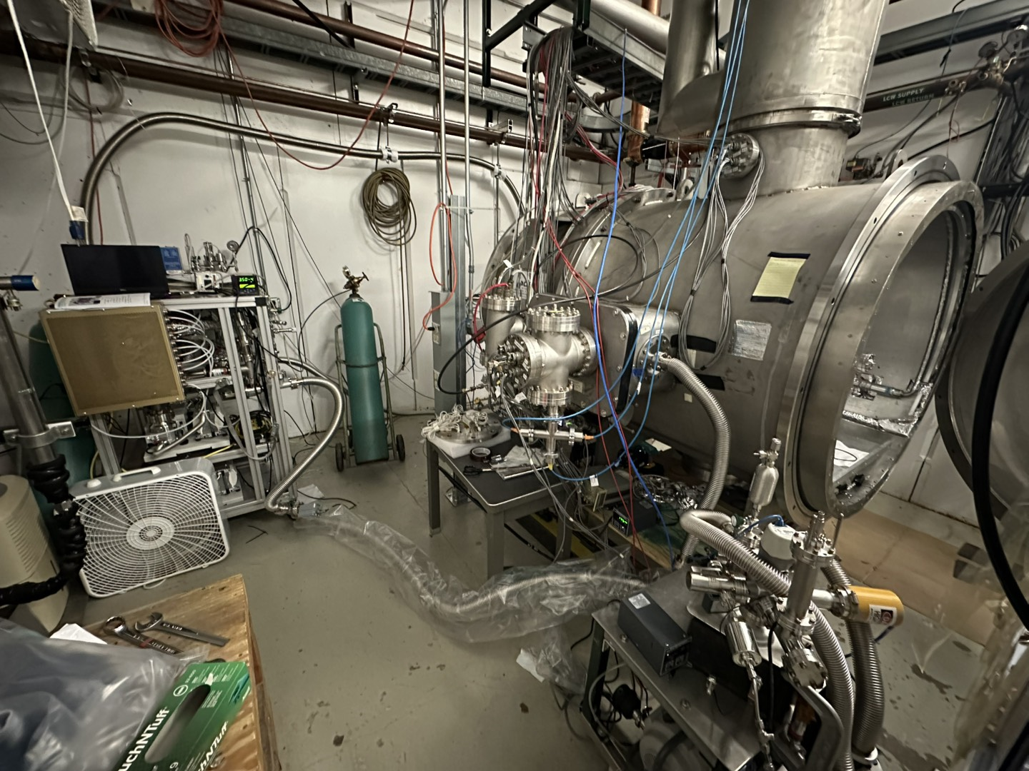
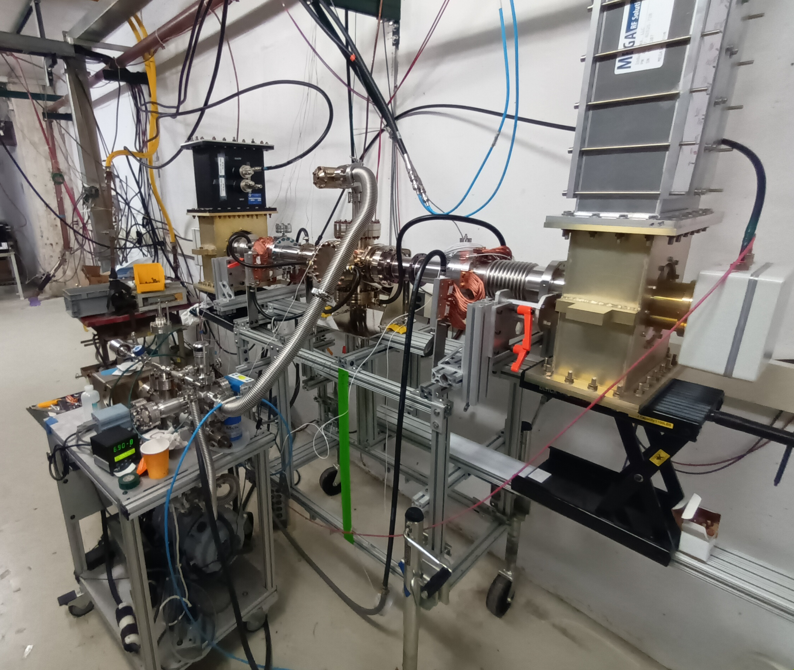
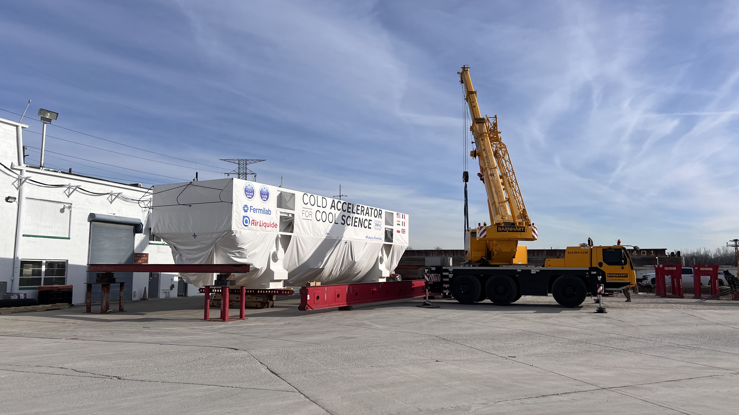
SRF Cryo
SSR2 Cavity: reconfiguration of STC to allow in-situ plasma processing
SSR cavities and cryomodules
  Three out of five pre-production SSR2 cavities needed for the string have been qualified. No additional cavities were qualified in November to allow for the reconfiguration and integration of the plasma cart at STC.
  Three out of three pre-production SSR magnets fabricated in industry meet technical requirements and are accepted.
  SSR2 production cavities MRR was carried out by the end of the year, and cavities fabrication started. Niobium batch 1 has been delivered at RI.
  ppSSR2 string assembly is currently forecasted to happen in March 2025 with CM completion during the summer.
650 cavities and cryomodules
  Disassembly of HB650 pCM has been completed, one of three cavities has been reprocessed and qualified by UKRI.
  A qualified, jacketed LB cavity is being shipped to CEA, while two others will be tested next week (one at INFN, one at MSU)
  The first pair of high-power couplers have been fabricated and delivered to FNAL and passed incoming QC. An issue with RF testing at MDB facility is holding the room temperature testing.
Cryoplant
  Coldbox has arrived in Romeoville, and to be delivered to Fermilab on December 19th.
  The Warm Compressors left the Howden factory in Glasgow, Scotland the week of November 4th and set sail on November 19th with and arrived at the Port of New Jersey on December 16th
  Preparations to accept compressors/Coldbox are ongoing. Working with ISD, Site Security and Comms on onsite logistics.
Cryogenics Distribution System:
  TTL (Tunnel Transfer Line): NX conversion for SSR2, LB650, and HB650 was completed. Currently working on Extension Can conversion. FEA was completed fro SSR1 vacuum jacket and FEA of the HTTS and piping is in progress.
  ITL (Intermediate Transfer Line): Completed fabrication of 6 out of 8 spools and FAT (factory acceptance testing) of 4 out 8 spools. Final components FAT expected in mid-January 2025.
  Warm Piping System: Fabrication/installation drawings, installation specifications, and procurement specifications have been completed.
Coupler RF test stand
Coldbox arrived in Romeoville
11

Slide 12
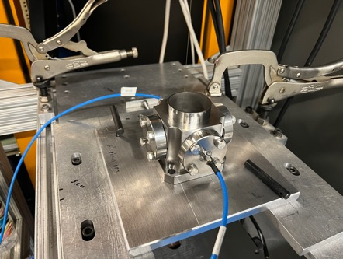
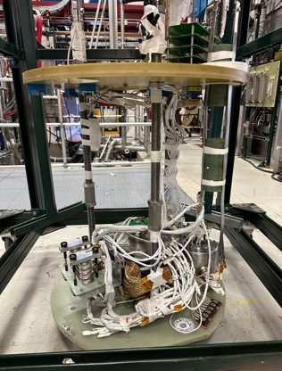
Accelerator Systems
Overall
  Addressing CPI/SPI volatility in past month. Although mostly recoverable, issues must be resolved to give predictable performance (MagPS replan, BI labor redistribution, MPS activity update, etc.)
  Most changes should be cost neutral, but are needed to improve fidelity of earned value.
MPS
  Pseudo-code generation for WFE interlocks, nearing completion and start of firmware generation.
HPRF
  Successful visit to JEMA and CEA about 40 kW SSA contract
  Nearing procurement of 162.5 MHz RF Distribution and 325 MHz circulators
LLRF
  Significant progress on implementing LLRF EPICS building in the FNAL AlmaLinux environment, a major step towards the final PIP-II system
  Good progress continues on the WFE LLRF system upgrade and Master Oscillator/Phase Ref Line
Magnets/Power supplies
  Work on rack layout for F37 continue towards successful resolution
  Vendor magnet designs continue to mature, with FDRs and vendor visits planned for early CY25
Vacuum
  Parts for vacuum carts and pumps for WFE and SCL are arriving, with QC starting smoothly
Controls
  Making significant progress on integration and system FDR preparation, work maturing rapidly
Instrumentation
  BPM stretched wire test stand updated
  Procurements starting to roll on all fronts, with laser wire first article to be built and tested in CY25
Safety Systems
  Resolving Beam Loss Monitor system design, and finalizing preparation for Cryoplant ODH install
4-button BPM Prototype Under Test
SSR1 Solenoid Prototype Under Test
12

Slide 13
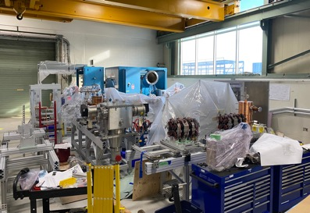
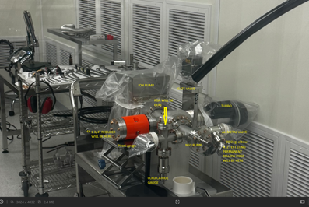
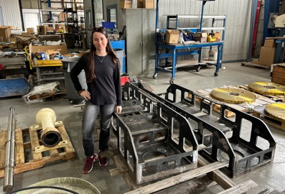
Installation and Commissioning
Warm Front End
  Assembly of PIP-II LEBT/MEBT girders and Ion Source cabinets continued at A0 staging facility
Test Infrastructure
  Cryogenic immersion heater installation in PIP2IT test cave was completed
  Cryomodule stands for SSR2 cryomodule test stand were delivered
  Assembly of beamline vacuum pumping station for SSR2 cryomodule test stand continued
Building Infrastructure
  Procurements and QC of received equipment continued (cables, racks, air and water manifolds, etc.)
  Planning for Process Clean Water (PCW) system installation in Utility Plant Building continued - installation expected to begin in March
Linac Installation
  Procurement process has begun for all PIP-II cryomodule stands
  Preparing for procurement of Warm Unit Structure stands
  Cryomodule Tunnel Transport System (CTTS) major weldments completed
  Installation Traveler development with L3’s ongoing
Commissioning & Accelerator Physics
  High-level applications (HLAs) and Shielding Assessment development continued
LEBT/MEBT girder assembly at A0
SSR2 test stand beamline vacuum pumping station
CTTS weldments

Slide 14
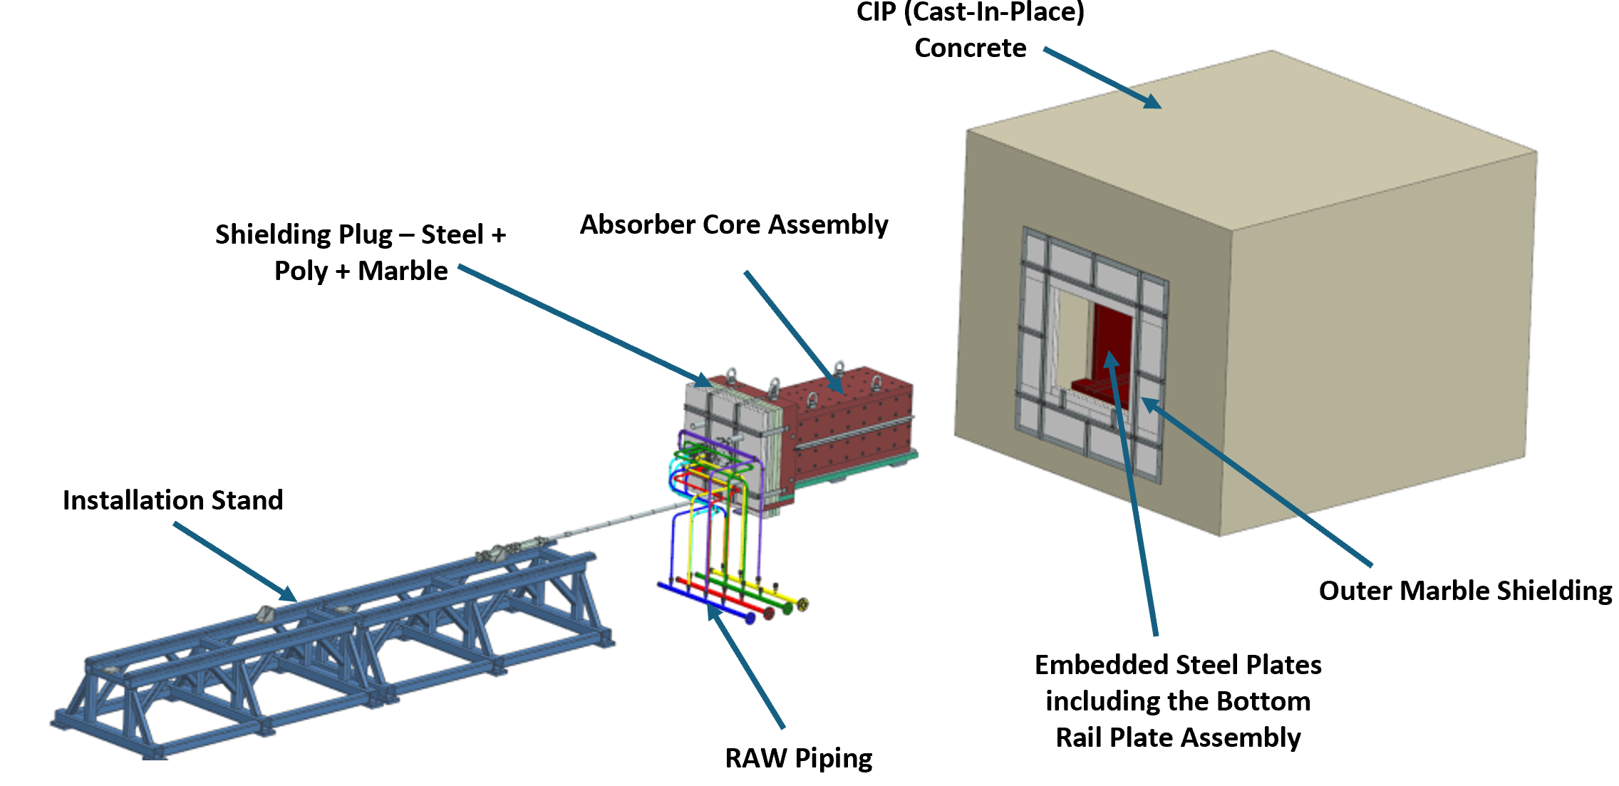
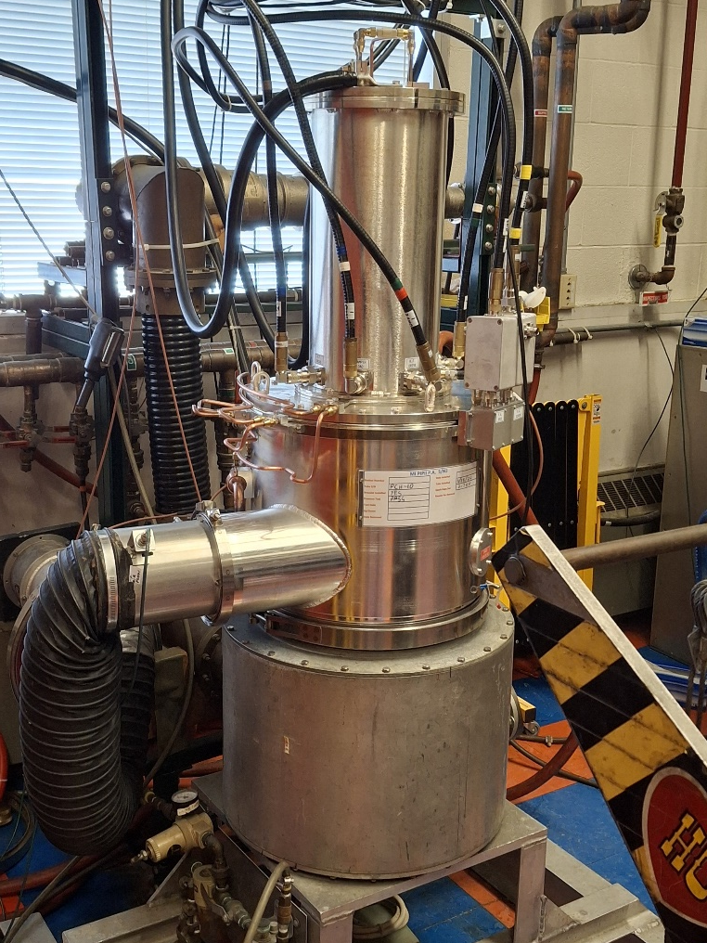
Accelerator Complex
BTL Installation
  Mu2e installation experts, Dean Still and Jim Morgan, from AD have agreed to assist the new Level 3, John Kujarik.
  Determining number of H blocks required for shielding in the two absorber access points in BTL.
  BTL stand designs for magnets, instrumentation and vacuum components continues for an FDR in October of 2025.
Beam Transfer Line/Beam Absorber
  BTL Collimators – PRR Teamcenter engineering document has been generated.
  Exploded view of 25 kW Absorber created.
  Meetings with Controls to discuss interfaces for 25kW absorber RAW skid instrumentation.
Booster
  Foil System FDR now being held off because of finalizing controls interface and Controls personnel availability.
  Booster longitudinal dampers FDR was completed.
  Booster Collimator - Validation Experiments for collimator have approval for operation on December 15 of 2024.
  Work on the CFM and ORBUMP magnets continues.
MI/RR/Booster RF
  Completed R&K 8kW Solid State Amplifier Preliminary Design Review.
  Testing of new MI PAs at Cross Gallery since MI-60 does not have power and water available.
  Received and modifying Y567 PA tube socket (CPI SK2000) for Dual PA Modulators.
  Received $1,294k worth of medium bore Booster cavity parts out of $1,400k ordered.
Exploded view of 25 kW Absorber created.
Testing of new Main Injector Power Amplifier.
14

Slide 15
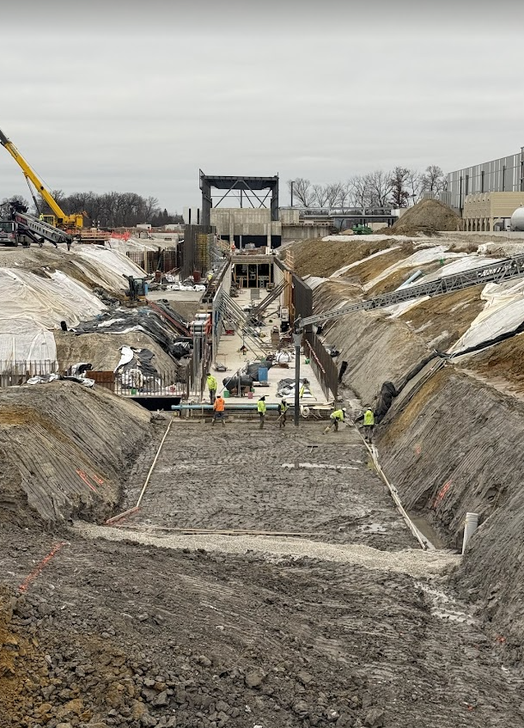
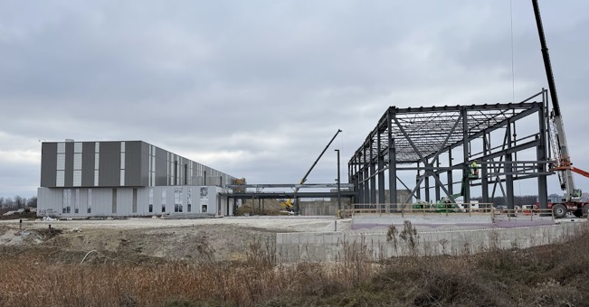
Conventional Facilities
ECF Subproject ​(100% complete)
Final Acceptance for all construction packages received.
CD-4 Independent Project Review held in November 2024
ESAAB scheduled for January 2025
WBS 121.06.05 – Linac Complex ​(~35% complete)
High Bay Building structural steel continued in November
Linac tunnel excavation and concrete work continues.
Mechanical/electrical work continues in utility plant at Cryogenic Plant Building
WBS 121.06.06 – Booster Connection
100% design review issued in October 2024
On track for completion in December 2024
High Bay Steel – 10DEC24
Linac Tunnel Work – 10DEC24
15

Slide 16
Technical Integration
Design Maturity
Cost-weighted Design Maturity through October increased to 97%
  1 PDR and 27 FDRs, and 5 Integration reviews remain.
  1 FDR was added for Beam Instrumentation Phase Reference Line
  2 reviews are planned for the remainder of this CY
  3 planned reviews were delayed until CY25
Design Change Requests (DCRs):
Completed DCRs Completed
  Warm front end exclusion area
  Dipole corrector max current and ramp time change
Upcoming DCRs
  Booster lattice update
  SSR and 650 MHz SSR CM design updates
  QPM chassis quantities
  Cavity radiation standardization
PIP-II Component Database is now operational and functional for all project stakeholders.
PIP-II Technical Integration Sharepoint site was reconfigured to facilitate access to integration and tracking tools implemented project-wide.
Key Teamcenter libraries created for PDRs, FDRs, PRRs, and IKC-PRRs.
16

Slide 17
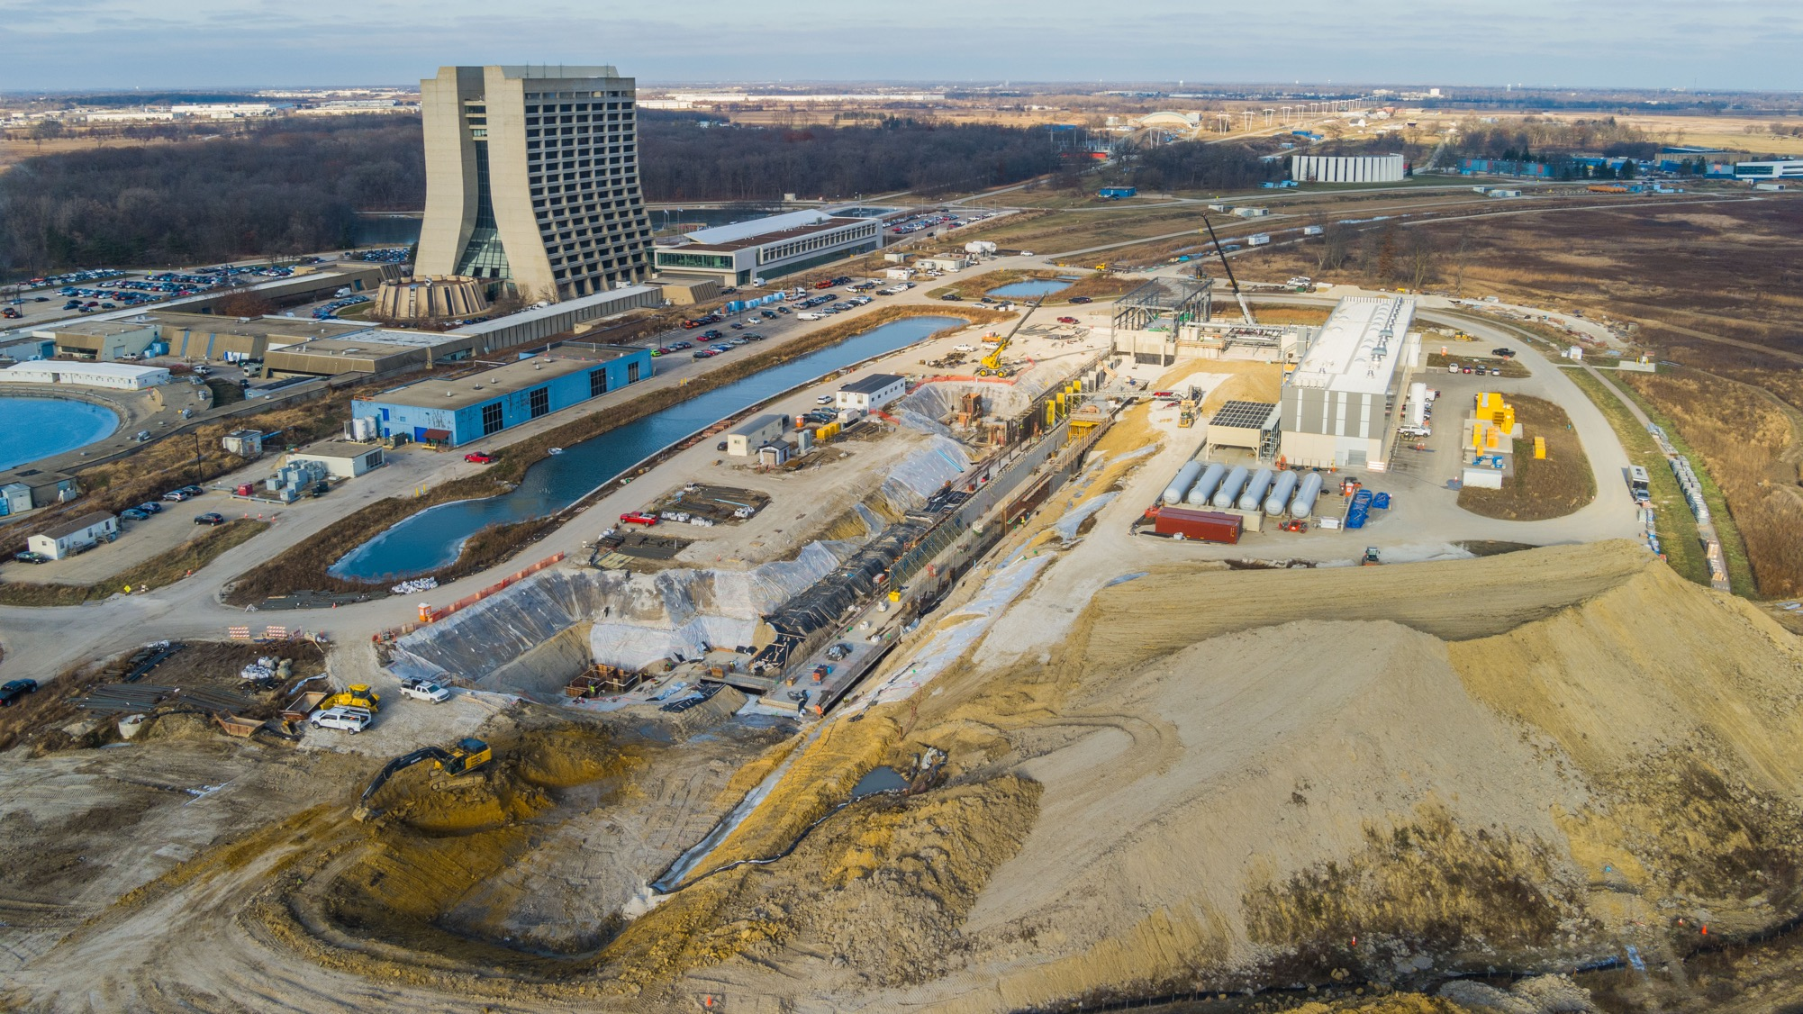



THE FUTURE OF FERMILAB
Follow us:
http://pip2.fnal.gov/
@PIP2accelerator
/showcase/pip-ii/

