Slide 1
Fermilab Trip 10/23-10/25

Slide 2
What we accomplished
Discussion with Ketevan and Louis about display we would have at LSC
Confirmed fiber connections between FCC and LSC
Tested loss in fiber connections
Measured polarization drift between FCC and LSC

Slide 3
Discussion with Ketevan
Showed what we have developed so far
  Measurement setup
  Comic
  Coloring books
  CHSH vs angle
  Brief discussion on plans for Valentine’s day
Discussed ideas for what to do at LSC
  Ketevan suggested we do measurement time vs uncertainty, i.e. the longer they measure the more std dev they are from the value of 2

Slide 4
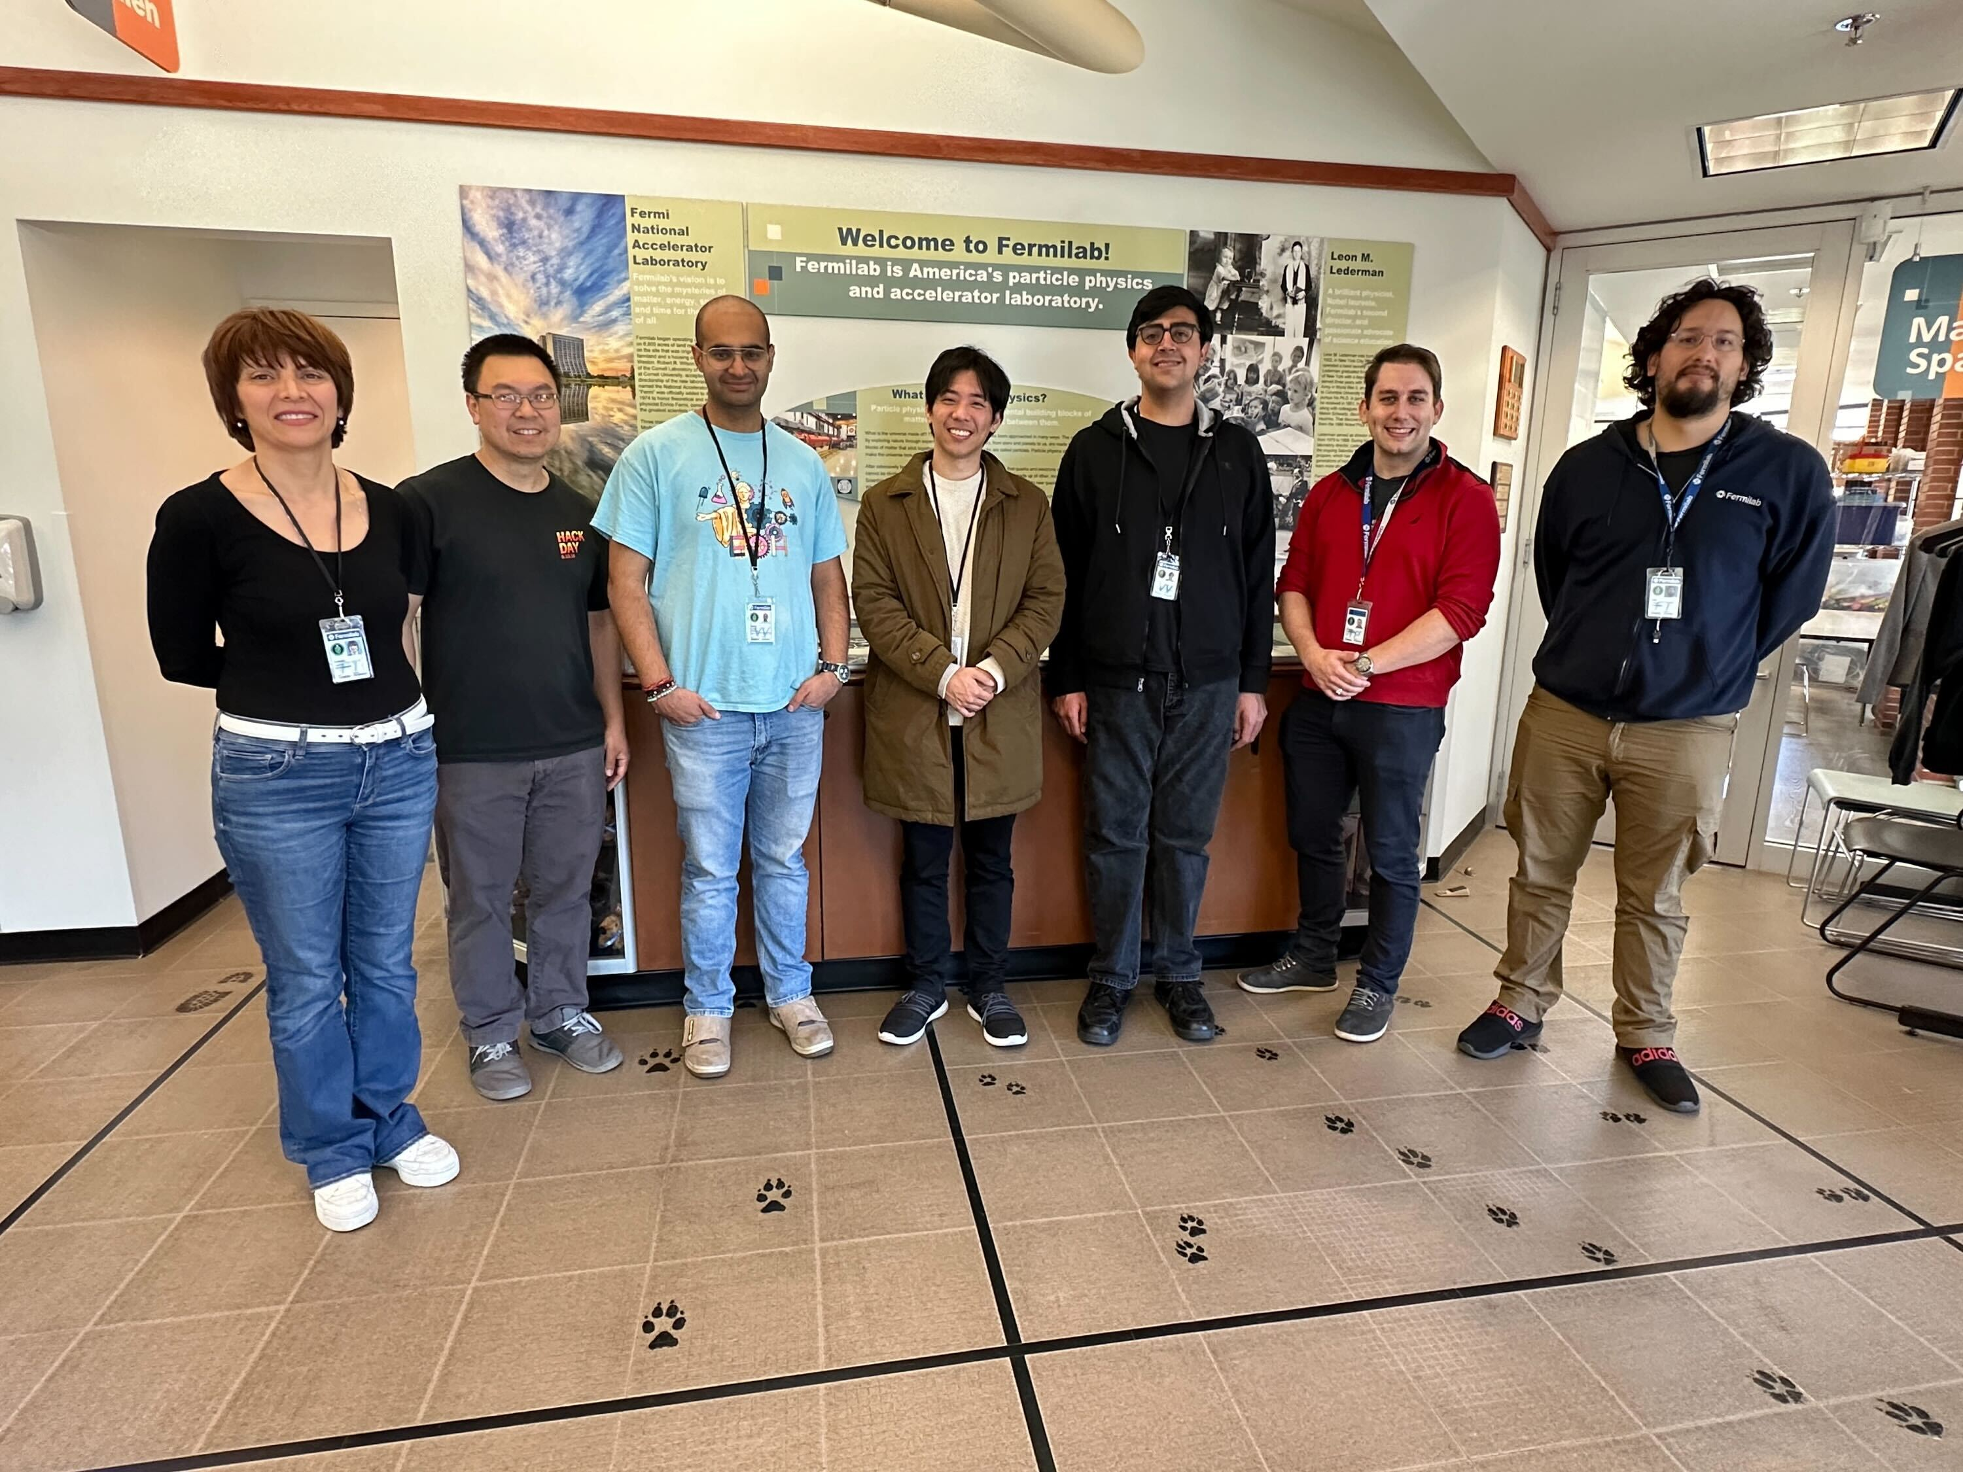
LSC Space
Have space for ~6ft table where we saw last time
Network closet has standard size networking rack which we can put our measurement system in

Slide 5
Fiber connections
4 strands of fiber between FCC and LSC
Optical switch at FCC to link locations
FCC Lab
LSC Network Closet
Switch

Slide 6
Fiber connections
About 2km of fiber between switch at FCC and LSC
~2.2+dB of loss in each link from switch to LSC(OTDR)
~5dB loss over round trip
  We notice ~7dB loss round trip, consistent with 1dB insertion loss into optical switch
FCC Lab
LSC Network Closet
Switch
>2dB loss
2km
1dB insertion loss

Slide 7
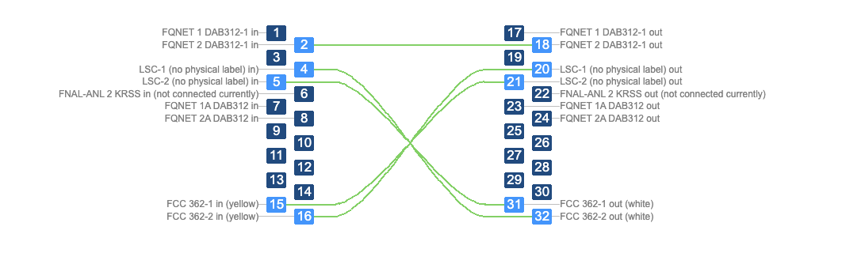
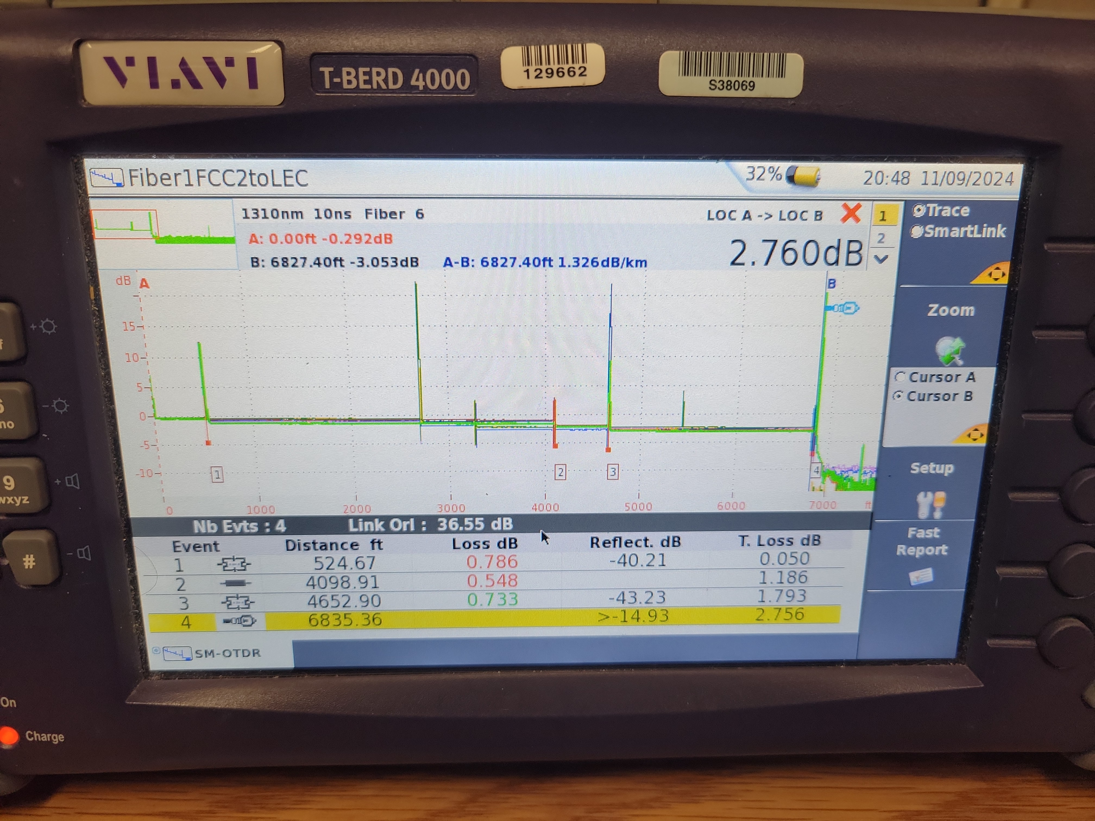
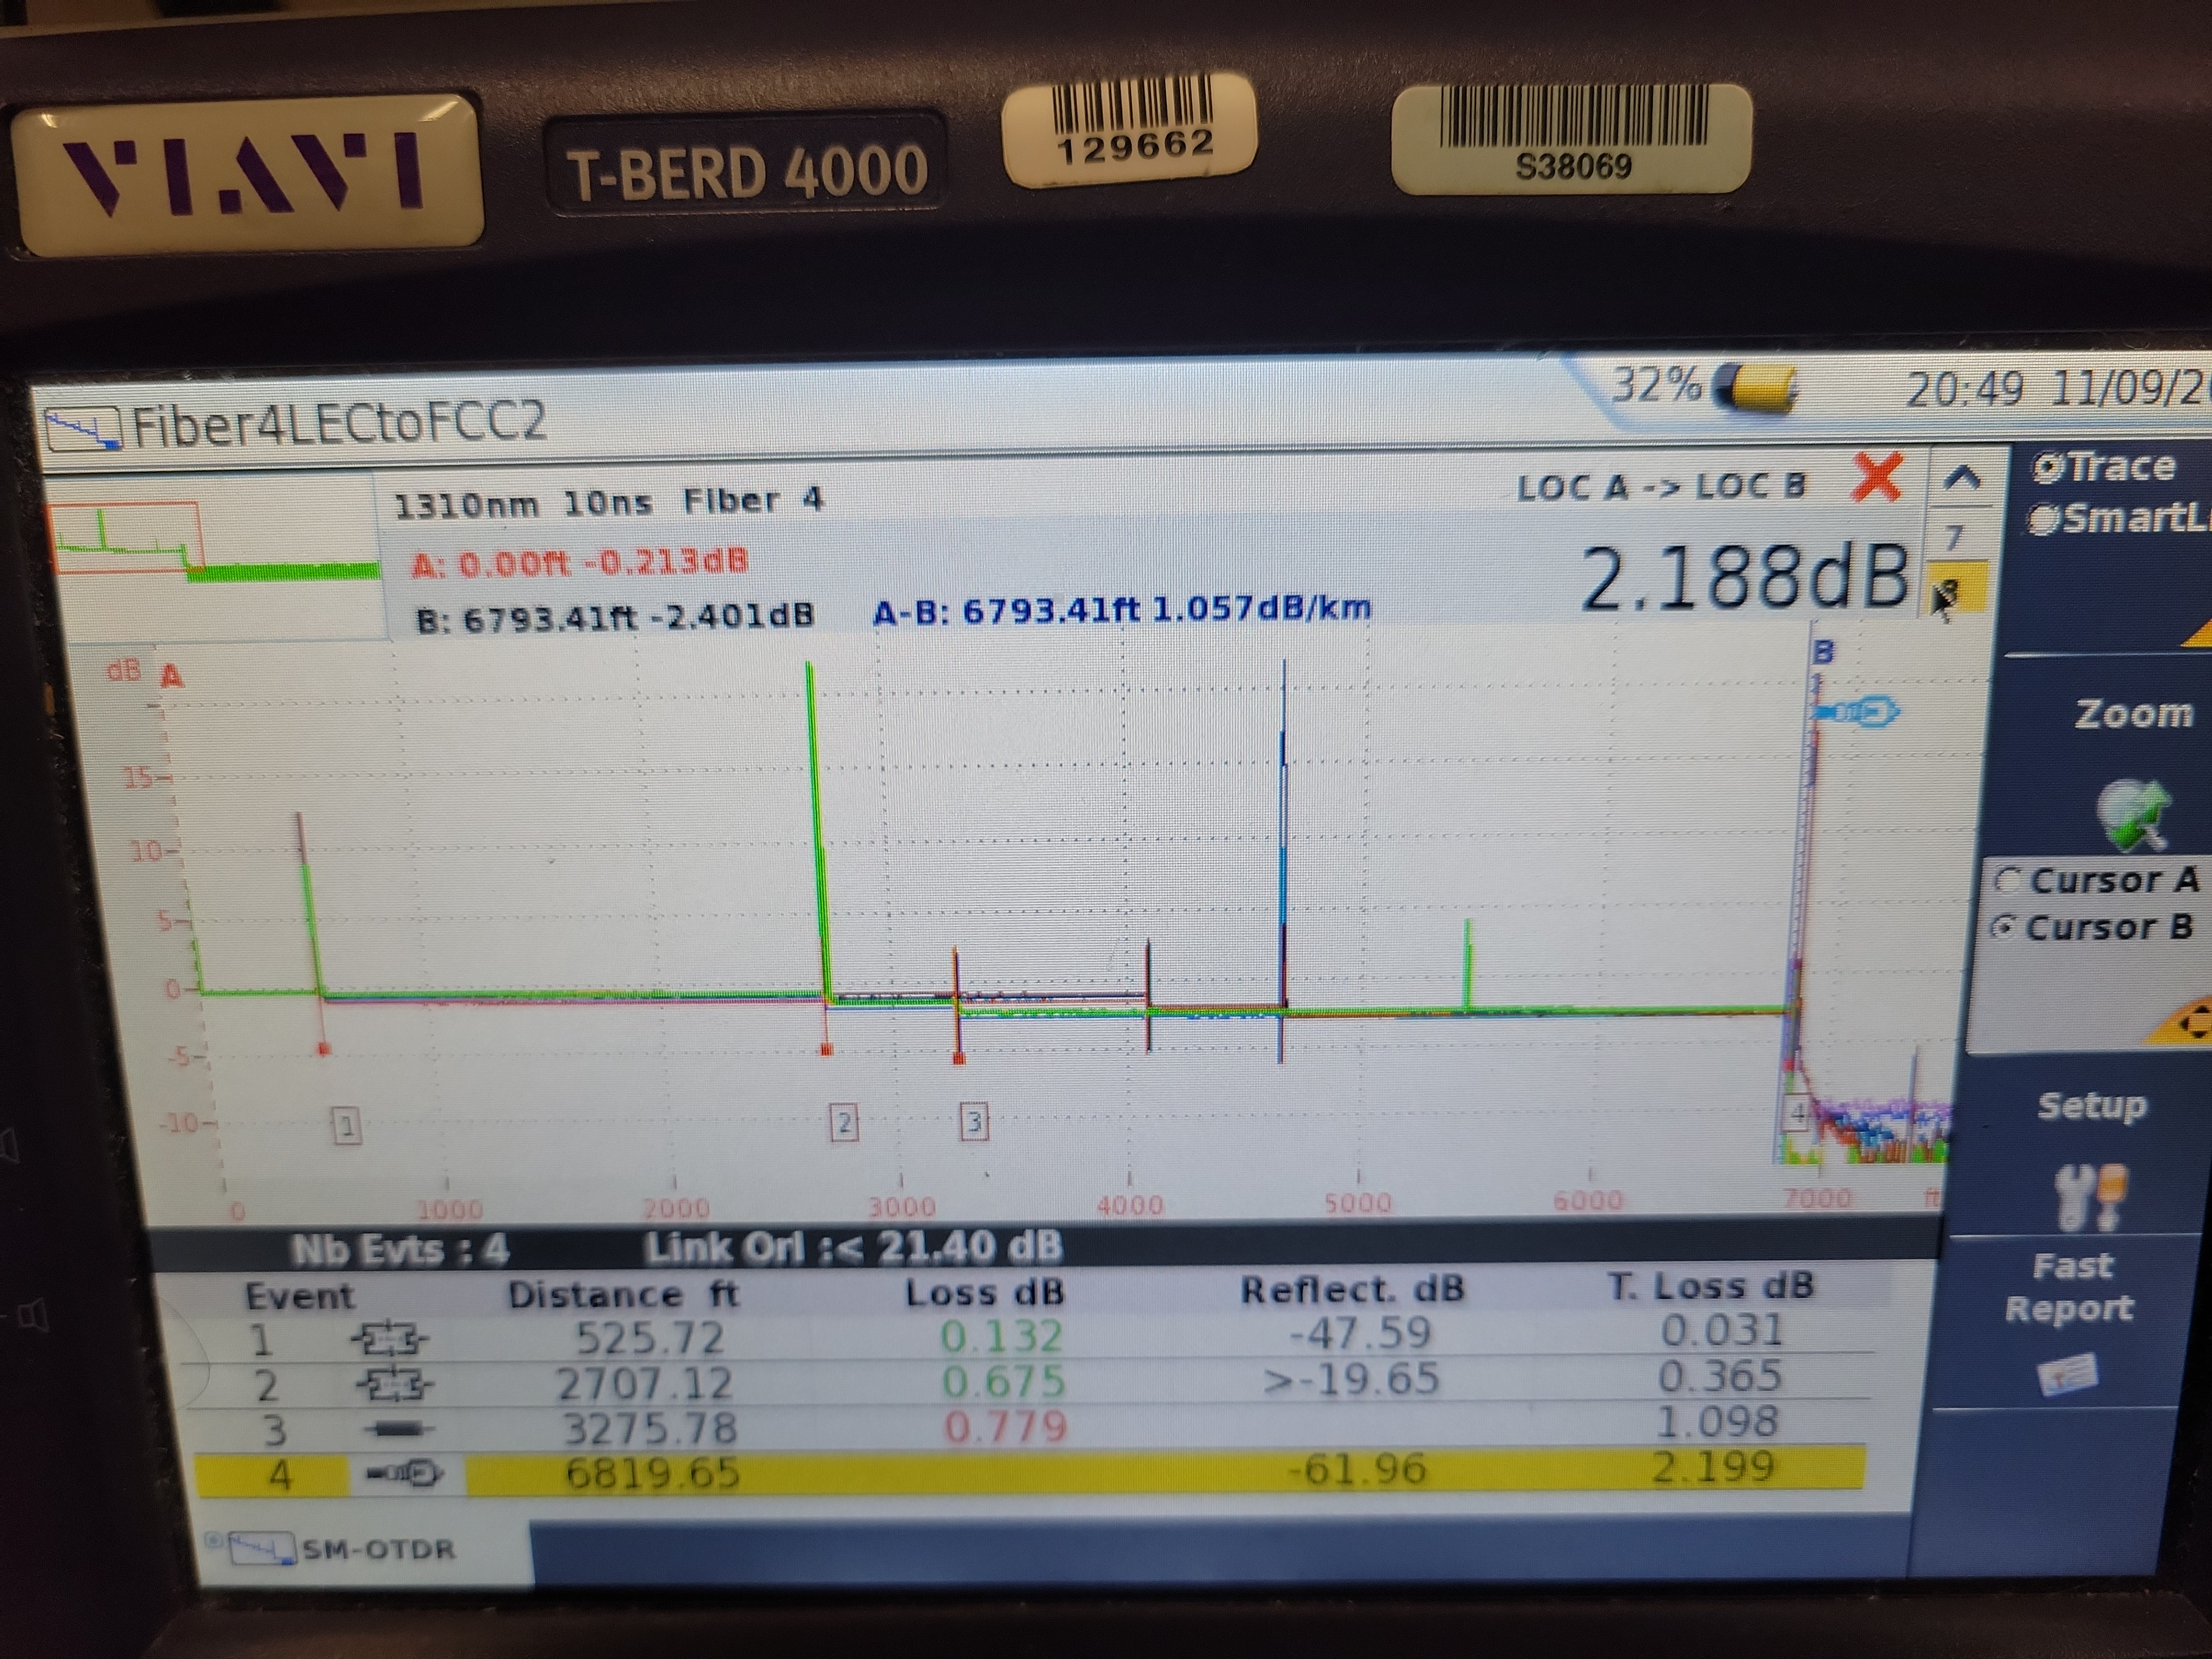
Fiber connections

Slide 8
Fiber Drift Measurements
We used the PPCL550 laser, set to 1560nm (current operating wavelength of PQN source)
Directed to LSC through fiber switch

Slide 9
Fiber drift fiber set 1

Slide 10
Fiber drift fiber set 2

Slide 11
Laser drift

Slide 12
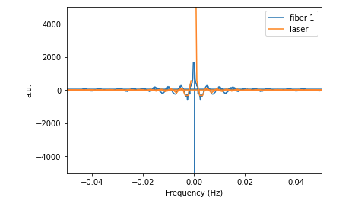
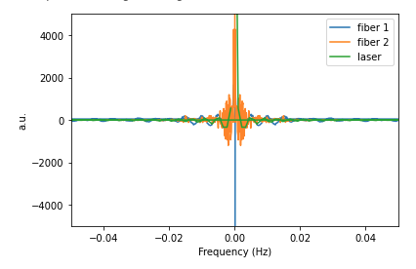
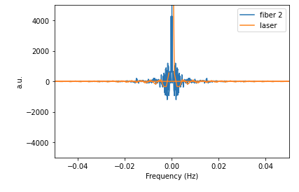
Fourier Transforms Az
Real
Noise might be mainly from laser for fiber 1?

Slide 13
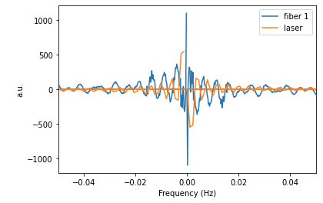
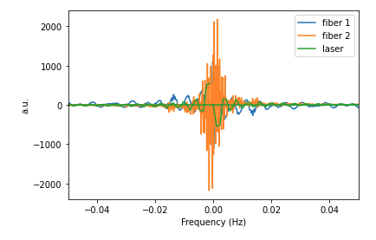
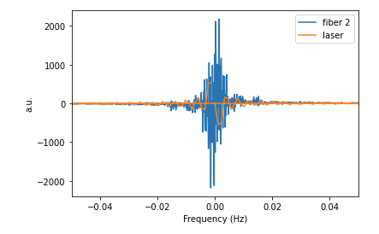
Fourier Transforms Az
Imag

Slide 14
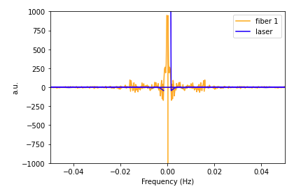
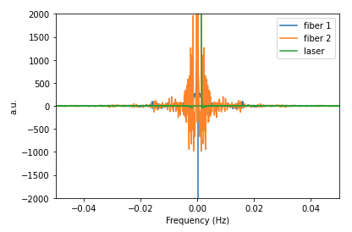
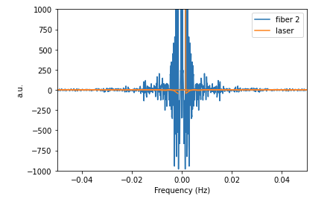
Fourier Transforms Az
Real w/out Spikes

Slide 15
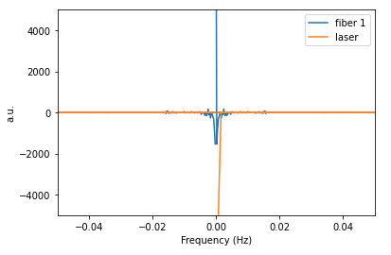
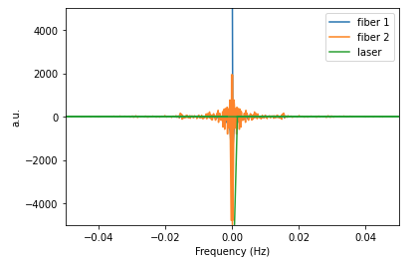
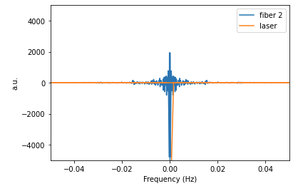
Fourier Transforms El
Real w/out Spikes

Slide 16
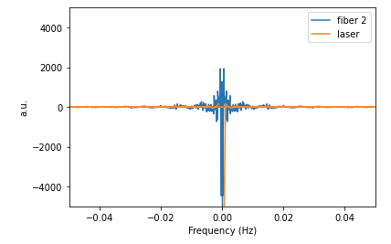
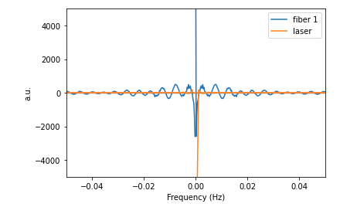
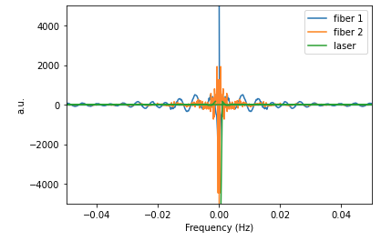
Fourier Transform El
Real

Slide 17
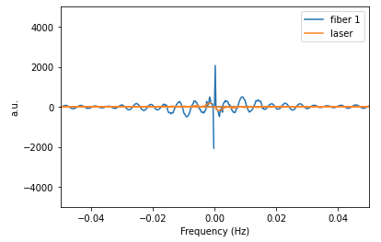
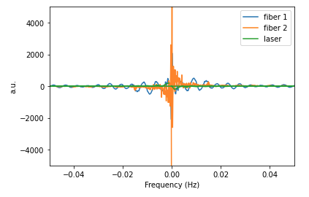
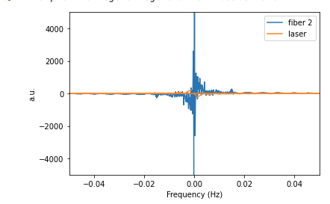
Fourier Transform El
Imag

Slide 18
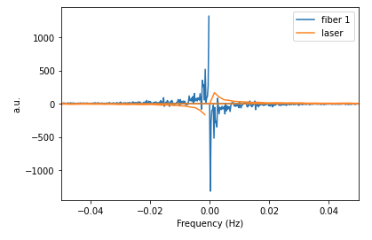
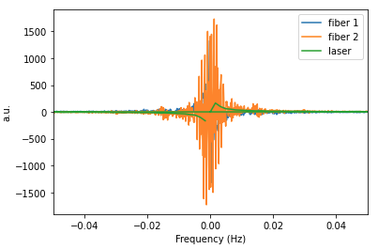
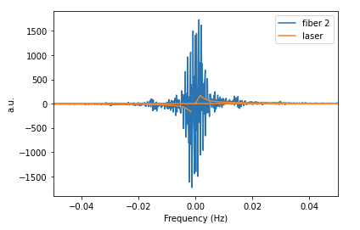
Fourier Transform Az
Imag w/out Spikes

Slide 19
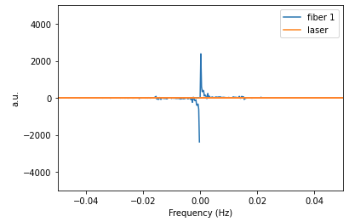
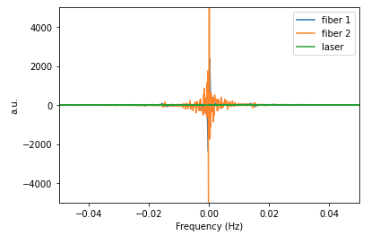
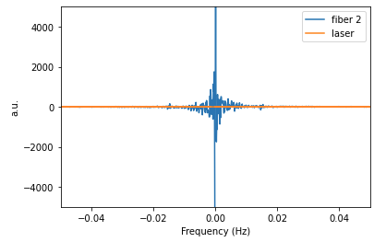
Fourier Transform El
Imag

Slide 20
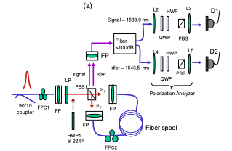
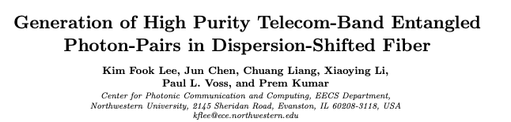
SFWM source for PQN

Slide 21
SFWM sources for PQN
Possibly switch DSF with PMF to reduce Raman Noise
1060nm → 810nm + 1510nm
Cannot find stable solution for 1550nm near degenerate case
Multiple modes supported in 1550nm PMF fiber

