Slide 1
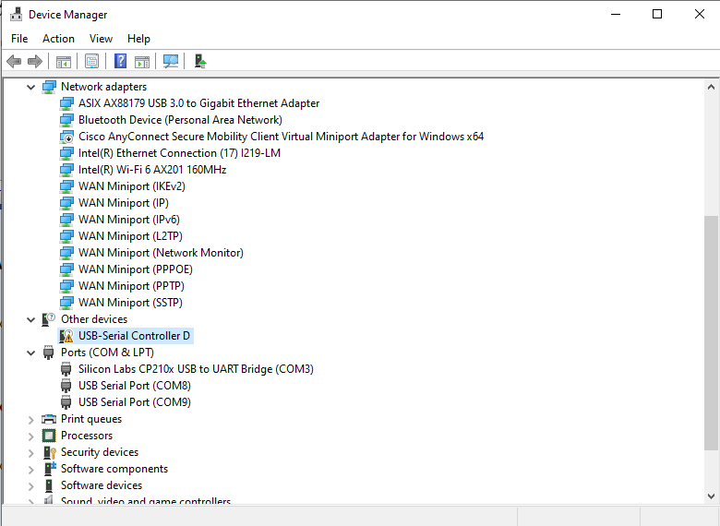
Updates on Clock Synchronization between FNAL-ANL
Fiber link between FNAL-ANL
The link has been tested and found working.
The hardware for clock detection, amplification and transmission at Argonne (B360) has been installed.
Feedback control for minimizing clock drift
This part is divided into a few smaller steps:
Update: The time drift detection and recording with Swabian Time Tagger has been completed and tested to be working.
The code for delay adjustment with the Newport Motorized Delay Line using the mean drift obtained from the Swabian is completed.
Current State: The Newport Motorized Delay Line is connected via a RS232 to COM converted and windows require a USB-to-serial driver like the Prolific PL2303 or FTDI FT232 driver. It has not been detected as a COM port otherwise. I have tried several of the drivers but the right driver is yet to be found. Andrew has used this device earlier from Ubuntu machine and it is relatively easy to interface in Linux.
Next Step: Update the driver and Run the control between FCC and DZERO and then between DZERO and ANL (B360).

