Slide 1
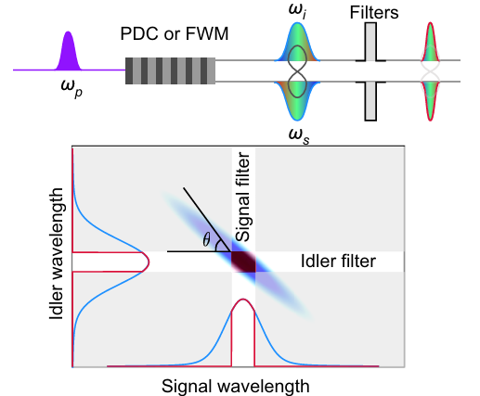
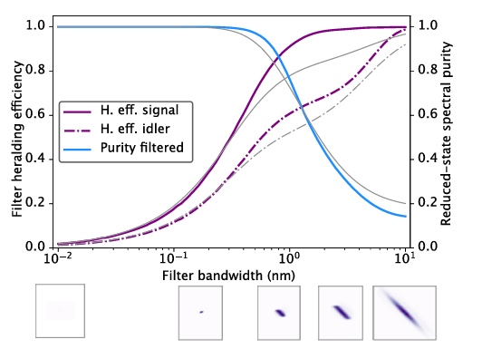
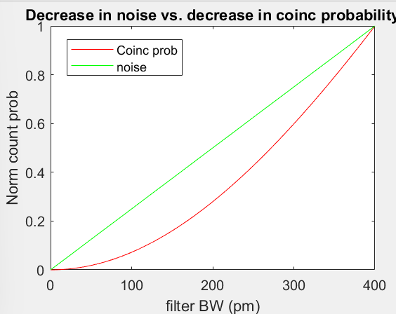
Effect of narrow spectral filtering joint spectrum and implications for noise mitigation
Comparing to noise, herald eff reduces but noise does not at the same rate

Slide 2
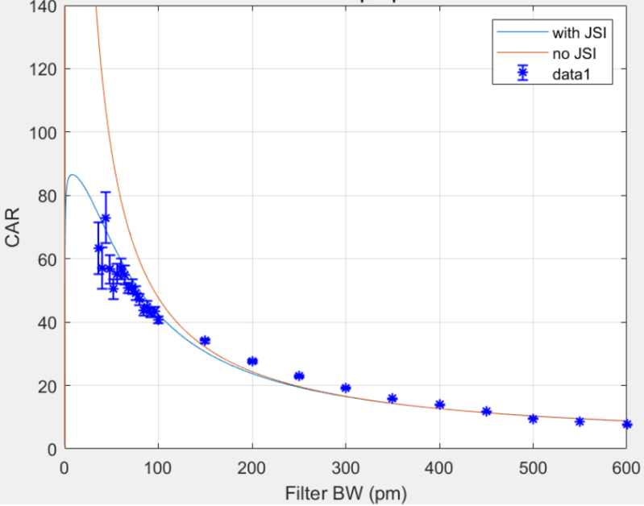
Experiment results: CAR vs. filter BW
Experimentally shows that CAR diverges from typical model in narrow spectral filtering regime
Typical model
Modified model including filtering JSI
singles
noise
True coinc
Modeled from

Slide 3
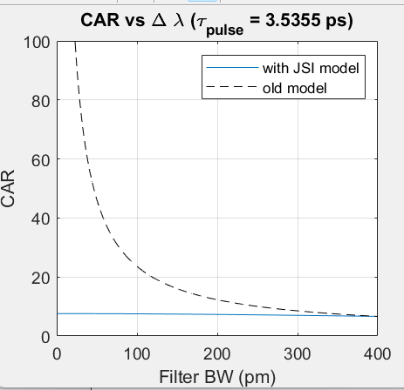
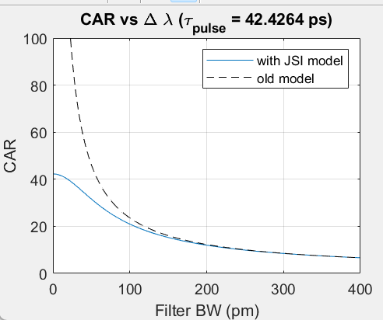
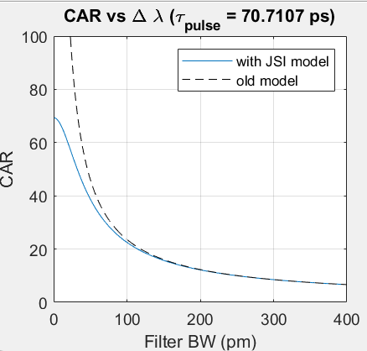
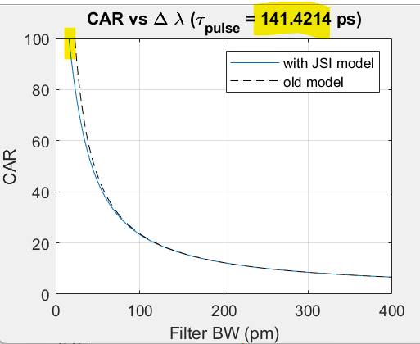
CAR vs. pump pulse width/spectral bandwidth
The more one increases the pulse width, the higher the BW where detrimental effects on coincidence probability occur
The more one increases the pulse width the closer it approaches the ideal model

Slide 4
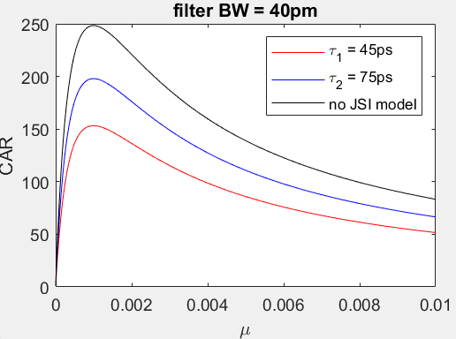
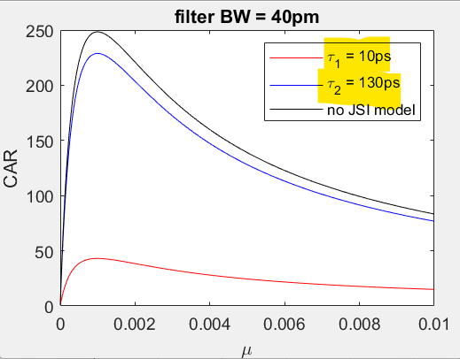
CAR vs. mu for different pulse widths
CAR will depend on the mean photon number, and will also change depending on the choice of pulse width for a given filter BW

Slide 5
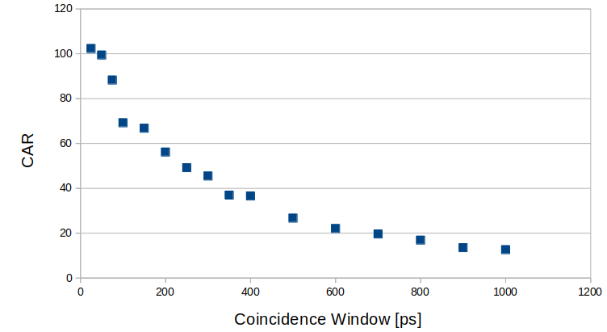
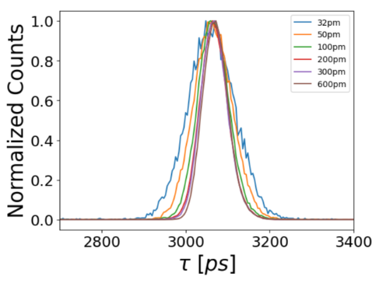
Narrow time filtering
Examining time filtering narrower than the photon temporal width

Slide 6
Final steps
Would like to see if can get plots versus mean photon number, but are limited to very low mean photon numbers when filtering narrow due to limits in power. May not be able to get this plot for a paper
Time bin entanglement coexisting with 10 Gbps over 25km/25km as a demo
Moving on from this experiment this week to swapping

