Slide 1
FD1/FD2 Installation Engineering Update
Nicholas Joniak
12/03/2024

Slide 2
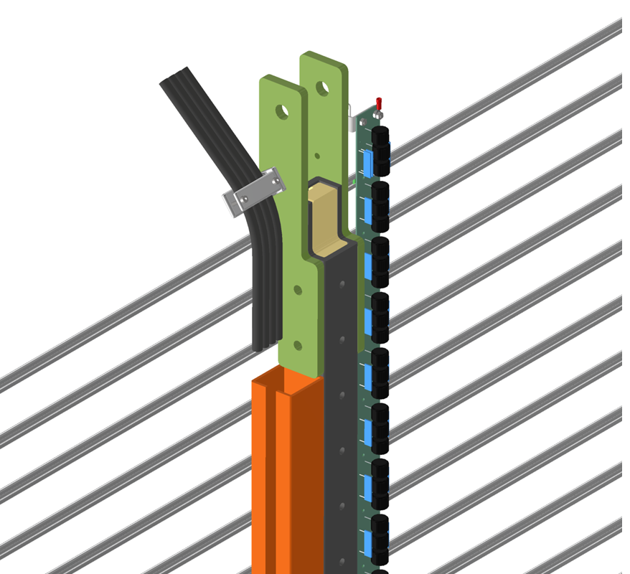
Engineering Updates
Procurement Status:
  Upcoming:
    See engineering updates.
  Existing:
    No update.
FD2 PDS Fiber Routing:
  Proposed guide shown.
FD2 TCO:
  Analysis Plans submitted to compliance office for review:
    TCO Hoist Beam.
    TCO Platform.
Can be locked to provide strain relief.

Slide 3
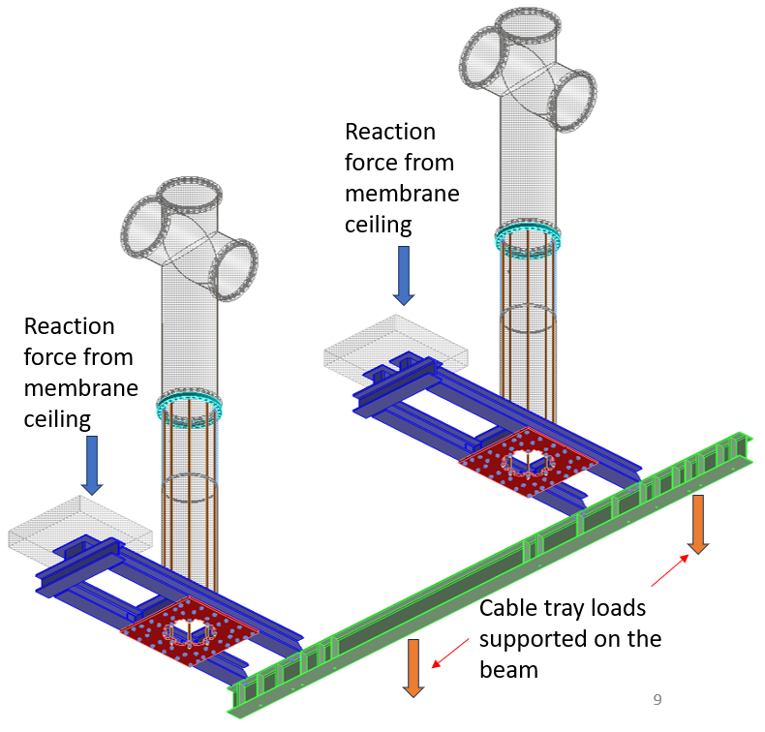
Engineering Updates
Vertical Drift – BDE Cable Tray Support
  Simplified design with only thread rod supports.
  Early simulations promising with single penetration analysis.
  Full model simulation (ambient) presents some concerns with buckling.
    Mitigation methods being tested this week.
  After solving, thermal simulations to be completed.

Slide 4
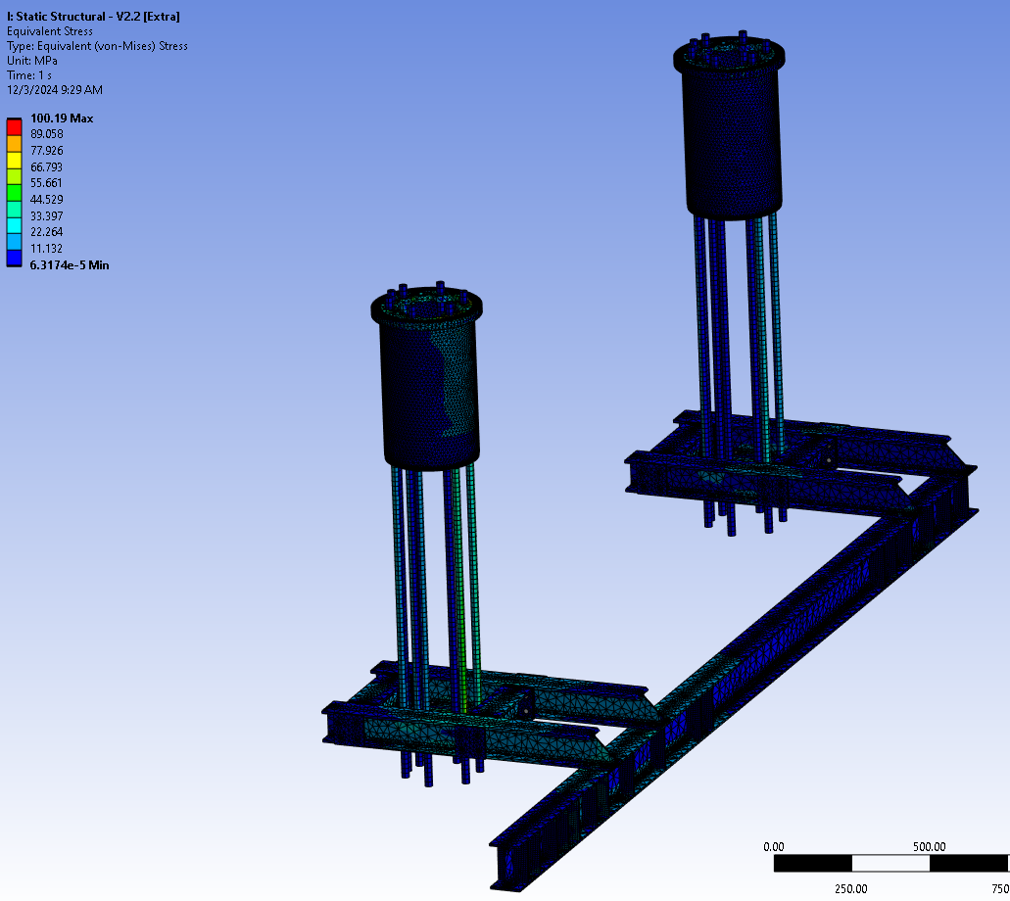
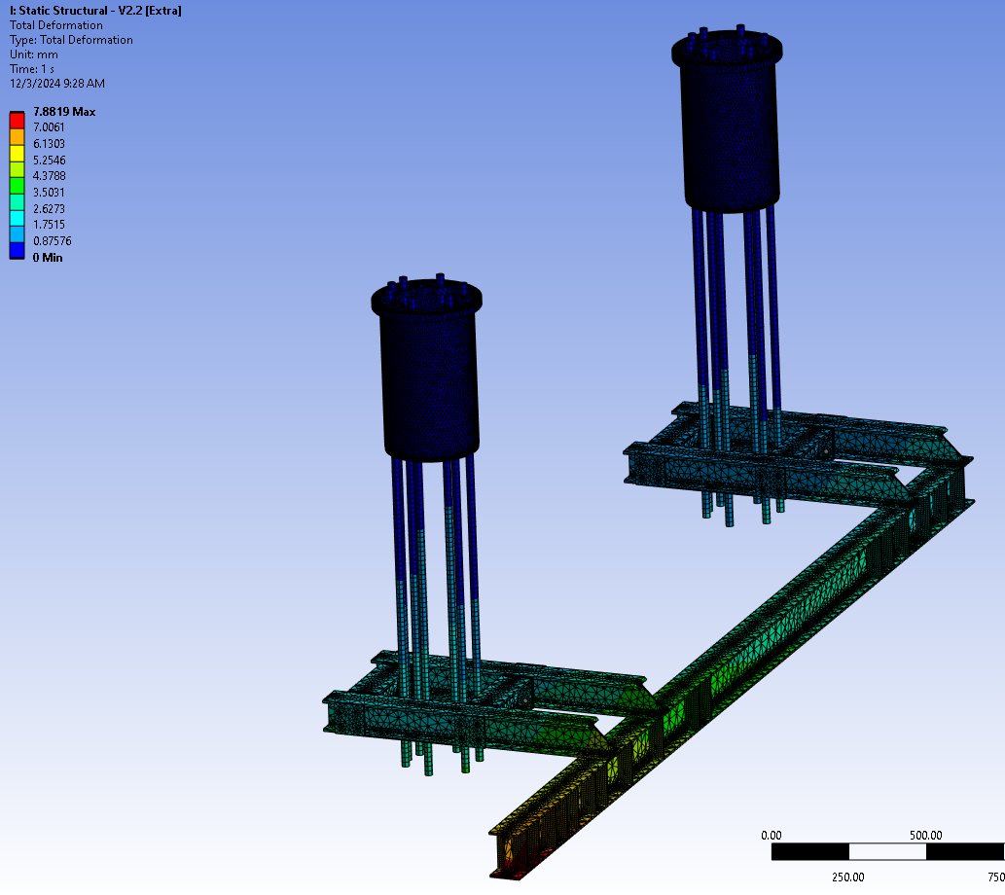
Engineering Updates

Slide 5
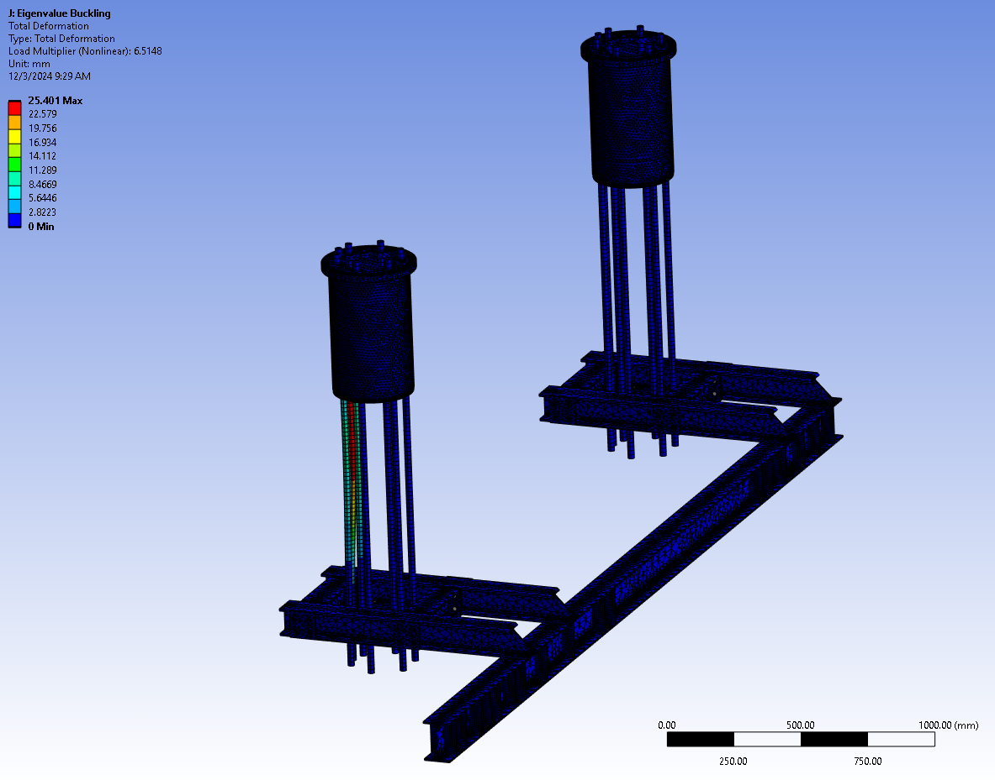
Engineering Updates

