Slide 1
APA Frame Welding Issues
Eric James
FD-HD Technical Board Meeting
December 11, 2024

Slide 2
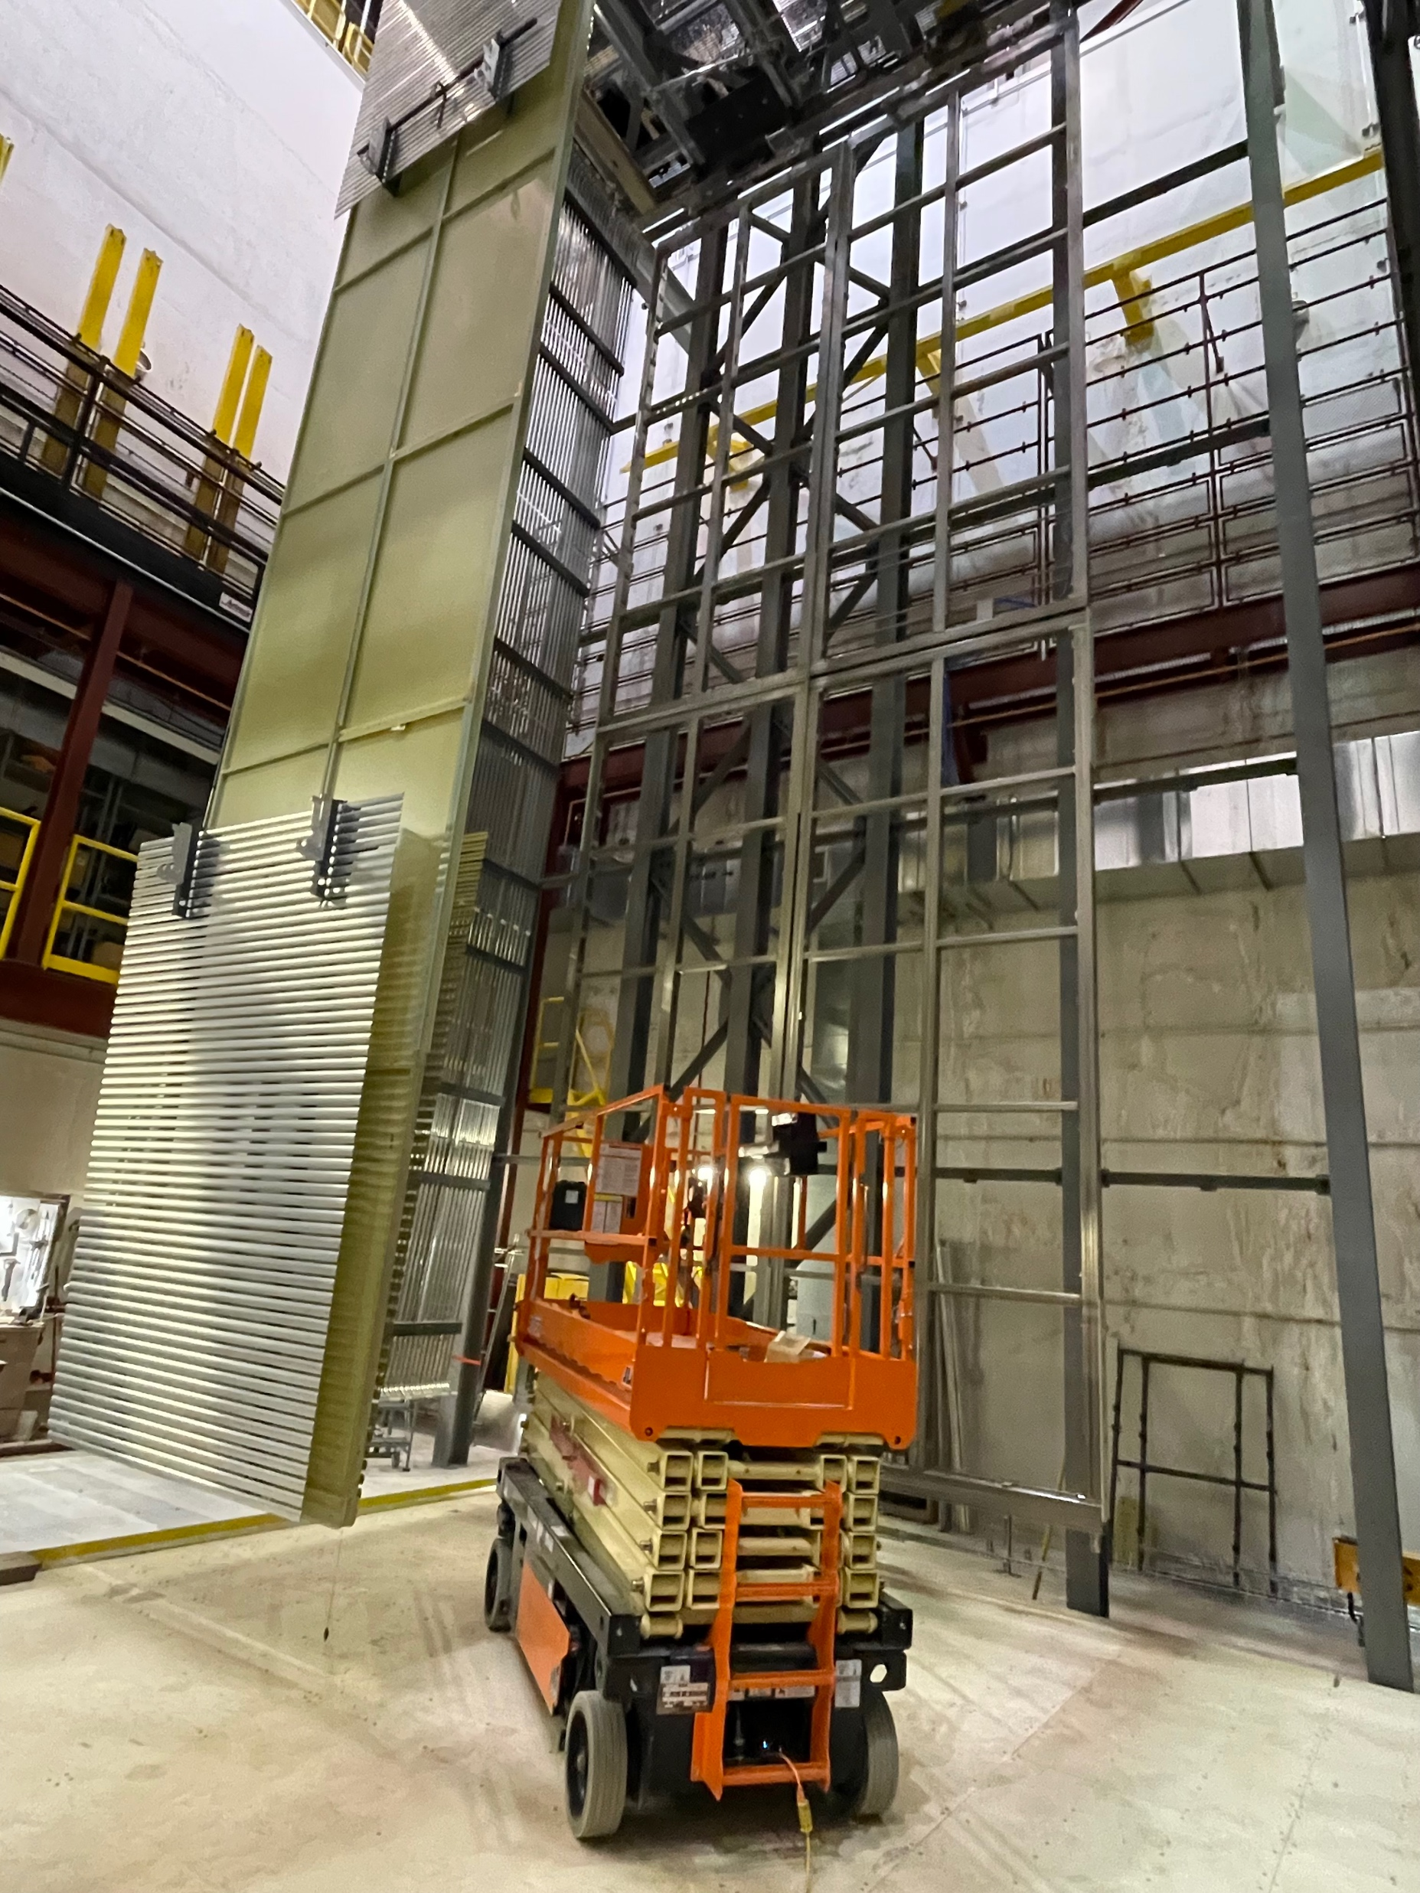
Ash River Installation Prototyping

Slide 3
Primary Issue
Recently, we had been investigating some small differences in APA frame welding procedures in the US and UK
As part of this investigation, the original calculations done to verify the strength of the frame welds were re-visited
It was noticed that for four particular welds on the frame, the original calculation was based on a four-sided weld whereas the frame drawing specified a three-layer weld plus stitch welds on the fourth side

Slide 4
Primary Issue (cont.)
When we re-did the calculations for these four welds, utilization ratios above one were found for several load cases
However, because the original calculations gave utilization ratios well below one several conservative assumptions had been applied
We now have two new sets of independent calculations for these welds indicating that the utilization ratios are below one for all of the load cases

Slide 5
Additional Issue
As part of this investigation, it was noticed that the quality of the stitch welds on the fourth side of the frame had not been performed consistently
In particular, the thickness of these welds on some frames did not meet the drawing specifications
To make sure that this is not an issue for us, we re-did the new calculations assuming complete removal of the stich welds on the fourth side of the frame
Even in this extreme case, we still obtain utilization ratios below one (albeit with smaller margins)

Slide 6
Next Steps
Since these welds have utilization ratios closer to the limits than expected, we want to check to make sure that there are no other hidden issues
We plan to x-ray all welds on the two APA frames that we have been using to conduct installation prototyping activities at Ash River
The goal will be to evaluate the “hidden” chamfer welds made on the other three sides of the APA frame

Slide 7
APA Testing at CERN
Based on updated calculations, we have received permission to resume manipulations of APAs in the NP04 clean room
We need to arrange for APA testing to get back underway after the start of the New Year
First step is to get team from Daresbury to CERN to repair broken wire

