Slide 1
Phase I&II LAr Simulations… toward Module 3
Eric Church
9-December-2024
Notes:
Image: Abstract Data Visualization – Stock Photo

Slide 2
Outline
Fast MC for APEX, e.g., physics sensitivities
BackgroundExplorer simulations
Need for geometries

Slide 3
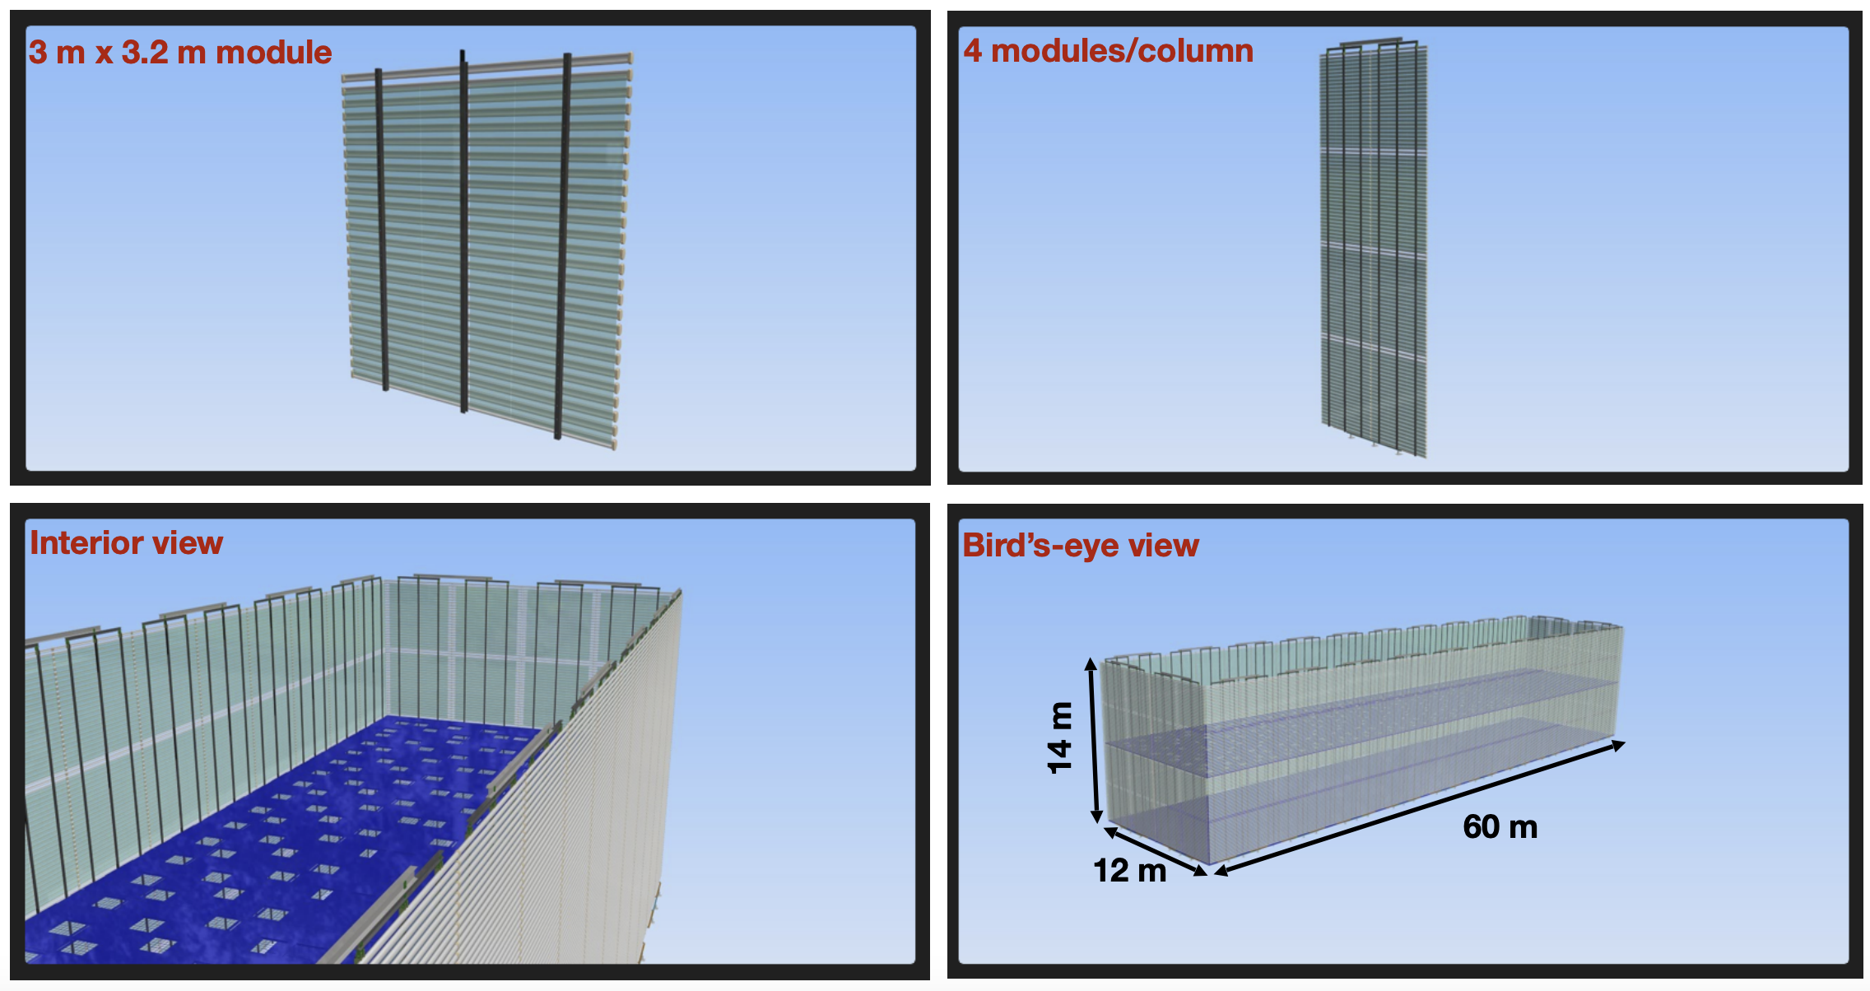
APEX
A proposed Module 3
Small perturbation to a previous module
That can be built say 3 years after Module 2.
We want this Module (VD) to have incremental cost over previous modules.
Obviously must be LAr
APEX is the leading contender. (There now is one other I know about, POWER.)
Costs are VD + \epsilon
Puts extensive xARAPUCA coverage on the field cage

Slide 4
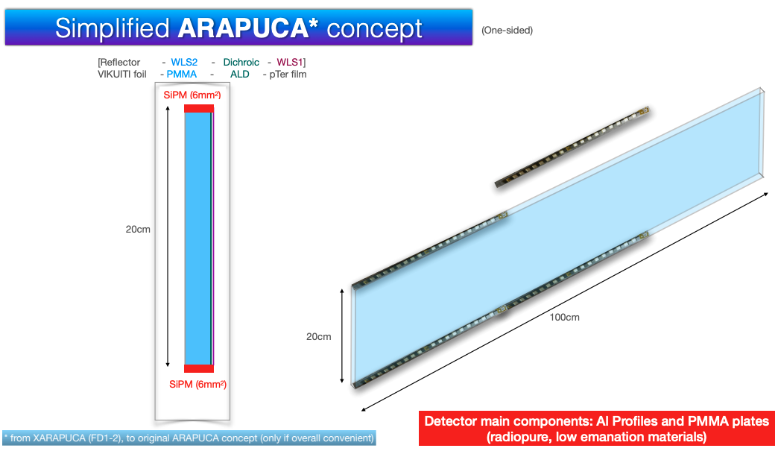
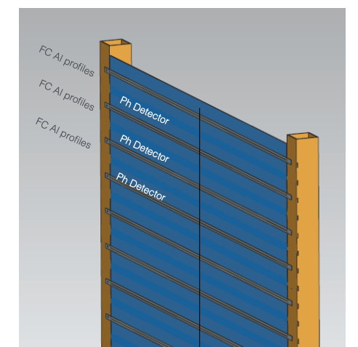
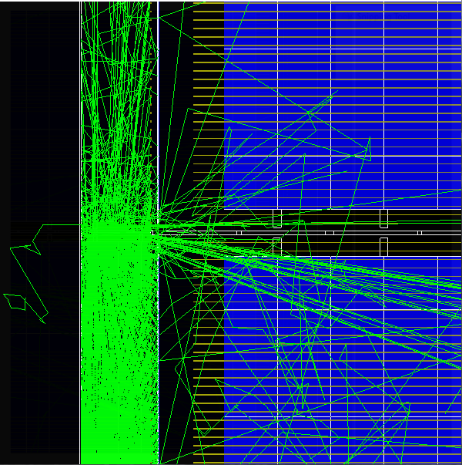
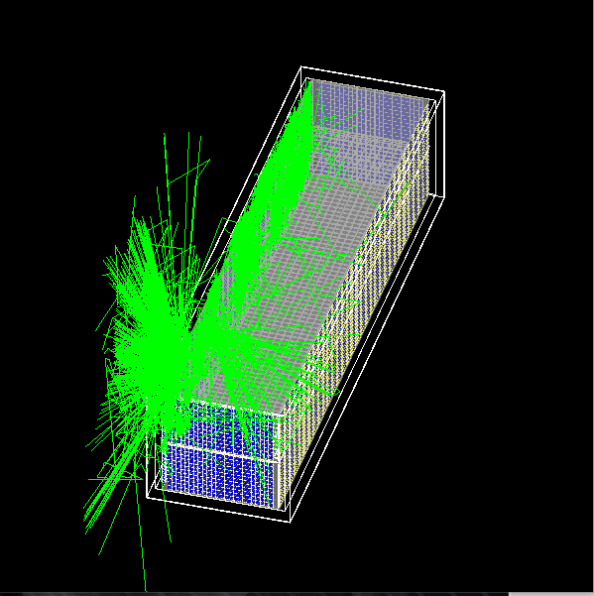
Low-Background Light Sensors
DUNE Phase 2 options converging on increased light collection to allow lower energy threshold
Baseline option is combined light sensor (xARAPUCA) and field cage
No measurement of xARAPUCA radioactive background contributions at all so far
PNNL Plan: Make complete evaluation of Phase 2 xARAPUCA backgrounds, to impact and refine the design
See DUNE FD3 Mini-Workshop (https://indico.fnal.gov/event/59908/) June 2023
APEX background light simulations by Eric and Carlos Moreno

Slide 5
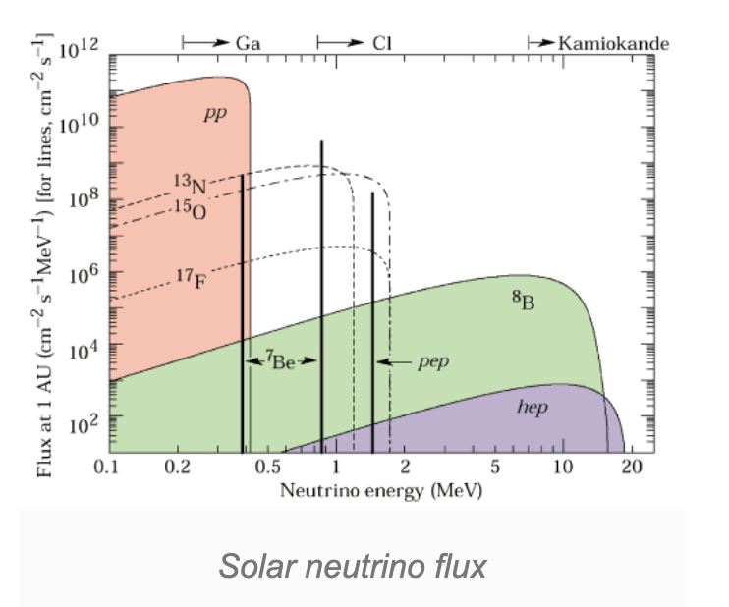
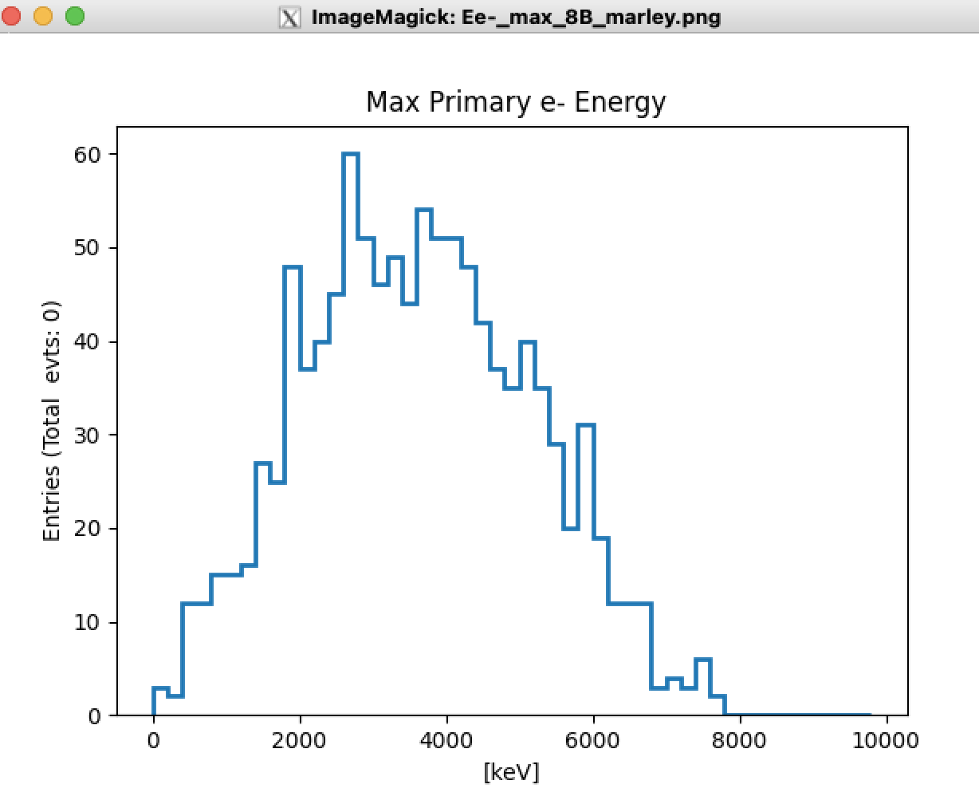
⁸B events: a study in APEX
This is a nice low energy “calibration source”
Wide, low energy distribution from a couple MeV up to 10 MeV deposited
neutrons from three sources
Cold cryostat steel
Warm cryostat steel
Cavern neutrons
True deposited energy

Slide 6
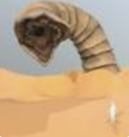
Need the Detector Light Response at all voxels
Simulation in standalone sndwrm package (simulation of a neutrino detector with radiopure materials) – github.com/echurch/sndwrm/tree/APEX
These are slices along z, the beam direction. Each (0.5 m)^3 voxel shows the light detected for photons launched from that voxel.
These 3 slides shown at Santa Fe
collaboration mtg
and previous APEX mtgs

Slide 7
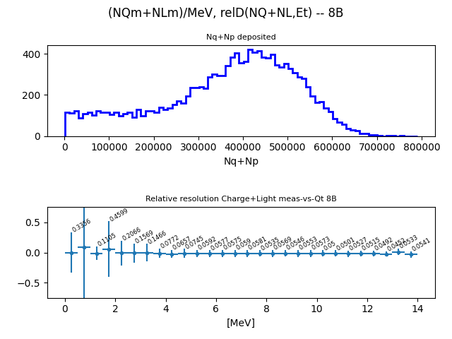
Q+L
Q+L
Q + L energy resolution
About 5.7% at 8 MeV.
True deposited energy

Slide 8
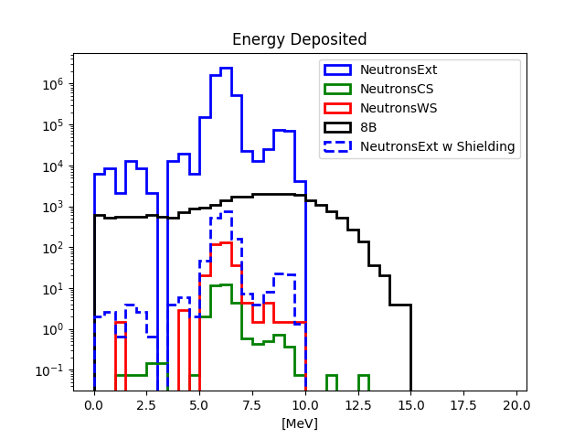
Deposited ⁸B and n-bkgds energy from Q+L
The blue peaks are the 6.1 and 8.4 MeV n-capture peaks off ⁴⁰Ar and ³⁶Ar. It is in our interest to keep them sharply defined.
Rn and γ bkgds shown in boxes for cartoon estimate

Slide 10
Background Modeling
different simulation effort:
This is the
NEXT-White
bgd model plot as an example.
DUNE will want to do the equivalent of this with early Phase I data
DUNE Currently:
Background model developed by SDSMT, et al.
Representative simulations of small detector slices are scaled to produce background estimates.
No database that holds the model
an example: the NEXT experiment

Slide 11
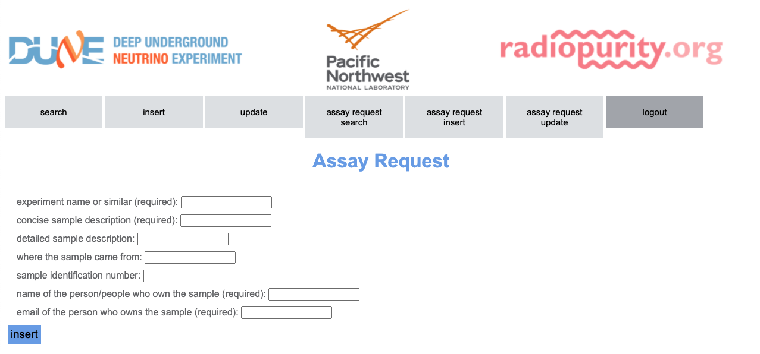
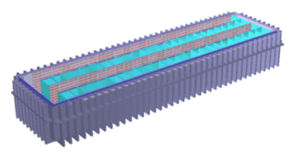
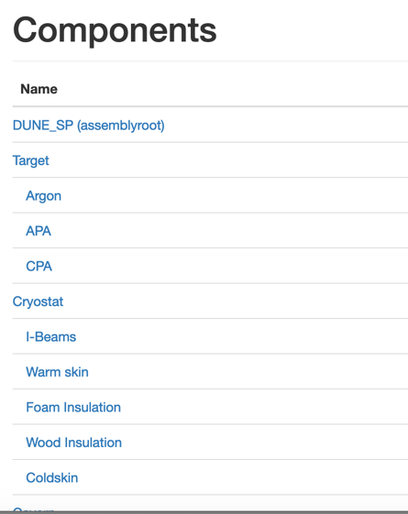
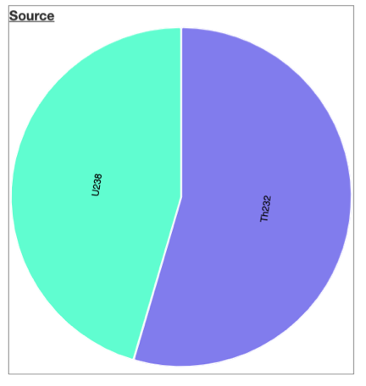
Integrated Background Control / Assay Mgmt
GEANT4 radioactive background simulations
Material assay framework
DUNE Currently:
Disparate background tools
BackgroundExplorer:
Provides a systematic and integrated background control toolkit
Tabulates/displays results
Background model must be adjusted during production to respond to assays
Background triage
and assessment
Material selection and physics sensitivities

Slide 12
Now, simulation to build a background model
Here, we want to use LArSoft to populate BackgroundExplorer
In order that we can use the same geometry the collaboration uses
And eventually for the use of a full reconstruction
sndwrm is not as appropriate here
For BgdExplorer we will just be interested in energy deposits
Start with Phase I: HD, then VD
Gleb Sinev at SDSMT and I have done a lot of this
for HD
for neutrons only so far: from cryostat, rock, shotcrete, concrete
Automation of the fcl scripts and running is needed
Geometries (gdml files)
Full HD (exists!), VD, partial geometries
Then, full APEX
…

Slide 13
Building the gdml’s
Viktor Pec is largely responsible for this heroic work
Uses cumbersome, time-consuming,error-prone perl scripts
From the 2010 era. A scripting language nobody uses anymore in the real world and your grad student should not learn it.
Brett Viren’s GeGeDe is a python tool
Which Gleb, Aaron Borkum, Pierre Lesorak have used
And that many of us think is the way forward
An HD GGD-built geometry is in use now by some of us
Many geometries eventually need to be built
Including the full VD, APEX, 2x7x14, 1x6x8 ….
We had a first meeting 2 weeks ago with
myself, Xin Qian, Christopher Jackson, Brett, Viktor, Gleb
Stay tuned
Offer your student’s help!

Slide 14
Timeline

Slide 15
Summary
sndwrm simulations for studies (APEX, SLoMo, other Phase II modules)
solar ⁸B sensitivities, for example
LArSoft simulations in various geometries to populate BackgroundExplorer
To build the background model to prepare for data
To make convincing case for Low Energy Physics prospects for Module 3
Effort ongoing to exploit GGD to make those geometries

Slide 16
Backup

Slide 17
Module 4 -- SLoMo
Sanford Low background Module – going to the low background extreme

Slide 18
SLoMo Properties
VD in all respects, including PoF!, with following changes
Outer water shielding
Radiopure steel, etc
UAr
~20% SiPM coverage
Heavily fiducialize events
Interior structure
Optically hermetic acrylic box
Perhaps allows to confine UAr to smaller volume (2 Ar circulation systems)
Not necessary to be acrylic
Something to hold WLS panels w SiPM modules
At PNNL, we have put this to the side for the moment

