Slide 1
Accelerator Division All Hands
Summer Shutdown Summary
Tony Busch
AD Shutdown Coordinator
Planning & Integration Department

Slide 2
ShutCo to Runco
Switchover from ShutCo to RunCo
  Transitioning into operational mode happened on
    Friday November 8th @ 00:01 hrs.
  Runco’s (2nd Tour)
    George Deinlein
    Jason Crnkovic

Slide 3
Shutdown 2024
Our Original Shutdown parameters were:
Duration: 10 weeks
Many coordinators and managers were very helpful in getting a schedule together that was viable for the 10 week timeframe.
Due to the Kautz Road transformer fire and other issues ie… Main Injector heat exchangers, we were extended several weeks.

Slide 4
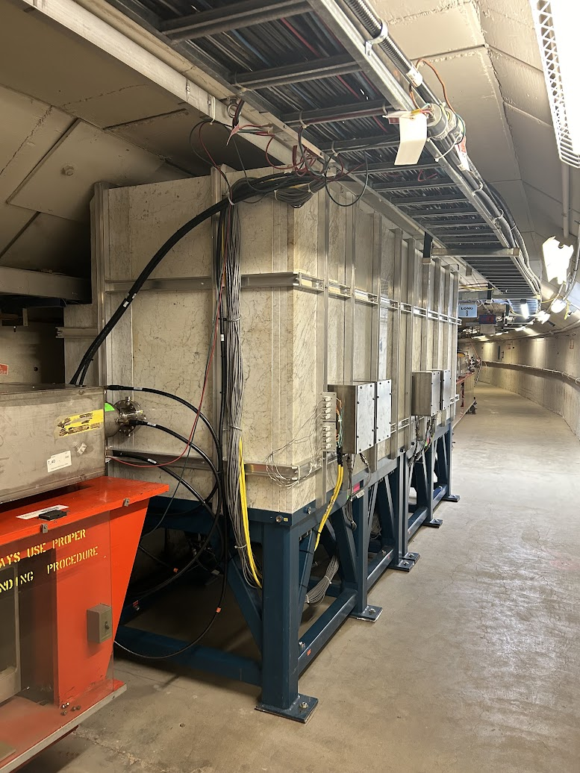
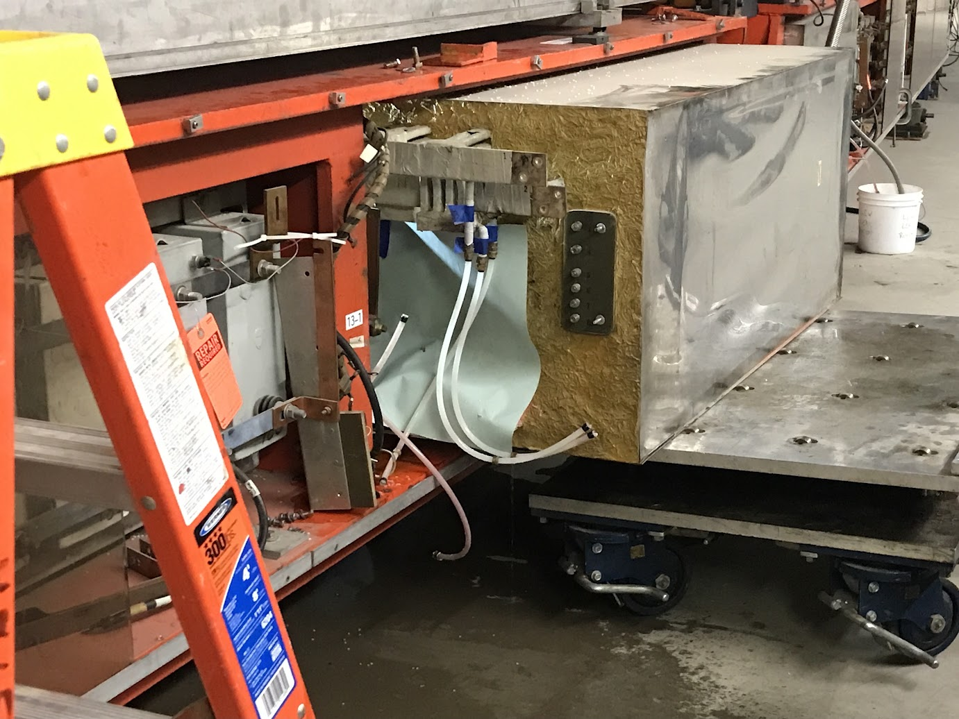
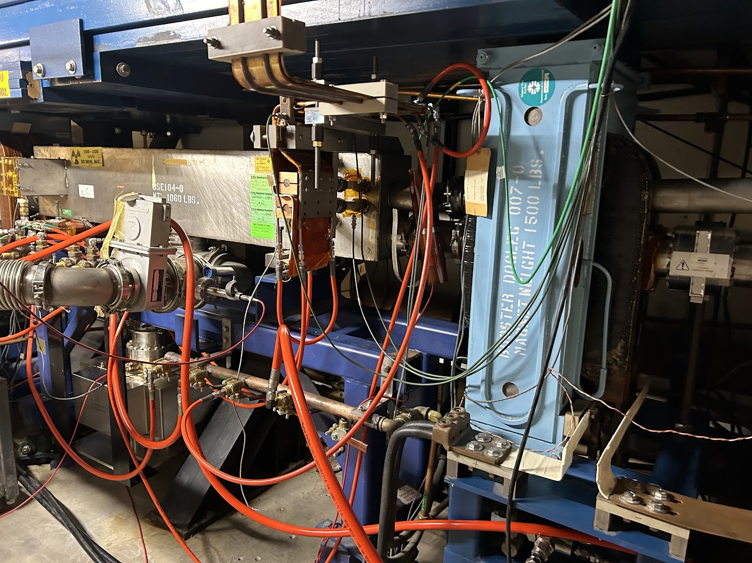
Booster Shutdown Work
Two girder chokes refurbished.
MP03 extraction septa manifold LCW leak repair and hose replacement.
New Collimator installed.
Major effort, Booster, MSD, Controls, Iron Workers, Instrumentation, Alignment, & Safety.

Slide 5
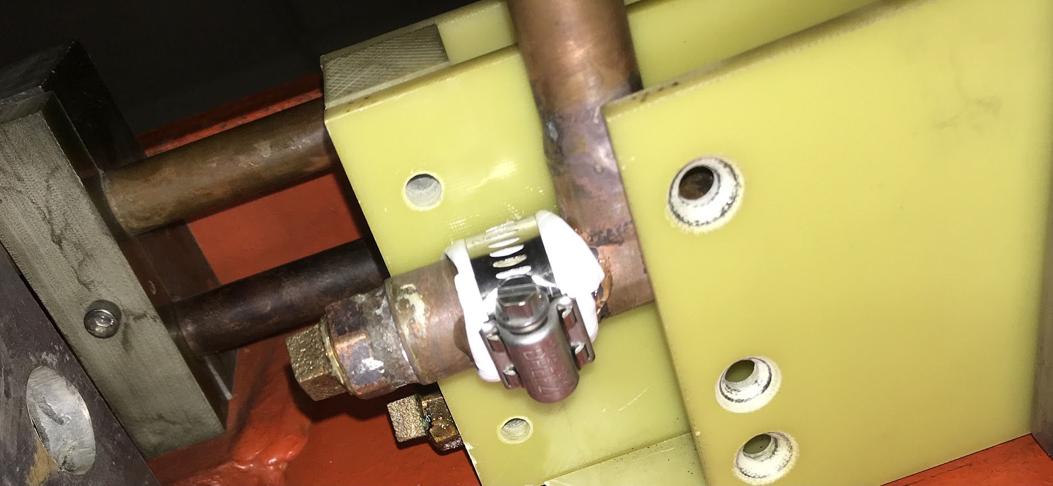
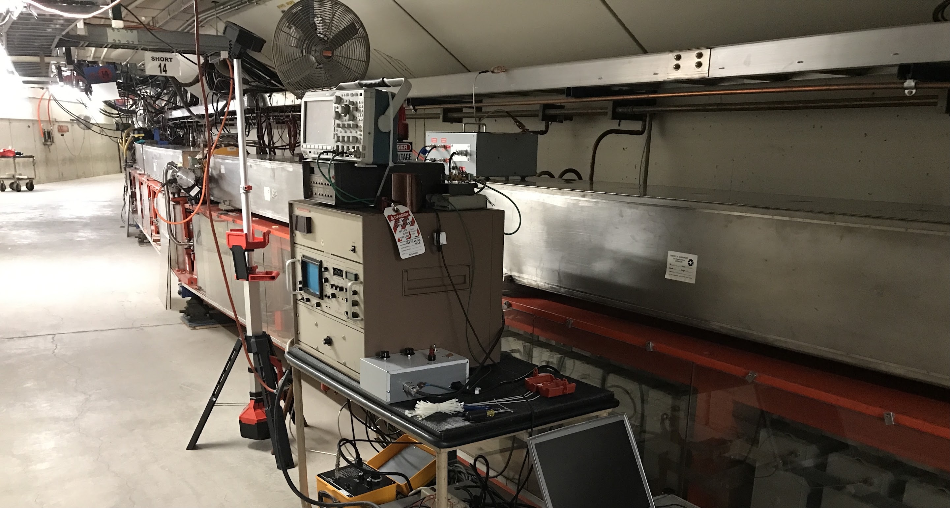
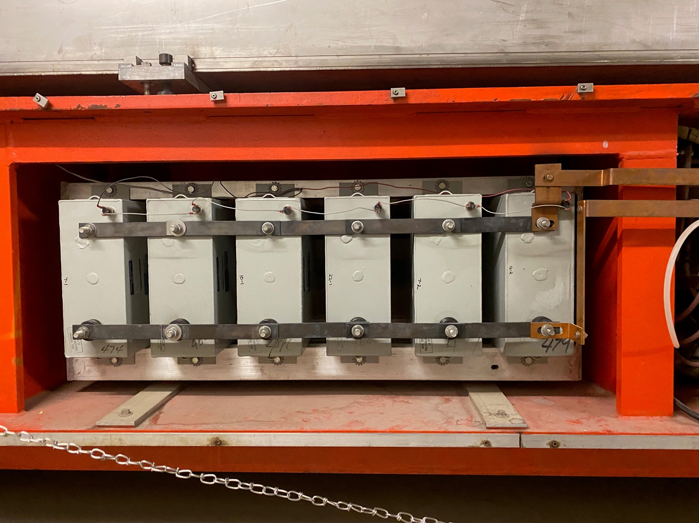
Booster Shutdown Work
Operational gradient magnet corona testing. Part of planning for 20 Hz running with PIPII.
P2-2 girder manifold LCW leak patch. Extremely difficult area to work behind girder.
P6 HRA replaced bad girder capacitors.

Slide 6
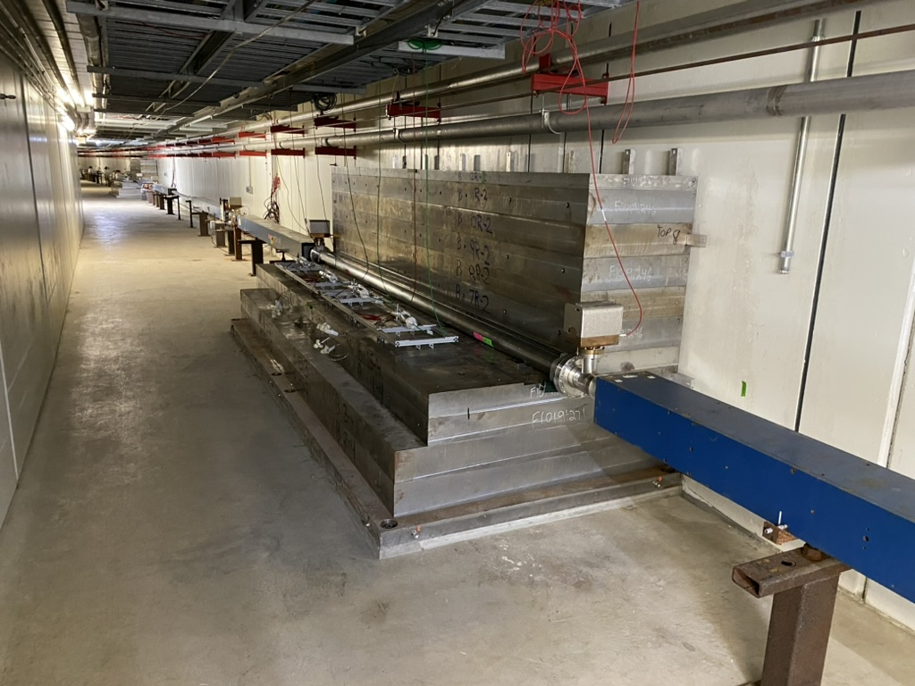
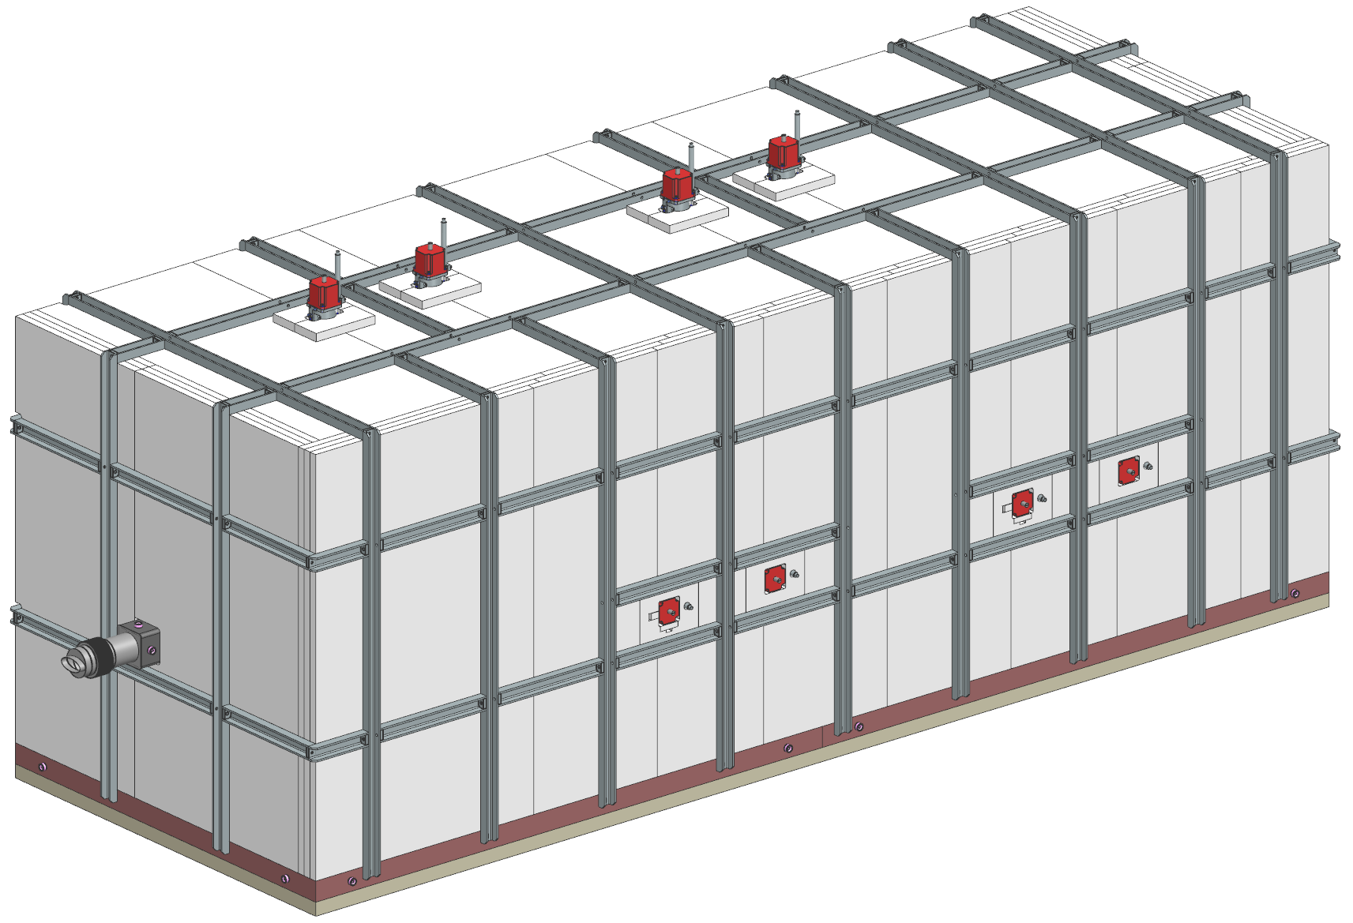
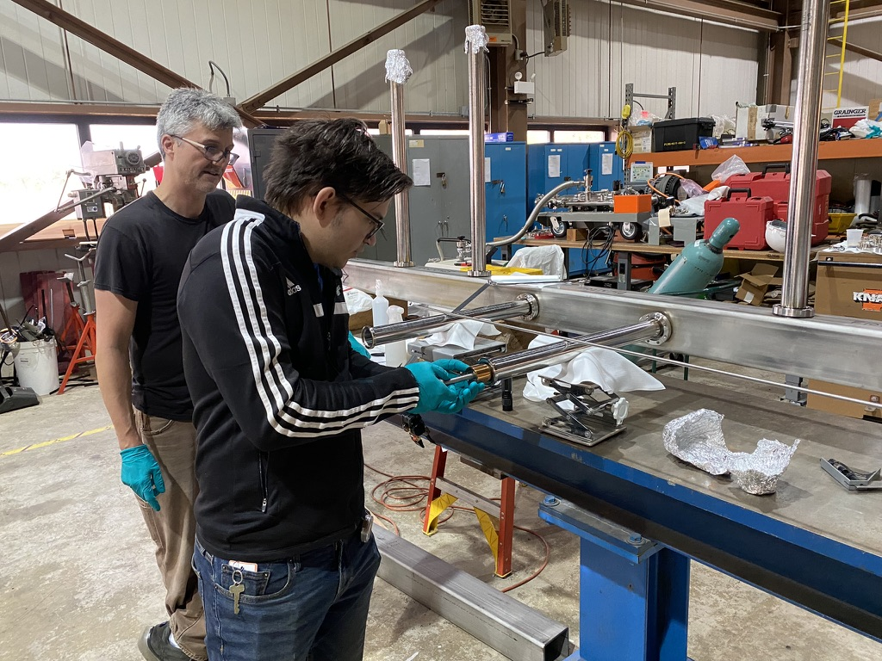
Main Injector 8 Gev Collimators
2 Collimators
  825-826 and 827-828
Weight per collimator station: ~175,000 lbs. (88 tons)
  Installation is ~75% complete. Vacuum chambers are assembled and ready to install during the next shutdown. The 8 GeV line is reassembled and ready for operations.
  Collimator installation will be completed during shutdown 2025.
  Fully assembled jaws and vacuum chambers for both 825 and 827

Slide 7
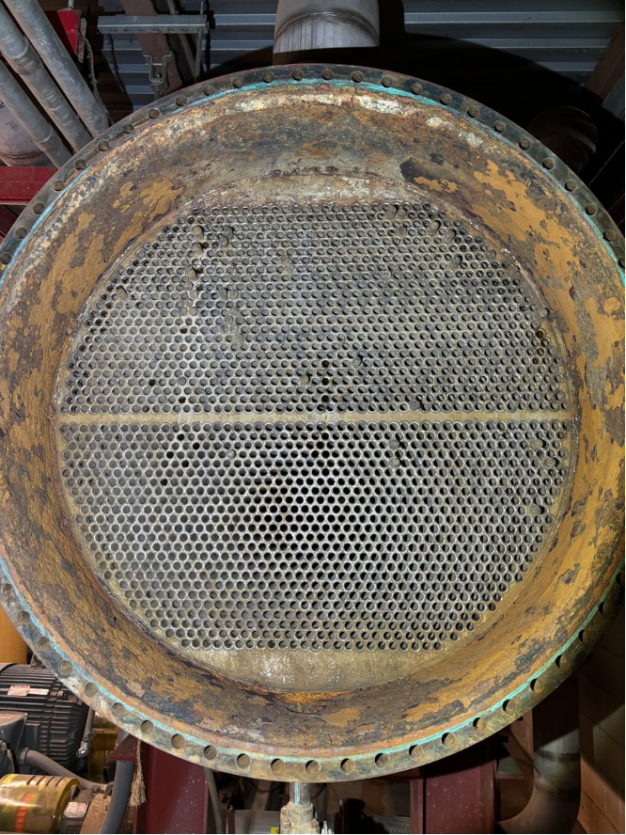
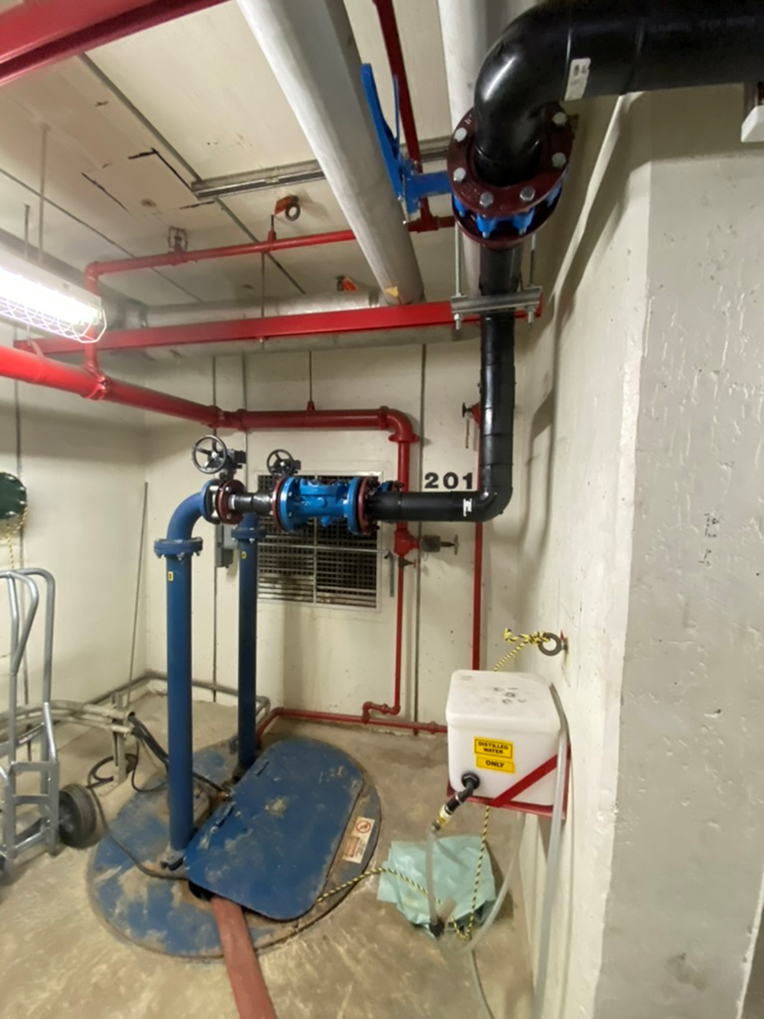
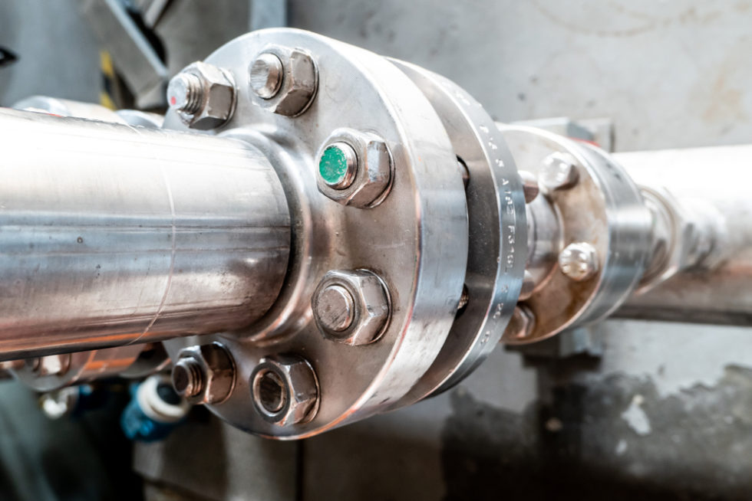

Main Injector shutdown work
MI 201 and 218 Sump Discharge Repairs. Replaced with HDPE.
Main Injector heat exchangers have corrosion issues. All heat exchangers are being evaluated for use.
All MI LCW Pump Discharge Gaskets were replaced over a 2 week period.

Slide 8
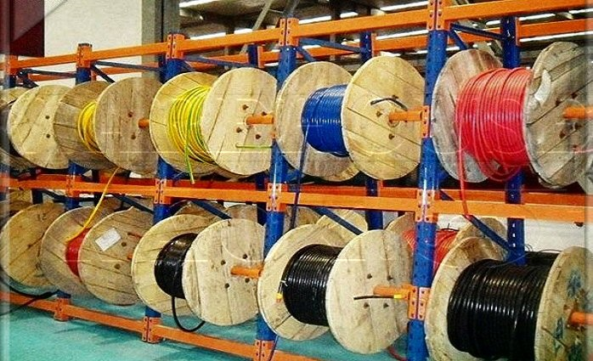
Electrical work/ upgrades
Dual PA’s at MI 60 for PIP2.
8 GeV and Booster collimators. The Controls group contributed work on both Booster and 8 GeV controllers.
Upper and lower dipole at MI 20.
Numerous other pulls.
17 miles worth of cable pulled.

Slide 9
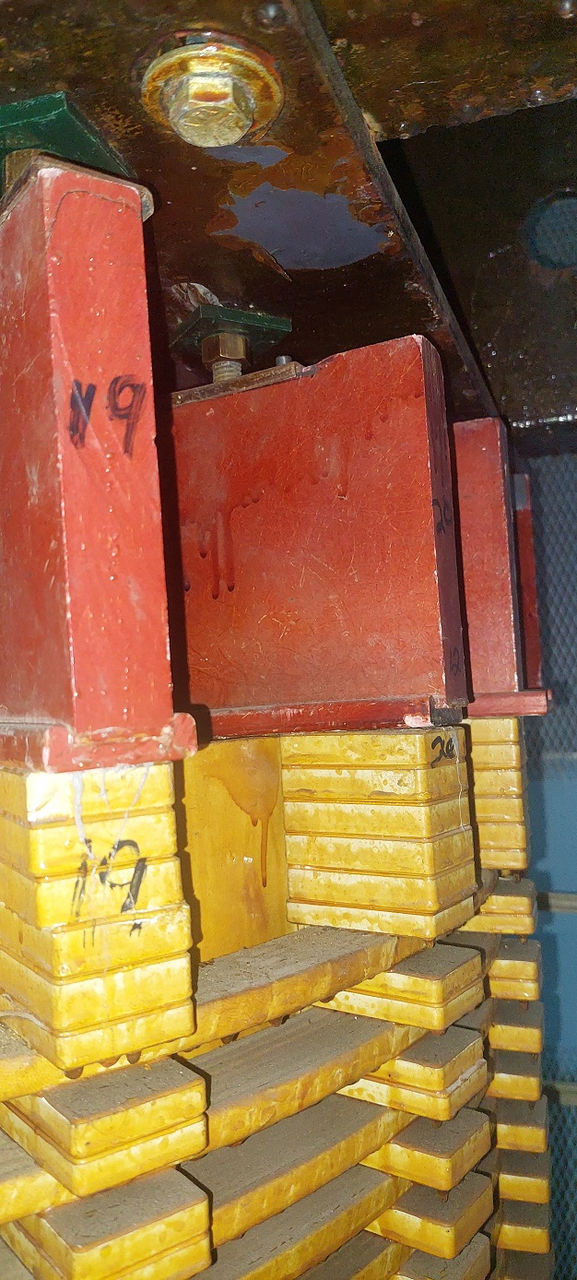
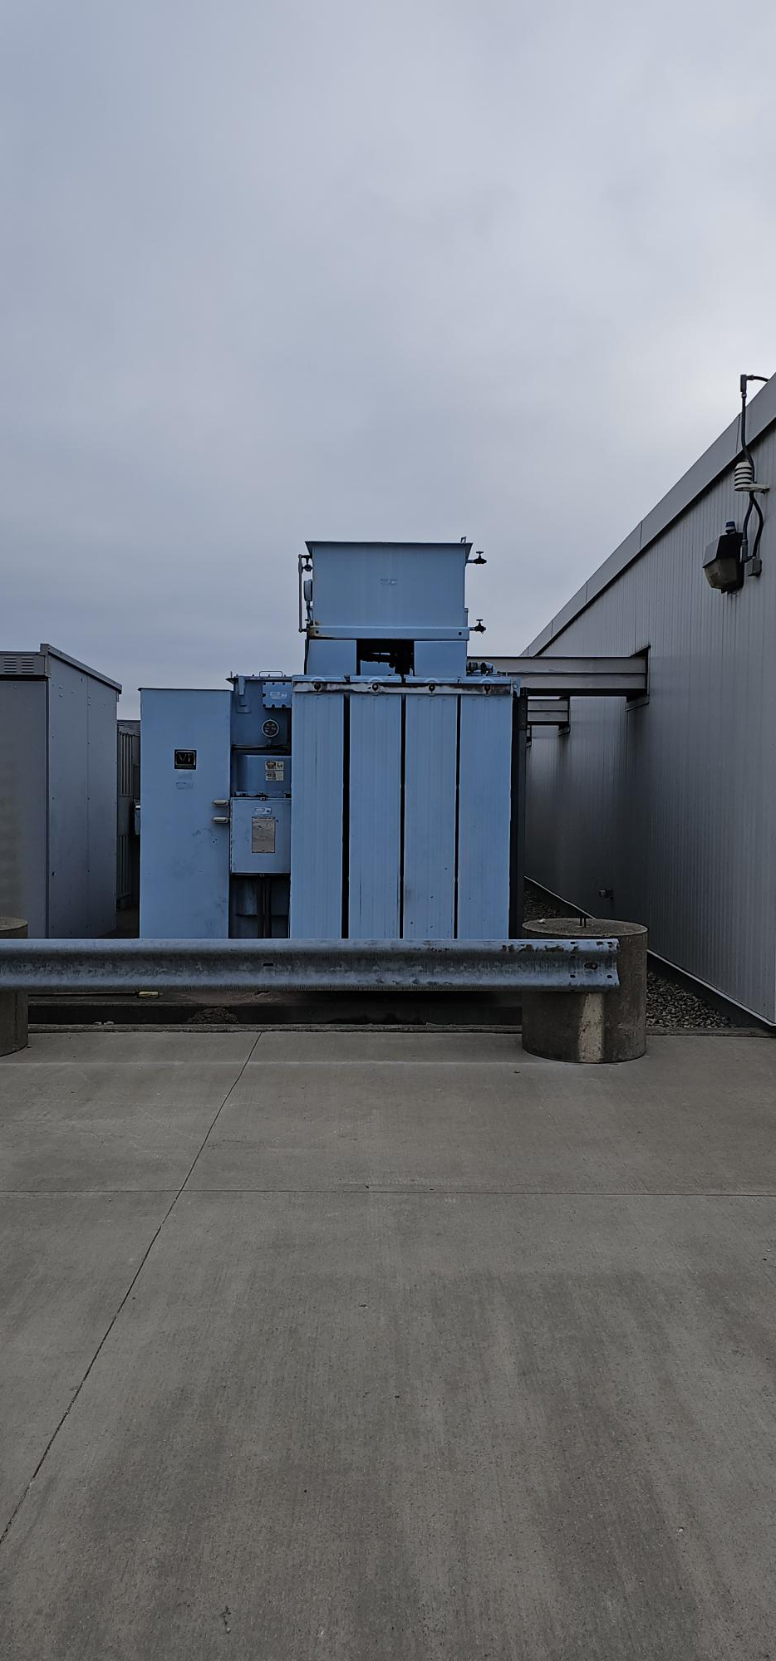
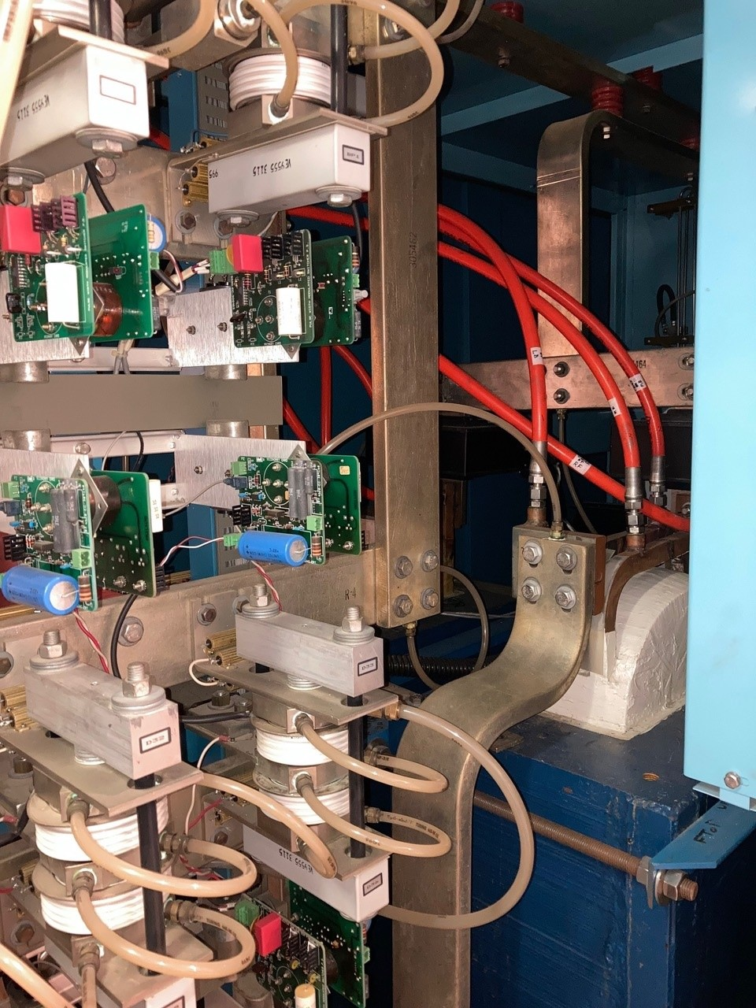
Power Electronics Systems Department
SEL-751 over current relay installation.
Transformer secondary cable replacement for MI-20 Lower & Upper.
Add filter cap bleeder resistors to support faster rep rate.
Add high-temp lugs to dipole supplies to support faster rep rate
Controls electrolytic cap replacement for MP02/MP03/ORBUMP
I:Q847 commissioning
Added 480V test points in multiple power supplies and disconnects across the accelerator complex to help support the absence of voltage verification.

Slide 10
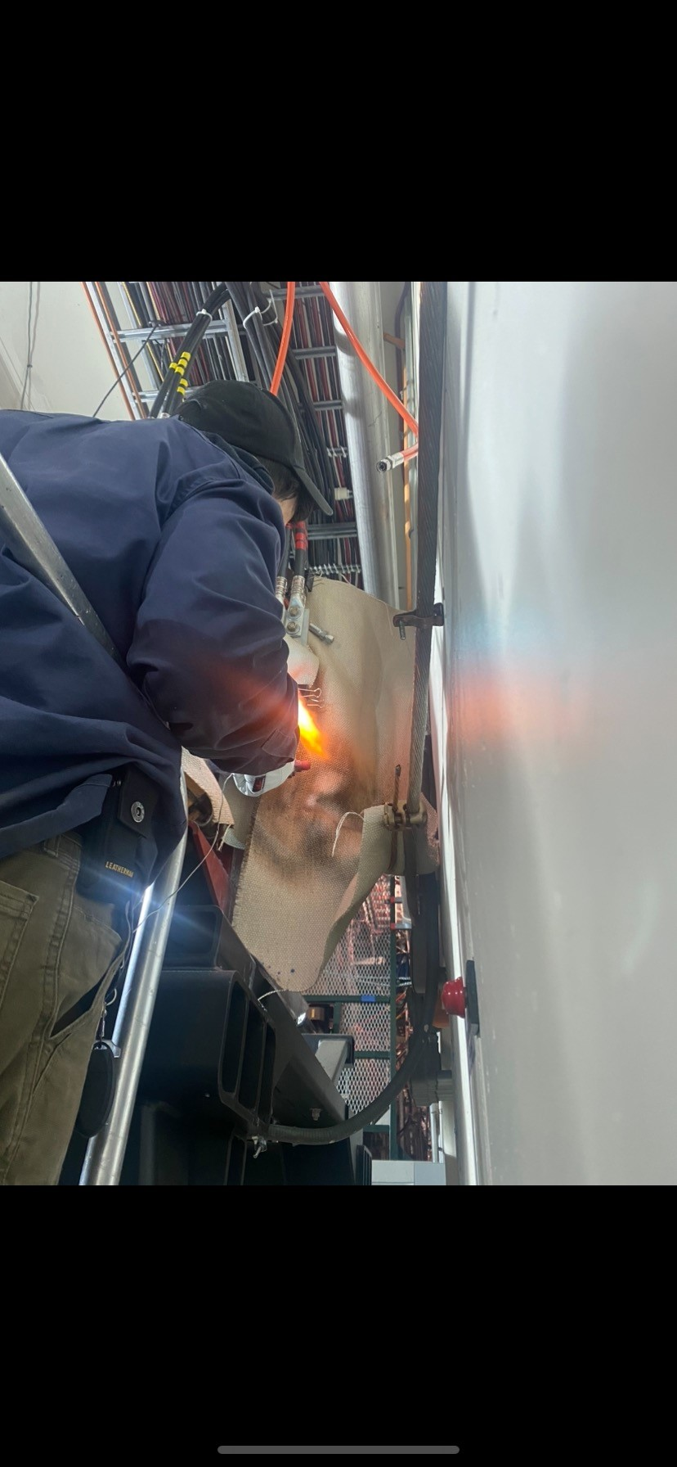


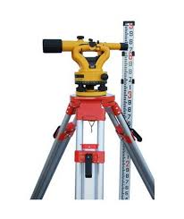

Shutdown work support
Infrastructure Services
APSTD Accelerator support crew
Alignment And Metrology
ES&H safety officers and radiation safety

Slide 11
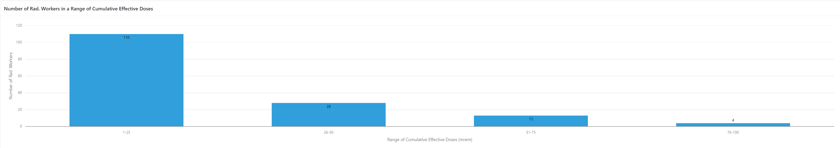
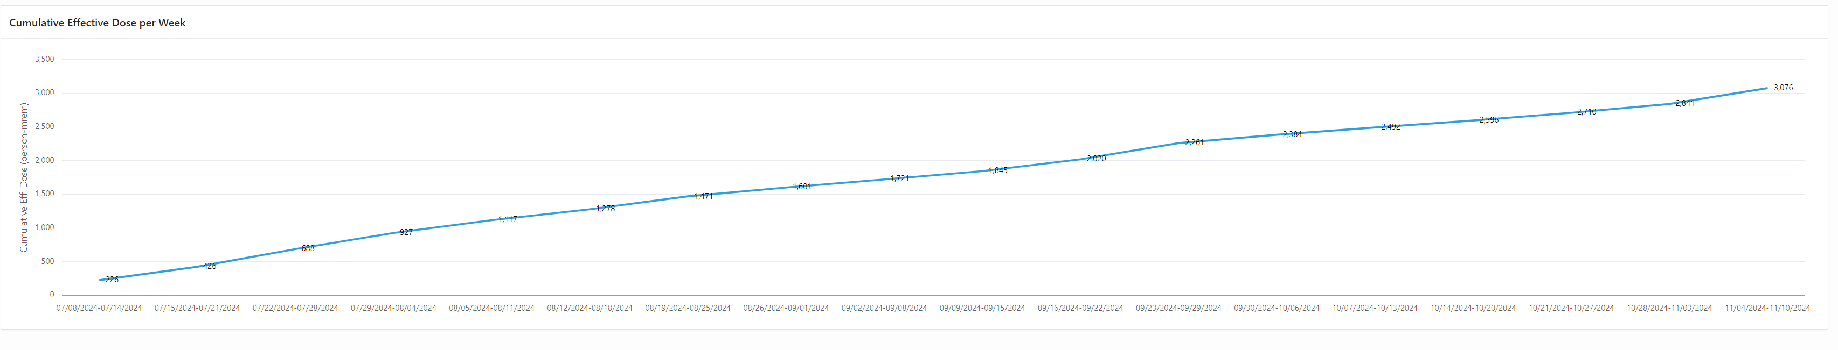
Shutdown work dose received
Estimated dose 3161 person mrem
Actual dose 3076 person mrem
Alignment And Metrology

Slide 12
Safety Record for the past 2 shutdowns
  Total Number of Injuries during shutdown periods (the past 2 shutdowns).
                0 !!
  This number is attributed to your hard work and attention to detail. Accidents can happen, but working safely is not an accident.
12/4/2024
Busch | All Hands Shutdown 2024

Slide 13
Schedule completion and shutdown summary
    We had ~ 650 jobs/tasks listed on the schedule.
    83% of the jobs were completed.
      Power outages 85% were completed.
        5 outages were deferred until next year. (all accelerator outages were completed)
    Radioactive/ Hazardous waste disposal one of the top priorities.
      Booster has shipped 8 drums, 6 skids, and one 4x4 box.
      Main Injector three 4x4 boxes.
      We know there is more waste for disposal and there will be more to come.
    Next year we will be allotted 10 weeks for shutdown work. Current planned date is 7/14/25.

Slide 14
Schedule completion and shutdown summary
    Lessons learned
      Di bottle. A bottle was delivered that was not properly assembled at the manufacturing facility. A process to test the bottles moving forward has been developed.
      There was an HRA/ Contamination area entry that was not properly monitored. Future jobs in an HRA/ Contamination area will have a full job brief/ debrief.
      Proactive waste disposal. We have been working with the RSO and updating our tasks to ensure that the waste stream disposal timelines will improve.
    Meetings will be starting on January 14^{th@} 1100 to start planning the next shutdown and work schedule.
      We need to stay ahead of known issues such as procurement and delivery dates that keep slipping.
        Previous shutdowns all work was ready to go for the first 4 weeks of the shutdown prior to work starting. Work needs to be properly queued.
        Our ability to pivot on jobs during this shutdown was reduced due to the availability of parts and equipment.

Slide 15
Thank you all for your help and dedication.

