Slide 1
Mu2e report
Greg Rakness (FNAL)
Friday 9am AD meeting
06-Dec-2024
https://indico.fnal.gov/event/67294/

Slide 2
Sundry stuff at Mu2e
Continuing leak detection of TSd Feedbox + transfer line + solenoid
This is a long winding volume at 10^{–10} torr, which is hard to do
Electricians working…
for beam enclosures at MC2
(Mu2e experiment is in Muon Campus building #2)
for full flow purifier at MC1
(Muon g–2 experiment was in Muon Campus building #1)
Coordinating with ISD for replacement of Automatic Transfer Switch (for backup power) at MC1
Note: cryo plant + air compressor for MC2 is at MC1
Coordinating work in Production Solenoid area
Pour Extinction monitor collimator filter concrete
Install Production Solenoid on stand and install Heat & Radiation Shield
Installed toe clamps to hold external stands in place
To prevent movements in case they get accidentally bumped

Slide 3
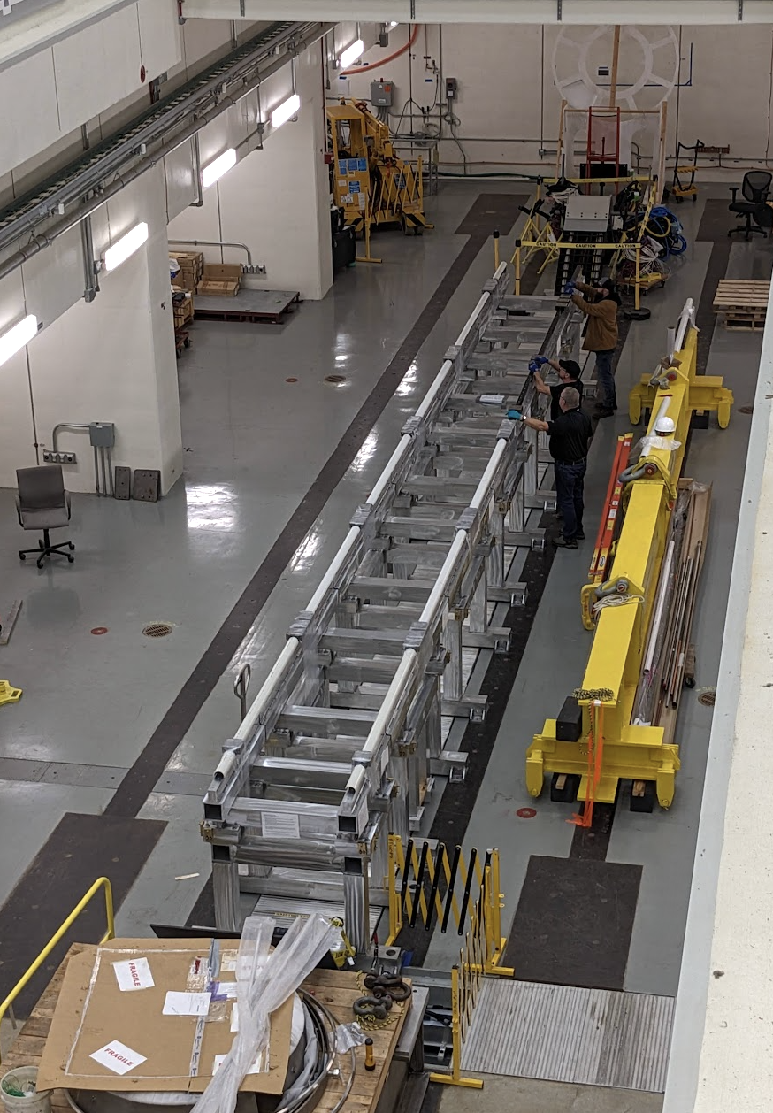
Detector Solenoid Endcap arrived at Mu2e
Endcap comprised of
Vacuum Pump Spool Piece
For pumping insulating vacuum & muon beamline
Instrumentation Feedthrough Bulkhead
For cables and optical fibers for detector train
Was like this
Vacuum Pump Spool Piece (VPSP)
Stopping Target + proton absorbers
Detector Solenoid
Tracker
Instrument Feedthrough Bulkhead (IFB)
Calorimeter
External Stands
Muon Beam Stop

Slide 4
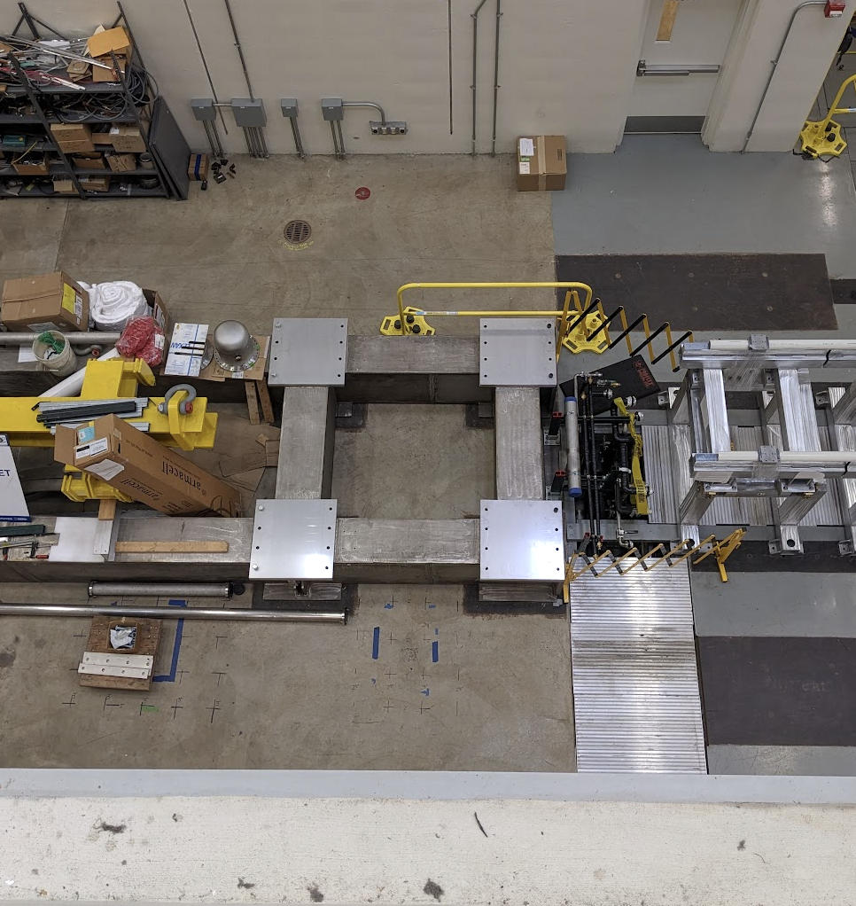
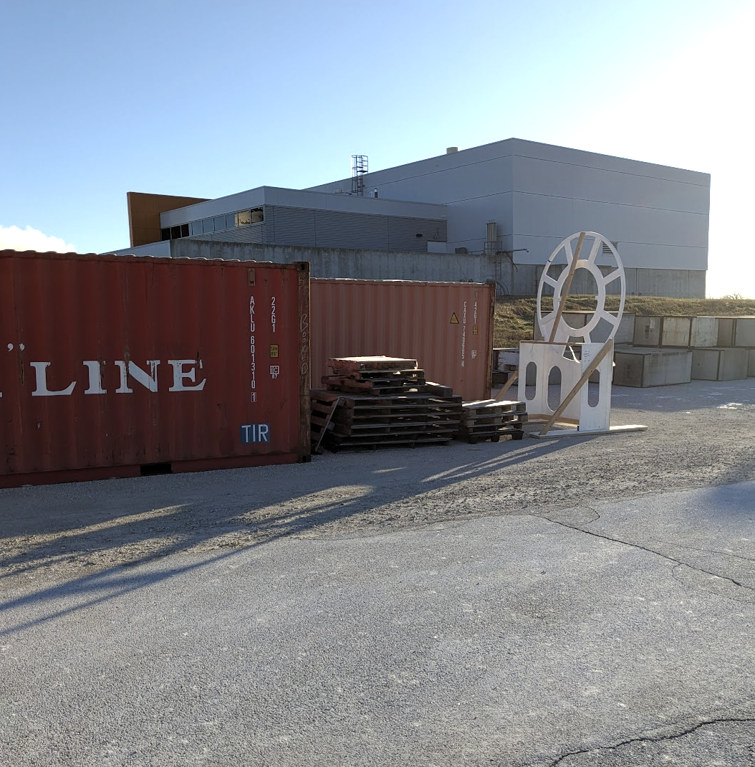
Prep work
Move IFB wooden mock-up outside
Clear stand for VPSP

Slide 5
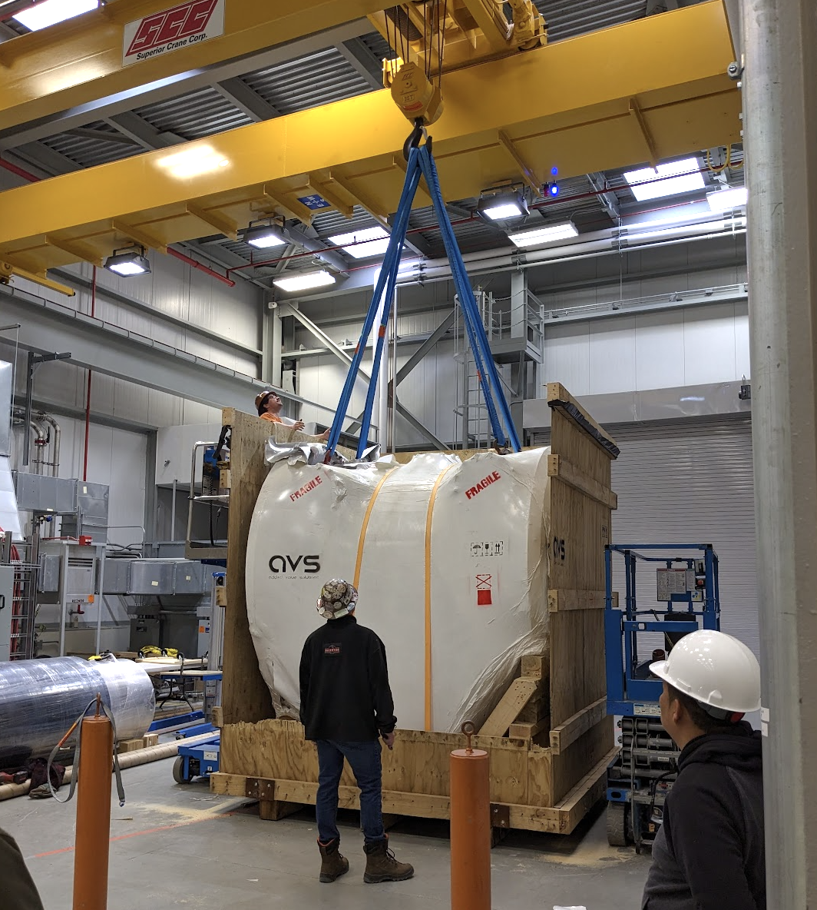
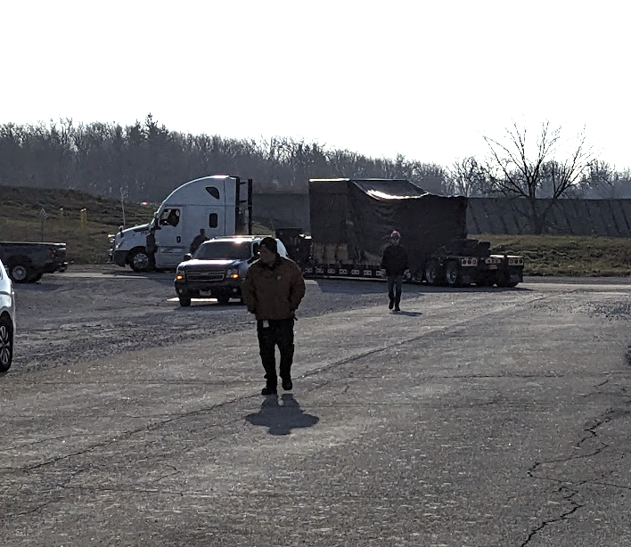
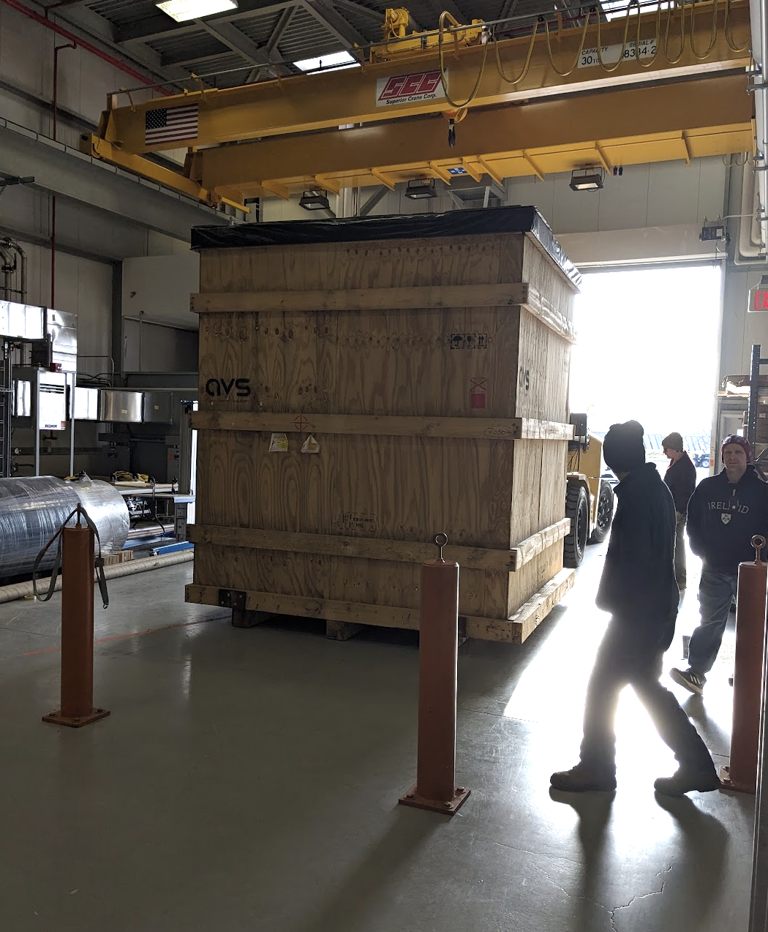
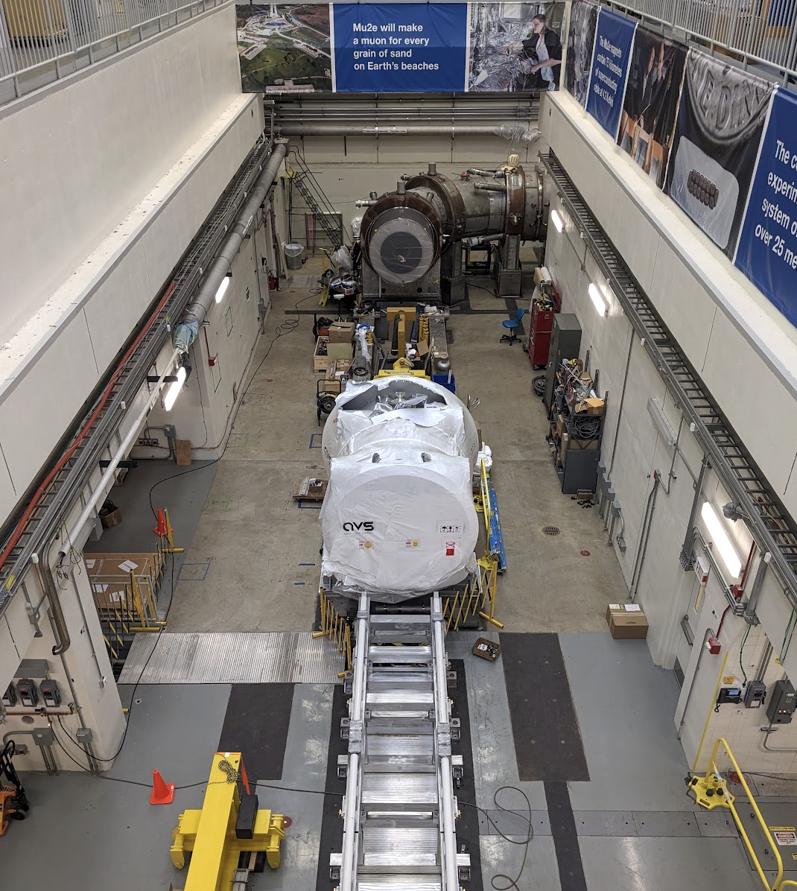
Step by step (1/2)
3. Pick it up
1. Here comes the truck
4. Put it down
2. Bring VPSP into the high bay

Slide 6
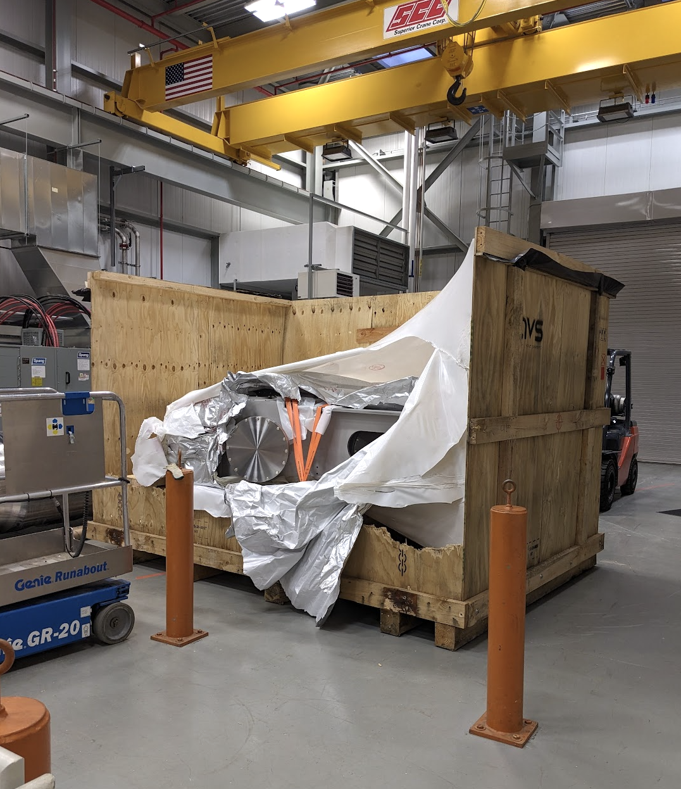
Step by step (2/2)
5. Bring IFB into the high bay for staging
6. (to be done) receive hillman rollers, move around external stands, bring IFB downstairs…

