Slide 1
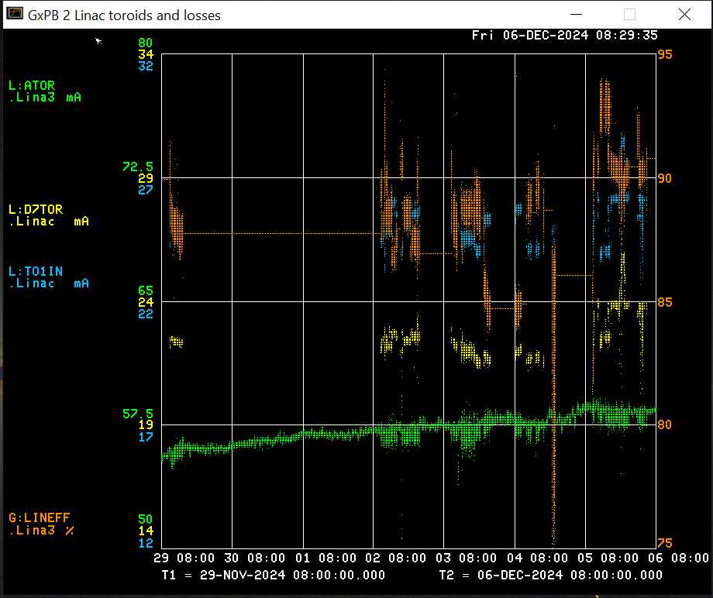
Linac Operations Report
Tuesday
Klystron waveguide compressor air dryer leak
DM attempted to fix, but parts are needed for repair
Dryer valved out for now, running on backup dryer for now
Thursday
LRF4 trip during DI bottle change
RF water skid tripped causing filament to turn off
Marx PLC required a power cycle
Station recovered in < 2 hours
KRF2 Sol #2 PS failed
PS replaced within the hour
Beam output: Source: 57.8 mA
TO1IN: 25.5mA
D7TOR: 23.5 mA
Efficiency: 92 %
HEP beam for Booster studies/tuning
Bunch Length Detector studies

