Slide 1
Project Activities for MSD
Mayling Wong-Squires
AD Operations Friday 9am Meeting
6 December 2024

Slide 2
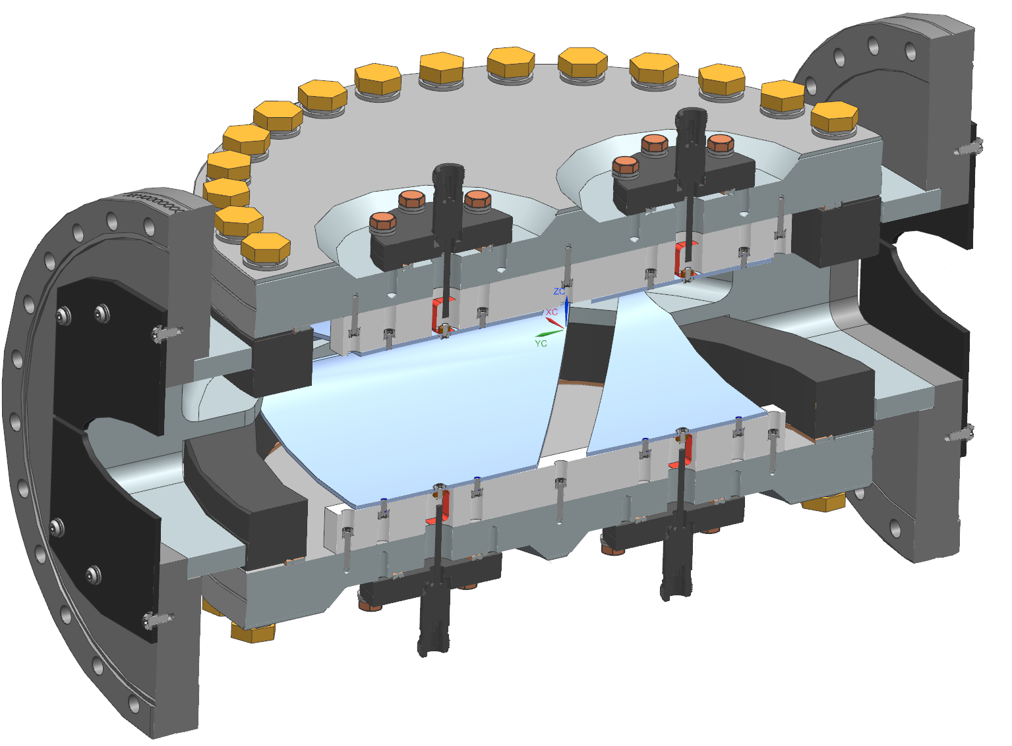
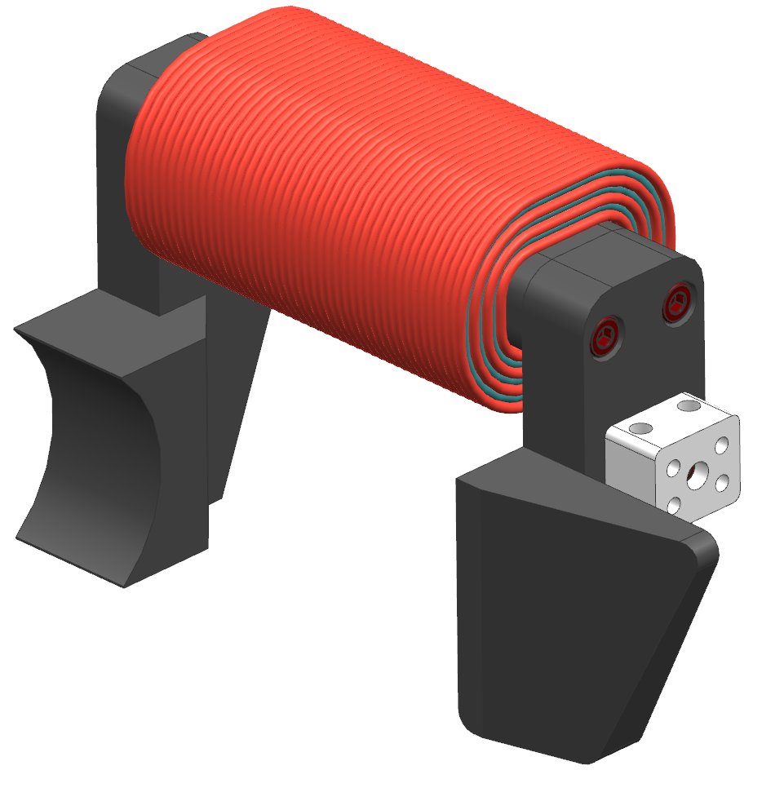
PIP-II Instrumentation Update Dakota Krokosz, Amadon Faul, Eric Pirtle
Type-N Feedthroughs
Scraper Plates
Wirescanners
MEBT actuators have arrived. Still waiting on a few machined components.
Bidding period for the BTL and diagnostic cart linear actuators closes on 12/10/2024
Emittance Scanners
LEBT construction delayed due to machined parts being late.
Currently installing a second limit switch for home position.
Dry assembly of the MEBT AES is in progress. Currently waiting for the brazing of the faraday cup to be complete.
Working with controls to setup a designated test stand for verification and acceptance of all actuators. Parts should be available for this by mid February.
Diagnostic Cart
Procurement on-going.
BPM’s
Mechanical development of the model / concept for the elliptical shoebox split plane BPM is in progress.
Received re-work of the prototype buttons from SST. Still seeing quality issues on the welded electrodes.
Testing of the 2” BPM continues.
Laserwire
Quotes for magnet came back high. Looking at options of producing them at FNAL.
Bidding period on vacuum chambers has closed. Currently evaluating bids.
Elliptical Split Planes
Shoebox / Split plane BPM Concept Model
Coils
Yoke
PIP-II Laserwire Magnet

