Slide 1
0900 AD Shutdown Scheduling Meeting
Marty Murphy
06 Dec. 2024

Slide 2
Current Status
Demonstration of beam to BNB on Wednesday before Thanksgiving.
MI LCW
BNB cooling problem solved (next slide). Thanks to MSD, OPS, ESH & everyone else not mentioned here who pitched in. This was a team effort!
Will need heat exchangers to establish beam to Muon Campus.
MI-201 sump pump discharge frozen with ice plug twice since Wednesday. Will need help from ISD to move forward.
MI-30 straight section (HRA) alignment jobs are moving forward w/ increased work planning; should wrap next week.
MI-307 interlock box repaired.
MI Power
MI-10 house safety disconnect was having issues opening/closing. Ops reported it up the chain and inspection revealed it needed to be replaced. That work has started today with a 2-3 day estimate. No beam to BNB until this is complete.
AD continues to work with ISD to determine the best configuration for powering beam lines and to adjust LOTO procedures as needed.

Slide 3
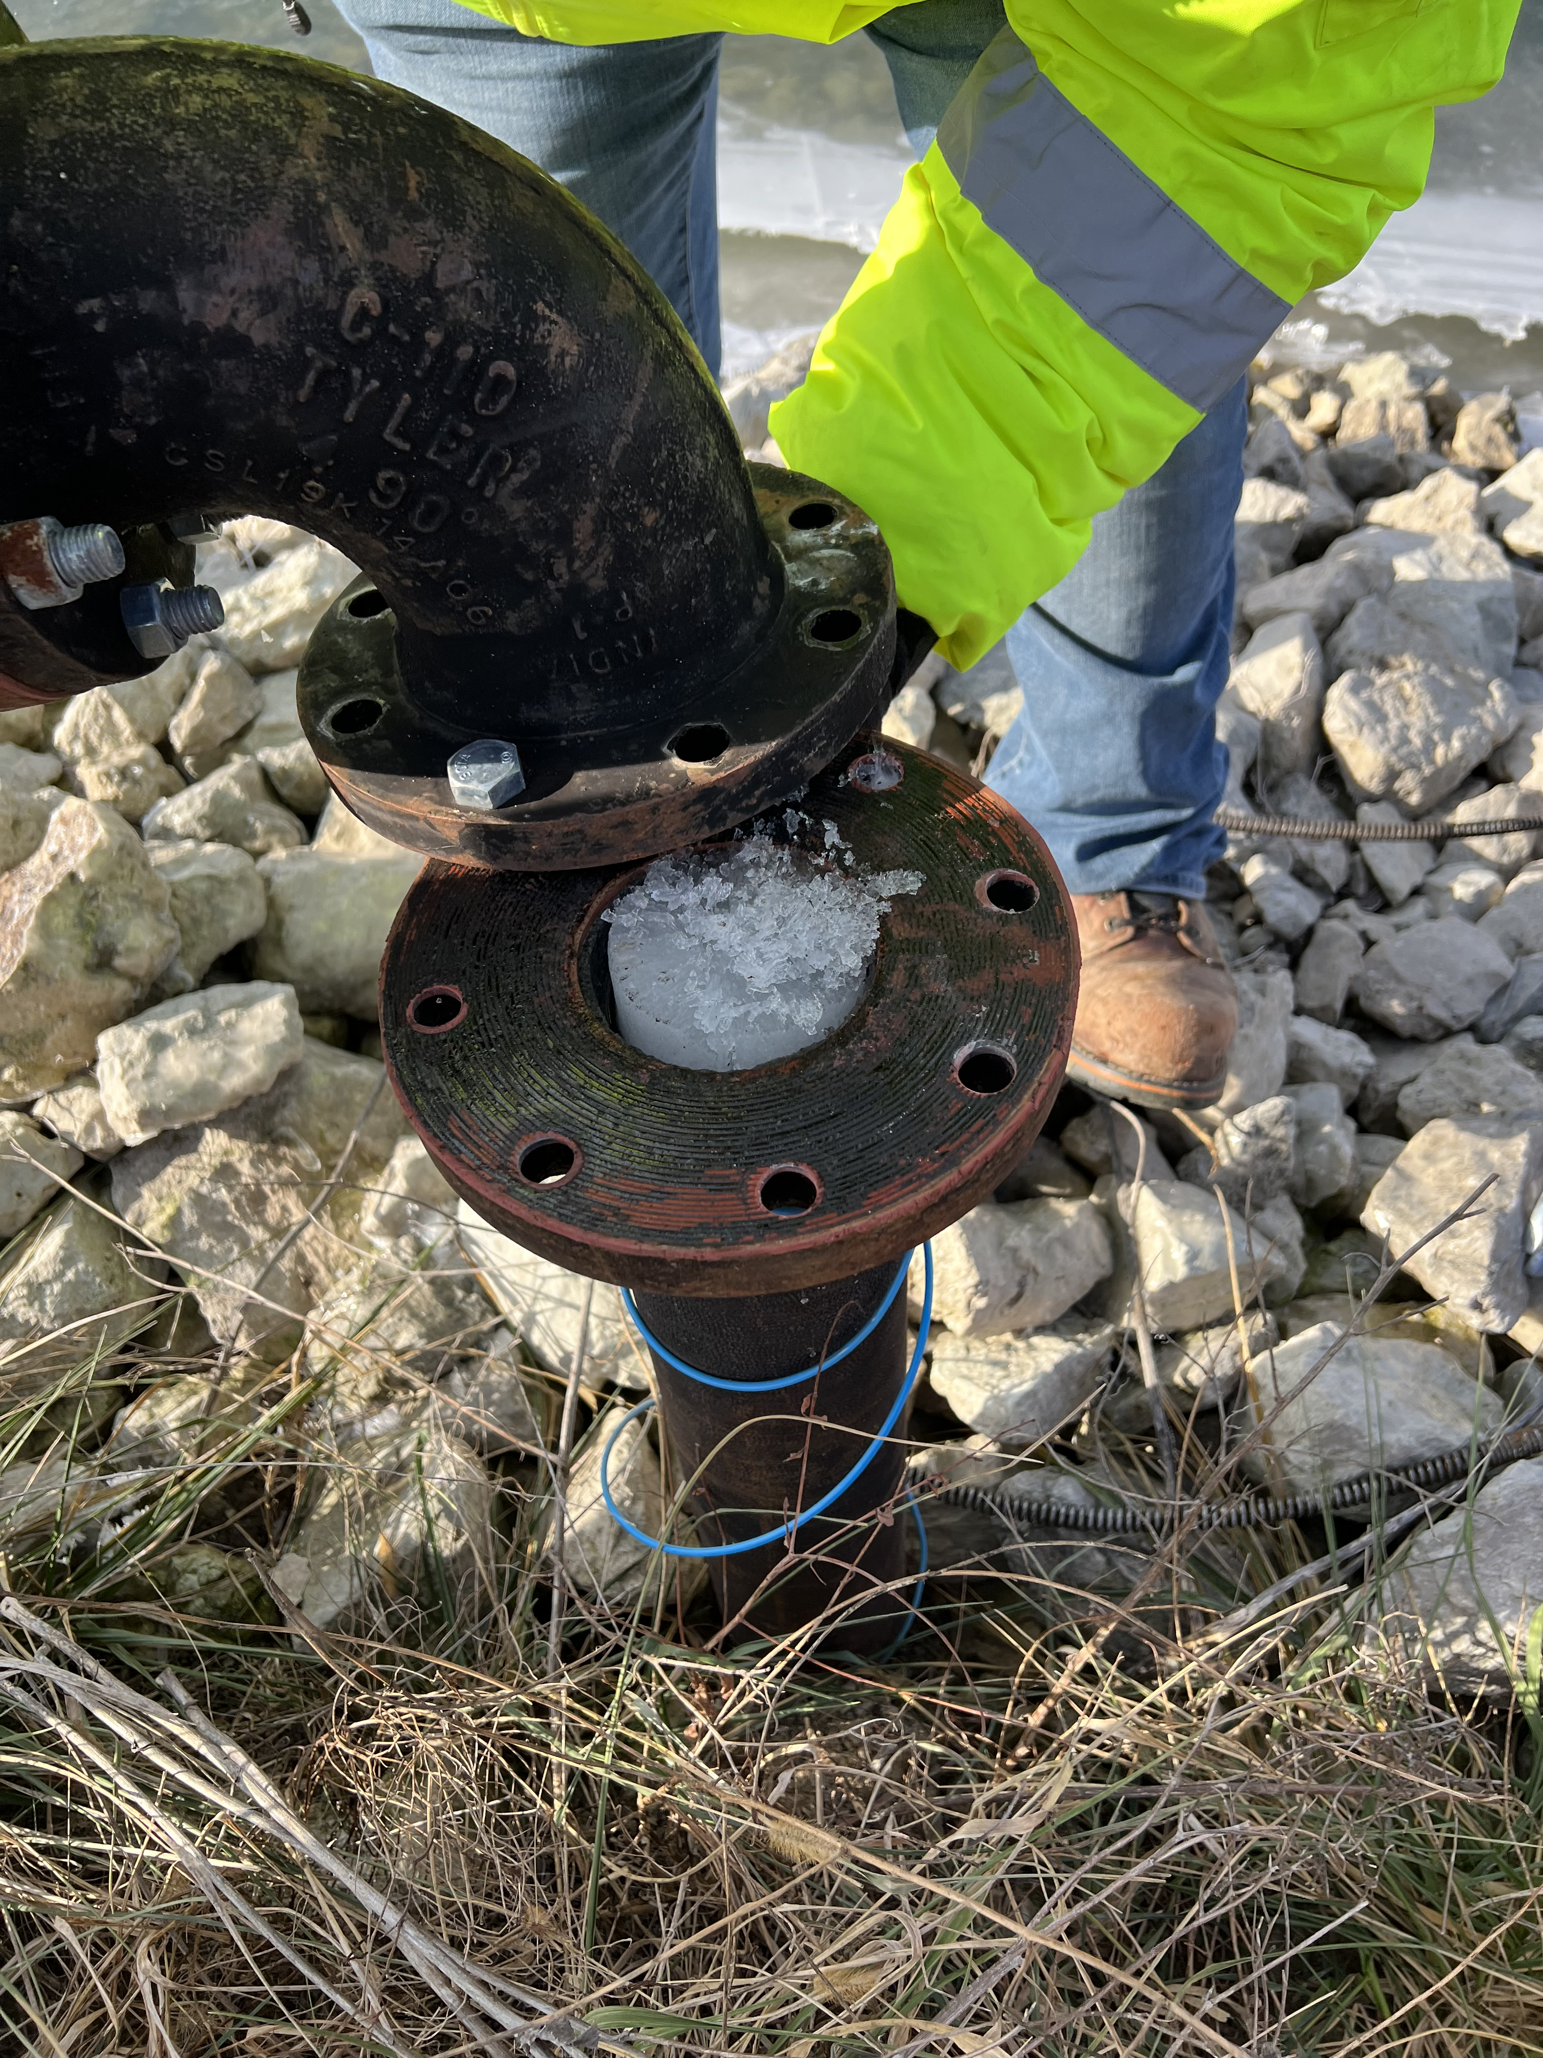
MI-201 Ice Plug

Slide 4
Before
MI-30
MI-20
BNB
MI-10

Slide 5
After MI-10 & MI-20 LCW off, MI-30 to MI-10 magnets mostly valved out
MI-30
MI-20
BNB
MI-10

Slide 6
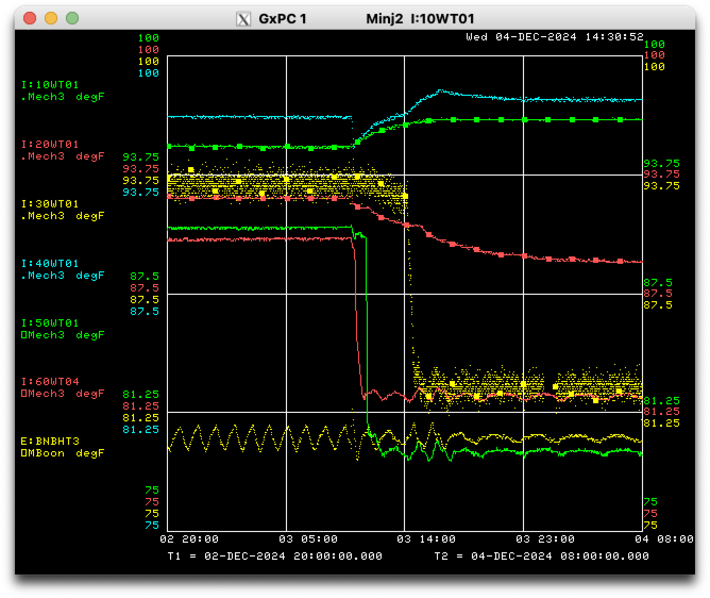
MI LCW Temperature after reconfiguration

Slide 7
Plan:
For Beam to BNB:
Deliver beam to BNB once MI-10 electrical work is complete, early next week.
For Everything Else:
Dual PA testing of MIRF continues on day shift.
Complete magnet moves in 30-straight section.
Resolve the freeze issue with the MI-201 sump pump discharge line.
Note: The MI-418 sump discharge line needs to be replaced due to a leak (summer ‘25).

