Slide 1
Muon Campus Shutdown Report
Jim Morgan
Friday 09:00 Ops Meeting
December 6, 2024

Slide 2
Muon Campus status
Electrostatic Septum ESS2 installation and new stand check-out for both septa
ESS vacuum good enough to begin high voltage conditioning
Periodic vacuum “burps” went away when adjacent vacuum pumped down
Motion-control check-out began on ESS1 & ESS2, modifying limit switch brackets
Q205 rad hard quadrupole and modified vacuum pipe installation
Vacuum connections made and pump-down started just before Thanksgiving
Vacuum leak discovered Monday; seal replaced to fix it
Water manifold union has leak, TD experts to investigate today
Domestic water line repair north of AP-0 and over MI-8 Line
Berm integrity has been confirmed after repairs and documented
Muon Campus safety system testing on Tuesday
Ops secured Muon tunnel enclosures on Sunday
Muon LCW resistivity improved when two fresh DI bottles installed
Numerous LCW leaks have been repaired
Large leak on Q406 valved out by Ops on 11/22
F-27 water skid has issues that require further investigation
Working with controls on BPM application program modifications
Also, BPM tests to check out system
AP-0 A/C work remains paused
Study – M1-M3 Optics
Study – Alternative M5 optics

Slide 3
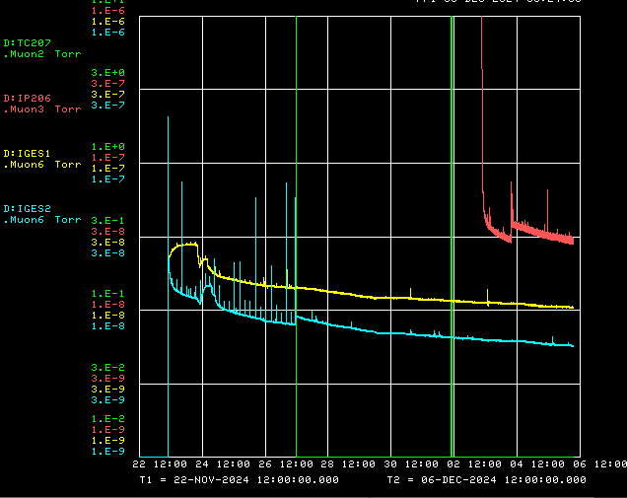
ESS and Q205 region vacuum pump-down
Initial Q205 region
pump-down
Q205 region pump-down
after seal repair
Turbo valved out
206 ion pump
ESS1 Ion Gauge
ESS2 Ion Gauge
207 thermocouple

Slide 4
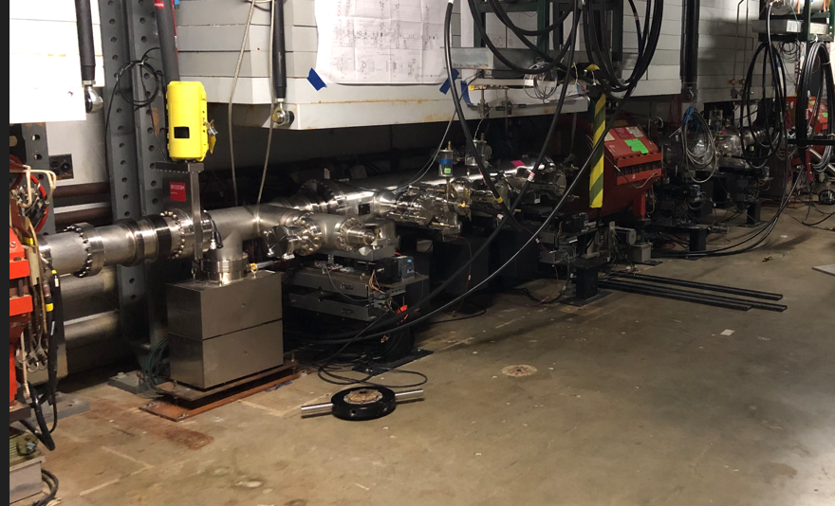
Boundary between ESS and Q205 area vacuum
BVH203
ESS area vacuum
Q205 area vacuum
ESS1
IP203
ESS2
Q204

Slide 5
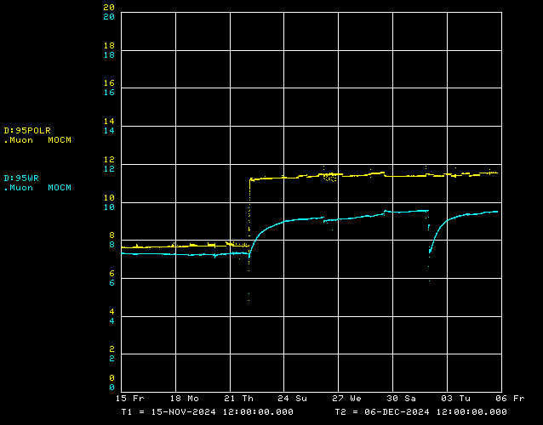
Muon LCW conductivity improvement
Two fresh DI bottles
Q205 valved in
Polish conductivity
LCW conductivity

Slide 6
Upcoming work
Tunnel work is largely completed
Install new limit switch hardware for horizontal motion on ESS1 & ESS2
Q205 union leak will hopefully get fixed today
A few remaining small LCW leaks
Need to do final walk-through of Delivery Ring
ESS2 High Voltage Conditioning to start soon
Need safety system testing signed off to get electrical permit
Other upcoming work
Continue ESS1 & ESS2 motion-control check-out and limit switch modifications
Repair Kirk Key hardware on disconnects, requires more modifications to disconnect
Replace several power supply circuit breakers and some primary wiring
Prepare to install Mu2e Extinction Monitor Collimator in Absorber area
M4 Final Focus vacuum installation, A/C dipole installation
Preparing for beam operation
Work towards power supply check-out and preparations for beam
Hope that upstream accelerators can deliver beam when we’re ready
Concerned that PIP-II construction could impact beam operation in January

