Slide 1
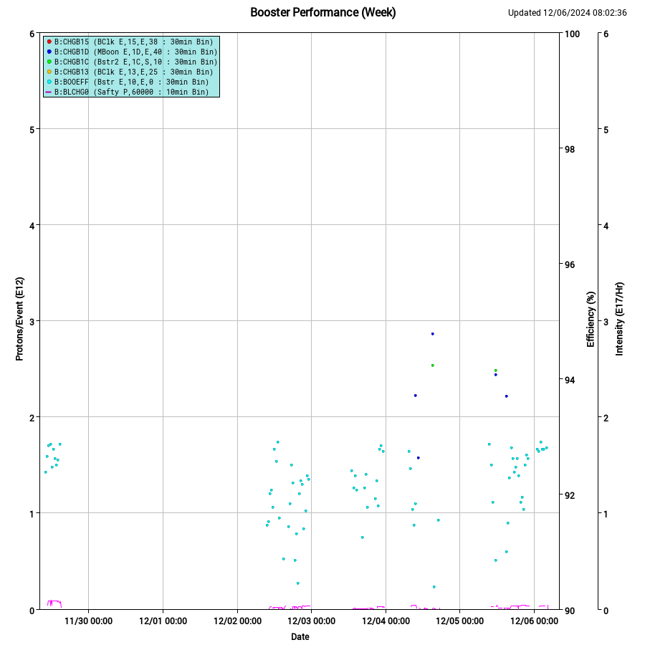
Booster Summary
BRF13 bias supply replaced with BS from BRF14
B25 application crashing, while using snapshot function
Aperture scans
Flat injection studies
Digital LLRF studies Wed, Thurs
Increased West side P12 sump activity persists since Tues.
Planning collimator shielding validation study on the 14th
E4R 15Hz gradient magnet measurements
MI8BND ground fault trips – need PESD to investigate

