Slide 1
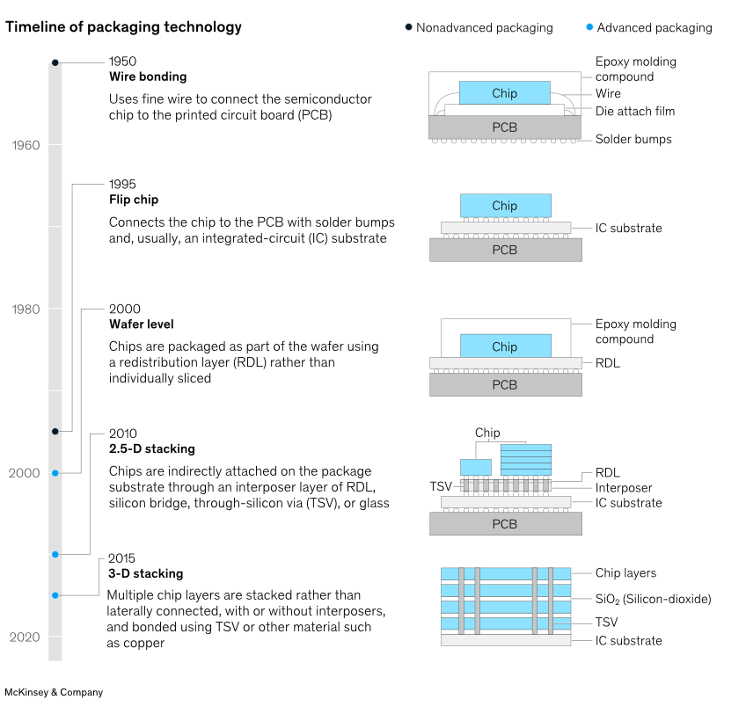
Interconnects
R. Lipton
Fermilab/RL Physics Consulting

Slide 2
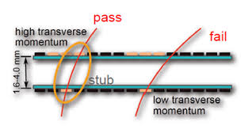
Much of modern detector design and construction is an exercise in large scale electronics packaging.
Fine pitch interconnect
Unusual topologies
Local data transmission
Moderate distance data transmission
Low mass supports and cooling
With considerations of
Signal/noise
Power
Data rates
Local trigger and processing
Geometry and information flow
… Most is this is based on 10-year old work on ILC,
muon collider and CMS
CMS PS module – data from top strip sensor
must flow to bottom bump bonded pixel chip
Power on left, I/O on right.
Folded fine pitch Kapton substate

Slide 3
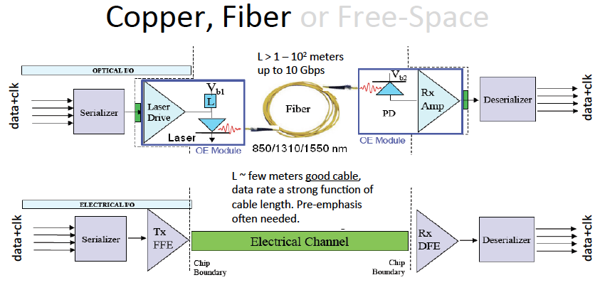
Data Transmission Considerations
Power: Optical links – current technology
  20 pj/bit (~ lpGBT) -> 1-10 pj/bit
  10->100 Gbit/sec per interconnect
  ~ 2pj/bit 25GB/sec demonstrated
  But needs to be rad hard
Copper – mostly on-chip
P ~ switching rate x Voltage x Capacitance
Bandwidth ~ Capacitance
Reduce interconnect capacitance and length
Shorter interconnects
Smaller features.
Where does the data need to go
On device trigger (CMS track trigger)
On device AI?
Off-detector bandwidth and rate

Slide 4
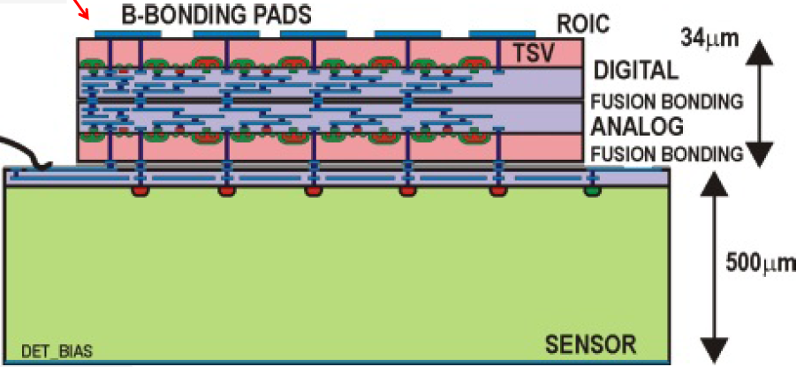
3D/Hybrid bonding
A three-dimensional integrated circuit (3D-IC) structure is composed of two or more layers of active electronic components using horizontal intra-tier and vertical inter-tier connectivity. Component Technologies
Through Silicon Vias (TSV): small diameter vertical connectivity - not only to build chips but also for attaching detectors to readouts
Bonding: Oxide-, polymer-, metal-, or adhesive
  Wafer-Wafer, Chip-Wafer or Chip-Chip
Wafer thinning
Back-side processing: metallization and patterning
<3 micron interconnect pitch
Low interconnect capacitance
Heterogeneous bonding
First Three-tier demonstration for HEP in by FNAL/Ziptronix/Tezzaron in
~2011
This is now core technology for camera image sensors. Being
implemented in a wide variety of foundries.
Issues include – Availability (but at MIT-LL, Sandia, Novati …)
TSV insertion (TSV mass, via last geometry, Yield)
Cost
FNAL 3D chip to wafer bonds

Slide 5
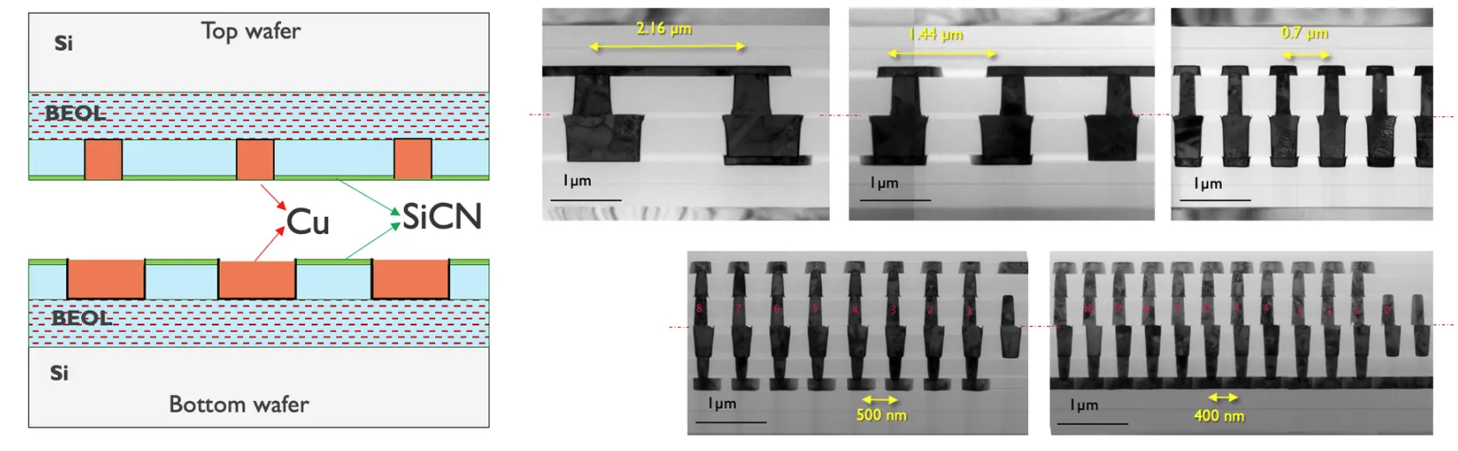
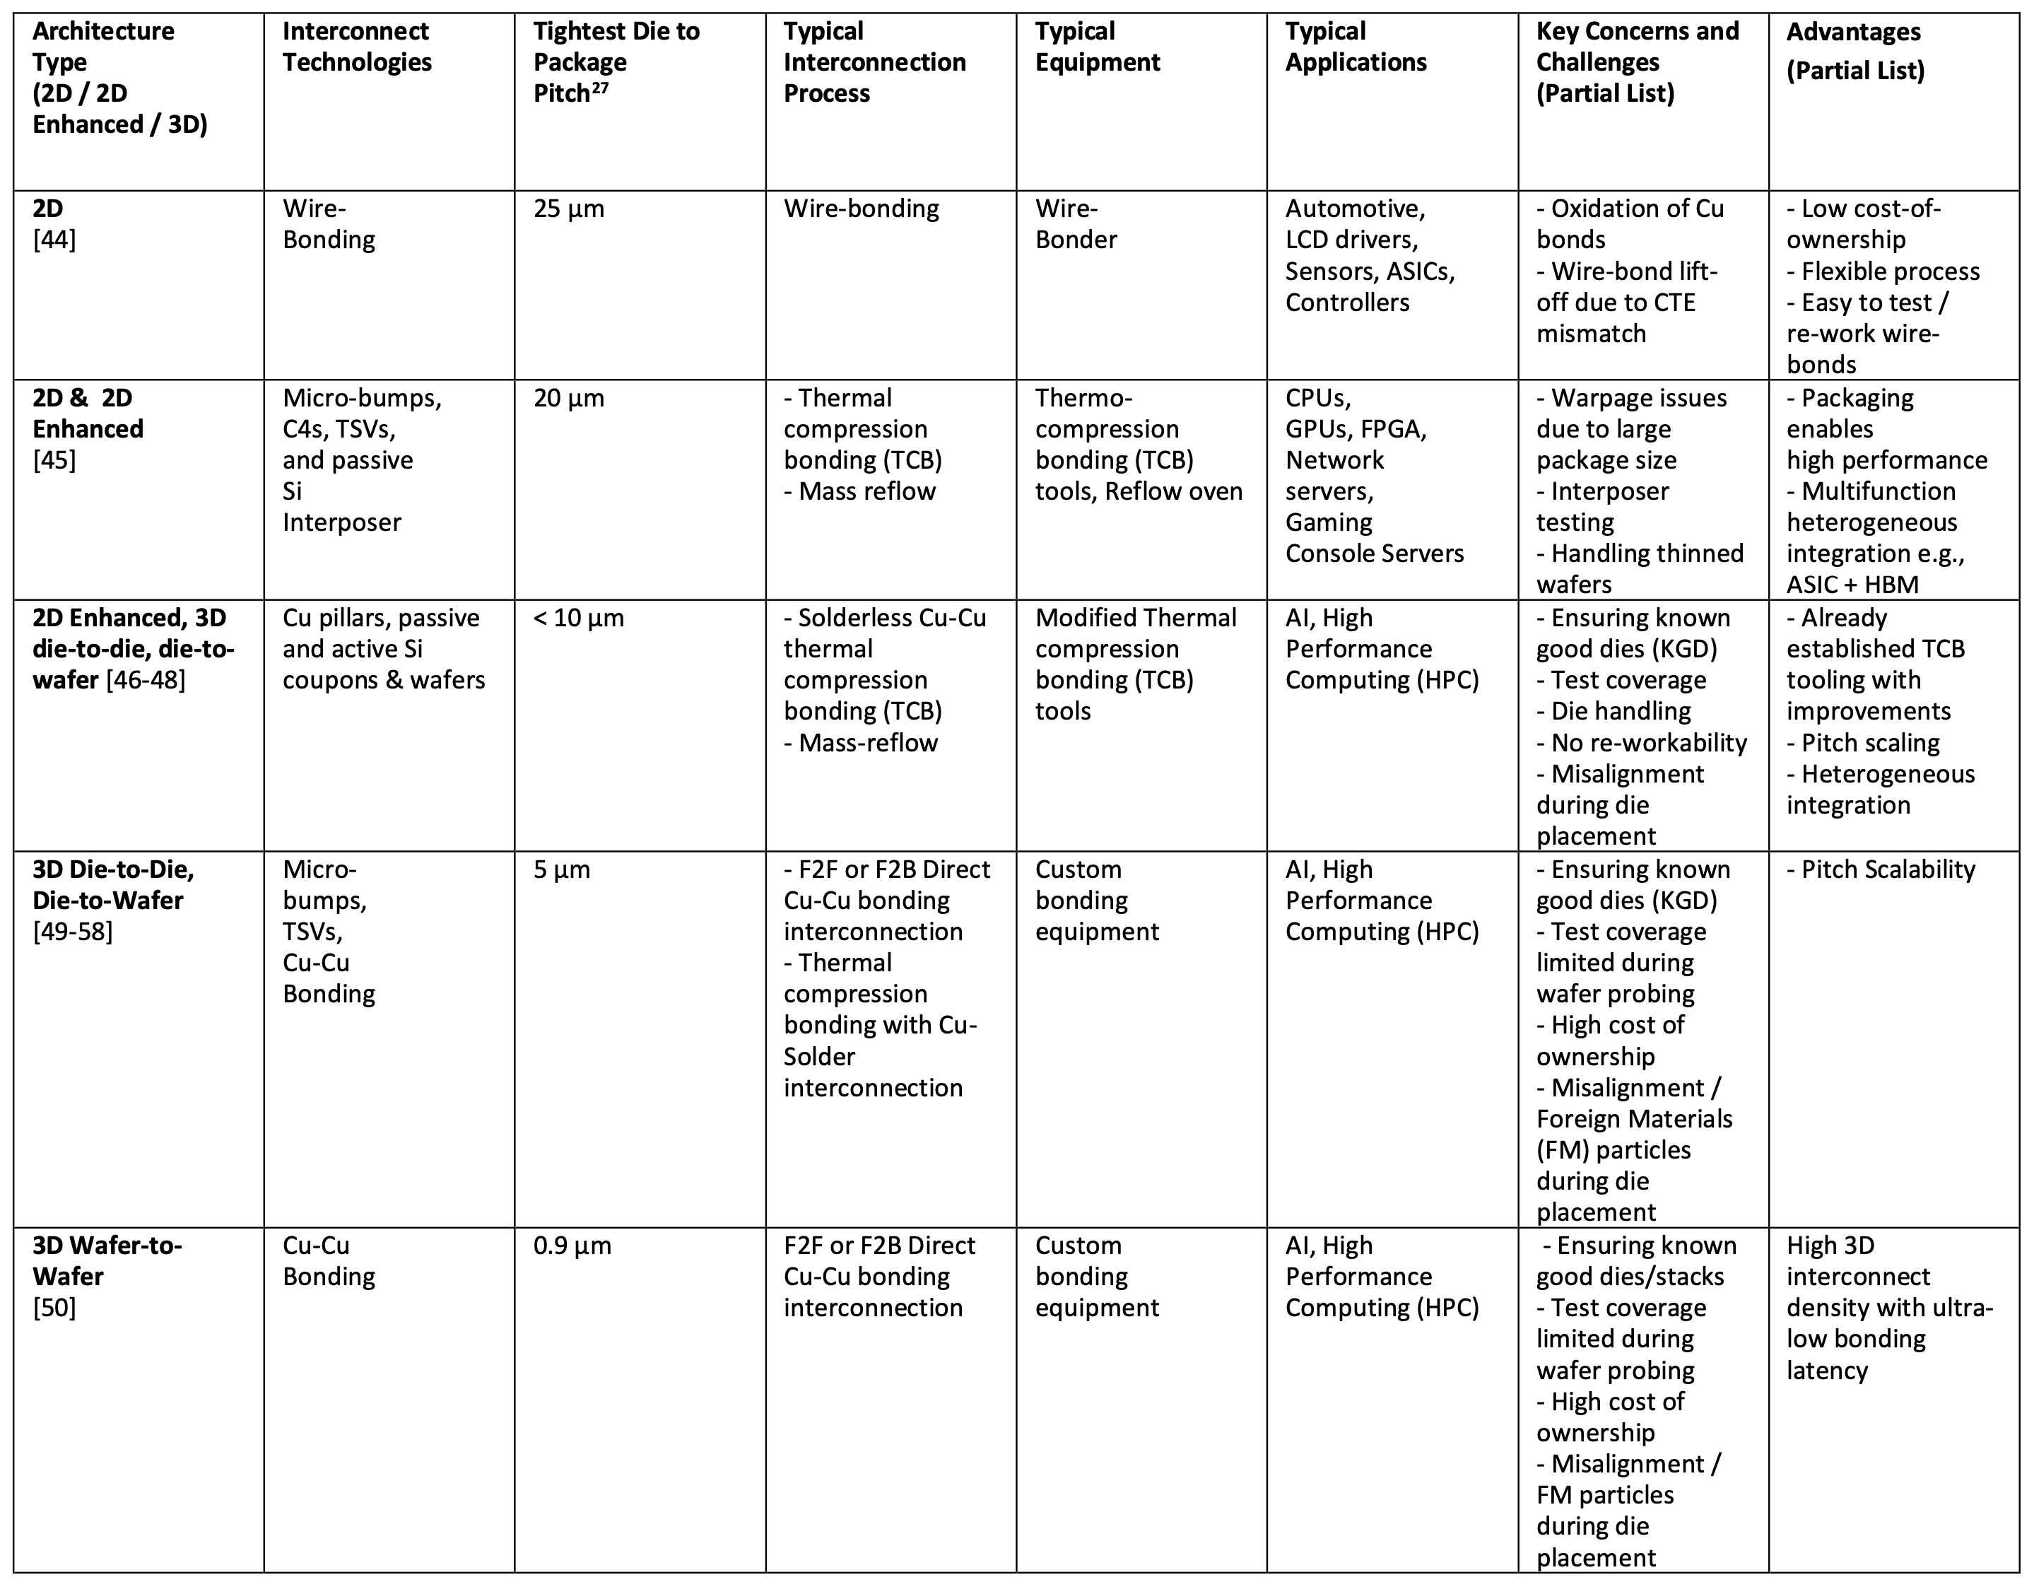
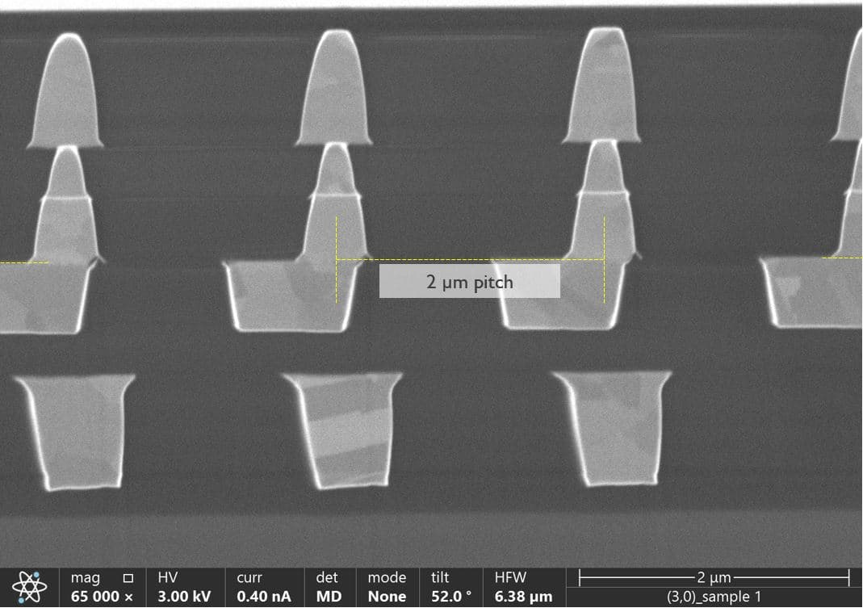
3D State of the art
Chip-to-wafer
Heterogeneous integration
(https://eps.ieee.org/images/files/HIR_2024/HIR_2024_ch22_2D-3D.pdf)
wafer-wafer 400nm
IMEC
Chip-wafer 2 micron

Slide 6
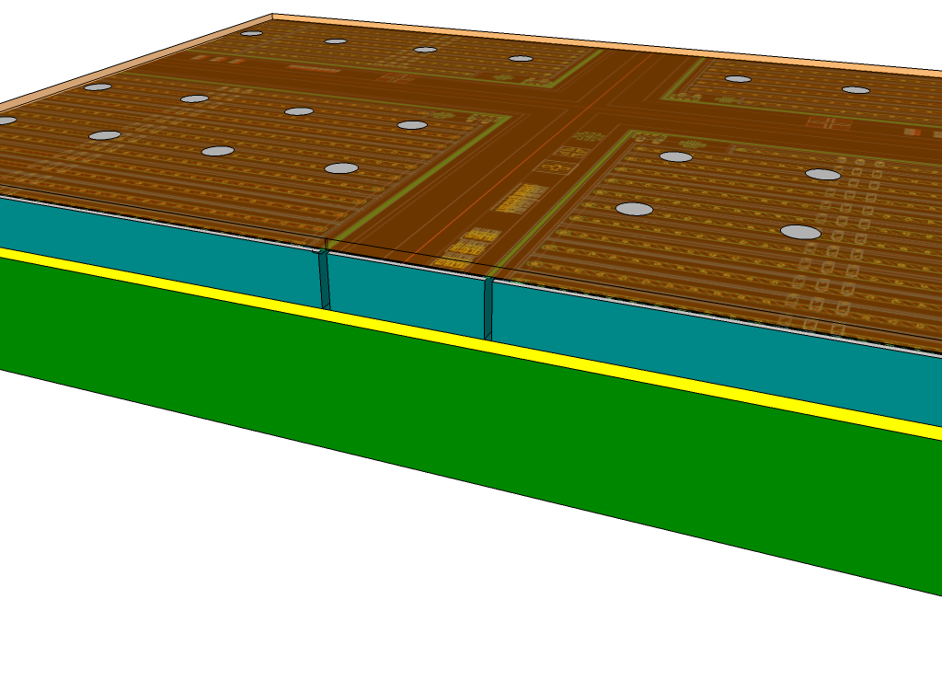
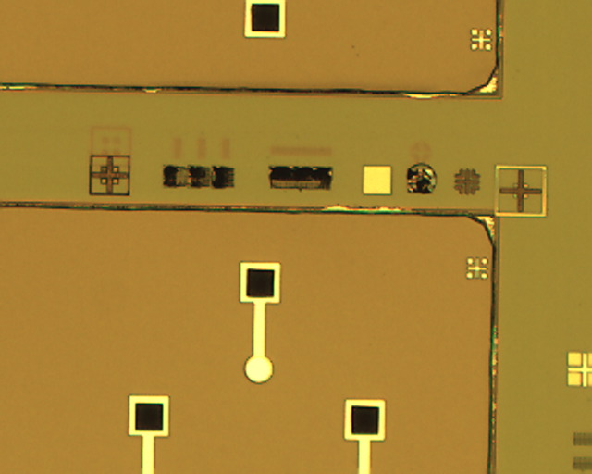
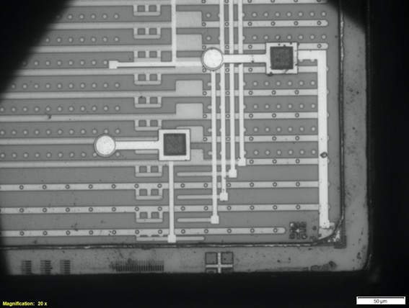
Tiled arrays
Active Edge devices
Stitched reticles
Panel
Active edge or CMOS sensors enable 4-side
buttable arrays
3D with TSV enables complex readout and processing
Silicon (10μ)
readout
IC and pads
200 micron
Buried
oxide
sensor
trenches
Handle wafer
FNAL Tile demonstration
3D bonded active edge sensors
Infrared image

Slide 7
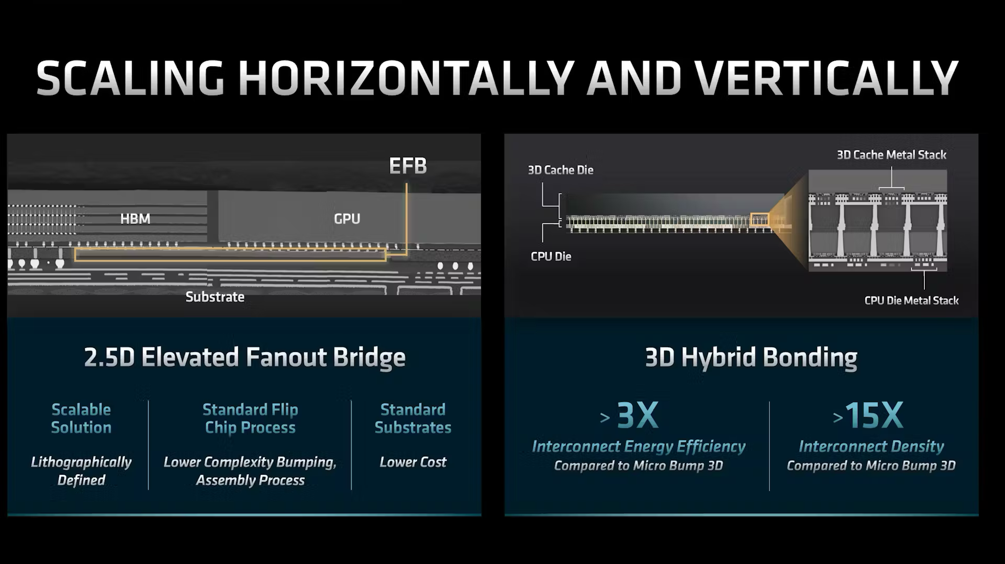
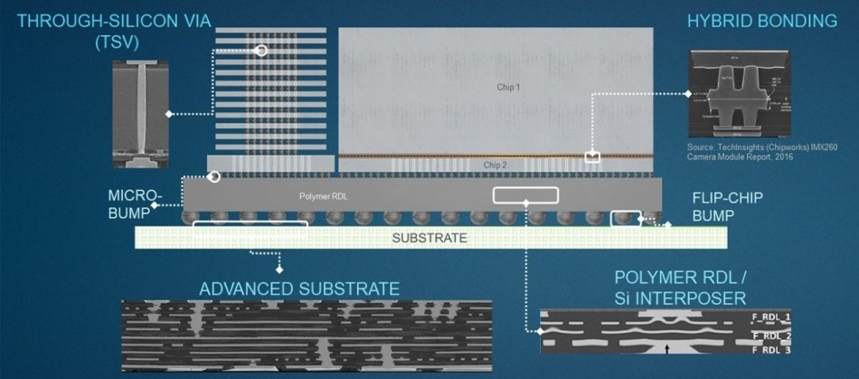
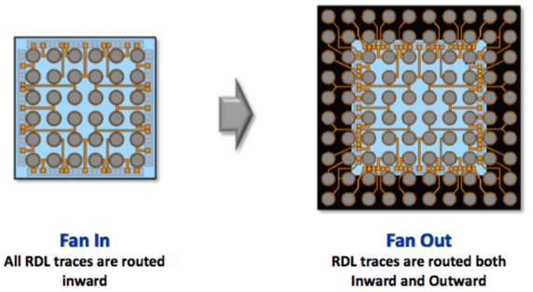
2.5D/interposers
A 2.5D substrate allows us to match large area sensors to chips limited by CMOS reticules to 2-3 cm on a side
Can be an enabling technology for large area sensors and focal plane arrays
Issues – Availability (Foundries (TSMC, GF, Skywater …) packaging firms
Wafer level packaging – use redistribution layers to provide connections (fan in/out) before dicing
(electronic design)

Slide 8
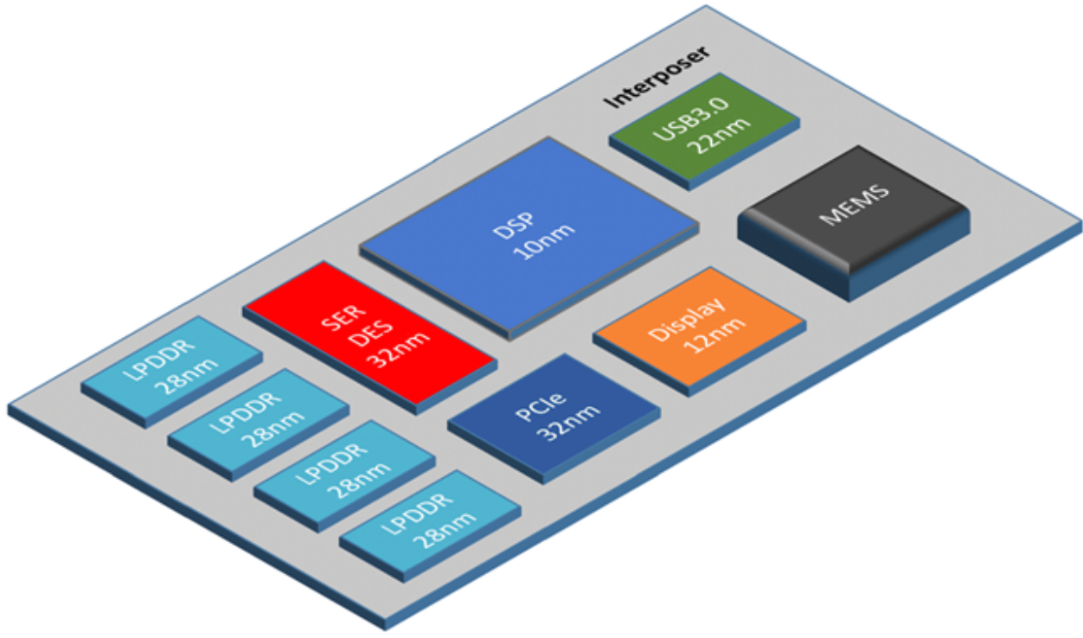
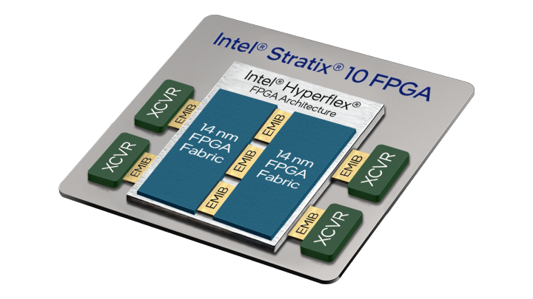
Chiplets
“A chiplet is a discrete unpackaged die that can be assembled into a package with other chiplets; each chiplet is optimized to its function, using the node best suited to the function.”
This technology is intended to utilize standard “off the shelf” die to assembly a functional system – high tech silicon (or glass) motherboard.

Slide 9
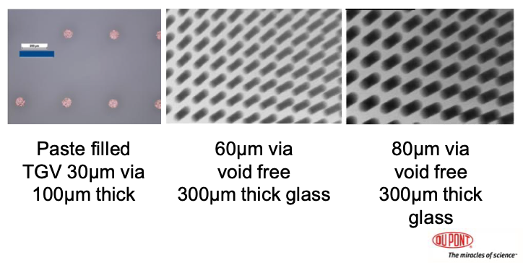
Panel Processing
Expanded substrate with high density interconnects -
Organic, silicon or glass
Glass
  Through glass vias, ink jet wiring or direct metalization
  500x500 mm panels
  CTE match to silicon (3.2-12.4 ppm/degC)
  Low loss, can be flexible
  Poor thermal conductivity

Slide 10
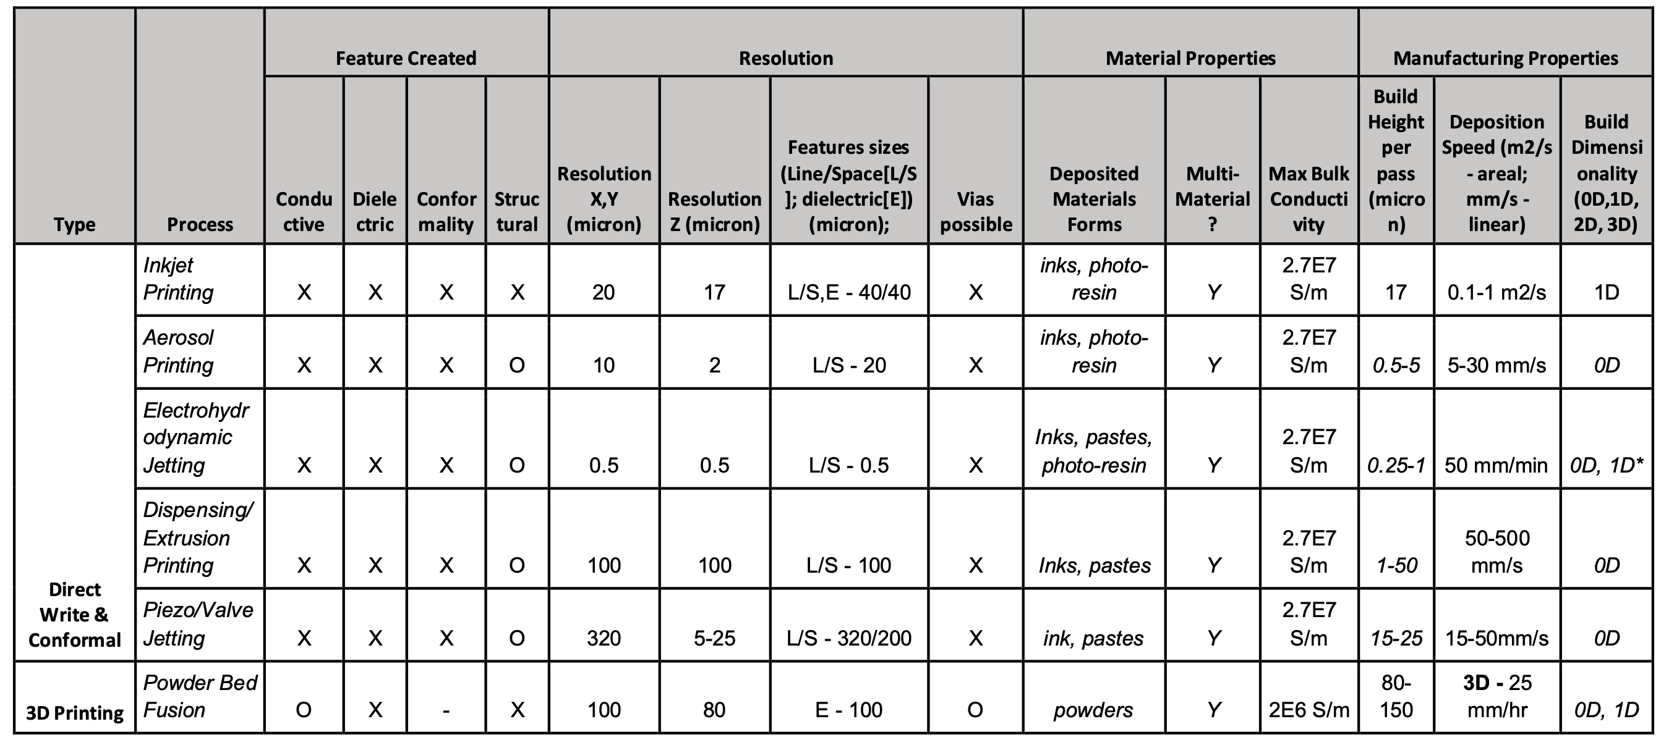
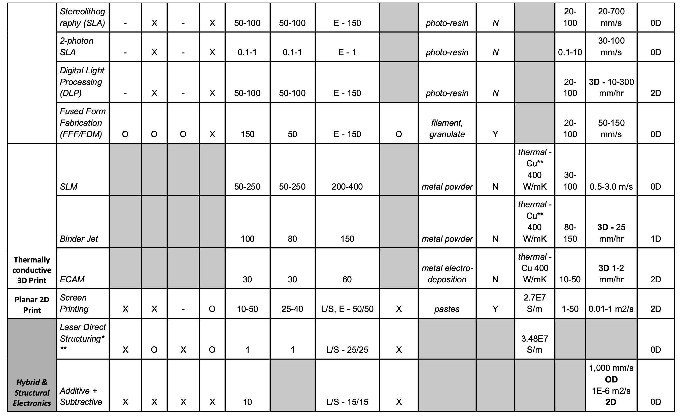
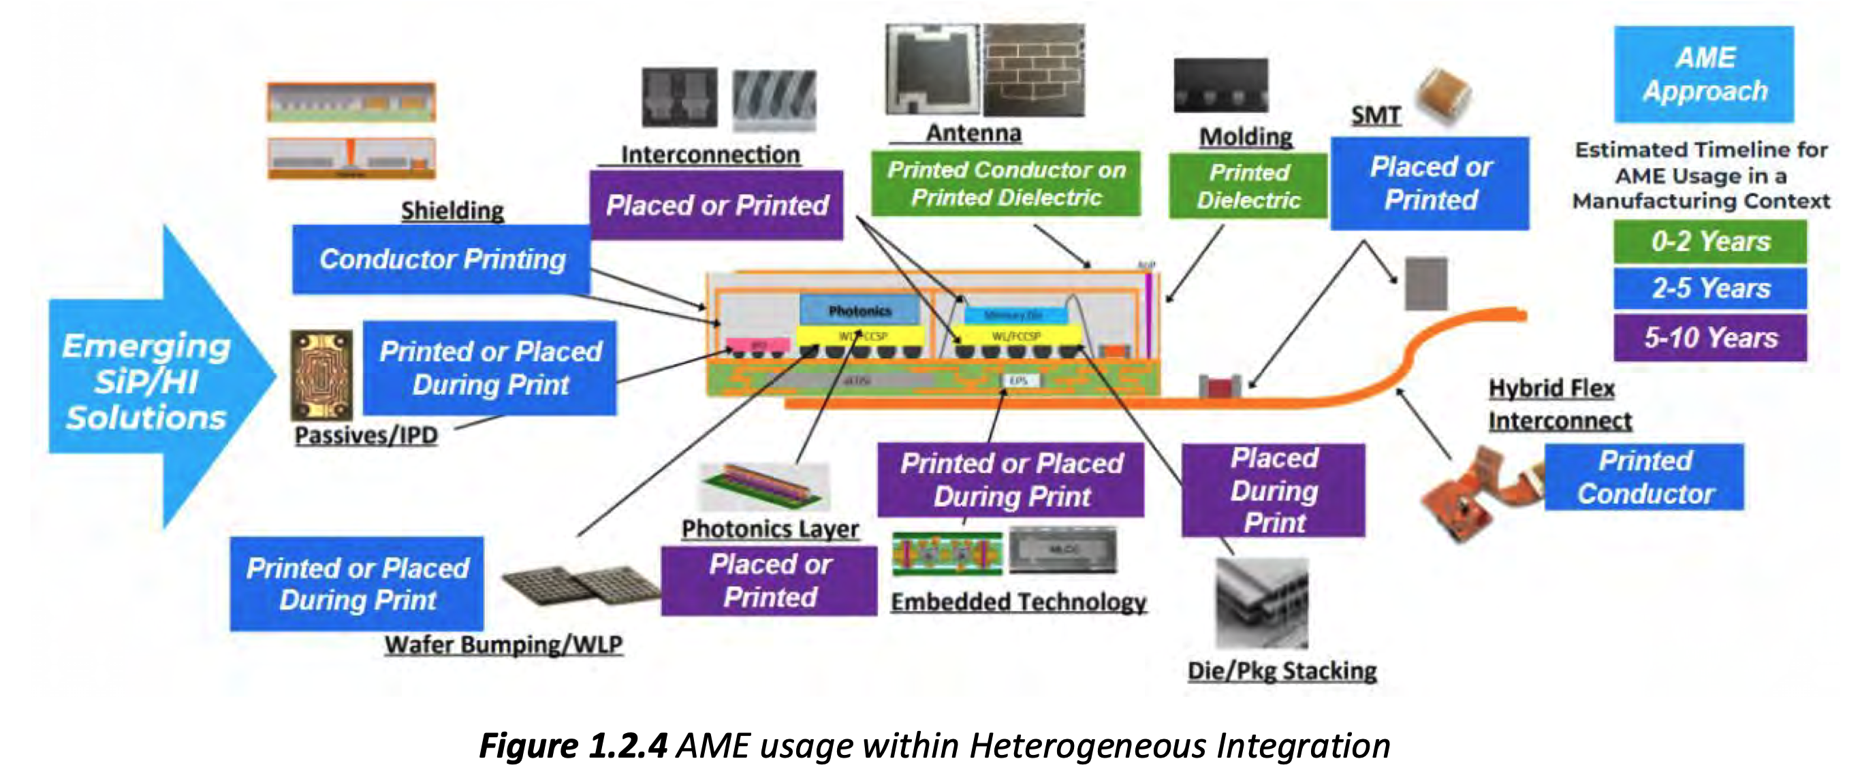
Additive Manufacturing
Wide variety of techniques and materials.
Could be applicable for our small scale projects
Substrate flexibility (literal and fig.)
Process simplicity and flexibility
(https://eps.ieee.org/images/files/HIR_2024/HIR_2024_ch25_AME.pdf)

Slide 11
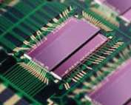
Example - Printed Electronics
interconnects can be 25 to 30 microns wide by 5+ microns in height.
Direct on die
Die to die interconnects on large area array
Adapt to non-planar toplogy
Alterative to stitching
+ Stamp Transfer

Slide 12
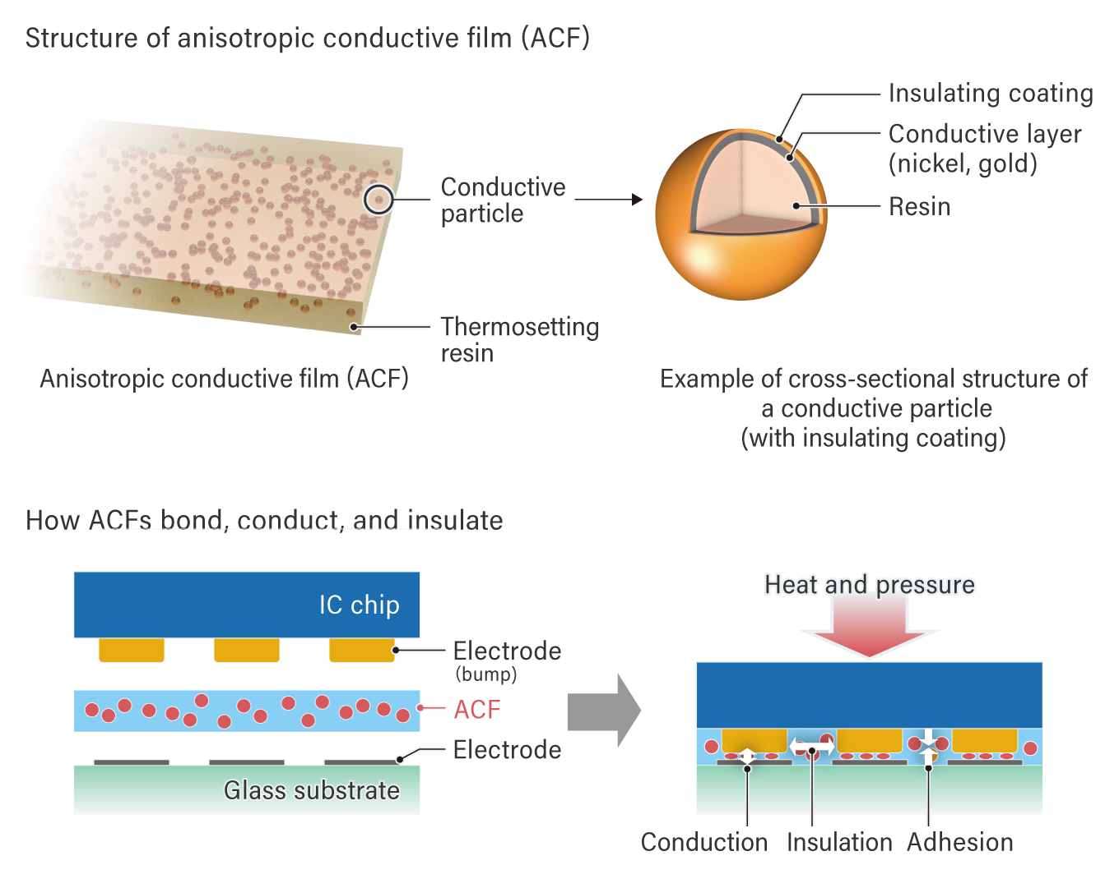
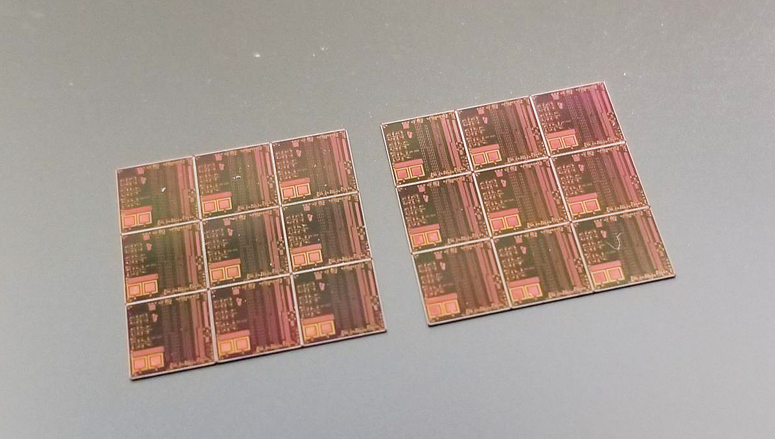
Anisotropic Conductive Films
Others
Mostly used for LCD type panel displays
Conductive balls or fibers
Requires pressure and often elevated temperature for connection
Pitch can be as small as 12 microns but usually much larger
Quilt Packaging
Addition of top metal “nodule” which extends beyond the normal chip boundry. The wafer is then background and etched to remove the street area leaving the interconnect nodule. Adjacent die can be connected by depositing solder on the nodules and heating.
Arbitrary die shape
Avoids stitching

Slide 13
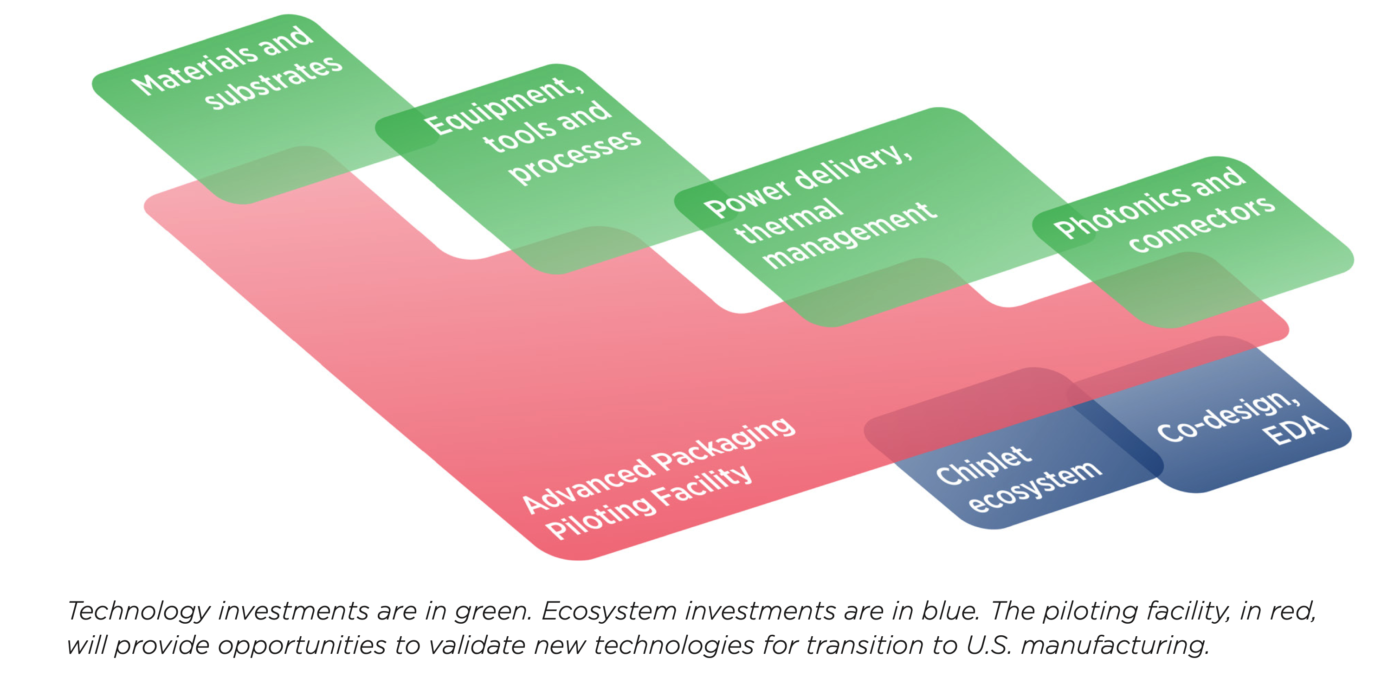
Final Comments
Packaging is seen by many in the semiconductor industry as the extension to Moore’s law
The bar to entry can be high – new techniques must integrate into the supply chain
No shortage of ideas and opportunities
Focus will depend on HEP needs:
FCC ee or hh –precision and radiation tolerance
Muon collider – focus on on-detector background rejection, radiation tolerance, timing
On detector neural filters
Opportunities in CHIPS packaging initiatives – National Advanced Packaging Manufacturing Program (NAPMP)
Absolics, Inc. in Covington, Georgia (glass panels …)
Applied Materials in Santa Clara, California
Arizona State University in Tempe, Arizona (+ Deca and Skywater)

