Slide 1
Operations Meeting Summary
Steven Timm
Dec 9 2024

Slide 2
Running Experiments
NP04 drain started Dec 6
NP02 fill started Dec. 6
Expected to take about a week.
Official as of last week there will be no main injector beam at Fermilab in FY2025 and thus no beam run for 2x2/Minerva.

Slide 3
Services
Data Management:
  Metacat v4_0_1 bug reported 12/2 was fixed same day (null created_timestamp)
  Expect Rucio v35_6 upgrade today
  No DM meeting tomorrow due to the tutorial
  Inadvertent staging of files from CERN CTA last week, changing to a multi-hop configuration so that this will not happen again
JustIN
  Tests of JustIN v01_02 have been successful need to set a time to deploy on production, sometime this week probably good, Production needs to sign off due to ongoing production
Global Pool
  JustIN tests successful all the way from JustIN to NERSC

Slide 4
Other business
Authentication—recent meeting between Fermilab security (Mine’) and CILogon indicated that Rucio wants to be its own token issuer, this is first we had heard of that. Rucio testing with CILogon and tokens has been going good up until now. Need more info, may be discussed at tomorrow’s WLCG open technical forum.
ETF—Chris is trying to take over the ETF service, get the infrastructure upgraded to EL9 and get it working with tokens.
Tokens at ARC—2 known UK sites now working on this.

Slide 5
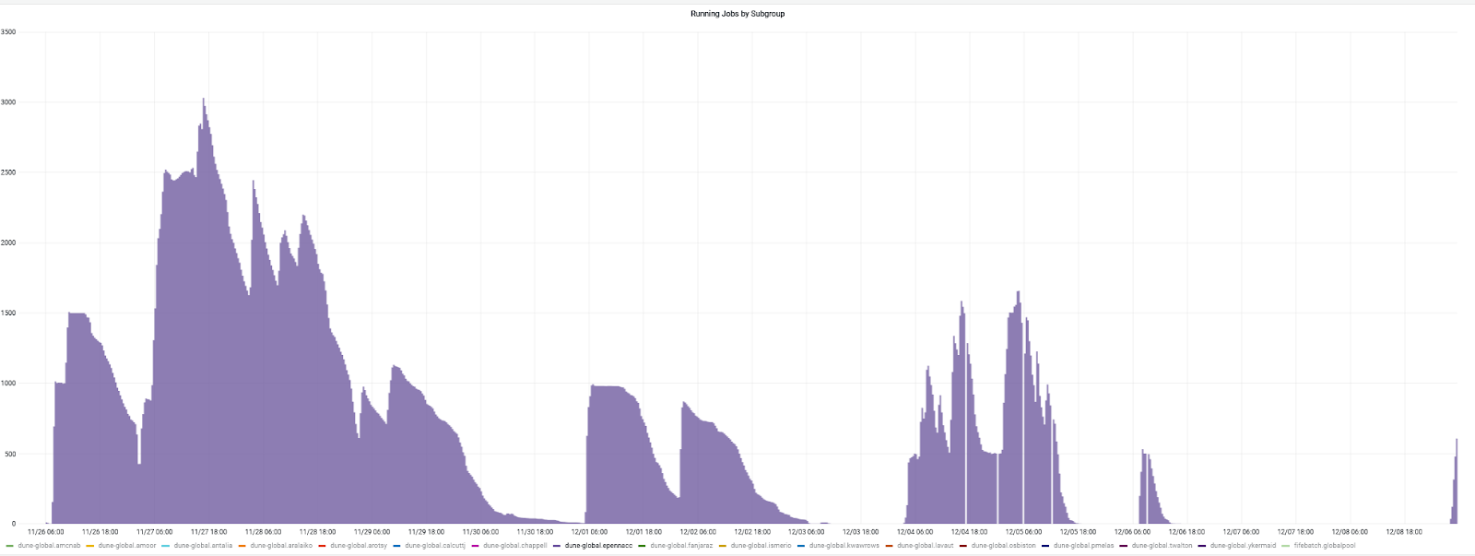
Production
First 2 LE samples finished (no background), small output, pending merging and declaring.
Third LE sample (with background) ready to start will make 700TB have to coordinate with DM.

