Slide 1
HL-LHC Accelerator Upgrade Project PMG #66
Giorgio Apollinari/Gianluca Sabbi/Vito Lombardo
Project & Deputy Project Managers
PMG – Dec 17th, 2024

Slide 2
Plans for Today
AUP Status – Apollinari/Sabbi/Lombardo
Funding
Shipment of LQXFAB-02
Progress on Crab Cavities
Budget Status, Risks and Objective KPPs - Lombardo
Next PMG:
Feb. 18th 2025 (-27 mos from WS early CD-4)

Slide 3
Project Manager Summary Assessment and Funding
AUP is fully funded at the rebaseline TPC level ($266M)
FY24-FY26 are “Carry-forward years”, with FNAL funds supporting activities at BNL and LBNL, if necessary
No transfer to BNL expected.
Completed a $2M transfer of funds from FNAL to LBNL.
Further BCRs and Manual EAC adjustment might require additional corrections.
Followed on monthly basis, might be impacted by future BCRs
 | Funding Received to Date | ACWP+OC to date | Remaining Funds at CD-4 (Based on BAC) | Remaining Funds at CD-4 (Based on EAC)
BNL | 45,541 | 38,334 | 602 | 604
LBNL | 46,634 | 44,153 | -910 | -926
Updated Oct 2024

Slide 4
CERN Cost & Schedule Review 2024
Appreciation of Threshold vs. Objective KPPs and IPR Management Recommendation to start addressing Scope Contingency
CERN is giving upmost priority to Q1/Q3 cryomodules
(All) Crab Cavities delays at center-stage during C&S, with discussions of delayed installation

Slide 5
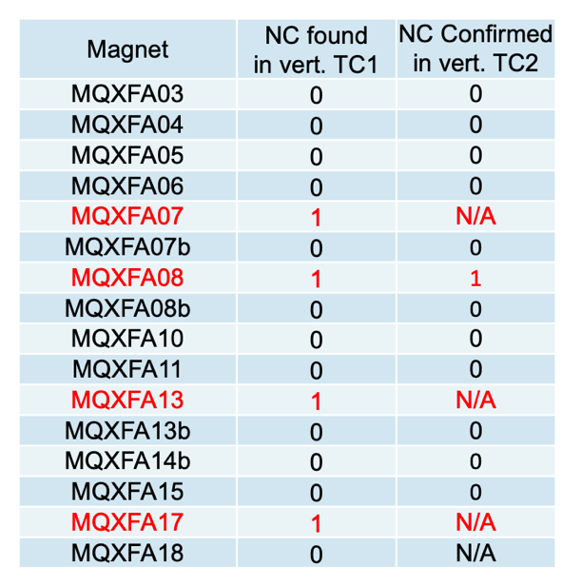
Cost Reduction Measure Magnet Vertical Test Decision
Decision: Test all remaining MQXFA Magnets vertically through only TC1 and reduce number of magnetic measurements at BNL.
BCR implemented in Nov. ’24 schedule, with an AUP cost savings of ~1M$
Pros:
Reduce considerably risks for LQXFA/B, eliminating the necessity to carry forward a cryomodule re-assembly in the baseline schedule
Reduces costs and anticipates schedule
Cons:
Training memory establishment delayed from Vertical Test to LQXFAB Horizontal Test

Slide 6
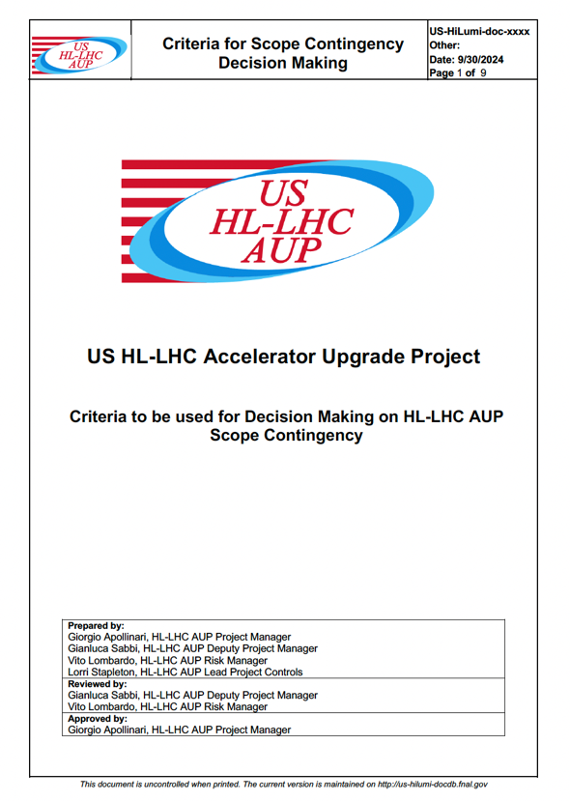
Objective vs. Threshold KPPs Criteria for Decision Making
Criteria to trigger discussion with CERN on scope Reduction:
Based on decreasing contingency performance
Criteria to execute scope Reduction:
Based on preserving success for overall HL-LHC endeavor

Slide 7
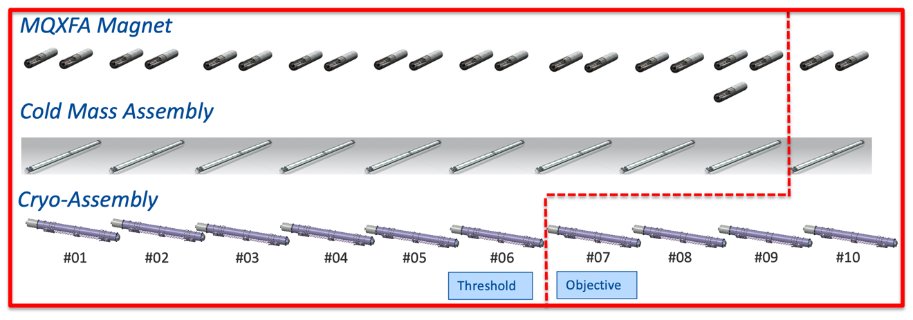
Examples of Potential Solutions for Scope Contingency
Hard Scope: Magnet Assembly
AUP commitment to produce last 2 magnets
Soft Scope: CryoM. Test
Will receive help from CERN for test of 3 Cryomodules at ~75k$/test

Slide 8
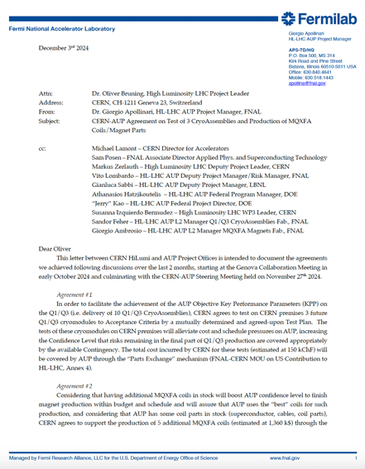
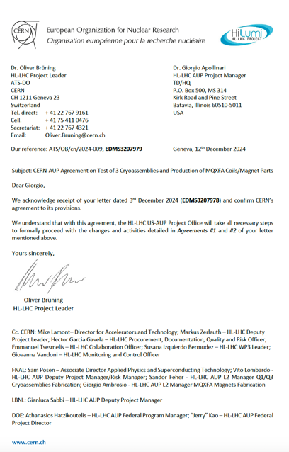
CERN-AUP Agreement
Achieved agreement with CERN including:
Test of 3 cryoassemblies at CERN
Production at FNAL of 5 additional MQXFA coils funded by “debt” in ”Part Exchange”. Coils not used by AUP will be sent to CERN
Vito to show implications for AUP related to achievement of Objective KPPs.
Request from APS-TD Associate Director:
Is there a way to “retrieve” testing scope back to the US ?
Are we sure the # of CERN tests is limited to 3 ?
Review/Workshop

Slide 9
HT at FNAL
Simple-minded bean-counting assessment.

Slide 10
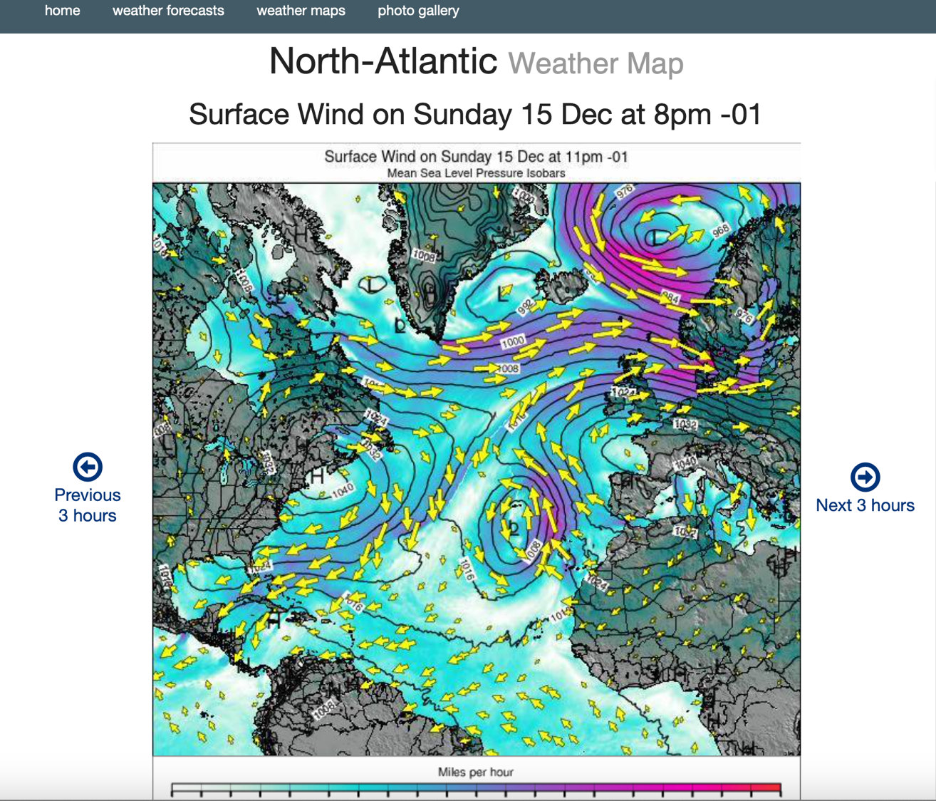
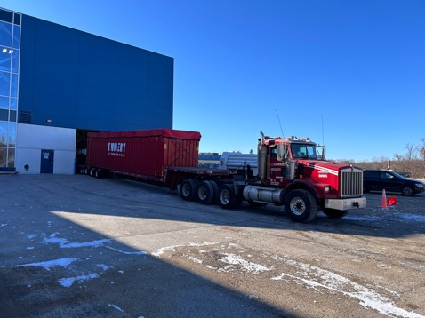
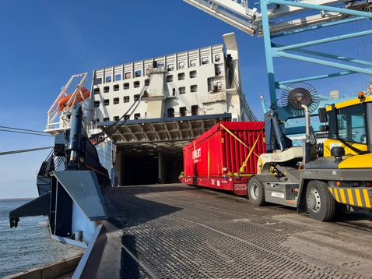
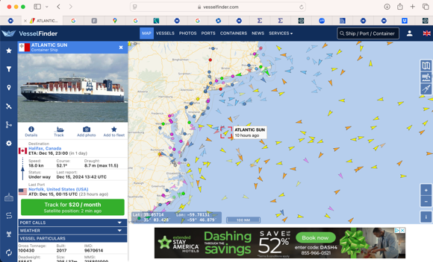
Shipment of LQXFAB-02
LQXFAB-02 left FNAL on Dec. 5th.
LQXFAB-02 boarded “Atlantic Sun” and left Norfolk on Dec. 14th (C. Orozco on site)
Expected at Antwerp after Christmas, will be stored under roof-coverage until departure for CERN, with planned arrival on Jan 8th.

Slide 11
RFD Crab Cavities
Embraced in an interesting Tango.
Last Steering Meeting (mostly dedicated to CERN CA tests) on Nov. 27th. Another interesting “contribution” from WP4 (see below), followed by recent comments that CERN was not a part of Production stop at ZANON.
Under discussion
Approval of NCRs for “built objects” (2 pre-series and 1 series)
Approval of Construction Documents (MIPs and Welding Books) for Bare and Jacketed Cavities

Slide 12
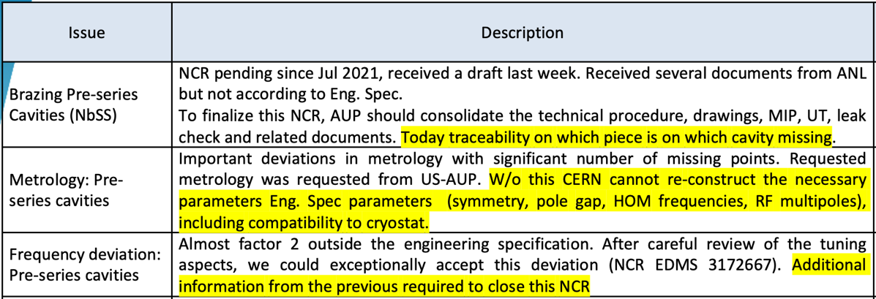
RFD Crab Cavities - NCRs
Brazes accepted by CERN. Traceability info uploaded by AUP on Feb. ‘24. Probably “lost” to CERN due to massive upload. Points at lack of communication
Prepared AUP Metrology Assessment to guide CERN to reconstruction of necessary Eng. Spec. parameters. Appears to point at lack of communication
As of Dec 9th, CERN appears to plan acceptance of all pre-series cavities NCRs (email communication from WP4 leader and, in some cases, actual approval in EDMS).

Slide 13
WB and MIPs approval
ZANON mis-led by Approval of Procedure for Nb-SS brazed joints, some of them already assembled in Series #3-to-#6.
Critical item for CERN is lack of C-Scan. Hard for AUP to perform.
Ti-SS brazes approved at Manufacturing Company by NDT and Notified L3 Body. Initially rejected by CERN upon metallurgy
As of Dec 9th, CERN appears OK in C-scanning all AUP brazes

Slide 14
Interactions with ZANON & CERN
ZANON production has been stopped by mid-October after AUP realized Nb-SS brazed flanges were not going to be approved without a C-Scan, which is increasingly difficult to perform as the parts progress in the manufacturing.
Company maintains collaborative spirit but submitted REA (Request for Equitable Adjustment) and a proposal for tri-partite CERN-AUP-ZANON meetings to ensure no surprises - due to lack of approval(s) - lurk in the future.
Proposed interactions over next ~1-1.5 months:
Brazing/NDT and Metrology (Wednesday, December 18th)
Welding Book (Jan.)
MIPs for bare and jacketed (Jan.)
MRR to finalize all documentation prior to manufacturing (Feb.)
Surprisingly, CERN appears opposed to an MRR (too late)
Stay tuned !

