Slide 1
Notes about AUP Budget, Risks and Objective KPPs
Vito Lombardo
PMG – Dec 17th, 2024

Slide 2
Outline
A few notes on Contingency and Risk Analysis
Impacts of agreement with CERN to EAC and risks
Impacts to risk confidence level
Impacts to critical path
Working dates for CA 04-05-07 wrt to HL-LHC IT string schedule
Conclusions

Slide 3
Contingency at a glance
Total Project Cost (266M$)
Total available contingency (TPC-EAC)
Estimate at Complete
Estimate Uncertainties
Risk Cost Exposure at X%CL
Monetized Schedule Risk Exposure at X%CL
TPC (Total Project Cost) fixed at 266M$
EAC (Estimate at Complete)
EUC (Estimate Uncertainty)
Total available contingency (TPC-EAC) is meant to cover all EUC and risks (both cost and monetized schedule) at X confidence level.

Slide 4
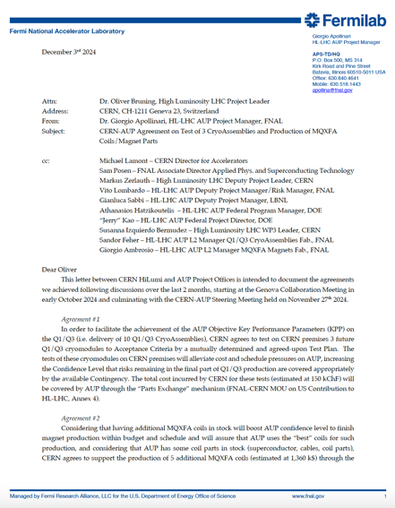
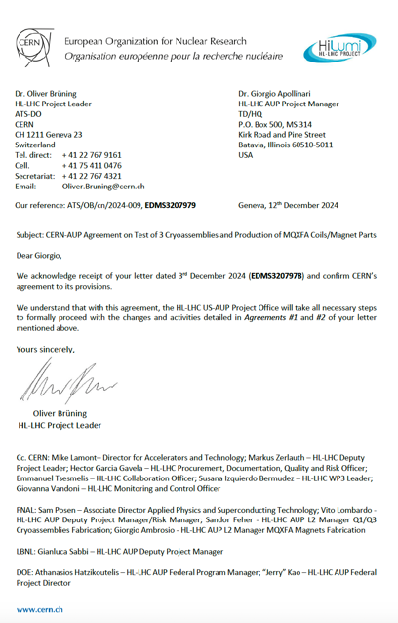
CERN-AUP Agreement
Achieved agreement with CERN includes:
Production at FNAL of 5 additional MQXFA coils funded by “debt” in ”Part Exchange”. Coils not used by AUP will be sent to CERN. This substantially reduces our coil yield risk.
Test of 3 cryoassemblies at CERN. This will reduce our EAC and will provide a net reduction in risk exposure, which will translate in a higher chance of delivering the full set of objecting KPPs.

Slide 5
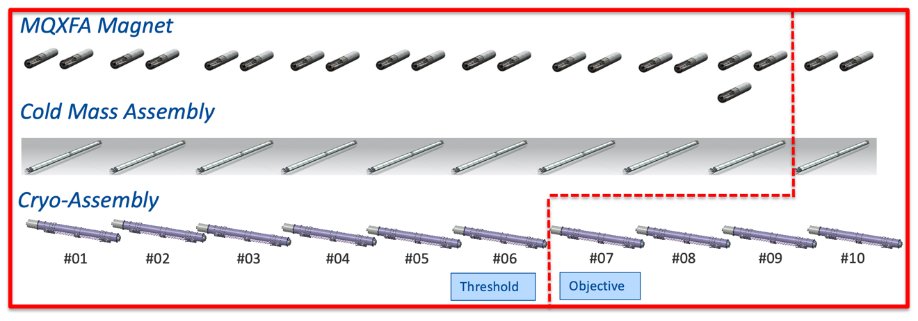
What-if Analysis
October 2024 working schedule
Includes vertical tests of all remaining magnets (1TC)
Assumes all remaining Cryo-Assembly (CAs) tested horizontally at Fermilab
What-if analysis based on October 2024 working schedule
Includes vertical tests of all remaining magnets (1TC)
Assumes CA03-06-08-09-10 tested at Fermilab
Assumes CA04-05-07 tested at CERN @ 75k for CA05-07.

Slide 6
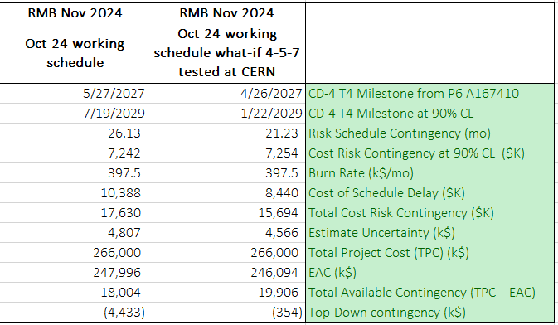
Results of Oct. 2024 Working Schedule (All CA tested at Fermilab) and What-If (CERN tests CA4-5-7)
Executing this plan will
Provide savings in EAC (*1): ~2M$
(-) Cost reduction due to not executing 3 cryo-assembly tests at Fermilab
(-) Shortening the overall project duration which translates into LOE savings
Provide a net reduction in project risk (*2): ~2M$
(-) Elimination of risk due to potential Fermilab delays in testing CA04-05-07
(-) Residual risks of delays in remaining horizontal tests are now absorbed by more generous float in between horizontal tests.
(+) Addition of risk of having to ship CA04-05-07 back to Fermilab for rework and back to CERN at Fermilab’s expenses.
(*2)
(*1)

Slide 7
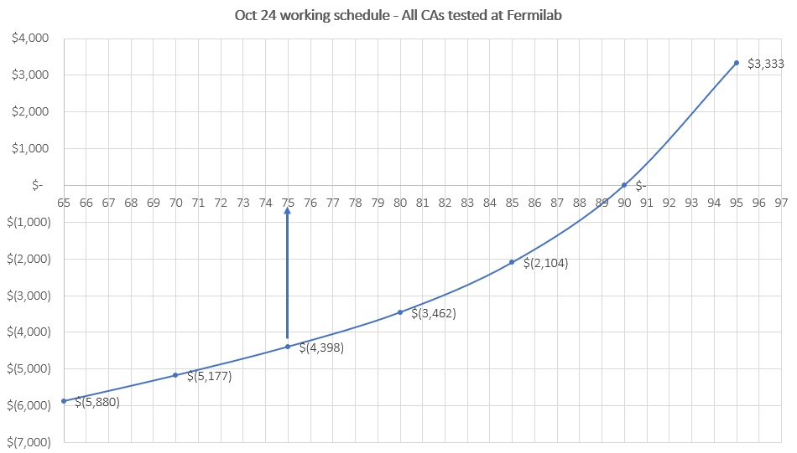
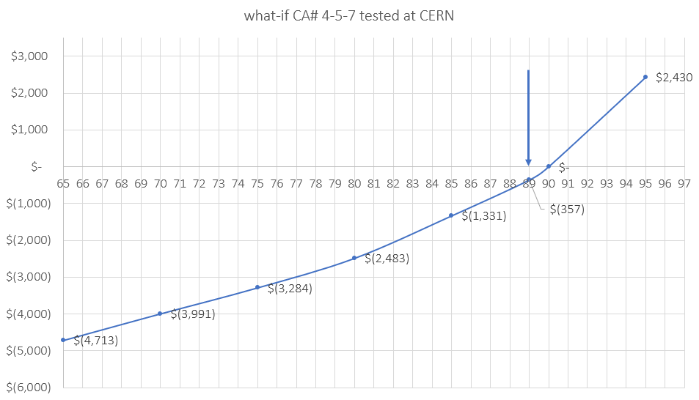
Results of Oct. 2024 Working Schedule (All CA tested at Fermilab) and What-If (CERN tests CA4-5-7)
 | October 24 working schedule - ALL CAs tested at Fermilab | October 24 working schedule what-if 4-5-7 tested at CERN
TPC (k$) | 266,000 | 266,000
EAC (k$) | 247,996 | 246,094
EUC (k$) | 4,807 | 4,566
Risks @ 90%CL | 17,630 | 15,694
Leftover contingency | (4,433) | (354)
CA 4-5-7 tested
at CERN
All remaining CAs tested at FNAL
CL 89%
CL 75%

Slide 8
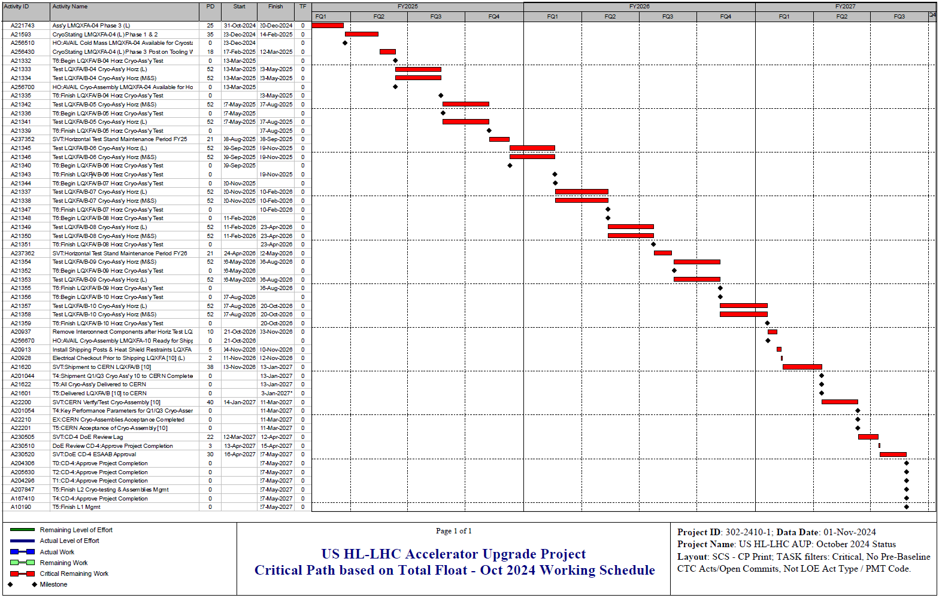
Critical Path – October WS
Test 4
Test 5
Test 6
Test 7
Test 8
Test 9
Test 10
Ship 10 to CERN
CERN accepts 10
ESAAB
Project complete
Entirely driven by horizontal test @ Fermilab

Slide 9
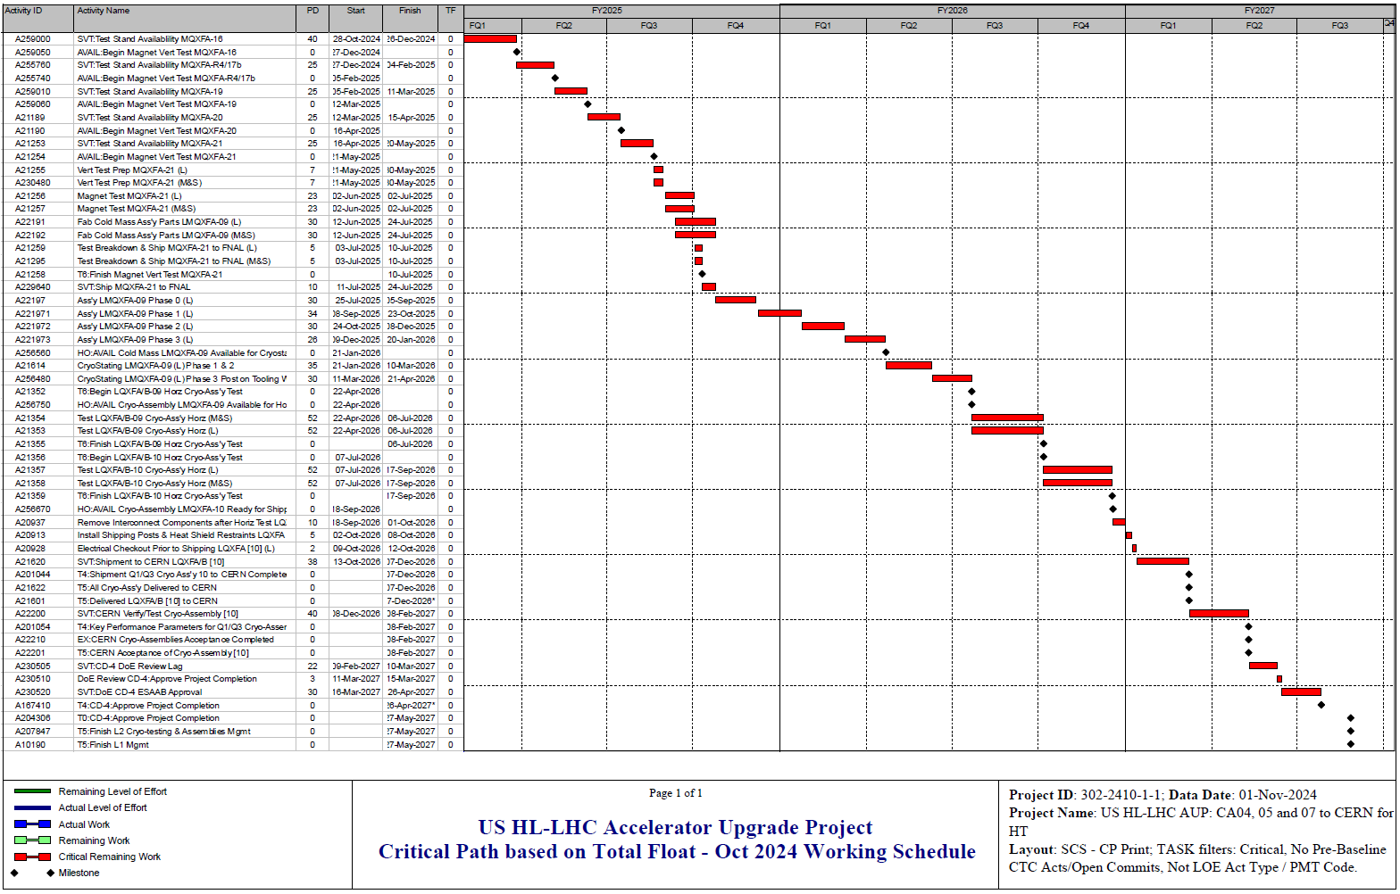
Critical Path – what-if 4-5-7 tested at CERN
Magnet vertical tests @ BNL
CM/CA 09 assy @ FNAL
Test 09 @ FNAL
Test 10 @ FNAL
Ship 10 to CERN
CERN accepts 10
ESAAB
Project complete
Driven by vertical tests at BNL, CM/CA assembly of 09 and 10 at Fermilab and horizontal test of CA10 at Fermilab

Slide 10
Activity Name | Start
HO:AVAIL Cryo-Assembly LMQXFA-04 Ready for Shipping Preparation | 13-Mar-25
HO:AVAIL Cryo-Assembly LMQXFA-05 Ready for Shipping Preparation | 20-May-25
HO:AVAIL Cryo-Assembly LMQXFA-06 Ready for Shipping Preparation | 3-Nov-25
HO:AVAIL Cryo-Assembly LMQXFA-07 Ready for Shipping Preparation | 13-Nov-25
HO:AVAIL Cryo-Assembly LMQXFA-08 Ready for Shipping Preparation | 14-Apr-26
HO:AVAIL Cryo-Assembly LMQXFA-09 Ready for Shipping Preparation | 7-Jul-26
HO:AVAIL Cryo-Assembly LMQXFA-10 Ready for Shipping Preparation | 18-Sep-26

Slide 11
Conclusions
The recent agreement with CERN is estimated to show an improvement of about 14 points (from 75% to 89%) in our project risk confidence level.
Critical path will shift from horizontal tests at Fermilab to magnet vertical tests at BNL, CM/CA assembly at Fermilab and ultimately horizontal tests for CA9-10 at Fermilab.
Executing this plan will put AUP in a significant better shape by reducing the overall cost, duration and risk of our project.
Ultimately this solution will boost the confidence of AUP delivering on the full objective KPP scope of the AUP project.

Slide 12
Backup

Slide 13
Horizontal Test - Float

Slide 14
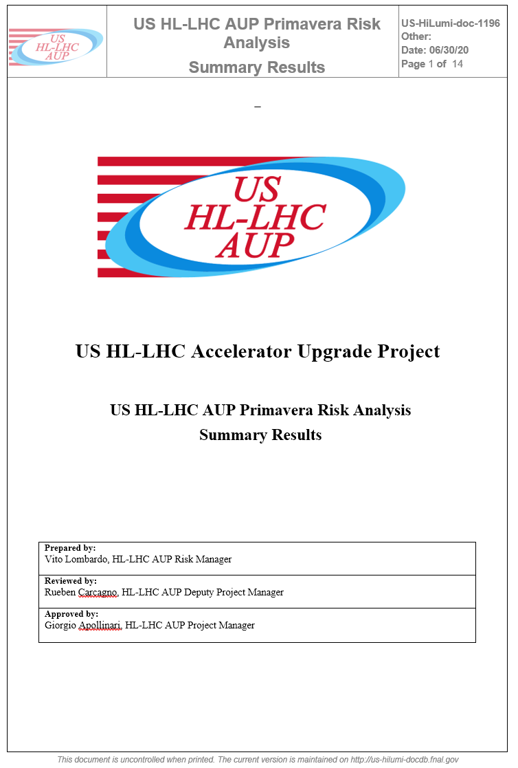
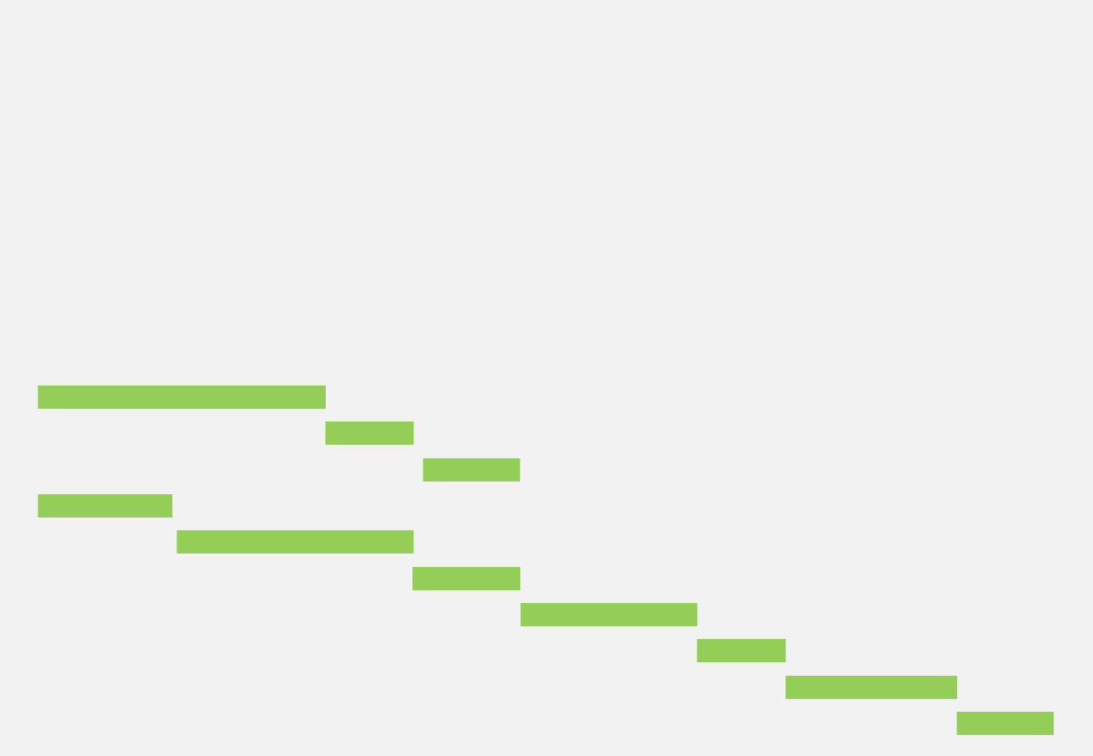
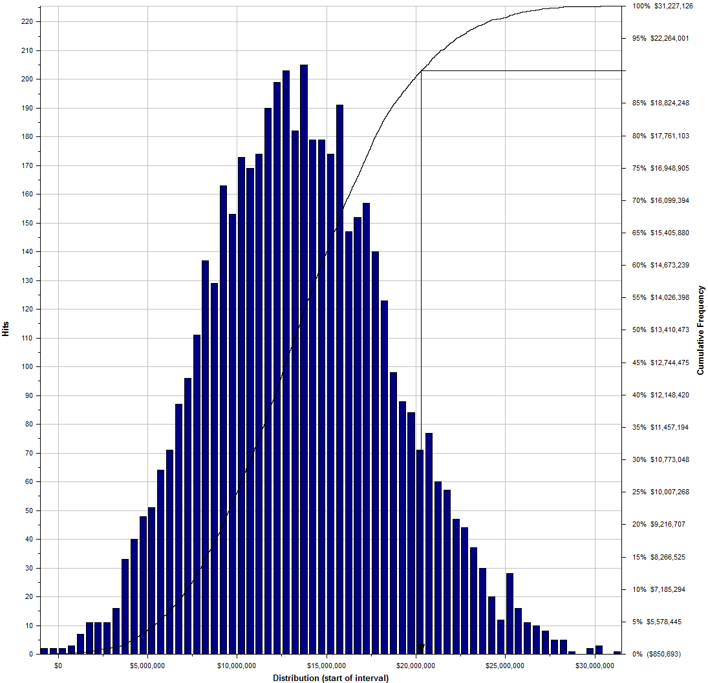
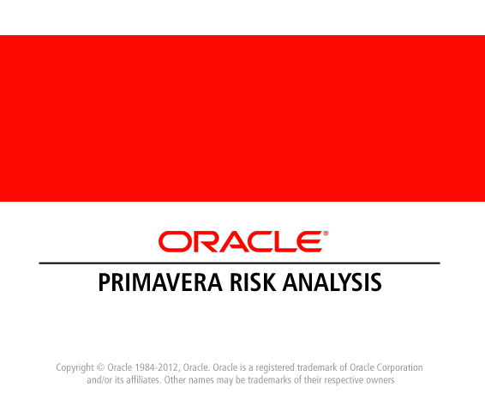
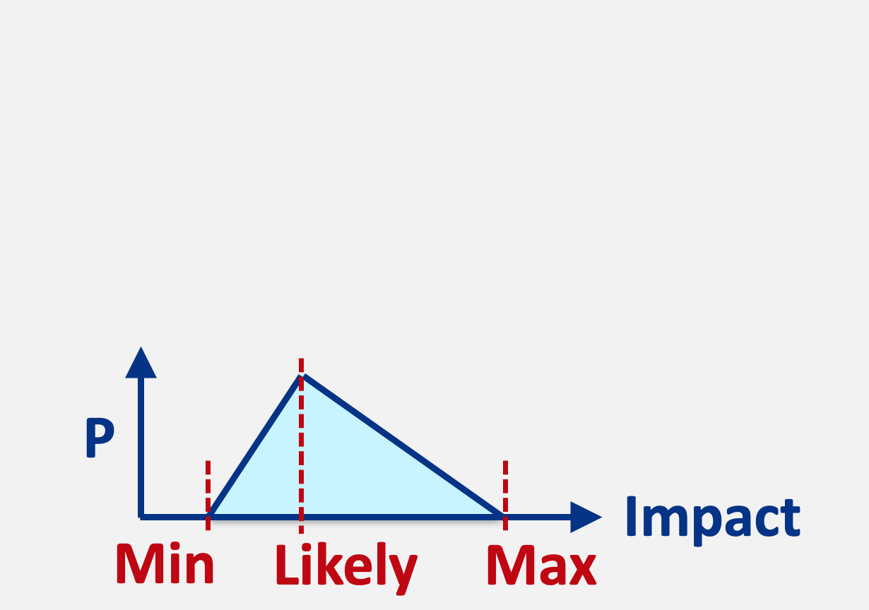
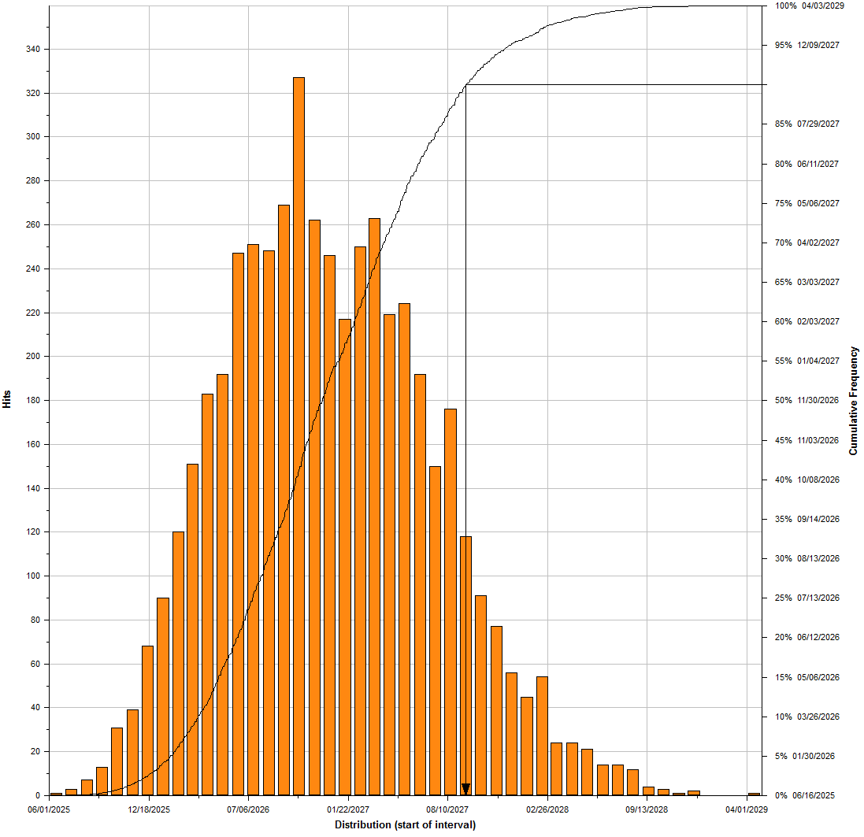
Risk Contingency Analysis
After each Risk Management Board meeting, the most up to date risk register is loaded into PRA and the overall cost and schedule risk contingencies are estimated against current P6 working schedule.
A Monte Carlo simulation is performed to aggregate cost and schedule impact of all open project’s risks and produce cost and schedule risk distributions.
Based on these distributions, the project can evaluate at which confidence level the project can afford to cover risk given a certain amount of available contingency.
The project strives to maintain confidence level as close as possible to 90%.
Cost Risk Distribution
P6 Schedule
Risk Register
MC framework
Each risk triggers according to its probability and affects the project according to an impact distribution (cost and/or schedule as appropriate)
Schedule Risk Distribution

