Slide 1
PPD DH Meeting DSO Slides
ES&H
December 18, 2024

Slide 2
Summary
Training/ITNA Status
CAIRS Reports in November
ORPS/NTS in November
FESHM & FRCM Updates in November
Checking for Faults in Drum Handling Equipment

Slide 3
ES&H Training and ITNA Status for employees – as of 12/16/24
 | Training Courses |  |  |  | Individual Training Needs Assessments
Div/Sec | Completed | Required | Percent | Employees | < 1 Year Old | Percent | Missing | Missing for New Hires
 | 404 | 455 | 88.79% | 34 | 30 | 88.24% | 1 | 0
AD/ACTD | 5,850 | 6,192 | 94.48% | 224 | 221 | 98.66% | 0 | 0
AD/ARD | 313 | 339 | 92.33% | 15 | 15 | 100.00% | 0 | 0
AD/BD | 4,047 | 4,327 | 93.53% | 146 | 146 | 100.00% | 0 | 0
APS-TD/CS | 1,247 | 1,541 | 80.92% | 40 | 35 | 87.50% | 0 | 0
APS-TD/DFS | 992 | 1,042 | 95.20% | 51 | 51 | 100.00% | 0 | 0
APS-TD/MAG | 2,159 | 2,352 | 91.79% | 87 | 82 | 94.25% | 0 | 0
APS-TD/SRF | 1,496 | 1,583 | 94.50% | 66 | 65 | 98.48% | 0 | 0
COM | 497 | 518 | 95.95% | 43 | 41 | 95.35% | 0 | 0
CSAID/DSSL | 521 | 526 | 99.05% | 40 | 39 | 97.50% | 0 | 0
CSAID/RTPS | 369 | 393 | 93.89% | 29 | 28 | 96.55% | 0 | 0
CSAID/SCSS | 651 | 653 | 99.69% | 55 | 54 | 98.18% | 0 | 0
DCO | 38 | 48 | 79.17% | 4 | 4 | 100.00% | 0 | 0
DI | 2,177 | 2,315 | 94.04% | 240 | 228 | 95.00% | 0 | 0
DI/COO/COAS/QU | 132 | 134 | 98.51% | 7 | 7 | 100.00% | 0 | 0
DI/IA | 48 | 48 | 100.00% | 4 | 4 | 100.00% | 0 | 0
ES | 3,179 | 3,444 | 92.31% | 100 | 98 | 98.00% | 0 | 0
ETD/IARCD | 151 | 161 | 93.79% | 6 | 6 | 100.00% | 0 | 0
ETD/MD | 262 | 289 | 90.66% | 20 | 20 | 100.00% | 0 | 0
ETD/QID | 201 | 217 | 92.63% | 16 | 11 | 68.75% | 3 | 0
FI | 1,199 | 1,260 | 95.16% | 110 | 95 | 86.36% | 0 | 0
FRA | 25 | 25 | 100.00% | 2 | 1 | 50.00% | 0 | 0
HR | 578 | 584 | 98.97% | 48 | 48 | 100.00% | 0 | 0
ISD | 5,788 | 6,111 | 94.71% | 208 | 202 | 97.12% | 0 | 0
ITD | 1,164 | 1,166 | 99.83% | 115 | 115 | 100.00% | 0 | 0
LBNFDUNE | 891 | 1,000 | 89.10% | 56 | 56 | 100.00% | 0 | 0
NQC/NQCDIV | 714 | 812 | 87.93% | 46 | 36 | 78.26% | 1 | 0
PIPII/PIPII | 303 | 315 | 96.19% | 21 | 19 | 90.48% | 0 | 0
PPDIR/CPD | 386 | 429 | 89.98% | 36 | 33 | 91.67% | 0 | 0
PPDIR/DOSD | 2,030 | 2,240 | 90.63% | 69 | 66 | 95.65% | 0 | 0
PPDIR/EPD | 1,531 | 1,621 | 94.45% | 65 | 65 | 100.00% | 0 | 0
PPDIR/MD | 280 | 320 | 87.50% | 18 | 18 | 100.00% | 0 | 0
PPDIR/NPD | 743 | 803 | 92.53% | 58 | 53 | 91.38% | 0 | 0
PPDIR/PAD | 275 | 319 | 86.21% | 21 | 13 | 61.90% | 0 | 0
PPDIR/THD | 363 | 417 | 87.05% | 45 | 44 | 97.78% | 0 | 0
SEC | 2,408 | 2,450 | 98.29% | 89 | 78 | 87.64% | 0 | 0
Fermilab Total | 43,412 | 46,449 | 93.46% | 2,234 | 2,127 | 95.21% | 5 | 0
This month:
PPDIR/CPD | 408 | 455 | 89.67% | 38 | 37 | 97.37% | 0 | 0
PPDIR/DOSD | 2,034 | 2,262 | 89.92% | 70 | 67 | 95.71% | 0 | 0
PPDIR/EPD | 1,558 | 1,655 | 94.14% | 66 | 66 | 100.00% | 0 | 0
PPDIR/MD | 283 | 324 | 87.35% | 18 | 17 | 94.44% | 0 | 0
PPDIR/NPD | 757 | 818 | 92.54% | 59 | 52 | 88.14% | 0 | 0
PPDIR/PAD | 275 | 319 | 86.21% | 21 | 14 | 66.67% | 0 | 0
PPDIR/THD | 363 | 419 | 86.63% | 50 | 45 | 90.00% | 1 | 0
Last month:
(As of 11/05/24)
Notes:
Direct Link to Dashboard: https://cdv-fdashp.fnal.gov/Reports/report/Management%20Systems%20-%20MS/ESH/Reports/ESH%20Training%20and%20ITNA%20Completion

Slide 4
CAIRS Reports in November
11/11/2024 - First Aid Only / Not Reportable, AD
An employee mis-stepped while descending a set of two steps of a building and fell.
11/18/2024 - First Aid Only / Not Reportable, ISD
An employee tripped over a crack/elevated piece of road as they were walking. They fell forward and put their arms out to catch themself. They hit their face on the ground and received a small abrasion across their forehead.
11/19/2024 - First Aid Only / Not Reportable, DI
An employee bent over to lift a banker's box from floor to move it to the table behind them when they experienced immediate pain in their lower back.
11/21/2024 - First Aid Only / Not Reportable, ISD
While attempting to close the pickup truck bed’s roll-on cover, the bracket/latch slipped and cut the employee's left forearm.

Slide 5
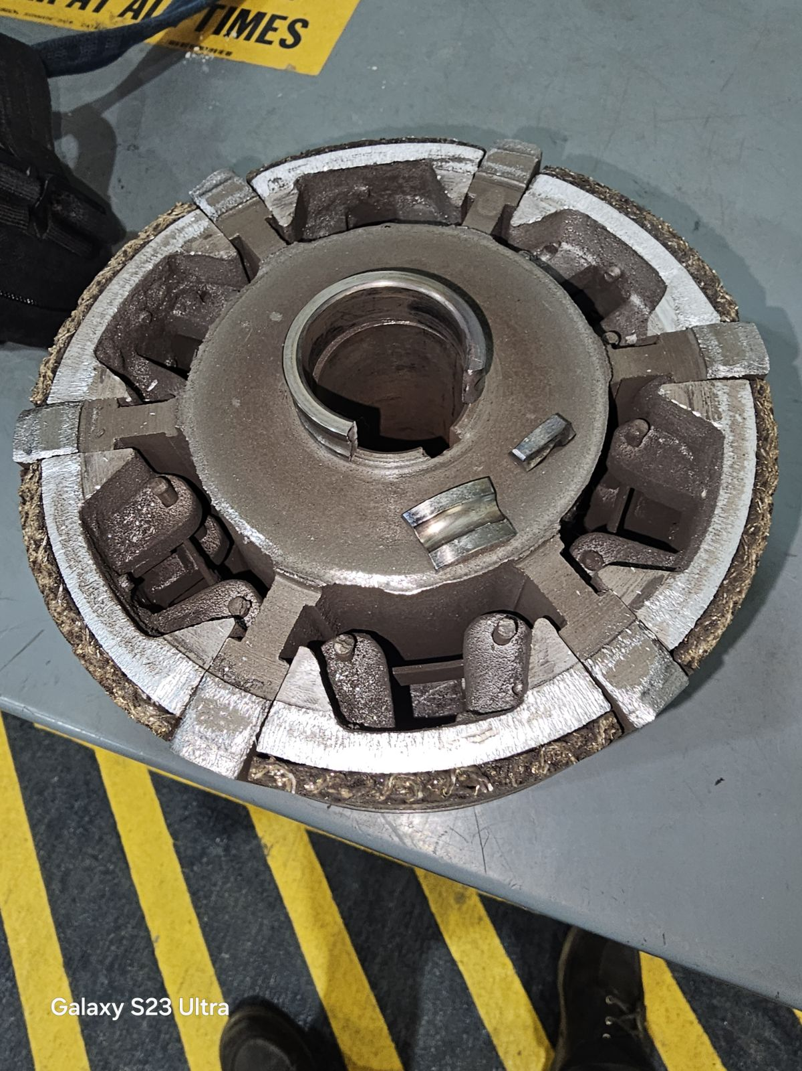
ORPS/NTS in November
MI-65 elevator issue, 11/11/2024 (ORPS Event, Level 2)
The Target Group was using the MI-65 Elevator to send compressed gas cylinders down, per procedure. The two individuals at the bottom who were waiting to unload the cylinders witnessed the elevator making grinding noises and doing unusual "bouncing" when it got to the bottom that it doesn't normally do.
As they sent the elevator back up after emptying, it made another grinding noise. They thought that they saw a piece of something fall out of the side of the elevator. They immediately hit the disconnect and locked out the elevator, notified the MCR and DSO, and the MCR restricted access. ISD was notified of the issue.
ISD states a centrifugal clutch broke. The subcontractor is working on replacing the part.

Slide 6
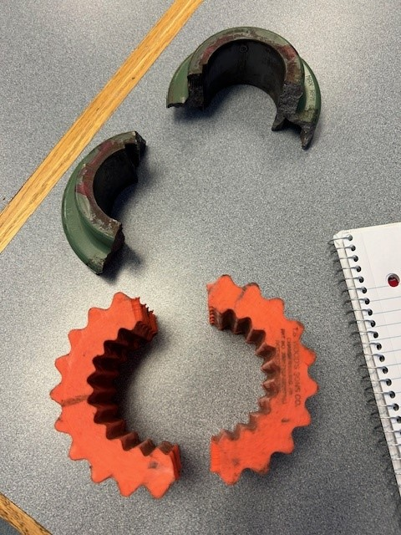
ORPS/NTS in November
LCW pump coupling near miss, 11/15/2024 (ORPS Event, Level 2)
An LCW pump in the IB1A building was not working. A work order was submitted to troubleshoot it. Electricians met with the individual who submitted the work order and upon arrival they attempted to turn the pump on to confirm there was power to the pump. To see if the motor would turn, the electricians locked out the pump and removed the cover for the shaft. One electrician attempted to turn the shaft to ensure it wasn’t seized. The shaft rotated at that time. The electricians decided to try reversing the polarity of the pump to attempt running in reverse. Once the polarity was reversed, the LOTO device was removed, and the pump was restarted. The cover was not placed back over the shaft. As soon as the motor was turned on, the coupling broke into two pieces. Those pieces traveled in opposite directions, between 10-15 feet from the pump. No one was in the direction or proximity of where the projectiles landed.
The electricians locked out the pump again and manually tried to rotate the pump shaft forward, but it was locked up. The electricians changed the lock on the equipment to a configuration control lock. They then returned to their building to put in a new work order and order replacement parts to make repairs. The electrician’s supervisor and the Division Safety Officer were informed that the coupler broke.

Slide 7
FESHM & FRCM Updates in November
The following chapters were updated last month. A brief summary is provided below.
11/05/2024 - FESHM 4110: Hazard Communication
Changes:
Updated responsibilities for directorate safety officers.
Updated process for submitting safety data sheets.
11/05/2024 - FESHM 4105: Chemical Management
Changes
Updated responsibilities for supervisors and directorate safety officers.
Updated procedures for chemical purchases.
Removed procedure for safety data sheet management.
11/06/2024 - FESHM 5032: Cryogenic System Review
Changes
Clarification added to exclusions for cryocoolers and dilution refrigerators.
Added reference to responsibilities section on egress requirements.
Updates to responsibility section nomenclature.
Updated D/S/P nomenclature to ALD/SD/PD.

Slide 8
FESHM & FRCM Updates in November
The following chapters were updated last month. A brief summary is provided below.
11/14/2024 - FRCM Chapter 4: Radioactive Materials
Changes:
Changes to Articles 411, 412 defining radioactive material.
Changes to Article 413 introducing a ‘Class 0’ label and RCO responsibility for surveying all radioactive material.
Changes to Articles 421, 422 regarding material release program.
Changes to Article 423 to align with Fermilab Transportation Safety Document.
Removed procedural instructions from Article 441.
Created 453 Excavation of Soil with Potential Radiological Hazard.
11/18/2024 - FESHM 2110: Ensuring Worker Safety when Using International Codes or Standards
Changes:
Renamed title.
Updated for the consistency purpose with the 10 CFR Part 851, relating to non-ASME pressure systems.
Detailed mitigation measures for accepting pressure equipment codes utilizing 7 attributes.

Slide 9
FESHM & FRCM Updates in November
The following chapters were updated last month. A brief summary is provided below.
11/20/2024 - FESHM 9120: AC Electrical Power Distribution Safety
Changes:
5-year review and update
Organizational names and types updated and minor grammatical improvements and terminology updates made throughout.
Clarified in 4.1.c that substandard working clearance mitigation is only available for existing legacy installations.
Clarified in 4.4.c when “means of prompt communication with site emergency personnel” is needed for approved manipulative energized work.
Clarified in 6.2.e that listed devices must be used to close unused holes in electrical enclosures.
Added lamicoid label requirements for MV equipment specs in the TA.

Slide 10
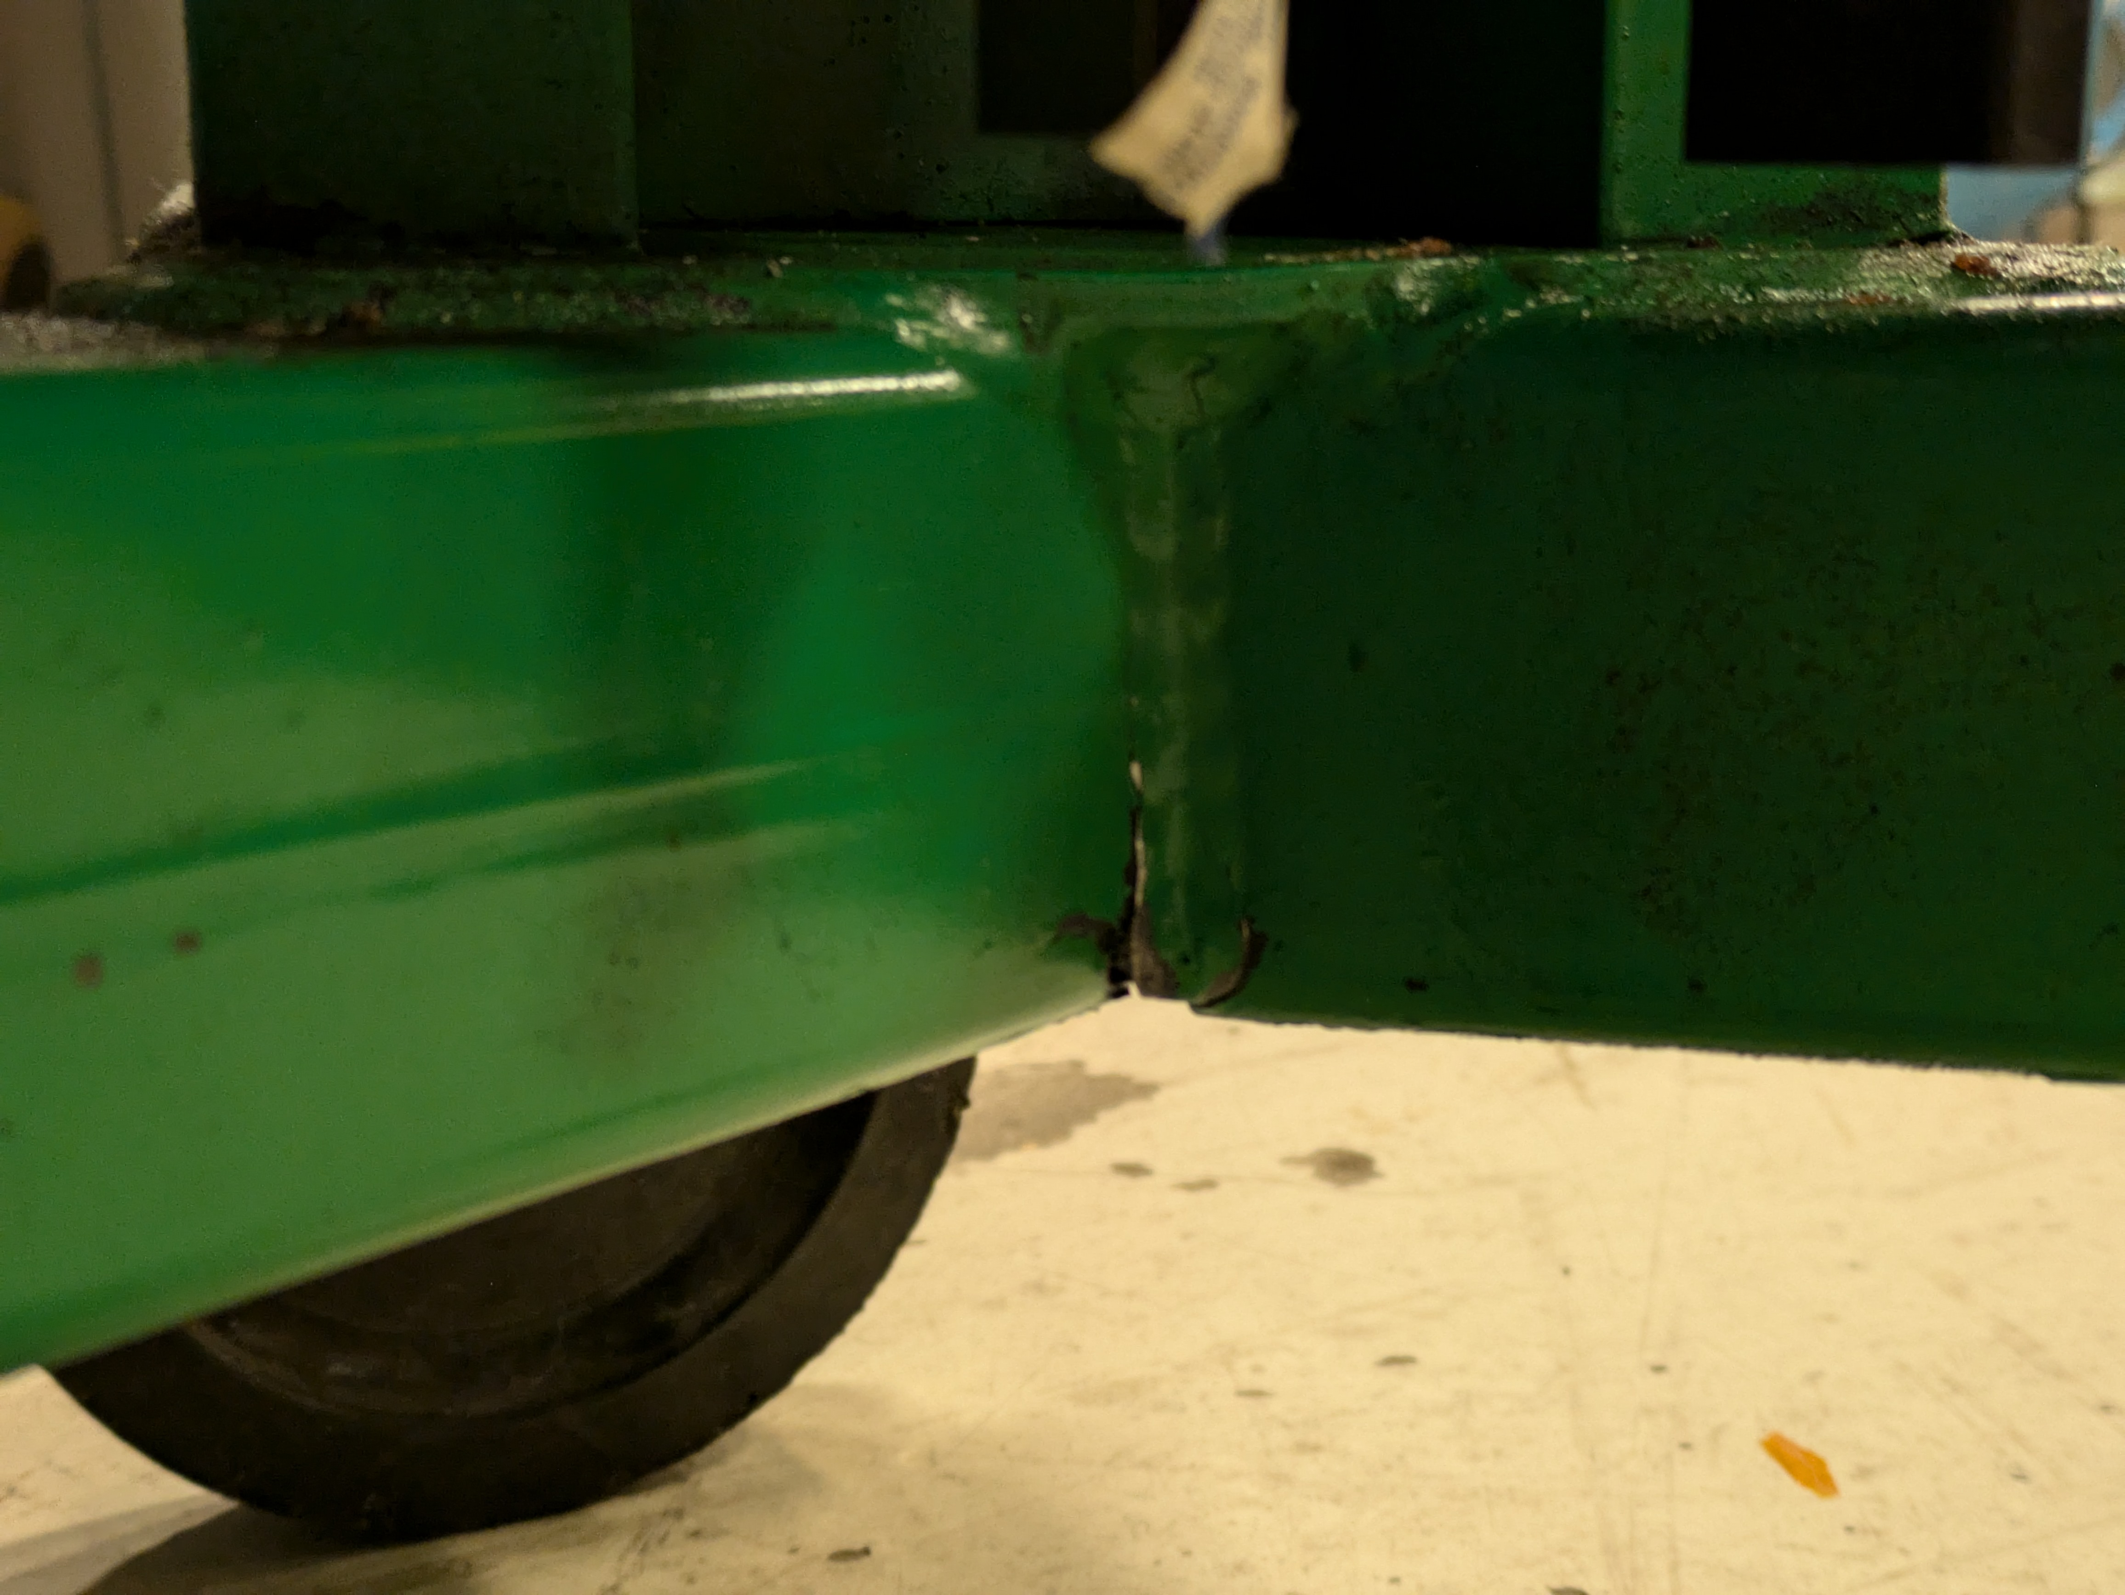
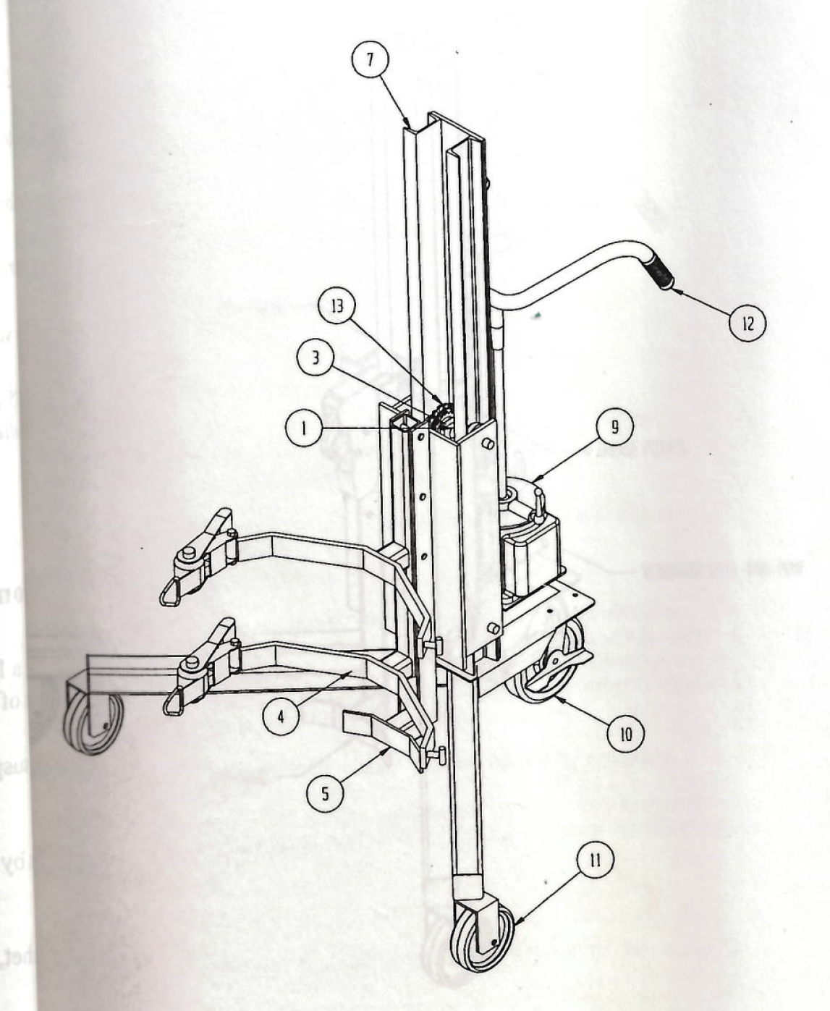
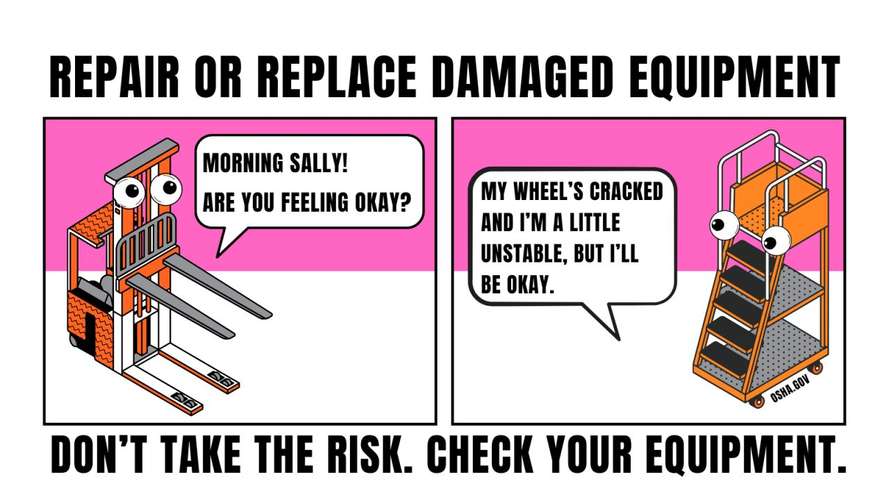
Checking for Faults in Drum Handling Equipment
On 11/04/2024, an employee reported that a Valley Craft Model A82851-00 drum handler with manufacture date of 05/2003 had experienced a weld failure.
The manual provided with this drum handler indicates it is like drum handlers with model numbers 8575, 8576, and 8577.
Please inspect existing drum handlers and remove them from service if they exhibit signs of failure.
Awareness of unusual operation, appearance, and sounds can assist in identifying potential deficiencies.
Comic source: OSHA

