Slide 1
FD1/FD2 Installation Engineering Update
Nicholas Joniak
12/10/2024

Slide 2
Engineering Updates
Procurement Status:
  Upcoming:
    See engineering updates.
  Existing:
    No update.
FD2 TCO:
  Analysis Plans submitted to compliance office for review:
    TCO Hoist Beam.
  Analysis Plans reviewed with comments:
    TCO Platform.
      Comments noted and implemented.
      Engineering note in progress.

Slide 3
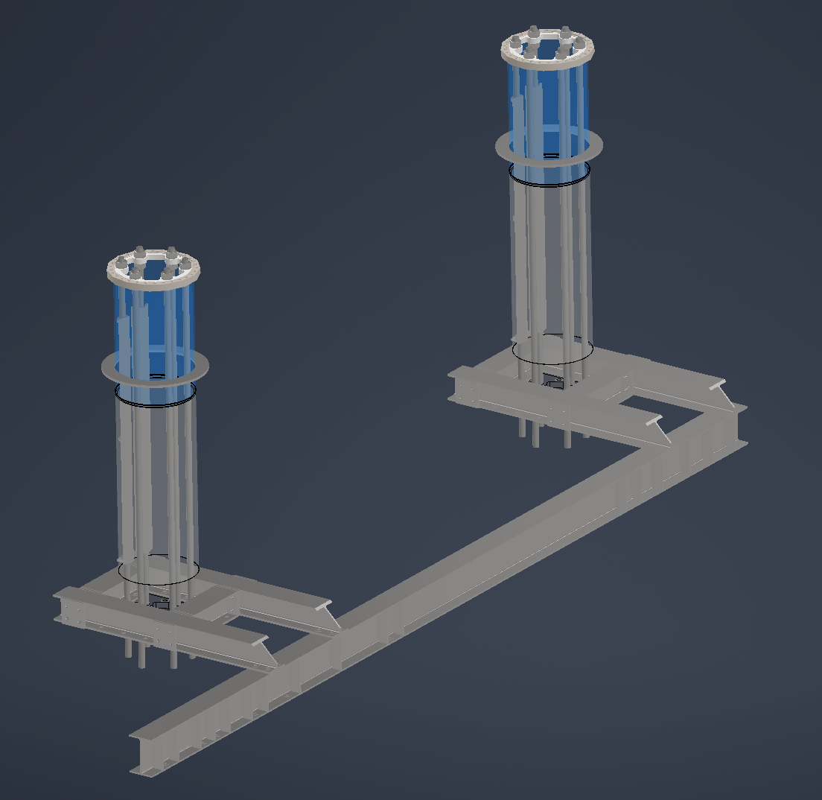
Engineering Updates
Vertical Drift – BDE Cable Tray Support
  Simplified design with only thread rod supports.
  Full model simulation (ambient) presents results with reasonable stresses, deflections, and buckling safety factors.
    Buckling concerns addressed with compression supports on select support rods.
  Thermal simulations to be completed.

Slide 4
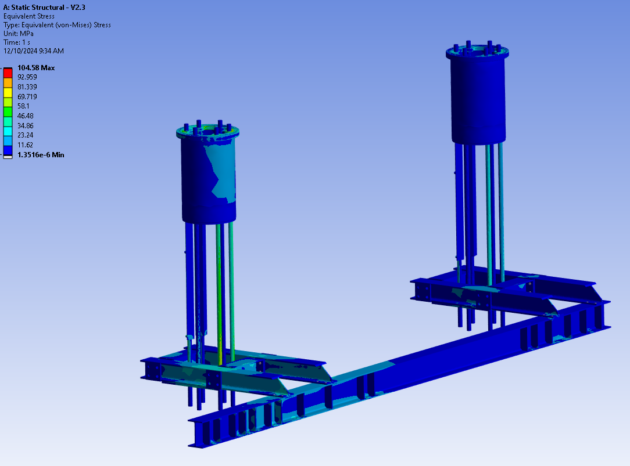
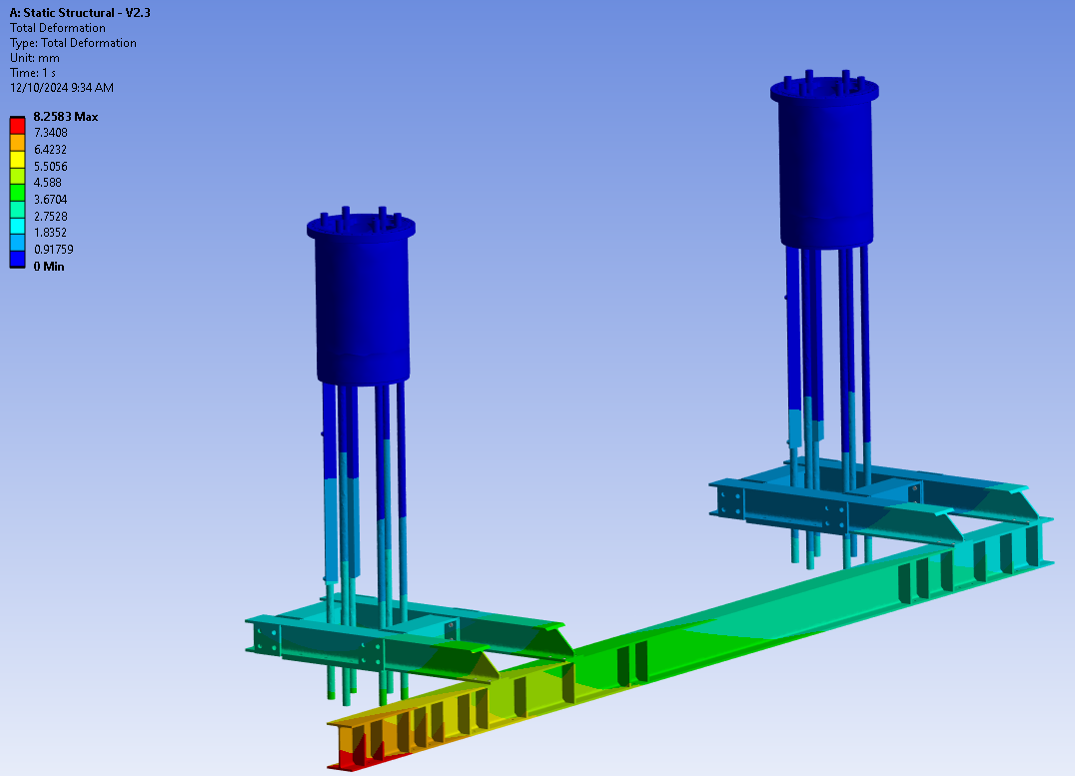
Engineering Updates

Slide 5
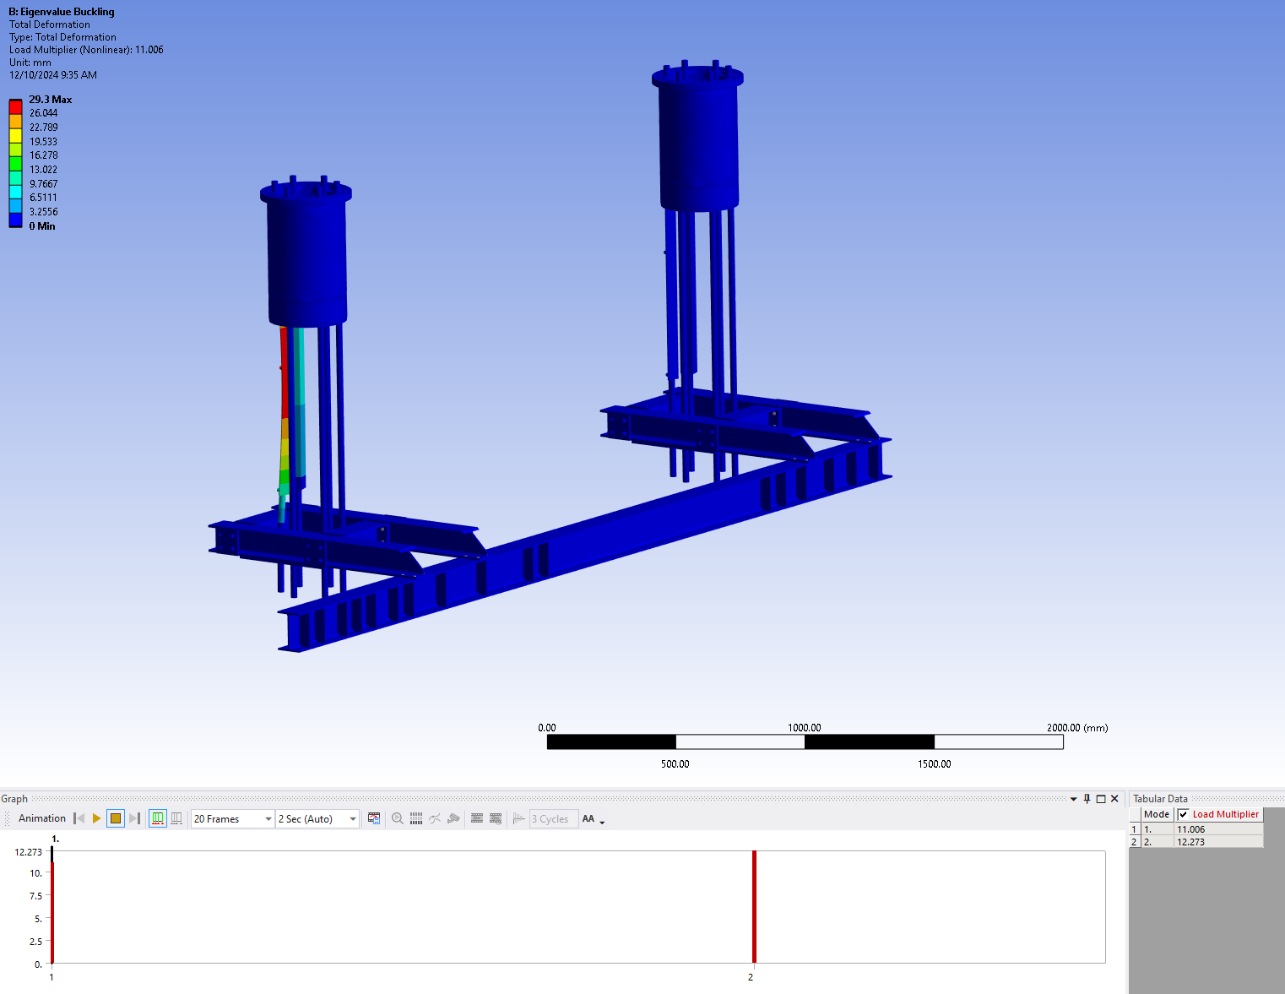
Engineering Updates

Slide 6
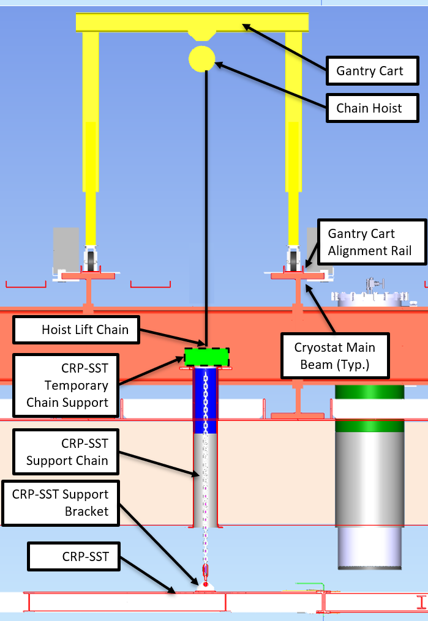
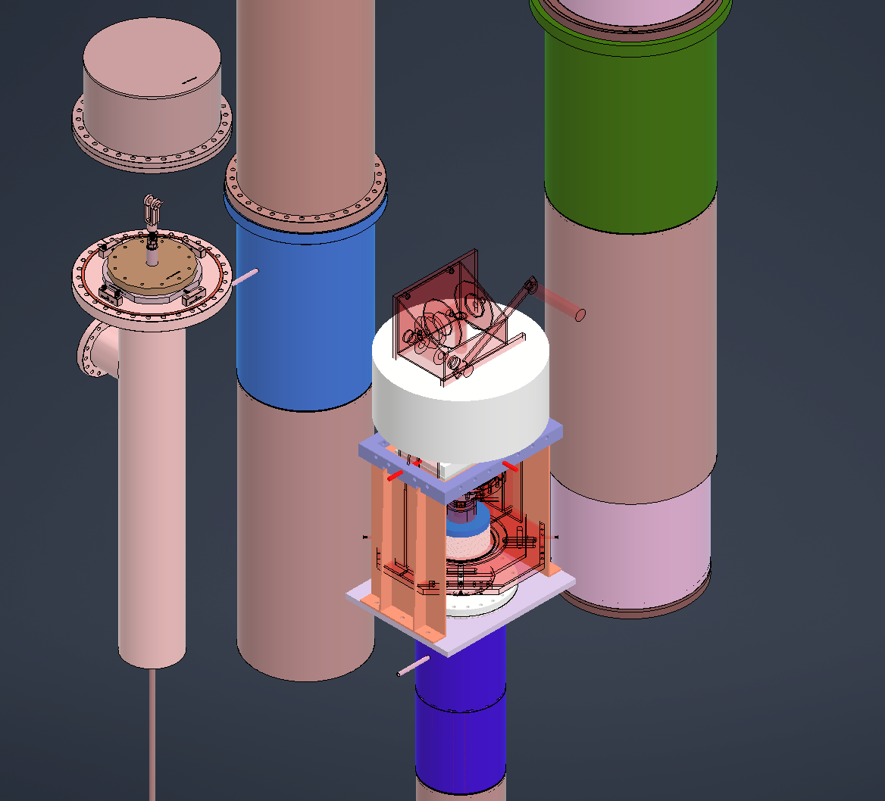
Engineering Updates [Other]
Vertical Drift – Updated penetrations model to be compared with original.
Working on establishing installation procedure for CRP-SST frames.
  Gantry crane.

