Slide 1
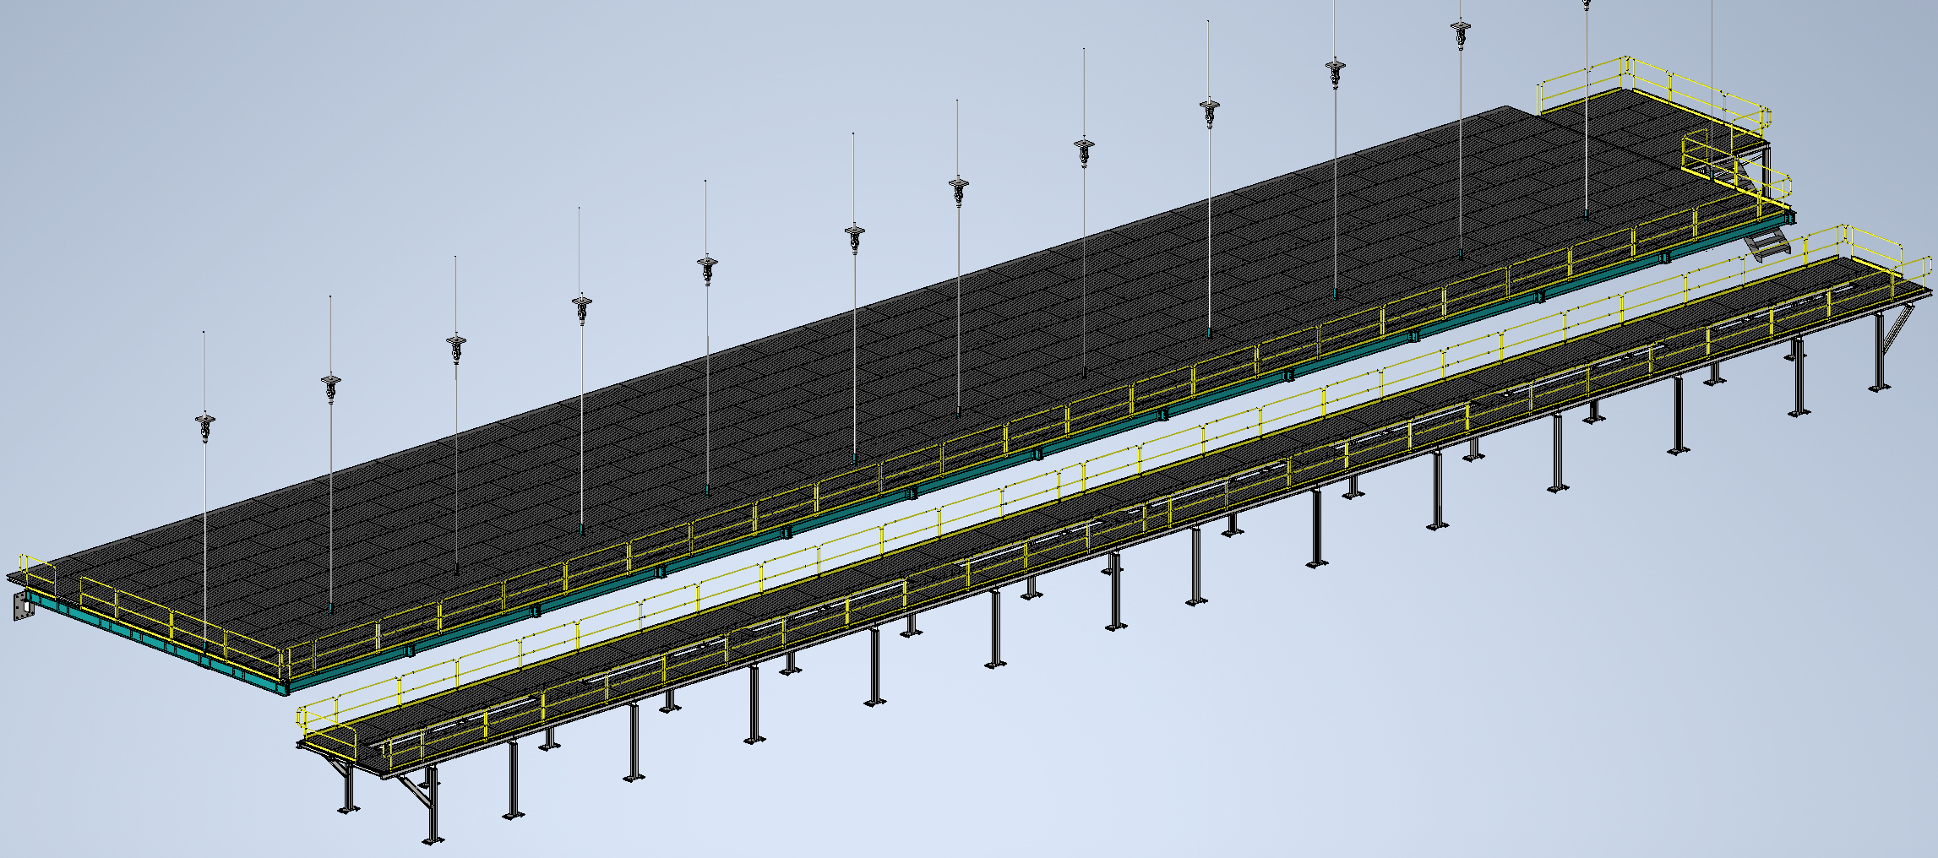
Mezzanine Flooring and Railing
Status
Design note and calculation note uploaded to edms
264185
Walking surface and railings for mezzanines
Install Activity:
Install flooring and railing onto detector, cryo, and ledge mezzanines
16-Sept-26
Tech Spec. | N/A | Starting this week
3D Model | N/A | Complete | 11/1/24
Design Note | N/A | First Draft Complete | 11/8/24
Eng. Analysis | N/A | First Draft Complete | 12/2/24
CO Report | N/A | Empty
2D Drawings | N/A | Empty
Schedule Contact | N/A | Empty
Install Procedure | N/A | In Process
Store/Move 120d - 4mo
Fabrication
30d – 1mo
Procurement plan
Decking and railings are COTS
Two types of custom railing mounts will be required
Self install
Procurement
90d – 3mo
Latest “Submit to Procurement”
16-Jan-26
Fabrication/delivery
PRR Target: Dec. 2024

Slide 2
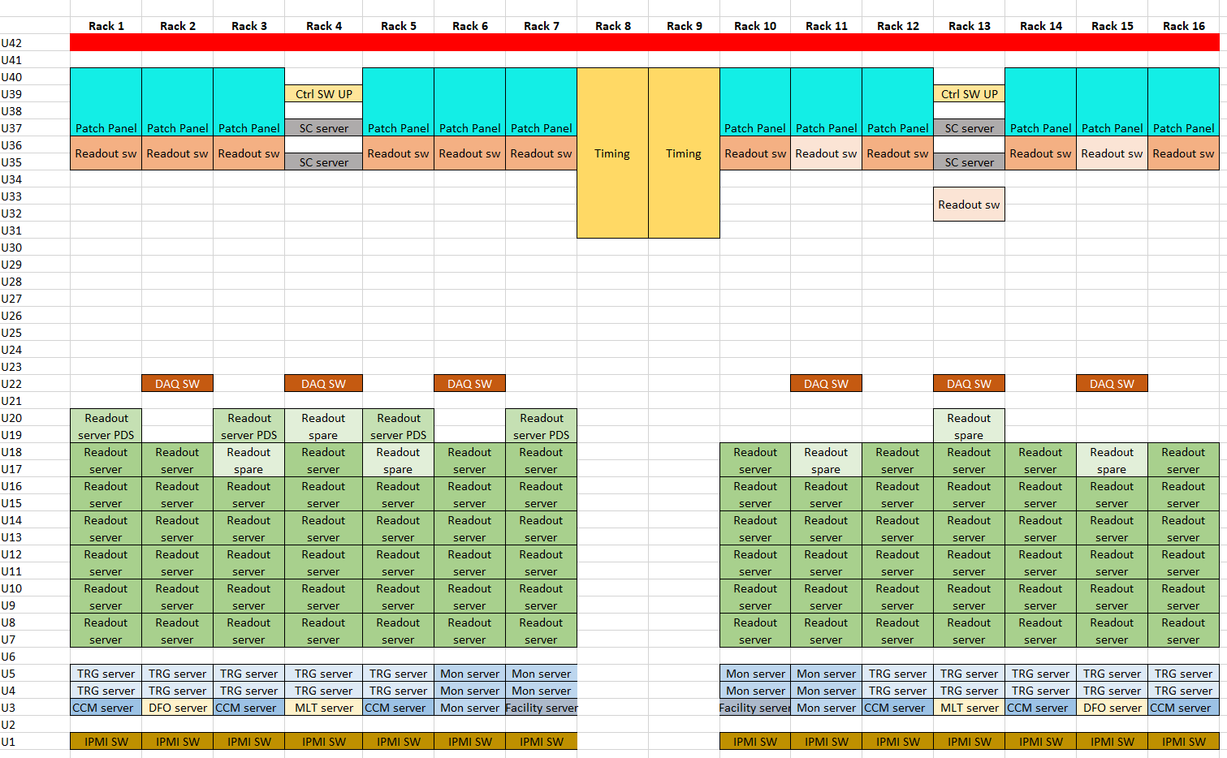
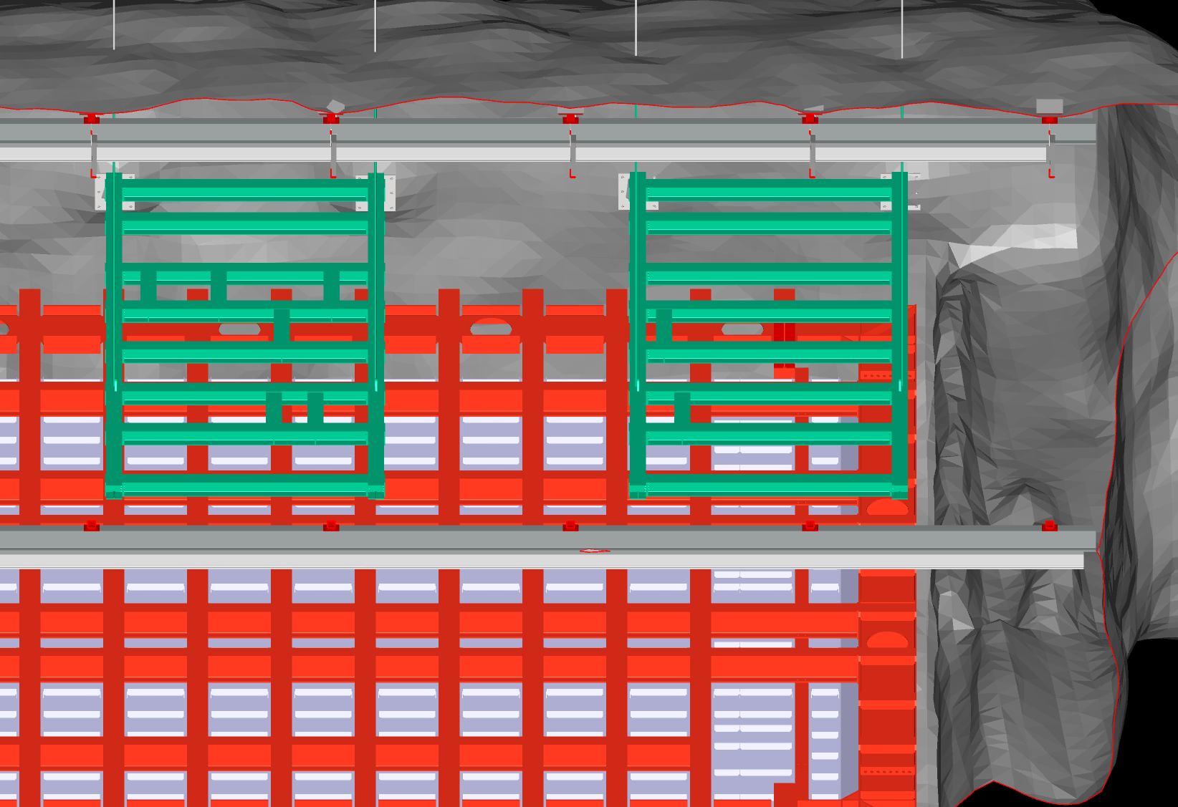
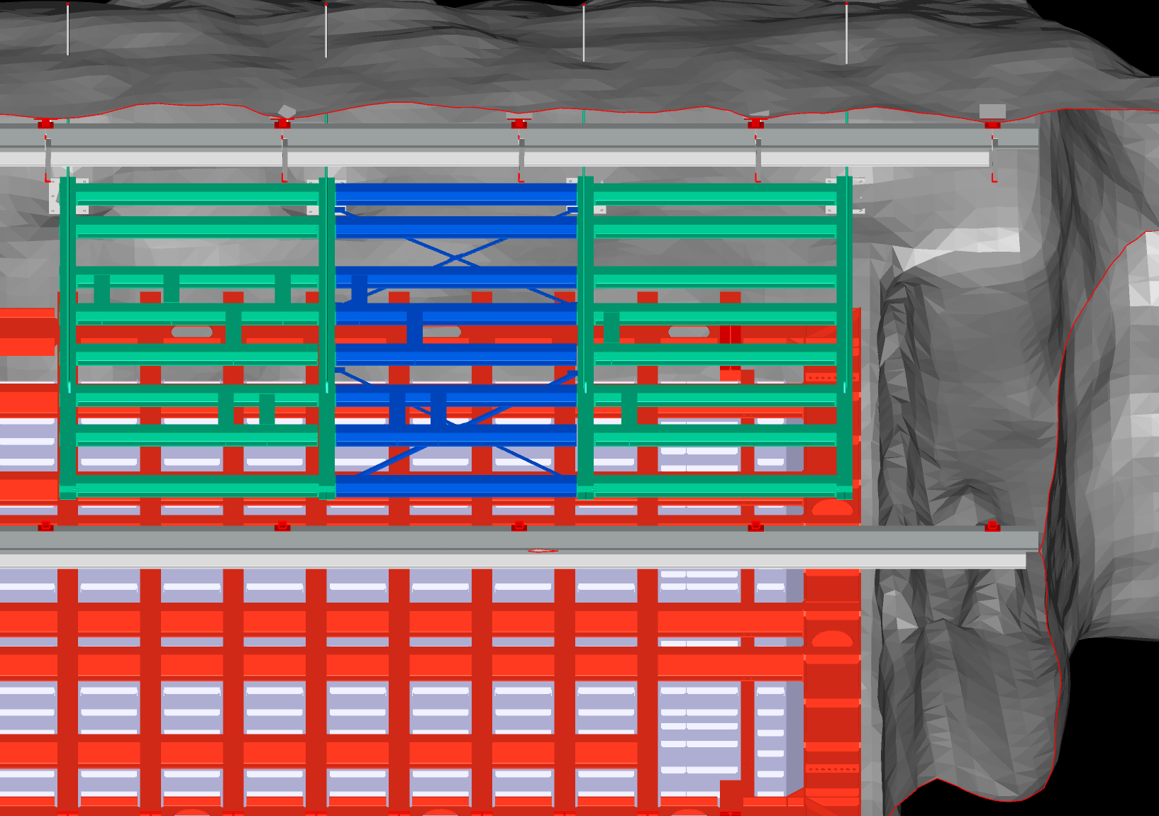
Last Week
Mezzanine Railing
Engineering note first draft complete
Minor adjustments made from Justin’s feedback
Uploaded to EDMS @ 264185 along with design note
DAQ
Pulling together power draw from DAQ racks to begin specifying air handler
Working on further development of DAQ rooms
Cryo Mezzanine Installation
Working on updated installation plan for updated cryo mezzanine construction

