Slide 1
HD/VD engineering update – 12/10/2024
HD Coldbox
  Received final PRR Report, working on addressing recommendations
Air handling equipment for cryostat installation
  Fermi ventilation engineer has green light and is preparing unit specification
Cryostat external ladder/guardrail cable (fall protection system)
  Correct loading understood for analysis from ASCE, will begin analysis procedure
Cryogenic mezzanine structure
  Analysis plan submitted and reviewed by compliance office
  Working on engineering report

Slide 2
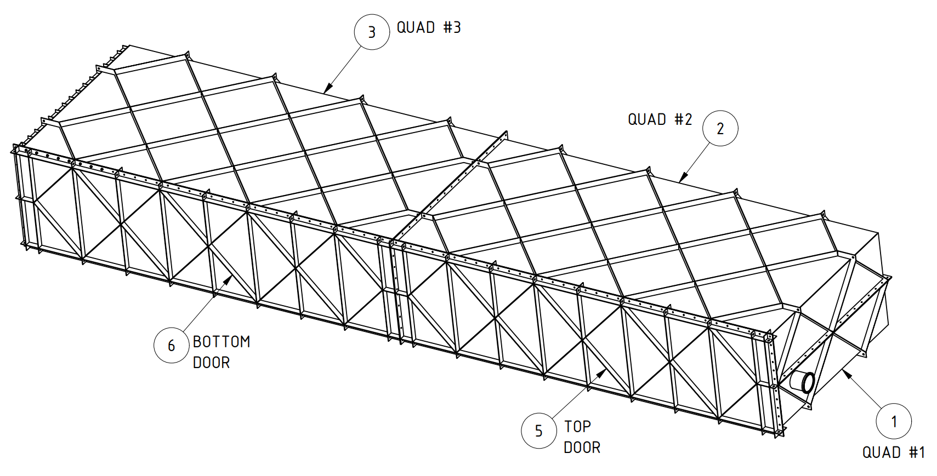
HD Coldbox
https://edms.cern.ch/project/CERN-0000252193
Status
  Documents released
  PRR held Oct. 28, 2024
  PRR panel questions answered, final report due Nov. 25
  QC requirements checklist received, added documents to procurement specification
  Working on critical lift plan
Install Activity:
Assemble the cold boxes for the HD detector
8-Jun-26
Tech Spec. | 252224 | Released | 10/17/2024
3D Model | 252254 | Released
Eng. Analysis | 252285 | Released
CO Report | 252317 | Released
2D Drawings | 252347 | Released
Schedule Contact | 252407 | Empty
Install Procedure | 252437 | Released
Store/Move 120d - 4mo
Fabrication
180d – 6mo
Procurement plan
  LPTA
  Fabrication drawings send to vendor
  Final subassemblies delivered to SDWF
Procurement
180d – 6mo
Latest “Submit to Procurement”
15-Dec-24
Fabrication/delivery
PRR Target: October 2024

Slide 3
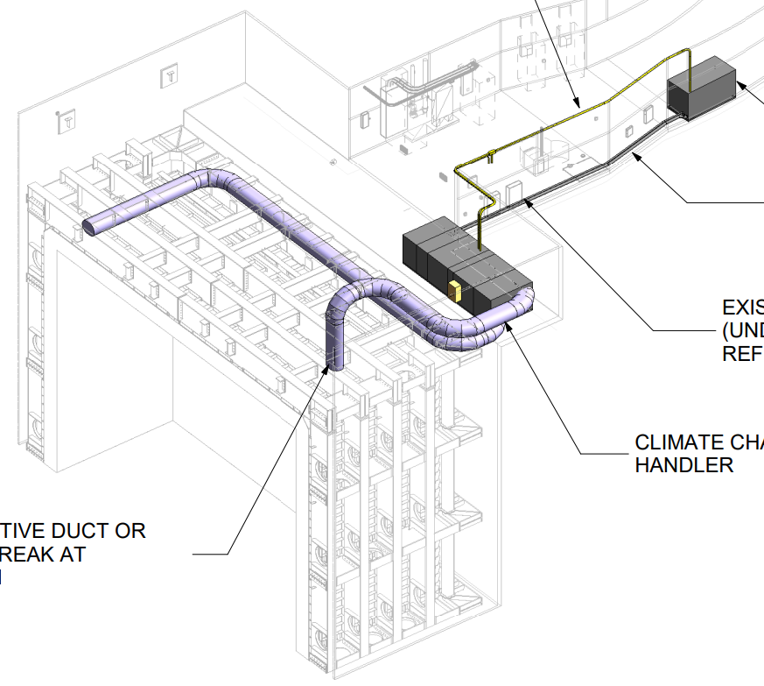
VD Temporary AHU
https://edms.cern.ch/project/CERN-0000252187
Status
  Procurement specification, 2D drawings created
  Awaiting additional information from ventilation engineering
Install Activity:
Install the air units and filters on the manholes of the cryostat in the South Cavern 24-Jan-26
Tech Spec. | 252218 | Eng. Check | 10/17/24
3D Model |  | n/a
Eng. Analysis | 252278 | Released | 04/13/23
CO Report |  | n/a
2D Drawings | 252341 | In work | 10/17/24
Schedule Contact |  | Empty
Install Procedure |  | n/a
Store/Move 120d - 4mo
Fabrication
90d – 3mo
Procurement plan
  Best Bid Value
  Installed by vendor
Procurement
120d – 4mo
Latest “Submit to Procurement”
30-Mar-25
Fabrication/installation
PRR Target: ISD/ESH document review Oct 2024 (fulfills PRR)

Slide 4
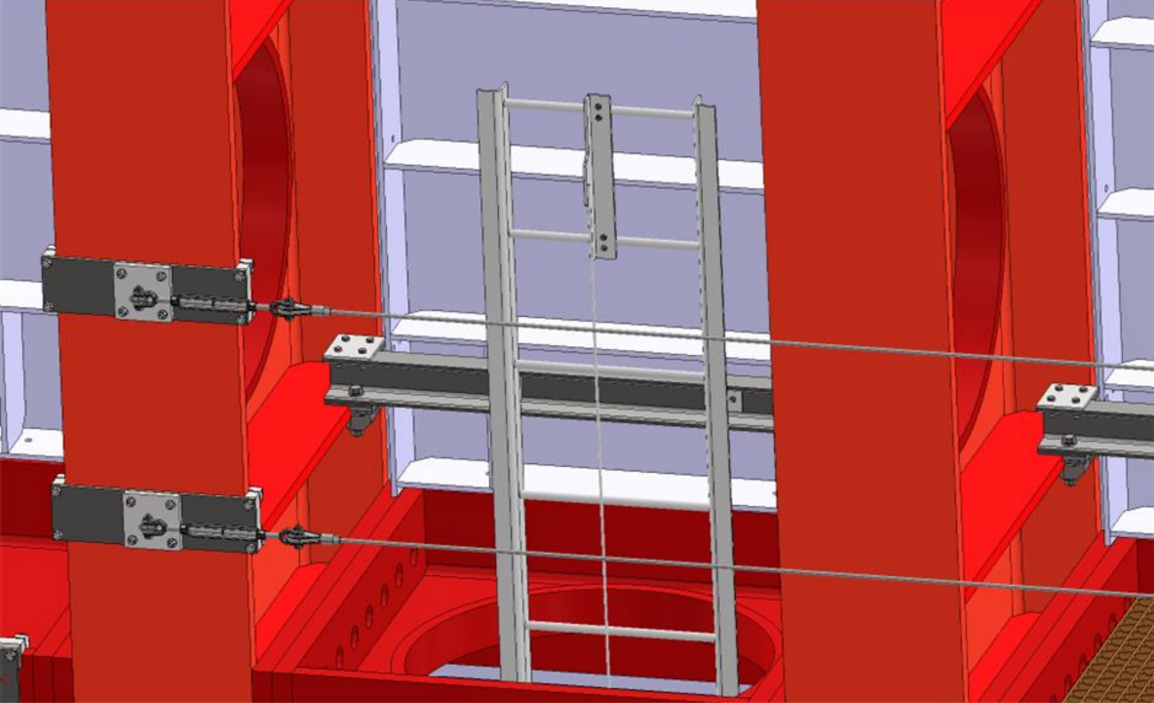
VD Cryostat Fall Protection (Ladders/Guardrails)
https://edms.cern.ch/project/CERN-0000252186
Status
  Procurement specification drafted, reviewing by ES&H
  2D drawings created, with interfaces
  Installation to be self-performed
  Need loads for analysis plan (OSHA 1926.502, OSHA 1910.28)
Install Activity:
Install the ladders and the access system for the side walls of the cryostat in the South Cavern
24-Jul-26
Tech Spec. | 252217 | In work | 10/17/24
3D Model |  | Empty
Eng. Analysis |  | Empty
CO Report |  | Empty
2D Drawings | 252340 | In work | 11/11/24
Schedule Contact |  | Empty
Install Procedure |  | Empty
Store/Move 120d - 4mo
Fabrication
180d – 6mo
Procurement plan
  LPTA
  Fabrication drawings send to vendor
  Final subassemblies delivered to SDWF
Procurement
180d – 6mo
Latest “Submit to Procurement”
30-Apr-25
Fabrication/delivery
PRR Target: November 2024

Slide 5
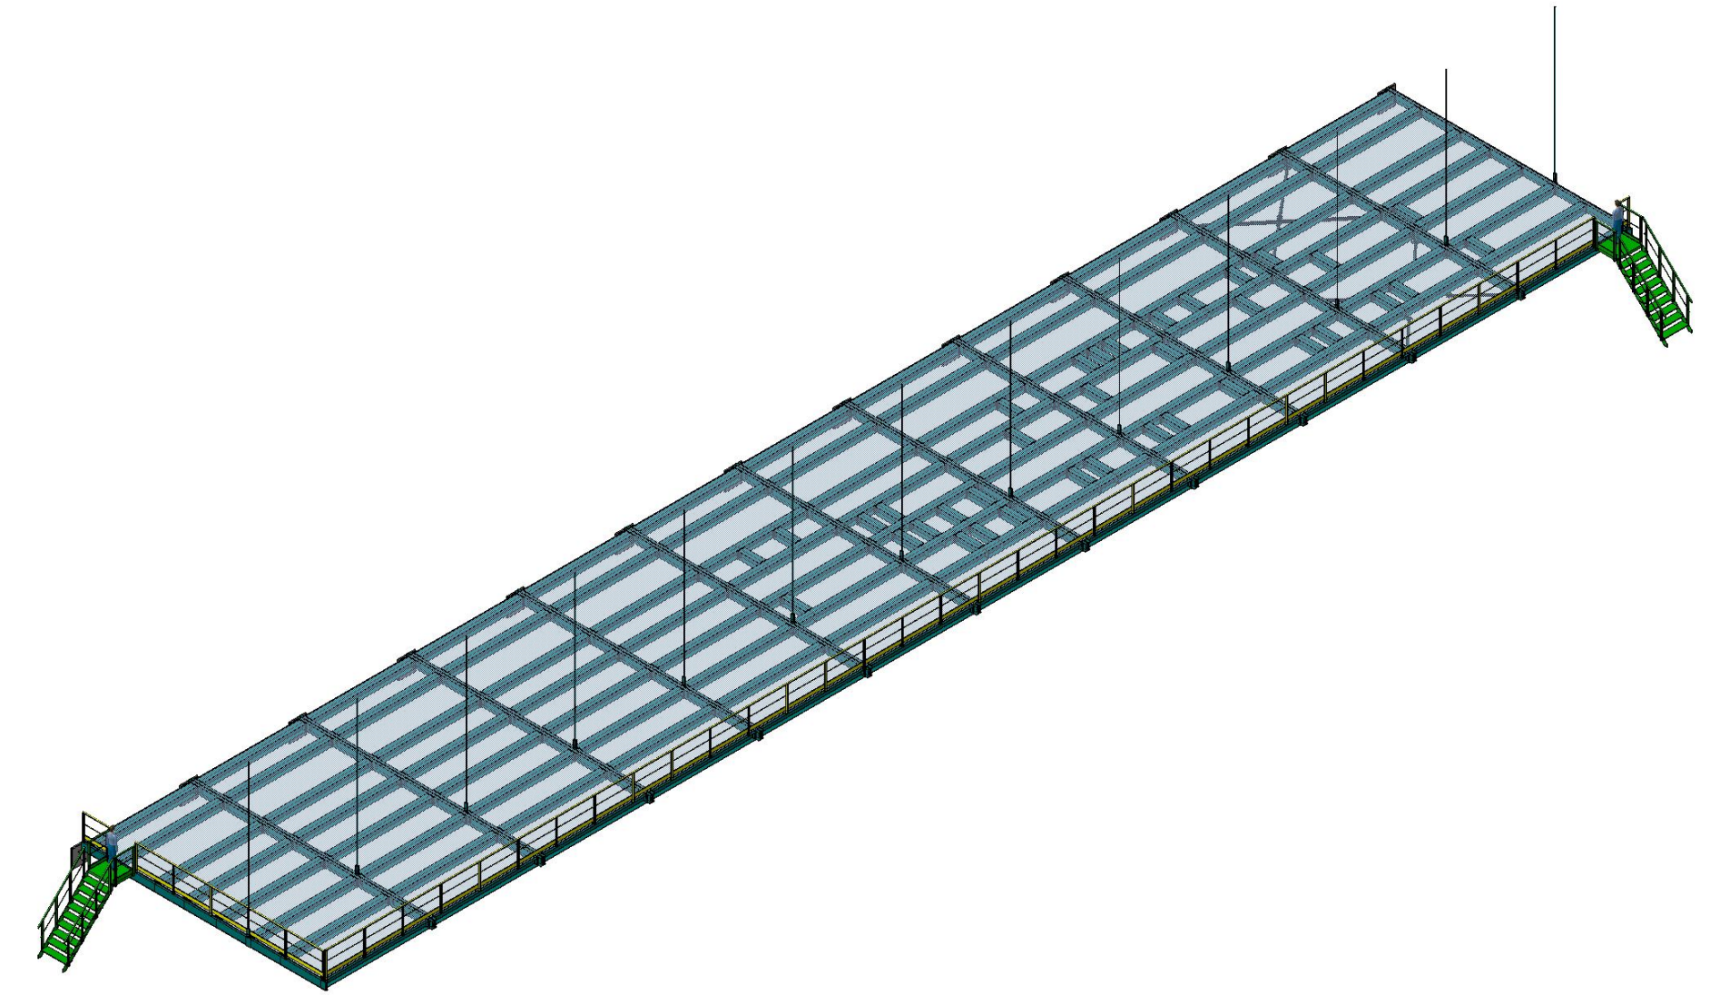
HD/VD Cryogenic Mezzanines
https://edms.cern.ch/project/CERN-0000252179
Status
  Revising model and engineering note for accommodating updated assembly plan and beam profiles
Install Activity:
Install cryogenic Mezzanine level 1 for cryostat #1 - FNAL personnel 28-Jul-26
Tech Spec. | 252213 | Empty
3D Model | 252243 | In work
Eng. Analysis | 252273 | In work
CO Report | 252306 | Draft
2D Drawings | 252336 | Empty
Schedule Contact | 252396 | Empty
Install Procedure | 252426 | Empty
Store/Move 90d - 3mo
Fabrication
150d – 5mo
Procurement plan
  LPTA
  Fabrication drawings send to vendor
  Structural components delivered to SDWF
  Installed by contractor
Procurement
180d – 6mo
Latest “Submit to Procurement”
3-Jun-25
Fabrication/installation
PRR Target: December 2024

