Slide 1
9 AM Meeting
Judah O’Neil
MCR Crew Chief
Wednesday December 11th, 2024

Slide 2
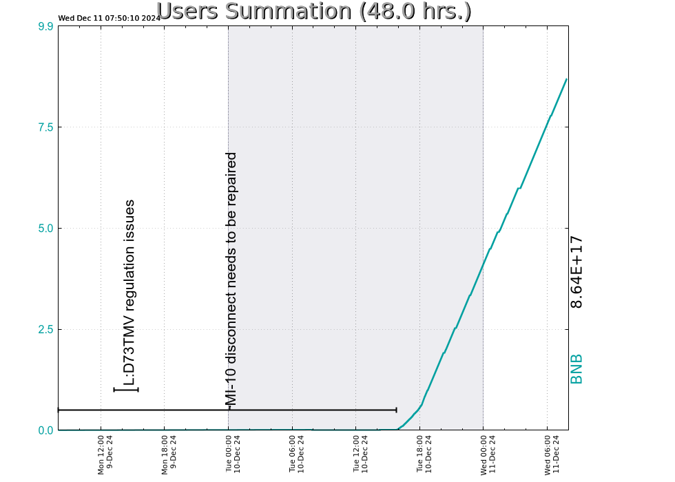
Since Monday…
MI-10 outage completed
Work was completed ~2:00pm on Tuesday
New house disconnect installed successfully
Beam established to BNB ~16:00
Ops tuned overnight
Booster Studies
TeV outages continue
C0-C4, D0-D3 outage underway
Beam to BNB

