Slide 1
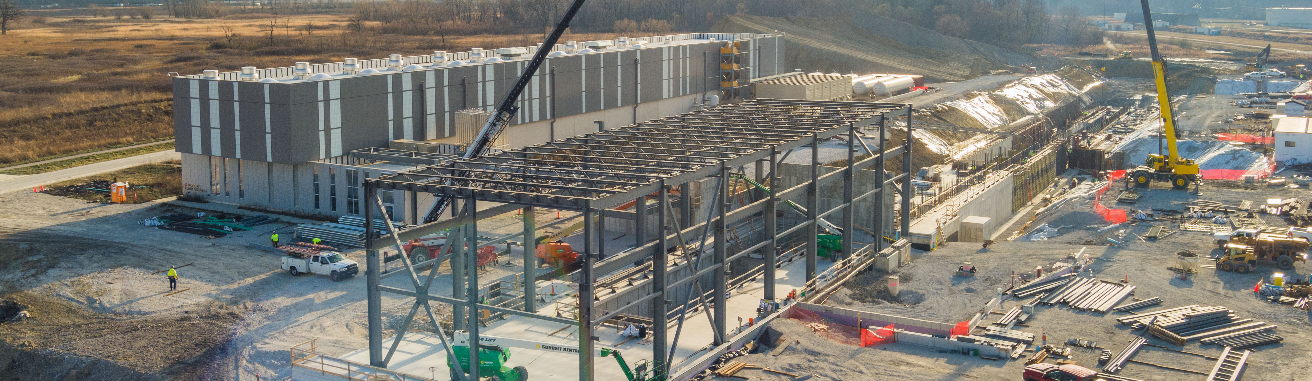
PIP-II Report
PIP-II Team
Project Management Group
December 2024

Slide 2
Project Management
The cryoplant arrived on site on December 21. All safety concerns about the on-site transportation route have been cleared. The on-site transport was performed today.
The compressors for the cryoplant arrived on site as well. They were delayed at port of entry due to documentation issues. The first units have already been placed in the building.
The ESAAB for the CD4 of the ECF subproject. ESAAB is planned for Jan 16, 2025.
The Cryo team is working on a presentation for HEP to receive approval for the IKC scope transfer of the CDS-TTL and inclusion in the baseline.
The design refresh for the booster connection is completed
Most of the team took time off during the Christmas break.
2

Slide 3
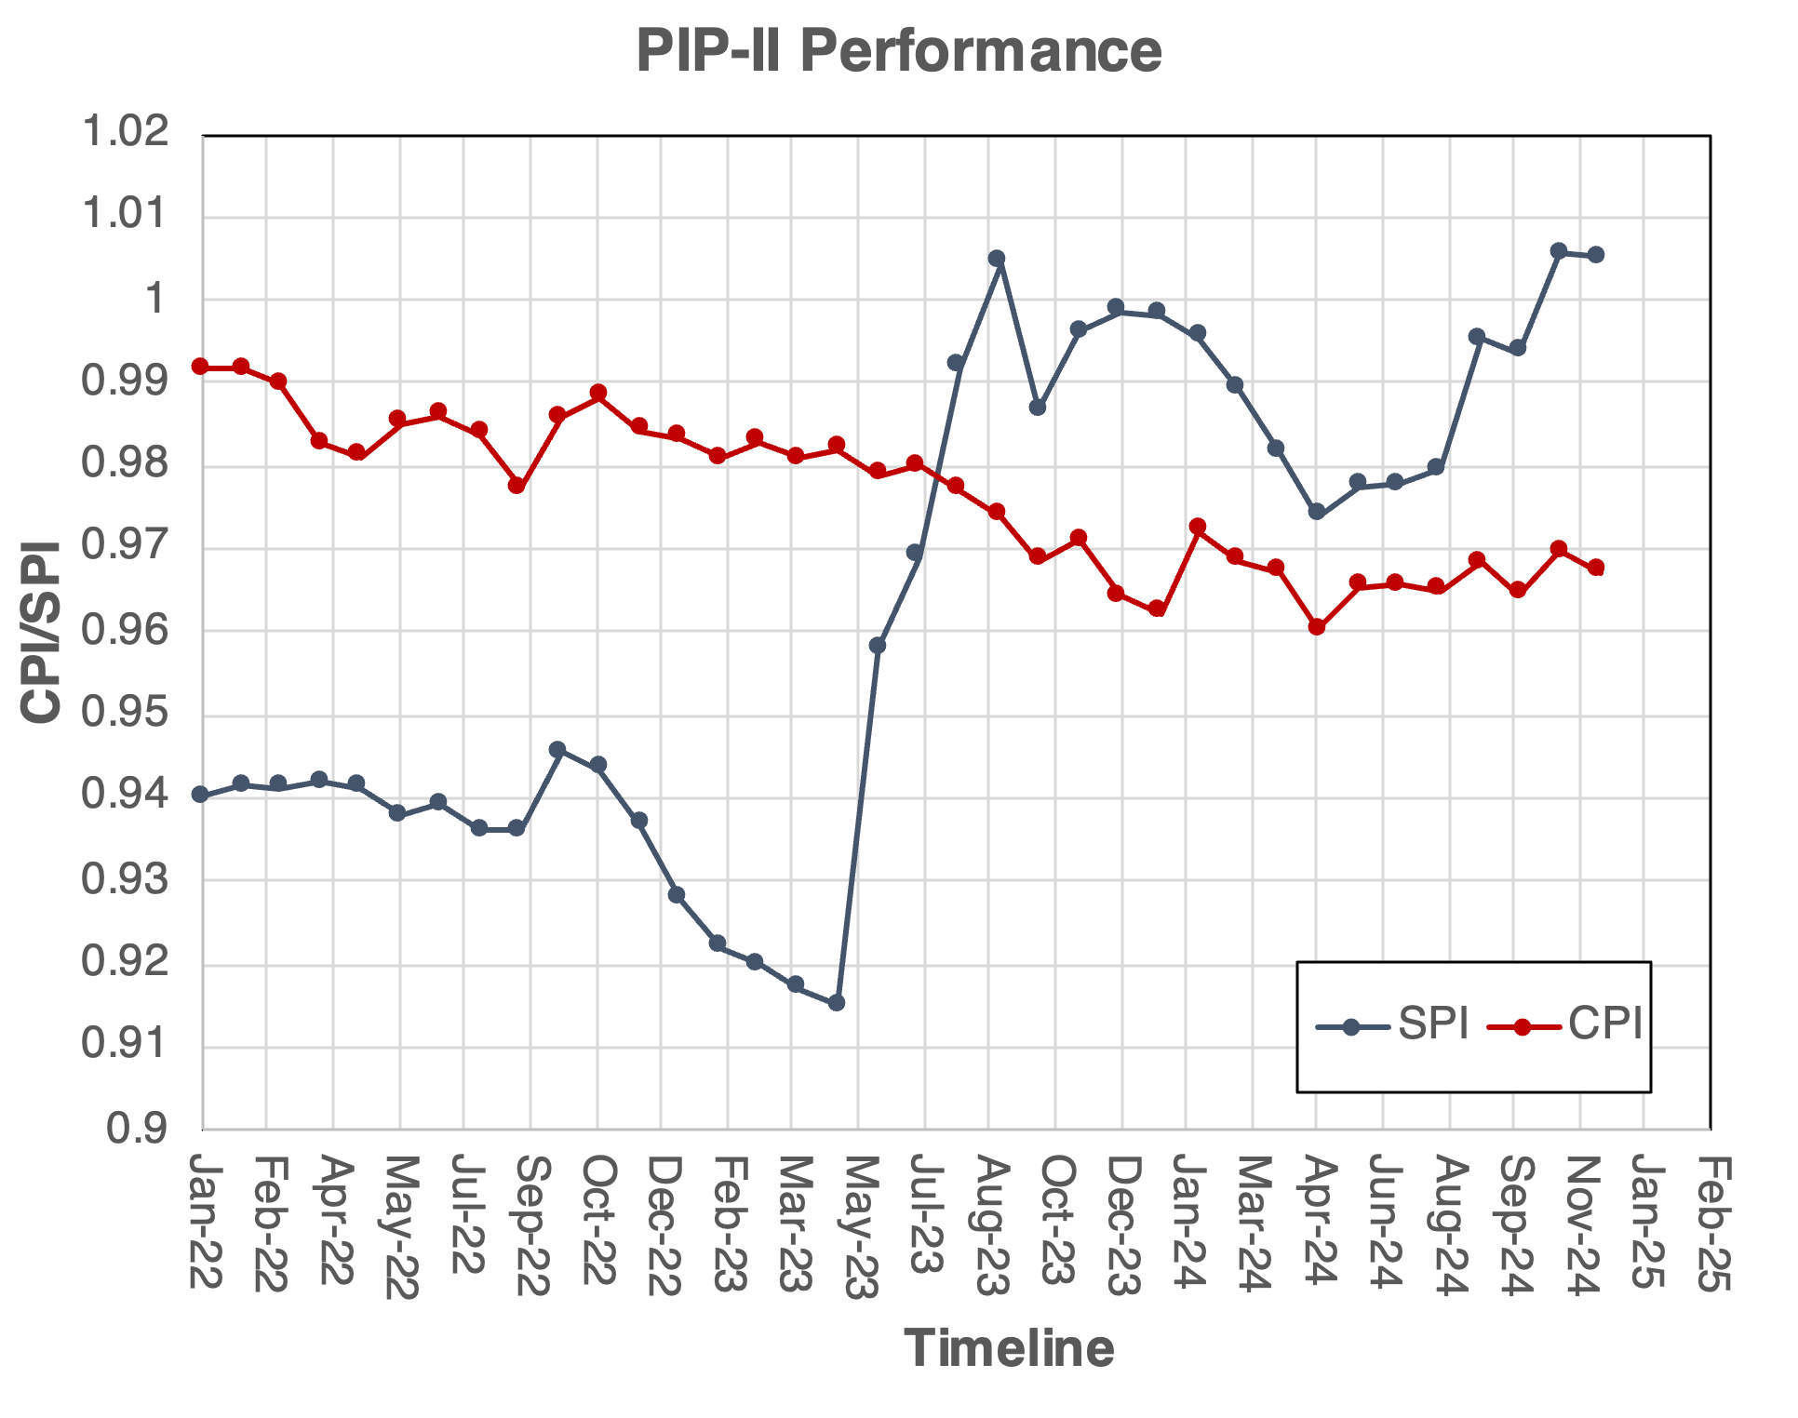
Financials
SPI
1.01
0.00
CPI
0.97
0.00
BSI
0.92
-0.01
BEI
0.92
0.00
ETi
0.92
0.00
%Com
50.1
1.30
Notable SV Variances:
SRF delay in coldbox and compressors delivery
AccS slow progress in LLRF, Vacuum, beam instrumentation and Controls
Notable CV Variances:
AccS slow progress in LLRF, Vacuum, beam instrumentation and Controls
CF P6 alignment to subcontract execution

Slide 4
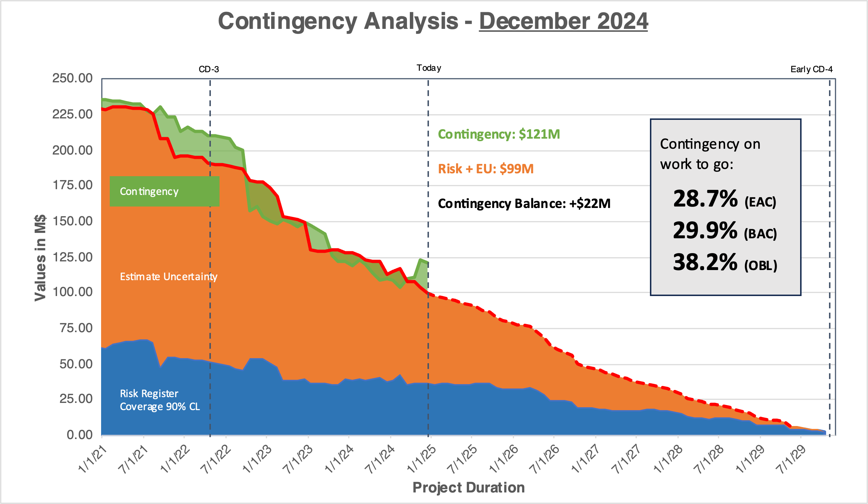
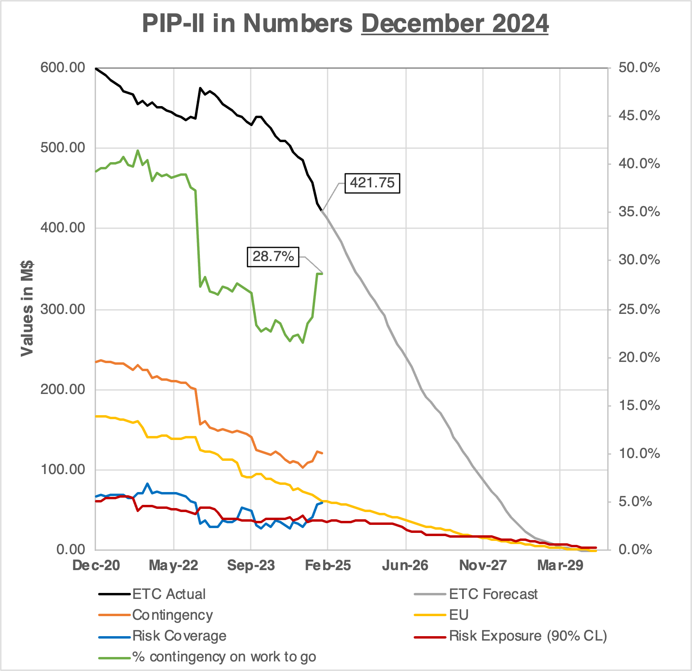
RLS Development Status
Contingency on WTG recovering now at 28.7% (+0.1%)
The critical path through CF.
BCRs for $0.46M, including support for additional DAE visitors to follow the cryoplant installation
Early CD-4 stable
Schedule contingency 40 months
4
Notes:
Add

Slide 5
QA
QC Planning / Execution
  Worked with 650 Cavity SPM to follow up on the LB650 Cavity ACLs and Incoming Inspection Travelers.
  IN2P3 uploaded multiple QC documents, including NCRs and Cavity Test Results, to Atrium. Reviewed these with the SPM.
New Lesson Learned entered (#104) from SRF/Cryo - "Annealing of Thermal Straps"
Provided review, feedback, and approval of multiple procurement specifications/SOW's including: CDS tunnel warm piping install, Thermal straps, BTL collimators, Intermediate Cooling Skids, and more.
Started a desktop assessment of our Document Management and Control Procedure. Plan to formally document this effort and capture all actionable outcomes.
Followed up on multiple Discrepancy Reports, gathering sufficient evidence prior to closure.
  Master NC Log updated to include some additional charts, including a 2024 wrap up.
5
Notes:
Who was interviewed,a dd statistics o QC per each system, standard QA on SOW to mark on DOE414 based on check list for QA

Slide 6
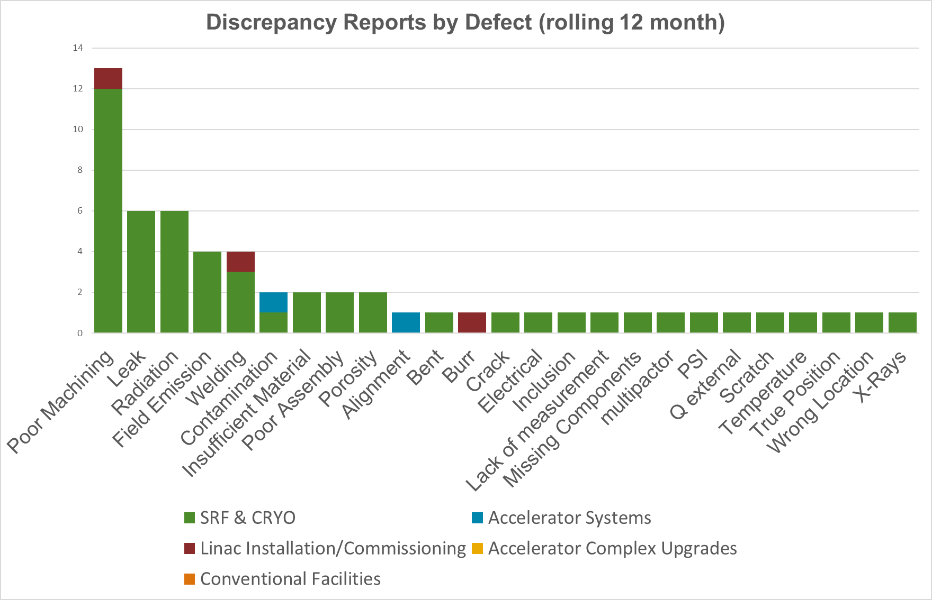
Nonconformance Metrics
Discrepancy Reports (DRs)
  Last Month
    Opened: 3
    Closed: 9
  This Month
    Opened: 10
    Closed: 9
Ex. “Poor Machining” DRs
  DR 13611 (Closed) - 650 tuners tapped holes issue (SRF/Cryo)
    CA: Updated drawing to include detailed instruction on how to tap holes.
    PA: Requested vendor to add additional QC check of installing screws into tapped holes.
  DR 13758 (Open) – Upstream SSR1/2 Adapter Plate thread size issue (LIC)
    CA: Use as-is and notified vendor.
    PA: TBD
  DR 13601 (Closed) – Couple units failed leak check due to conflat seal surface not machined exactly to ASTM standards. (SRF/Cryo)
    CA: Reworked/machined copper seal
    PA: Added to technical specification that conflat seals to be procured or machined to ASTM standards.

Slide 7
ESH
The Coldbox coordination efforts have been taking place leading up to the move on January 15, 2025. Security and emergency management, ISD, roads and grounds, radiological protection, Fermilab FD, FSO, and the PIP-II team have all been involved in the planning.
First crane critical lifts have occurred at the PIP-II Cryoplant building.
Pre-Construction meeting with Depue Mechanical for the PIP-II Cryoplant Integration Piping was conducted on January 9, 2025.
PIP-II Hazard Analysis Report (HAR) and The Environmental Management System (EMS) has been updated, related iTrack item closed.
Safety Statistics December 2024
  Zero First Aid Cases
  Zero Recordable Cases
  Zero Lost Time Cases
7

Slide 8
International
DAE:
  DAE's Cryoplant coldbox is at Fermilab !!! This is the single largest IKC component! This reflects years of collaborative work by DAE's BARC and Fermilab. (More info in SRF&Cryo slides)
  70 kW SSA internal review has concluded, and the FDR is being planned for early-February.
  Four Short-term (3 months) visitors for 325 MHz HPRF and LLRF are at Fermilab, and two more for Cryogenics expected in March.
CEA:
  CEA LB650 PPCM procurements are progressing, & team is preparing to perform validatory cavity cleanroom assembly steps that will be validated at FNAL's STC. First cavity for validation is at CEA and cleanroom work is beginning.
CNRS/IN2P3/IJCLab: In facility upgrade mode (no change since last month).
INFN:
  INFN 38 cavity contract has been awarded! All Nb for these cavities has been delivered, and will be Eddy Current Scanned next at DESY, the contract for which has also been placed. Total cost of the IKC is greater than what was budgeted and highlights INFN's commitment .
UKRI:
  HB650 Cavities: 2nd pre-series jacketed cavity will be tested in January.
  HB650 CM procurements progress.
WUST, WUT, TUL:
  WUST cost-shared funding proposal has been submitted to the Polish Ministry of Higher Education and Science. Will be reviewed in the next few weeks, and a decision expected in the next two months.
  WUT proposal is being prepared for submission to the Polish government, as cost-shared IKC.
  Work progressing through FNAL POs.
8

Slide 9
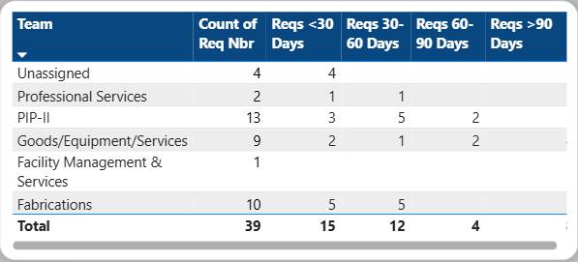
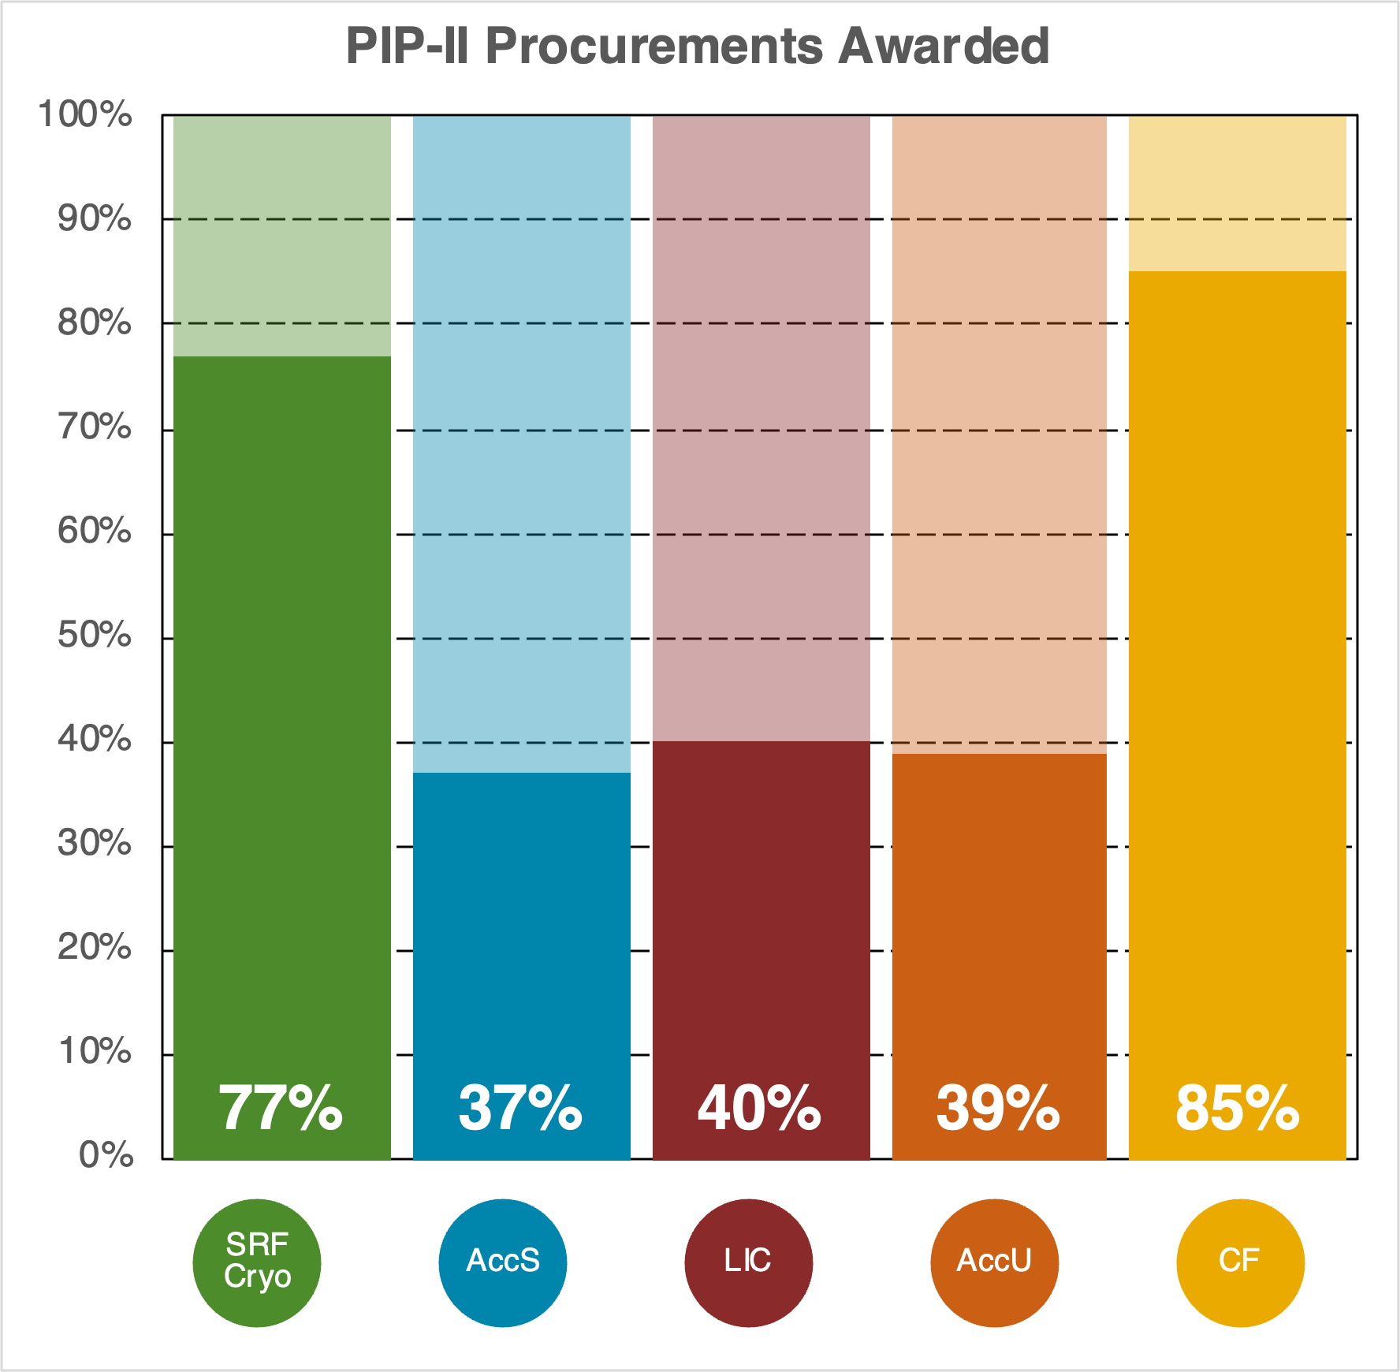
Procurement
Key Items
Advance Acquisition Plan
PIP-II Procurement Page
Power BI Dashboard
Procurement Status
Req in Procurement 39
Previous month 42
Value $23M

Slide 10
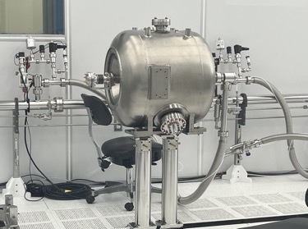
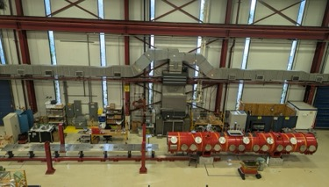
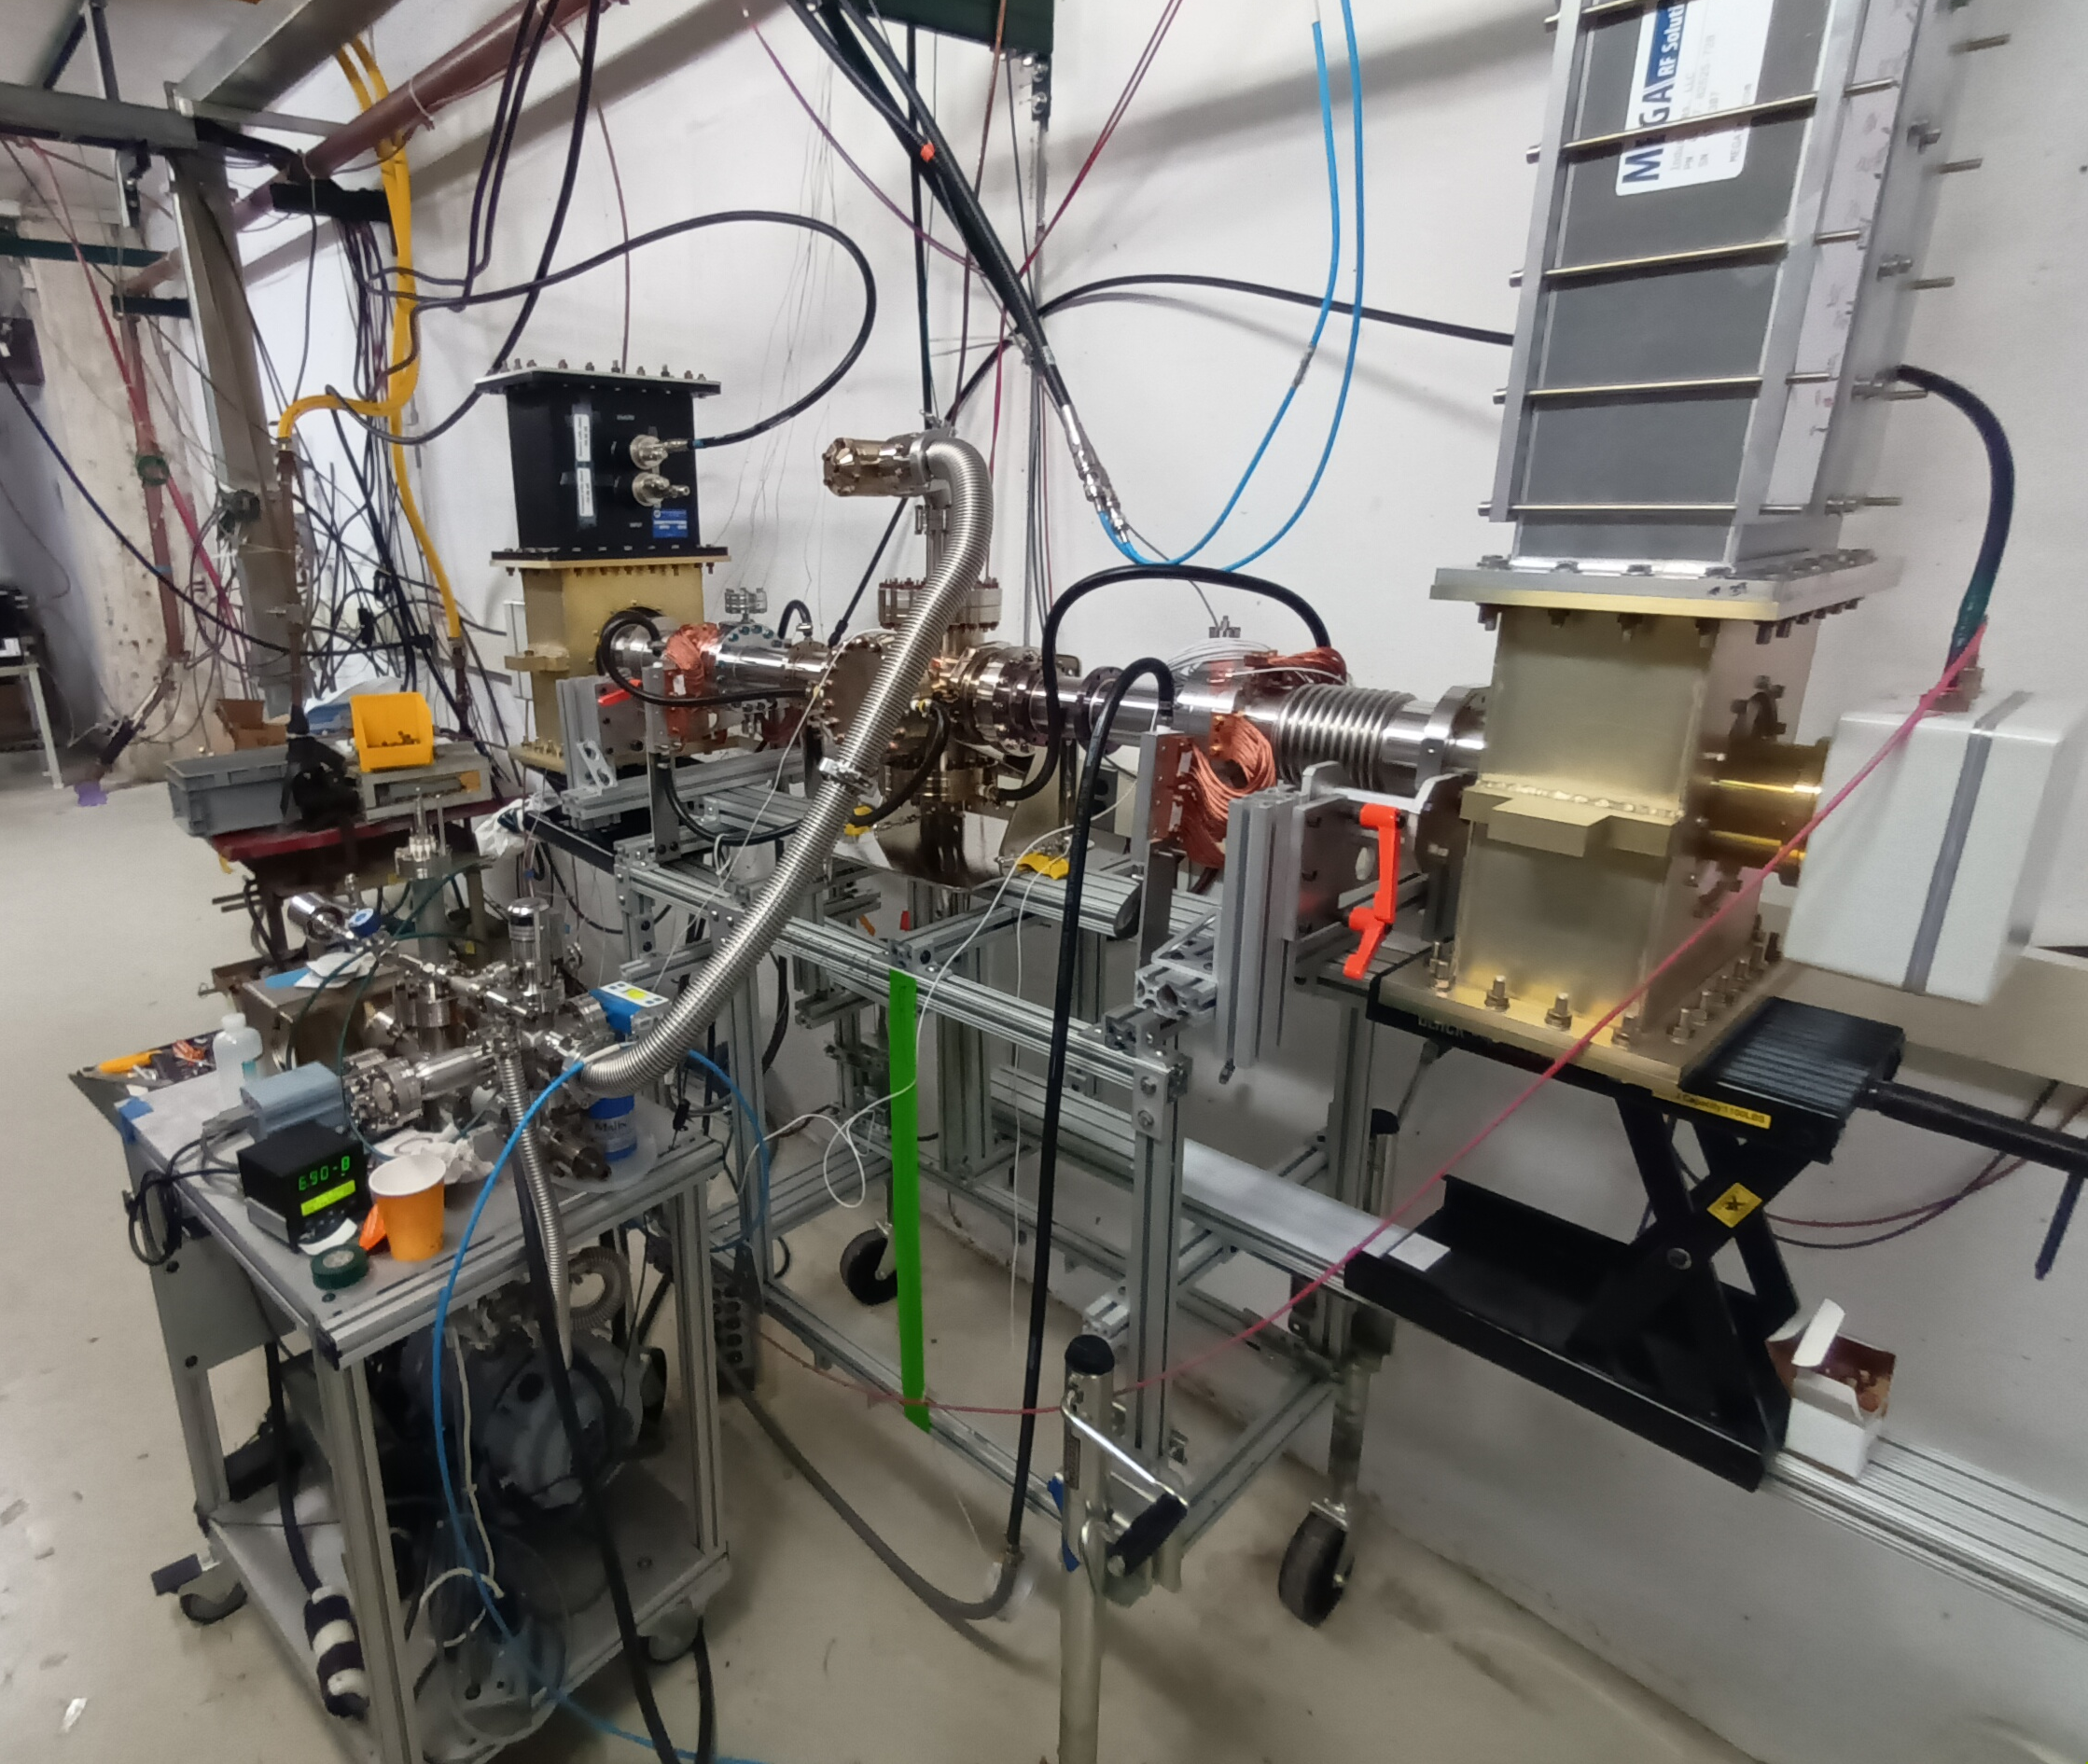
SRF Cryo
SSR2 Cavity: coupler and bellows installation in the cleanroom
Completed fabrication and processing of 8 SSR2 cavities and 3 solenoinds in industry
  5 cavities were cold tested and qualified with unity coupler; 2 cavities qualified with HPC.
Launched the fabrication and processing of 9 SSR1 & 33 SSR2 prod cavities in industry.
Completed the transfer of technology to the UKRI partner to process (N-doping) the production HB650 cavities in industry. The first two pre-series cavities are exceeding spec.​
All 5 LB650 cavities have been qualified bare and are jacketed.
Launched the fabrication of all 119 production PIP-II SRF couplers in US industry
  The first pair of high-power couplers has been fabricated and delivered to Fermilab.
The HB650 pCM completed 3 phases of 2K testing at PIP2IT, with modifications performed between phases to improve heat loads performance, and to verify the transatlantic shipping.
  The disassembly of the pCM has been completed, and the components are now prepared for shipping and reassembly at UKRI under Fermilab’s oversight next year.
Completed procurement and incoming QC of the ppSSR2 vacuum vessel and strongback, with preliminary validation tests successfully completed.
Started the fabrication of all major components for the production SSR1 cryomodules initiated and proceeding, including 2 vacuum vessels, thermal shield and magnetic shields
The vacuum system of the MP9 cleanroom 2 has been reconfigured to support the preparation and assembly of the pre-production SSR2 string assembly in early 2025
The MP9 cold mass and cryomodule assembly area has been prepared.
HB650 CM disassembly in ICB
Coupler RF test stand
10

Slide 11
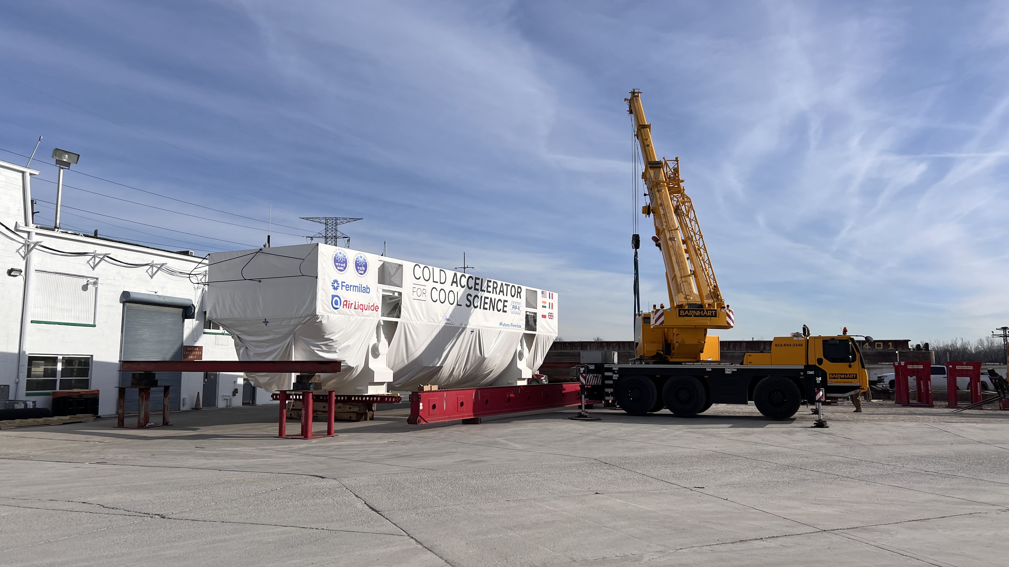
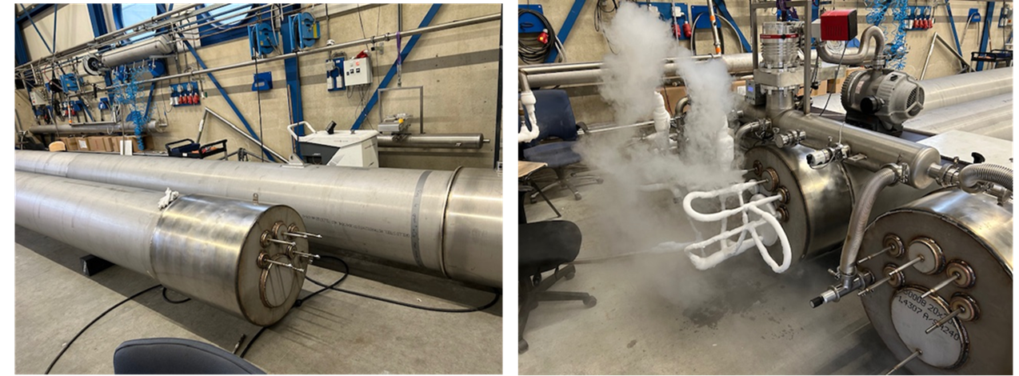
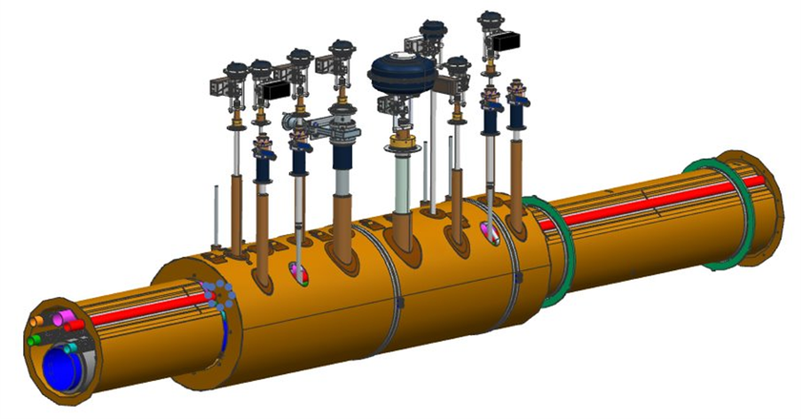
SRF Cryo
Coldbox arrived in Romeoville
The Air Liquide Coldbox and Warm Compressor fabrication has been completed and deliveries have begun.
  Coldbox has arrived in Romeoville, and to be delivered to Fermilab on December 19th
In preparation for the Cryoplant arrival, much in-house work has been completed:
  Cryoplant building is being prepared to accept deliveries
  Recovery System piping installation has been completed
  Recovery System electrical installation is currently 80% complete
  Vaporizer transfer line has been fabricated
  Fabrication of tower supports is nearly complete
  Vaporizer, LN₂ and LHe Dewars have been delivered and installed
Completed factory acceptance tests of 4 of 8 spools of Intermediate Transfer Line
Completed final design of Warm Piping; handover of installation specifications and drawings to Linac Integration; begun procurement of long lead items
Awarded contracts >$2M for Cryogenic Controls System; received several key pieces of equipment
Made significant progress on the final design of Tunnel Transfer Line (i.e., ASME compliance)
  ASME compliance
  Choice of "proven" design for supports and components
  Practically achievable manufacturing and assembly sequences
  Getting ready to start procurement in early 2025.
Spools of Intermediate Transfer Line
Fermilab design of Tunnel Transfer Line
11

Slide 12
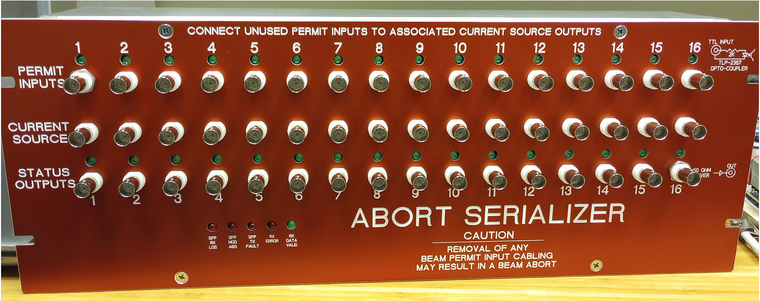
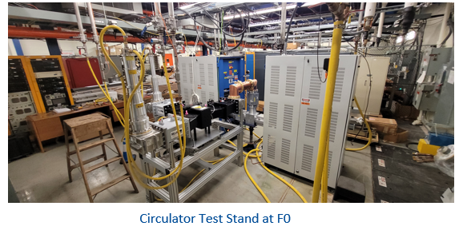
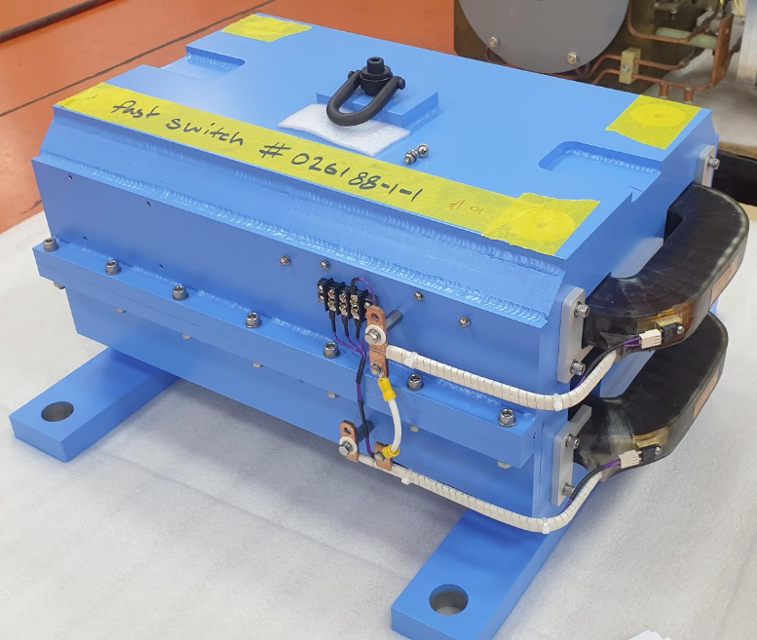
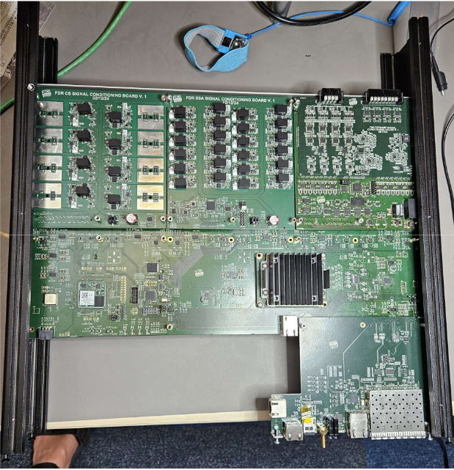
Accelerator Systems
Overall
  Major transition from design to procurement across Accel Sys
  EVMS reevaluation and significant set of performance improvement actions completed
MPS
  Full system FDR completed successfully
  Prototype hardware built and tested (serializer, main units, digitizers)
  Pseudo-code logic for MPS functionality well advanced after much inter-team effort
HPRF
  Successfully supported PIP2IT 650 MHz pCM testing
  Completed design of the 162.5 MHz RF Dist for PIP-II, strongly advanced 325 and 650 MHz designs
  Awarded contract for 6x 40 kW 650 MHz SSAs to support PIP2IT including RF distribution and layout
  Worked closely with DAE colleagues to advance SSA designs (last FDR in February ‘25)
  Established RF test stand at F0 to support SSA, circulator, and coupler testing and development
LLRF
  RF Station FDR and RFPI FDR (TUL) completed successfully
  Supported PIP2IT and STC testing include demonstration of LLRF performance on all cavity types for PIP-II on the integrated RF platform including final RFPI design
  Completed majority of WFE LLRF system upgrade
  Completed majority of RF Master Oscillator/Phase Ref Line design and prototyping
Magnets/Power supplies
  All Vendor magnet contracts awarded, and significant progress on designs and prototyping
  Majority of 10 A and 80 A parts ordered and fabrication completed in-house
  Completed RAPR regulation design and prototype built and demonstrated
  Successful smooth transition from long-term L3/CAM to his deputy
Fast Switch Magnet Prototype
4 Cavity RFPI Module
12

Slide 13
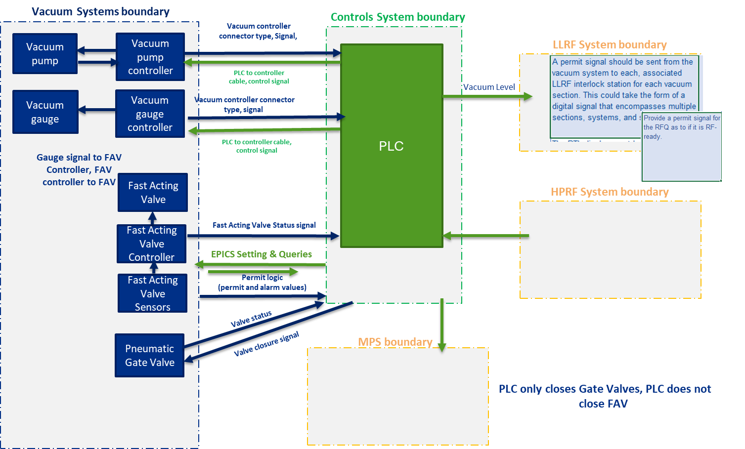
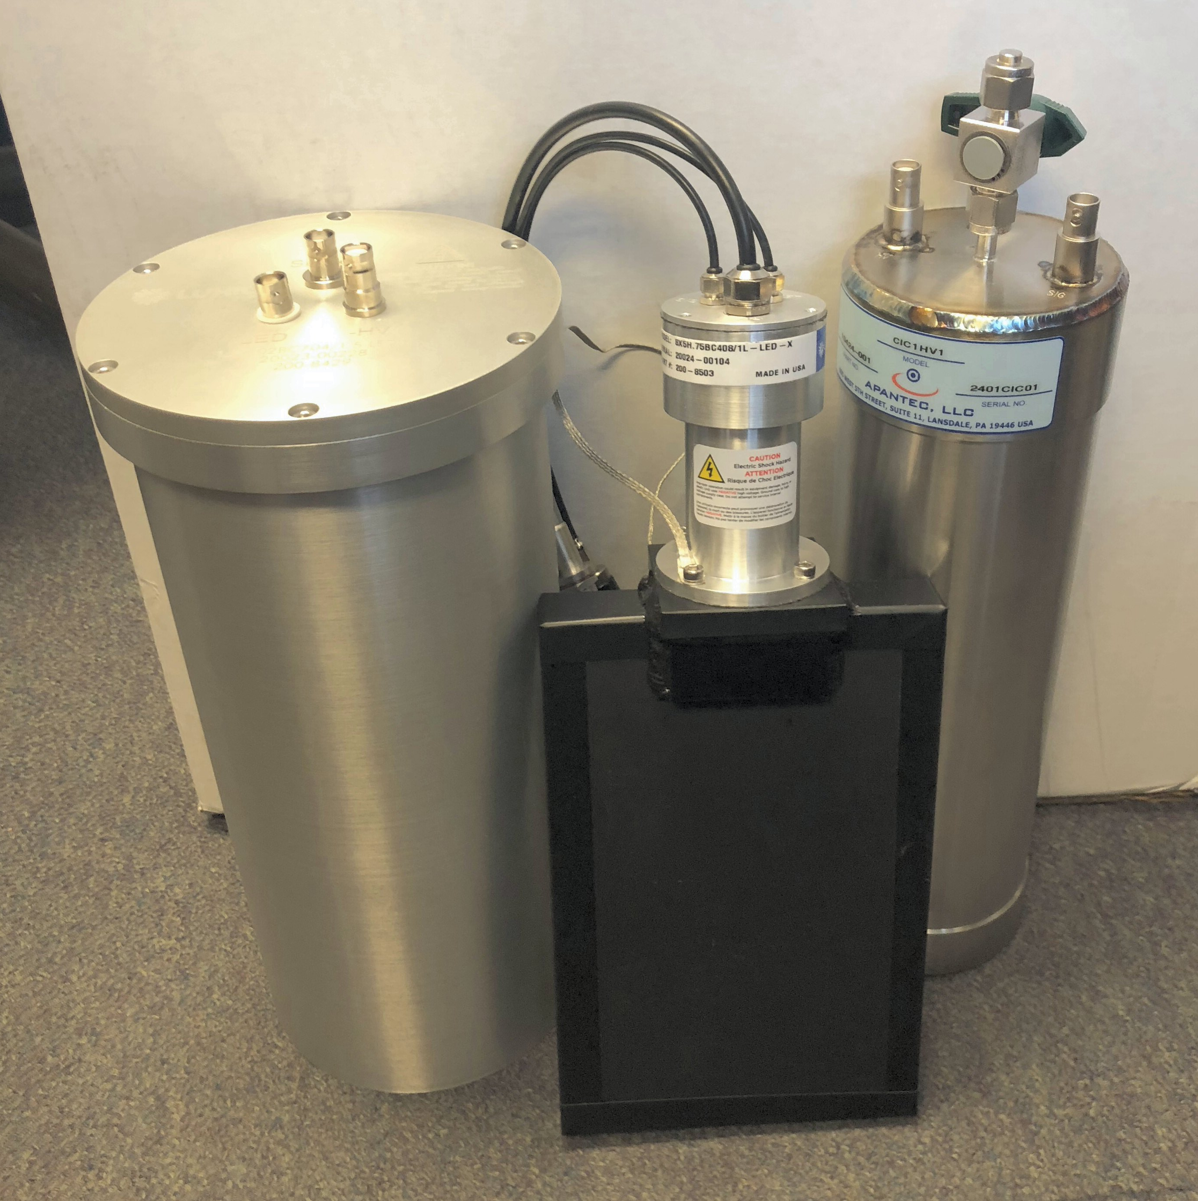
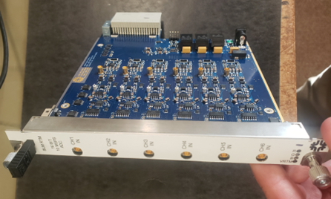
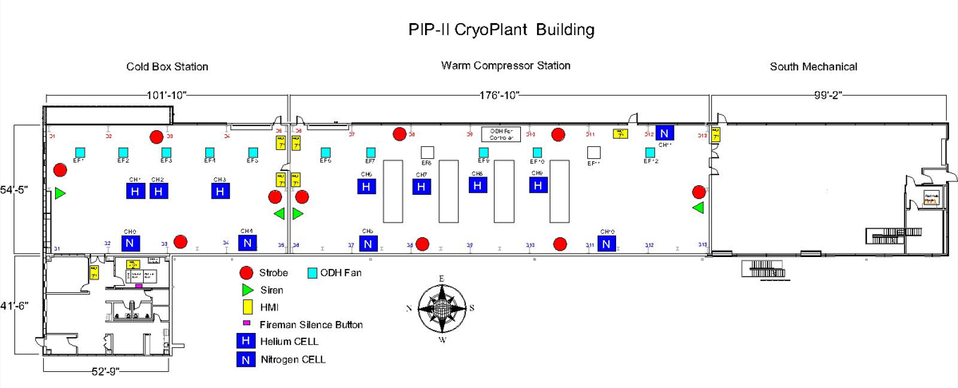
Accelerator Systems
Vacuum
  Smooth transition from long-term L3 to their Deputy, including identification of a new deputy
  Completed all remaining FDRs including Vacuum Integration FDR including refinement of all interfaces and requirements, permits, and other logistics
  Finalized detailed design for WFE and SCL, with strong progress on BTL lattice
  Started bulk procurements for WFE and SCL (mass flow carts, leak check carts, gauges, pumps)
  Strongly contributed to final detailed design of laser wire vacuum box
Controls
  Smooth transition from long-term L3 to new L3 from SBND including additional deputy for software
  Supported PIP2IT testing of HB650 pCM and started coordination with Cryoplant Controls
  Demonstrated many key services (web-based applications, Phoebus screens, Alarm handlers, etc.)
  Significant progress made on integration and system FDR preparation, work maturing rapidly
  Completed full control system FDR and controls infrastructure FDR successfully
  Transition to containerized Kubernetes infrastructure completed
Instrumentation
  Completed all remaining FDRs (electronics/software, laser wire)
  Completed detailed design of laser wire system (transport system, optical box), with first article procurement starting now
  Finished testing and validation of all electronics boards and integrated microTCA systems
  BLM, BCM, BPM procurements proceeding well with hardware starting to arrive for testing
  Awarded Beam Instrumentation Phase Reference Line contract to partners at Warsaw University of Technology (delivered ESS reference lines)
Safety Systems
  Strongly advanced Beam Loss Monitor system design with shielding and safety teams
  Completed Cryoplant ODH system design and preparation for installation
Vacuum Systems, Machine Protection, LLRF, and HPRF System Interfaces Signal Diagram from Integrated Vacuum Systems Final Design Review
Prototype BLM RTM Board
Prototype BLM Ionization, PMT and Neutron Detectors
13

Slide 14
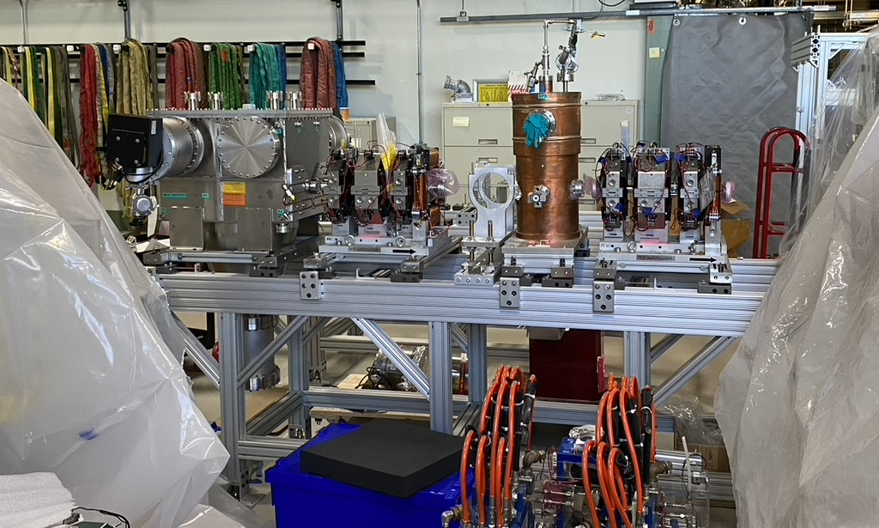
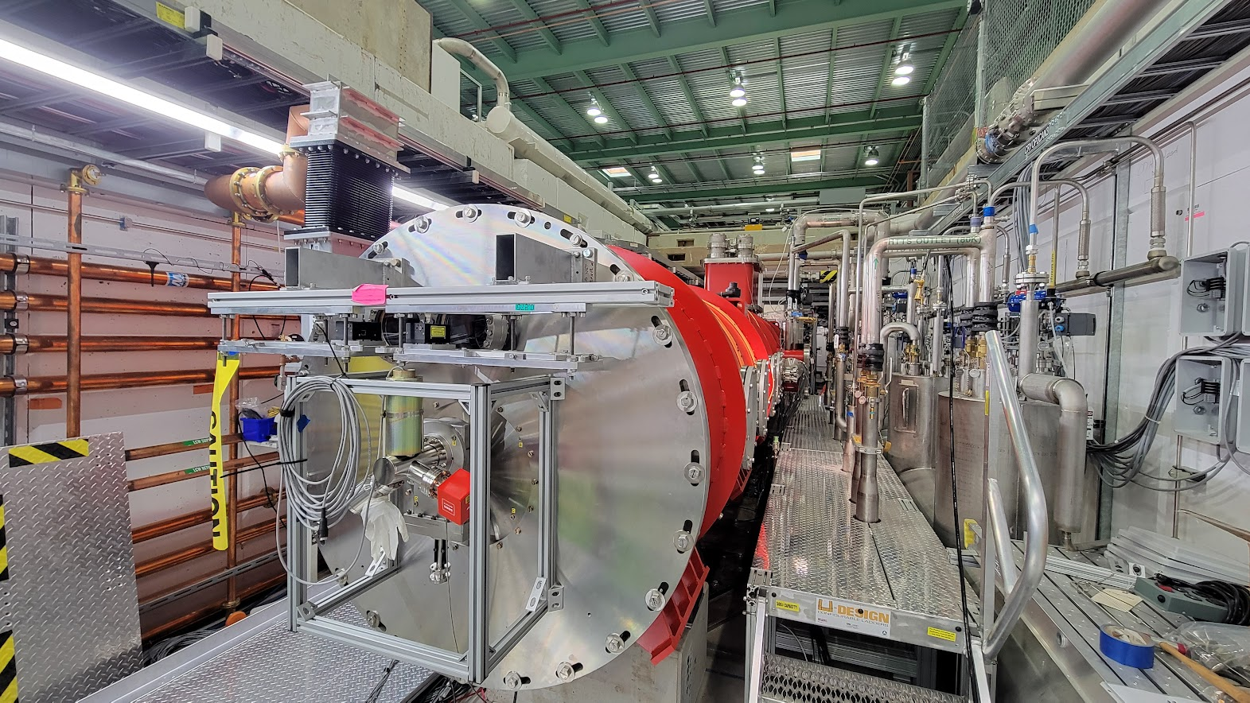
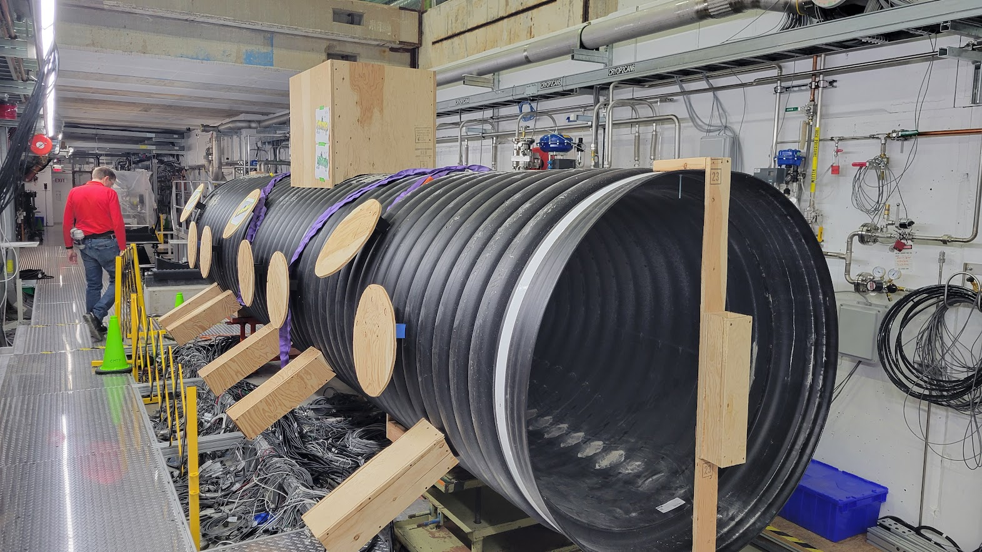
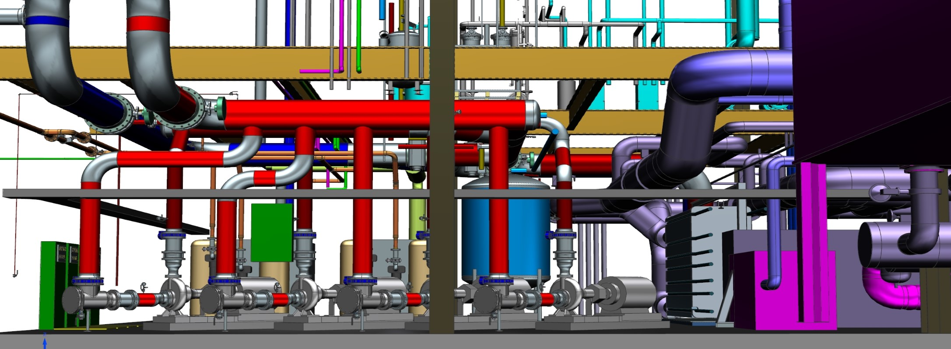
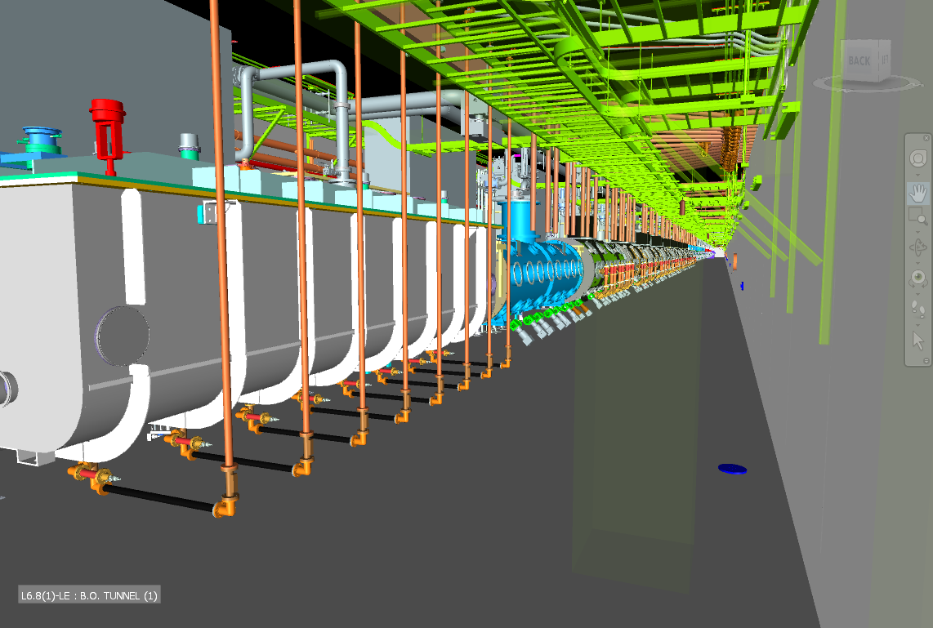
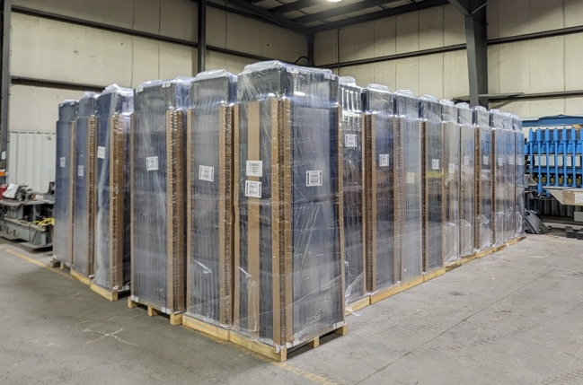
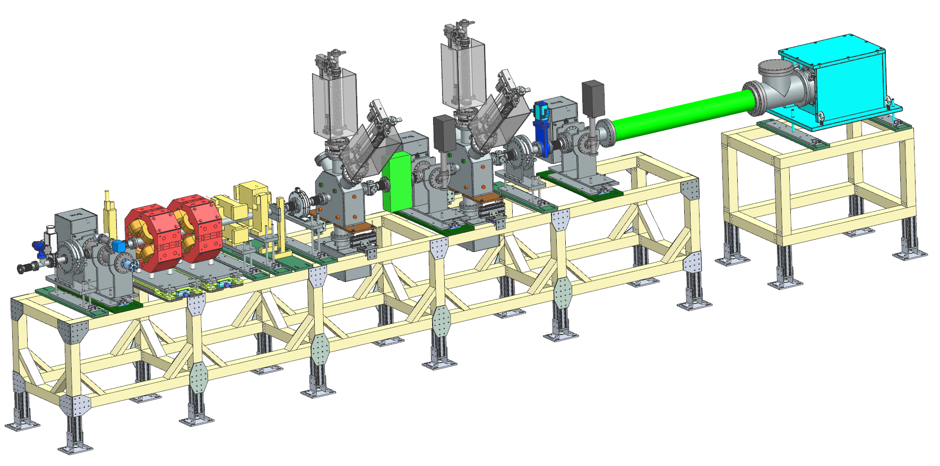
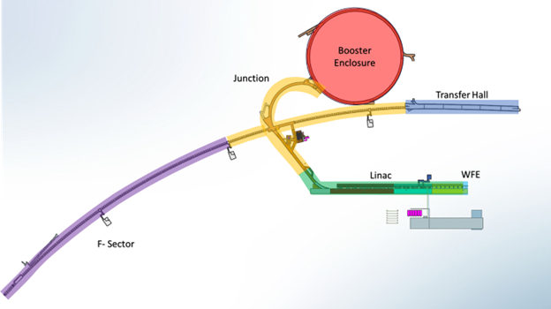
Installation and Commissioning
MEBT Girder
Warm Front End
  Assembly of kicker drivers and LEBT/MEBT girders
Test Infrastructure
  Installation/removal cycle for pHB650 completed
  PIP2IT 420.2D Accelerator Safety Documentation established
  Preparation of SSR2 cryomodule test stand underway
Building Infrastructure
  Process Clean Water (PCW) installation contract awarded
  Procured ~ $5M worth of equipment (cables, racks, utility piping, manifolds, etc.)
Linac Installation
  New CAD tools developed (VR visualization & Navisworks integration with CF)
  Cryomodule Tunnel Transport System went from FDR to fabrication
  Procurements began for cryomodule stands, warm unit structures, tools and equipment
Commissioning & Accelerator Physics
  Beam commissioning plan & TTO plan completed
  Instrumentation cart design completed
  Booster Studies needed to achieve project goals completed
  High Level Applications (HLA) development
    Specifications for 8 HLAs written, prototypes for 6 tested in Linac
  Shielding Assessments – preliminary versions under review
PIP2IT preparation for SSR2
PCW Piping System in the PIP-II Utility Plant
CAD visualization
Relay Racks
Movable Instrumentation Cart
Shielding Assessment Zones

Slide 15
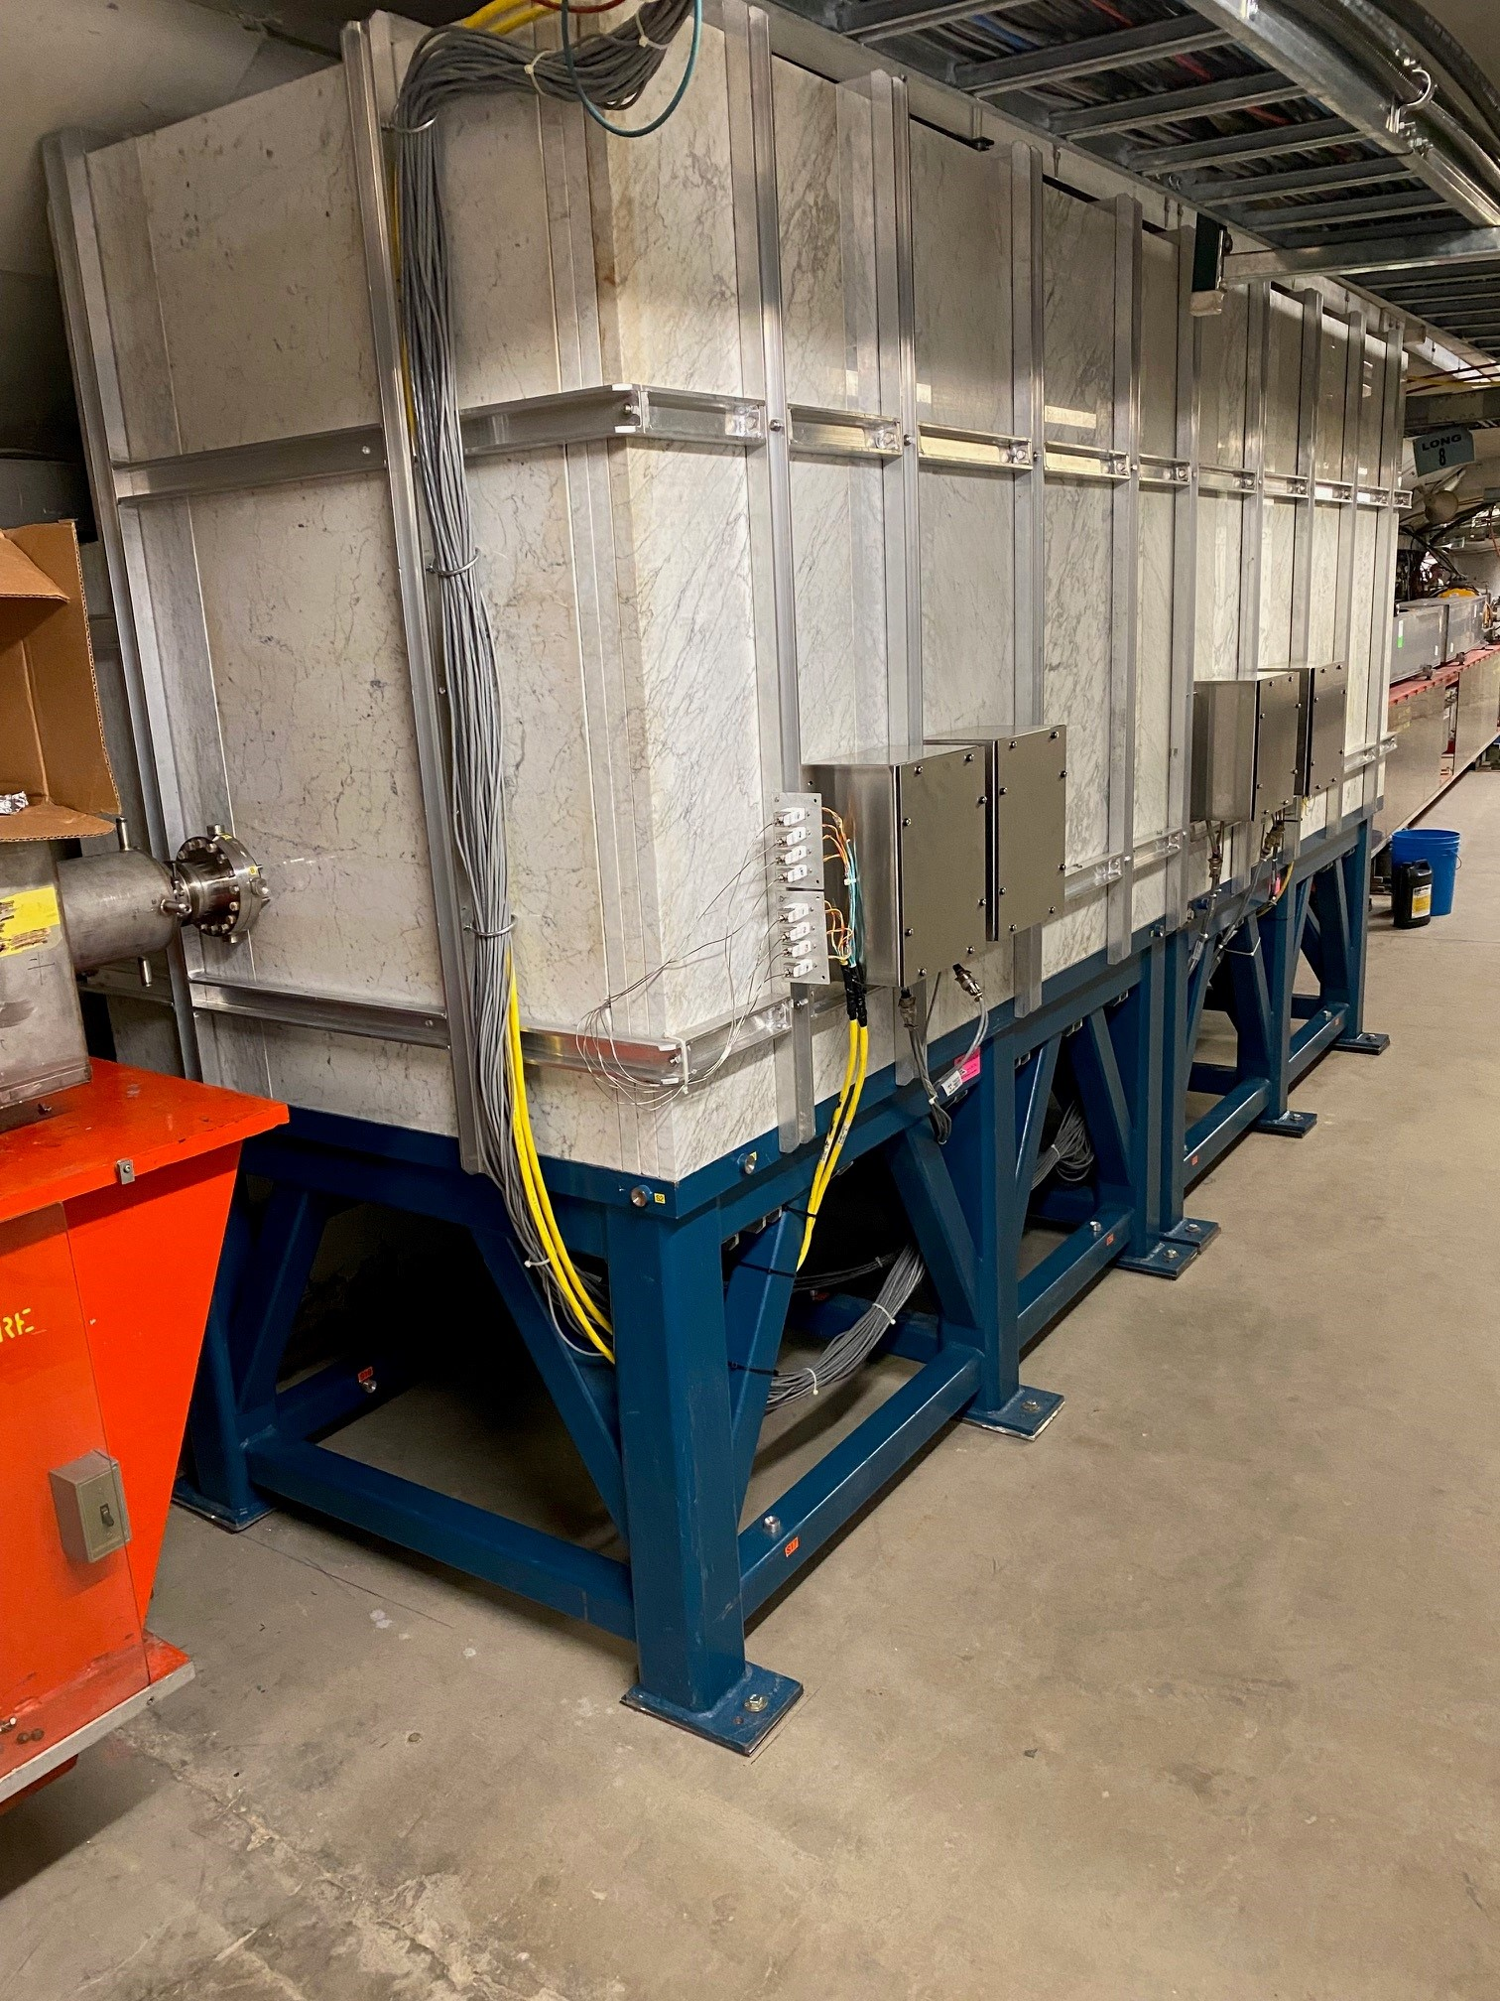
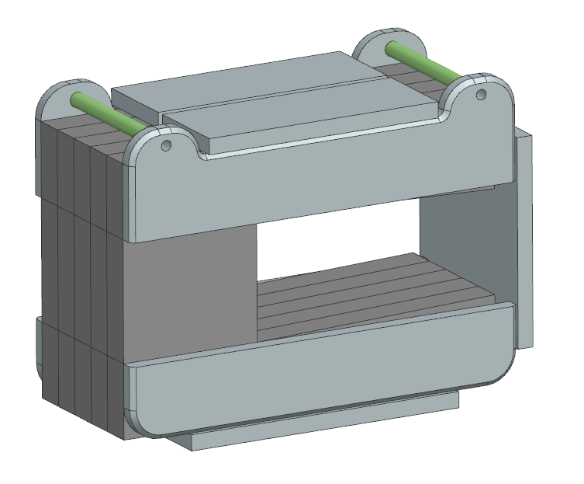
Accelerator Complex
BTL Installation
  Removed Tevatron components from the Main Ring where the BTL intersects.
  Former L3, Denton Morris, has retired and is now a guest scientist at the lab. Denton and John Kuharik, the new L3, have had two meetings now to smooth out this transition.
  108 H blocks will be required for shielding in the two absorber access points in BTL.
Beam Transfer Line/Beam Absorber
  Mechanical Design of the 2kW and 25kW absorbers incorporating design features for final manufacturability at reduced cost, installation and transportation 90% complete.
  Placed requisition for RAW water skid for 25kW absorber.
  BTL Collimators – PRR is now scheduled for January of 2025.
Booster
  The Booster Collimator was successfully operated with beam on December 15th of 2024. In the coming months, we will be working on transferring this to operations.
  Working towards PDR for Painting Magnets. Preliminary design study of the core is in progress and placement in Booster lattice was completed.
  PDR for Combined Function magnets was done in June.
  ORBUMP magnet is working towards the completion of the PRR.
MI/RR/Booster RF
  Completed R&K 8kW Solid State Amplifier Final Design Review with manufacturer.
  Five Main Injector Power Amplifiers were completed.
  Two production dual series tube modulators were completed and tested in MI-60 test station.
  All five Booster girders for the medium bore Booster cavities have been manufactured.
  Received $1,364k worth of medium bore Booster cavity parts out of $1,400k ordered.
Booster Collimator has now operated with beam.
Booster Painting Magnet design study.
15

Slide 16
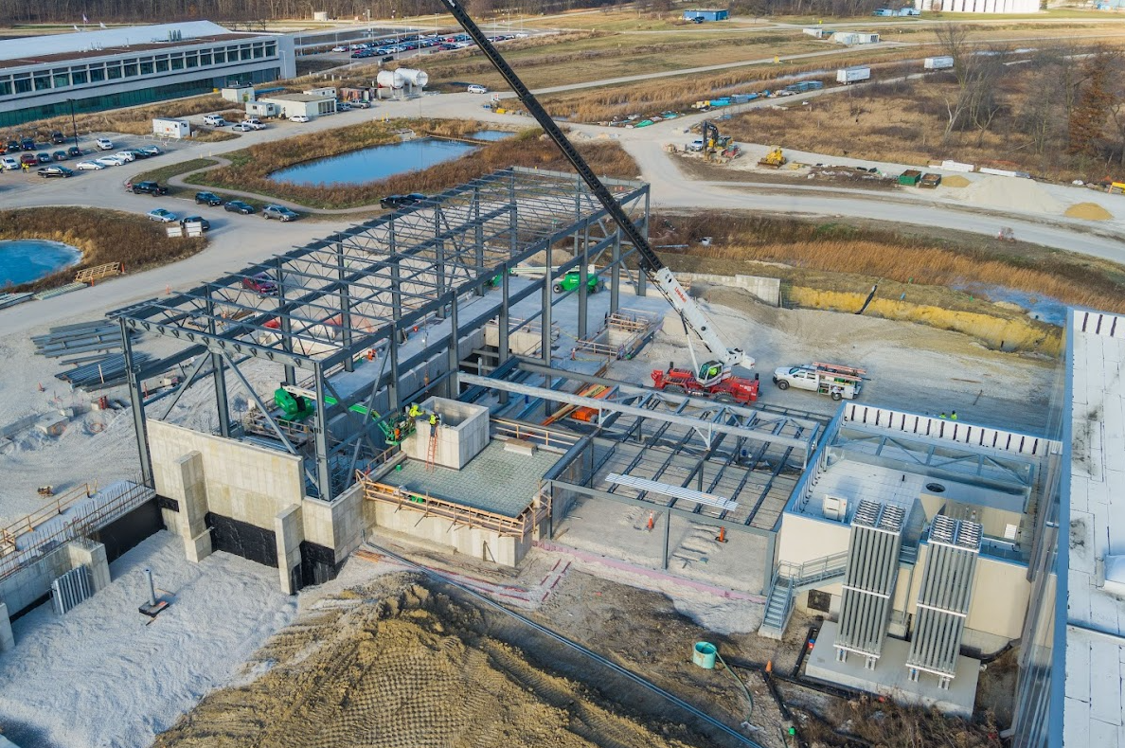
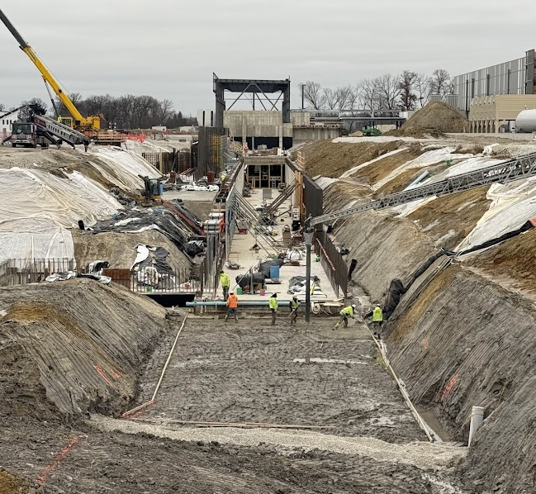
Conventional Facilities
ECF Subproject ​
Achieved Final Acceptance of Cryogenic Plant Building
Achieved Final Acceptance of Isolated Cooling Loop
Achieved Final Acceptance of Process Power Transformer
Held a successful DOE IPR for CD-4
ESAAB scheduled for January 2025
WBS 121.06.05 – Linac Complex ​(~40% complete)
Restarted construction in January 2024
Placed 9,428 cubic yards of concrete
  ~1,200 concrete trucks
  equal to ~37 miles of typical sidewalk
Completed High Bay Building foundations
Completed 59% of Linac Tunnel concrete
Completed 43% of RF Trench concrete
Started structural steel erection at High Bay Building
Completed 60% of the mechanical outfitting of the Utility Plant
WBS 121.06.06 – Booster Connection
Completed design refresh update
High Bay Building Structural Steel
Linac Tunnel Construction
16

Slide 17
Technical Integration
Design Maturity
Cost-weighted Design Maturity through December increased to 97.3%
  1 PDR and 26 FDRs, and 5 Integration reviews remain.
  Conventional Facilities completed their last technical review – Booster Connection.
  1 FDR was added for the electromechanical design of the SSR solenoids to be held in January
Design Change Requests (DCRs):
Completed DCRs Completed
  Cryomodule demagnetization
Upcoming DCRs
  Booster lattice update
  SSR and 650 MHz SSR CM design updates
  QPM chassis quantities
  Cavity radiation standardization
  Addition of Ring Monitor and Multiwire to Beamline
A requirements (room data sheet) review of the F37 building is underway
17

Slide 18
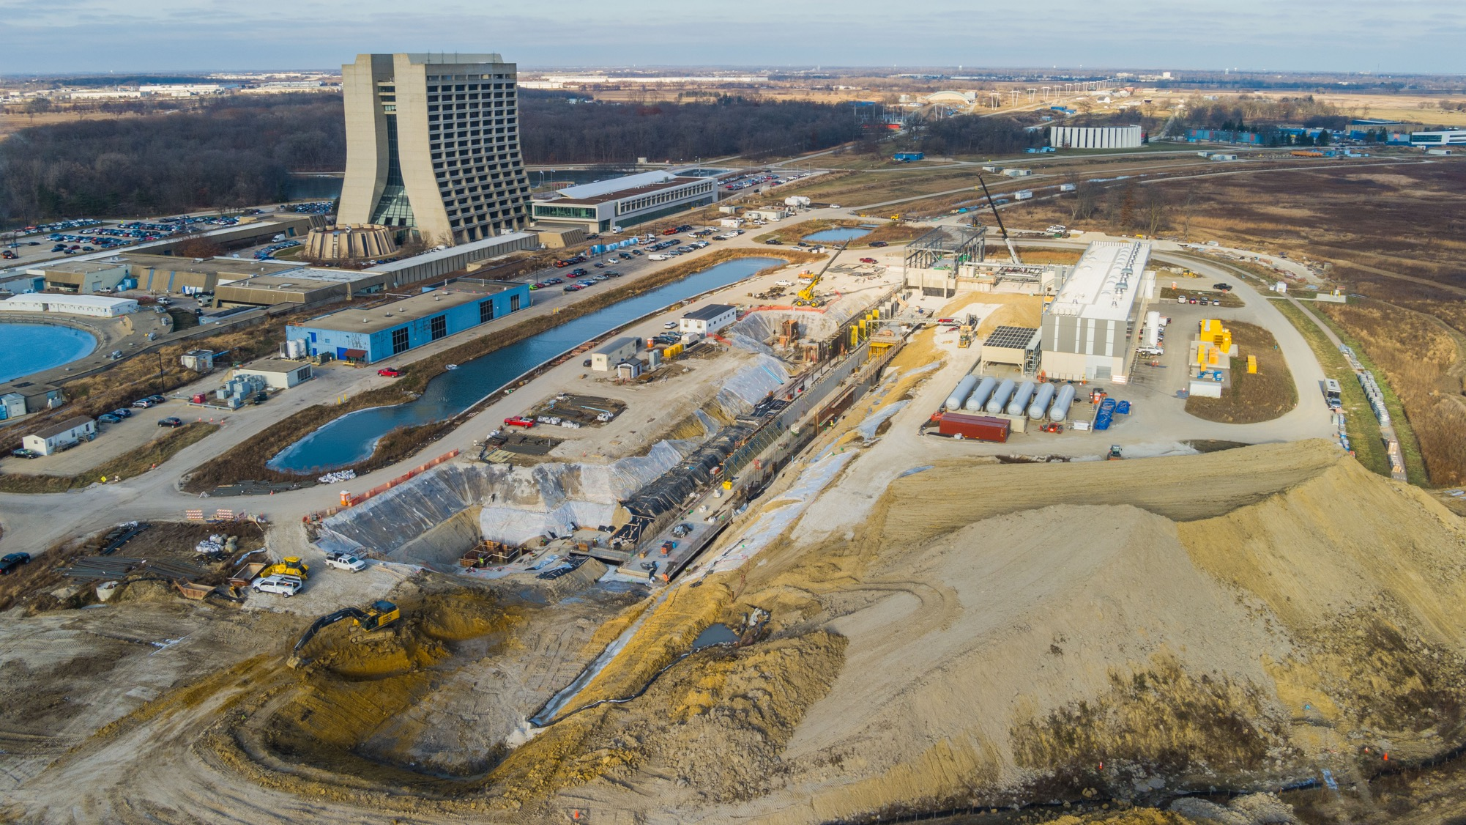



THE FUTURE OF FERMILAB
Follow us:
http://pip2.fnal.gov/
@PIP2accelerator
/showcase/pip-ii/

