Slide 1
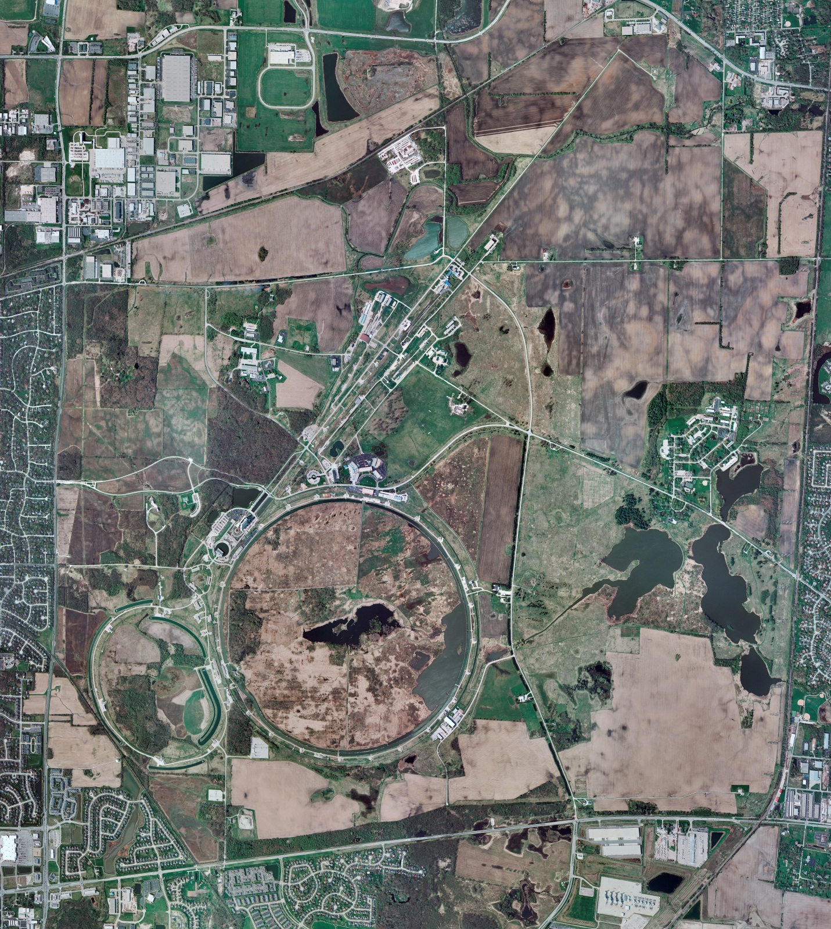


Helium Cryogenics
Status 12/13/2024 J.Makara
CMTF: SCP cold and running fine; CMTS: HECM26 warmup to RT almost complete
PIP2IT: South Stand being modified for SSR2 pCM
North Stand empty
MCTF: cryo system cold with 3 compr and 2 Fridges online
MDB/HTS: at RT
MDB/STC: at RT but will be cooled down soon
MDB Magnet: at RT
NML/FAST: Cryo system is shut down and isolated for extended shutdown period
CC1: at RT
CC2: at RT
CM: at RT
IB1: cryo system cold using ALAT CBx but some difficulties with 10 kL Lhe dewar being addressed
Muon Campus: at RT with comprs off and system depressurized; LN2 system at RT; g-2 Expt Hall at ODH=0 (not ODH area)
Misc: …MR service bldg. temperatures need vigilance against frozen water during intermittent power outages.

