Slide 1
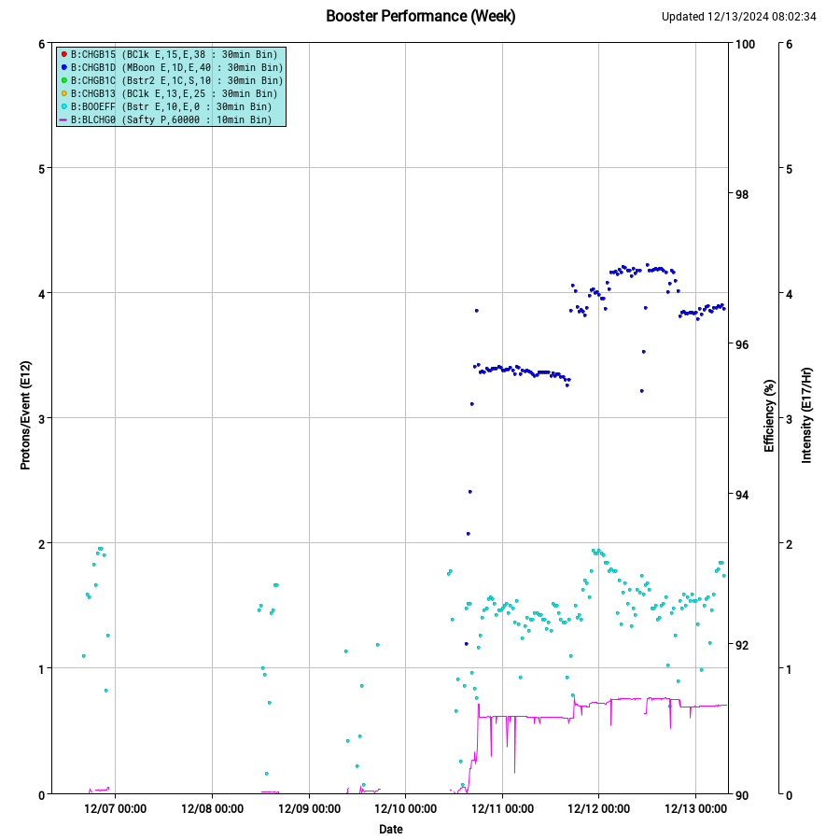
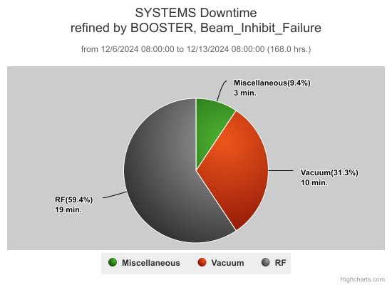
Booster Summary
  Friday last week PESD repaired MI8BND supply, internal water leak found.
    E4R GMPS magnet 15Hz testing
    BBPL12 Timing Board repair/delay trigger chassis replacement to fix BBPL12 BPMs
  Flat injection studies on Sunday
  Mon, tested controls for 2SC. Had issues with IOC functionality after update. Beam was off to Booster for this test.
  Tues digital LLRF studies, established beam to BNB.
  Wed general tuning after BNB target scans.
  Thursday Another 2SC IOC controls test to debug issues. General Booster tuning. Flat Inj studies. 2SC orbit prep.
    Request: Controls test today at 3:00-3:30
  Planning collimator shielding validation study at 0800on Sunday Dec15th. No beam to BNB 4-6hr
  E4R: probe replacement today, more measurements next week, trying to finish 15Hz before January.
DT: about 30min
BRF8 EAPS trips

Slide 2
Booster Dedicated/Parasitic Study Report:12/4/2024-12/12/2024
Booster Digital LLRF study (Ed Cullerton, Brian Schupbach, John Kuharik, Kent, Salah, Chandra …) (Needed for PIP/PIP-II)
  Type of Study: Dedicated
  Date: 4th, 5th, 6th and 10th
  Goal: Test and commission the DLLRF with new firmware for beam to Beam-dump, BNB and MI/RR.
    Previous studies with old firmware
      Pre-study Calibrations
        LLRF start and Bmin Calibration – 5/17/22 Study
        Notch Calibration, MI Reset Calibration, Beam Extraction Sync (BES) Calibration – 5/17/22 Study
      No-Beam Studies
        Frequency-to-Tuner Curve Calibration - 5/22/24 Study
      Beam Studies
        Accelerate Beam to Dump 6/12/24 and to BNB
    Developing new firmware (between 6/12-present- work is in progress)
    Study with dedicated beam since12/4
      Achieved all of the above except beam to BNB
      Beam intensity~4.2E12ppp
        Injection and beam capture looks acceptable– needs work
        Transition crossing: far smoother than current operation
        Beam data is taken and being analyzed. Longitudinal dampers needs to be phased in.
Work in progress (needs several dedicated studies)
Booster Flat injection Study (Chandra Bhat, Salah Chaurize, John Kuharik, Kent Triplett, (Ralitsa)) (Needed for PIP/PIP-II)
  Type of Study: Dedicated and parasitic
  Date: 3rd, 8th ,9th , 12th
  Goal: Flatting the injection front-porch for ~300 μs using Booster dipole correctors in current operation
    This is a continuation of the studies carried out in June 2024 (Kiyomi, Ralitsa, …..)
    Study (Dec. 3-12)
      Orbit were flattened for ~240 μs
      Confirmed that operationally used frf curve is not optimal, needs matching to the CFM dipole field to eliminate beam motion below 5ms
      Studied effect of reset delay B:RSTDLY
      Tried different dipole corrector ramp to flatten the effective B field at beam injection.
Work in progress (needs several dedicated studies)

