Slide 1
Muon Campus Shutdown Report
Jim Morgan
Friday 09:00 Ops Meeting
December 13, 2024

Slide 2
Muon Campus status
Muon Campus Electrical Safety System signed off on Tuesday
  Still have testing to do for Radiation Safety System
Electrostatic Septum ESS2 installation and new stand check-out for both septa
  High Voltage Conditioning began late yesterday afternoon
  Waited to finish most of tunnel work before beginning conditioning
  Fabricated new limit switch brackets for horizontal motion
Q205 rad hard quadrupole
  Vacuum looks good
  Water manifold union has leak due to corrosion, TD techs providing spare
Vacuum work
  Made improvements to several CIA crates and replaced several cards
  Replaced some ion pump power supplies
  Leak found on bellows at Q617, where ceiling water leak had caused corrosion
Muon LCW resistivity adequate , but would like more fresh DI bottles installed
Several more LCW leaks have been repaired
  Would like to fix 414 sub-header leak today, requires rad coverage & burn permit
F-27 water skid has issues that require further investigation
AP-0 A/C work remains paused
Study – M1-M3 Optics
Study – Alternative M5 optics

Slide 3
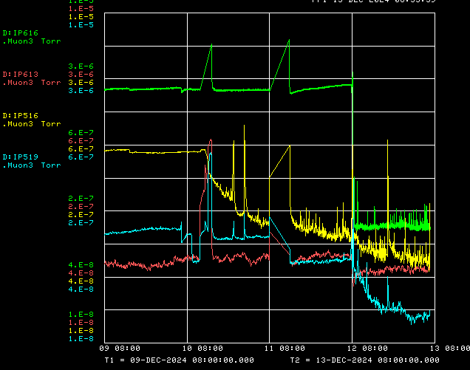
Vacuum leak repair near Q617
Leaking bellows vacsealed

Slide 4
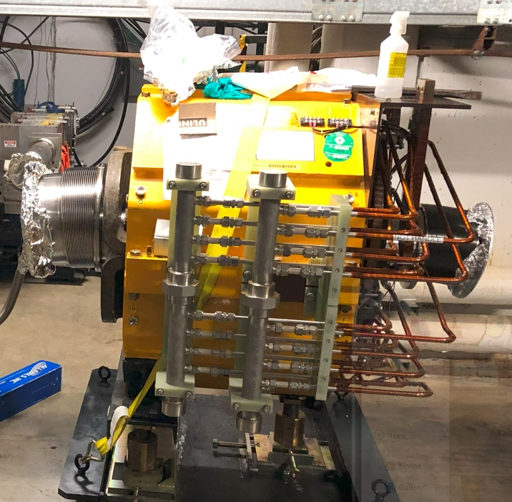
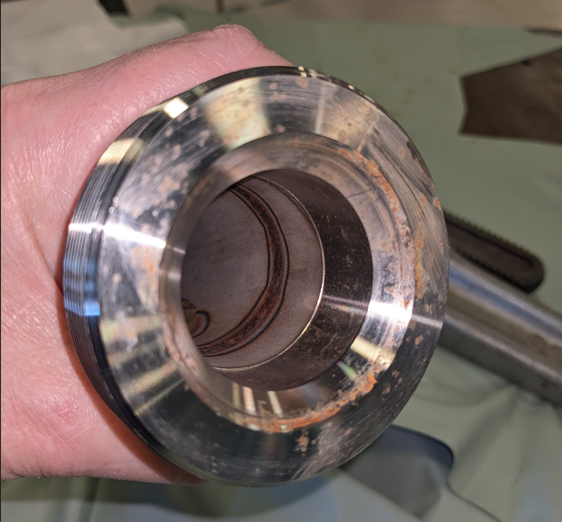
Q205 leaking LCW manifold union
Manifolds
Unions
Corrosion on union sealing surface

Slide 5
Upcoming work
Tunnel work is largely completed
  Install new limit switch hardware for horizontal motion on ESS1 & ESS2
  Q205 leaking manifold will be replaced when TD techs are available
  A few remaining small LCW leaks
  Final walk-through of Delivery Ring on Monday
ESS2 High Voltage Conditioning through Monday
  Expert will be out of town beginning Tuesday, back 12/27
Radiation Safety System testing
  Tentatively planned for Tuesday
Other upcoming work
  Repair Kirk Key hardware on disconnects, requires more modifications to disconnect
  Replace several power supply circuit breakers and some primary wiring
  Installation of Mu2e Extinction Monitor Collimator in Absorber area
  M4 Final Focus vacuum installation, A/C dipole installation
Preparing for beam operation
  Work towards power supply check-out and preparations for beam
  Now understand that MI heat exchanger problem will hold us off for a month+
  Expect that PIP-II construction will impact beam operation in late January

