Slide 1
Project Activities for MSD
Mayling Wong-Squires
AD Operations Friday 9am Meeting
13 December 2024

Slide 2
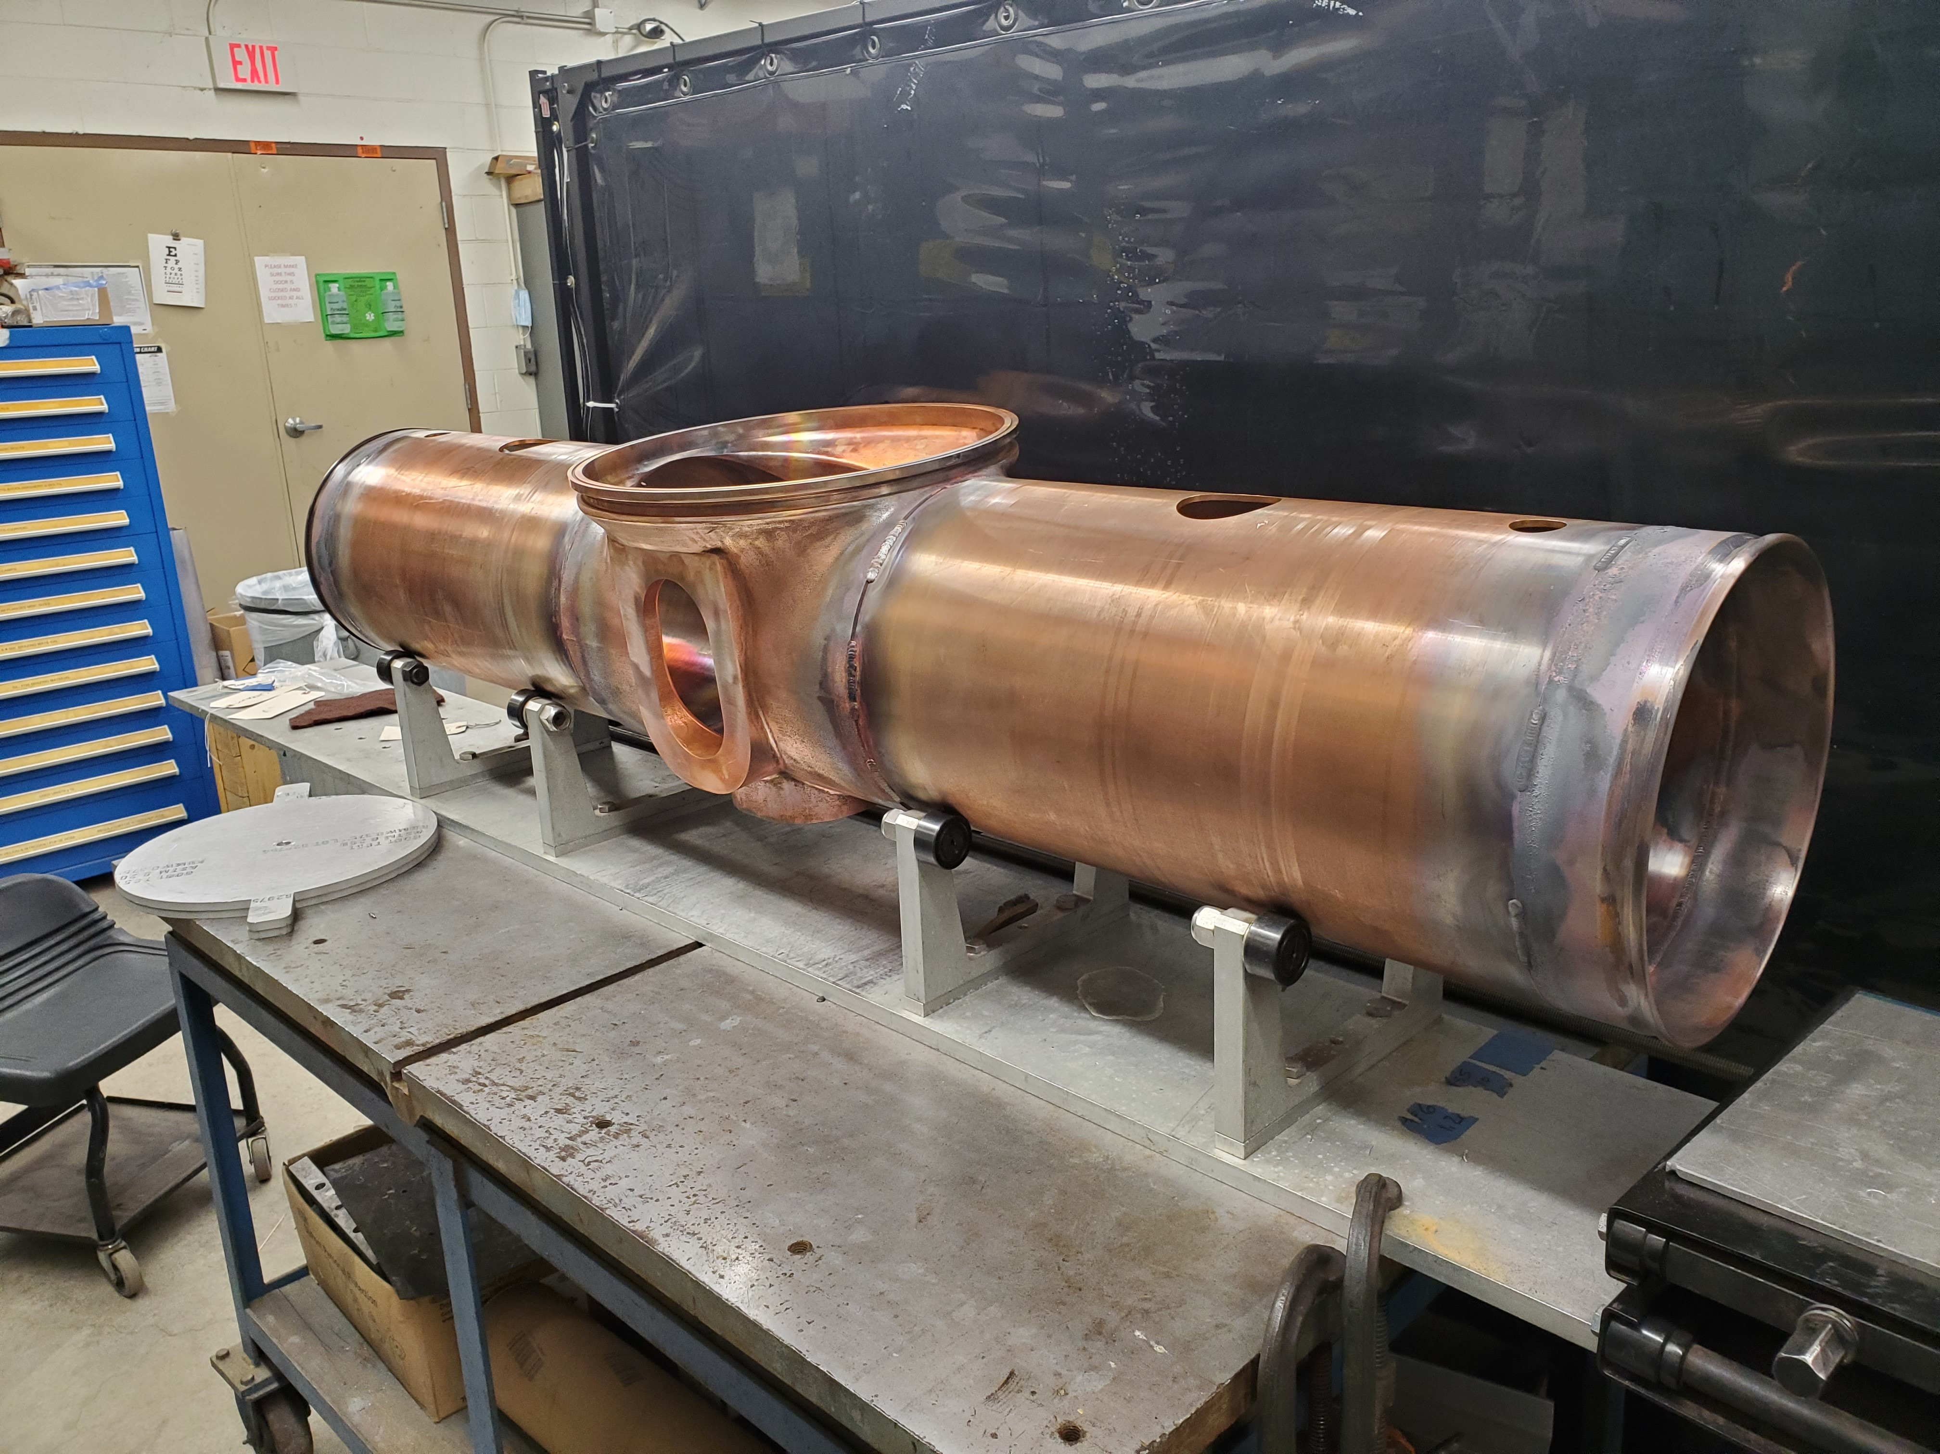
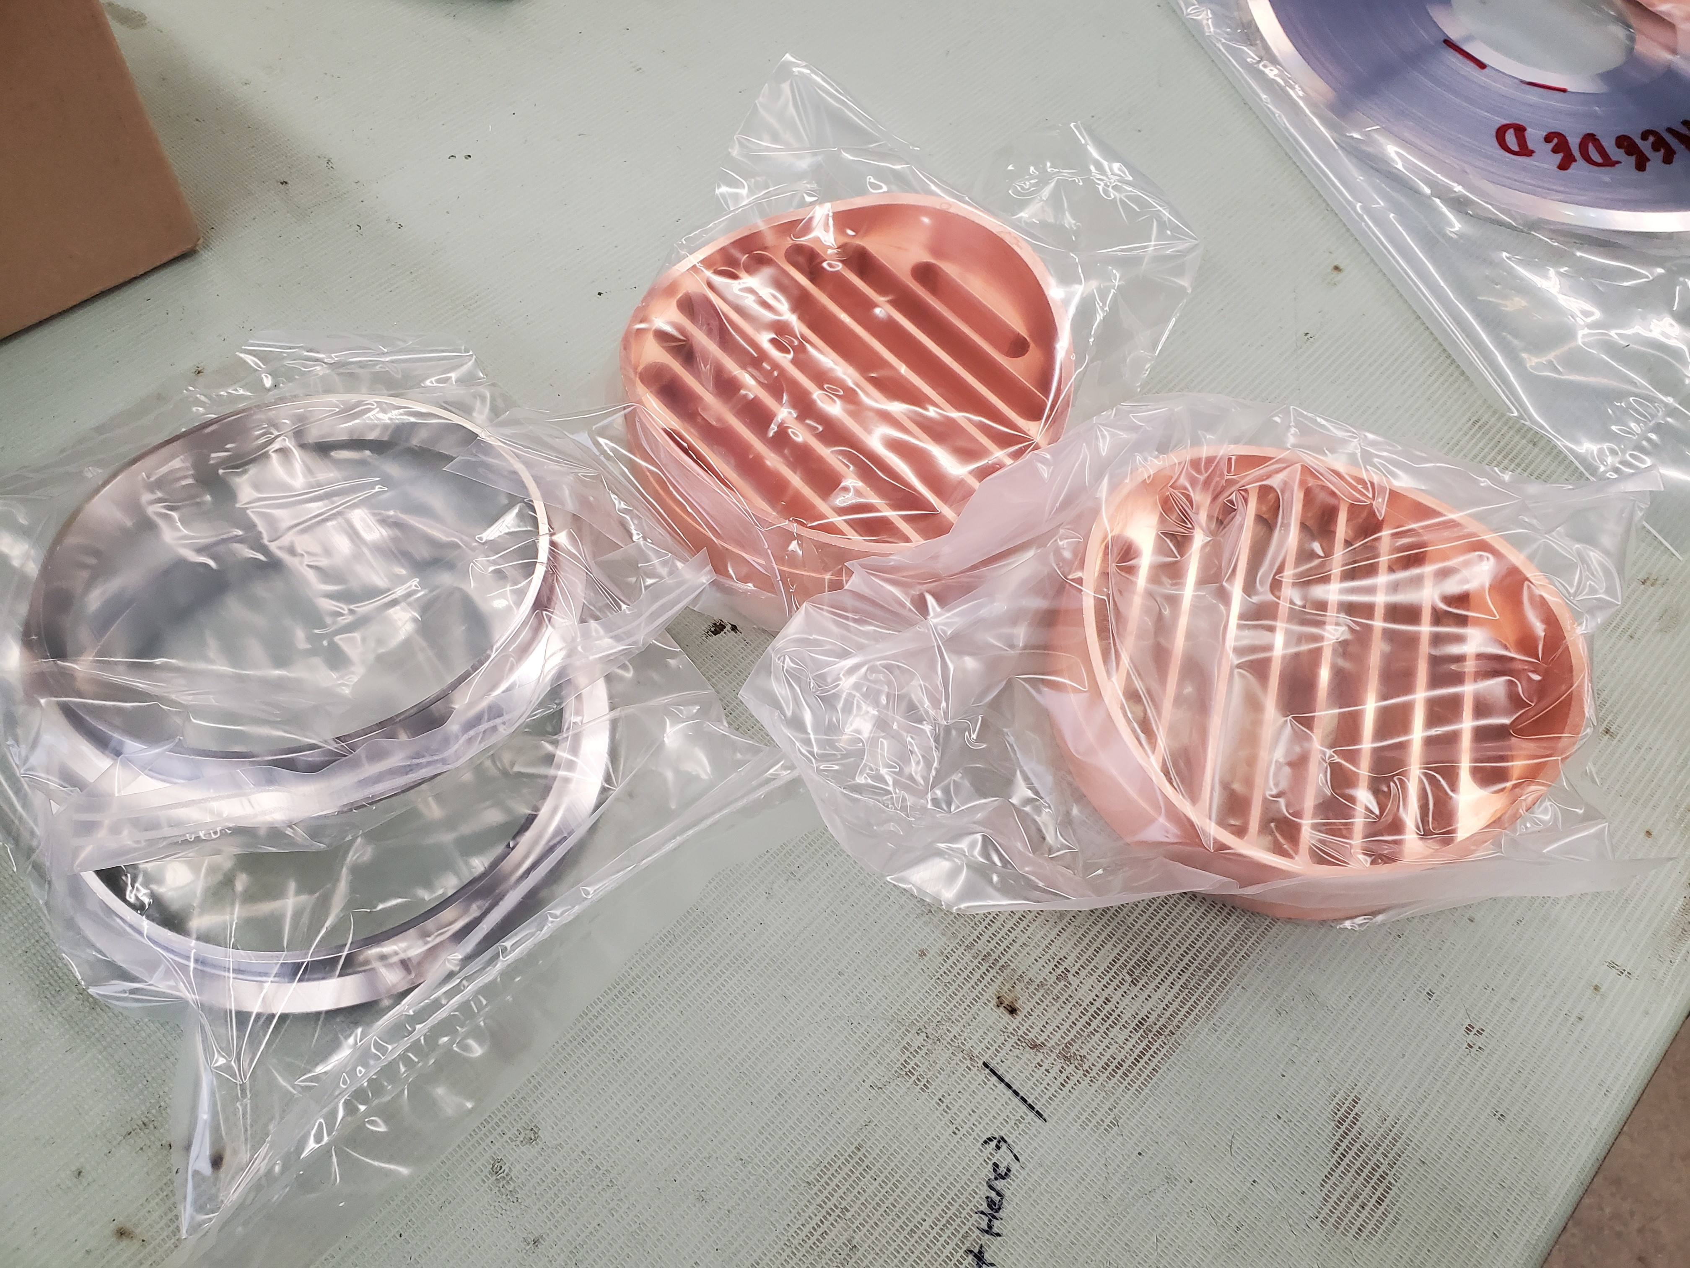
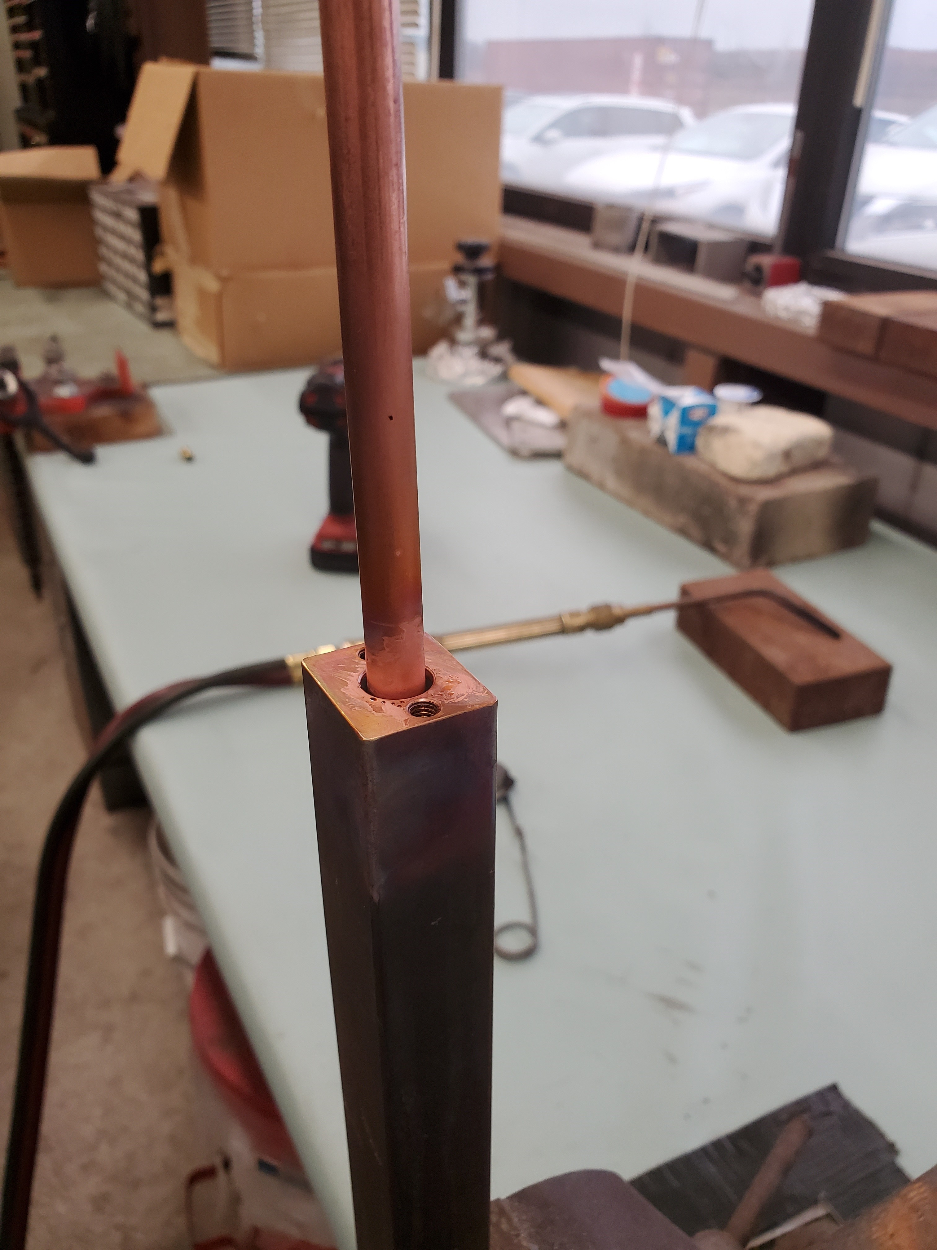
PIP-II RF Booster Cavity
P. Minton, R. Dlugopolski, M. Slabaugh (PPD), MSD RF Cavity Group
Fabrication of plumbing for girder three has been finished.
Beam tubes are being crated for shipment to vender for final machining.
The center casting and main outer shell components for the third cavity have been welded and sanding has been started.
The hand brazing of the outer bus bars has run into complications. An induction brazing vender has sourced. Testing using silver solder is underway as backup option.
Cavity #3: center casting and main outer shell weldment
Ion pump QD connections cleaned and bagged for brazing.
Outer bus bar silver solder test #2

Slide 3
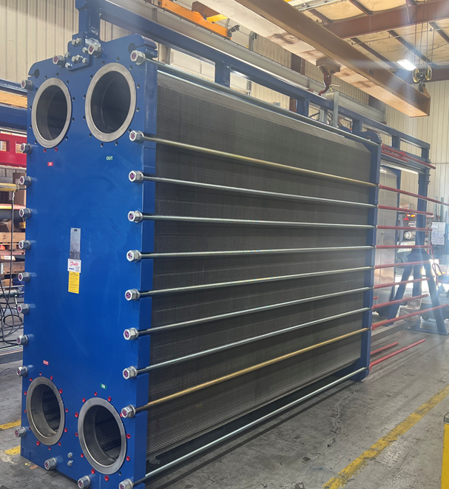
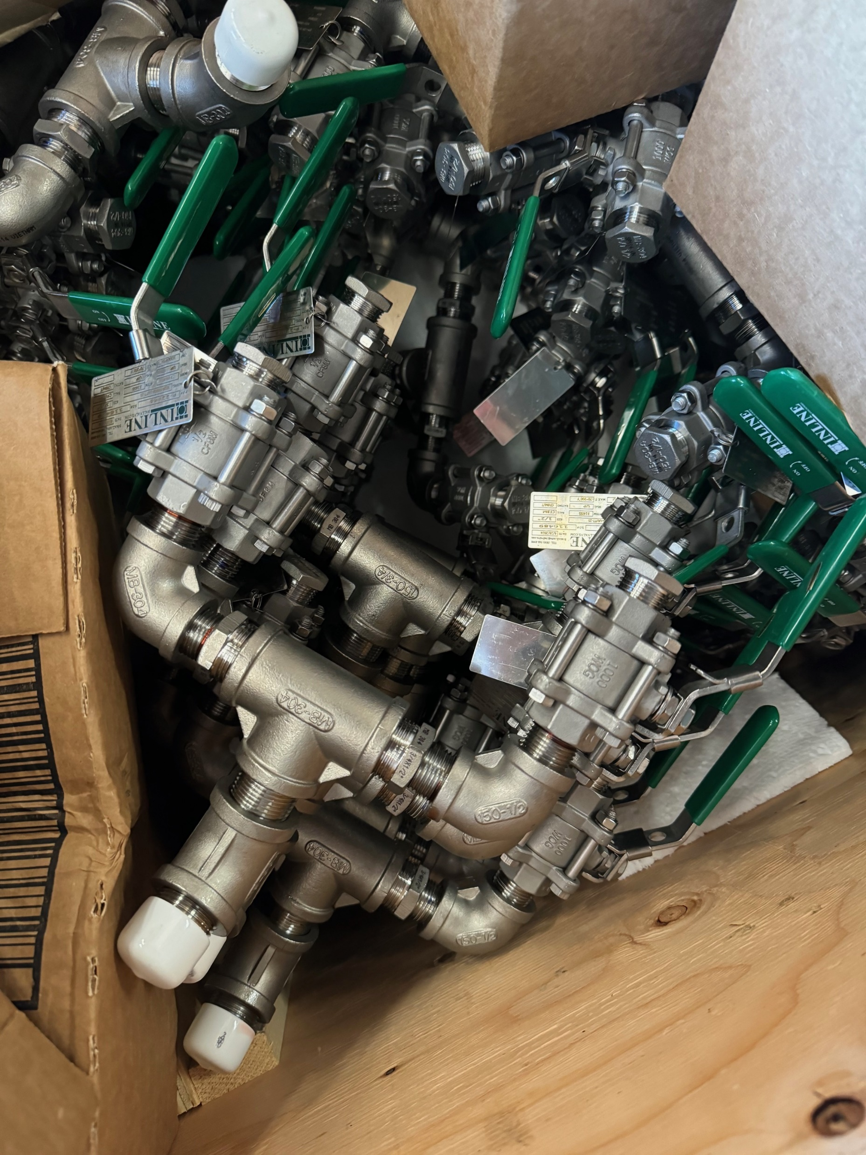
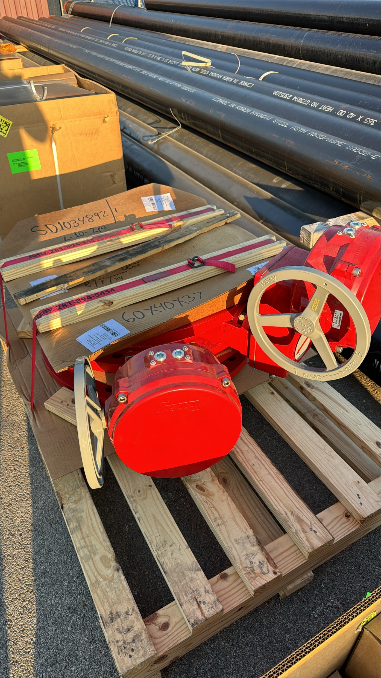
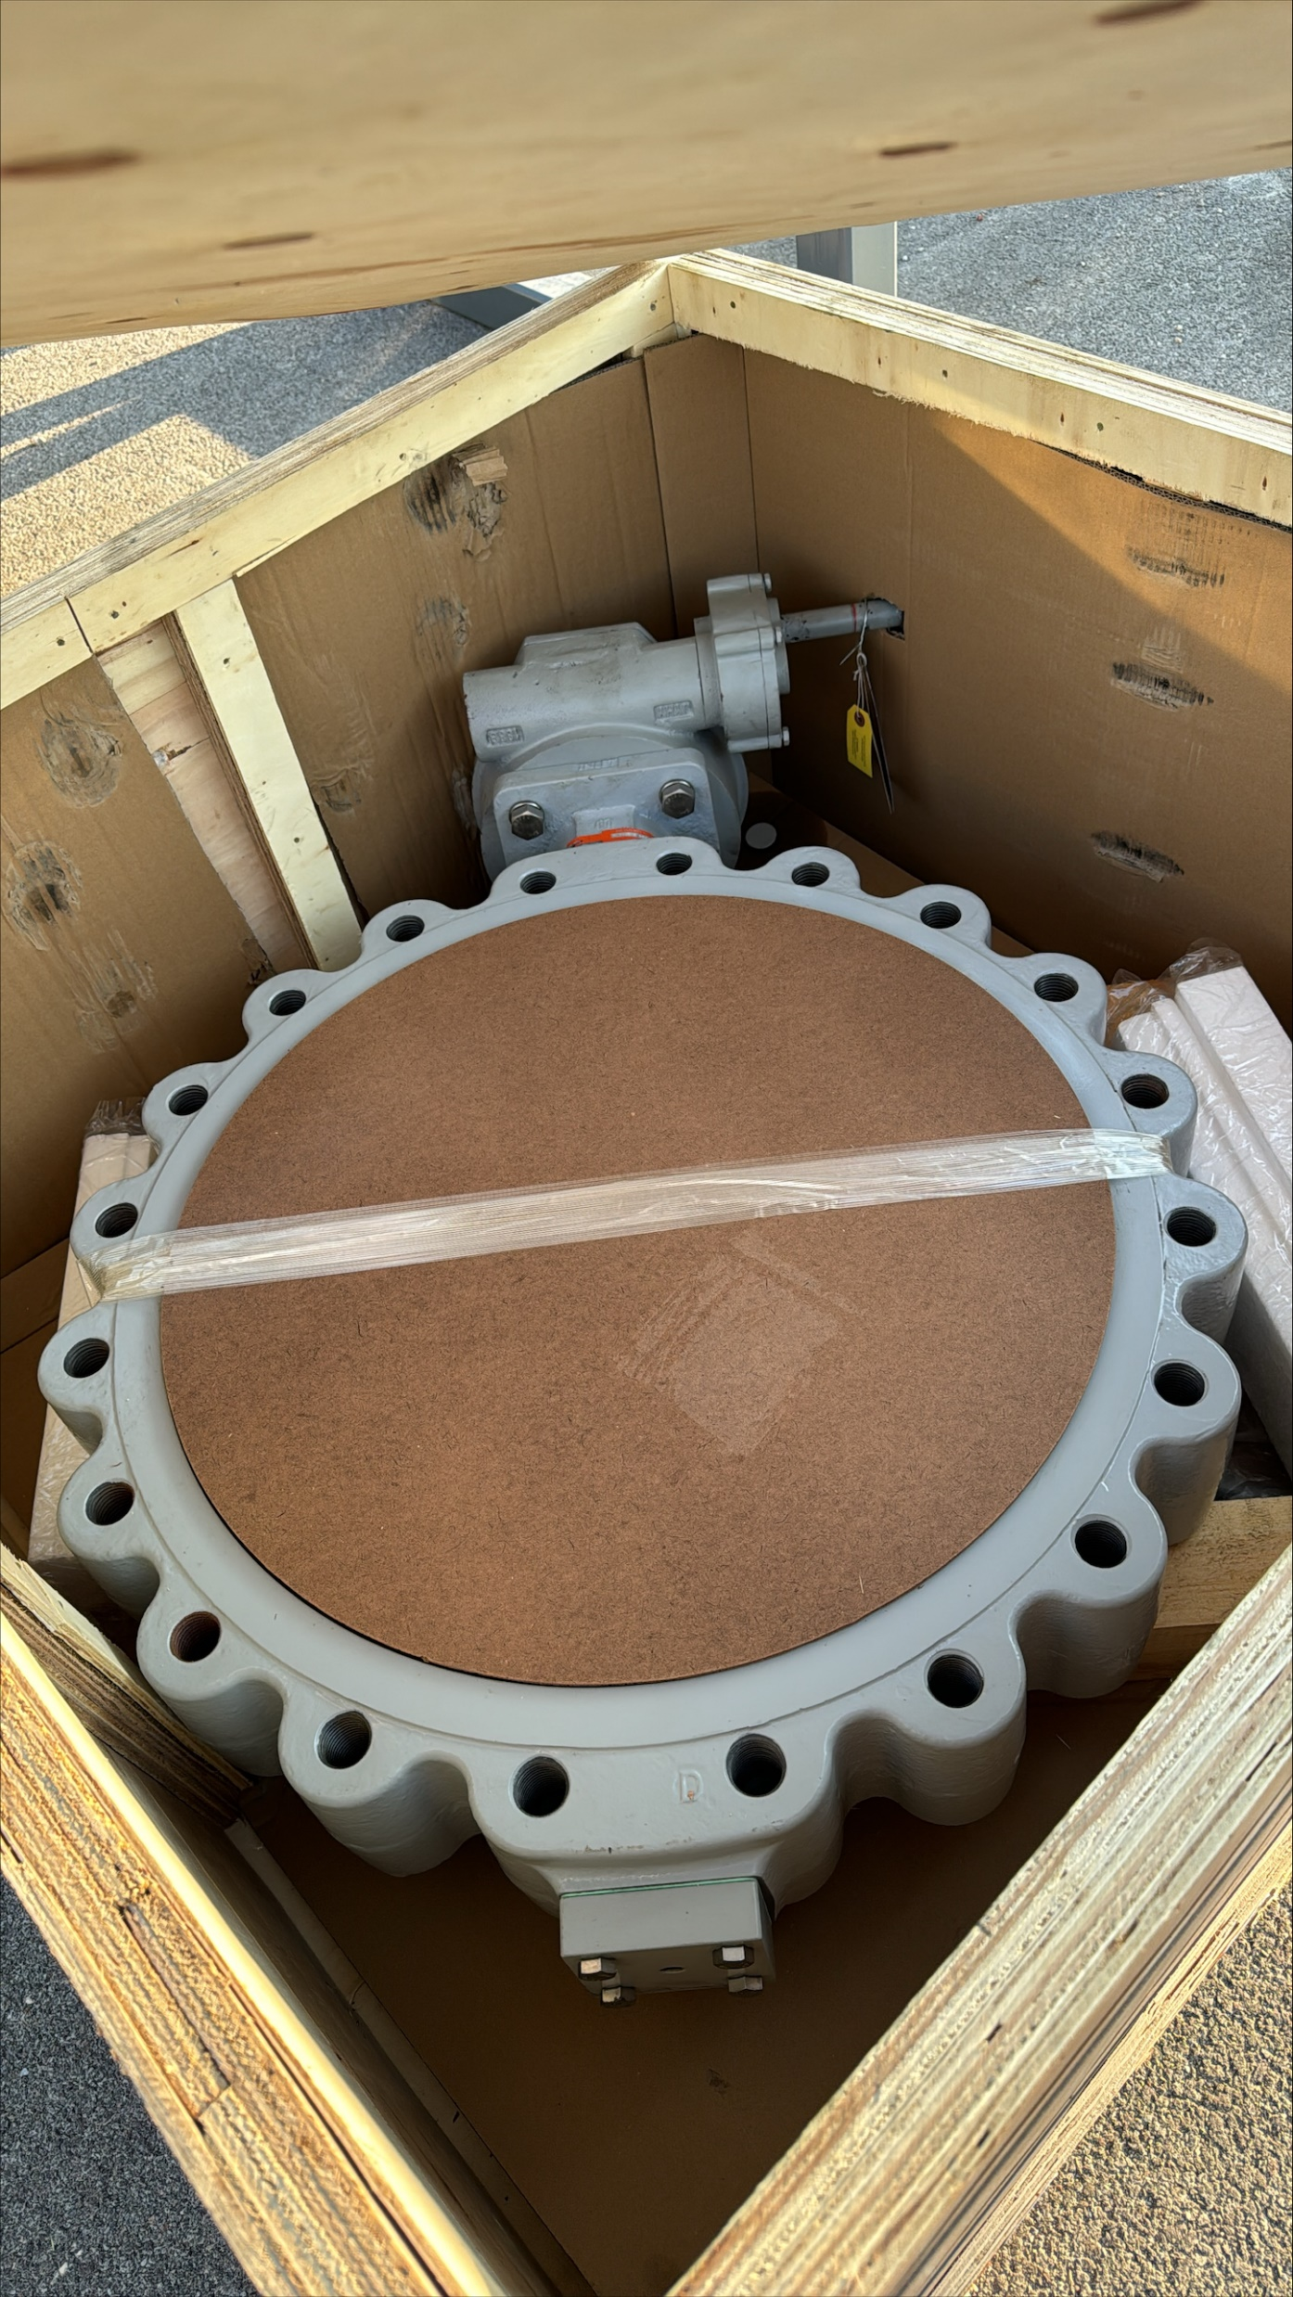
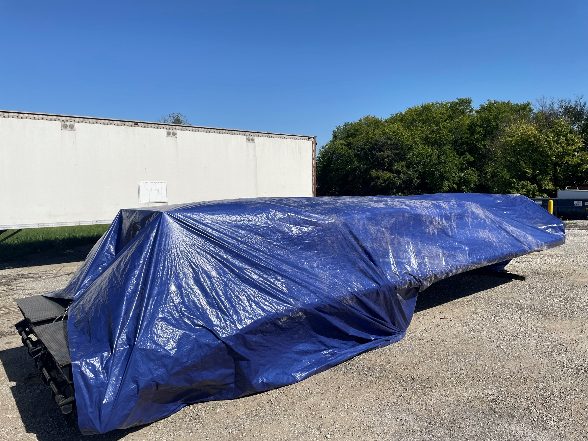
PIP-II Fluid Systems Update
Maurice Ball, Michael Geelhoed, Michael Hanson, Jason Grischkat, Monika Sadowski, Frank Rios, Amos Horton
Process Clean Water (PCW) Pump Room Piping System Installation
  Installation contract underway
  Milestone: heat exchanger delivery expected today
  Other materials arriving and stored until installation begins
Procurement for Warm Front End
  Evaluating bids for Ion Source & LEBT LCW Manifolds, and RFQ LCW intermediate skid
  MEBT LCW manifold out for bid
  Creating to Statement of Work Documents for Linac Installation
  ”Goldilocks” manifold for BTL LCW piping headers assembly underway by MSD techs
PCW Heat exchanger at the Danfoss Manufacturing Plant readying for shipment
“Goldilocks” manifold assemblies for BTL LCW Piping System
Various valve, piping, and materials arrived and stored onsite

Slide 4

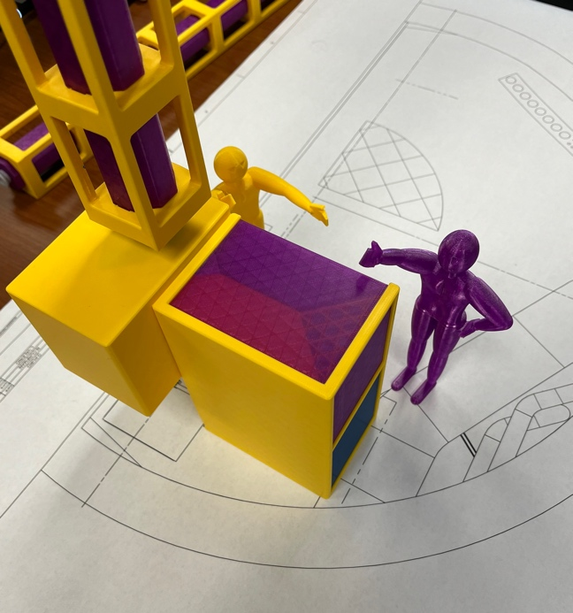
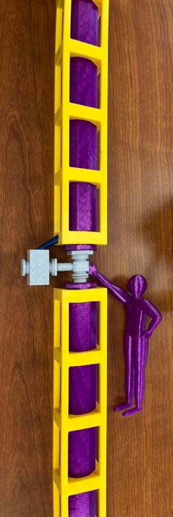
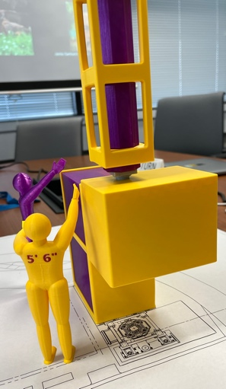
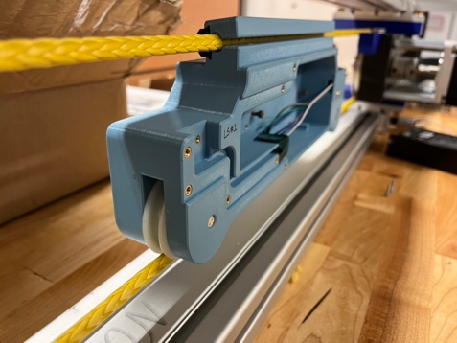
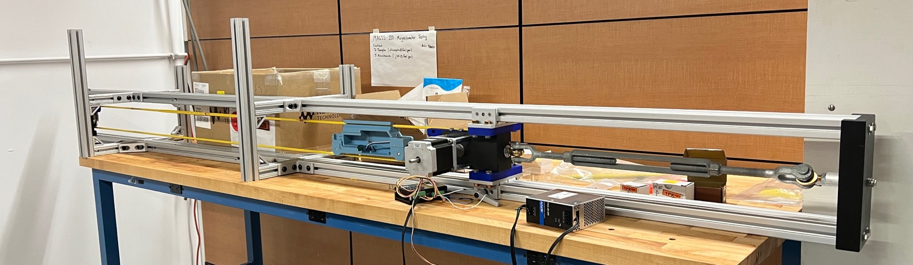
MSD Team: Linda Valerio (Project Engineer), Noah Curfman (Lead Mechanical Engineer), Ty Funk (Lead Vacuum Engineer and Mechanical Engineer), Ron Kellett (Vacuum/Mechanical Design and Technical Support), Dirk Hurd (Designer), Bill Dymond (Assembly Coordinator)
Other AD (not from MSD): Jamie Santucci (Lasers), Marty Murphy (Installation Coordinator)
Working on
Installation and personnel access planning workshop held Nov 21. Further development continues for this significant challenge.
Beam tube magnetometry system prototype being assembled.
Vacuum instrumentation and controls design ready for technical review by collaboration.
Preparing for NEG/IP vacuum pump test.
Bake system component RFI nearly ready for release.
QA testing for custom rod ends as batches arrive.
Laser lab construction nearing completion.
Department resources needed
Engineering: Continuous effort from Linda, Noah, Ty. Support engineer(s) anticipated later in FY25.
Technicians: Continuous effort from Ron. Support from Bill and others when requested to support tests.
Design/Drafting: Continuous effort from Dirk. Support from others as needed.
Installation and personnel access planning workshop included scaled printed models to help team visualize and communicate challenges.
Beam tube magnetometry system prototype being assembled.

Slide 5
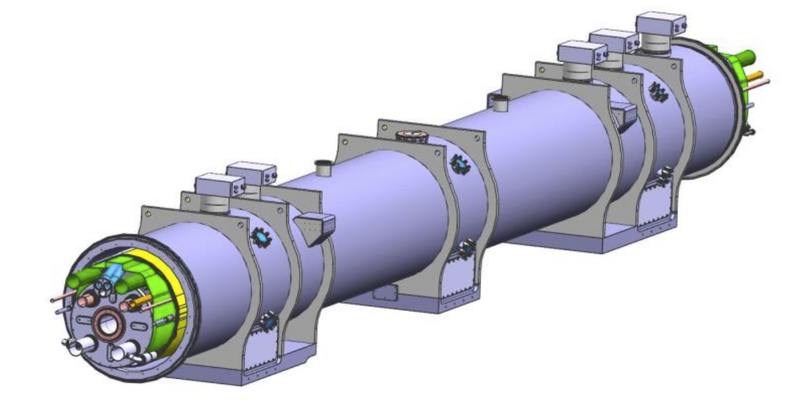
Hi-LuMI LHC Accelerator Upgrade
Bob Steinberg, Alex Chen, James Williams
The leak testing procedure, authored by AD and APS-TD personnel, was formally approved by CERN in April.
Background info: Cryo-assembly #2 (CA02) leak tests began in June. Completed two of the four leak checks. Schedule needs necessitated CA02 be sent to IB1 for cryogenic testing.
Currently: CA02 is back in ICBA for final leak checks.
Remaining tasks include completing CA02 leak tests, vacuum equipment maintenance and upkeep between tests, and overseeing CA03-CA10 tests.
  Start of CA03 leak tests has been delayed
Cryo-assembly built at APS-TD’s ICBA building for CERN

