Slide 1
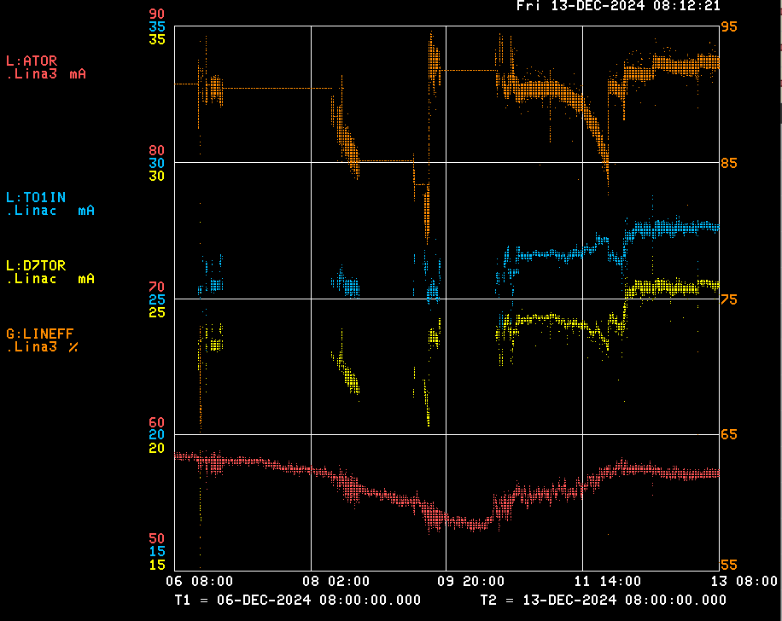
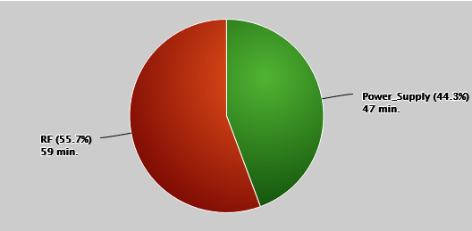
Linac/Preacc Operation (Dec 6 – Dec 12, 2024)
PREACC (0 min)
LINAC (1 hrs 46 min)
25.5 mA on D7TOR, 92% efficiency.
Notable Events:
MEBT Buncher Tomco Over Duty trips – traced to a bad cable, permanent repair to come.
Driver swap at LRF2
Autosteer Issues – needed to tune up

