Slide 1
Mu2e report
Greg Rakness (FNAL)
Friday 9am AD meeting
13-Dec-2024
https://indico.fnal.gov/event/67450/

Slide 2
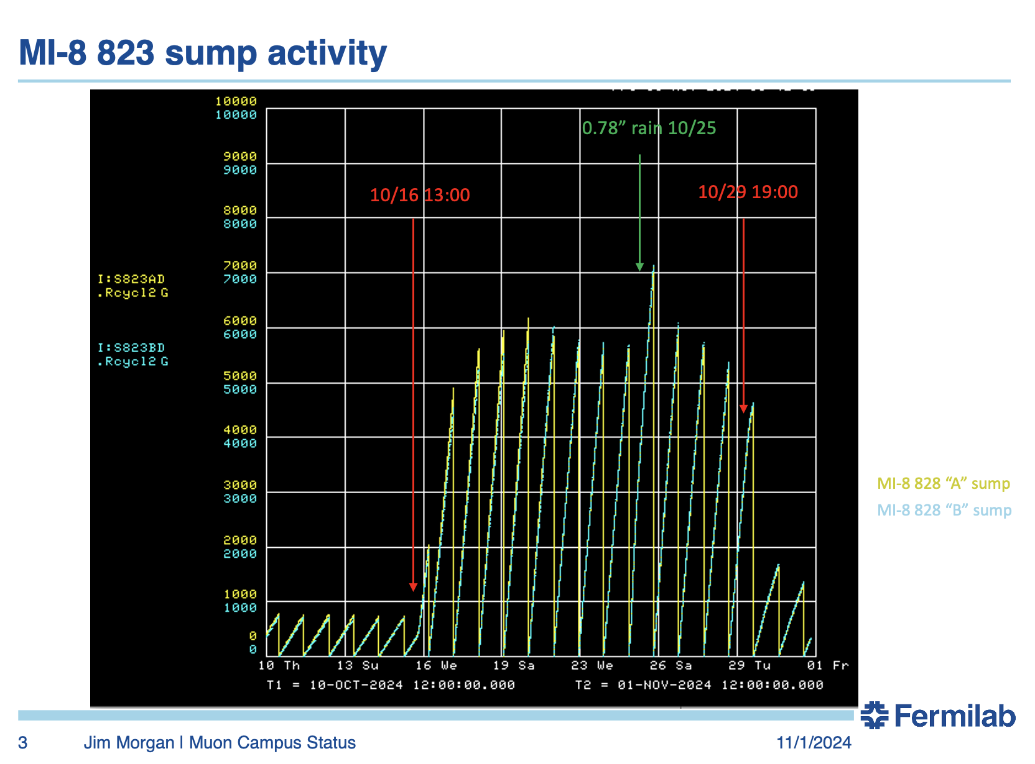
Mu2e sundry
Downstream Transport Solenoid (TSd) → pinpointed leak in cryo transfer line
  Now trying to figure out what to do
Upstream Transport Solenoid (TSu) → leak checking starting
Electricians continue to work…
  for beam enclosures at MC2 (Mu2e at MC2)
  for full flow purifier at MC1 (g-2 and Mu2e cryo plant at MC1)
Replacement of Automatic Transfer Switch (for backup power) at MC1 delayed until January
Coordinating work in Production Solenoid area
  Pour Extinction monitor collimator filter concrete
  Install Production Solenoid on stand and install Heat & Radiation Shield
Purchased sump level monitor
  Plan to follow in footsteps of Jim Morgan

