Slide 1
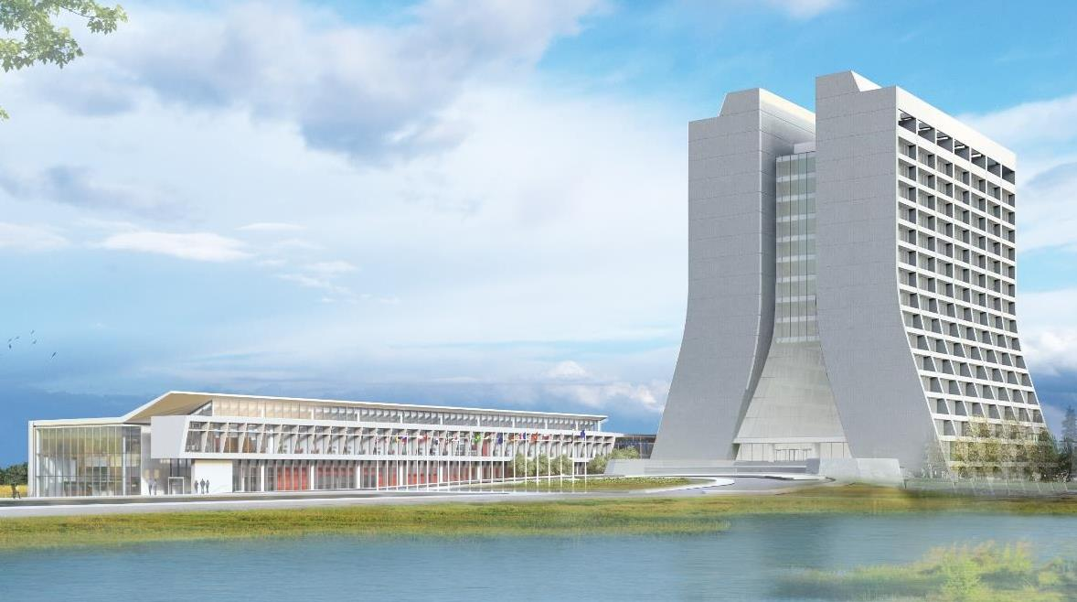
Infrastructure Services Division Updates
Pressing Issues / Special Topic:
  Village Water Main – Dorm 5 & 6 are suffering a main leak that has displaced staff.
  Wall Leak Injections (MT6) – completed yesterday (need to verify)
  Sewer pipe repairs (TG) – Planned to be completed before the holiday
  Sewer pipe repairs (NML) – Completed
Noteworthy Items:
  Fire Protection Collaboration – The lab’s direction to move from past operating to a safer building envelope including staying off the radar of DOE Standard 420.1C Facility Safety
    MI-8 and MDB – have had some walk throughs and we have been working toward a better practice of electrical panel safety – just received a new batch of panel notification stickers.

Slide 2
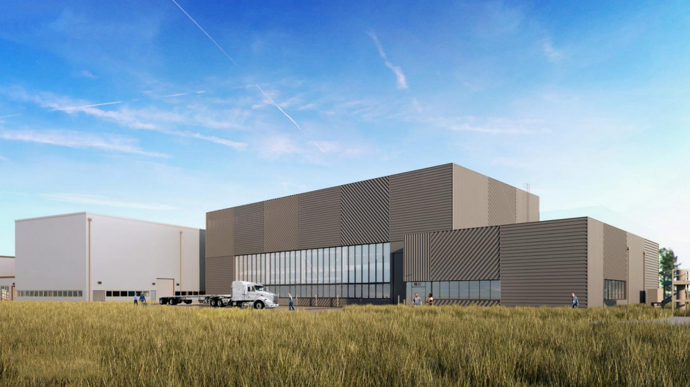
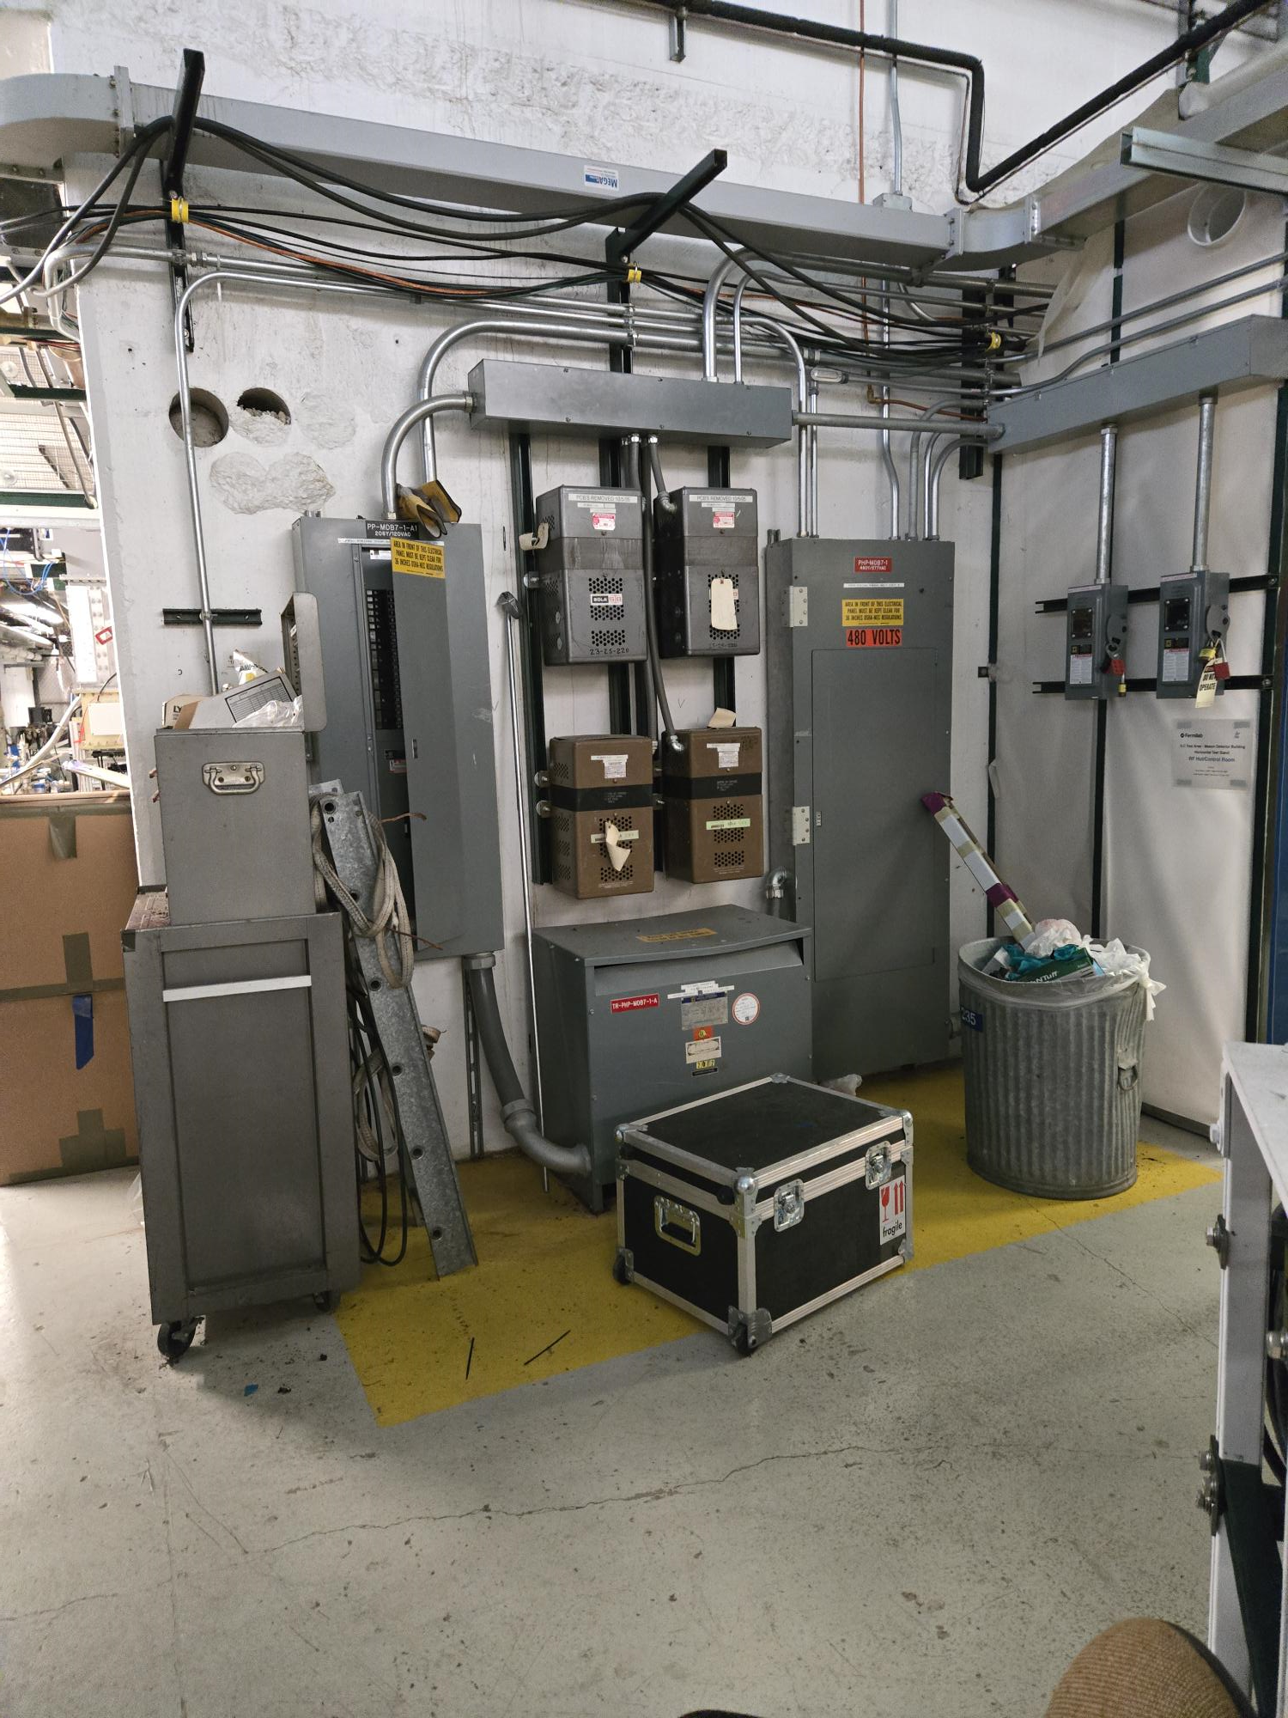
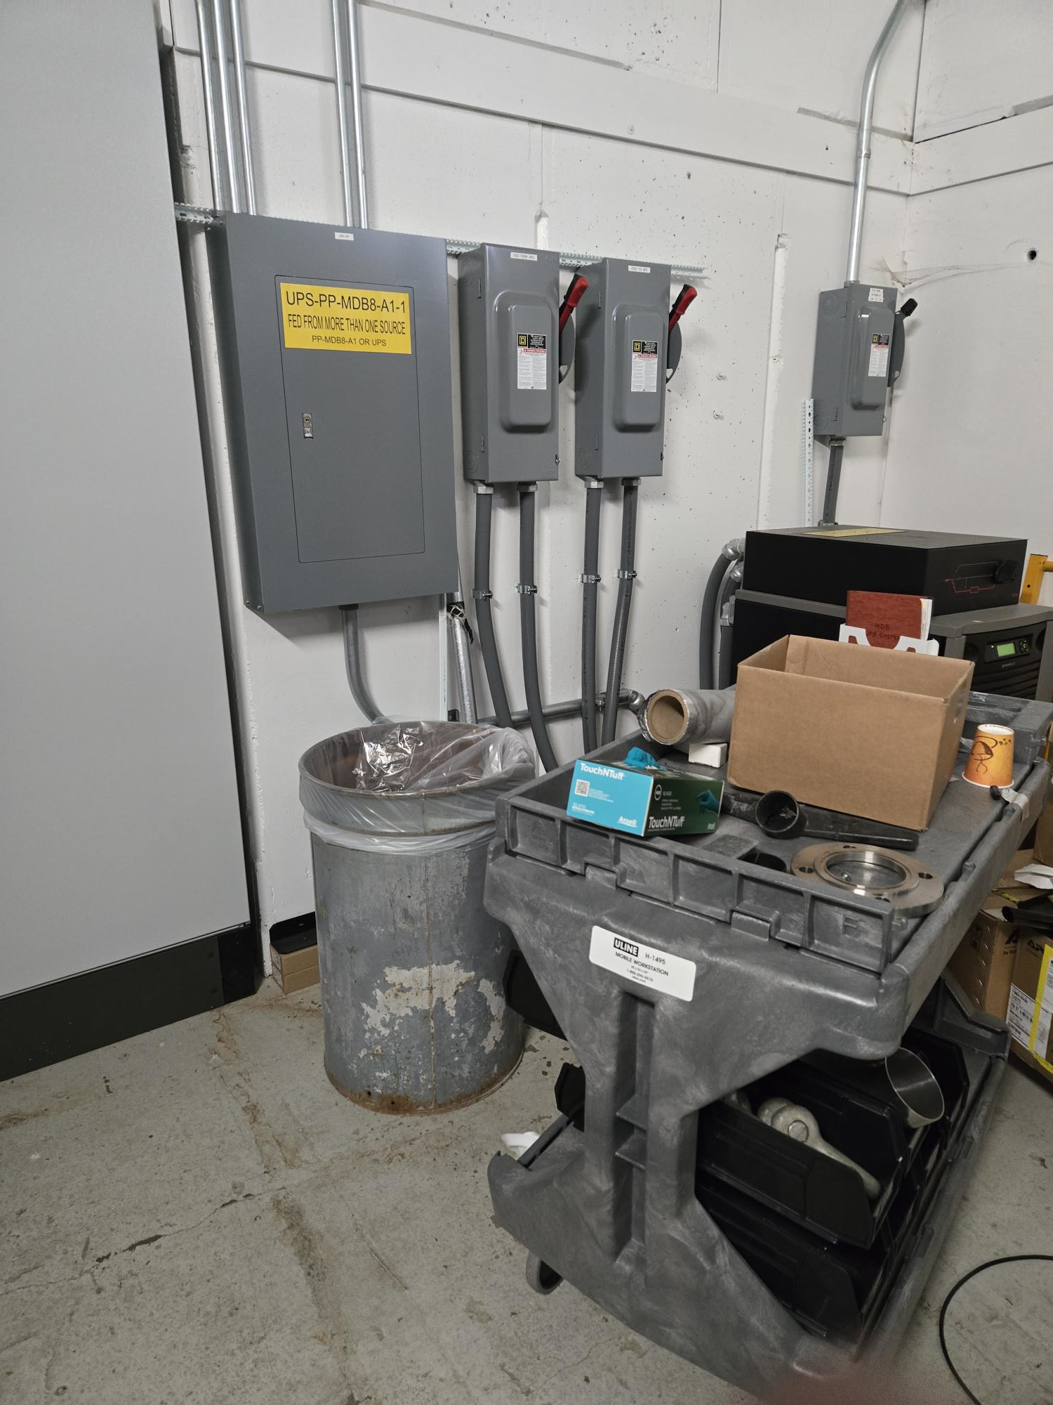
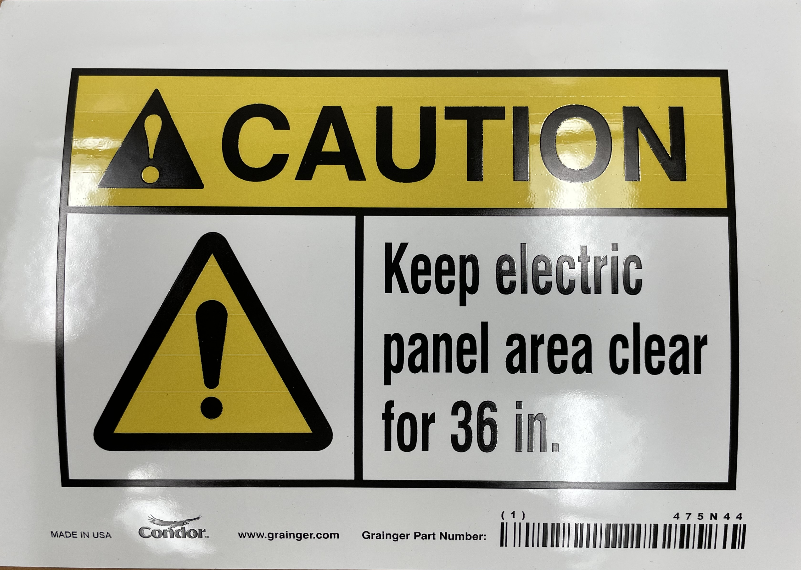
Special Topic:
Power Panels need to always have 36” of clearance around them. Current Safety walks are looking hard at this.
I just received another batch of stickers to send out if needed.

Slide 3
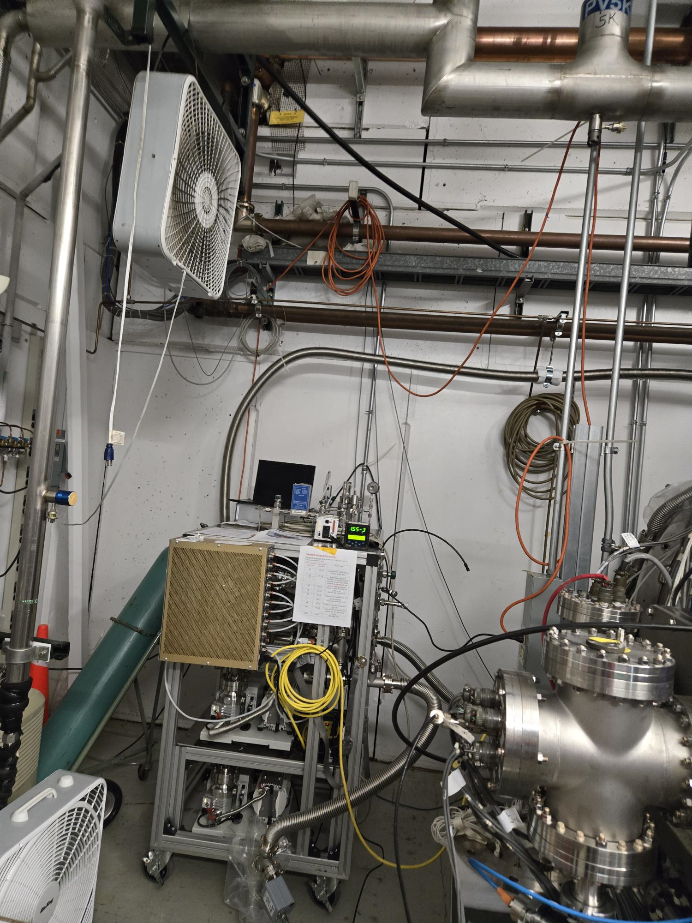
Noteworthy Items
MMR Changes – The MMR Process is changing a bit in cataloging and requesting materials to be moved. Moving toward a more generally practiced process in the industry. – In Progress
Service Agreement – Verifying AD/ISD equipment is moving along nicely at about 42.29% of roughly 8000-line items. In Progress 🔺up 2.29%
Safety Concern (see picture to the right) - Permanent temporary power by use of extension cords are being looked at more critically. Solutions will need to be searched for to provide power by adding boxes nearer to the experiments.
New Roofs
Minos - is prepping (Emergency Roof on high bay in progress),
Village Gym/Fuel Station - are next up and just waiting on different phases of the projects to firm up dates.
Minos – Emergency Roof – In review process. In Progress

Slide 4
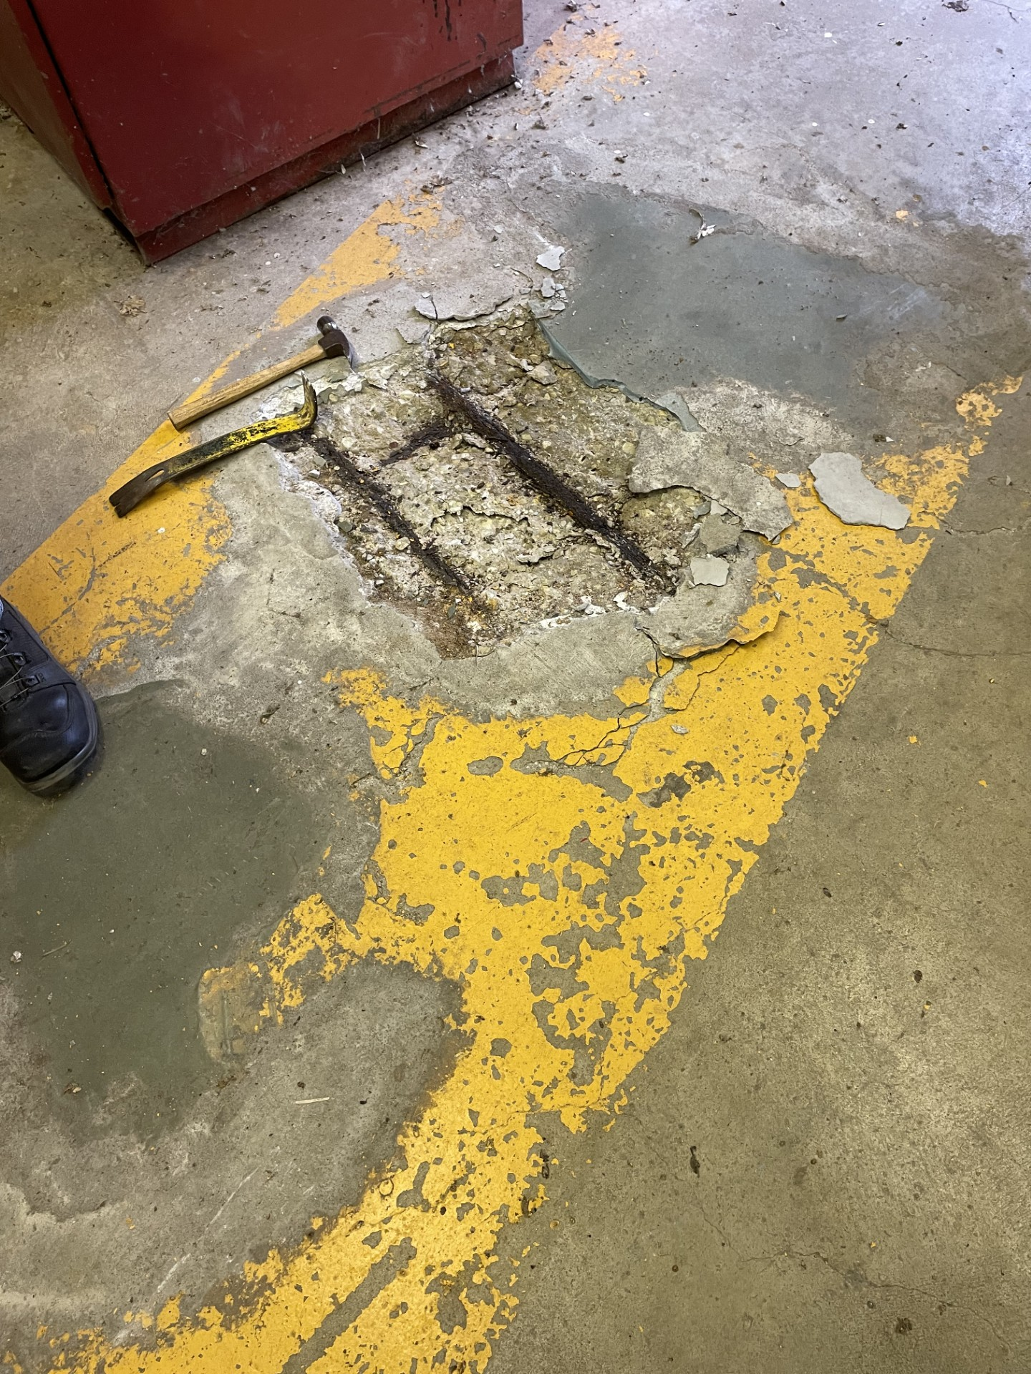
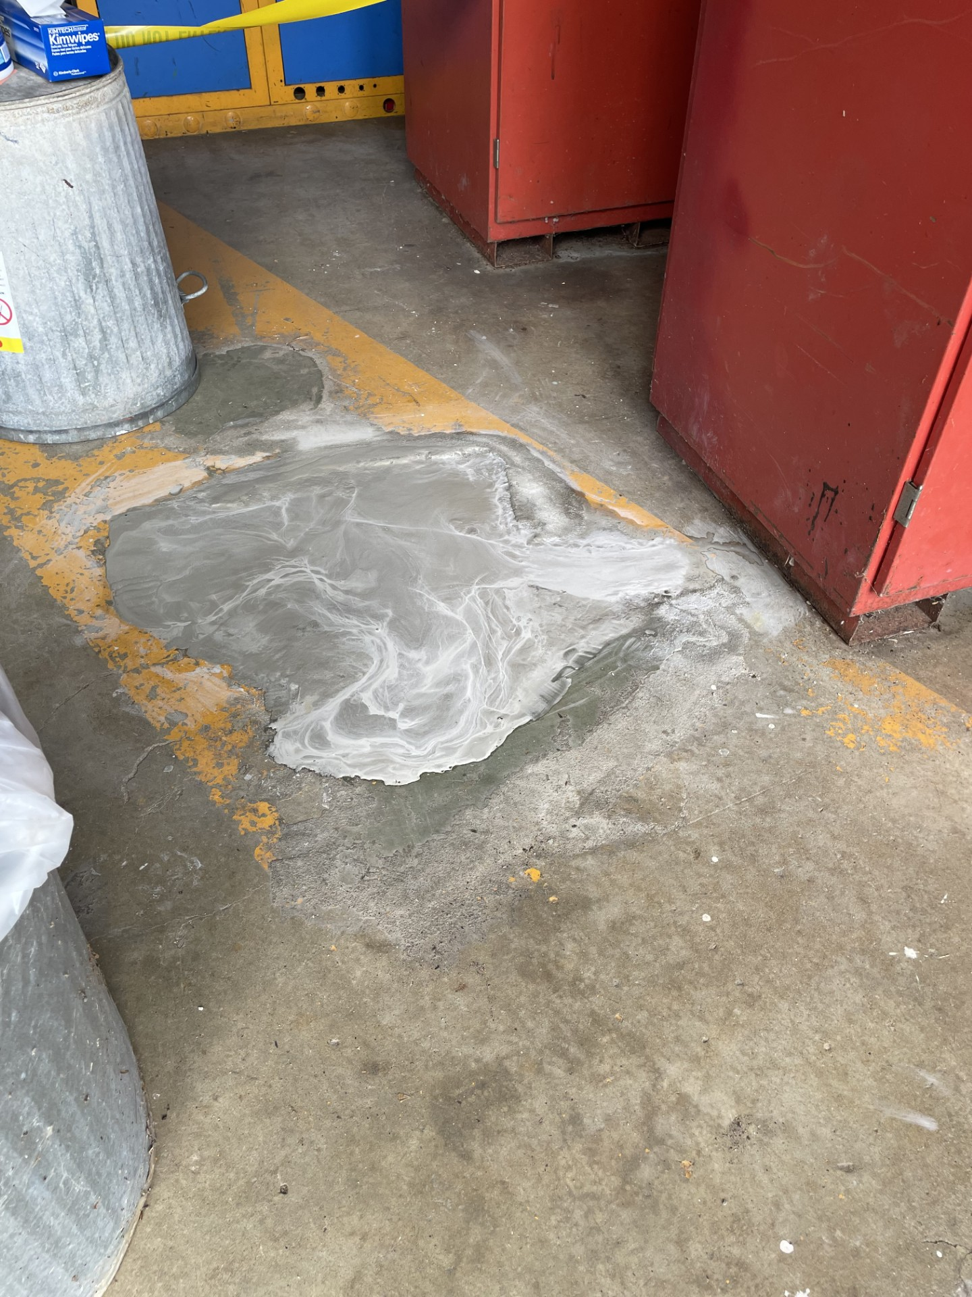
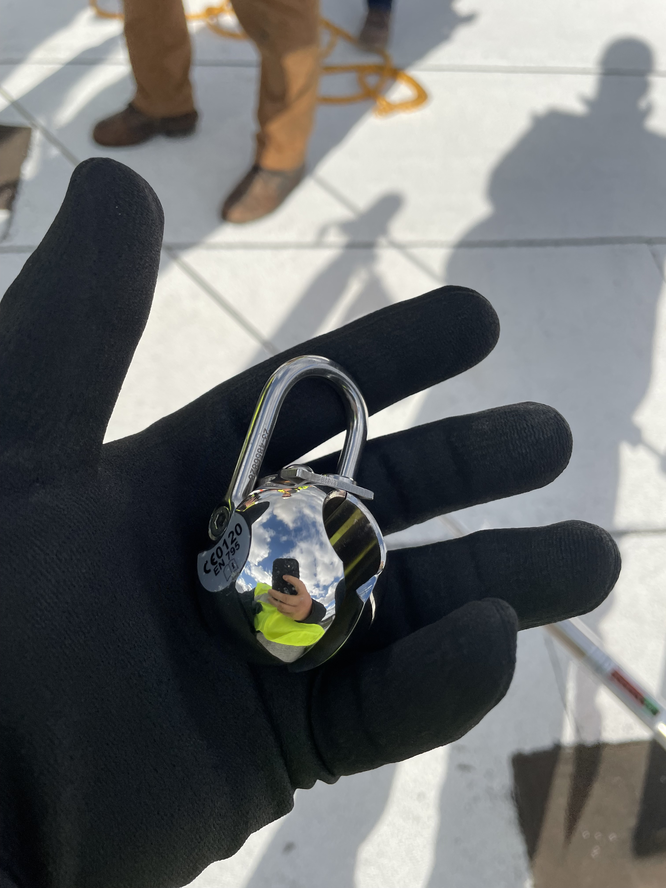
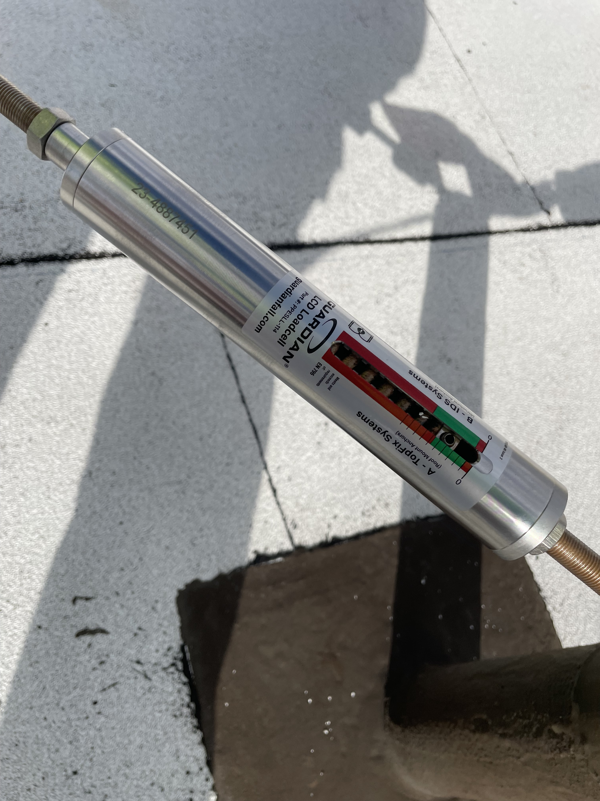
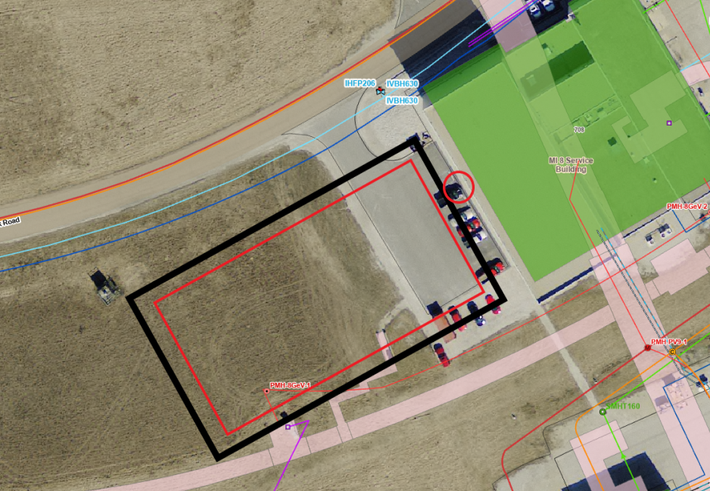
Active Projects still in motion and Contractors on Site
Other Happenings:
FREP (Fermilab Resilience & Efficiency Project) - has been walking various buildings working out details of the future scope of work (SOW) for controls and HVAC upgrades.
NS3 – is getting the HVAC equipment delivered.
NWA – North AC unit is finished so this coming summer the temp should be better. Next will be the south unit will make the list
Structure Move – Looking into getting the F4 Trailer moved out.
TSIB – Completed a building walk and roof fall protection training. This building has a cool fall protection system that is a horizontal pull system – only one on the lab so far.
.

