Slide 1
AD Scheduling Meeting - PIP-II Report
Darren Crawford, PIP-II Beam Commissioning L3 Manager
13-Dec-24

Slide 2
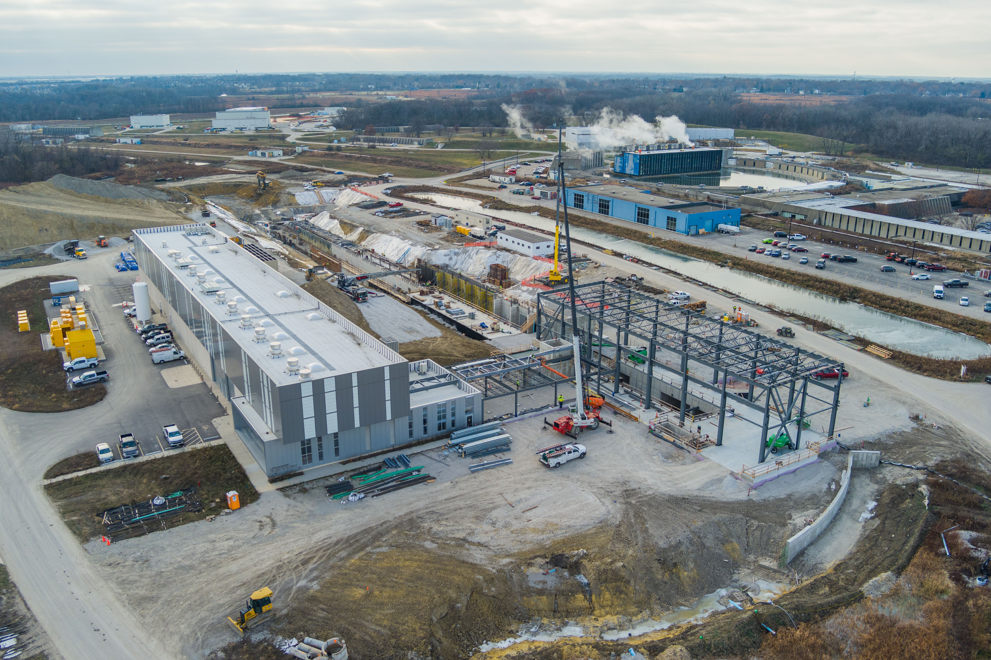
PIP-II Construction Site

Slide 3
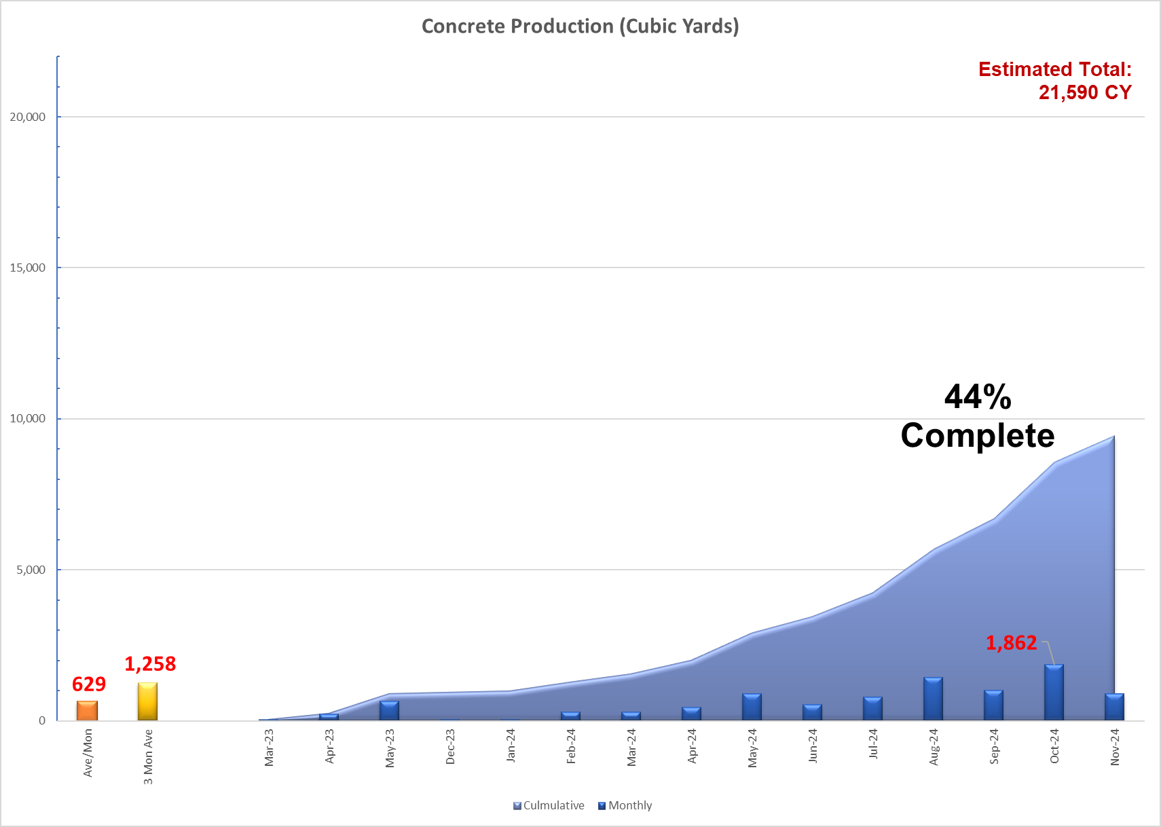
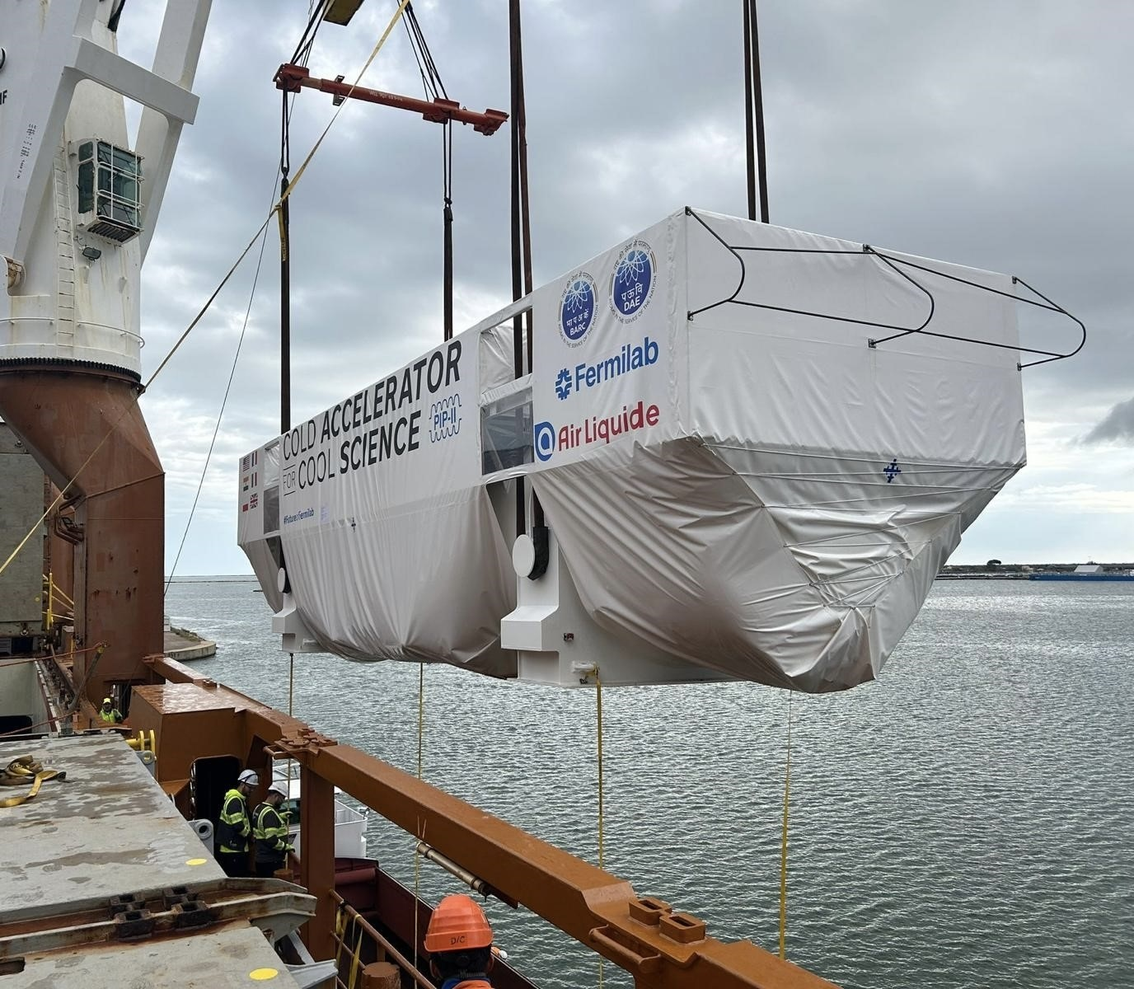
PIP-II Update
Linac Tunnel 54% complete
RF Trench 38% complete
Coldbox arrival 07-Jan-25
High Bay Building AUP 23-Jun-25
Linac Tunnel AUP 19-Sep-25
240 trucks

Slide 4
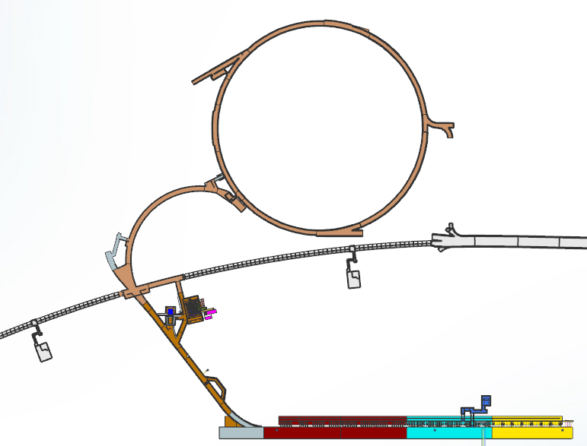
Existing Machines + PIP-II
The current operational accelerator complex near the PIP-II project includes the Booster machine and the P3 beamline that delivers beam to the Switchyard beamlines and experiments
Booster
P3
To Switchyard

Slide 5
PIP-II Shielding Assessments
The PIP-II Project will be creating or altering 4 different Shielding Assessments through the life span of the Project.
The two operational machines along with…
Two additional SAs of our own
PIP-II broke up SAs based on the construction packages:
PIP-II Linac
Beam Transfer Line
Booster
SA
Beam Transfer Line SA
SY120
SA
PIP-II Linac SA

Slide 6
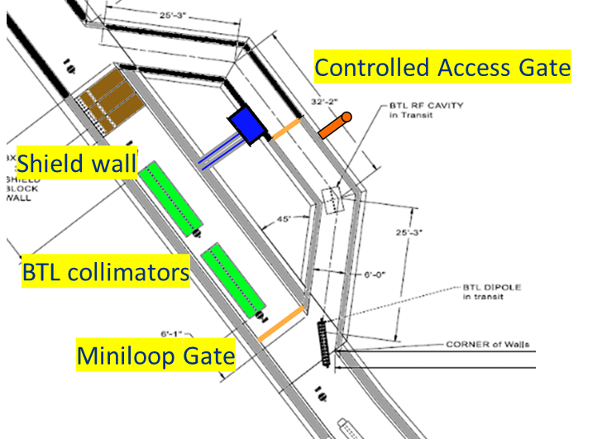
Enclosures - AD Complex Integration
The Project worked with the Accelerator Directorate/Beams Division/Proton Source Dept Head and associated group leaders for their input into the future enclosure Critical Device Controllers (CDCs). In general, the radiation simulations determine what devices can be considered a critical device. These devices are designed for a fail-safe manner, meaning positive control of this device allows beam to continue to enclosure its protecting.
Booster
Junction
Low Exposure Geelhoed (LEG) Bypass
PIP-II

Slide 7
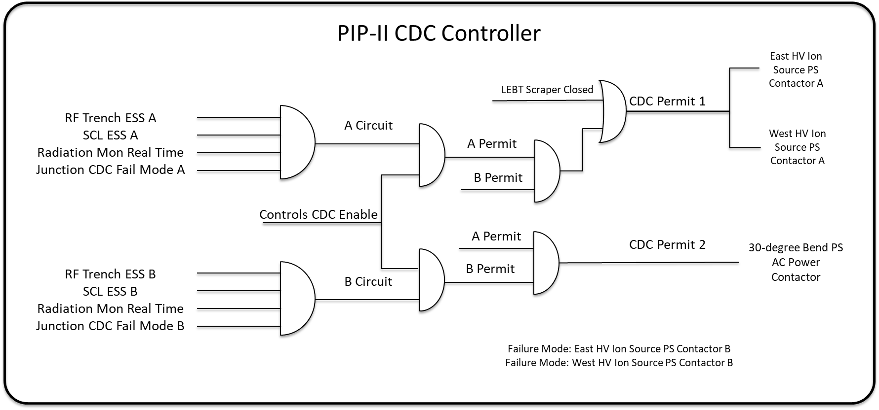
Enclosure CDCs – PIP-II Linac
Ion Sources
30 Bend Magnet
HV Racks
WFE is a radiation area

Slide 8
Enclosure CDCs - Junction

Slide 9
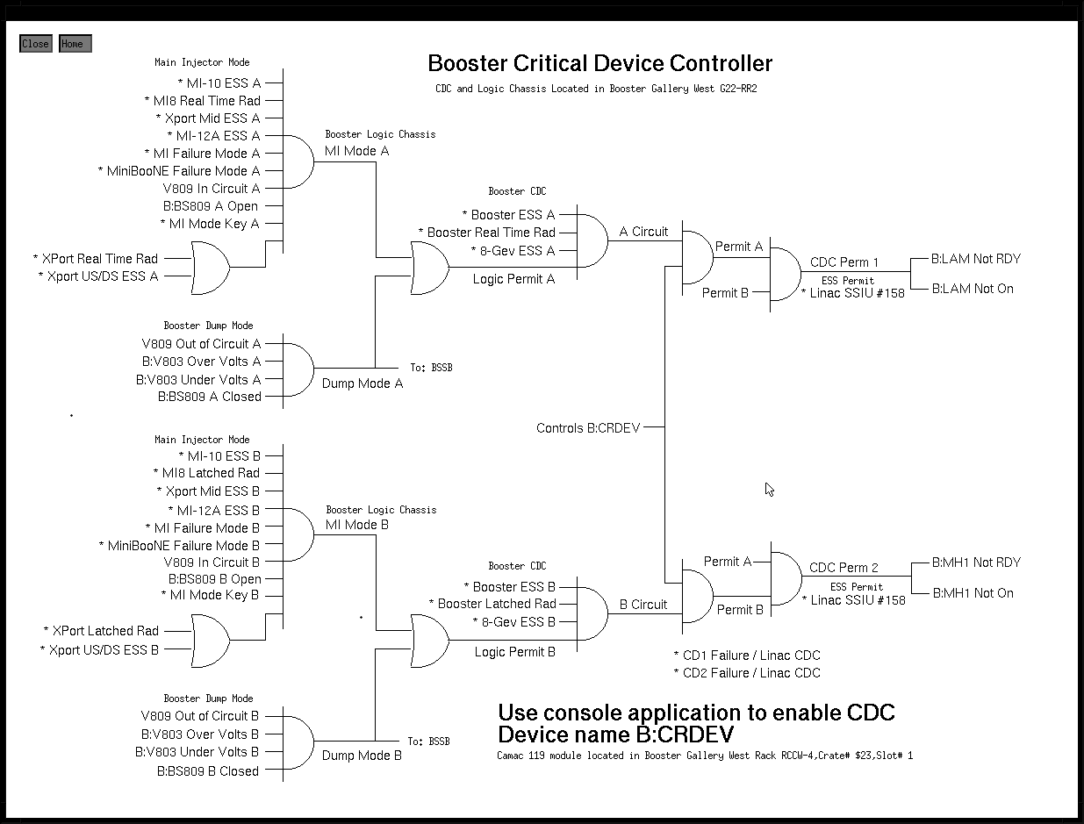
Enclosure CDCs - Booster
Arc 2 Dipole PS #1
Arc 2 Dipole PS #2

Slide 10
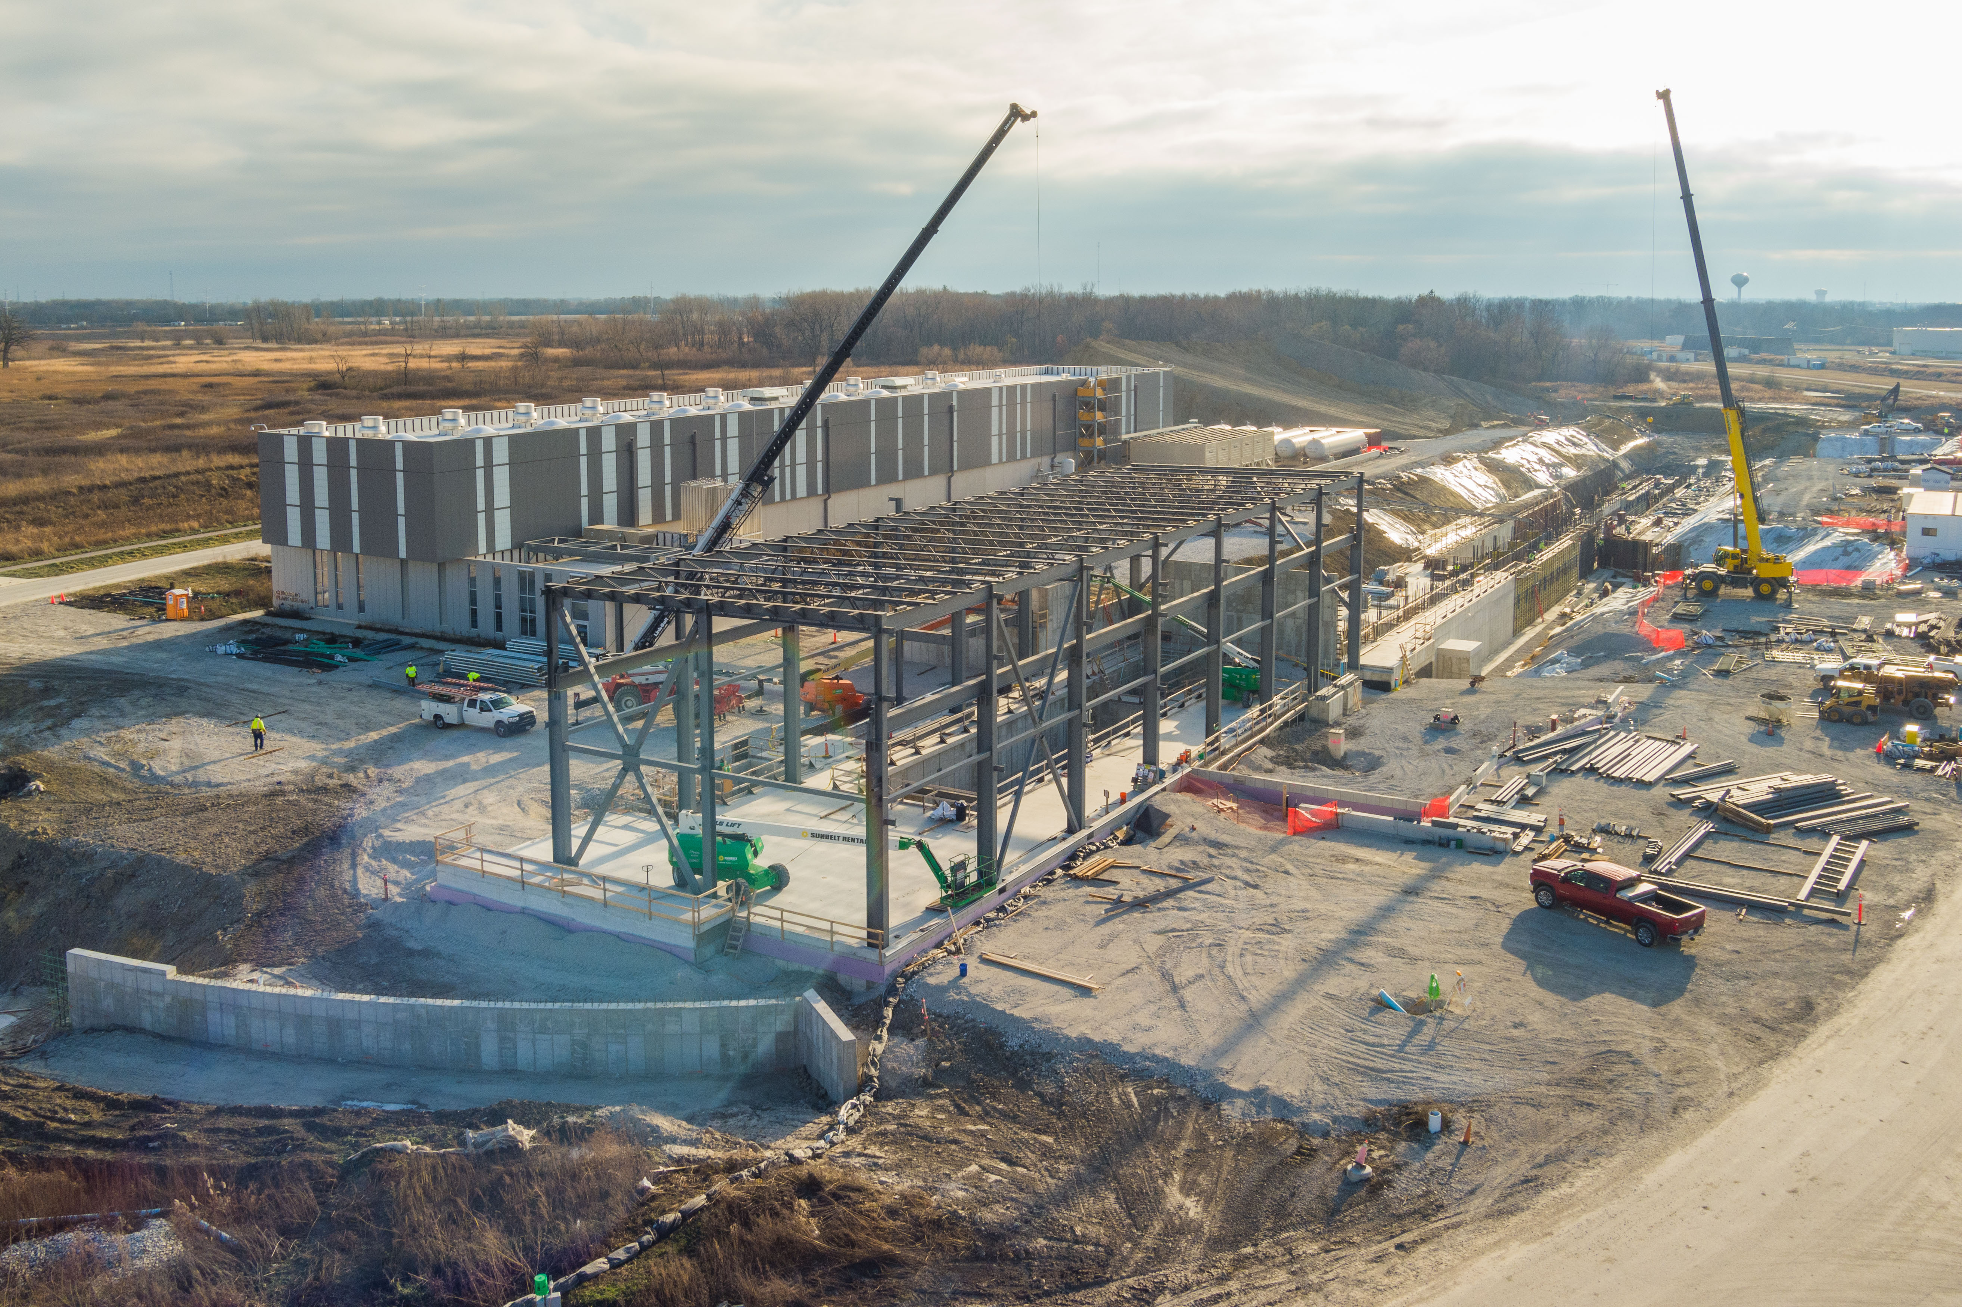
Thank you

Slide 11
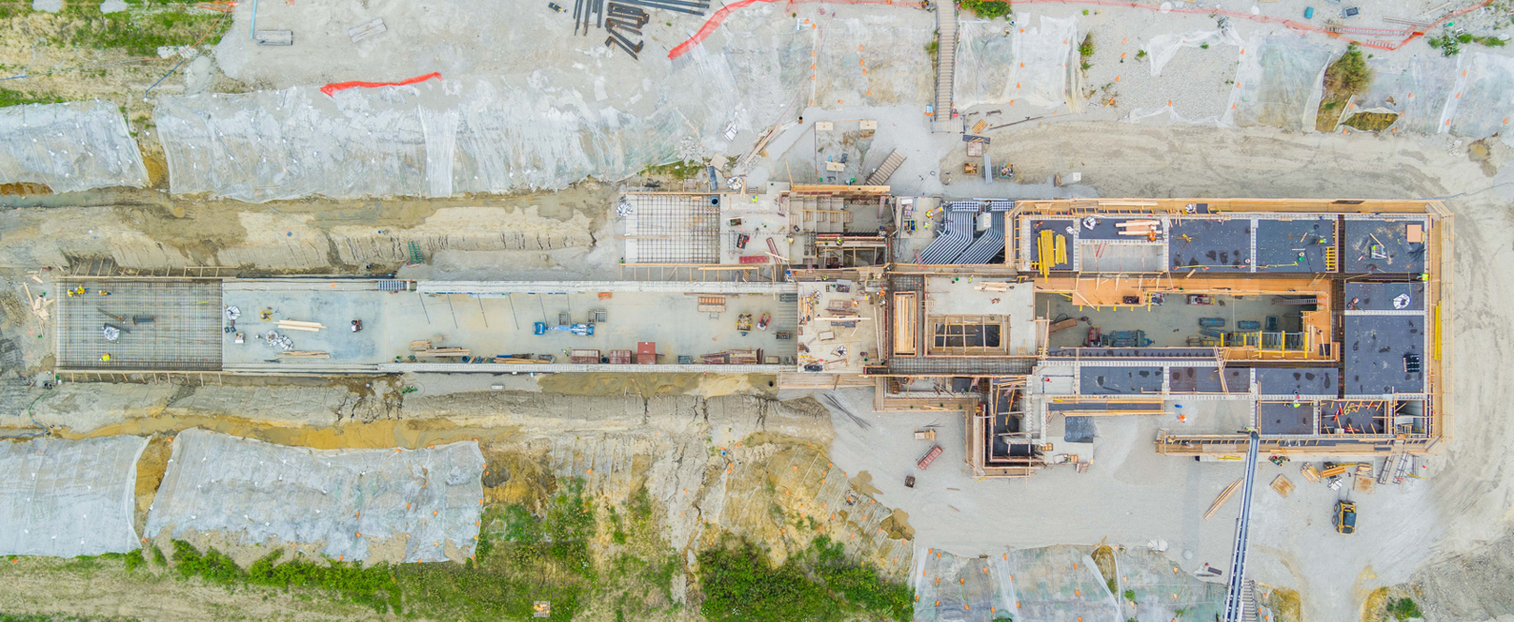
PIP-II Construction Site

Slide 12
PIP-II Construction Schedule
The Beam Transfer Line construction package is broken into two phases.
Phase 2 turns beam off to the complex
Phase 1 disables beam to the Muon Campus & NuMI via Main Injector
These areas plan to operate during Phase 1 construction
The P3 beamline (F Sector ESS) is a logical input to Main Injector Critical Device
Since IPR 2023, PIP-II has developed a plan along with Accelerator Directorate
Starts
Dec 2025
Starts
June 2027
P3 beamline

