Slide 1
9 AM Meeting
Judah O’Neil
MCR Crew Chief
Friday, December 13, 2024

Slide 2
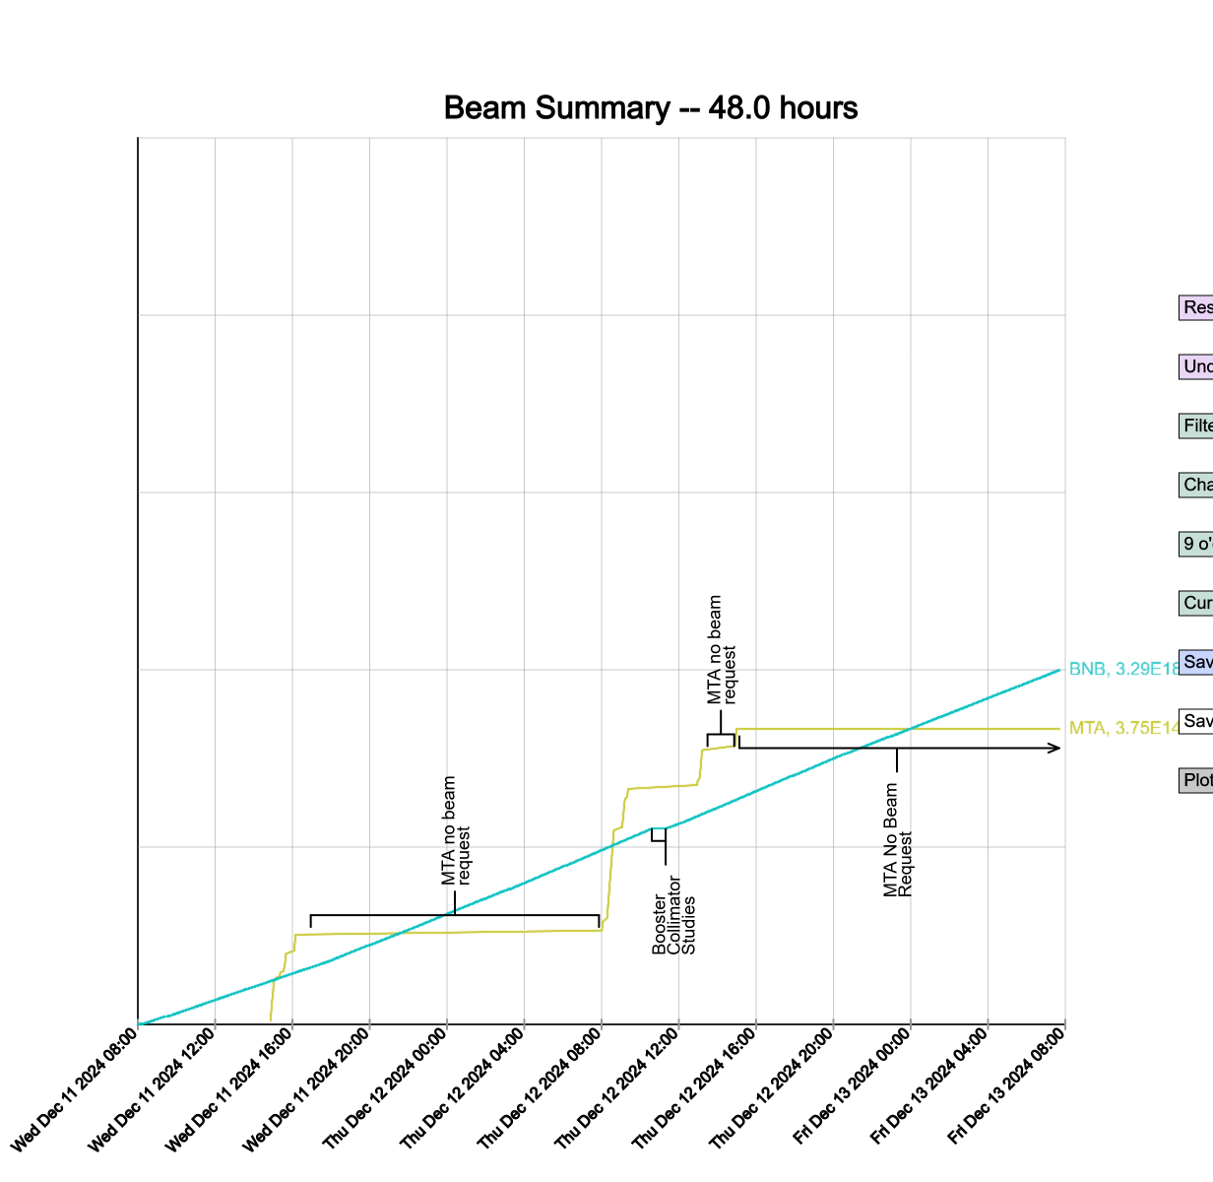
Since Wednesday…
Booster studies performed through the week
TeV ring power outages
Beam to BNB and MTA when available
Operator tuning in the off-shifts
Wednesday:
BNB Target scans
Thursday:
Positioned a Grindex at sump 201 in MI
Booster collimator studies
Beam to BNB

