Slide 1
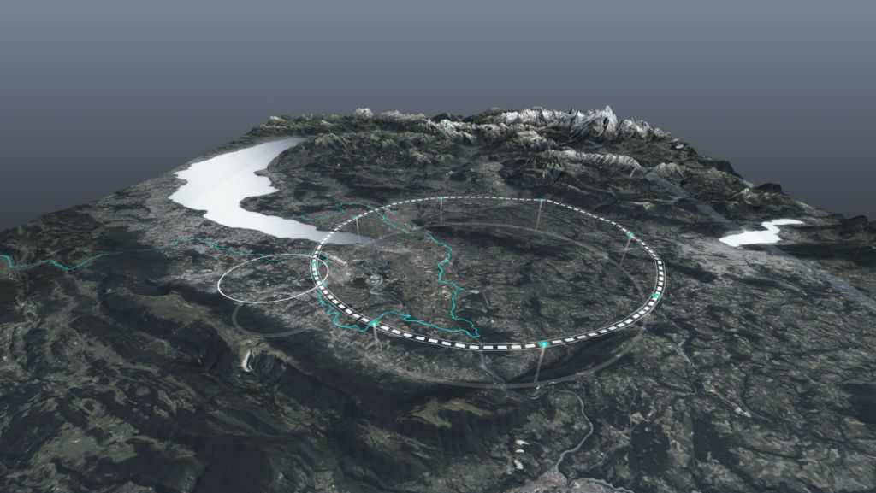









Future Circular Collider
design overview and possible topics for collaboration
Jean-Paul Burnet, Michael Benedikt, Frank Zimmermann, CERN
on behalf of FCC collaboration
1st meeting of US HFSC, FNAL, 15 January 2025
http://cern.ch/fcc
Work supported by the European Commission under the HORIZON 2020 projects EuroCirCol, grant agreement 654305; EASITrain, grant agreement no. 764879; iFAST, grant agreement 101004730, FCCIS, grant agreement 951754; E-JADE, contract no. 645479; EAJADE, contract number 101086276; and by the Swiss CHART program
photo: J. Wenninger

Slide 2
Feasibility study completion

Slide 3

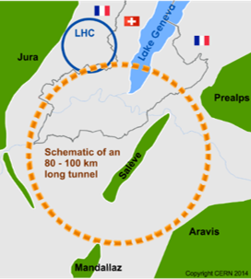
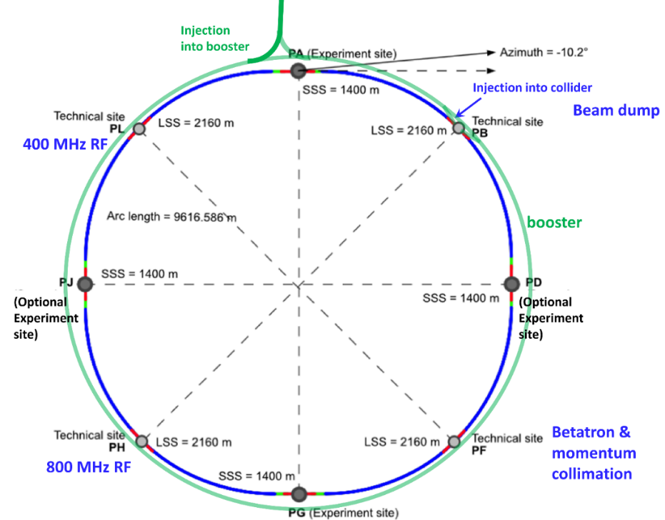
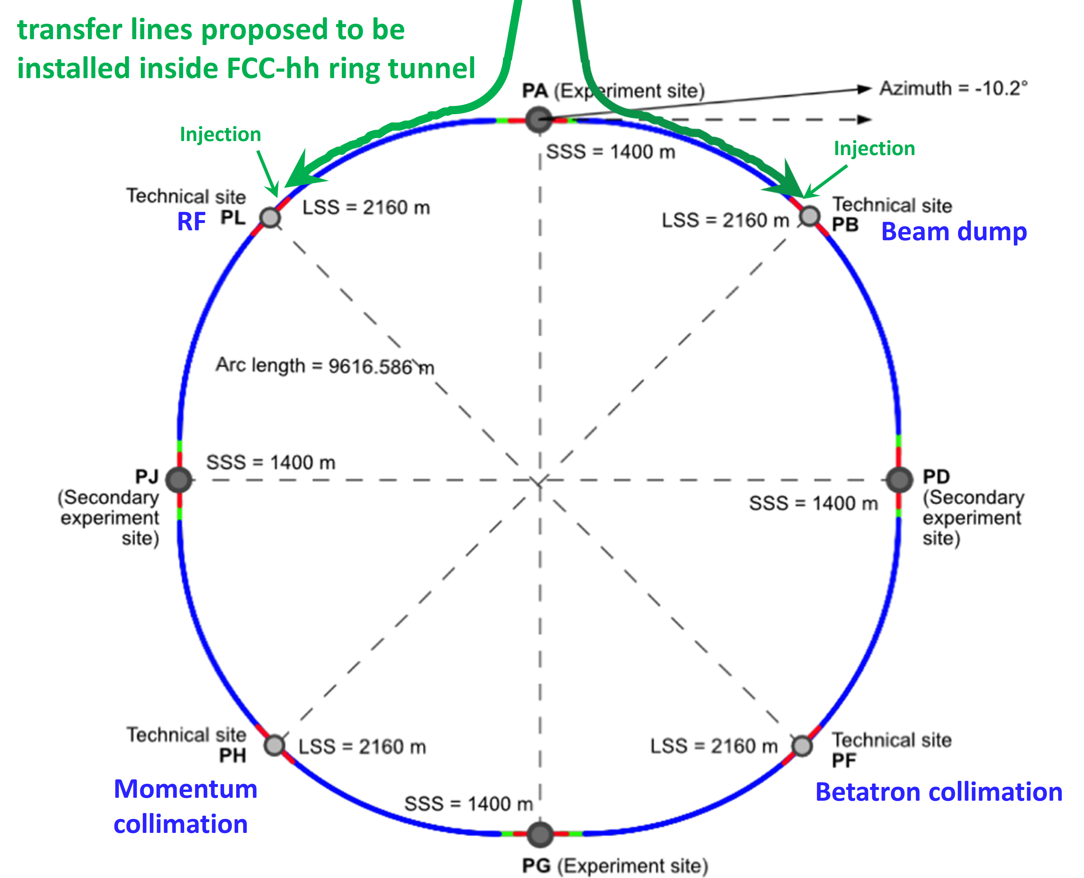
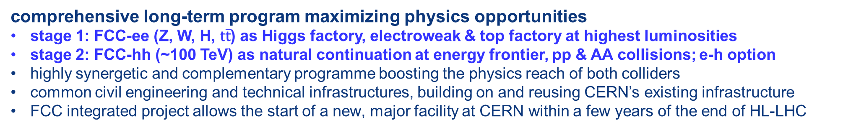
FCC integrated program
3
comprehensive long-term program maximizing physics opportunities
stage 1: FCC-ee (Z, W, H, $\text{t}\overline{\text{t}}$) as Higgs factory, electroweak & top factory at highest luminosities
stage 2: FCC-hh (~100 TeV) as natural continuation at energy frontier, pp & AA collisions; e-h option
highly synergetic and complementary programme boosting the physics reach of both colliders
common civil engineering and technical infrastructures, building on and reusing CERN’s existing infrastructure
FCC integrated project allows the start of a new, major facility at CERN within a few years of the end of HL-LHC
FCC-ee
FCC-hh
2020 - 2040
2045 - 2060
2065 - 2090

Slide 4
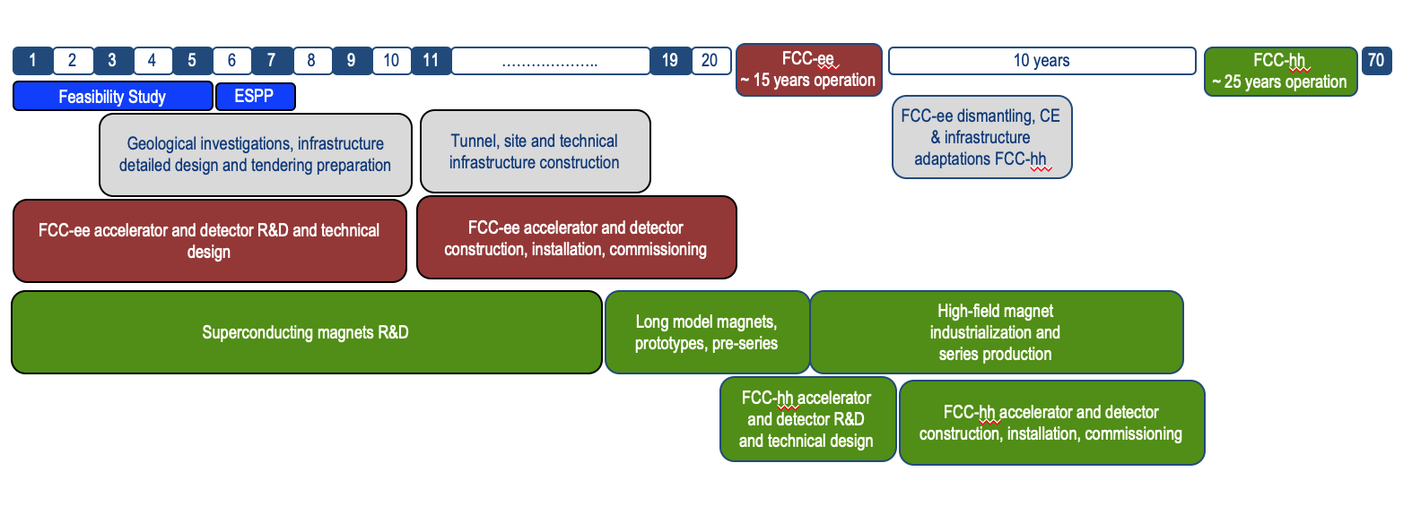
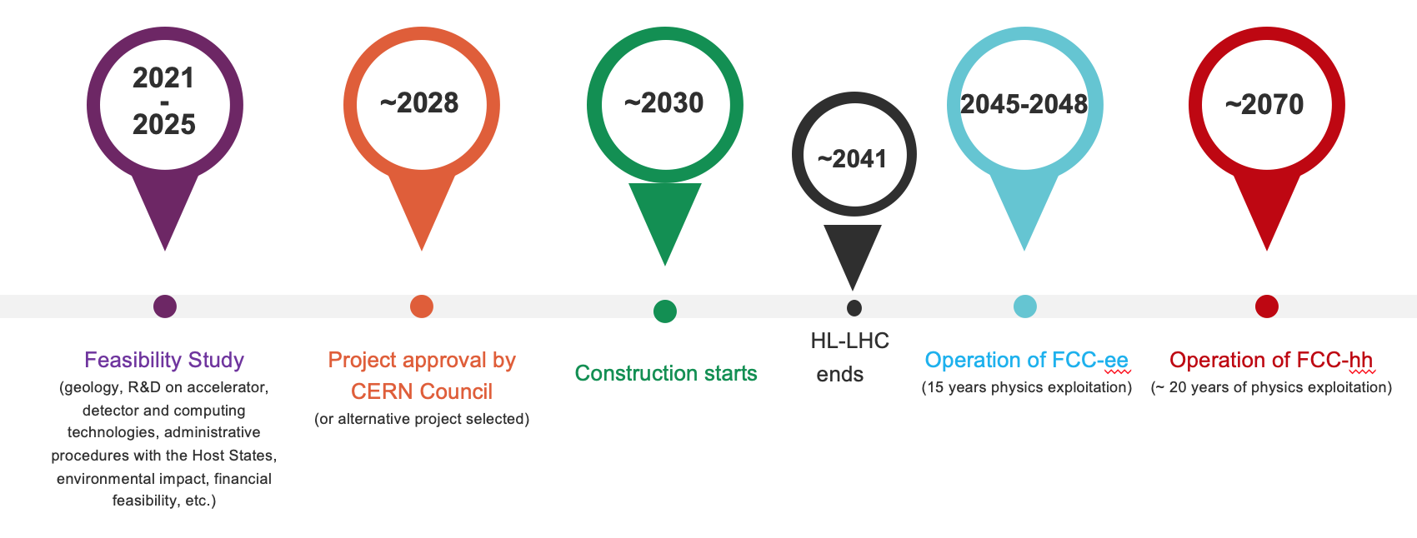
FCC integrated program - timeline
4
Note: FCC Conceptual Design Study
started in 2014 leading to CDR
in 2018
Ambitious schedule taking into account:
past experience in building colliders at CERN
approval timeline: ESPP, Council decision
that HL-LHC will run until 2041
project preparatory phase with adequate
resources immediately after Feasibility Study
2027/28
~2032
~2045
~2070

Slide 5




Possible time line till start of construction
2024 |  |  |  | 2025 |  |  |  | 2026 |  |  |  | 2027 |  |  |  | 2028 |  |  |  | 2029 |  |  |  | 2030 |  |  |  | 2031 |  |  |  | 2032 |  |  |  | 2033
Q1 | Q2 | Q3 | Q4 | Q1 | Q2 | Q3 | Q4 | Q1 | Q2 | Q3 | Q4 | Q1 | Q2 | Q3 | Q4 | Q1 | Q2 | Q3 | Q4
Feasibility Study
Pre-TDR Phase
TDR Phase
Construction →→→
FS Report
cost update
ESPPU
2025/26
pre TDR
cost update
TDR
cost update
Project Decision
accelerator design, technical infrastructure design, R&D, towards TDR
engineering design →
Environmental Impact study & Authorization Process
Phase 1 Site Investigations
Phase 2 Site Investigations
CE Concept Design update
CE Tender Design
Construction Design
Start construction
Detector EOI submissions
FC³ formation, call for CDRs
Detector CDRs submitted to FC³

Slide 6

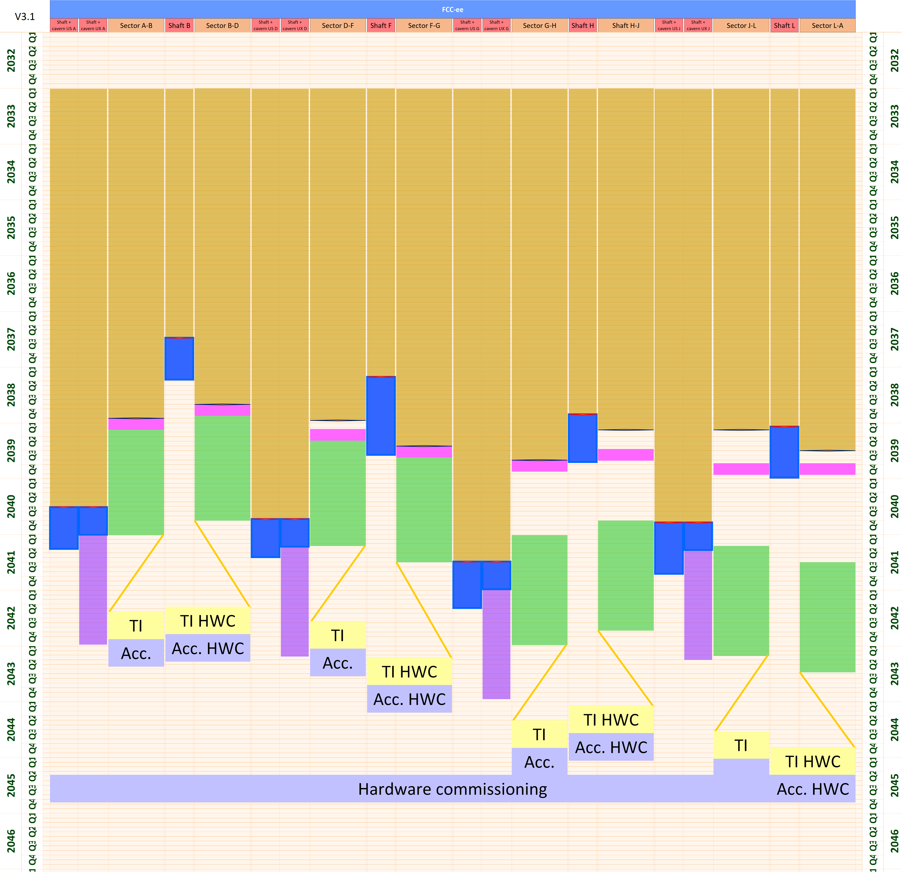
Construction and installation planning stage 1
Baseline stage 1 FCC-ee schedule
Q1 2033, Start of CE construction work
Q2 2041, Completion of last lot of CE construction
Q2 2043, Overall completion of TI installation
Q4 2044, Accelerator installation completed
Q4 2045, HW commissioning completed
Q1 2046, First beams
Q1 2048, Start of nominal operation
Q3 2041 – Q3 2044, Experiment installation
Q1 2046, Start beam commissioning
Civil eng. works
Experiment. install.
Accelerator HWC
Shaft works
Geodetic install.
TI HWC
TI installation
Machine install.
Shaft release
First alcove release

Slide 7
FCC Feasibility study report
3 report volumes are inputs for the Update of the European Strategy for Particle Physics
Volume 1: Physics and Experiments
Physics case, detector requirements and concepts, software and computing, energy calibration, polarisation, monochromatisation, community building.
Volume 2: The integrated project
Particle accelerators, technical infrastructures and safety.
Volume 3: Implementation
Civil engineering, territorial implementation, environmental aspect and sustainability/
Other documents under preparation:
Cost estimate and funding models
Environmental reports volume I and II.
Socio-economic impact study
Territorial opportunities and constraints
Volumes will be completed by 17 March 2025 for submission to the European Strategy Update by Monday 31st March, 2025.
Volumes 1 to 3 will be published by Springer-Nature in the EPJ series: requires further reviews, copy editing and quality management to become valuable and lasting references for the community.

Slide 8
Subsurface investigations

Slide 9
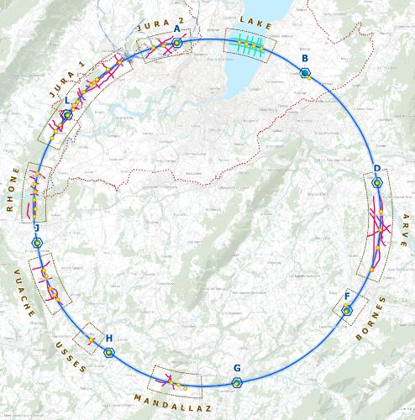
Key achievement: start of subsurface investigations
Continusouly incoming results of initial subsurface investigations in areas with lack of information or particular challenges:
optimise alignment depth and inclination.
get a better understanding for the choice of the most adapted construction techniques.
Increase the cost reliability and control.
Gain experience with permitting and environmental impact assessments and associated schedule management.
Prepare the project for subsequent, more detailed subsurface investigations.
28 boreholes between 10/24 and 12/25
80 km of geophysics between 10/24 and 10/25

Slide 10
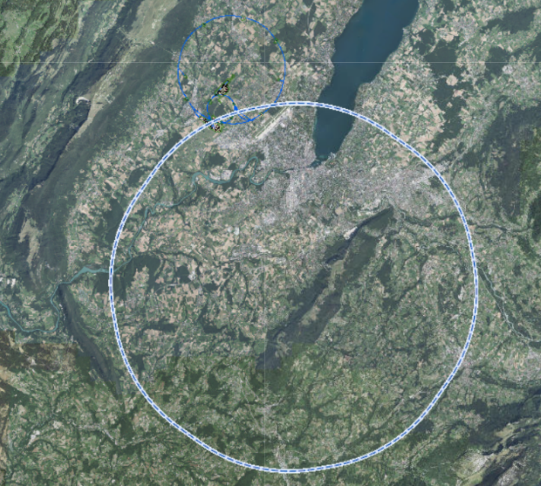
Advancement by December 2024
North:
Awaiting for permits in Switzerland.
Expected end February 2025
South:
Geophysics in sections Arve, Mandallaz, Usses and Vuache complete: 40 km.
Geophysical interpretation in progress.
Drilling 50% complete
ARVE
VUACHE
BORNES
Complete
USSES
Ongoing
MANDALLAZ
Starting shortly

Slide 11
Planning for March 2025
South: complete
North:
Geophysics and drilling in Jura 1 in progress.
Reprocessing of existing SIG 3D seismic campaign for Lake and Jura in cooperation with UNIGE complete.
Prepare drilling in lake for start in April 2025
Rhône: No drilling before September due to environmental impact constraints.
Finalisation of all activities by December 2025
JURA2
LAKE
JURA1
RHONE
ARVE
VUACHE
BORNES
Complete
USSES
Ongoing
MANDALLAZ
Starting shortly

Slide 12
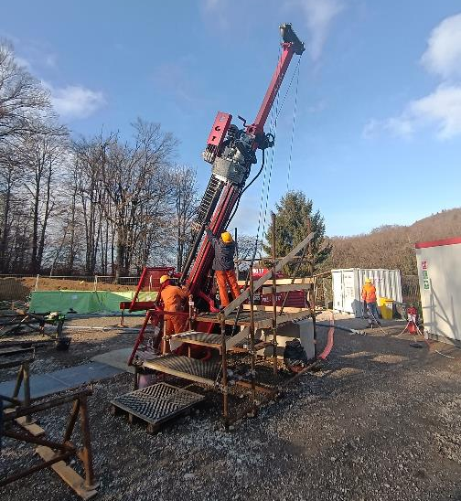
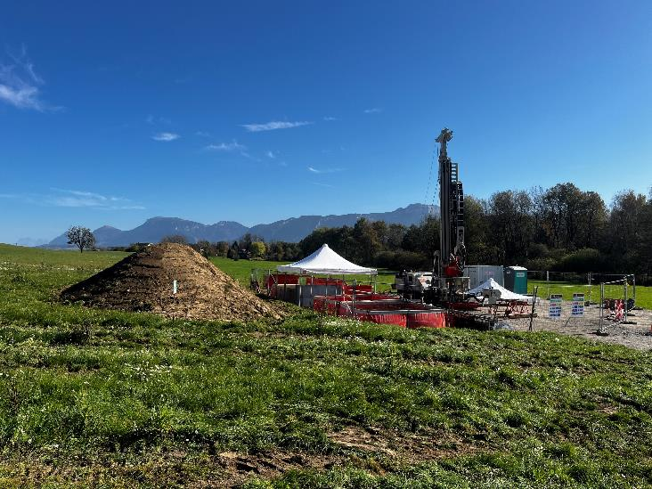
Geotechnical investigations: impressions

Slide 13
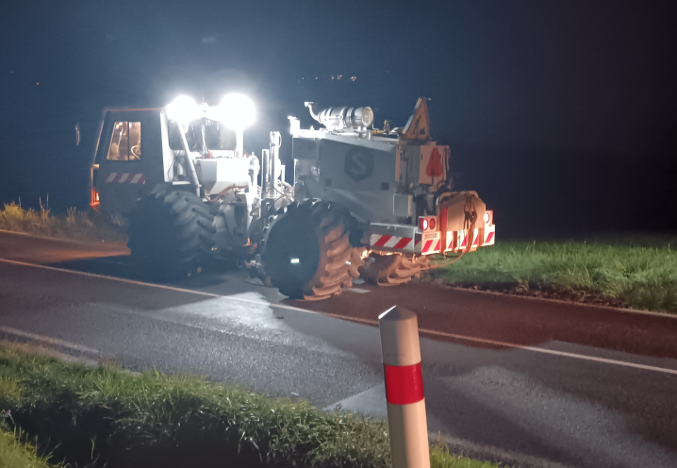
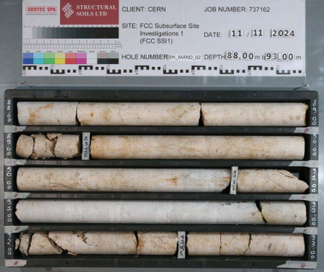
Geophysical investigations and limestone cores

Slide 14
Sustainability

Slide 15
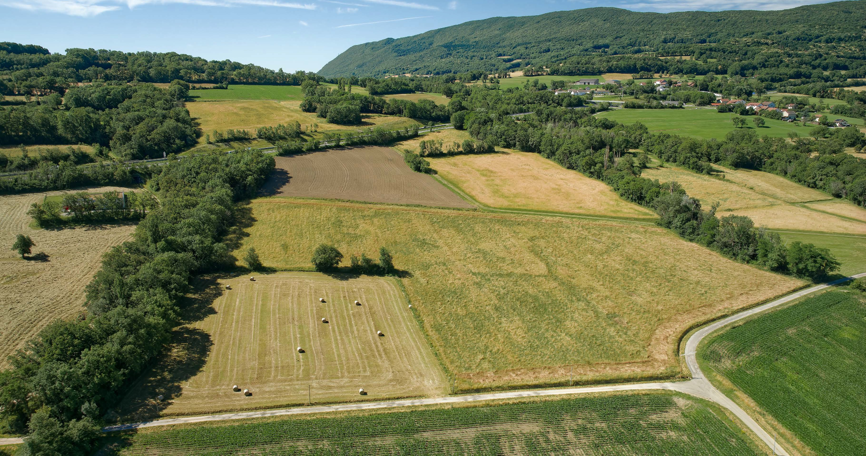
Land consumption
15
Scenario development led to land use reduction:
From 12 to 8 sites
From 100 to 45 ha
4,5 ha par an,
limited to 10 years of construction.
Note:
- Re-use of LHC Pt8 spaces in Ferney-Voltaire needs to be maximized.
- Re-naturalisation projects around sites still
need to be developed, but are foreseen.
-55%
For comparison:
France artificialises 66 ha per day
Switzerland artificialises 13 ha per day

Slide 16
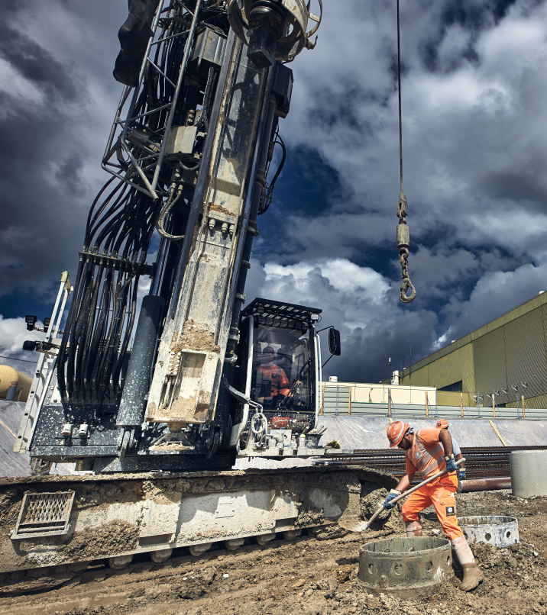
Construction carbon footprint:
530 000 tCO₂(eq)
16
Studied with industrial partner WSP applying European Norms EN 17472, EN15804+A2
Comparable to 3 years of CERN operation
Corresponds to 0,11 kg (115 g) per capita in Member States per year of construction
Note: Paris Agreement goal for 2050 is
2 000 kg per person per year.
For comparison
Channel tunnel: 13 million tCO₂
Lyon-Turin tunnel: 10 million tCO₂
Gotthard tunnel: 24 million tCO₂

Slide 17
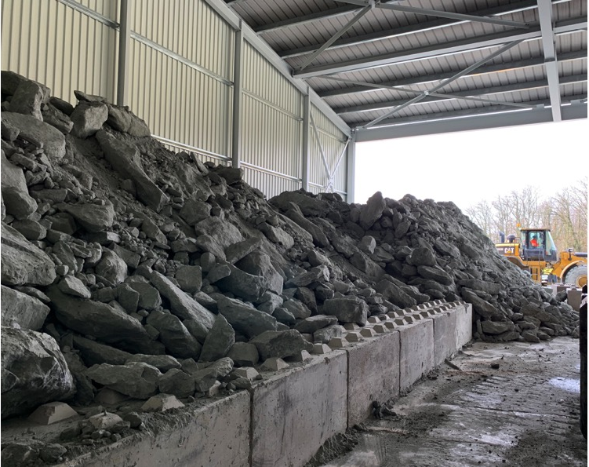
Excavated materials management challenge
Manage 8.5 million m³ of excavated materials.
A project management and territorial implementation topic and part of the authorisation conditions.
Deposit in quarries is in principle feasible, but is expensive (> 500 million euro) and possibilities are reducing from year to year.
95% is molasse, a heterogeneous, sedimentary rock for which no re-use scenario exists today.
Typically conventional construction projects (tunnels, roads, appartment house projects, public works) are too small and have too tight schedules to engage innovation actions for this type of material.

Slide 18
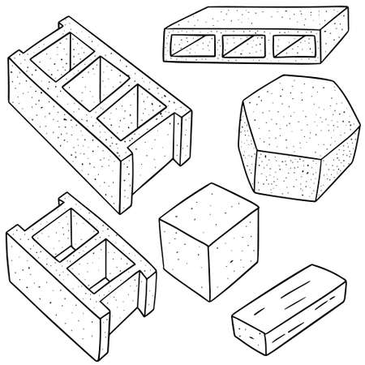
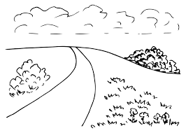
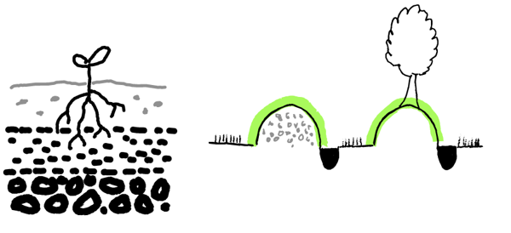
Identified credible re-use pathways being studied
Traditional channels
Use of sand and limestone for concrete production
Innovative construction materials
Use inside and in vicinity of the project
Landscape design
Unpaved tracks, rural and forest paths
Creation of new land
Wasteland refurbishment
Polluted soil treatment
Creation of leisure areas and parks
Improvement of acid soils
Territorial developments
Quarries renaturation
Noise barriers
Raised hedges
Covered road tranches
Trials for pathways with a potential of
2 million m³ planned at OpenSkyLab

Slide 19
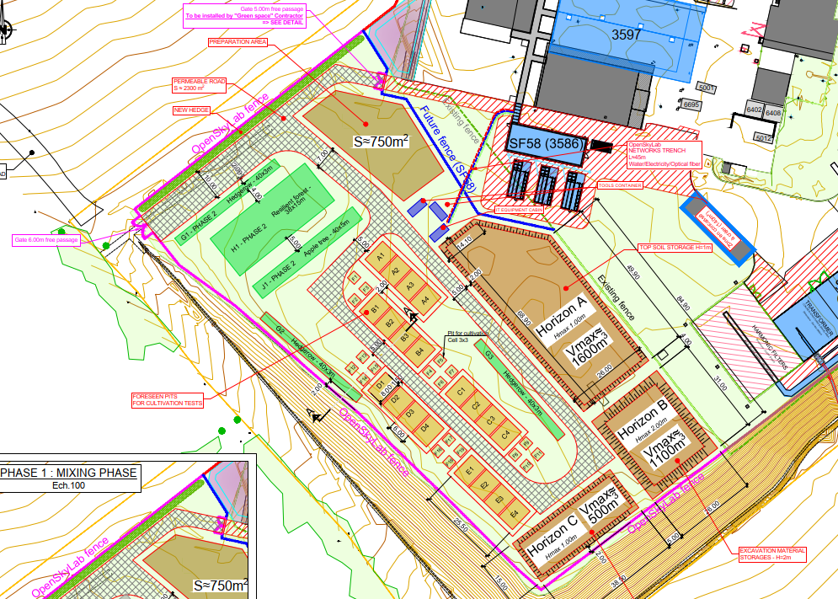
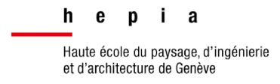







OpenSkyLab
Academic and industrial collaboration
Location: CMS Pt5, Cessy, 1 ha of land
Materials: Molasse from the HL-LHC construction
Duration: 4+ years (2024 - )
Budget: Approximately 4 MCHF
Trials with 5 000 t molasse
Field monitoring system with sensors and drone to permit comprehensive and systematic process of the development of methods and products as required by regulatory frameworks.
Note: agreements need to be established with offtakers before the materials are produced!

Slide 20
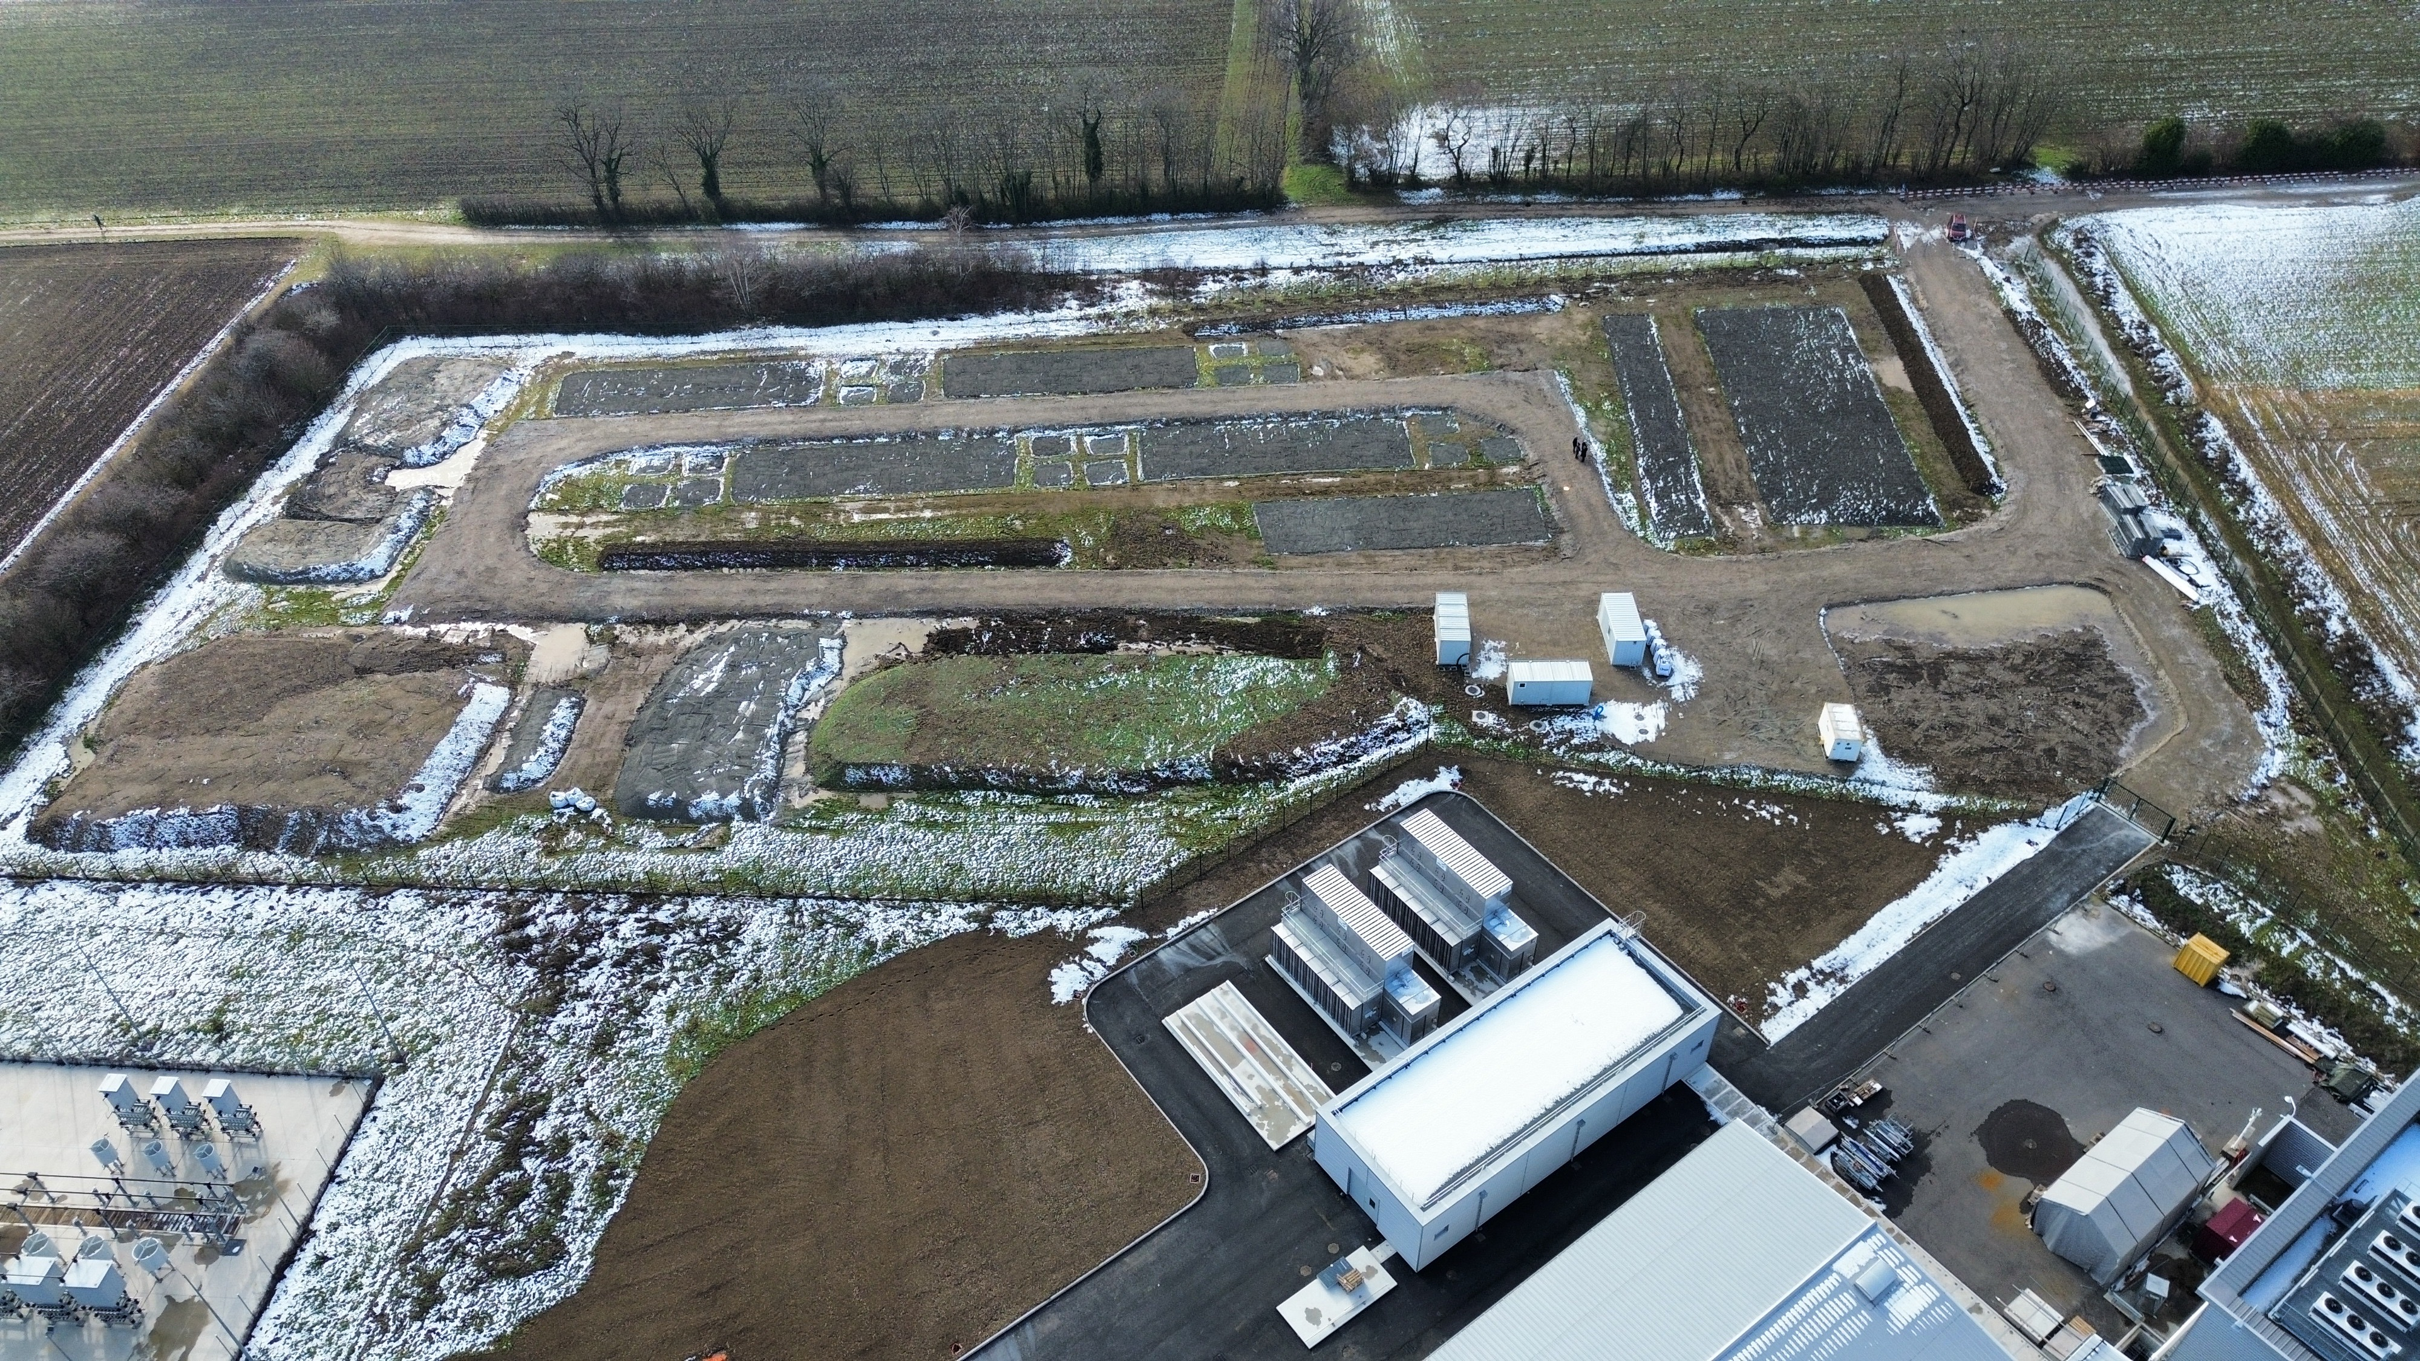
OpenSkyLab status and progress
Fertile top soil
Control
molasse

Slide 21
Surface sites

Slide 22
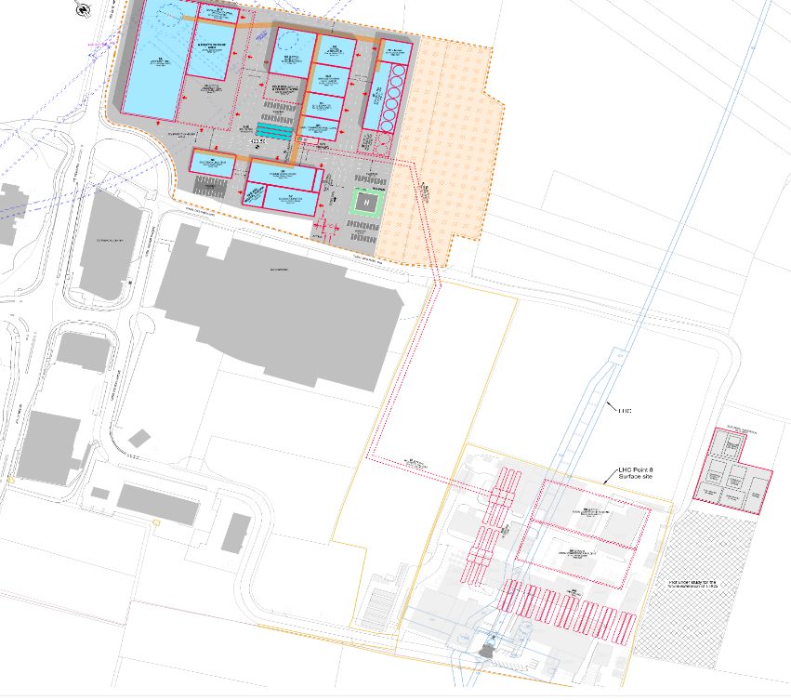
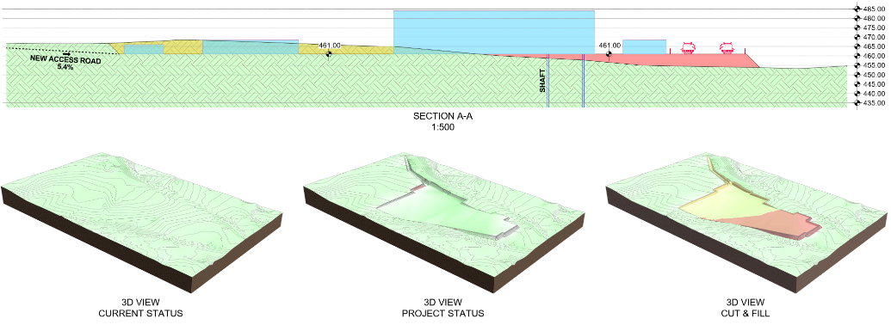
Concurrent : engineering & architecture concepts
EFFEKT / 14 - 184
Continuation of technical work on envelopes and costing based on the reference placement locations and their constraints.

Slide 23
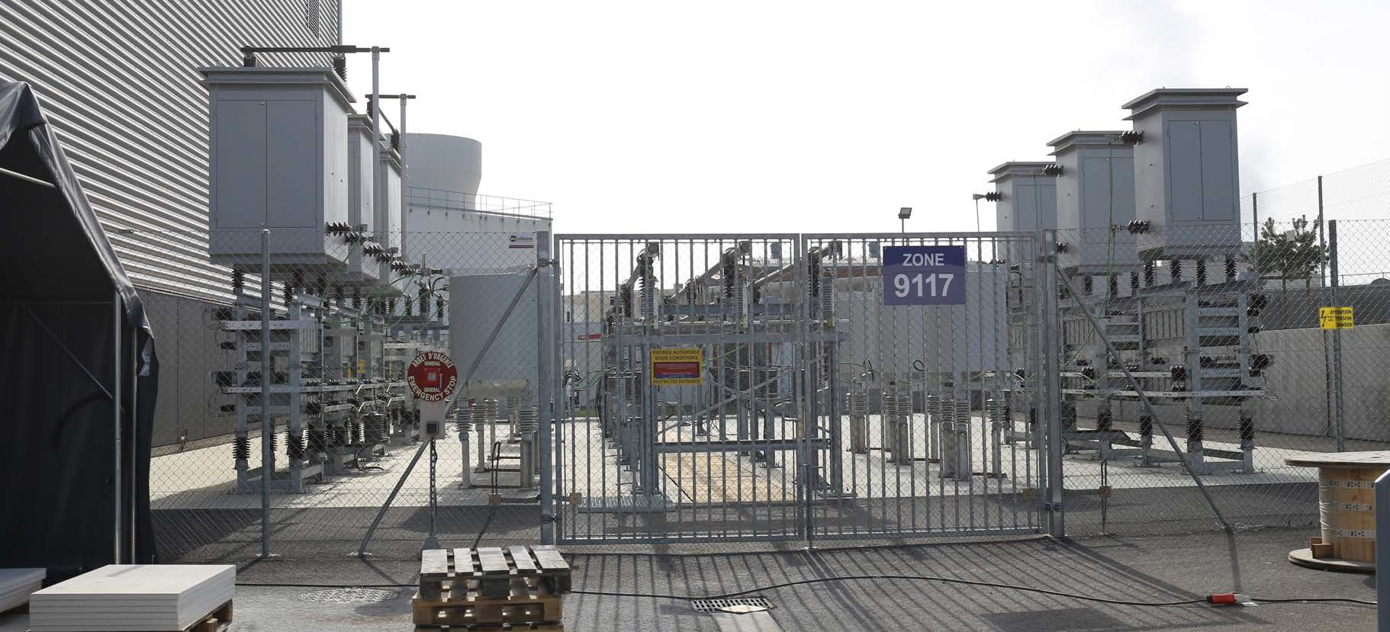
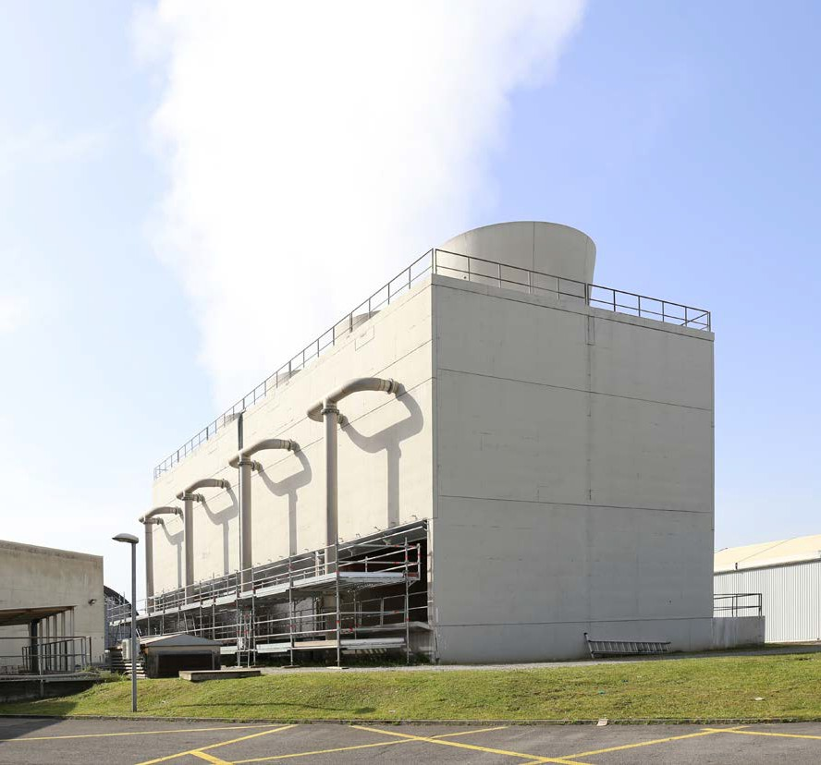
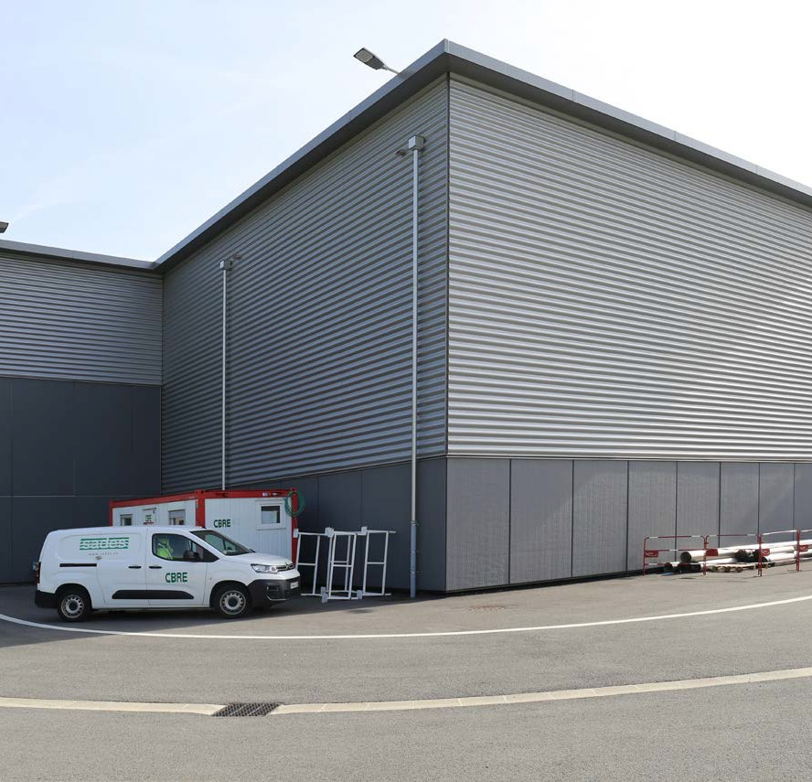
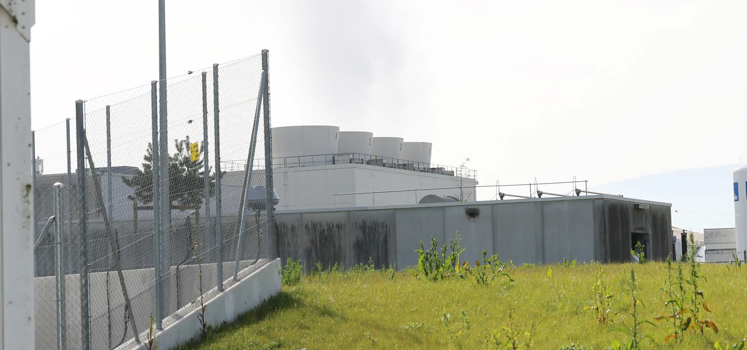
Societal acceptance is different than in the past

Slide 24

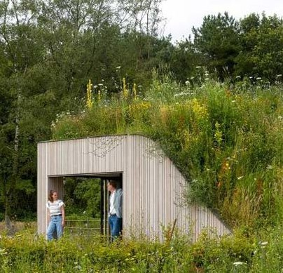
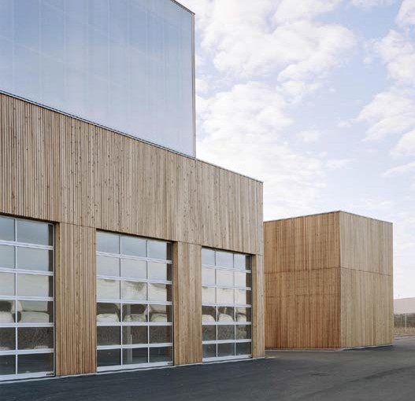
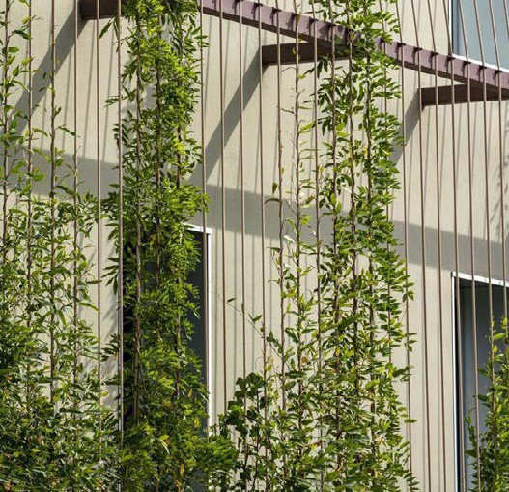
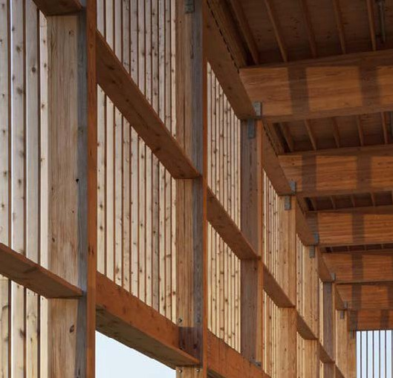

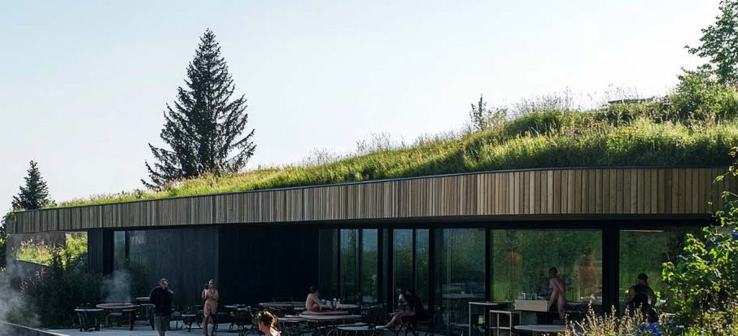
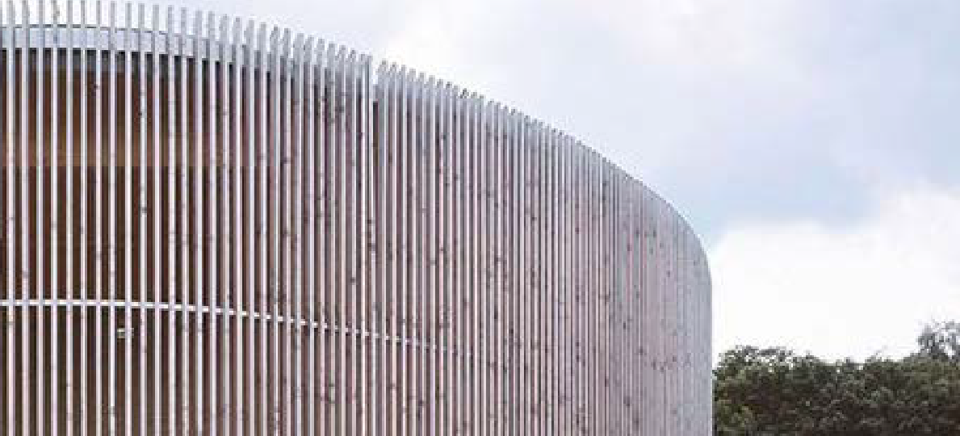

Toolkit for dialogue based on existing projects
Green roofs
Innovative methods
and materials
Facade expression

Slide 25




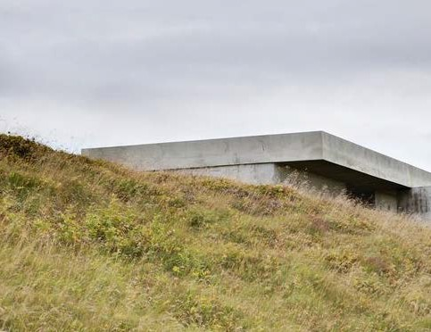
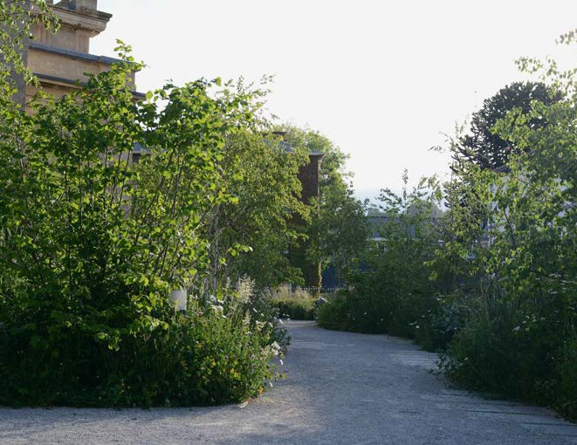
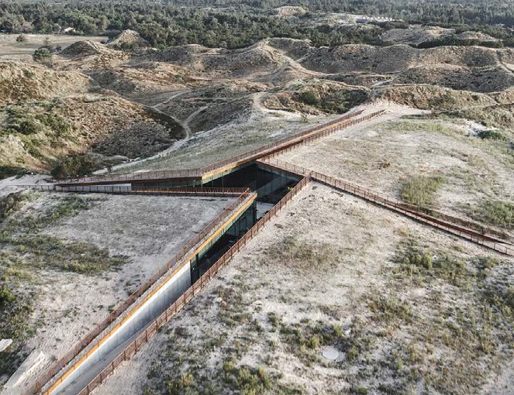

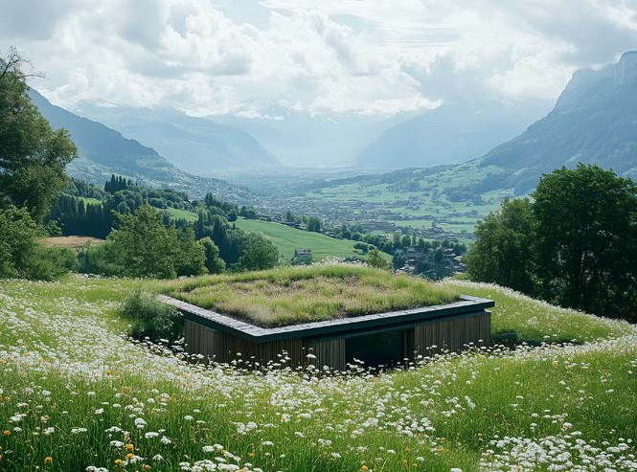
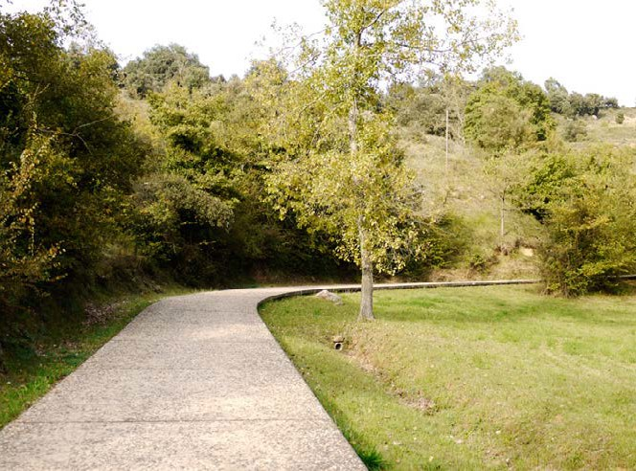
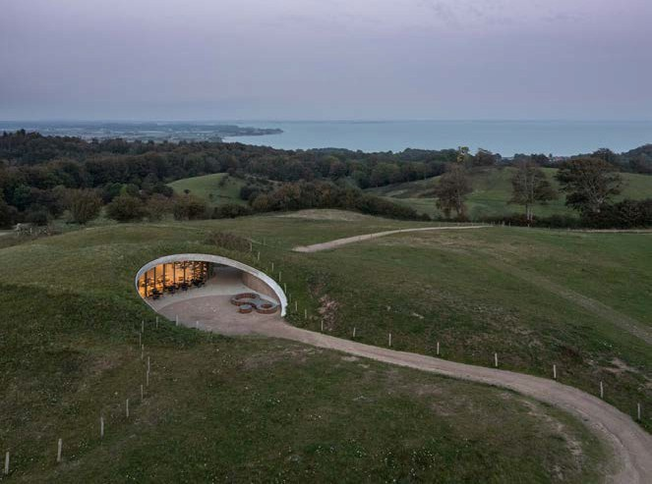
Toolkit for dialogue based on existing projects
Nature restoration
Utilising terrain
Green buffer
Uninterupted landscape

Slide 26
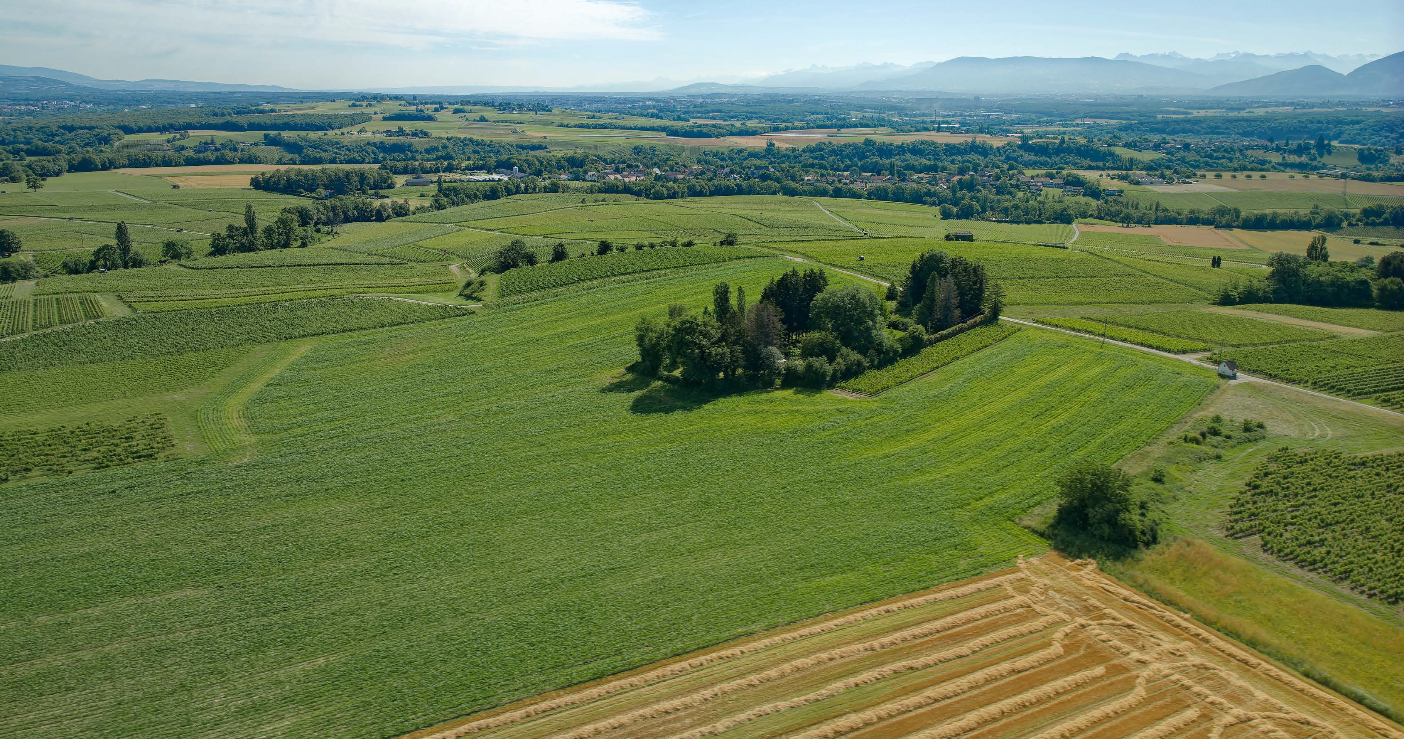
26

Slide 27
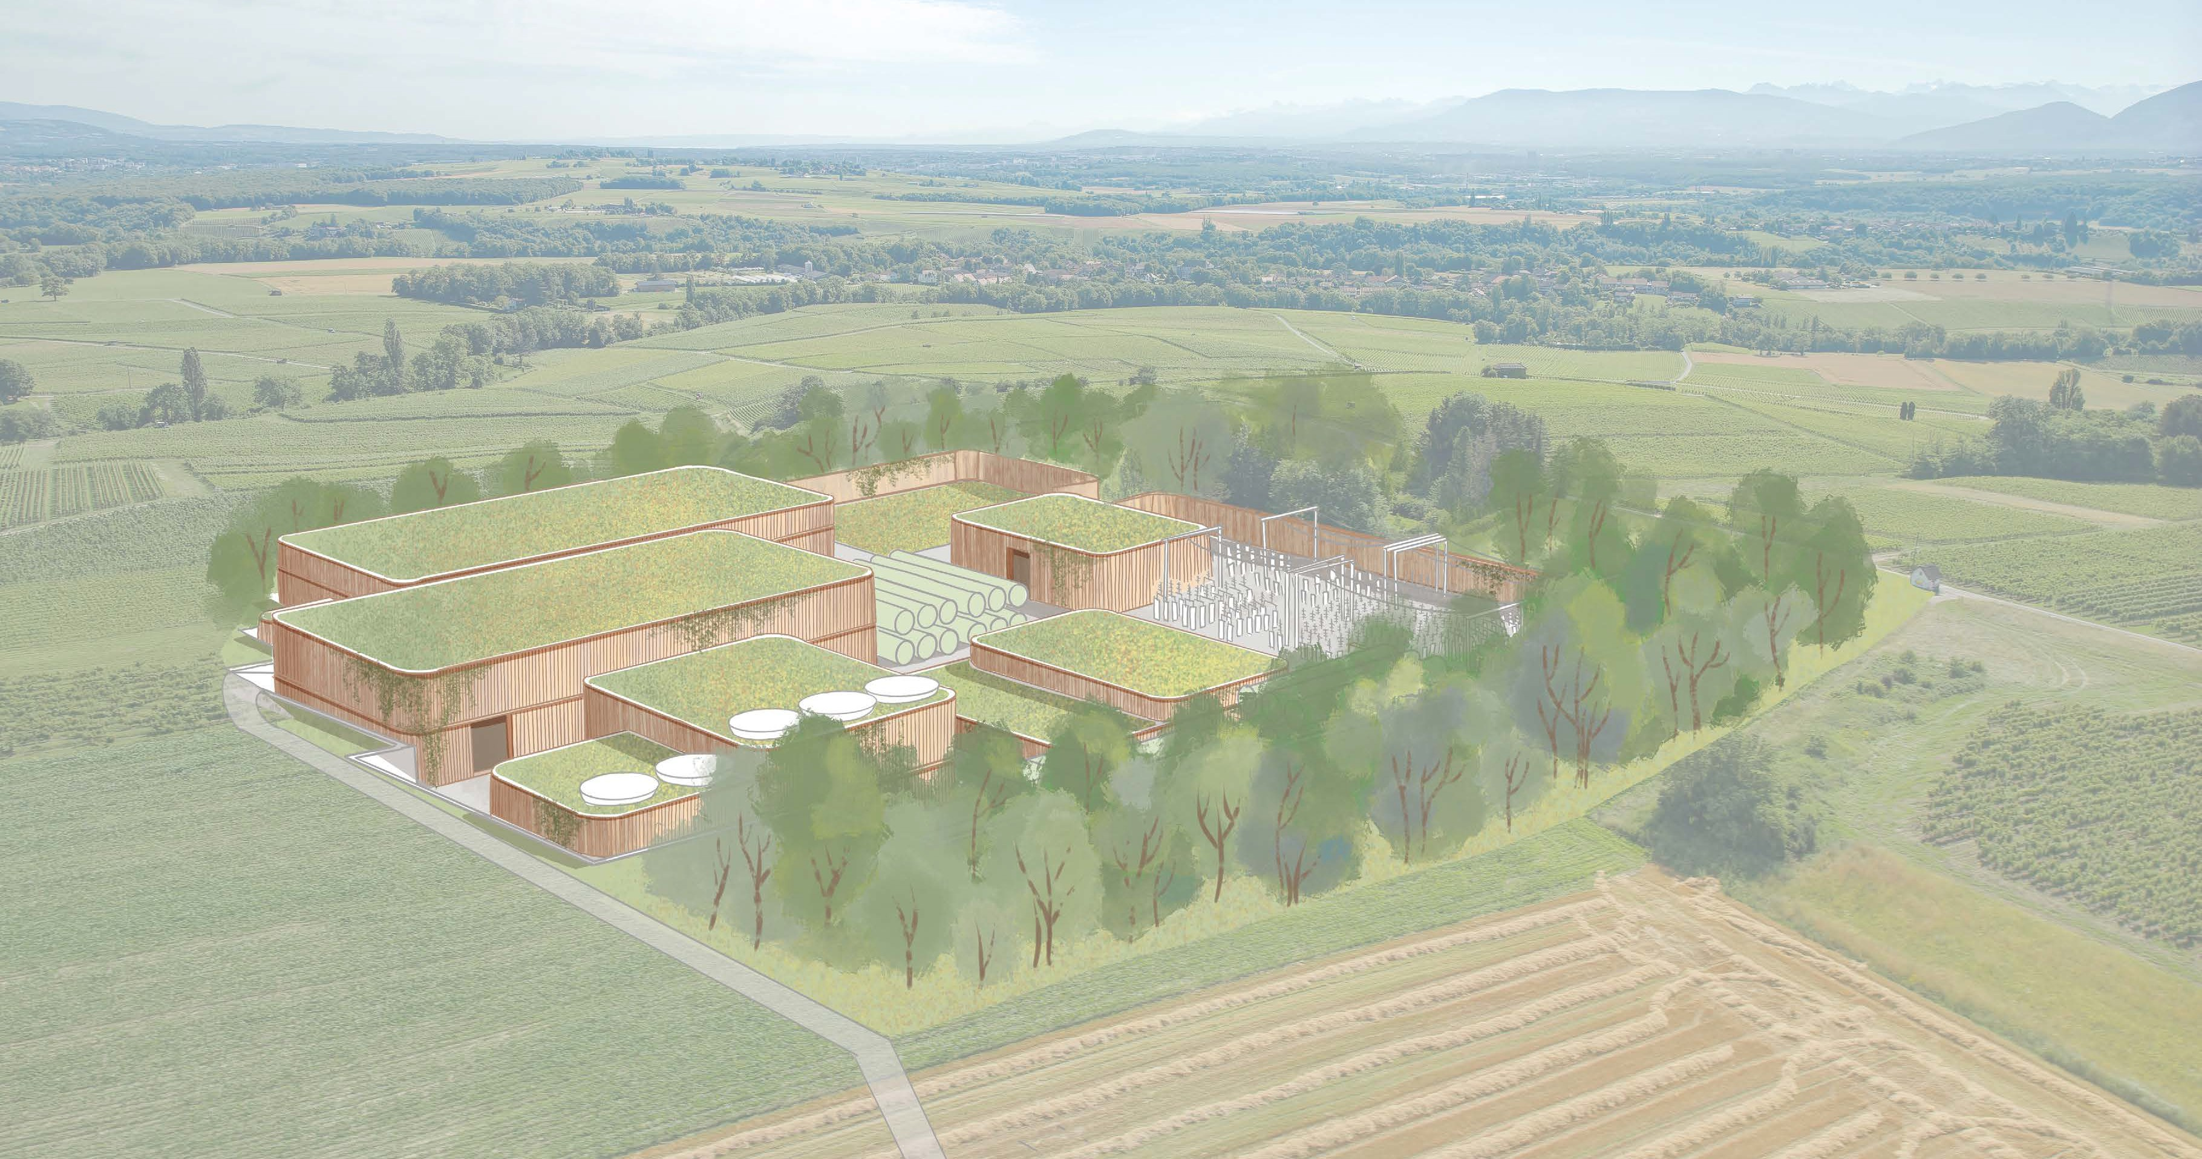

Slide 28
Accelerator design

Slide 29
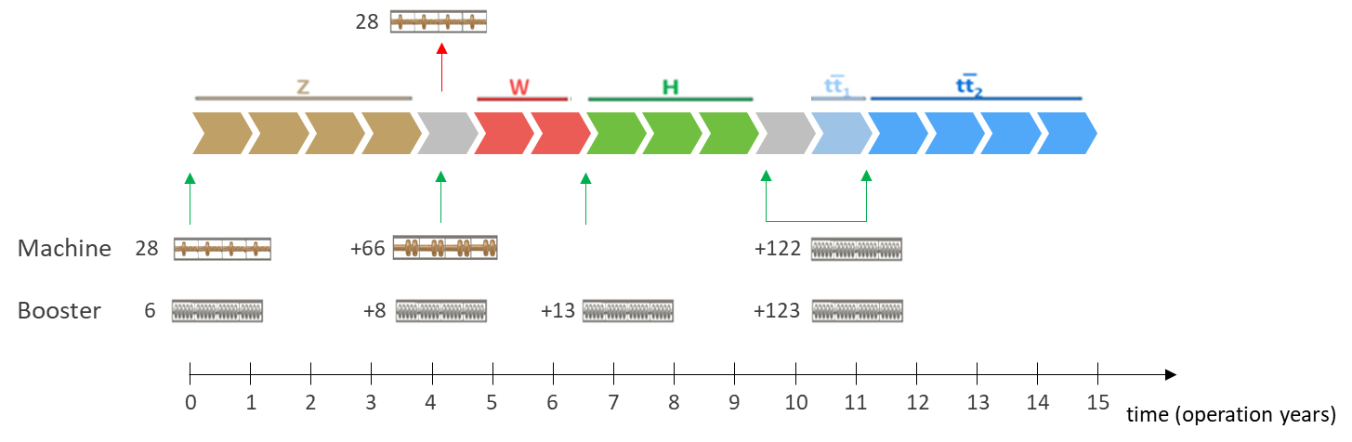
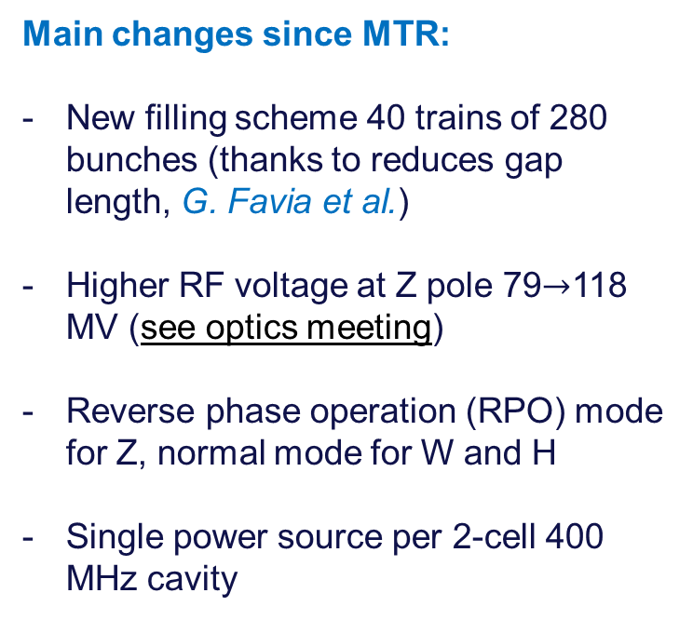
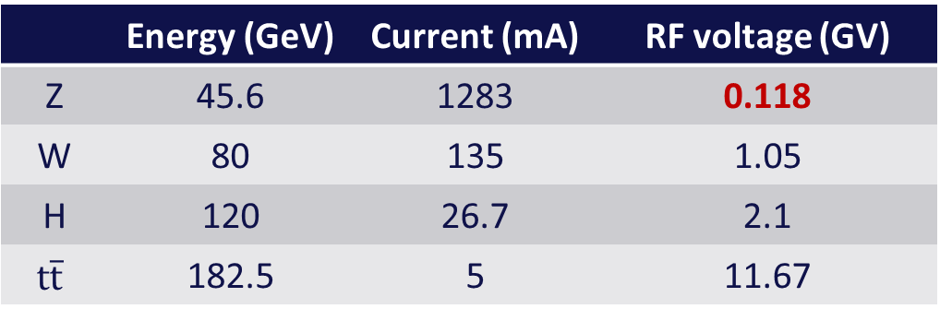
New collider RF system configuration
29
 | Energy (GeV) | Current (mA) | RF voltage (GV)
Z | 45.6 | 1283 | 0.118
W | 80 | 135 | 1.05
H | 120 | 26.7 | 2.1
$$t\overline{t}$$ | 182.5 | 5 | 11.67
Main changes since MTR:
New filling scheme 40 trains of 280 bunches (thanks to reduces gap length, G. Favia et al.)
Higher RF voltage at Z pole 79$→$118 MV (see optics meeting)
Reverse phase operation (RPO) mode for Z, normal mode for W and H
Single power source per 2-cell 400 MHz cavity
K. Oide, 29.05.2024
66
Courtesy of O. Brunner

Slide 30
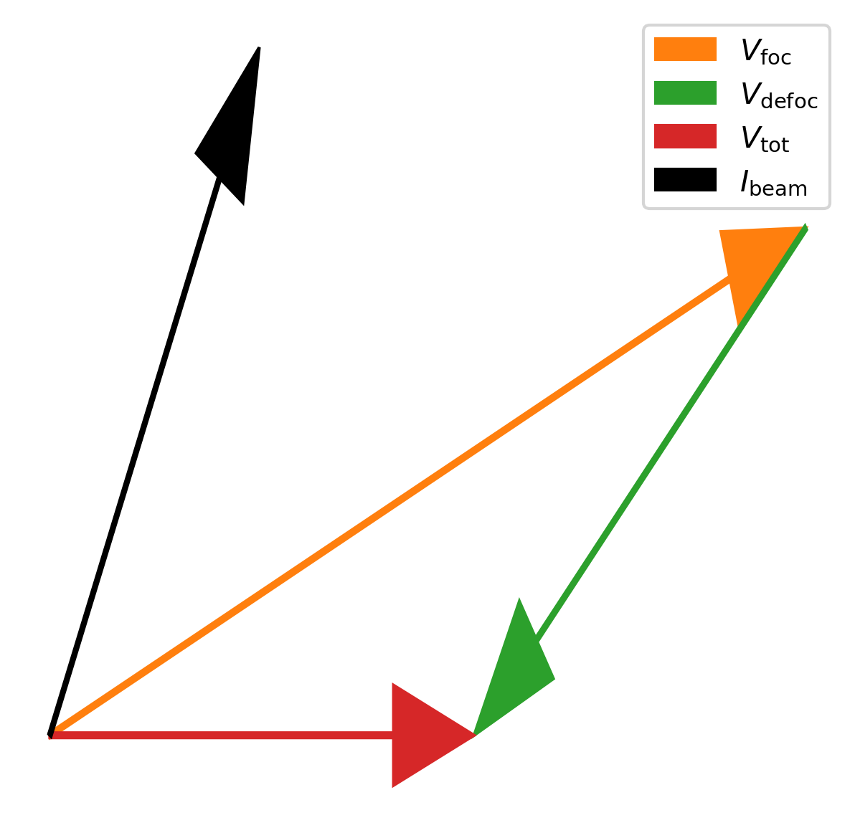
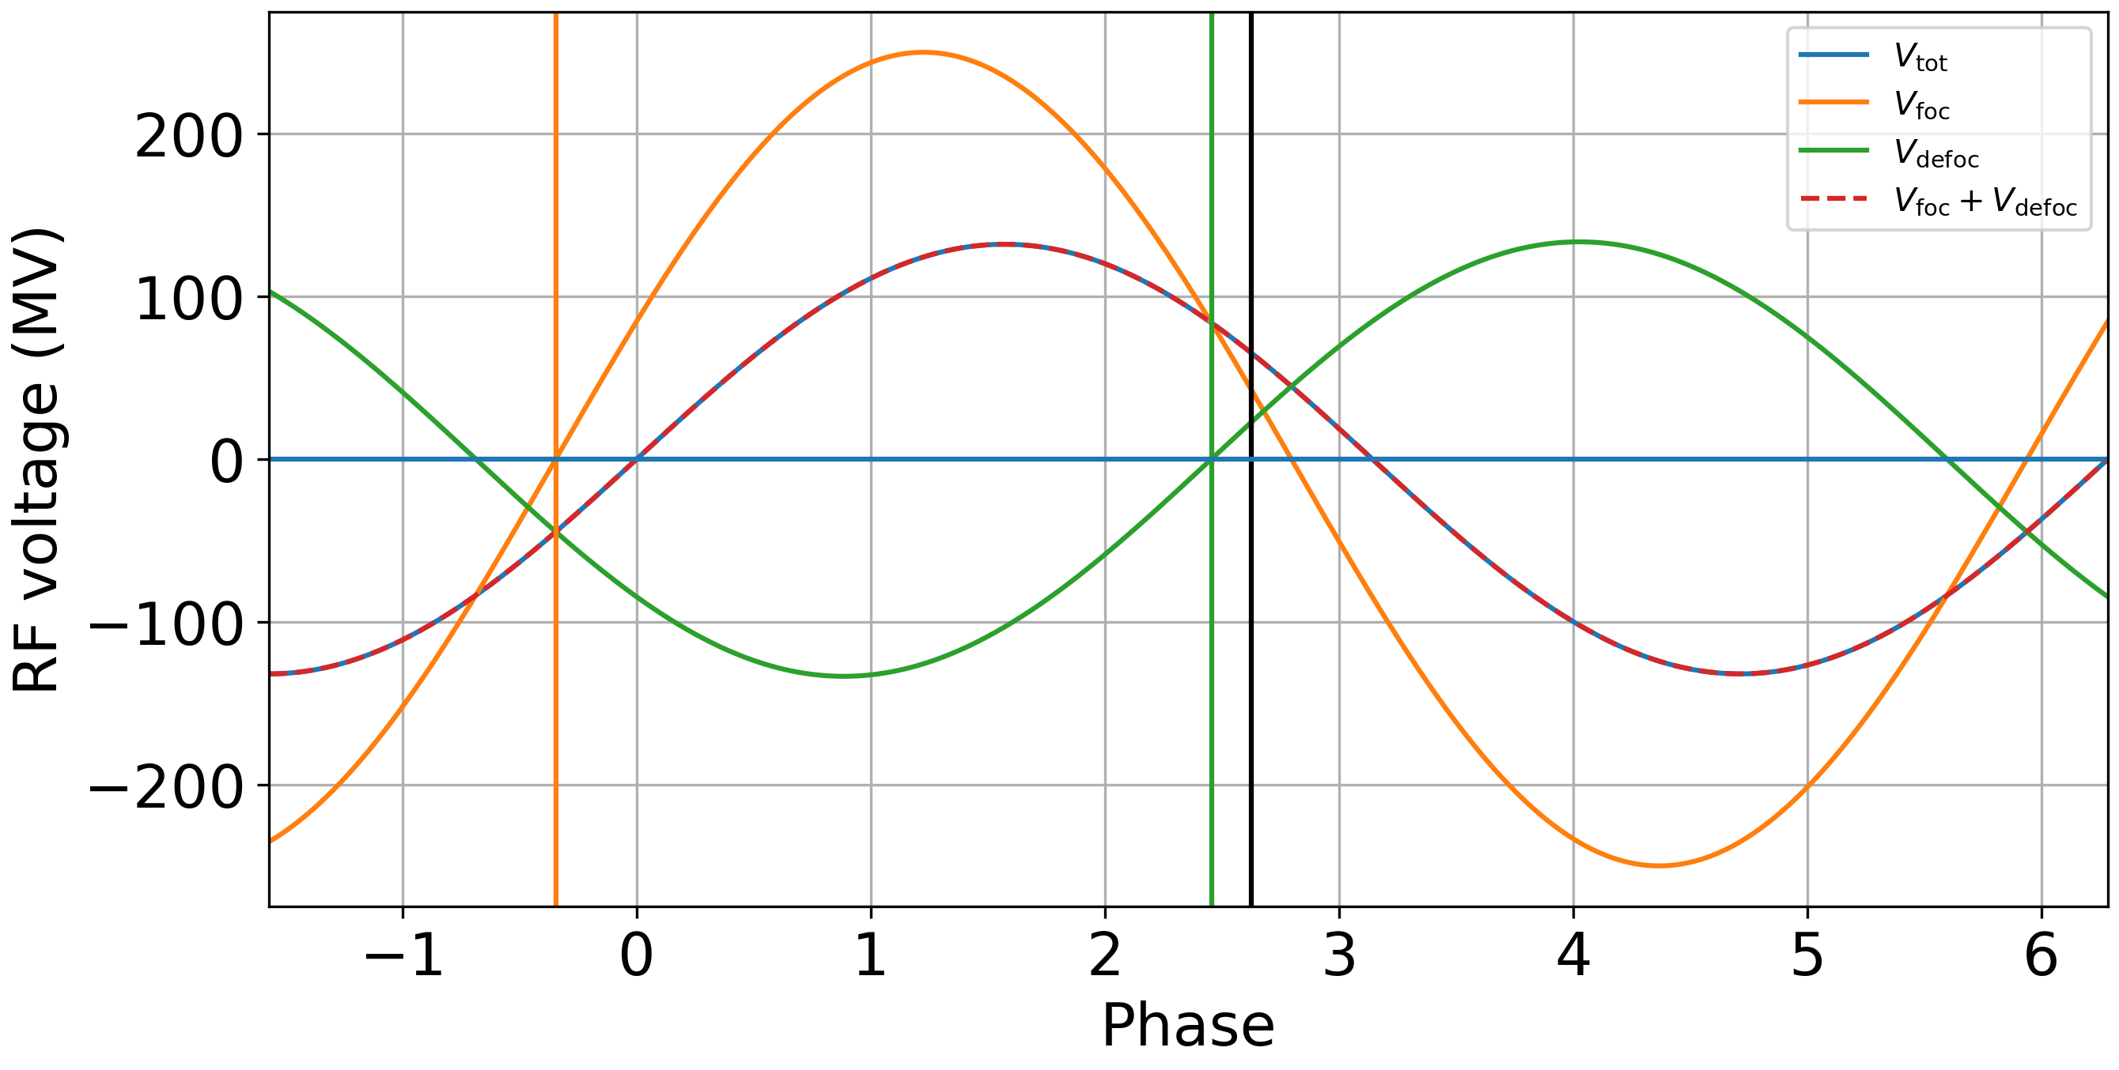





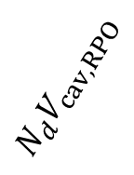





Reverse phase operation
30
Reverse phase operation (RPO) mode allows for increasing RF cavity voltage having optimal static beam loading compensation (Y. Morita et al., SRF, 2009)
Experimentally verified with high beam loading in KEKB (Y. Morita et al., IPAC, 2010)
Baseline solution for EIC ESR (e.g., J. Guo et al., IPAC, 2022)
RF waves
Phasors
$$N_{f}V_{cav,RPO}$$
$$N_{f}+N_{d}=N_{tot}$$
$$φ_{s}^{∗}+π/2$$
$$φ_{f}$$
$$N_{tot}V_{cav,IPO}$$
$$N_{f}V_{cav,RPO}$$
$$N_{d}V_{cav,RPO}$$
$$φ_{s}$$
$$N_{d}V_{cav,RPO}$$
$$φ_{d}$$
$$N_{tot}V_{cav,IPO}$$
*Electron convention for synchronous phase: $φ_{s,proton}=\frac{π}{2}+φ_{s,electron}$

Slide 31


Synchrotron radiations absorbers and shielding
31
Effect of shielding: cumulative dose (ttbar)

Slide 32
Optimized injector concept and parameters (PSI & CERN)
32
Mid-term review recommendations to reduce gradients and repetition rate → new linac optimization in terms of cost and power density
  Overall power consumption (for linacs) is reduced by more than a factor 3 by means of:
    new accelerating structures with higher shunt impedance;
    lower gradient (29.5 MV/m → 22.5/20.5 MV/m);
    lower repetition rate (200/400 Hz → 100 Hz).
  Repetition rate of 100 Hz with 4 bunches per rf pulse
  New layout: Damping Ring at higher energy 2.86 GeV, no common linac with 2x repetition rate.

Slide 33



Optimised injector implementation at Prévessin site
33
Good integration with existing CERN Prevessin Site and strongly reduced visibility from outside.
Ideal connection to existing experimental halls.
Good conditions for construction.
High Energy LINAC
Damping
Ring
CERN Fenced Area
Entrance CERN Prevessin Site

Slide 34

Opportunities to exploit the facility
34
Assure that the entire FCC programme including injector and booster represent an attractive long-term platform for science.
Provide opportunities before the collider enters in operation.
Non-collider science opportunities at FCC-ee
(August 2024)
Other science opportunities at the FCC-ee
(November 2024)
Examples:
Photon science with high beam current (, positron source for materials science, testbeds for muon colliders, plasma acceleration of positrons, physics beyond colliders and much more.

Slide 35
Other FCC-ee science applications under study
35
→ Workshop on “Other Science Opportunities at the FCC-ee”
28-29 November at CERN, https://indico.cern.ch/event/1454873/
for example:
FCC-ee booster as diffraction limited storage ring with coherent synchrotron radiation down to 0.1 Å
FCC-ee injector as the world’s ultimate positron source for material studies and paving a path towards the first Bose-Einstein condensation of Ps (511-keV gamma-ray laser)
using beamstrahlung for radionuclide production
e⁻ beam driven neutron source
etc.

Slide 36
FCC-hh main machine parameters
36
parameter | FCC-hh | HL-LHC | LHC
collision energy cms [TeV] | 81 - 115 | 14
dipole field [T] | 14 - 20 | 8.33
circumference [km] | 90.7 | 26.7
arc length [km] | 76.9 | 22.5
beam current [A] | 0.5 | 1.1 | 0.58
bunch intensity [10¹¹] | 1 | 2.2 | 1.15
bunch spacing [ns] | 25 | 25
synchr. rad. power / ring [kW] | 1020 - 4250 | 7.3 | 3.6
SR power / length [W/m/ap.] | 13 - 54 | 0.33 | 0.17
long. emit. damping time [h] | 0.77 – 0.26 | 12.9
peak luminosity [10³⁴ cm⁻²s⁻¹] | ~30 | 5 (lev.) | 1
events/bunch crossing | ~1000 | 132 | 27
stored energy/beam [GJ] | 6.1 - 8.9 | 0.7 | 0.36
Integrated luminosity/main IP [fb⁻¹] | 20000 | 3000 | 300
With FCC-hh after FCC-ee: significant amount of time for high-field magnet R&D,
aiming at highest possible collision energies
Target field range for cryo-magnet R&D
Formidable challenges:
high-field superconducting magnets: 14 - 20 T
power load in arcs from synchrotron radiation: 4 MW → cryogenics, vacuum
stored beam energy: ~ 9 GJ → machine protection
pile-up in the detectors: ~1000 events/xing
optimization of energy consumption: → R&D on cryo, HTS, beam current, …
Formidable physics reach, including:
Direct discovery potential up to ~ 40 TeV
Measurement of Higgs self to ~ 5% and ttH to ~ 1%
High-precision and model-indep (with FCC-ee input)
measurements of rare Higgs decays (𝛄𝛄, Z𝛄, µµ)
Final word about WIMP dark matter
F. Gianotti

Slide 37



Key activities on FCC-hh: cryo magnet system, optics design
37
Optics design activities:
adaptation to new layout and geometry
shrink β collimation & extraction by ~30%
optics optimisation (filling factor etc.)
betatron collimation straight
experimental straight
M. Giovannozzi. G. Perez, T. Risselada
High-field cryo-magnet system design
Conceptual study of cryogenics concept and temperature layout for LTS and HTS based magnets, in view of electrical consumption.
Update of integration study for the ongoing HFM designs and scaling to preliminary HTS design.
  → Confirmation of tunnel diameter!
HFM R&D (LTS and HTS) on technology and magnet design, aiming also at bridging the TRL gap between HTS and Nb₃Sn.
Collider Center
F. Valchkova

Slide 38
Collaboration

Slide 39



Status of FCC global collaboration
39
Increasing international collaboration as a prerequisite for success:
→links with science, research & development and high-tech industry will be essential to further advance and prepare the implementation of FCC
FCC Feasibility Study:
Aim is to increase further the collaboration,
on all aspects, in particular on
Accelerator and Particle/Experiments/Detectors
155 Institutes
36 countries
+
CERN

Slide 40
FCC collaboration members in the US
40
https://fcc.web.cern.ch/collaboration
United States
Northern Illinois University, DeKalb
U.S. Department of Energy (DOE)*, Washington DC
Brookhaven National Laboratory, Upton
Cornell University, Ithaca
University of New Mexico (UNM), Albuquerque
UCSB, Santa Barbara
University of Houston, Houston
University of Iowa, Iowa City

Slide 41


FCC Week 2024 - San Francisco – 10 to 14 June
41
449 participants, 50 public sessions, 216 oral presentations, 32 posters
US efforts getting organized, towards completing the FS by March 2025

Slide 42



Progress on international collaboration
42
26 April 2024
White House Office of Science and Technology Policy Principal Deputy U.S. Chief Technology Officer Deirdre Mulligan signed for the United States while Director-General Fabiola Gianotti signed for CERN.

Slide 43

EU Competitiveness Report
edited by Mario Draghi, and officially handed over to Ursula von der Leyen in September 2024
43
“One of CERN’s most promising current projects, with significant scientific potential, is the construction of the Future Circular Collider (FCC): a 90-km ring designed initially for an electron collider and later for a hadron collider..
Refinancing CERN and ensuring its continued global leadership in frontier research should be regarded as a top EU priority, given the objective of maintaining European prominence in this critical area of fundamental research, which is expected to generate significant business spillovers in the coming years.”
https://commission.europa.eu/topics/strengthening-european-competitiveness/eu-competitiveness-looking-ahead_en

Slide 44

Supporting statements at CERN’s 70 anniversary
44
“….No European country alone could have built the world’s largest particle collider. CERN has become a global hub because it rallied Europe and this is even more crucial today.
I am proud that we have financed the feasibility study for CERN’s Future Circular Collider (FCC). This could preserve Europe's scientific edge and could push the boundaries of human knowledge even further. And as the global science race is on, I want Europe to switch gears. To do so, European unity is our greatest asset. ….”
Ursula von der Leyen, President of the European Commission

Slide 45


45

Slide 46


46

Slide 47

47
P5 Town Hall
BNL 13 April 2023
F. Gianotti

Slide 48

FCC Feasibility Study - organisational structure
48
Key contributors from US:
L. Merminga / FNAL
Steering Committee
M. Minty / BNL
Scientific Advisory Committee
A. Lankford / UCI
Collaboration Board Co Chair
T. Raubenheimer / SLAC
Accelerator WP coordinator
T. Lundin / FNAL
Surface building designs WP
J. Seeman / SLAC
IR MDI co-coordinator

Slide 49

FCC Main Goals for Coming Years
49
HL-LHC well underway, exciting physics till $\sim$2040
CERN now prepares for post-LHC era, focus on FCC, a lot of efforts
By 2027-2028, possible FCC project approval, start of CE design contract:
  specifications to enable CE tender design by 2028 (underground) and 2029 (surface)
  requires overall integration study and designs based on technical pre-design of accelerators, technical infrastructure and detectors
  refined input for environmental evaluation and project authorisation process
By 2032, start of CE construction:
  CE groundbreaking
  TDR to enable prototyping, industrialization towards component production
Strong collaboration with ANL and APS-U of great interest. Similar challenges in optics & beam dynamics. How can this get momentum?

Slide 50
Ongoing & possible collaborations with / contributions from US
50
FCC accelerator pillar (co-)coordination
high-field magnet program
SRF (FNAL, JLAB, …)
FCC-ee MDI & IR design (SLAC, BNL)
beam impedance (SLAC)
FCC-ee spin dynamics (BNL, Cornell, FNAL, UNM)
EIC-FCC collaboration topics (code development, …)
…
topics discussed with Cornell (pol. e- gun, SRF,…)
topics discussed with ANL

Slide 51

Tor Raubenheimer,
Vladimir Shiltsev, SBU mtg.
51

Slide 52


Optimisation for operation: 400 MHz SRF and beam switchyard
52
Beam switching between (Z, W) and ZH operation
2-cell 400 MHz cavities for all three working points, identical configuration thanks to reverse phase operation: (1) experimentally verified w high beam loading at KEKB (Y. Morita et al., 2009), (2) baseline solution for US EIC
ES separators + magnetic field for switching beams
Allows quasi “instantaneous” switching between Z, W, ZH
 | Energy (GeV) | Current (mA) | RF voltage (GV)
Z | 45.6 | 1280 | 0.08
W | 80 | 135 | 1
H | 120 | 26.7 | 2.08
ttb | 182.5 | 5 | 11.67
Beam crossing and combination
at RF section in point H
Collider RF integration at point H
(Z, WW and ZH operation)
Z, W
ZH
33 CM
33 CM
33 CM
33 CM
Beam 1
400 MHz
400 MHz
400 MHz
400 MHz
Beam 2
E&M
sep.1
E&M
sep. 2a
E& M
sep. 2b
extra year of operation thanks to single RF system

Slide 53






RF R&D activities
53
RF system R&D is key for increasing energy efficiency of FCC-ee
Nb on Cu 400 MHz cavities (KEK as R&D partner), seamless cavity production, coating techniques
Bulk Nb 800 MHz cavities, surface treatment techniques
RF power source R&D in synergy with HL-LHC.
5/6-cell 800 MHz cavity development collaboration with JLAB
high-efficiency klystron R&D
400 MHz
monoblock prototype

Slide 54





Interaction region mock up at INFN-LNF (Frascati)
54
INFN-LNF, CERN and INFN-Pisa collaboration
  Central chamber with paraffin cooling in production – Tests starting end of Oct.
  Conical chamber(s) with water cooling ~ to be ordered – Delivery end of the year
  Vertex mechanical structure Carbon fibre foils arriving
Assembly & test lab in Frascati
  Vertex air cooling tunnel – orders placed – assembled Q1 2025
  Support tube - orders expected Q1-2025
  Bellows ~ design almost finished, to be ordered
  Integration & overall assembly Q4-2025
B. 5/a Serv. ing. mecc. (SIM) div.acc.
M. Boscolo, F. Fransesini, F. Palla

Slide 55
Procurement handbook

Slide 56
Procurement handbook
56
  Objectives
  Provide a holistic overview of most major items/requirements (systems, equipment, materials, components, activities) needed for FCC-ee
  Cross check Cost Estimates and monitor Cost Estimate Classification evolution
  Identify and develop tendering strategies
  Identify items that could be provided as in-kind contributions, and associated boundary conditions
  For in-kind contributions: seek for matching possibilities between requirements and collaborating partners (industry, institutes, and other)
  Strategy / Methodology
  Database implementation : create & manage & regularly update requirements
  Generate Procurement Handbook based on collected information
  Continuous monitoring and consolidation of information related to items / requirements
  Identify new needs and major deviations
  Establish relations with representatives from national administrations and ILOs to disseminate information about in-kind contribution opportunities
Courtesy Jerome Pierlot, Anders Unnervik

Slide 57
Shopping list
57
Recording all FCC-ee needs for in a Shopping List
  Shopping List is the data source for Procurement Handbook
    unique reference
    cost estimate classification
    cost range & estimated amount (by CERN)
    procurement code (as codified by CERN)
    requirement description
    boundary conditions
    contracts interactions
    contract type
    supplier risk classification
    procurement process
    procurement strategy
    exposure to commodity price volatility
    possible hedging strategy
    needs for prototyping / pre-series production
    other procurement general info (KT, dates, etc.)
    automatic document generation
    for in-kind contribution:
      strategy for communication
      collect interest
      establish rules for attribution in case of multiple interest
    for procurement:
      strategy for communication
      identify alternative supply chains
      create competition as the case maybe

Slide 58



Procurement handbook
58
The procurement handbook will be provided to the CERN council in the coming weeks.

Slide 59
Summary
59
FCC is moving from the feasibility study to the Pre-TDR phase (25-28).
The update of the European Strategy for Particle Physics is ongoing.
FCC has strong support in Europe, communication with the public is essential
Many collaborations with the US
Need to discuss participation / collaboration / contribution to the next phases (Pre-TDR, TDR, construction)
The procurement handbook is a tool to help the identification of interest

