Slide 1
Thoughts on Accelerator R&D for FCC: The Next Decade and Beyond
Vladimir SHILTSEV 1st Meeting of HFCC-A · January 15, 2025 · Fermilab

Slide 2
Content
WHAT
WHO
HOW
WHY

Slide 3
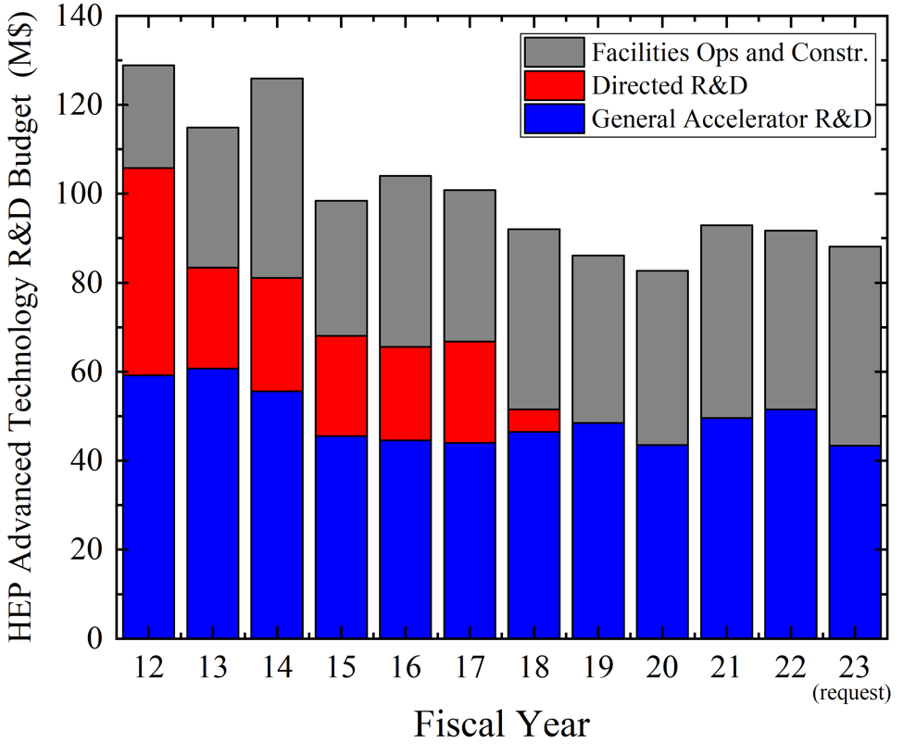
Gap in R&D Towards Future Colliders
Completed:
US ILC
US LARP (LHC)
US MAP (Muon)
Accel. Test Facilities
Proposed
for FY24-30:
Future Colliders
.......
Proposed program :
FCCee, ILC,
C^3, HELEN,
Muon Collider, etc
In US and abroad
Design and R&D
https://arxiv.org/abs/ 2209.14136

Slide 4
Key Goals of the Targeted R&D
Progress or Develop Technologies in Initiate a Project
Reduce Cost of Accelerators
Improve (Design) Performance (Luminosity)
Better Energy Efficiency and Minimal Environmental Impact
Help to Build Faster/Commission Faster
Improve US Accelerator Capabilities, incl. Industrial Base
Develop the Accelerator Workforce
Advance International Cooperation

Slide 5
Snowmass’21 Implementation Task Force On the scale of targeted R&D (past efforts): ILC (three regions) ~600M$ 6-10 years LHC magnets, etc >300M$ 12-15 years

Slide 6
P5 Area Recommendations
 | Now (FY24 $) | P5 Recomm.
General Accelerator R&D * | ~55M$/yr | +10 M$/yr
Targeted Collider R&D | 0 M$/yr | +35 M$/yr
FNAL Accel.Complex Plan | 0 M$/yr | +10 M$/yr
~1 B$
combined
over
the next
decade
* Note: in addition, GARD Facility Ops are supported at ~30M$/yr – these are of great relevance for R&D and projects (eg tests and pre-project R&D)

Slide 7
Key Qs on Targeted R&D Towards FCC
WHAT
WHO
HOW

Slide 8
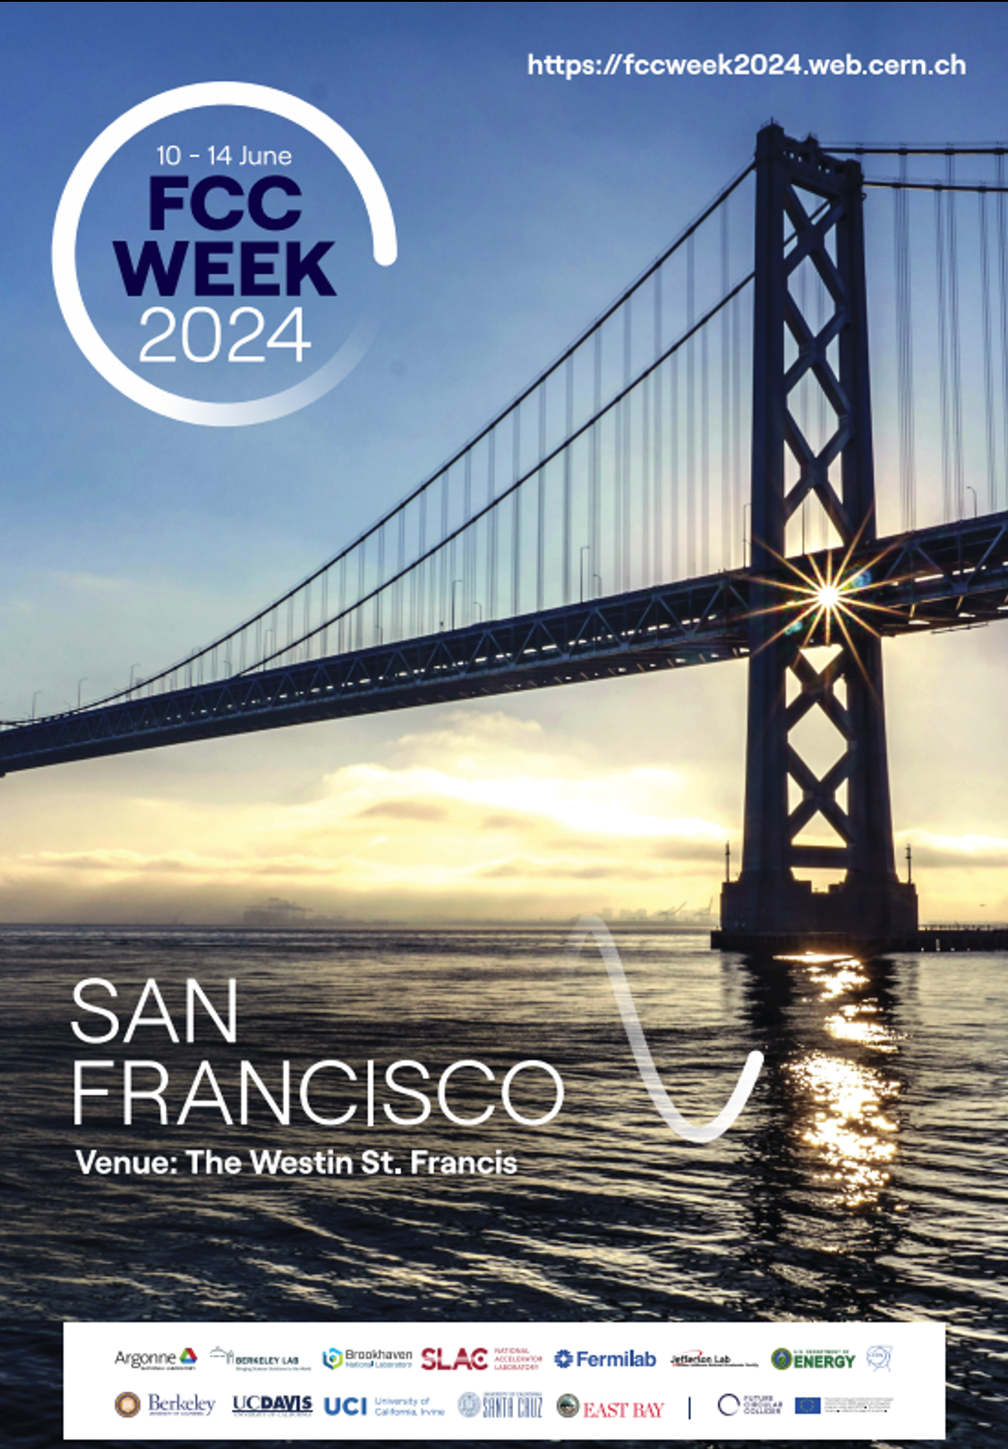
Accelerators at the FCC Week
>40 talks, full spectrum of topics covered:
FCC-ee baseline design & optics, top-up
Collimation, Optics alternatives & variants
Collective Effects
FCC-ee optics correction & tuning
FCC-ee injector incl. booster
FCC-ee code development and other themes
MDI (2 - jointly with PED)
EPOL (2 - jointly with PED)
FCC-hh
SRF (3)
Accelerator Technical Design & R&D
FCC-ee magnet development in the US

Slide 9
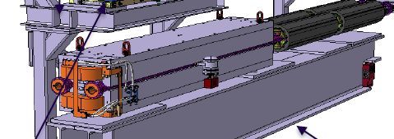
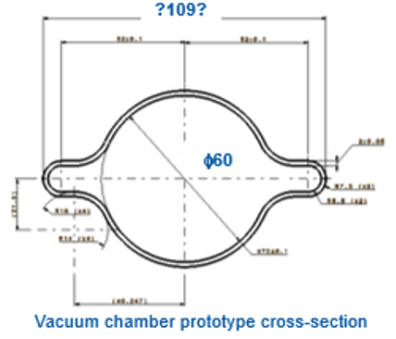
Possible US-FCC Fabrication Elements (as presented to P5 - TBD)
2.1 GV 800 MHz SRF for Higgs, 28 CMs O(0.2B$)
18.4 GV of 800 MHz SRF for ttbar, 244 CMs O(1.7B$)
6-20 GeV S-band C^3 type linac O(0.25B$)
IR magnets for 4 IPs O(0.6B$)
Magnets for the collider and booster rings O(1B$)
270 km of vacuum pipes (collider, booster) O(0.3B$)
Several km RF bypass (switch btw tt and ZH) - TBD
Beam instrumentation/polarization O(0.15B$)
Collimation, halo monitors | Polarization wigglers, meters, sources | TMCI feedback
Technical Infrastructure contributions - TBD
Alignment | Radiation protection | Safety systems | Power converters

Slide 10
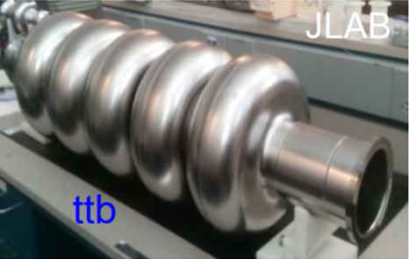
1. R&D Items - RF Systems (see more in Donato’s talk)
800 MHz SRF for Booster and Collider:
R&D on cavities with Q0 = 3e10 at 25 MV/m for Booster up to Higgs operation
R&D on cavities with Q0 = 6e10 at 25 MV/m for Booster and Main Ring for ttbar operation
CM(cryomodule) design optimization for 800 MHz cavities possibly with integrated focusing
800 MHz RF power sources:
R&D on high efficiency power sources for 800 MHz with h > 80%
Development of high efficiency modulators for 800 MHz RF sources
NC RF for injector linac (L- or S-band C^3 type):
R&D on high gradient 70 MV/m 150 MOhm/m cool copper RF for injector

Slide 11
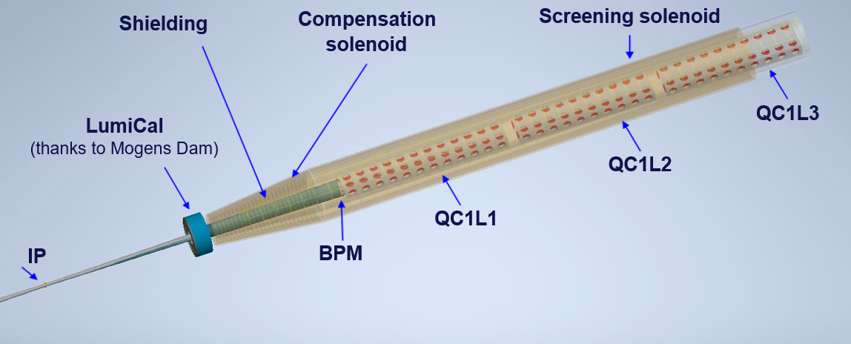
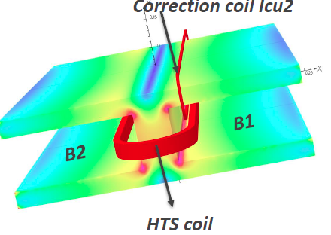
2. R&D on Magnets and MDI (see more in the afternoon)
IR magnets and cryostats
R&D: Comparative analysis of technical options
Design/Prototyping of two most critical magnets
Collider ring magnets (low field):
R&D: comparative analysis of technical options
Design/Prototype of HTS cable-based solution
Design/Prototype of PM dipole
FCChh collider ring magnets:
R&D/prototyping: 14-20T dipoles (part of MDP*)

Slide 12
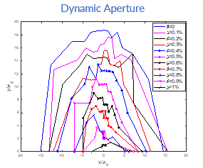
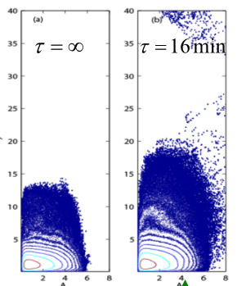
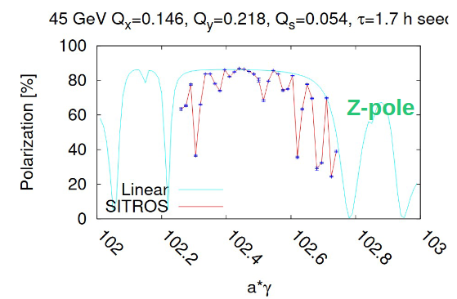
3. Modeling & Design / Collimation / Polarization /Instrumentation (more in PM)
Interaction region design, and integrated machine design:
Modeling/simulations: crab waist and beam-beam/beamstrahlung
Modeling: DA, chromatic compensation and optics correction schemes
Design: as needed for the “US-FCCee magnets” hardware
Losses, collimation and background:
Modeling/simul: halo formation, background in detectors, TMCI
Design: efficient collimation systems (elens/NLO/CS), detector background masking
Polarization:
Modeling/simulations: 45-80 GeV energy calibration, error analysis
Design: wigglers, polarimeters, polarized sources
Beam Instrumentation:
Design and prototyping: BPMs, Lumi, TMCI FB, emittance, halo monitors

Slide 13
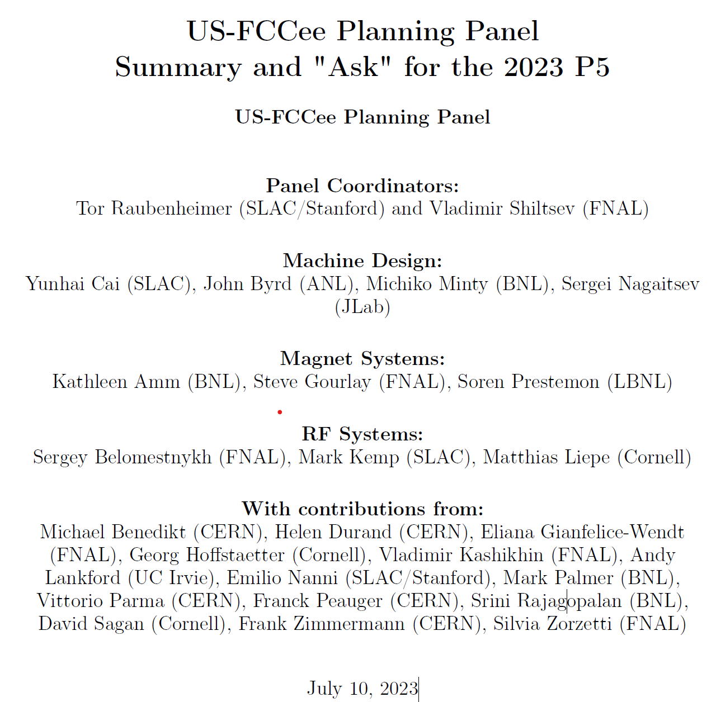
2023 (pre-P5) Planning: US-FCC
Total 2024-33: 184M$
Incl. Labor: 333 FTEs
?
?

Slide 14
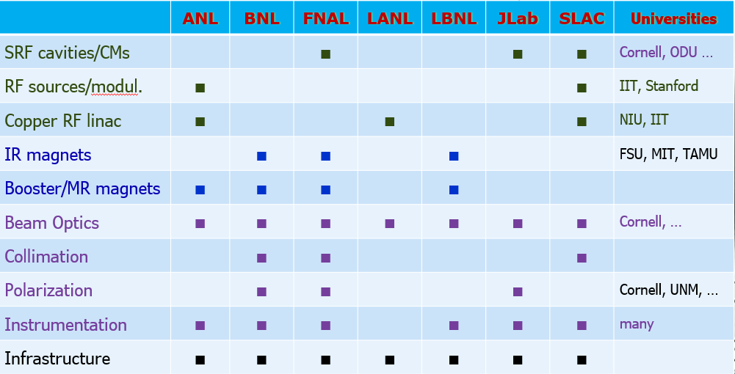
US Expertise in Circular e+e- HFs (HFCC Mtg SBU 11/08/24)

Slide 15
EoIs Summary: Accelerators (possibilities for FY24-25) FTEs (Sci + Tech.)
The 2nd US FCC Workshop, MIT, 03/27/24
Institution | RF/SRF Systems | Magnets/MDI | Design/Instr./etc
Cornell | ? | - | 1.5
NIU | ? | - | 0.5?
MIT | ? | ? | ?
Fermilab | 0.3+0.6 | 0? | 0?
BNL | ? | ? | ?
SLAC | 0.3+0.1 | 0.4+0.1 | 1.6+0.4
LBNL | 0.5 | 0.5 | 0.5
SUM FTEs | 1.8 (+ ????) | 1.0 ( + ???) | 4.5 (+ ????)

Slide 16
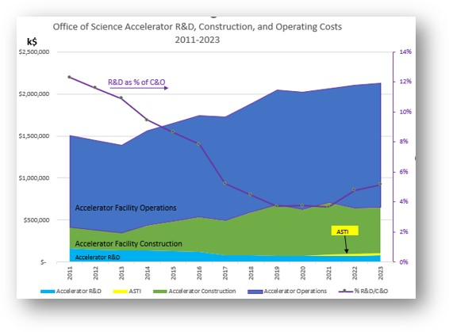
Integrated US DOE Office of Science Accelerator Expenditures (annual, 2011-2022 actuals, and 2023 request) TOTAL ~2.1B$/yr Ops. ~1.5 B$/yr Constr. ~0.5 B$/yr R&D ~0.11 B$/yr (~5%)
E.Colby (DOE), NAPAC 2022

Slide 17
Accelerator Workforce in the US (mid 2020’s)
incl Natl. Labs and Universities; operations, projects, and research,
supported by DOE HEP/BES/NP/…, NSF, …
Total: 3000-3500
(numbers approx.)

Slide 18
US Contribution to an Off-Shore HF:
PIP-II
EIC
Scale of investment (P5 estimate) ~(1-3) B$
over 15-20 yrs → peak ~200-300M$/yr
1/3 - ½ to SWF → 60-150 M$/yr or 180-450 FTEs
With a typical accelerator project distribution, that’s
20-40 Scientists = 5-10% of total Sci.
60-140 Engineers = 10-20% of total Eng.
100-300 Tech. = 5-15% of total Tech.
More than 5% in the “longer training workforce” is a decadal problem
More than 10% in the “short-training workforce” is a serious problem

Slide 19
Thanks for your attention!
“How”
Lessons from the US LARP

Slide 20
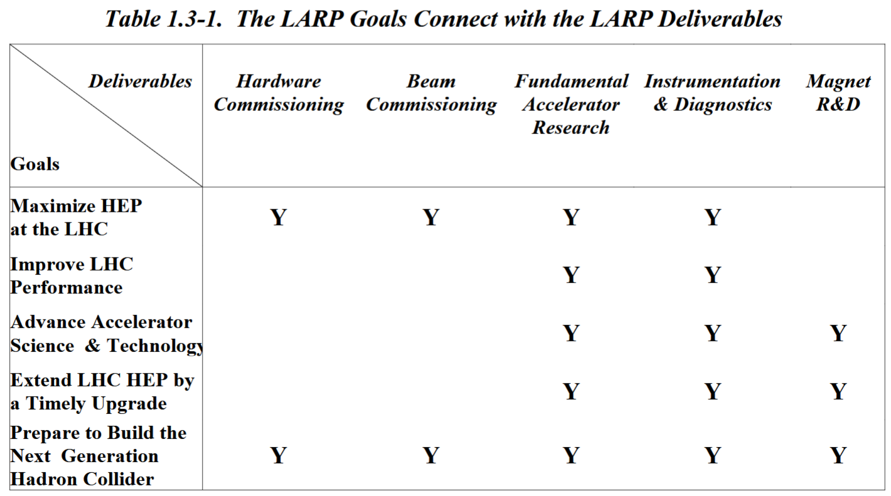
US LARP: LHC Accelerator Research Program
2003 Proposal (76 pages) → 2018 Transitioned to HL-LHC AUP
Goals:
make more luminosity, earlier
collaborate in interaction region upgrades, to make even more luminosity, later
use, develop, and preserve unique U.S. resources and capabilities.
https://www.uslarp.org/LARP_Proposal.pdf

Slide 21
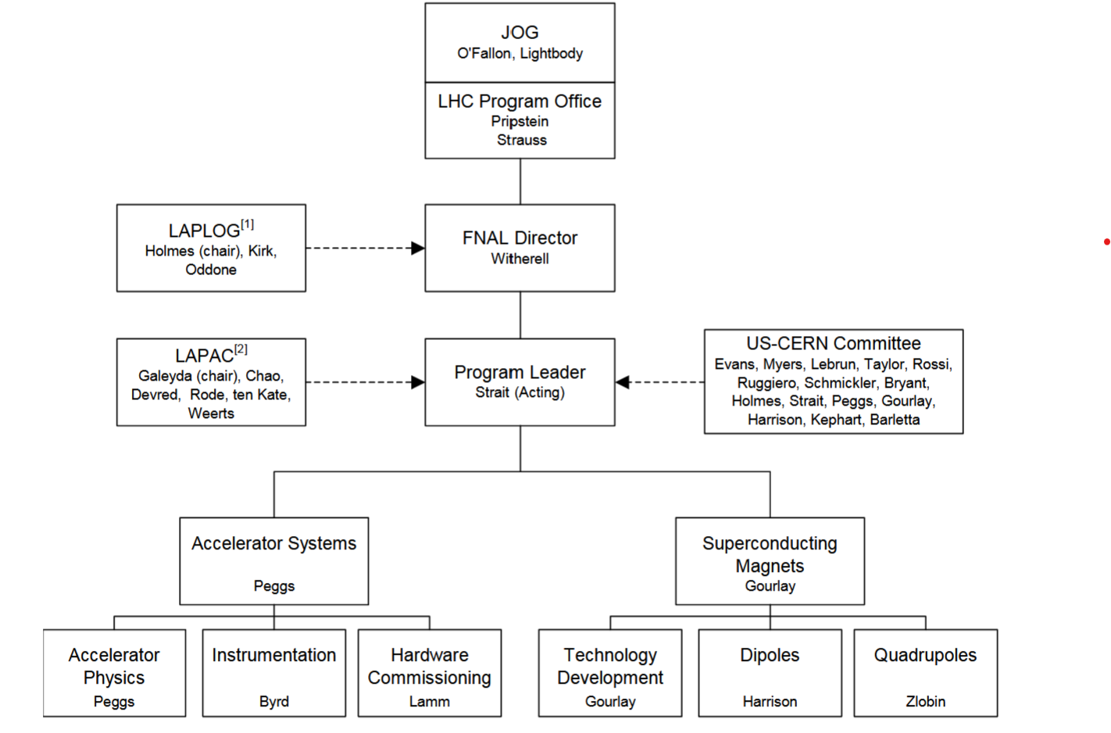
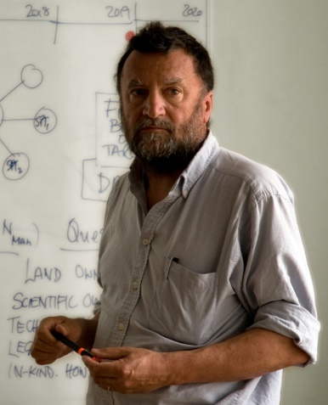
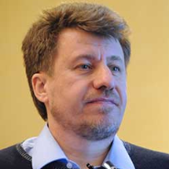
US LARP Structure 2003 -

Slide 22
LARP Lessons (1): Accel System and MAG
[ F.Zimmermann , HB2006 ]

Slide 24
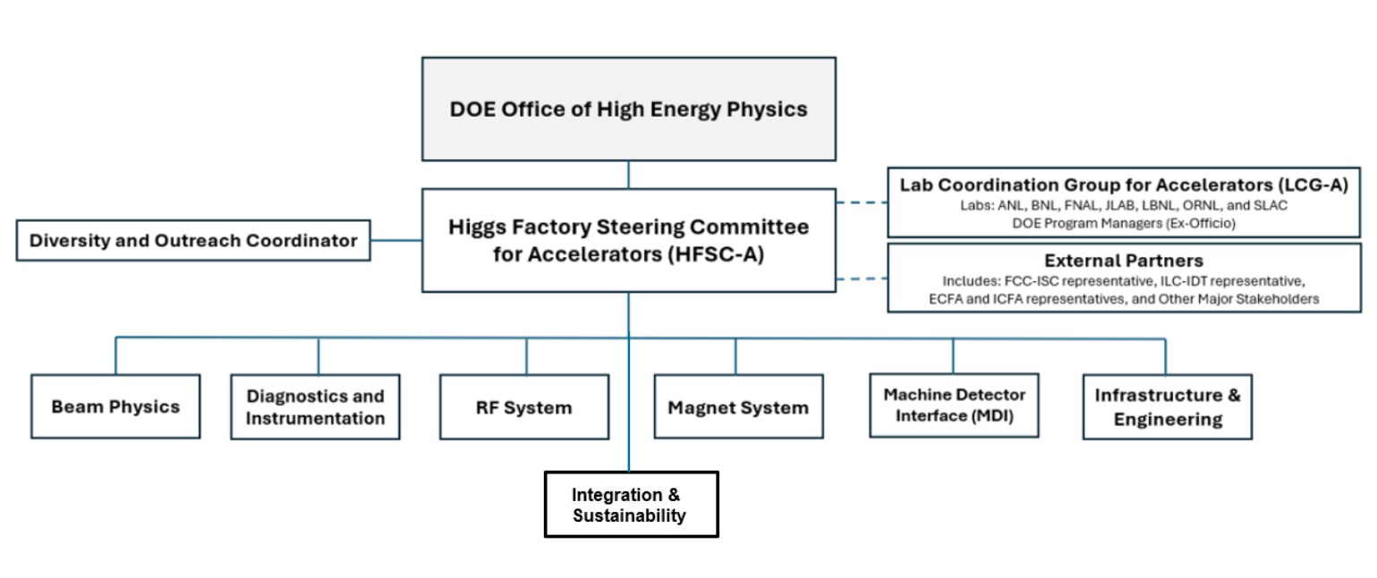

Slide 25
LARP Lessons (3): Tests and Studies
LARP
Magnet and conductor tests:
Facilities at LBNL, FNAL, BNL, etc
Experiments and beam studies:
Tevatron
RHIC
LHC, SPS…
US FCC
SRF tests:
Facilities at FNAL, Jlab, Cornell, other labs and universities
Magnet tests:
Facilities at LBNL, FNAL, BNL, etc
Experiments and beam studies:
Light sources, CESR, CEBAF, etc
US/GARD beam test facilities
Super KEKB?

Slide 26
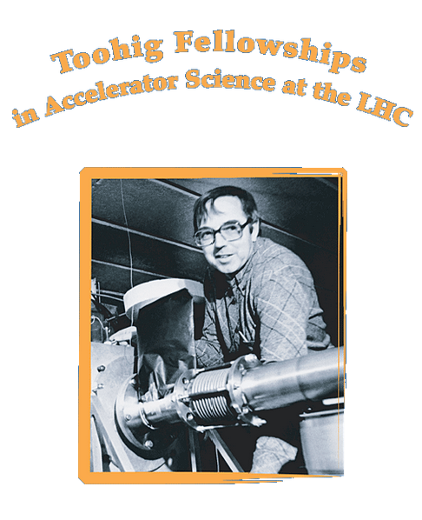
Supported by
US LARP

Slide 27
Summary (invitation for discussion)
We have a comprehensive list of possible US contributions to FCC
Most of them require some R&D (pre-CD-2, post CD-2… + commissioning)
Many labs and Universities identified capabilities to carry R&D and fabrication
HFSC is forming a collaboration and formulating R&D plan and proposal to DOE
Successful R&D plan should (eg based on the LARP success experience):
Lead to a US construction project (CD2)
Interconnect “RF” and “Magnets” with “Accelerator Systems”
Provide mechanism for “horizontal” ties with CERN/FCC teams
Include tests and beam experiments at operational facilities
Have components relevant to the future US-based HEP
Prioritize skilled workforce development at the labs and universities

Slide 28
2023 US-FCCee Planning Panel
Acknowledgments
Kathleen Amm (BNL/NHMFL)
John Byrd (ANL)
Steve Gourlay (FNAL)
Matthias Liepe (Cornell)
Sergei Nagaitsev (JLab)
Tor Raubenheimer (SLAC)
Sergey Belomestnykh (FNAL)
Yunhai Cai (SLAC)
Mark Kemp (SLAC)
Michiko Minty (BNL)
Soren Prestemon (LBNL)
Vladimir Shiltsev (FNAL/NIU)
With contributions from: I.Agapov, M.Benedikt, M.Chamizo-Llatas, H.Durand, E.Gianfelice-Wendt, X.Huang, G.Hoffstaetter, V.Kashikhin, A.Lankford, K.McGee, E.Nanni, A.Novokhatski, M.Palmer, V.Parma, F.Peauger, S. Posen, S.Rajagopalan, P.Raimondi, D.Sagan, J.Seeman, A.Valishev, J.Qiang, F.Zimmermann, S.Zorzetti

Slide 29
Thanks for your attention!
Thank you for your attention!
Questions?

Slide 30
1987 | 1992 | 2002 | 2007 | 2012 | 2017 | 2022 | 2027 | 2032 | 2037 | 2042
Collider Facilities Operations
Design Work and Project R&D (in the US, elsewhere)
“General” Accelerator R&D and Accelerator and Beam Physics
TEVATRON
LHC/HL-LHC
CESR
SuperKEKB
SLC/LEP
PEP-II/KEKB
HiggsF - ?
RHIC
EIC
View from 2022
LHC/LARP
FCChh
VLHC
FCCee
NLC
TESLA/ILC
CEPC
μμCollider
μμCollider - ?
High Field Magnets: NbTi, superferric, Nb₃Sn, HTS, fast cycling, 40 T solenoids…
RF Systems : NC RF S- to X-band, klystrons, SRF L-band, cool copper, …
Targets and Sources : 0.1-few MW, e- and e+ polarized, …
Plasma and Wake-fields : laser, beam, dielectric THz, …

Slide 31
Snowmass’21 Call for Future Colliders R&D Program
Organization:
Coherent national program
Collaborative effort of U.S. national labs and universities
Coordination:
Centrally coordinated and funded
Coordinated with global design studies and R&D
Periodic assessment
Support:
An impactful program might require an average annual investment of $25M (minimum) or more between now and the next Snowmass/P5 cycle.
Important: this program will also ensure the critical recruitment, development, and retention of a skilled workforce in accelerator science and technology
P.Bhat, et al, https://arxiv.org/abs/2207.06213

Slide 32
P5 Recommendations
Recommendation 2c: An off-shore Higgs factory, realized in collaboration with international partners, in order to reveal the secrets of the Higgs boson. The current designs of FCC-ee and ILC meet our scientific requirements. The US should actively engage in feasibility and design studies. […]
Recommendation 4a: Support vigorous R&D toward a cost-effective 10 TeV pCM collider based on proton, muon, or possible wakefield technologies, including an evaluation of options for US siting of such a machine, with a goal of being ready to build major test facilities and demonstrator facilities within the next 10 years […]
Wakefield concepts for a collider are in the early stages of development. A critical next step is the delivery of an end-to-end design concept, including cost scales, with self-consistent parameters throughout. This will provide an important yardstick against which to measure progress with this emerging technology path.

